Slide 1
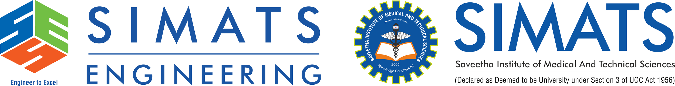
Ensemble Learning: Improving Machine Learning Performance
ITA0603 – Machine Learning
Guided By:
Dr. S. Ashok Kumar
Presented By:
D. Sindhu (192424197)

Slide 2
Introduction to Ensemble Learning
What is Ensemble Learning?
Ensemble Learning is a machine learning technique that combines the predictions of multiple machine learning models (called base learners or weak learners) to produce a single, stronger, and more accurate prediction.
Instead of relying on one model, Ensemble Learning integrates the outputs of several models, making the final prediction more reliable and robust.
Key Idea
"Many models working together perform better than a single model."

Slide 3
Need for Ensemble Learning
Problems with a Single Model
Lower accuracy
Overfitting
High bias or variance
Unstable predictions
Benefits of Ensemble Learning
Higher accuracy
Better reliability
Reduces errors
Improves generalization

Slide 4
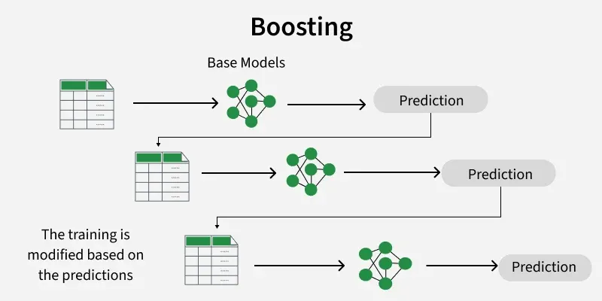
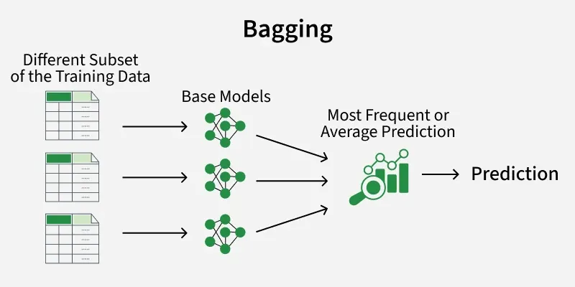
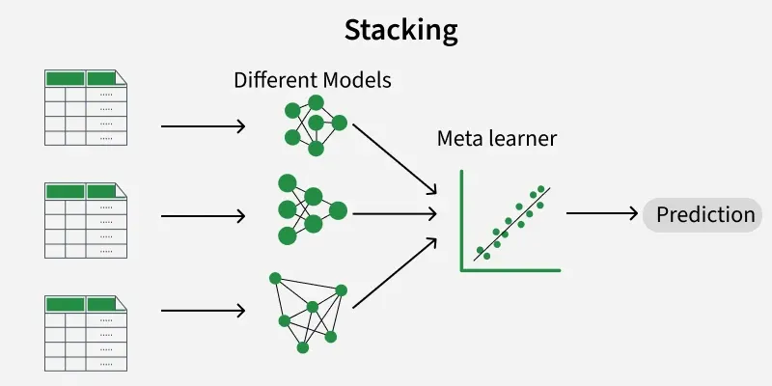
Types of Ensemble Learning

Slide 5
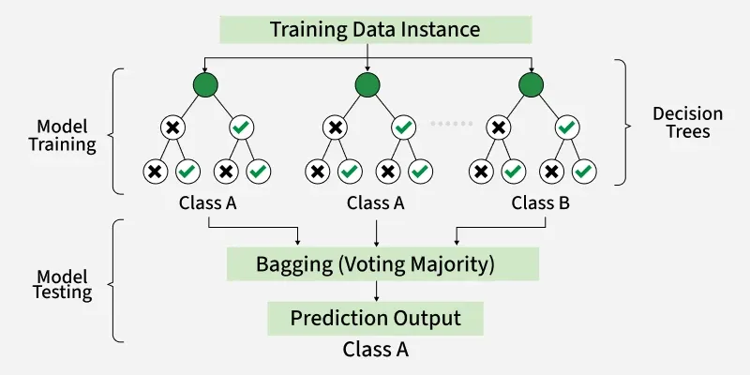
Popular Ensemble Algorithms
1. Random Forest (Bagging)
Definition: Random Forest is an ensemble algorithm that uses many Decision Trees to make predictions.
Working:
Creates multiple Decision Trees.
Each tree makes its own prediction.
The final result is based on majority voting.

Slide 6
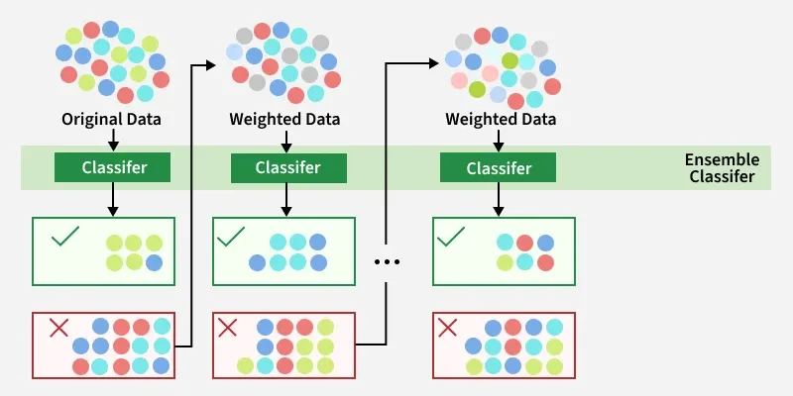
Popular Ensemble Algorithms
2. AdaBoost (Boosting)
Definition: AdaBoost is an ensemble algorithm that combines weak learners to build a strong model.
Working:
Trains one model at a time.
Each new model corrects the mistakes of the previous model.
Final prediction is made using weighted voting.

Slide 7
Advantages, Limitations & Applications
Advantages
Higher accuracy
Reduces overfitting
Better prediction
More reliable results
Works well with large datasets
Limitations
Takes more training time
Uses more memory
More complex than a single model
Higher computational cost
Applications
• Healthcare – Disease prediction • Banking – Fraud detection • Email – Spam detection
• E-commerce – Product recommendation

Slide 8
Conclusion and Future Scope
Conclusion
Ensemble Learning combines multiple models to improve prediction accuracy.
It provides more reliable and stable results than a single model.
The three main techniques are Bagging, Boosting, and Stacking.
It is widely used in healthcare, banking, e-commerce, and many other fields.
Future Scope
Use larger and real-time datasets.
Develop more accurate and faster models.
Combine with Deep Learning techniques.
Apply in advanced AI applications like self-driving cars and smart healthcare.
Improve model efficiency and interpretability.

