Slide 1
PHARMACEUTICAL SALES
&
CUSTOMER INSIGHTS
K.Sindhu Sree
Presented By

Slide 2
Objective:
Problem statement
Architecture
Conclusion
Future Enhancements &Business Impact

Slide 3
Problem Statement:
The Pharmaceutical Sales Insights Dashboard seeks to address the following key requirements:
Sales Performance Analysis:
Analyze sales data by tracking units sold, total revenue, and profitability (unit sales price vs. cost of production).
Identify top-selling drugs and low-performing drugs based on sales volume and revenue.
Evaluate sales trends over time to identify seasonal fluctuations, spikes, and downturns.

Slide 4
2.Customer Demographics and Segmentation:
Segment customers based on age, gender, and buyer type (individual, retailer, etc.) to understand purchasing behavior patterns.
Analyze the average spend per customer segment and identify high-value customers.
Evaluate the geographic distribution of customers to understand market penetration in various regions (based on country data).
3. Regulatory Compliance and Drug Performance:
Assess sales performance for each drug, taking into account regulatory compliance and drug performance over time.
Track the relationship between compliance and sales trends for specific drugs.

Slide 5
4. Profitability and Cost Analysis:
Analyze the cost of production for each drug and compare it with the unit sales price to calculate profitability.
Identify drugs with the highest profit margins and those that are under performing based on production costs and sales prices.
5. Trend Analysis by Date:
Track sales data over different time periods to understand how sales are evolving.
Visualize trends in drug sales over specific months or years, and detect patterns that can inform inventory and pricing decisions.

Slide 6
Architecture Diagram
Source
Power Query
1
Excel/SQL/CSV
2
Cleaning,Merge,Transformation
Data Model
3
DAX Measure
Realationships
4
KPI Logic
Report Pages
5
Power BI Service
Visuals
6
Publish

Slide 7
DATA COLLECTION
In this project, data has been gathered from a structured sales dataset that includes detailed information about drug sales, customer demographics, pricing, production costs, and regulatory compliance. The collected data enables comprehensive analysis of sales performance, customer behavior, profitability, and geographic trends. By integrating multiple data points such as sales transactions, drug details, and customer attributes, the dashboard supports accurate reporting, effective decision-making, and deeper insights into pharmaceutical market dynamics.

Slide 8
SL.NO | SALES DATA | DRUG DATA | CUSTOMER DATA | COST DATA
1. | SalesID | DrugID | CustomerID | Cost Of Production
2. | SalesDate | Drugname | CustomerName | RegulatoryComplianceID
3. | UnitsSold |  | Age
4. | UnitSalesPrice |  | Gender
5. | BuyerType |  | Country

Slide 9
DATA LOADING:
Loading the dataset/csv file into Power BI is super simple! Once you have opened Power BI desktop, click the Get Data button in the toolbar at the top of your screen, then select the Text/CSV option.
From there, a window will pop up and you will have to navigate to the folder you saved the dataset in. Once you’ve selected the dataset, you’ll see the following window which gives you a preview of the data in the file.
Click the Transform Data button in the bottom right corner, and it will take you to Power Query Editor.

Slide 10
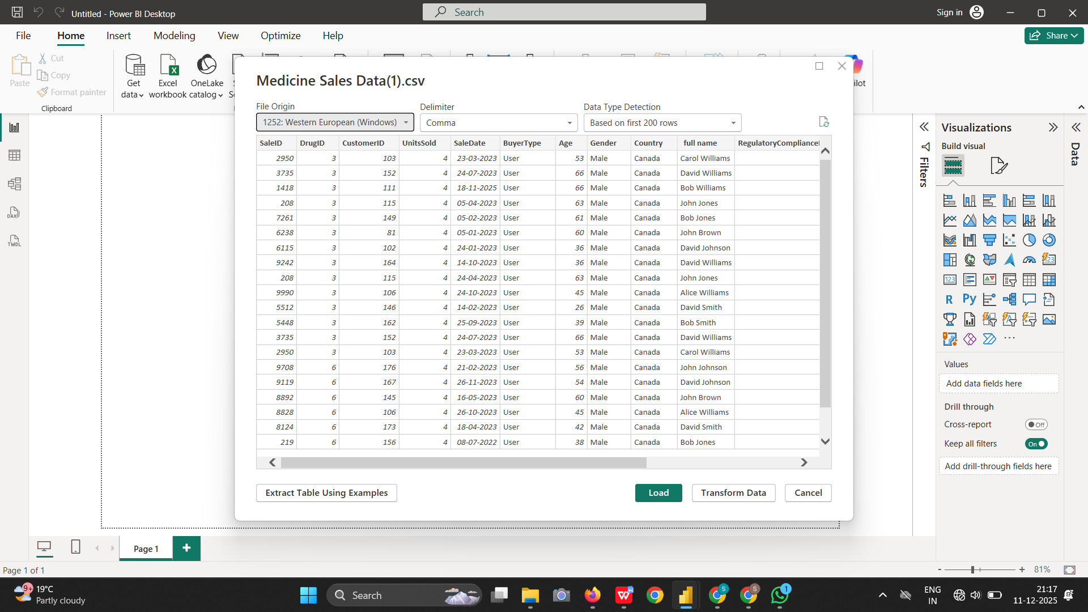

Slide 11
Data Cleaning in Power Query
Dataset validated: 16,314 rows and 14 columns
Power Query applied steps:
✔ Source
✔ Promoted Headers
✔ Changed Type
Inspected all columns for:
✔ Naming issues
✔ Data type mismatches
✔ Unwanted or unused columns
✔ Formatting inconsistencies
No null values found in the dataset

Slide 12
Original Columns:
SaleID,SalesDate DrugID, CustomerID, full Name, BuyerType, Age, Gender, Country, DrugName, UnitsSold, UnitSalesPrice, CostOfProduction, RegualatorycomplainceId
Standardized Names:
SaleID,SalesDate DrugID, CustomerID, Customer Name, BuyerType, Age, Gender, Country, DrugName, UnitsSold, UnitSalesPrice, CostOfProduction, RegualatorycomplainceId
Missing & Error Handling
Checked entire dataset (Column profiling: Based on entire dataset)
No null, blank, or error values found
No rows were removed or replaced
This ensures high data quality before modeling

Slide 13
Data Type Correction
Corrected types:
    SalesDate → Date
    CustomerID, DrugID → Text
    UnitsSold → Whole Number
    UnitPrice, CostPerUnit → Decimal Number
Why:
✔ Ensures accurate aggregation
✔ Prevents model errors
✔ Helps correct relationships

Slide 14
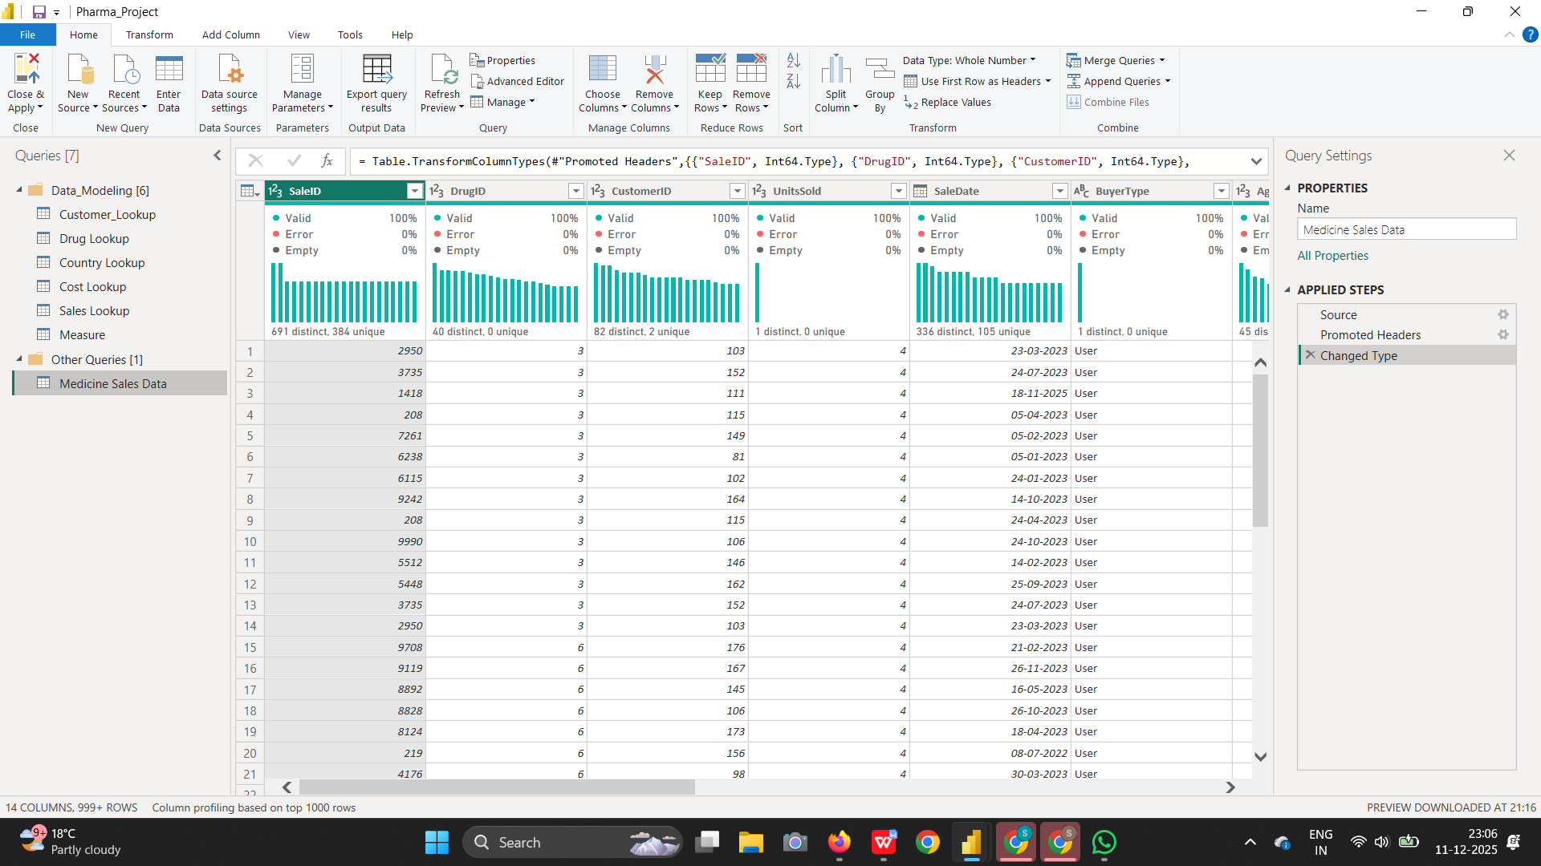

Slide 15
Lookup Table Preparation
Duplicated main dataset into:
✔ Customer Lookup
✔ Drug Lookup
✔ Cost Lookup
✔ Country Lookup
✔ Sales Lookup
Performed cleaning:
✔ Removed unnecessary columns
✔ Removed duplicates
✔ Validated row/column count
✔ Check column profiling
Lookup tables used as dimensions in star schema

Slide 16
Merge Queries & Load
      Main fact table merged with lookup tables
      Used Inner Join for accuracy
      Expanded merged tables to fetch related fields
      Verified matching rows count
      FactSales table acts as the central fact table connected to all lookup (dimension) tables.
      Ensured Enable Load is ON for the fact table
      Applied all changes via Close & Apply

Slide 17
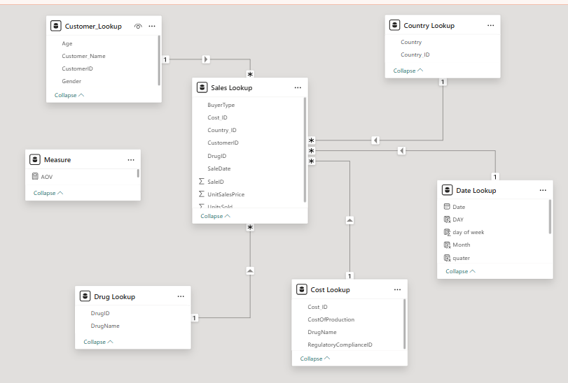
Star Schema Diagram

Slide 18
Date lookup
The main dataset contains only SalesDate and lacks key calendar fields such as Year, Month, Quarter, Week, Month Name, Year-Month, and Day.
To support advanced time-intelligence and flexible analytics, a separate Date Lookup table is created.

Slide 19
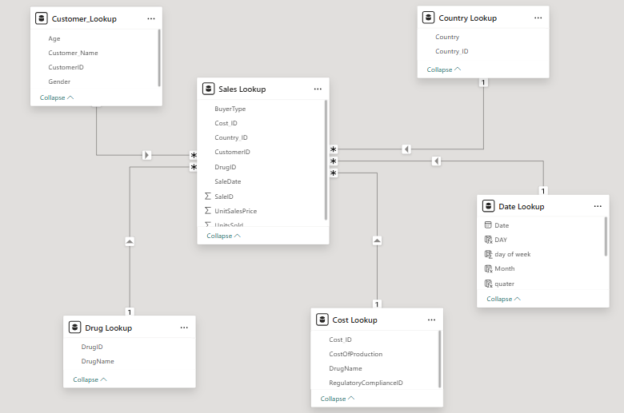

Slide 20
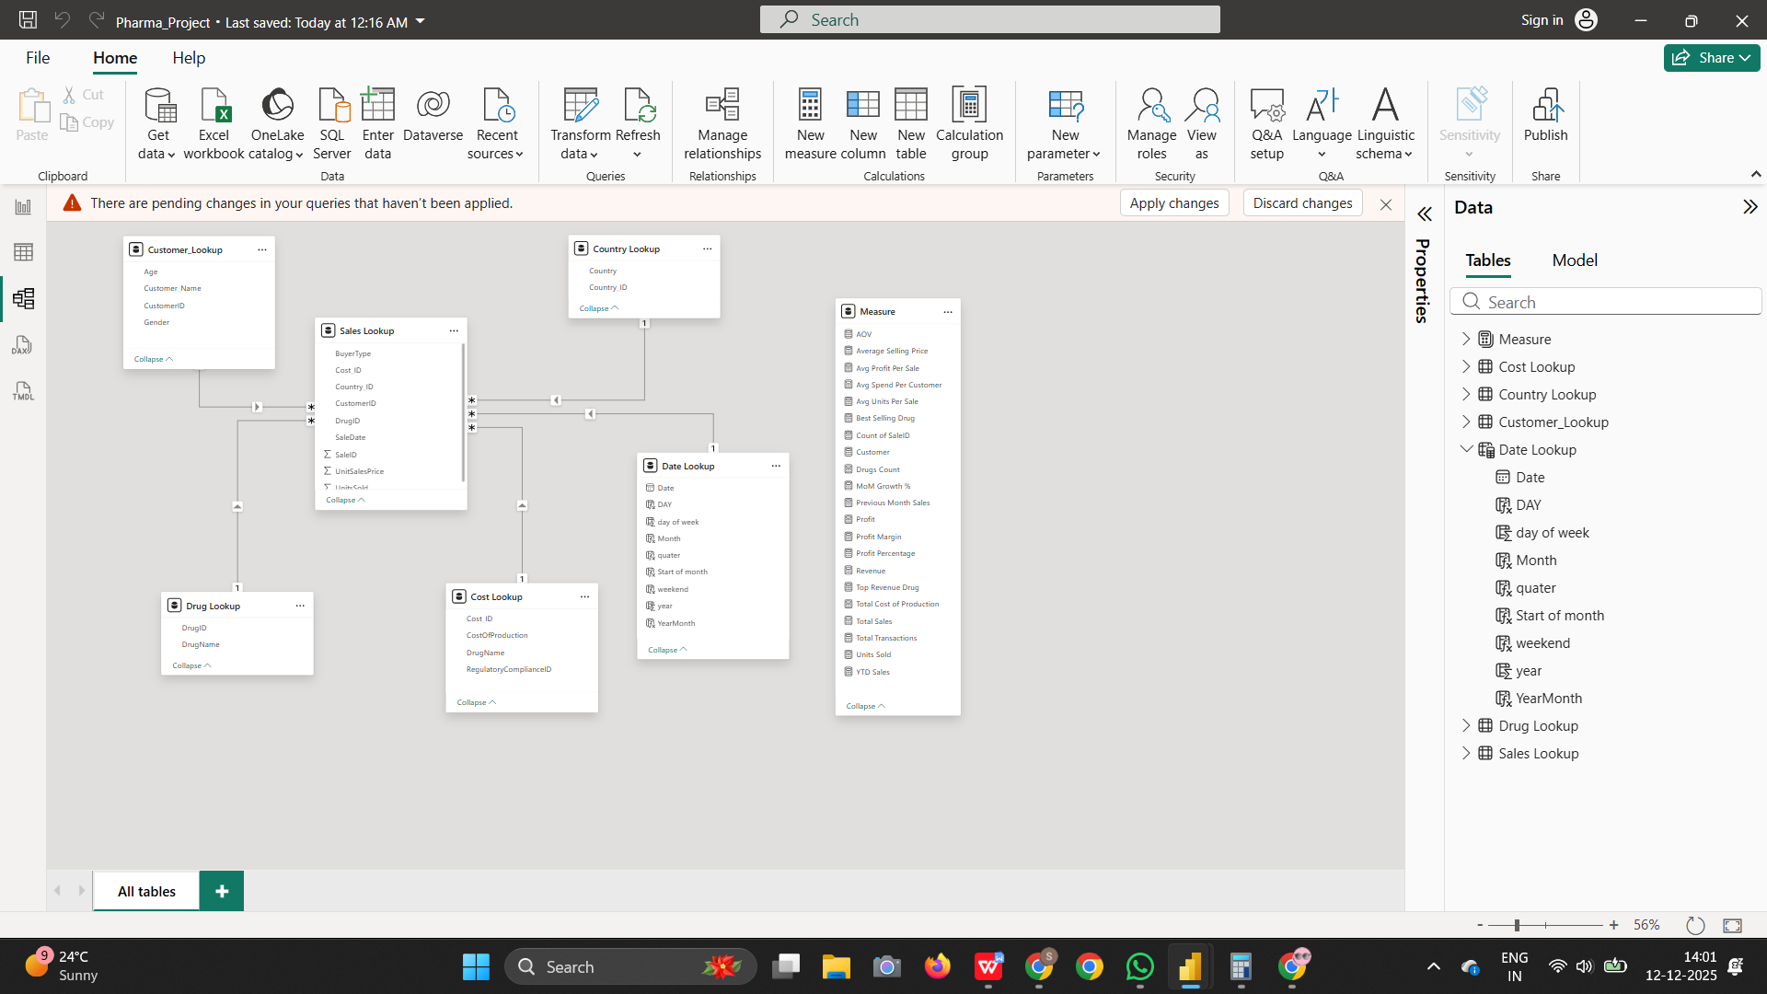

Slide 21
REPORT VIEW
Choose a clean and minimal report layout to maintain clarity and focus.
Use a consistent, professional theme with proper color combinations, fonts, and visual styling.
Arrange all visuals with proper alignment, equal spacing, and grid structure for a balanced look.
Place key KPIs at the top of the report so users can get quick insights at a glance.

Slide 22
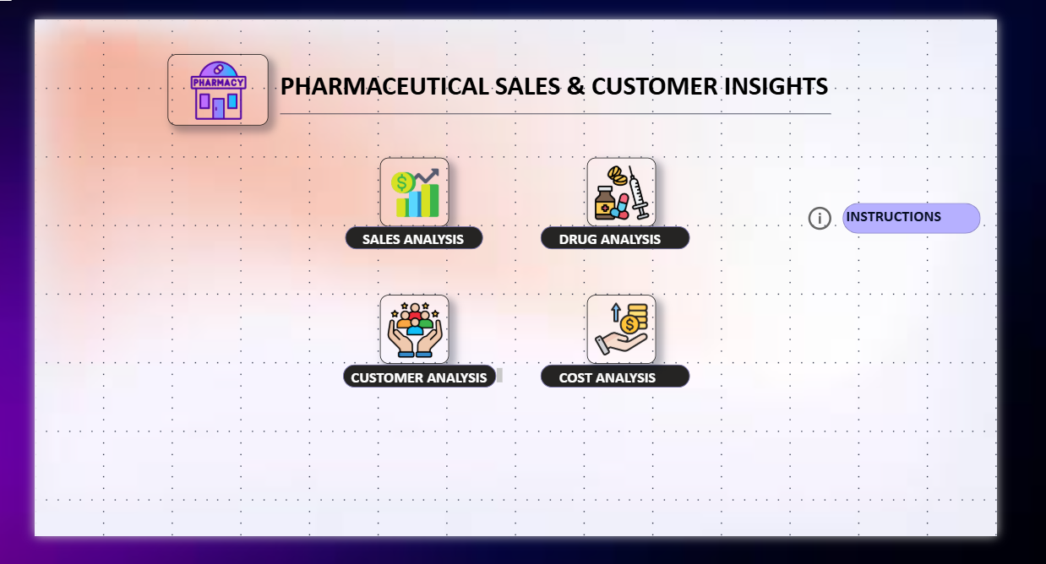
Home Page (Navigation Page)

Slide 23
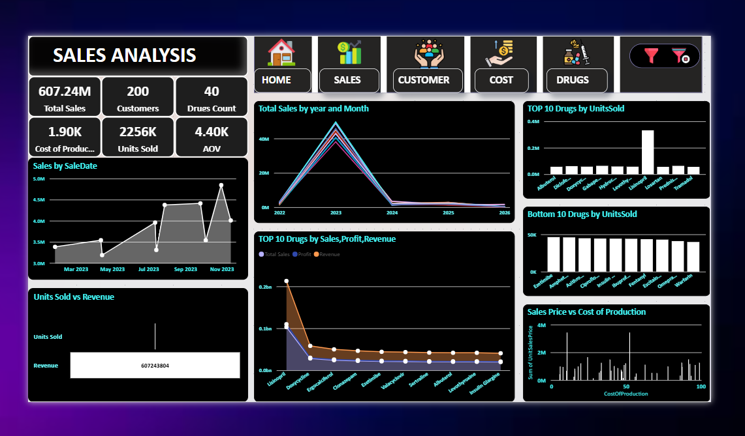

Slide 24
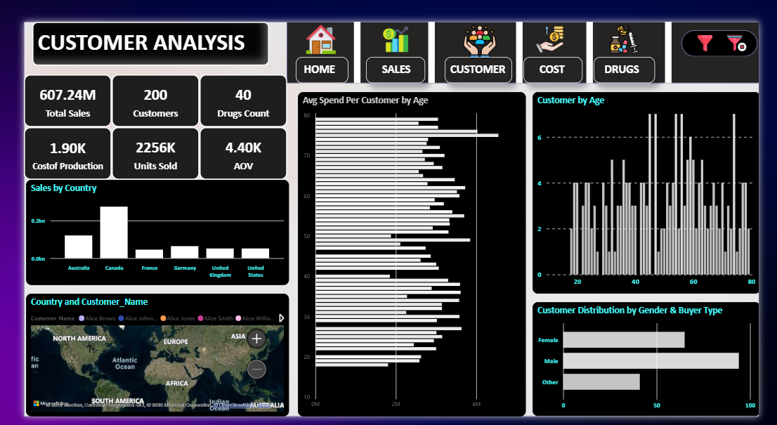

Slide 25
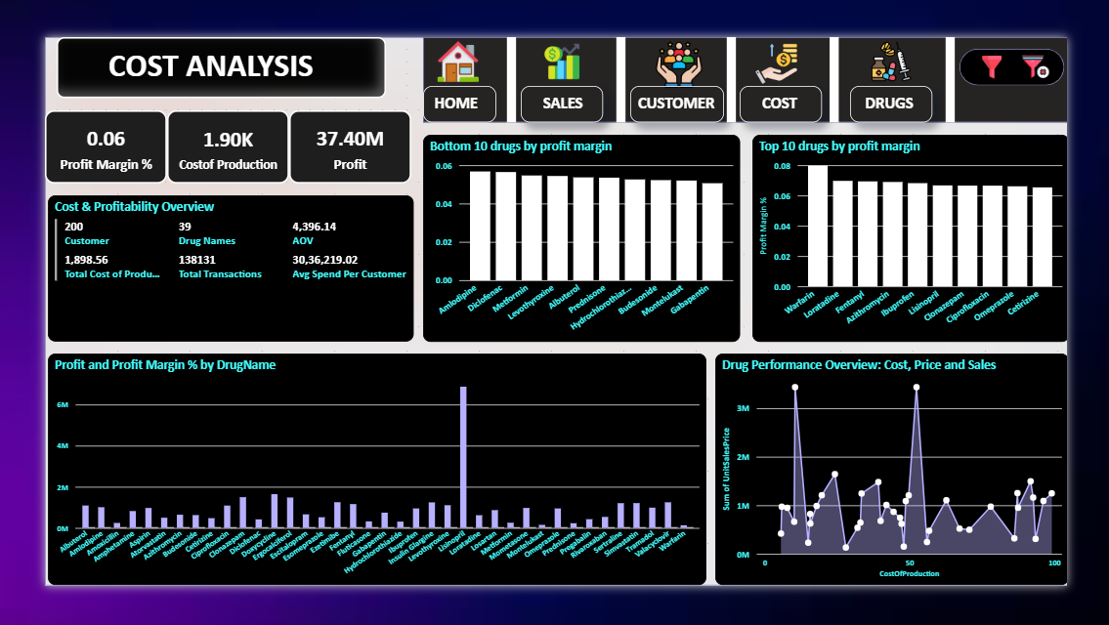

Slide 26
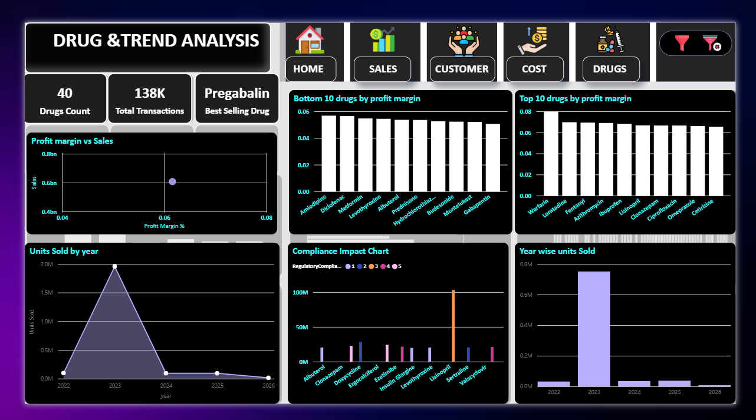

Slide 27
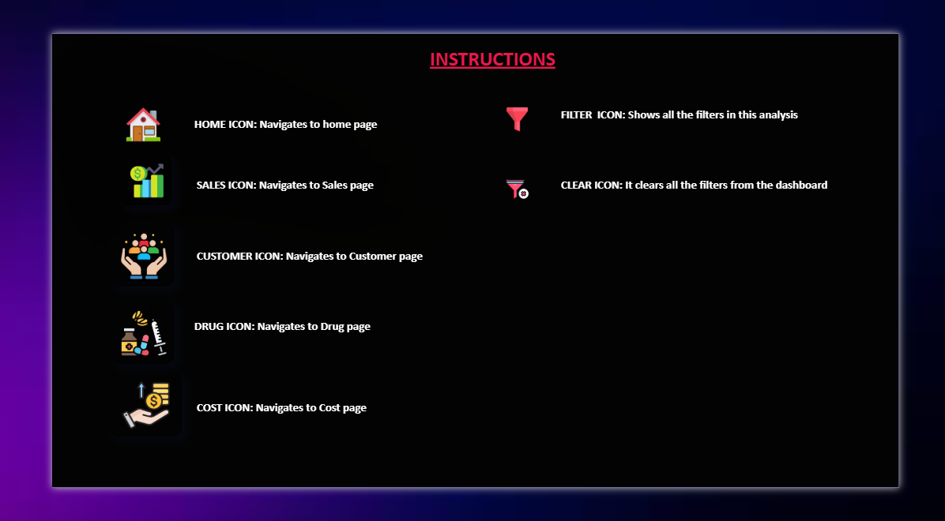

Slide 28
Conclusion
The Pharmaceutical Sales & Customer Insights Dashboard provides a complete analytical view of sales performance, customer behavior, profitability, regulatory compliance, and time-based trends.
By leveraging Power BI, the project transforms raw pharmaceutical sales data into clear, interactive, and actionable insights for business stakeholders.
The implementation of a star schema data model, date lookup table, and optimized DAX measures ensures high data accuracy, performance, and scalability.
Interactive KPIs and visuals enable quick identification of top-performing drugs, underperforming products, high-value customer segments, and profitability gaps.

Slide 29
Future Enhancements &Business Impact
Future Enhancements
Business Impact
Sales forecasting and predictive analytics
Advanced regulatory compliance monitoring
Customer Lifetime Value (CLV) analysis
What-if analysis for pricing and cost scenarios
Automated refresh and Row-Level Security in Power BI Service
Supports data-driven decision-making for pricing, inventory planning, and sales strategy.
Improves understanding of customer demographics and geographic markets.
Enables effective profitability and cost optimization analysis.
Enhances usability through a dedicated Instructions Page and intuitive navigation.

Slide 30
THANKYOU!..
K.SINDHU SREE
Presented by

