Slide 1
Data Analytics Group Project
Group 1: Rishtina bhetuwal, Shefali patel, Shirlyn sia, sindhuja Mahalingam, stanley ta

Slide 2
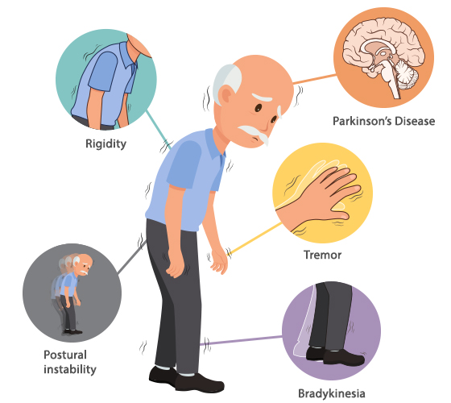
Parkinson’s Disease (PD)
One of the fastest growing disabilities globally
Affects 1-2 in every 1000 individuals at any time (Tysnes & Storstein,2017).
A neurodegenerative disorder with symptoms including motor dysfunctions such as tremors and bradykinesia (Ayano, 2016; Hallett, 2012), speech problems (C. O. Sakar & Kursun, 2010), and negative mental well-being (e.g., depression and anxiety) (Kano et al., 2011).
Total economic burden in the United States was $51.9 billion in 2017 (Yang et al., 2020)
The current treatment for chronic PD would only provide symptomatic relief (Giugni & Okun, 2014).
But progression of the disease can be halted if treatments are provided at an early stage (Karapinar Senturk, 2020)
Research in early-stage PD diagnosis has been gaining popularity
Notes:
Parkinson’s Disease (PD) is one of the fastest growing disabilities globally, with about 6 million people suffering in 2015.
Affects 1-2 in every 1000 individuals at any time .
It is a neurodegenerative disorder with symptoms such as motor dysfunctions including tremors, speech problems, and negative mental well-being.
Given that it is a chronic disorder, it eventually leads to progressive disability. As a result, individuals with Parkinson will have higher medical care costs and may also lose the ability to work, creating a substantial economic burden. For instance, the total economic burden of Parkinson in the US in 2017 was 51.9 billion dollars.
Current treatments for Parkinson are palliative. However, treatments for individuals diagnosed at an early stage may be able to halt the progression of the disease, reducing the physical and economic burden of Parkinson. Due to these findings, research in early-stage Parkinson detection has seen a surge in popularity

Slide 3
Machine Learning & Speech Patterns
Around 90% of PD patients suffer from vocal impairment (Sakar & Kursun, 2010)
Abnormalities in speech occur in the early stages of PD (Skodda et al., 2013)
Predicting PD from speech patterns is a simple and non-invasive method (Tsanas et al., 2009)
Leveraging machine learning techniques with extracted speech data may be an accurate and safe way to predict PD diagnosis (Rayan et al., 2019)
Present study:
Focused on determining which classification machine learning model should be utilized to achieve the highest PD diagnosis using extracted features from voice recordings of individuals.
Notes:
Around 90% of Parkinson patients suffer from vocal impairment with abnormalities in speech occur at the early stages of Parkinson.
Predicting Parkinson from speech patterns is a simple and non-invasive method, making it an ideal symptom to utilize in early detection of Parkinson.
Leveraging machine learning techniques with extracted speech data may be an accurate and safe way to predict the diagnosis.
this Present study focused on determining which classification machine learning model should be utilized to achieve the highest Parkinson diagnosis using extracted features from voice recordings of individuals.

Slide 4
Methods
The dataset includes 252 participants
PD patients (M age = 65.1, SD = 10.9)
Healthy individuals (M age 61.1, SD = 8.9)
Seven feature subsets were extracted from voice recording samples:
baseline features (21)
intensity-based features (3)
bandwidth and formant features (8)
vocal fold features (22)
Mel Frequency Cepstral coefficients (MFCC; 84)
wavelet transform based features (WT; 182), and tunable Q-factor wavelet transform based features (TQWT; 432)
Notes:
we have 252 participants in total.
Out of 752 features Seven feature subsets were extracted from voice recording samples:
baseline features (21)
intensity-based features (3)
bandwidth and formant features (8)
vocal fold features (22)
Mel Frequency Cepstral coefficients (MFCC; 84)
wavelet transform based features (WT; 182), and tunable Q-factor wavelet transform based features (TQWT; 432)

Slide 5
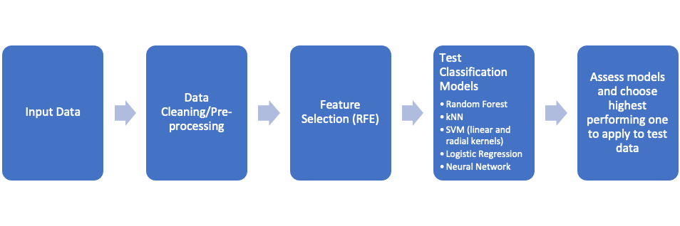
Overview of Study Workflow
Notes:
The training data was cleaned, feature selection was done by utilizing recursive feature selection and then fed into several classification to model with highest test accuracy.

Slide 6
Data Pre-Processing
The three samples from each participant was averaged to avoid correlated data between training and test set
Skipping this step would most likely lead to underestimating the error
N = 176
Features were subsequently standardized for uniformity
Some models such as KNN require standardization to be effective
Highly correlated features (r>0.75) were filtered out to reduce redundancy and noise in the data
In preparation for feature selection via RFE, we split the data into the training and test set using a 70/30 split
Notes:
Previous studies have found that using the voice recording of the same participants for testing and training set may cause biased results
Thus, the present study utilized mean of the three voice recordings to have one sample per participant in the training set, Features were then standardized to ensure uniformity.
This study used recursive feature selection (RFE) to select important features.
The new dataset with the most important features were fed into several classification models, such as Random forests, logistic regression, support vector machine of linear and radial kernels, neural network and K-Nearest neighbors .
We separated the training dataset into training and test sets using 60/40 split
We used cross-validation methods to determine the best gamma and cost parameters for SVM.
All analyses were conducted in R studio.

Slide 7
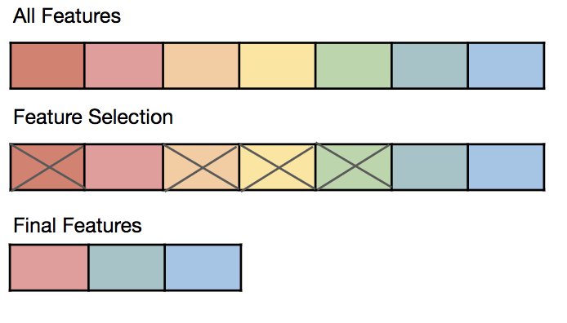
Feature Selection
Having too many predictors in a model increases the risk of overfitting
The original dataset has over 750 features!
"p>>n" issue – most models are unable to generalize and instead learn the statistical noise in the training data, resulting in a poor test set performance
Recursive Feature Elimination (RFE): A widely used algorithm for selecting features that are most relevant in predicting the target variable in a predictive model
Applies backward selection process to find the optimal combination of features
Feature importance was calculated using the random forest importance criterion
Implemented via the "caret" package in R
Notes:
Feature Selection:
This study selected a subset of relevant variables for use in model construction using recursive feature selection (RFE)
Since RFE uses random forest to select important features, highly correlated feature (r > 0.75) were omitted from the data to reduce redundancy and noise in the data.
We also wanted to reduce the dimension of the problem, and thus solutions greater than 20 were not considered

Slide 8
Predictive Modeling
Data from the RFE-selected features were used as input for each classification model:
Random Forest
K-NN
SVM (linear and radial kernels)
Logistic Regression
Neural Network
Utilized the "holdout method" with a 60/40 train-test split for K-NN, logistic regression, and neural network models
Notes:
Test classification models:
The new dataset with the most important features were fed into several classification models, specifically Random forests, logistic regression, support vector machine of linear and radial kernels, neural network and K-Nearest neighbors of K = 1, 3, 5, and 8.
We separated the training dataset into training and test sets using 60/40 split
We used cross-validation methods to determine the best gamma and cost parameters for SVM.

Slide 9
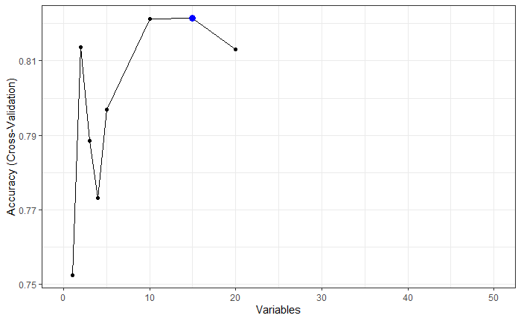
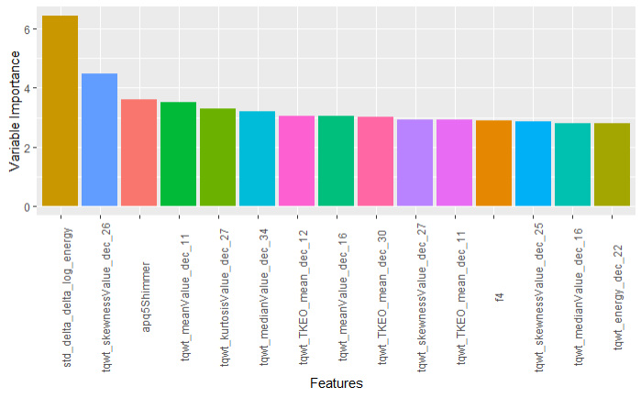
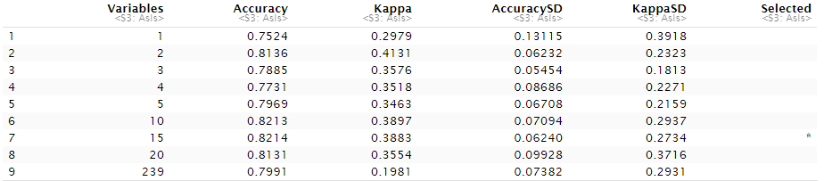
Results
Output from RFE returned 15 features for our model based on accuracy metric
TQWT features were influential in predicting PD classification, as discussed in Sakar, et al. 2019

Slide 10
Results
Model | Test accuracy
kNN (K=5) | 83.10%
Random Forest | 83.10%
SVM (kernel = linear) | 80.28%
SVM (kernel = radial) | 73.24%
Logistic regression | 80.28%
Neural networks | 80%
Notes:
A comparison of the six predictive models showed that KNN and random forest yielded the highest test accuracy of 83.10% using a 60% training and 40% test split. KNN randomly selected 4 values for K: 1, 3, 5, and 8. Out of the four, K = 5 resulted in the highest test accuracy at 83.1%. Random forest generated 500 trees and tried 3 variables at each split and yielded 83.1% test accuracy. There was a significant difference in performance between SVM linear (80.28% test accuracy) and SVM radial (73.24% test accuracy). Logistic regression and neural network models performed comparably with 80.28% and 80.00%, respectively.

Slide 11
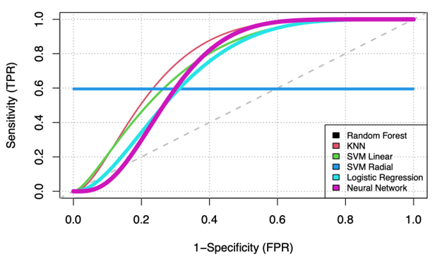
Results
Figure 4: ROC curves comparing all models

Slide 12
Discussion
KNN and Random Forest performed the best out of all the models we tested
RF is known to perform comparatively well with high dimensional data, also limits overfitting
KNN is robust when there are limited parameters to tune, and training dataset is small
SVM linear performed better than SVM radial
Which was also expected given that the present problem was binary classification
The application of a support vector machine with a linear kernel is to perform classification or regression. It will perform best when there is a linear decision boundary or a linear fit to the data, thus the linear kernel.

Slide 13
Discussion
The dataset had 3 samples for each subject that were averaged out to avoid using closely correlated data in both the training and test set
Averaging these observations caused the dataset to shrink which instigated other problems.
Initially, a 70/30 training-testing split was used
This split resulted in some of the test accuracies being higher than the training accuracies
Possibly due to the dimension of the problem or the unbalanced distribution between PD and non-PD observations
60/40 split alleviated the concern and was used for model building
ROC curve for the SVM radial model remained constant regardless of the false positive rate
Suggests that data was not fitted well using radial kernel
Other metrics of model success such as F-measure should be explored in future studies
Notes:
While building these models, we encountered a few issues that affected our analysis and needed to be addressed
Notes for bullet point 2:
the split resulted in underfitting as the testing accuracy was higher than the training accuracy for SVM radial and logistic regression
May be due to the dimension of the problem where we had a small sample size with a relatively large number of predictors; or the unbalaned distribution between PD and non-PD observations which we will discuss later.
60/40 split alleviated the underfitting concern and thus, we continued model building using this split instead.
Note for bullet point 3: ROC curve for the SVM radial model remained constant regardless of the false positive rate, suggesting that the data was not fitted well using the radial kernel. However, other metrics of model success such as F-measure should be explored in future studies.

Slide 14
Future Considerations
Model can be improved by implementing additional data pre-processing steps
There are other methods of handling repeated measures which do not involve discarding observations that may result in a more accurate model (e.g., mixed effect model)
Present dataset had a class imbalance
Approximately 75% of the subjects in the training dataset were PD patients
Machine learning algorithms will be biased towards the majority class in predictions
A classifier that only guessed PD would be about 75% accurate!
Future studies should implement oversampling techniques (e.g., Synthetic Minority Oversampling Technique) on the training set to balance the distribution of classes
Emphasize K-fold cross-validation to optimize model parameters

Slide 15
References
Tysnes, O. B., & Storstein, A. (2017). Epidemiology of Parkinson’s disease. Journal of neural transmission, 124(8), 901-905.
Ayano, G. (2016). Parkinson’s Disease: A Concise Overview of Etiology, Epidemiology, Diagnosis, Comorbidity and Management. Journal of Neurological Disorders, 4(6). https://doi.org/10.4172/2329-6895.1000298
Sakar, C. O., & Kursun, O. (2010). Telediagnosis of Parkinson’s Disease Using Measurements of Dysphonia. Journal of Medical Systems, 34(4), 591–599. https://doi.org/10.1007/s10916-009-9272-y
Kano, O., Ikeda, K., Cridebring, D., Takazawa, T., Yoshii, Y., & Iwasaki, Y. (2011). Neurobiology of Depression and Anxiety in Parkinson’s Disease. Parkinson&#x2019;s Disease, 2011, e143547. https://doi.org/10.4061/2011/143547
Yang, W., Hamilton, J. L., Kopil, C., Beck, J. C., Tanner, C. M., Albin, R. L., Ray Dorsey, E., Dahodwala, N., Cintina, I., Hogan, P., & Thompson, T. (2020). Current and projected future economic burden of Parkinson’s disease in the U.S. Npj Parkinson’s Disease, 6(1), 1–9. https://doi.org/10.1038/s41531-020-0117-1
Giugni, J. C., & Okun, M. S. (2014). Treatment of advanced Parkinson’s disease. Current Opinion in Neurology, 27(4), 450–460. https://doi.org/10.1097/WCO.0000000000000118
Karapinar Senturk, Z. (2020). Early diagnosis of Parkinson’s disease using machine learning algorithms. Medical Hypotheses, 138, 109603. https://doi.org/10.1016/j.mehy.2020.109603
Rayan, Z., Alfonse, M., & Salem, A.-B. M. (2019). Machine Learning Approaches in Smart Health. Procedia Computer Science, 154, 361–368. https://doi.org/10.1016/j.procs.2019.06.052
Liaw, A., & Wiener, M. (2002). Classiﬁcation and Regression by randomForest. 2, 5.
Breiman, L. (2001). Random Forests. Machine Learning, 45(1), 5–32. https://doi.org/10.1023/A:1010933404324
James, G., Witten, D., Hastie, T., & Tibshirani, R. (2013). An Introduction to Statistical Learning (Vol. 103). Springer. https://doi.org/10.1007/978-1-4614-7138-7
Christodoulou, E., Ma, J., Collins, G. S., Steyerberg, E. W., Verbakel, J. Y., & Van Calster, B. (2019). A systematic review shows no performance benefit of machine learning over logistic regression for clinical prediction models. Journal of Clinical Epidemiology, 110, 12–22. https://doi.org/10.1016/j.jclinepi.2019.02.004
van der Ploeg, T., Austin, P. C., & Steyerberg, E. W. (2014). Modern modelling techniques are data hungry: A simulation study for predicting dichotomous endpoints. BMC Medical Research Methodology, 14(1), 137. https://doi.org/10.1186/1471-2288-14-137

