Slide 1


Data analysis
Texas School Survey (TSS) of Drug and Alcohol Use (2019-2020)
SINDHUJA MAHALINGAM

Slide 2
Background:
Tobacco and alcohol use is known to be a well-established risk factor for many types of cancers.
According to Change et al., tobacco use initiation at a younger age was associated with an increased head and neck cancer risk with OR<10 years vs ≥30 years: 1.64.
According to Louie et al., early onset of alcohol use increases risk for alcohol-related neurocognitive impairment.
Also, alcohol consumption is negatively associated with academic performance (Singleton, 2007).

Slide 3
Texas School Survey of Drug and Alcohol Use (TSS):
Cross-sectional study design.
Self-reported survey instrument.
Administered to students from grades 7 to 12 (11 to 19 years of age).
Data is obtained from the samples of Texas public schools that were randomly selected.
Reports from this survey analyze data from (2019 to 2020).
Objectives :
1. Extent and nature of substance use among secondary students in Texas public schools.
2. Standard of comparison for districts conducting local assessments of drug & alcohol use.

Slide 4
Research question # 1
To assess if there is an association between living with both parents and the student’s smoking status using TSS in the year 2019-2020.
Exposure: Living with both the parents (Yes/No)
Outcome: Smoking status (Yes/No)
Covariates: Age, gender, race and ethnicity, employment, close friend’s smoking status, smokeless tobacco use, and alcohol use.

Slide 5
Table 1: Characteristics of the study sample for an association between living with both parents and smoking status using the Texas School Survey (2019-2020), presented with column percentages (n = 27,702)
Variable | N (%)
Age groups 11-14 years 15-17 years 18 or older | 14,425 (52.07%) 11,454 (41.35%) 1,823 (6.58%)
Gender Male Female | 13,897 (50.03%) 13,880 (49.97%)
Race/Ethnicity Hispanic African American White Others | 13,399 (49.97%) 1,489 (5.55%) 9,384 (35%) 2,542 (9.48%)
Employment status No Yes Missing | 20,895 (74.72%) 4,063 (14.53%) 3,007 (10.75%)
Close friend’s smoking status No Yes | 19,725 (73.55%) 7,094 (26.45%)
Smokeless tobacco use No Yes | 25,241 (92.64%) 2,004 (7.36%)
Alcohol use No Yes | 15,301 (59.21%) 10,542 (40.79%)
Living with both parents No Yes | 10,898 (39.67%) 16,574 (60.33%)
Tobacco use No Yes | 22,251 (85.47%) 3,784 (14.53%)

Slide 6
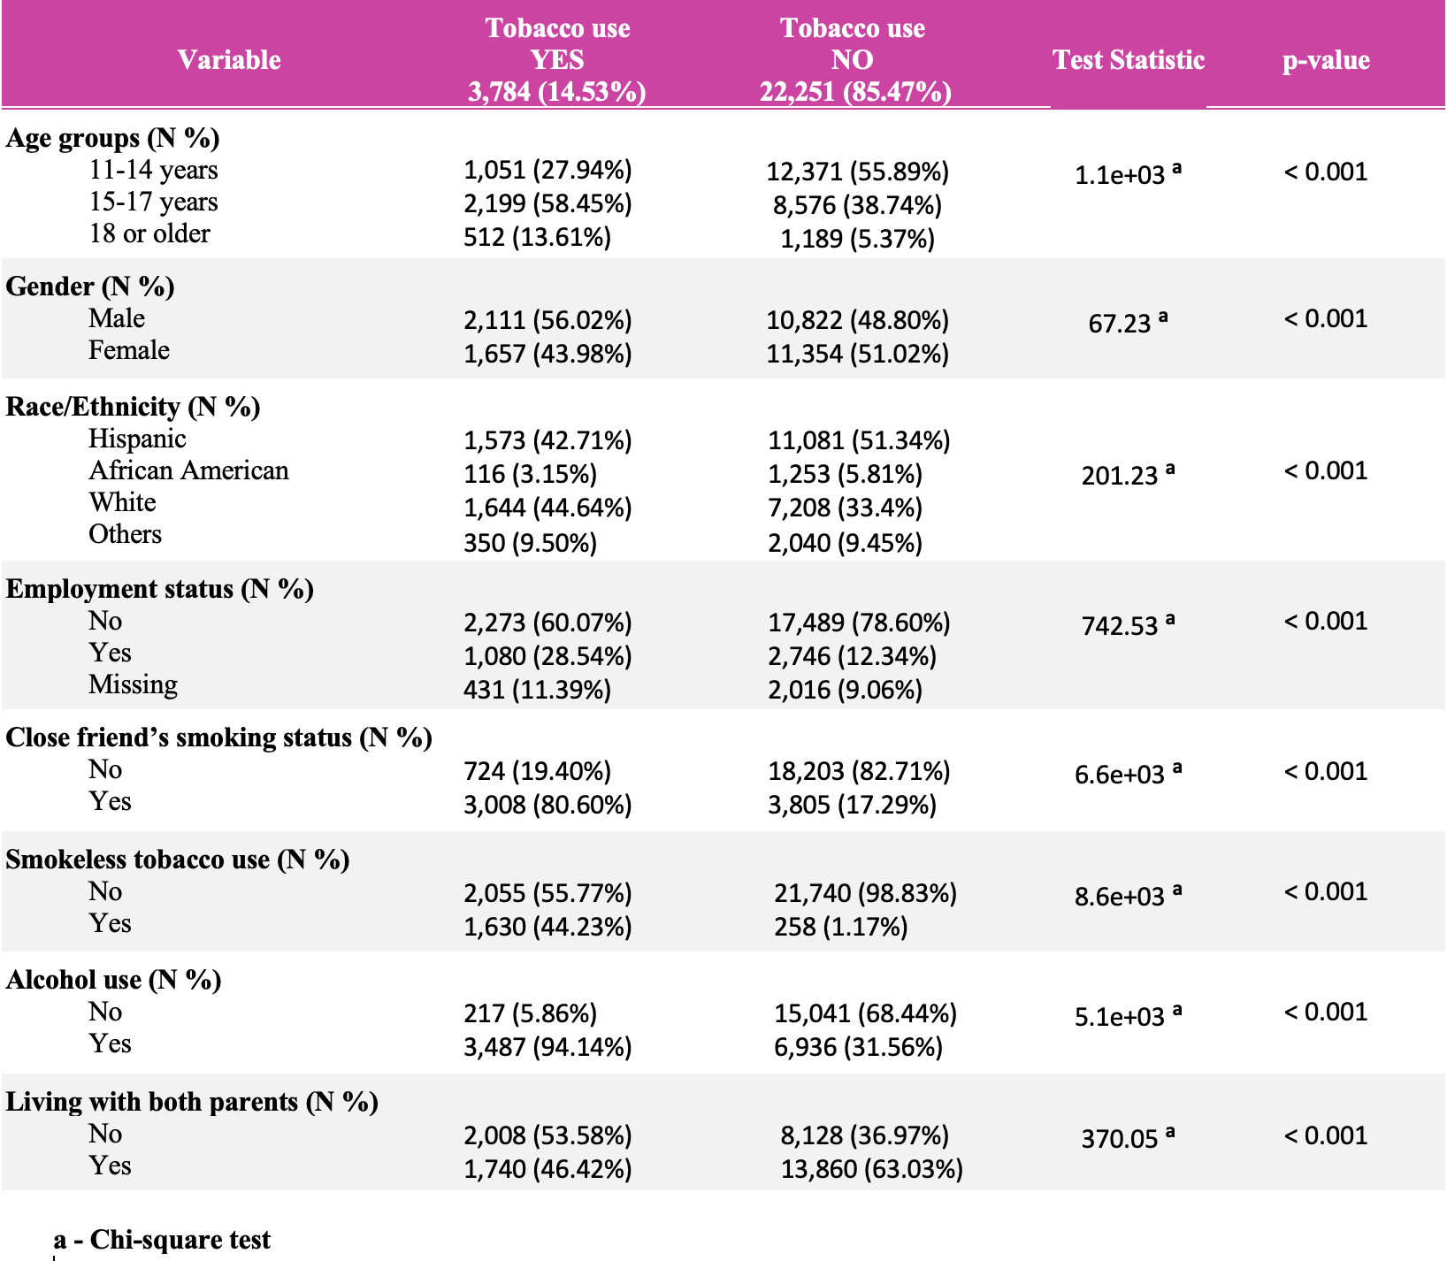
Table 2: Bivariate analysis for an association between living with both parents and smoking status using the Texas School Survey (2019-2020), presented with column percentages (n = 27,702)
Chi square test significance could be due to large sample size

Slide 7
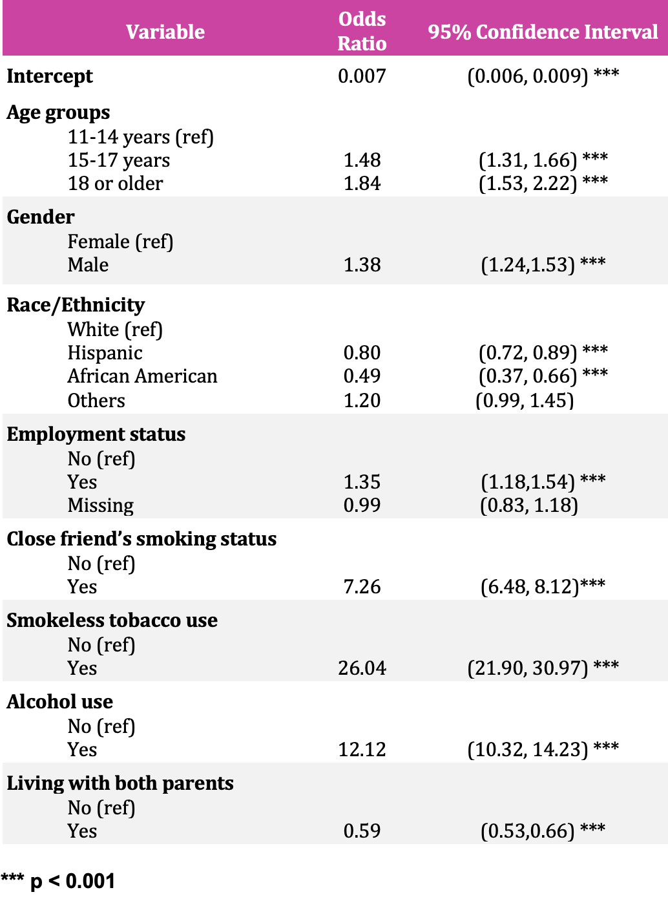
Table 3: Multivariable analysis for an association between living with both parents and smoking status using the Texas School Survey (2019-2020), presented with column percentages (n = 27,702)

Slide 8
Interpretation (Research Question 1):
The logistic regression analysis from Table 3 shows that children between ages 11 to 19 years living with both parents were less likely to smoke compared to those who do not live with both parents after adjusting for age, race-ethnicity, gender, employment status, smokeless tobacco use, and close friend’s smoking status, and alcohol use.
The odds of smoking are 0.59 times lower among those who lived with both the parents compared to those who do not live with both parents with a 95% confidence interval between (0.53, 0.66) and a p-value of < 0.001.

Slide 9
Research question # 2
To assess if there is an association between alcohol use and obtaining above average grades of the students using TSS in the year 2020.
Exposure: Alcohol use (Yes/No)
Outcome: Average grades { grades A & B (Yes), grades C,D,F (No)}.
Covariates: Age, gender, race and ethnicity, employment, smoking status, close friend’s alcohol use, alcohol use, drug/alcohol information from the school.

Slide 10
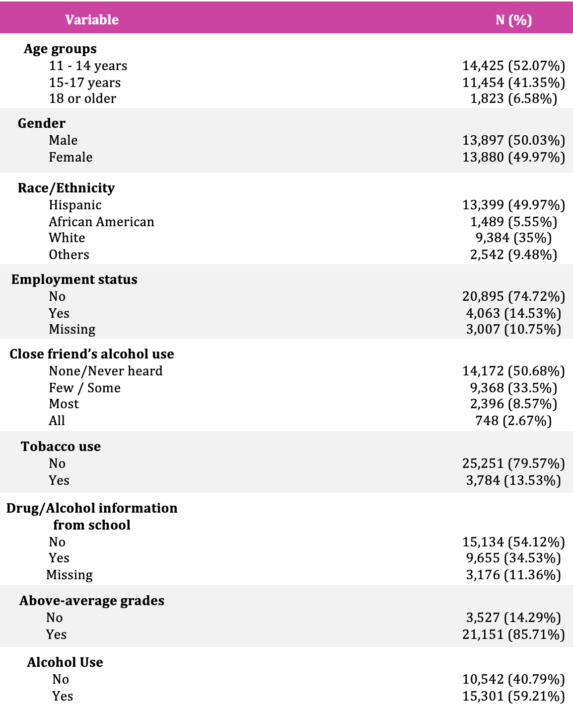
Table 4: Characteristics of the study sample association between alcohol use and average grades of the students using the Texas School Survey (2019-2020), presented with column percentages (n = 27,702)

Slide 11
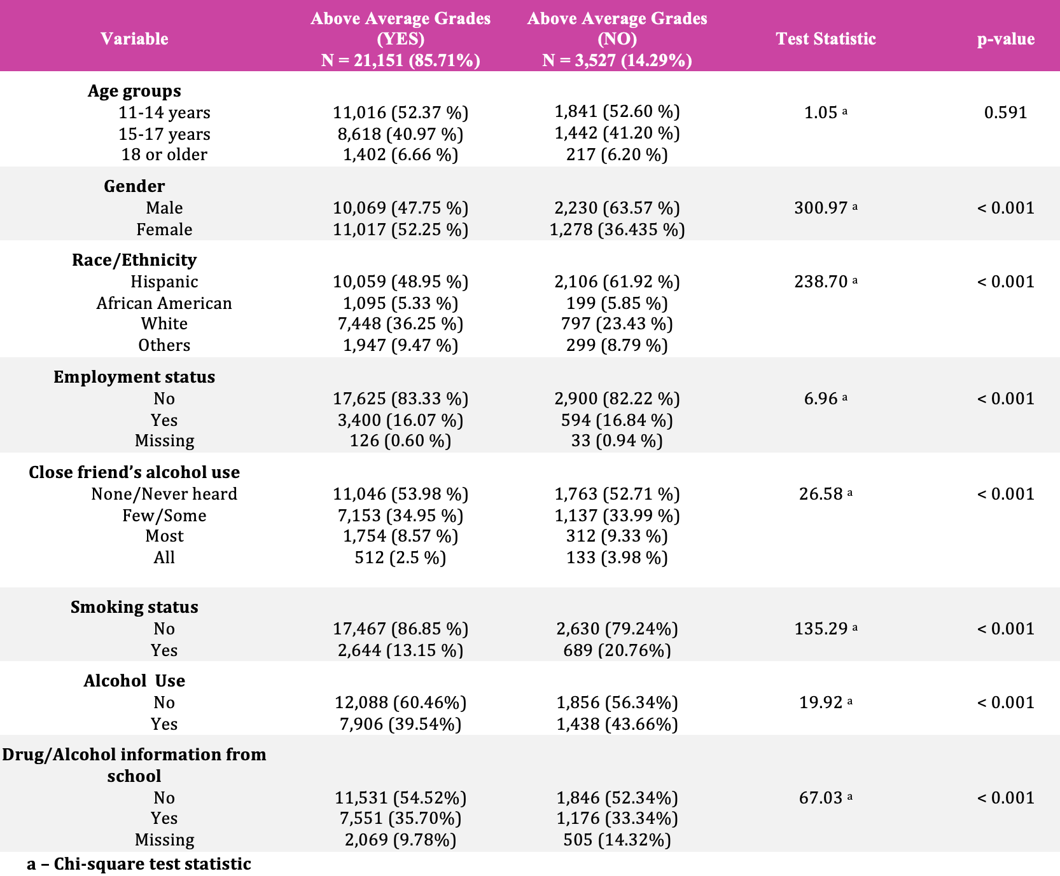
Table 5: Bivariate analysis an association between alcohol use and average grades of the students using the Texas School Survey (2019-2020), presented with column percentages (n = 27,702)
Chi square test significance could be due to large sample size

Slide 12
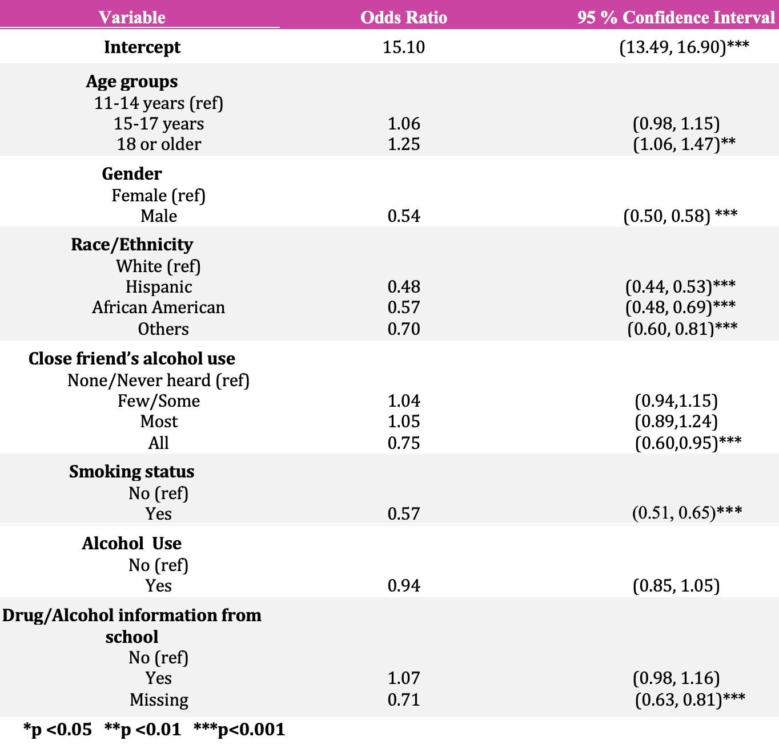
Table 6: Multivariable analysis an association between alcohol use and average grades of the students using the Texas School Survey (2019-2020), presented with column percentages (n = 27,702)

Slide 13
Interpretation (Research question 2):
The logistic regression analysis from Table 6 shows that the p-value for the association between alcohol use and obtaining above-average grades is p = 0.25 that indicates an insignificant association between alcohol use and above-average grades.

Slide 14
Study limitations:
The data was collected only from the public schools and doesn’t include from neither private school students nor drop-outs.
Since it is a cross sectional study, we cannot establish the temporal relationship.
The data may be subjected to reporting bias.
A certain amount of error is introduced when generalizing the findings to the population, as the survey data is based on the sample of Texas public school students.
Due to COVID-19, the Texas schools were closed in mid-March 2020 and the survey participation rates suffered. Therefore, the data in this year should be interpreted with caution.

Slide 15
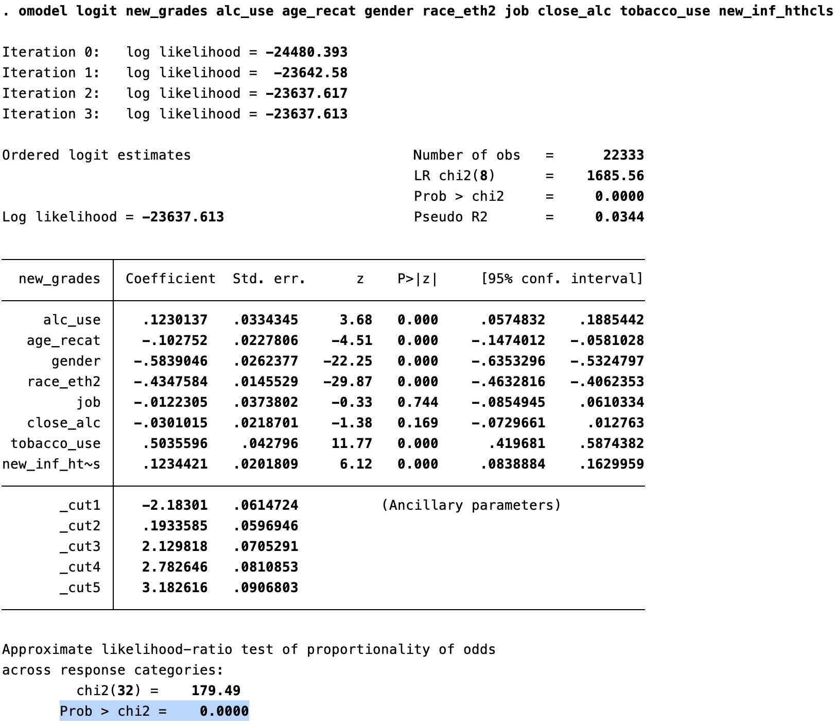
Lessons learned / challenges faced:
For RQ2 initial outcome was average grades (A, B,C,D,F and missing) which is ordinal with multiple categories.
To pass the cell size assumption variable employment and race/ethnicity are recategorized.
The proportional odds ratio assumption failed with p-value <0.001 to proceed with ordinal regression.
So, recategorized average grades variable into a binary variable above average ( Yes/No) and conducted a logistic regression instead of ordinal regression.

Slide 16
References :
1. Chang, C. P., Chang, S. C., Chuang, S. C., Berthiller, J., Ferro, G., Matsuo, K., ... & Lee, Y. C. A. (2019). Age at start of using tobacco on the risk of head and neck cancer: Pooled analysis in the International Head and Neck Cancer Epidemiology Consortium (INHANCE). Cancer Epidemiology, 63, 101615.
2. Rehm, J., & Shield, K. (2020). Alcohol use and cancers of the gastrointestinal tract. Epidemiology and preventive implications. Frontiers in Oncology, 10, 403.
3. Nguyen-Louie, T. T., Matt, G. E., Jacobus, J., Li, I., Cota, C., Castro, N., & Tapert, S. F. (2017). Earlier Alcohol Use Onset Predicts Poorer Neuropsychological Functioning in Young Adults. Alcoholism, clinical and experimental research, 41(12), 2082–2092. https://doi.org/10.1111/acer.13503
4. Singleton, R. A. (2007). Collegiate alcohol consumption and academic performance. Journal of studies on alcohol and drugs, 68(4), 548-555.

