Slide 1
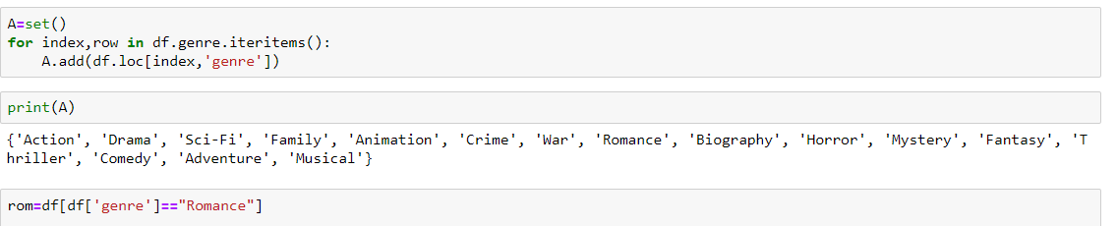
DATA CLEANING
The data set is split on the basis of genre. Set is used to get all the unique genres and a data frame is created for each genre. In each data frame all the missing values and zeroes are replaced by NANs

Slide 2
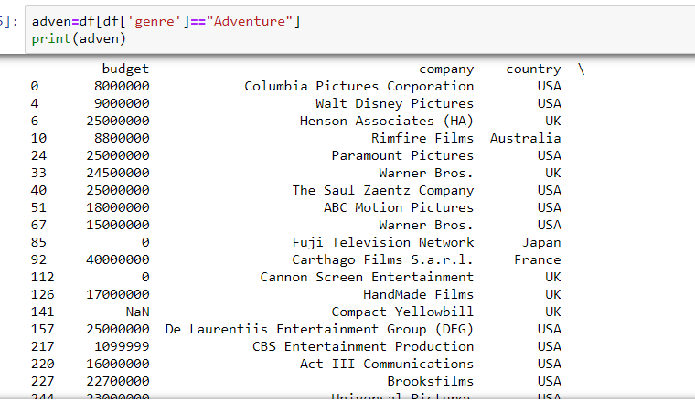
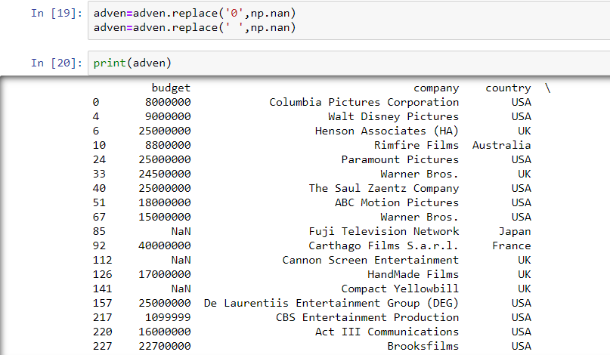

Slide 3
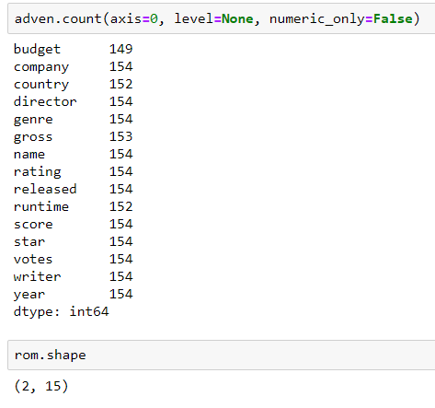
For each genre the coloumns
with NAN values are identified and appropriate replacement is choosen for both numerical and categorical data

Slide 4
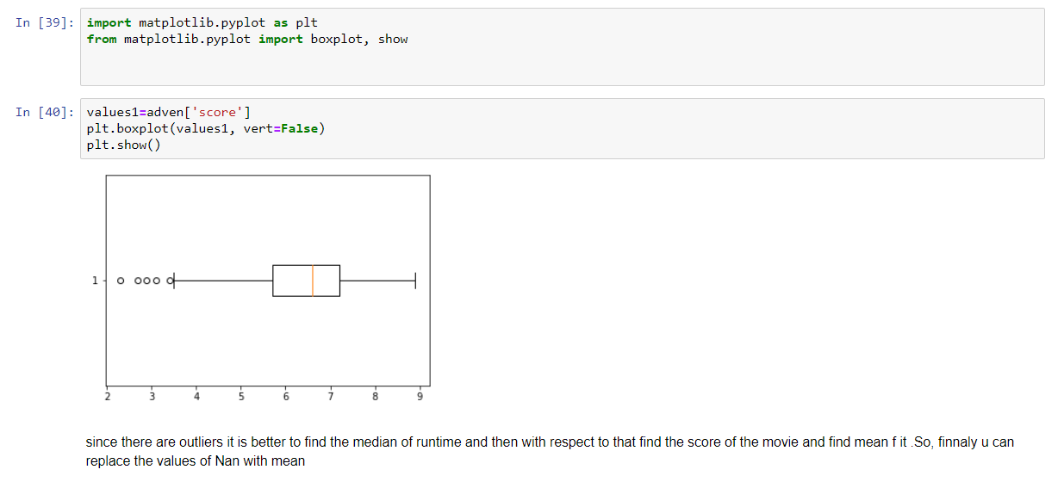
For Numerical data
We use a box plot to determine the appropriate replacement. If the data has more outliers interpolation and replacement by median is preferred as median is not affected by the outliers

Slide 5
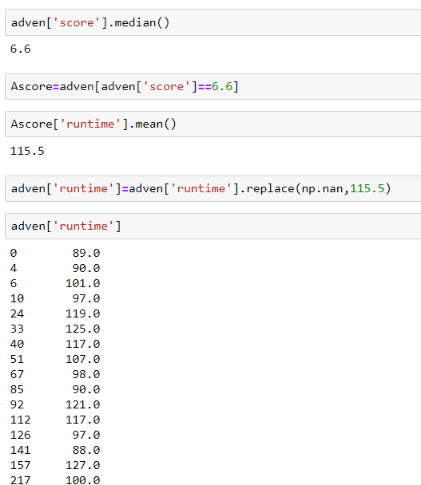
On plotting the boxplot for score of adventure genre we obtained many outliers and hence we preferred to find the median of score and mean of runtime of adventure movies having that median score and replace all the NAN values of runtime with that mean runtime

Slide 6
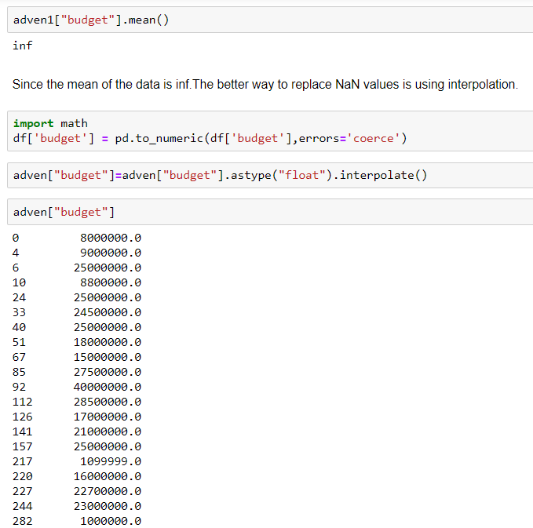
The mean is found by excluding all the NAN values
The mean is found to be infinity so the NAN values are replaced by interpolation

Slide 7
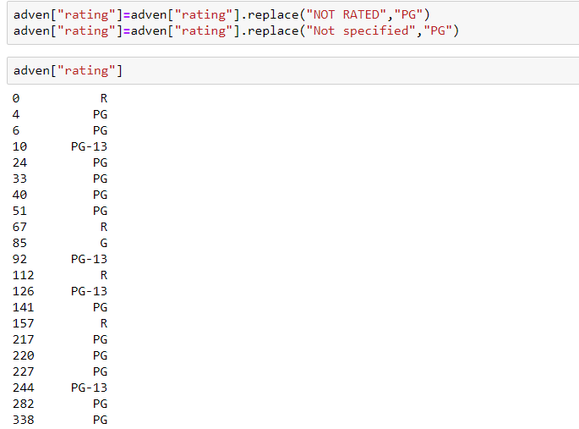
For categorical data
Mode is the best way of replacement for categorical data

Slide 8
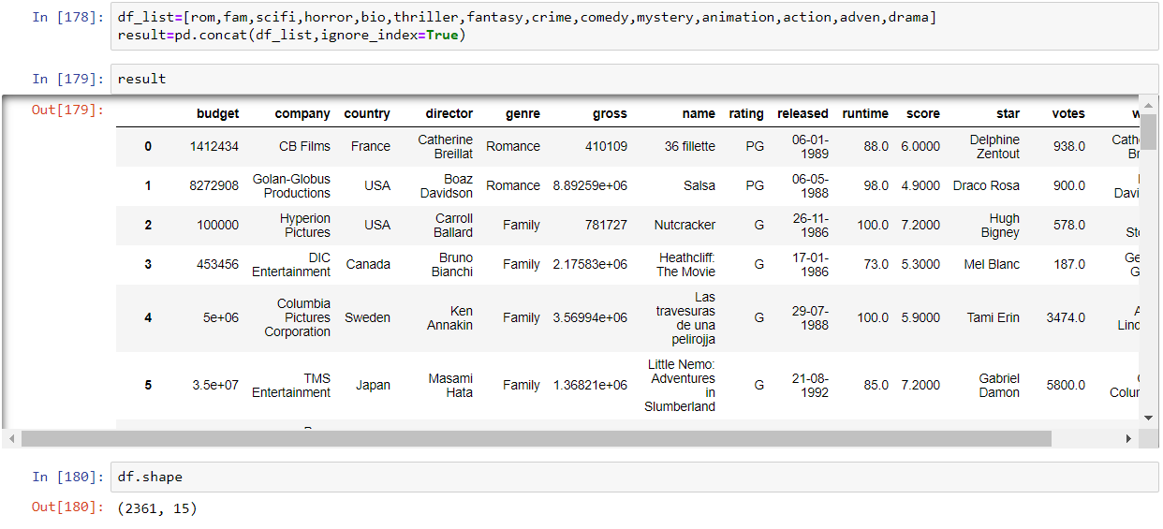
All the dataframes are cleaned in the similar way and are recombined

Slide 9
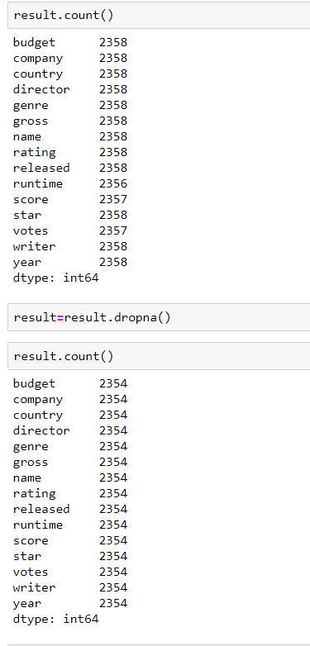
On rechecking we find that some of the NAN values are not replaced. The rows containing NA values are removed since the removal of small number of rows from a gaint dataset doesn’t matter.
But still the NAN values exist

Slide 10
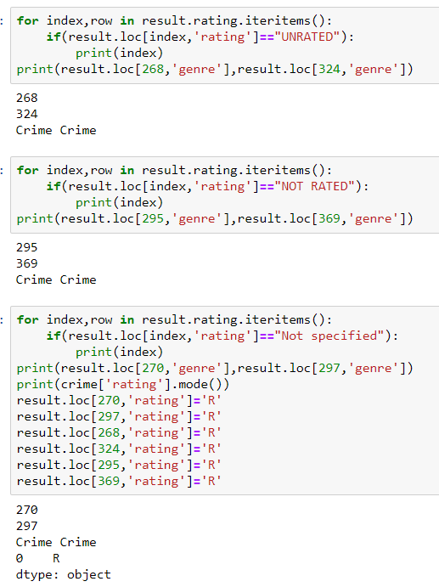
It is seen that rating coloumn is not free from junk
values and the genre which has unrated and Not specified
Is found to be ‘crime’ and hence unrated and Not specified are replaced with median of the rating of crime genre

Slide 11
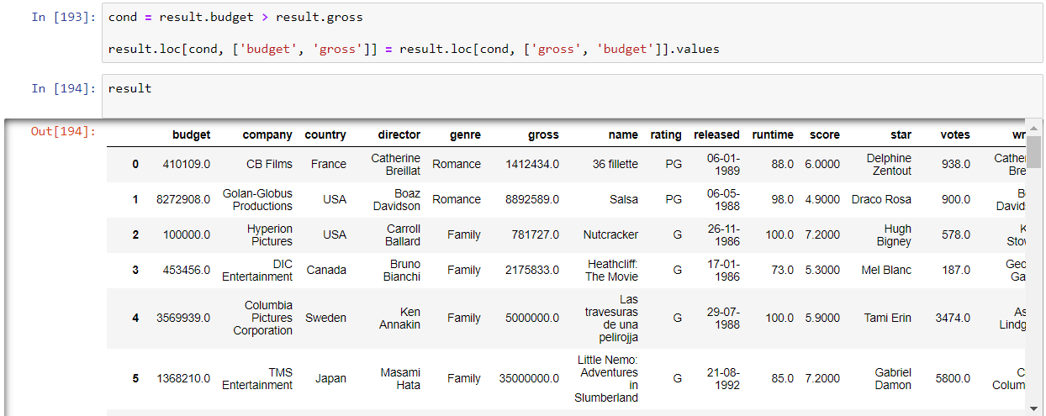
We then checked for the condition that the gross value is always greater than budget as the gross is budget plus tax
Wherever gross value is less than budget we swaped the values for gross and budget

Slide 12
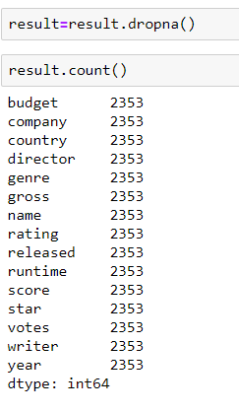
Finally the count produced the value equal to number of rows indicating that the data is cleaned

Slide 13
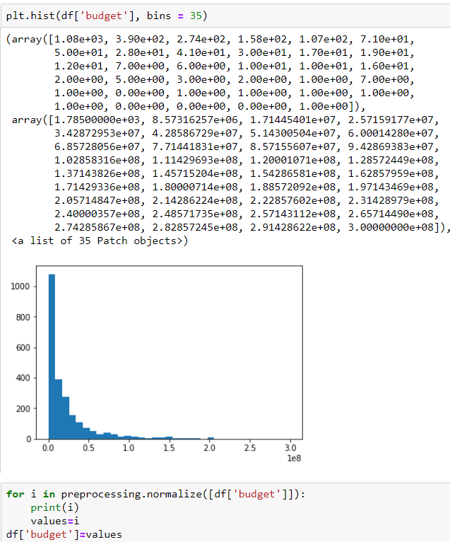
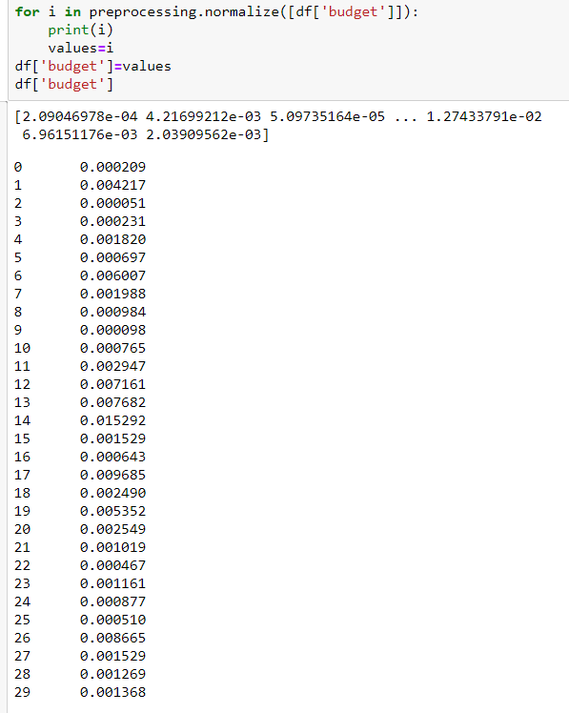
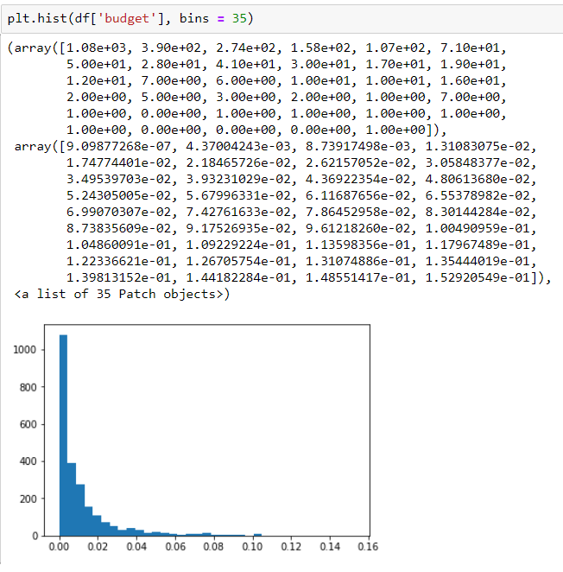
Normalisation
Histogram plot is drawn for each coloumn before normallisation and is compared with the histogram after normalisation. It is found that both the plots are similar indicating that the data is already normalised

Slide 14
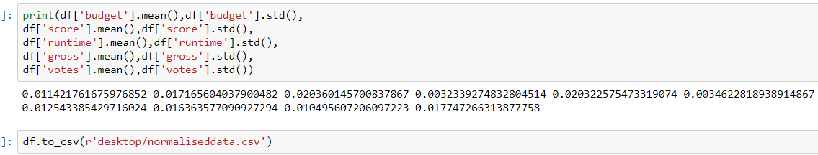
All the mean and standard deviation of numeric data is lying between 0 and 1
The goal of normalisation is to change values of data in the numeric coloumns to common scale. There is a great similarity between histogram plot before normalisation and after normalisation. The only thing which differs is that the range of values.After normalisation its easier to talk about range of values

Slide 15
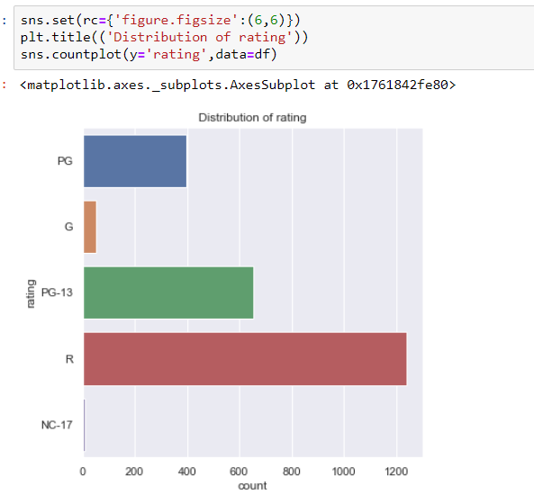
Visualisation
In an attempt to plat the graph between rating
and count of movies we got to know that highest
number of movies are ‘R’ rated and a very few
are rated “NC-1”

Slide 16
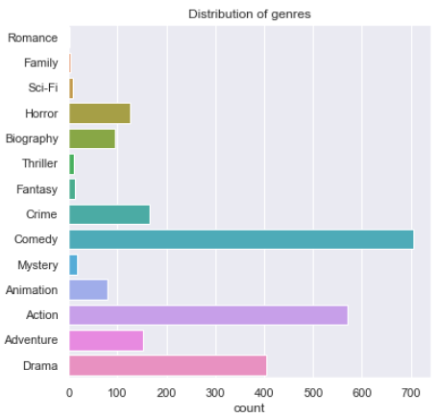
The plot of genre v/s count of movies revealed
That most of movies are of comedy genre and a least number of movies are of romance genre

Slide 17
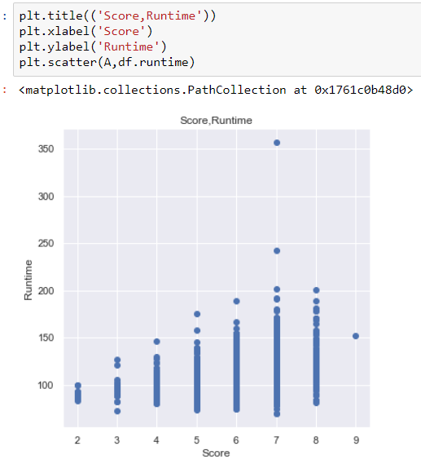
The scatter plot between score and runtime. The number of days movie had been running depends on the rating given by the people. The maximum number of days a movie had been running is 350 and it had score in the range 7-8

Slide 18
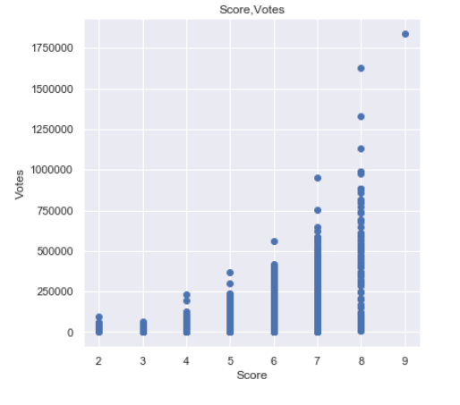
The scatter plot between votes and score
reveals that most of people re willing to watch the
Movies with high ratings. So the highest rating is 9
and the number of people who have watched
it is above 17 lakhs

Slide 19
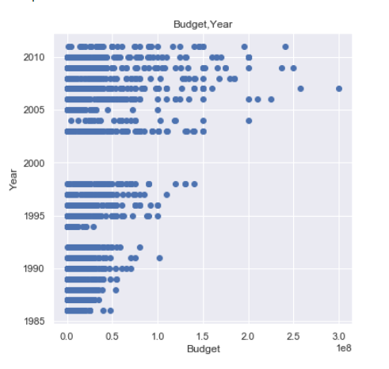
The scatter plot between year and budget tells explains budget spent for movies in that particular year. We notice that most of the budget is spent in the years between 2005 and 2010

Slide 20
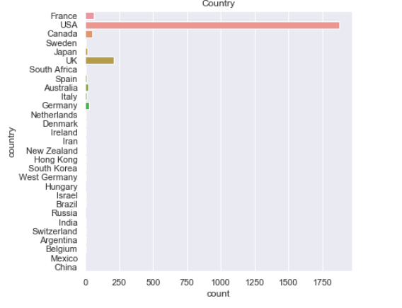
This graph reveals number of movies released by each country. We can see that USA has released most of the movies

Slide 21
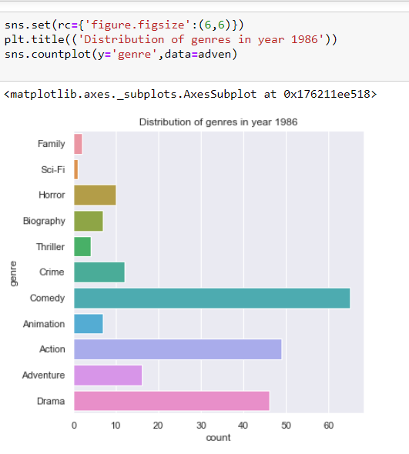
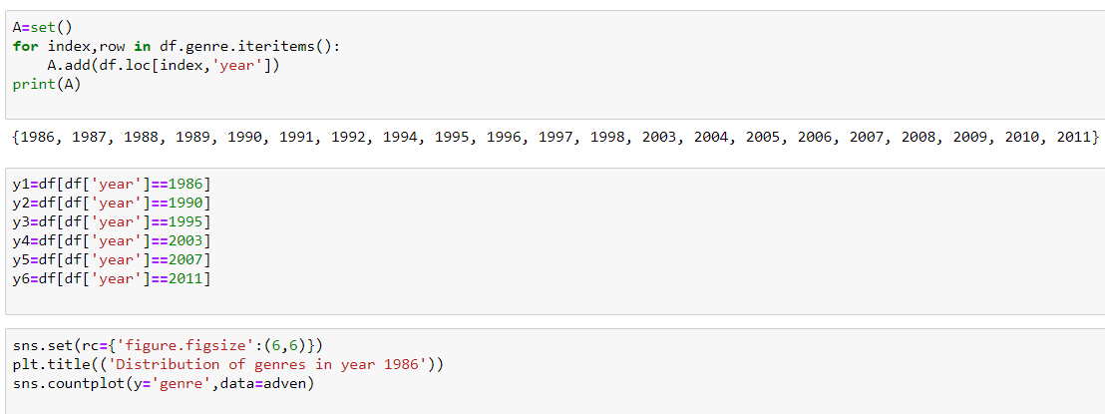
We found the number of year using set
and then analysed which genre is popular in each year

Slide 22
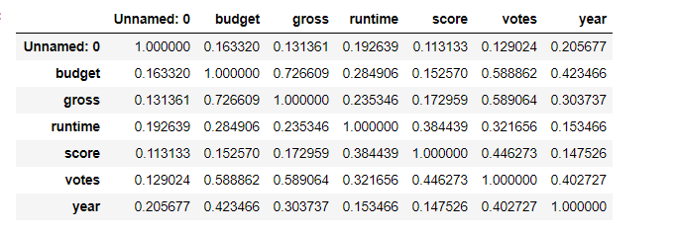
Correlation
Using heap map we found the correlation between various coloumns
The correlation is highest for budget and gross and is least for year and score

Slide 23
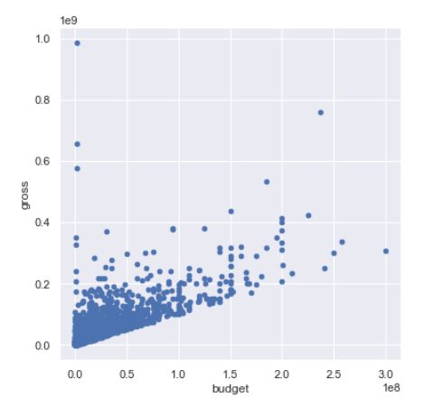
The scatter plot of gross and budget
showed positive correlation which means
that on increase in budget gross also increases
And vice versa

Slide 24
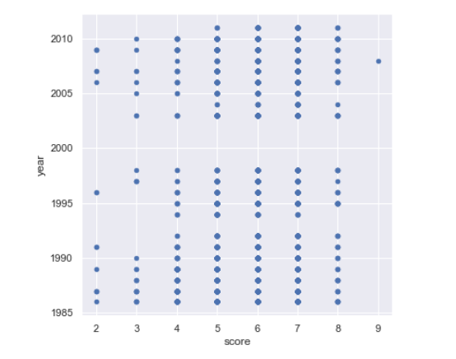
The scatter plot between year and
Score indicated that there is no correlation
between both

Slide 25
Hypothesis Testing
We are willing to do hypothesis testing for the entire population since
The number of data values are greater than 30paired Z test assuming that
Confidence level is 95%.
Null hypothesis-H0 average of budget is equal to average of gross
We obtained p value less than 0.05 and hence rejected null hypothesis
Therefore average of budget is not equal to average of grosss

Slide 26
