Slide 1
JAVA ACCESS MODIFIERS

Slide 2
What are access modifiers
What is scope ?
Scope refers to the lifetime and accessibility of a variable. How large the scope is depends on where a variable is declared
Access modifiers limit the scope of
Class
Method
Variables/Data members

Slide 3
Types of Modifiers
Access Modifiers | Visibility
Public | Visible to All classes.
Protected | Visible to classes with in the package and the subclasses of other package.
No Access Modifier (Default) | Visible to the classes with the package
private | Visible with in the class. It is not accessible outside the class.

Slide 4
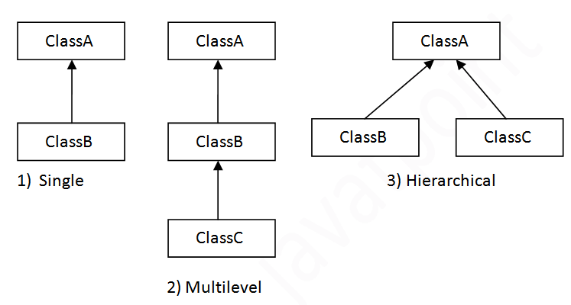
Inheritance in Java
Before we dive deep and learn various access modifiers, let’s see what inheritance in Java means
Terms you should know:
Super class/Parent
Subclass/Child

Slide 5
Demonstration of access modifiers using code
Access modifiers on class variables
Access modifiers on methods

Slide 6
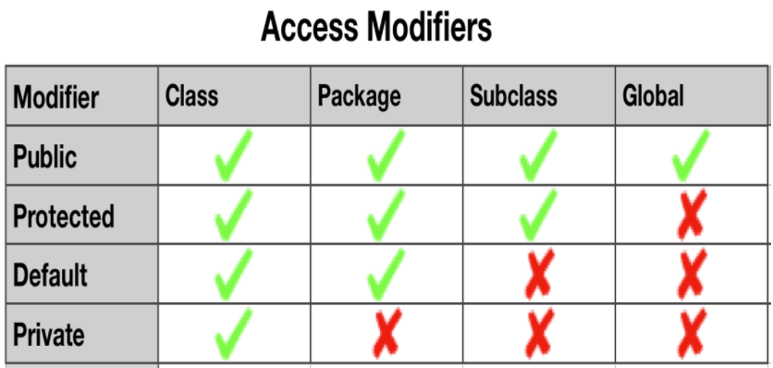

Slide 7
Recommendations
All data members(class variables) should be private
Constants (final static variables) that are shared across various class can be public/protected as required
Any methods that are intended to be used by other classes should be public
Any helper methods with in a class should be private

