Slide 1
RidePulse
How to Use the Power BI Report
Trainer / portfolio submission guide
Report capabilities
• 3 main pages
• Bookmarks + page navigation
• Dynamic metric switch
• Tooltip + drill-through
• RLS-enabled zone access
RidePulse • How to Use the Report • 1

Slide 2
1. Report Navigation
How to navigate
• Use the Page Navigator to move between the three main pages.
• Executive Overview = management summary.
• Demand & Surge Intelligence = demand, supply, surge and wait-time analysis.
• Driver & Customer Analytics = driver performance and customer behavior.
• Zone Tooltip and Zone Details are supporting pages.
Executive
Overview
Demand & Surge
Intelligence
Driver & Customer
Analytics
RidePulse • How to Use the Report • 2

Slide 3
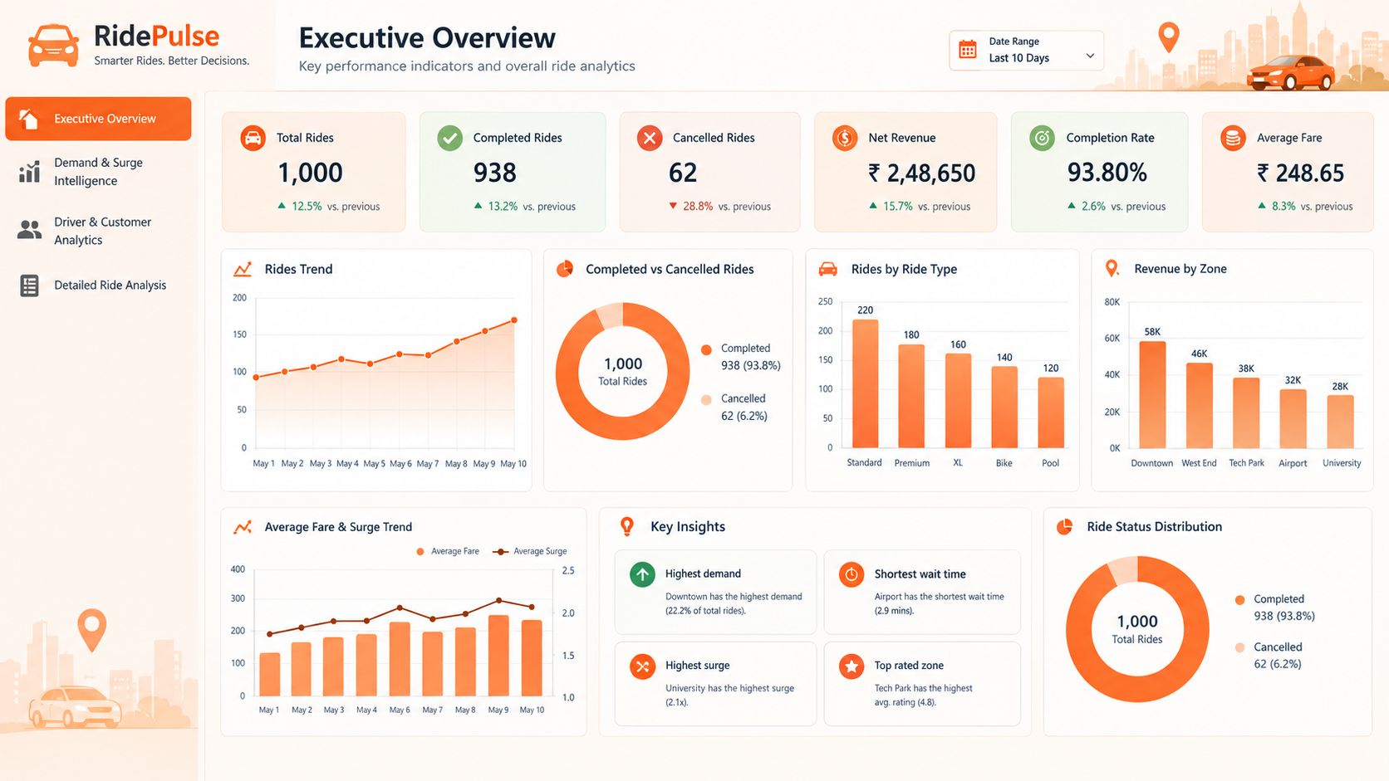
2. Executive Overview — Start With the KPIs
How to use
• Check KPI cards first.
• Use the Date slicer to set the period.
• Read the revenue trend for movement over time.
• Compare completed vs cancelled rides.
• Use zone and ride-type charts for context.
• Use Key Insights for headline findings.
RidePulse • How to Use the Report • 3

Slide 4
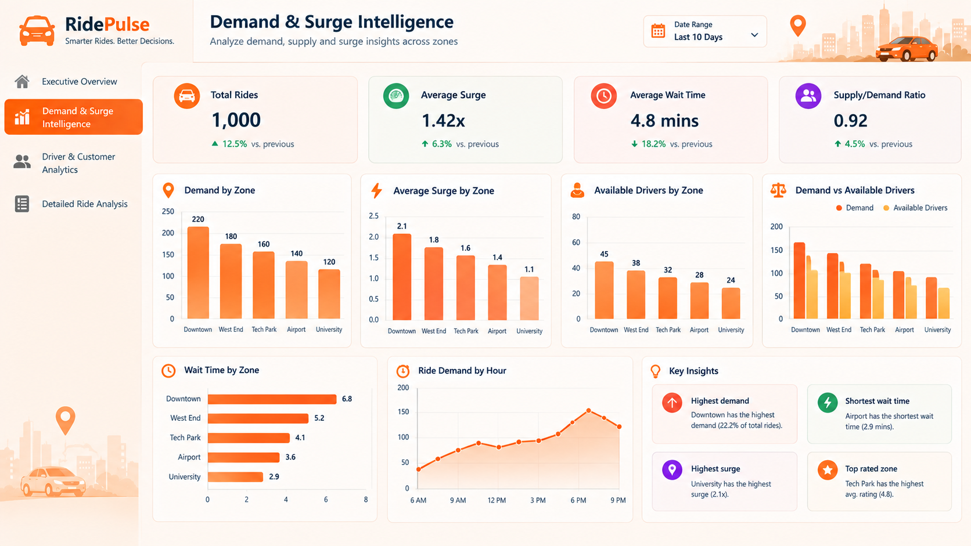
3. Demand & Surge Intelligence — Find Supply Pressure
How to use
• Compare demand by zone.
• Compare available drivers with demand.
• Use Average Surge by Zone to find pricing pressure.
• Use Wait Time by Zone for service delays.
• Use Ride Demand by Hour for busy periods.
• Hover over zones for the custom tooltip.
• Use the Dynamic Switch for metric focus.
RidePulse • How to Use the Report • 4

Slide 5
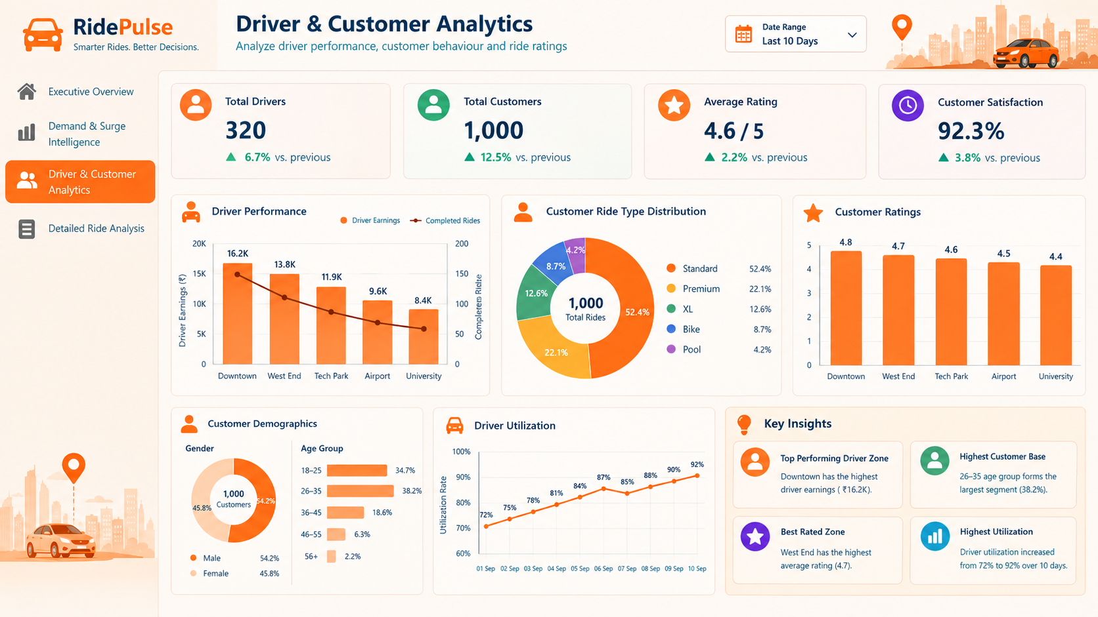
4. Driver & Customer Analytics — Understand Performance
How to use
• Review driver earnings and trip distance.
• Compare ratings by vehicle/driver segment.
• Use customer type and age-group views.
• Review customer rating for experience quality.
• Use the Date slicer for period analysis.
• Read Key Insights for the strongest patterns.
RidePulse • How to Use the Report • 5

Slide 6
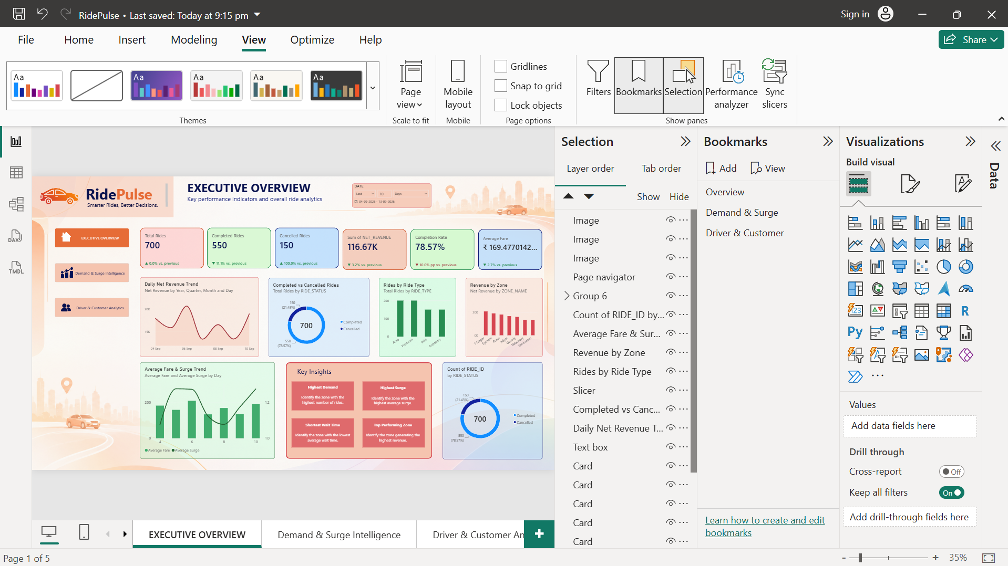
5. Bookmarks — Switch the Executive Layout
How to use
• Executive View emphasizes the management summary.
• Analysis View exposes the alternate analytical visuals.
• Bookmarks change layout/visibility, not the data.
• Use the bookmark buttons on the report page.
• Page Navigator still controls page navigation.
RidePulse • How to Use the Report • 6

Slide 7
6. Dynamic Switch — Change the Metric
How to use
• RidePulse Metric Switch is a Power BI Field Parameter.
• Available metrics: Total Rides, Net Revenue and Average Surge.
• Selecting a metric changes the connected analytical visual(s).
• This avoids duplicating multiple pages/charts.
• Combine the switch with the Date slicer and zone analysis.
RidePulse Metric Switch
● Total Rides
○ Net Revenue
○ Average Surge
RidePulse • How to Use the Report • 7

Slide 8
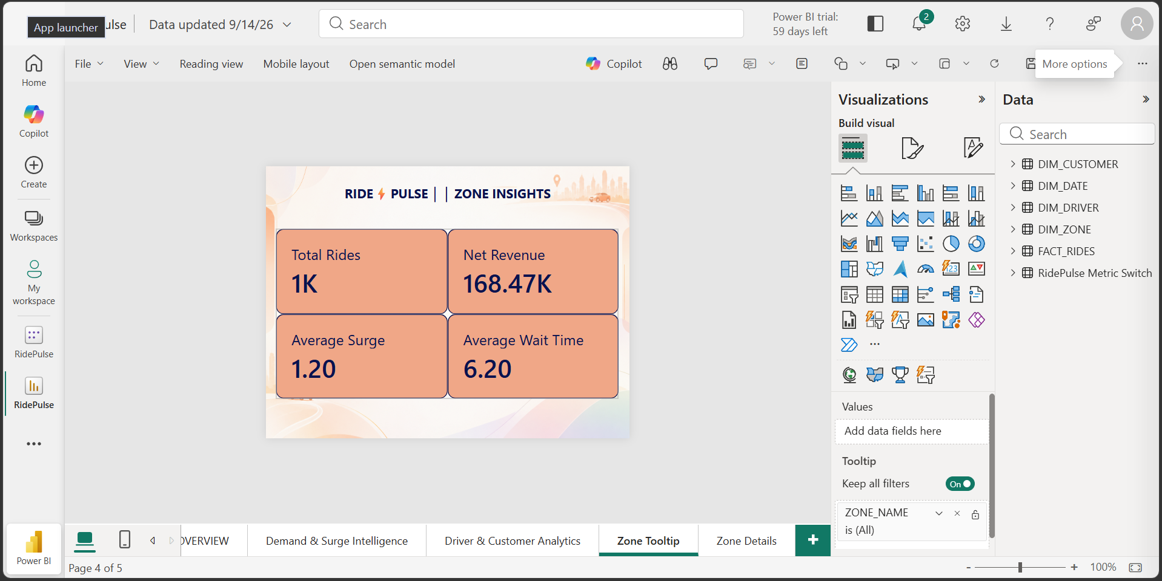
7. Tooltip & Drill-through — Investigate a Zone
How to use
• Hover over a zone visual for the Zone Tooltip.
• Tooltip shows Total Rides, Net Revenue, Average Surge and Average Wait Time.
• Right-click a zone and choose Drill-through → Zone Details.
• Zone Details uses DIM_ZONE[ZONE_NAME].
• Use Back to return to the source page.
RidePulse • How to Use the Report • 8

Slide 9
8. RLS — Zone-Level Security
Security rule
• Role: Zone_Manager
• Filter: DIM_ZONE[ZONE_NAME] = "Guindy"
• Filter propagates through the active DIM_ZONE → FACT_RIDES relationship.
• RLS has been successfully tested in Power BI Service.
• Assign production users/groups to the role and use read/view permissions where RLS enforcement is required.
Zone_Manager
[ZONE_NAME] = "Guindy"
RidePulse • How to Use the Report • 9

Slide 10
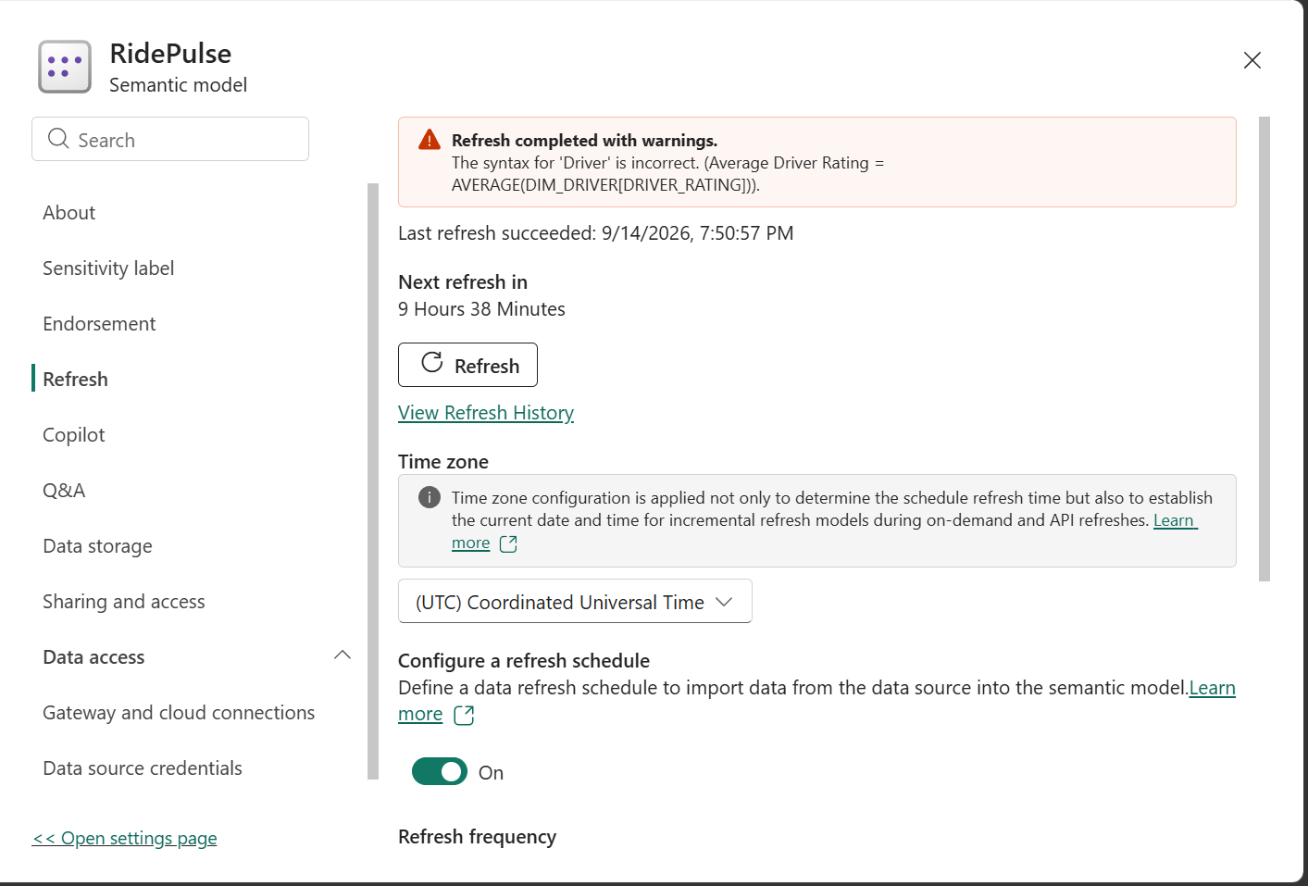
9. Power BI Service — Refresh & Finalization
Final checks
• Snowflake credentials are configured.
• Scheduled refresh is enabled.
• Captured Service evidence shows UTC time zone.
• Refresh warning relates to Average Driver Rating syntax.
• Correct the Desktop DAX, refresh, save, republish and refresh Service.
• Record the final configured refresh time in IST.
RidePulse • How to Use the Report • 10

Slide 11
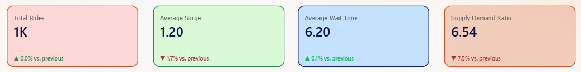
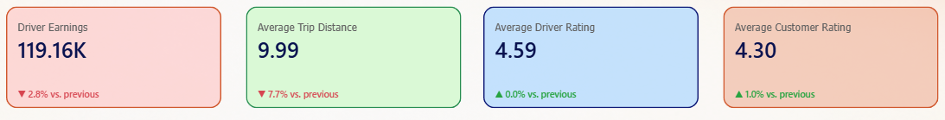
10. KPI Reading & Formatting
Reading the cards
• Currency values may use K for compact display.
• Driver Earnings should carry a currency symbol.
• Average Wait Time should be labelled in minutes.
• Ratings use a 5-point scale.
• Supply/Demand is unitless.
• Trend arrows are comparisons; interpret direction by metric.
RidePulse • How to Use the Report • 11

Slide 12
11. Recommended User Workflow
8-step analysis flow
• 1 — Select the required date range.
• 2 — Start on Executive Overview and review KPIs.
• 3 — Use bookmarks for the alternate Executive layout.
• 4 — Move to Demand & Surge Intelligence for zone/supply analysis.
• 5 — Use the Dynamic Switch to change the metric.
• 6 — Hover over zones for tooltip context.
• 7 — Drill through to Zone Details when deeper investigation is needed.
• 8 — Move to Driver & Customer Analytics for performance and customer patterns.
RidePulse • How to Use the Report • 12

Slide 13
12. Trainer Submission Checklist
Power BI Desktop
• ☐ PBIX saved with final changes.
• ☐ Three main pages verified.
• ☐ Page Navigator verified.
• ☐ Bookmarks verified.
• ☐ Dynamic Switch verified.
• ☐ Tooltip verified.
• ☐ Drill-through verified.
Power BI Service & documents
• ☐ RLS verified.
• ☐ Snowflake credentials verified.
• ☐ Average Driver Rating warning cleared.
• ☐ Scheduled refresh configured with final IST time.
• ☐ Data Architecture document updated.
• ☐ This How-to-Use PPT submitted with screenshots.
RidePulse • How to Use the Report • 13

