Slide 1
Lab-0
Write a python program to import and export data using Pandas library functions
Note: In this lab exercise we will be working on data which is either in numerical or categorical form and
is in row/column format. And not with Image, Video, or only Text data.

Slide 2
What is Pandas ?
Pandas is a Python library used for working with data sets.
It has functions for analyzing, cleaning, exploring, and manipulating data.
The name "Pandas" has a reference to both "Panel Data", and "Python Data Analysis" and was created by Wes McKinney in 2008.

Slide 3
Four different ways of importing datasets
Method-1: Initializing values directly into DataFrame
Method-2: Importing datasets from sklearn.datasets
Method-3: Importing datasets from a specific .csv file
Method-4: Downloading datasets from existing dataset repositories like Kaggle, UCI, Mendely, KEEL, etc.

Slide 4
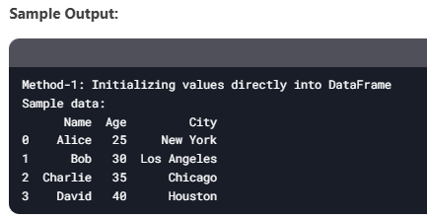
Method-1: Initializing values directly into DataFrame
A DataFrame is created directly from a Python dictionary.
This is useful for small datasets or testing purposes.
import pandas as pd
# Create a DataFrame directly from a dictionary
data = {
'Name': ['Alice', 'Bob', 'Charlie', 'David'],
'Age': [25, 30, 35, 40],
'City': ['New York', 'Los Angeles', 'Chicago', 'Houston']
}
df = pd.DataFrame(data)
print("Sample data:")
print(df.head())
Printing the dataframe
df.head(n) to show the first n rows of the dataframe.
df.tail(n) to show bottom n rows of the dataframe.

Slide 5
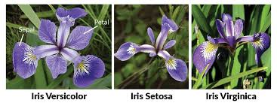
What is sklearn.datasets ?
Sklearn datasets are synthetic datasets created using the Python library sklearn. They are used to develop, test, and benchmark machine learning models and algorithms
https://scikit-learn.org/stable/datasets/toy_dataset.html
What is Iris dataset ?
The Iris dataset is a collection of measurements of iris flowers that includes the length and width of the sepals and petals.

Slide 6
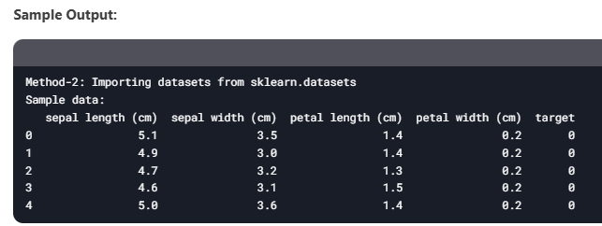
Method-2: Importing datasets from sklearn.datasets
The Iris dataset is loaded using sklearn.datasets.
The dataset is converted into a Pandas DataFrame for easier manipulation.
from sklearn.datasets import load_iris
iris = load_iris()
df = pd.DataFrame(iris.data, columns=iris.feature_names)
df['target'] = iris.target
print("Sample data:")
print(df.head())

Slide 7
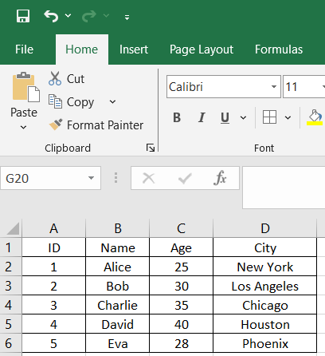
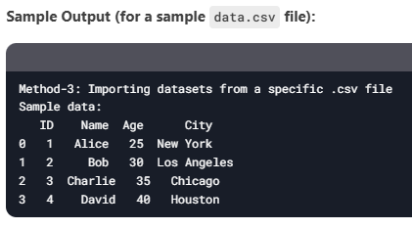
Method-3: Importing datasets from a specific .csv file
data.csv
# Load data from a CSV file (replace 'data.csv' with your file path)
file_path = 'data.csv' # Ensure the file exists in the same directory
df = pd.read_csv(file_path)
print("Sample data:")
print(df.head())
print("\n")

Slide 8
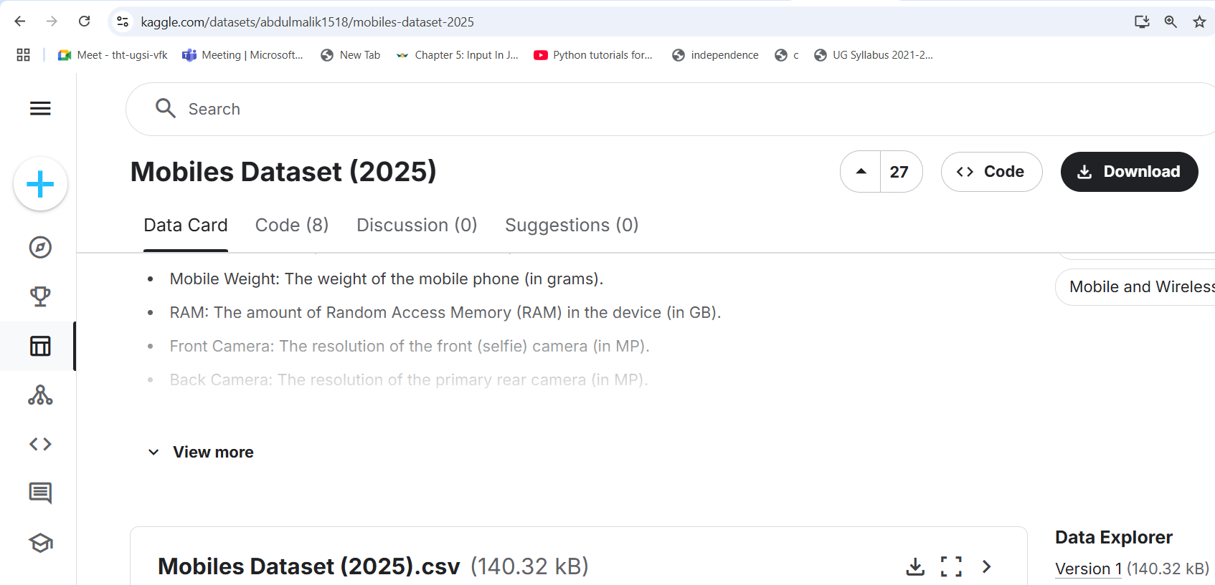
Method-4: Downloading datasets from existing dataset repositories like Kaggle, UCI, Mendely, KEEL, etc.
Kaggle: https://www.kaggle.com/datasets/abdulmalik1518/mobiles-dataset-2025
Download “mobiles-dataset-2025.csv” using the above URL
df = pd.read_csv('mobiles-dataset-2025.csv')
print("Sample data:")
print(df.head())

Slide 9
To Do
As shown in the previous slides the code, complete the exercise for the following
Method-1: Initializing values directly into DataFrame
Insert your know values, five rows of data with column headings as “USN, Name, Marks”
Method-2: Importing datasets from sklearn.datasets
Loading diabetes datasets sklearn.datasets.load_diabetes
Method-3: Importing datasets from a specific .csv file
sample_sales_data.csv
Method-4: Downloading datasets from existing dataset repositories like Kaggle, UCI, Mendely, KEEL, etc.
https://data.mendeley.com/datasets/wj9rwkp9c2/1
Download diabetes datasets from Mendely using above link

Slide 10
Exporting data
Load data from a CSV file into a Pandas DataFrame
Export a DataFrame back to a CSV file, use the df.to_csv() function:
import pandas as pd # Reading data from a CSV file df = pd.read_csv(‘sample_sales_data.csv') # Displaying the first few rows of the DataFrame print(df.head())
# Writing the DataFrame to a CSV file df.to_csv('output.csv', index=False) print("Data saved to output.csv")
index=False: Ensures that the row indices are not
included as an extra column in the saved file.

Slide 11
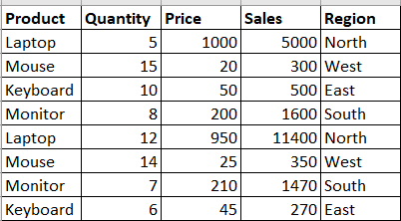
Example: Analyzing a Sales Dataset
sample_sales_data.csv
Step 1: Reading the Sales Data
Step 2: Performing Basic Analysis
2.1 Summarizing Sales by Region: 2.2 Identifying the Best-Selling Products:
# Reading sales data from a CSV file sales_df = pd.read_csv('sales_data.csv') # Displaying the first few rows of the dataset print("First few rows of the sales data:") print(sales_df.head())
# Grouping by Region and calculating total sales sales_by_region = sales_df.groupby('Region')['Sales'].sum() print("\nTotal sales by region:") print(sales_by_region)
# Grouping by Product and calculating total quantity sold best_selling_products = sales_df.groupby('Product')['Quantity’].
sum().sort_values(ascending=False) print("\nBest-selling products by quantity:") print(best_selling_products)

Slide 12
Example: Analyzing a Sales Dataset
Step 3: Saving the Analysis Results to a CSV File
# Saving the sales by region data to a CSV file sales_by_region.to_csv('sales_by_region.csv') # Saving the best-selling products data to a CSV file best_selling_products.to_csv('best_selling_products.csv') print("\nAnalysis results saved to CSV files.")

Slide 13
Importing Stock Market Data for Analysis
In this real-life scenario, we’ll use the Yahoo Finance API to download historical stock market data for “Reliance Industries Ltd., Tata Consultancy Services Ltd., Infosys Ltd.” and analyze it with Pandas.
# Step 1: Import required libraries
import yfinance as yf
import pandas as pd
import matplotlib.pyplot as plt

Slide 14
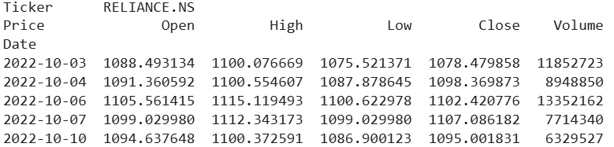
Importing Stock Market Data for Analysis
# Step 2: Downloading Stock Market Data
# Define the ticker symbols for Indian companies
# Example: Reliance Industries (RELIANCE.NS), TCS (TCS.NS), Infosys (INFY.NS)
tickers = ["RELIANCE.NS", "TCS.NS", "INFY.NS"]
# Fetch historical data for the last 1 year
data = yf.download(tickers, start="2022-10-01", end="2023-10-01", group_by='ticker')
# Display the first 5 rows of the dataset
print("First 5 rows of the dataset:")
print(data.head())

Slide 15
Importing Stock Market Data for Analysis
# Step 3: Basic Data Exploration
# Check the shape of the dataset
print("\nShape of the dataset:")
print(data.shape)
# Check column names
print("\nColumn names:")
print(data.columns)
# Summary statistics for a specific stock (e.g., Reliance)
reliance_data = data['RELIANCE.NS']
print("\nSummary statistics for Reliance Industries:")
print(reliance_data.describe())
# Calculate daily returns
reliance_data['Daily Return'] = reliance_data['Close'].pct_change()

Slide 16
Importing Stock Market Data for Analysis
# Calculate daily returns
reliance_data['Daily Return'] = reliance_data['Close'].pct_change()
reliance_data['Close']:
This refers to the column in the reliance_data DataFrame that contains the closing prices of the stock for each day.
.pct_change():
This is a Pandas function that calculates the percentage change between the current and a prior element in a column.
By default, it calculates the percentage change between the current row and the immediately preceding row.
For example, if the closing price on Day 1 is ₹100 and on Day 2 is ₹105, the percentage change is:
Percentage Change=((105−100)/100)×100=5%
reliance_data['Daily Return']:
This creates a new column in the reliance_data DataFrame called Daily Return.
The column will store the daily percentage changes (returns) of the stock's closing price.

Slide 17
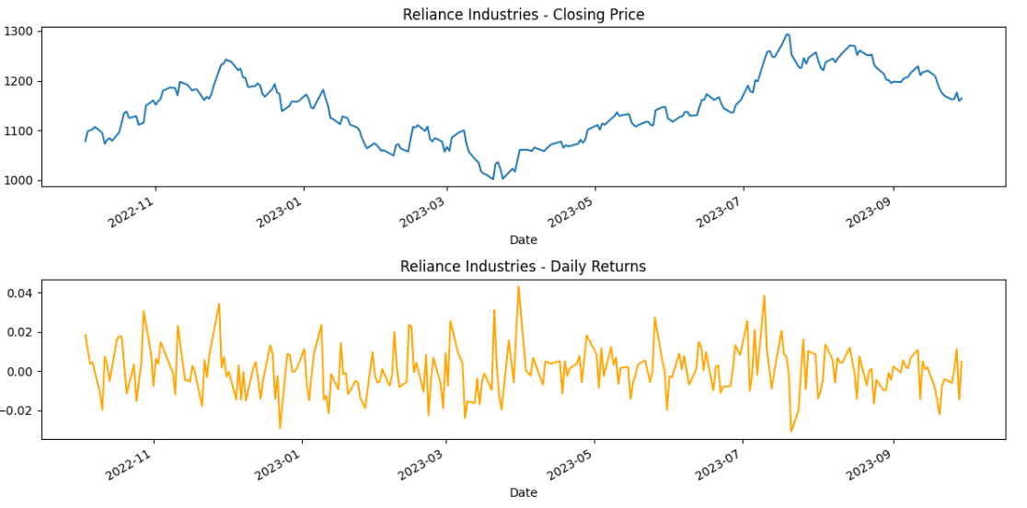
Importing Stock Market Data for Analysis
# Plot the closing price and daily returns
plt.figure(figsize=(12, 6))
plt.subplot(2, 1, 1)
reliance_data['Close'].plot(title="Reliance Industries - Closing Price")
plt.subplot(2, 1, 2)
reliance_data['Daily Return'].plot(title="Reliance Industries - Daily Returns", color='orange')
plt.tight_layout()
plt.show()

Slide 18
Exporting Stock Market Data
# Step 4: Saving the Processed Data to a New CSV File
# Save the Reliance data to a CSV file
reliance_data.to_csv('reliance_stock_data.csv')
print("\nReliance stock data saved to 'reliance_stock_data.csv'.")

Slide 19
To Do
Using the code given in the above slides, do the exercise of the “Stock Market Data Analysis”, considering the follwoing
1. HDFC Bank Ltd. , ICICI Bank Ltd , Kotak Mahindra Bank Ltd.
tickers = ["HDFCBANK.NS", "ICICIBANK.NS", "KOTAKBANK.NS"]
2. Start date: 2024-01-01, End date: 2024-12-30
3. Plot the closing price and daily returns for all the three banks mentioned.

