Slide 1

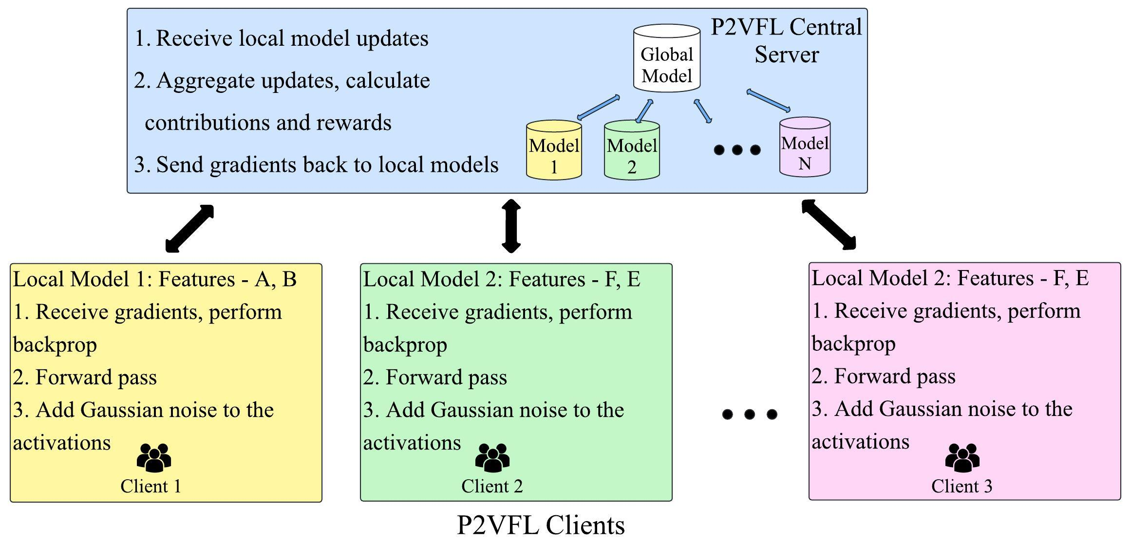
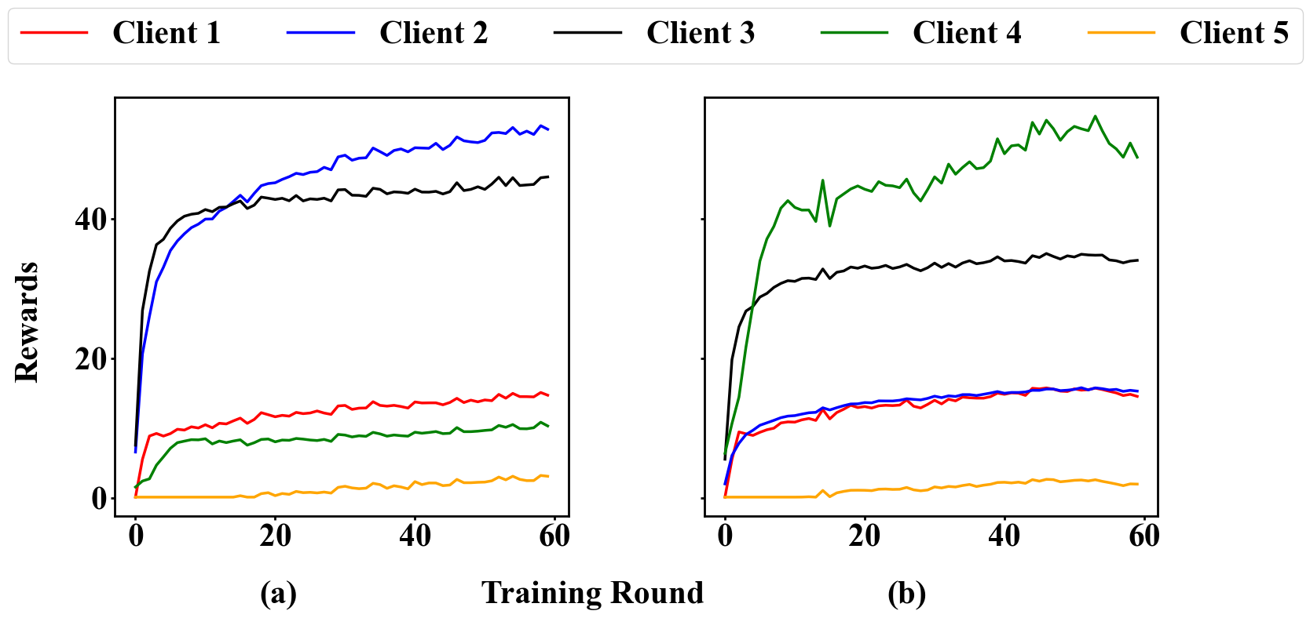
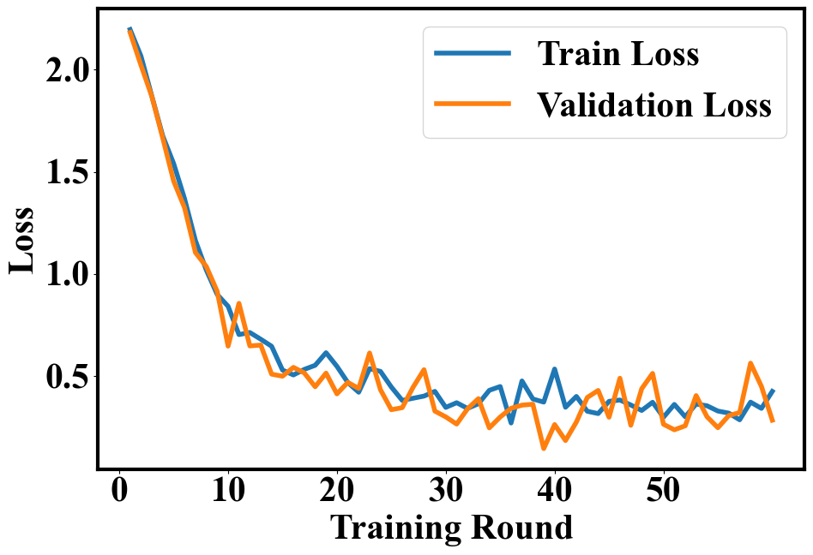
Motivation: Participants do not always participate in Federated Learning (FL) training process as FL systems are vulnerable to privacy attacks and participants have resource constraints.
Goal: Develop an attack-resistant, robust VFL system with incentives to achieve high prediction accuracy, client privacy, and contribution equity.
Novelty, Innovation, & Impact: Our approach combines incentives with privacy in VFL to boost client participation and resist attacks.
Key Technical Approach
System Objective:$\begin{aligned}\max_{ε_{i}∈[ε_{L},ε_{U}]}R_{it}=α⋅S_{it}+β⋅P_{it}\end{aligned}$
Our system provides feedback for the clients to choose their own privacy parameters as:
$$\begin{aligned}G_{contribution}=α(\frac{∂S_{it}}{∂h_{it}}⋅\frac{∂h_{it}}{∂ε_{it}})+β\frac{∂P_{it}}{∂ε_{it}}\end{aligned}$$
Client utility is computed as: $\begin{aligned}U_{it}=τ_{it}-B_{it},\end{aligned}$
We tokenize rewards as:$τ_{it}=\left(\frac{R_{it}}{\sum_{j=1}^{N}{R_{jt}}}\right)×\left(\frac{N×(N+1)}{2}\right)$
where S is the contribution objective, P is the privacy objective, $ε$ is
the Differential Privacy parameter, R is the reward, B is the client cost,
N is the number of clients, $τ$ is the total budget for the FL training.
Experimental Results & Analyses
$$\begin{aligned}ε_{t}^{t+1}=min\{ε_{\text{U}},max\{ε_{\text{L}},ε_{it}+G_{contribution}|_{ε^{it}=ε_{it}^{r}}\}\}\end{aligned}$$
Attack Strength | Label Inference Accuracy |  | Model Accuracy
 | Vanilla- VFL | P2VFL | Vanilla-VFL | P2VFL
1 | 0.82 | 0.4281 | 0.785 | 0.7
0.5 | 0.723 | 0.39 | 0.775 | 0.71
0.3 | 0.6524 | 0.3816 | 0.779 | 0.75
0.1 | 0.6004 | 0.376 | 0.75 | 0.68
P2VFL: Privacy-Preserving Incentive Mechanism for Vertical Federated Learning
Sindhuja Madabushi, Ahmad Faraz Khan, Haider Ali, Jin-Hee Cho
Department of Computer Science, Virginia Tech
P2VFL converges well with ~78% accuracy even with DP noise with MNIST dataset.
Reward distribution changes with uniform vs. non-uniform resource allocation.
P2VFL is resistant to inference attacks.

