Slide 1
Walk-time Address Adjustment For Improving The Accuracy of Dynamic Branch Prediction
Team #9
Sindhuja Nandikonda
Atrayee Bhadra
Sharmila Kannan
Under the guidance of
Prof. Gita Alaghband

Slide 2
Agenda
Introduction
Motivation
Walk Time Techniques
Link Time
Branch Interference
NOP instructions
Address adjustment Techniques
Constrained Address Adjustment
Relaxed Address Adjustment
Branch Classification
Performance Metric and Analysis
Conclusion
Our Project

Slide 3
Introduction
Dynamic branch prediction can deliver accurate branch prediction without changes to the instruction set architecture.
It has been an effective technique for boosting the performance of modern high performance microprocessors.
Limitation of hardware predictors:
Limited number of 2-bit counters, which leads to branch interference.

Slide 4
Motivation
To reduce the branch interference.
Instead of designing more accurate predictors with large predictor tables- we can use the same branch predictors(with limited 2 bit counters) combined with address adjustment techniques .
This provides accuracy same as that of predictors with large predictor table.

Slide 5
Role Of A 2-bit counter in Branch Prediction
pattern history Table, whose each entry is a 2-bit counter
entryK
TAKEN??
PC
Next fetch address
PC+Inst size
HIT??
CACHE
Target address
Cache of target address
[Ref:Prof.Onur Mutlu lectures]

Slide 6
Walk time techniques
Walk time techniques are software translation techniques where the changes to the program are done at the link time
Walk time is nothing but link time
Changes are architecturally seen

Slide 7
Link Time
Link Time is after compile time and before run time
It refers to the operations performed by the linker
The operations performed by linker generally includes fixing up the addresses of externally referenced objects, relocating the machine code etc..
Link time is the time at which several object files obtained from the compiler are then combined with the libraries to form one executable files

Slide 8
Outline of source code execution
Compiler
Linker
Loader
Run-time
O/P
I/P
Compiler takes source code as the input,and generates an object file.
Linker takes the object file and generates an executable file.
Loader loads this executable file in memory, then code execution takes place.

Slide 9
Branch Interference
The branch behavior is maintained in the pattern history table.
Then the predictors use the pattern history table information, and predict accordingly.
The mapping of conditional branch is done by hashing with low-order bits of the branch addresses.
Branch interference occurs, when the 2-bit counter that keeps track of the branch history of a particular branch is altered by the history of another branch (i.e., several conditional branches are mapped to the same 2bit counter).

Slide 10
Example:
Branches i and k are mapped to the same 2-bit counter of the pattern table
Address/4 Profiling Instructions
480005ce 9433/9436 bnez i
480005ef 1/1 bnez j
. . .
. . .
480005ee 0/6788 bnez k
. . .
4800061f 5702/5792 bnez n
Pattern table
ENTRY 0
ENTRY 1
ENTRY 2
ENTRY 3
Entry 4 . .
ENTRY 14
ENTRY 15
ENTRY 16
2 bit counter

Slide 11
Effects of branch interference
The accuracy of prediction reduces
Explanation:
480005ce 9433/9436 bnez i
4800061f 5702/5792 bnez n
480005ef 1/1 bnez j

Slide 12
How to reduce the interference
The address adjustment techniques implemented during link time(walk time) can help to reduce the branch interference.
The technique focuses on how to include NOP instructions logically.

Slide 13
NOP instruction
An instruction that does nothing is called an NOP(Null Operation).
Example:
lw vo , 4(v1) // leads to a bug
jr v0
lw v0, 4(v1)
NOP
jr v0

Slide 14
Few Interesting Points
In MIPS, add 0 0 0 is an NOP instruction, since it does not affect any of the states
An NOP should advance the PC only by one instruction

Slide 15
Principle Uses Of NOP
To allow the future modification of the code, like reserving space in code memory
To add a known delay
To deal with hazards and sequencing problems in pipelining
To synchronize events

Slide 16
Two important issues while inserting NOP instructions are:
Right location to insert NOP instructions- To avoid wasting CPU cycles.
Proper number of NOP instructions - To avoid code expansion.

Slide 17
Address Adjustment
Logically adjust the static address of branch in the program, which causes the branch interference.
Inserting NOP’s in such a way that the branch is mapped to another entry in the table, avoiding interference.
This task is done by Linker at link time.
Any address adjustment scheme must tradeoff among code expansion, CPU overhead, and branch prediction accuracy.

Slide 18
Address Adjustment Techniques
Constrained Address Adjustment
Relaxed Address Adjustment
Branch classification

Slide 19
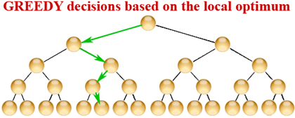
Approach
All the three algorithms follows greedy approach.
Greedy Approach:
At each step they try to get optimal result unlike optimal approach which considers only worst case scenario.

Slide 20
How does the algorithms work using Greedy
Scans the instructions only once
Insert NOP instructions appropriately
Once NOP instructions are inserted, they are not altered by the adjustment of the following instructions

Slide 21
Constrained Address Adjustment
Concept:
The method adjusts the addresses of instructions by inserting NOP instructions only after unconditional branches. NOP instructions inserted right after unconditional instructions are never executed. Dynamic instruction count remains the same and CPU cycles will not be increased.

Slide 22
Terms to concentrate
Unconditional branch
Conditional Branch
Reference count of Branch
Reference count of 2-bit counters
Profiling
Maximum Motion distance(MMD)

Slide 23
Unconditional Branch
A branch instruction which always leads to branching.
Branch instructions are used to follow control loops of program.
Examples:
J - jump to an address.
Jr- jump to an address stored in a register.
Jal- jump to an address and store the return address in register
Jalr-jump to an address stored in a register and store return

Slide 24
Conditional Branch
It is a branch which may or may not branch depending on the condition.
Examples
Beq-Branch if two registers are equal.
Bnz- Branch if two registers are not equal.
Bgtz-Branch if quantity in a register is greater than zero.

Slide 25
Reference count of a branch
It Explains that how many times the branch is visited and then we decide whether its taken or not taken.
Reference count of 2-bit counter
This defines how many times the branch is being mapped to the same counter in pattern table.
Profiling
It tells the underlying interaction between software and underlying machine architecture.
Indicates areas of improvement=>performance tuning.

Slide 26
Maximum Motion distance(MMD)
Based on the reference count of the selected branches, the algorithm determines how many NOP’S(maximum) should be inserted after the first unconditional branch. This is motion distance.
MMD is chosen in such a way that the references to the pattern table entries are spread as evenly as possible ,this lead to reduction in branch interference.
MMD is used to set an upper bound on the motion distance for an unconditional branch in order to avoid excessive code expansion.

Slide 27
Algorithm
Assumptions Made
U - number of unconditional branches.
C - number of conditional branches between two unconditional branches and there is a pseudo unconditional branch at the top and at the end of the program.
E - number of entries in the pattern table.
RCE[j] - reference count of entry in the pattern table, 1<=j<=E.RCE[j] is set to zero for each j.
RCC[q] - reference count of the selected Conditional branch q.
ADDRESS[q] - address of the conditional branch q.

Slide 28
Steps
Step 1: i=1
Step 2:Conditional Branches is selected between the unconditional branches i and i+1.
/*i.e., C- number of conditional branches */
Step 3:Read the profiling information of the selected conditional branches /* RCC[q]*/.
Step 4:For k=0 to MMD do
For j=1 to E do
P_RCE[j]=RCE[j];
End for
M[k]=0; /*m[k] refers to the highest reference count among the indexed entries*/
For q=1 to C do
Use (Address[q] + k) to index an entry ,say n in the pattern table;
P_RCE[n]=P_RCE[n]+RCC[q];
if(M[k] < P_RCE[n] )M[k] = P_RCE[n];
Endfor
Endfor

Slide 29
Step5: Find P such that M[P] = min{M[k],0<=k<=MMD};
/*If there is more than one minimum, then select the one with the smallest subscript.*/
Step6: Insert P NOPs right after unconditional branch I;
Step7: Update the address of the instructions after unconditional branch i and RCE[j], 1<= j <=E;
/*RCE[J] contains the reference count before unconditional branch i+1 considered*/
Step8: i++,Repeat steps until i=U

Slide 30
Example 1
Address/4 Profiling Instructions
480005ce 9433/9436 jmp i
480005ef 1/1 bnez j
. . .
. . .
480005ee 0/6788 jmp k
. . .
480005ff 0/5792 jmp m
. . .
4800061f 5702/5792 jmp n
Pattern table
Entry 0
Entry 1
Entry 2
Entry 3
entry4
……
……
Entry14
Entry 15
…..
Entry 31

Slide 31
After applying Constrained address adjustment algorithm..
Address/4 Profiling Instructions
480005ce 9433/9436 jmp i
480005ef . NOP
480005d0 1/1 bnez j
480005d1 . .
. . .
480005ef 0/6788 jmp k
. . .
480005ff 0/5792 jmp m
. . .
4800061f 5702/5792 jmp n
Pattern table
Entry 0
Entry 1
Entry 2
Entry 3
entry4
……
……
Entry14
Entry 15
…..
Entry 31
Now,Branches j and k share the same entry.
Branch j is executed only once,the interference between j and k is lower than i and k branch interference.

Slide 32
Example 2
Before applying the algorithm
Jump
…
…
Jump
Entry 0
Entry 1
Entry 2
Entry 3
entry4
……
……
Entry14
Entry 15
…..
Entry 31

Slide 33
After applying the algorithm
Entry 0
Entry 1
Entry 2
Entry 3
entry4
……
……
Entry14
Entry 15
…..
Entry 31
JUMP
NOP
NOP
JUMP

Slide 34
Constraint address adjustment
Relaxed address adjustment

Slide 35
Pros and Cons of Constrained address adjustment:
Pros:
Accuracy increases.
The interference is lowered because it considers the conditional branches between unconditional branch.
CPU will not execute NOP instructions.
Cons:
Do not reduce the branch interferences between the conditional branches.

Slide 36
Relaxed Address Adjustment
CONCEPT:
It extends constrained address adjustment technique by inserting NOP instructions both after conditional and unconditional branches.

Slide 37
Need to shift from constrained address adjustment technique to relaxed address adjustment technique
Reduce Interference between conditional branches
Example:
Let i , m be the unconditional branches and let j, k be the conditional branches.
Constrained focuses only on eliminating interference between i and m but it wont eliminate interference between j and k which are encompassed by i and m.

Slide 38
Considering interference in conditional branches…
Pattern History Table
//Each entry is a 2-bit
jump i counter
bnez j
bgtz k
jump m
ENTRY 1
ENTRY 2
ENTRY 3
ENTRY 4
ENTRY 5
ENTRY 6
ENTRY 7
ENTRY 8

Slide 39
Algorithm
Assumptions made:
C - number of conditional branches
E - the number of entries in the pattern table
RCE[e] - the reference count of entry e
RCE[j] - the reference count of entry j, before a conditional branch is considered, 1<= j <= E
RCC[i ] -the reference count of the conditional branch i, 1<= i <= C
ADDRESS[i ] - address of the conditional branch i
Also assume that first conditional branch is mapped to entry e.
that is, RCE[e] = RCC[1].

Slide 40
Steps
STEP 1: Read the profiling information of the branch i.
STEP 2: For k=0 to MMD do
Use (ADDRESS[i]+k) to index an entry, say n ,in the pattern table;
M[k] = RCE[n] + RCC[i];
Endfor
STEP 3: Select P such that M[P]= min{M[k],0≤ k ≤ MMD };
/* Take the minimum value of M[k] */
STEP 4: If there is no unconditional branches between conditional branches i-1 and i, then insert P NOP’S right after the branch i-1;
Otherwise, insert P NOP’s after an unconditional branch between i-1 and i ;
STEP 5: Update the addresses of the instructions after branch i-1 and RCE[j] , 1≤j≤E
STEP 6: i++; Repeat steps 2 ~ 6 until i= C

Slide 41
Step 3 Explanation
Assume branch i, to be a conditional branch.
for(int k=0;k< 8;k++)
Profiling information: {
3434/4456 ADDRESS[i]+k-> e[n];
M[k]= RCE[n] + RCC [i];
}
It collects M[K] for all the values of k.

Slide 42
Example 1
Address/4 Profiling Instructions
480005ce 9433/9436 bnez i
480005ef 1/1 bnez j
480005d0 . jmp
. . .
480005ee 0/6788 bnez k
. . .
480005ff 0/5792 bnez m
. . .
4800061f 5702/5792 bnez n
Pattern table
Entry 0
Entry 1
Entry 2
Entry 3
entry4
……
……
Entry14
Entry 15
…..
Entry 31

Slide 43
After applying Relaxed address adjustment algorithm..
Address/4 Profiling Instructions
480005ce 9433/9436 bnez i
480005ef 1/1 bnez j
480005d0 . jmp
480005d1 . NOP
. . .
480005ef 0/6788 bnez k
. . .
48000600 0/5792 bnez m
48000601 . NOP
. . .
4800061f 5702/5792 bnez n
Pattern table
Entry 0
Entry 1
Entry 2
Entry 3
entry4
……
……
Entry14
Entry 15
…..
Entry 31

Slide 44
Effects of MMD using 2bC predictor
Constrained address adjustment
Relaxed address adjustment
Larger MMD will result in , lower miss-prediction ratios, but more NOP insertion(Increases code size)
The graph shows that there is a balance between miss-prediction ratio and code expansion, when there are 8 2-bit counters.
Notes:
44

Slide 45
Pros and Cons of relaxed address adjustment:
Pros:
Considers interference between both conditional and unconditional branches.
More accurate than constrained based algorithm
Cons:
NOP’s will be now executed by the CPU which increases CPU overhead (but considerable ).

Slide 46
Branch Classification
CONCEPT
Examine the interference behavior of branches.
Map branches of similar behavior to same 2 bit counter of the pattern table.

Slide 47

Interference Problem
Constructive interference
Neutral interference
Branch Interference
Neutral interference
Destructive interference

Slide 48
Constructive Interference-
Miss-prediction of a conditional branch to be correctly predicted.
Neutral Interference-
This has no effect on miss-prediction.
Destructive Interference-
Miss-predicted to be predicted wrong.

Slide 49
Destructive interference
Branches with different branching behaviour are mapped to the same 2-bit counter.
Causes decrease in branch prediction accuracy.
Branch classification technique aims at reducing destructive interferences among branches.

Slide 50
Part 1 – Examine the branch behavior and Classify them
Branch is classified based on the branch direction.
Profiling information is used to find the Taken Probability of the branch.
Lets say, For a branch i, the Taken Probability is TP(i).
After we get the branch direction, it is classified to an appropriate class.
All conditional branches are classified into N classes, where N is the number of entries in Pattern table.
Therefore the classification values are from 0 to N-1.
For eg., the branch i will be mapped to the n^{th} 2bit counter of the pattern table.
(n modulo N) = Class (I)
{ 0 , if N-1/ N <= TP(i) < 1
{ 1 , if N-2/ N <= TP(i) < N-1/N
{ .
Class(i) = { .
{ .
{ N-2, if 1/N <= TP(i) < N
{ N-1, if 0 <= TP(i) < 1/N

Slide 51
How Branch ClassificationWorks
The branch classification works in two parts:
Part 1 – Examine the branch behavior and Classify them
Part 2 – Address adjustment of the branch by NOP insertion

Slide 52
Part 2 – Address adjustment of the branch by NOP insertion
After mapping is decided, the address of the branch is adjusted by inserting proper number of Null Operation instructions at the right locations.
Finally, updates the address of the branches and the following instructions after alteration.

Slide 53
Algorithm:
Assumptions made:
C – number of conditional branches
N – number of Branch classes
ADDRESS[i] be the address of the branch i , where 1<= i <=C
Step 1: i=1 /* Start from the very first conditional branch */
Step 2: Read the profiling information of conditional branch i and compute TP(i).
Step 3: Compute Class(i) and find the smallest positive integer P such that,
(ADDRESS[i] + P) modulo N = Class(i)
/*P is to find the least number of NOPs to be inserted, to avoid code expansion */
Step 4: If (i=1)
Then insert P NOPs at the beginning of the program;
If (i>1 && No unconditional branch between branches i-1 and i)
Then insert P NOPS after conditional branch i-1;
If(i>1 && an Unconditional branch between branch i-1 and i)
Then insert P NOPs after the unconditional branch;
Step 5: Update the address of instructions after conditional branch i-1;
Step 6: i++; Repeat steps 2~6 until i= C;

Slide 54
Example
Address/4 Profiling Instructions
480005ce 9433/9436 bnez i
480005ef 1/1 bnez j
. . .
. . .
480005ee 0/6788 bnez k
. . .
480005ff 0/5792 bnez m
4800061f 5702/5792 bnez n
Entry 0
Entry 1
Entry 2
Entry 3
entry4
……
……
Entry14
Entry 15
…..
Entry 31
Assume, branch i,j, n belongs to Class 0- map to even entries in the pattern table.
Branch k,m belongs to Class 1- map to odd entries in the pattern table.

Slide 55
After applying Branch Classification algorithm..
Address/4 Profiling Instructions
480005ce 9433/9436 bnez i
480005cf NOP
480005d0 1/1 bnez j
. . .
. . .
480005ef 0/6788 bnez k
480005f0 NOP
. . .
48000601 0/5792 bnez m
48000602 NOP
48000622 5702/5792 bnez n
Entry 0
Entry 1
Entry 2
Entry 3
entry4
……
……
Entry14
Entry 15
Entry 16
...
Entry 31
Branch k, is now mapped to entry 15- which predict for branches that belongs to Class 1.
NO INTERFERENCE, after branch classification technique.

Slide 56
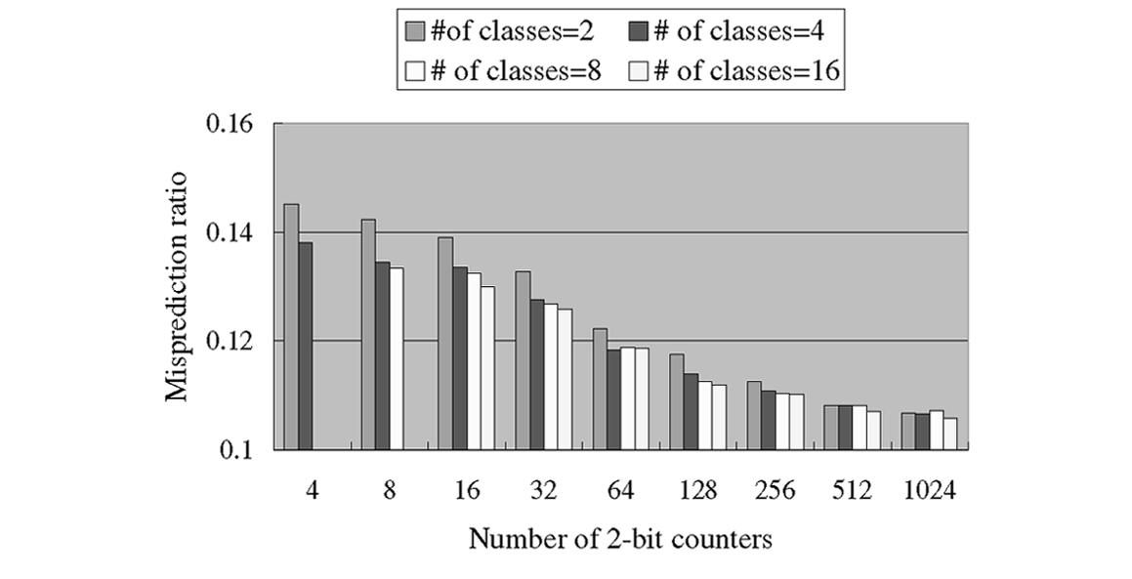
Relationship between the branch miss-prediction ratio and the number of classes
Large number of classes will result in,
Code expansion,and sometimes misprediction ratios remains the same after certain value
The graph shows that the appropriate value is the case when 4 classes is used, because it has lower misprediction ratios than when 2 classes are used.

Slide 57
Performance Metric
Performance metric used is Misprediction ratio, because
– reasonable metric for dynamic branch predictors.
– Independent of other part of processor organisation.
Misprediction ratios= 1- number of correct predictions
number of conditional branches executed
When Misprediction Ratio is reduced, the prediction accuracy increased.

Slide 58
Tools used
Machine
DEC 3000 workstations running OSF/1 version 3.2.
Benchmarks
– Specint92 suite
– Specint95 suite
ATOM
To collect statistics about branches, insert analysis procedures implementing the predictors.

Slide 59
Analysis
Analysis of:
Reduction in Miss-prediction ratio after applying the three techniques.
For the analysis, MMD is set to 8 and the number of classes is set to 4, since they are found to be the optimal values.
Predictors
Address adjustment
techniques
2bC
GAs
PAs
GShare
Constrained
Relaxed
Branch classification

Slide 60
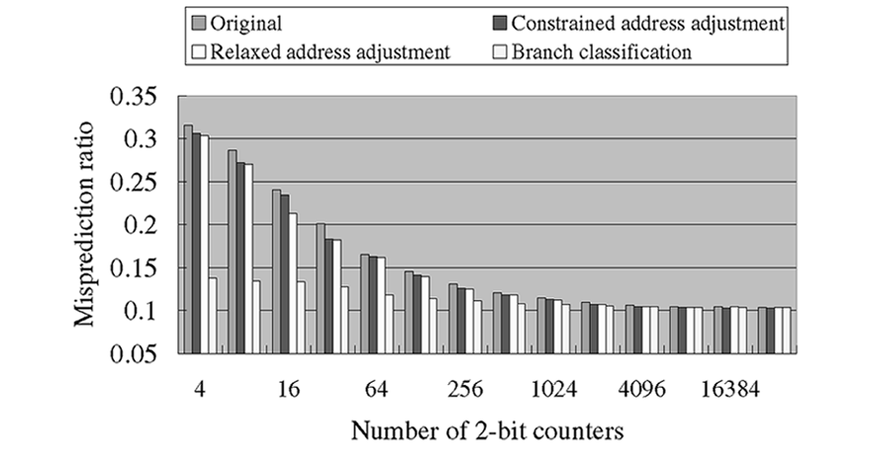
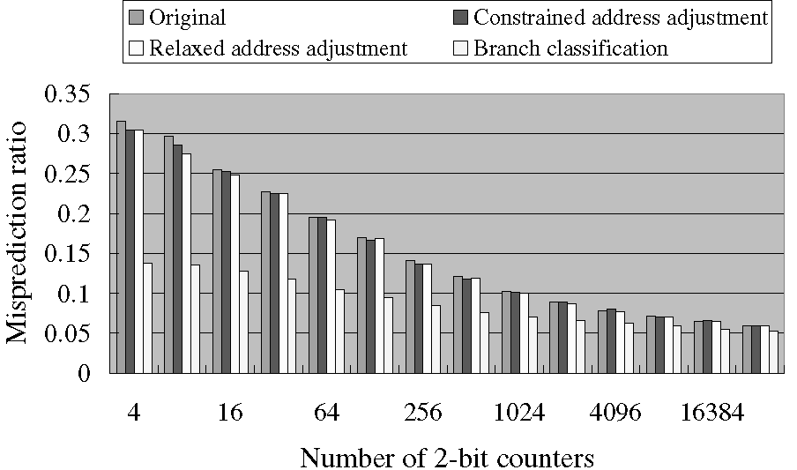
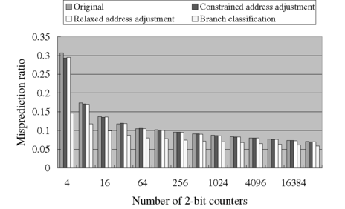
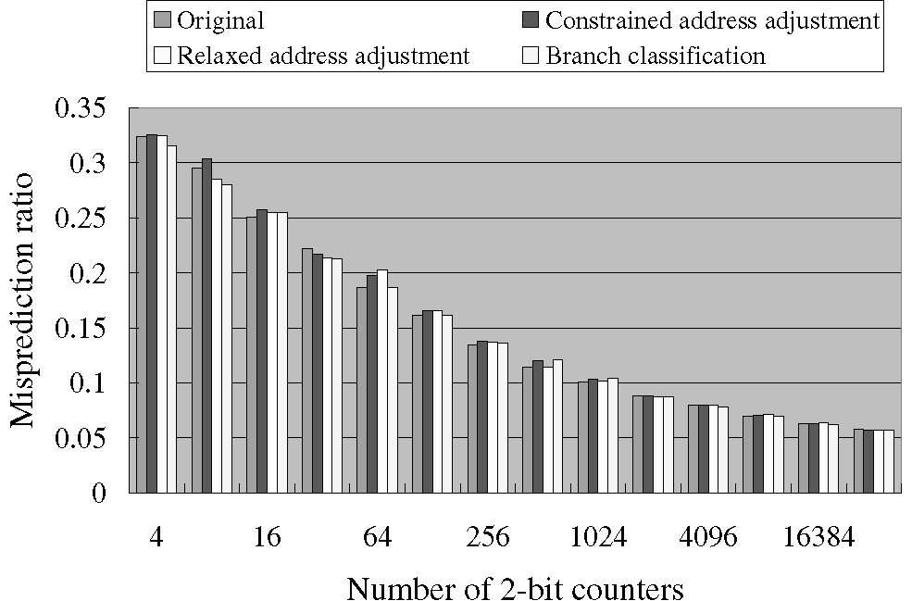
Misprediction ratios for 4 predictors
2bC predictor
GA predictor
PA predictor
Gshare predictor

Slide 61
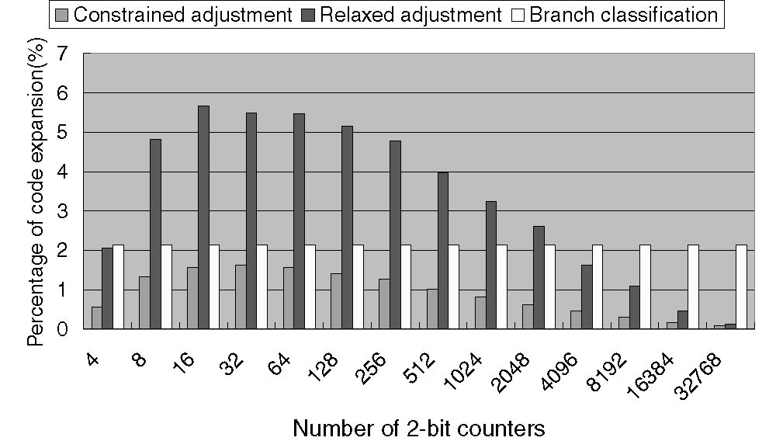
Limitation of Address Adjustment- Code Expansion

Slide 62
Best Among Three…
Among all the three address adjustment algorithms Branch Classification is best, because it removes all of the interference.
Any address adjustment scheme must tradeoff among code expansion, CPU overhead, and branch prediction accuracy.
Branch classification gives the best tradeoff among code expansion, CPU overhead and Branch prediction accuracy.

Slide 63
Conclusion
Predictors with large tables might not be useful.
Address adjustment with smaller predictors can deliver comparable performance.
Address adjustment is very effective in reducing the miss prediction ratios for 2bC, GAs, and PAs Predictors
Limitation:
Address adjustment technique cannot help predictors such as Gshare, which map the branches to the prediction table at runtime.

Slide 64
Our Project
We are going to work on the delay occurred while the execution of conditional branches.
Find the reason behind the delays.
Implementation of Re-Timing Techniques
Introducing parallelism into the conditional branches.
Analysis of the reduction of number of CPU cycles taken,
miss-prediction ratios etc..

Slide 65
References
[1]A. Srivastava and A. Eustace, a ATOM: A System for Building Customized Program Analysis Tools ,o Proc. SIGPLAN '94 Conf. Programming Languages Design and Implementation, June 1994.
[2]J.A. Fisher and S.M. Freudenberger , ªPredicting Conditional Branch Directions from Previous Runs of a Program,º Proc. Fifth Int'l Conf. Architectural Support for Programming Languages and
Operating Systems, 1992.
[3] J.A. Fisher, ªWalk-Time Techniques: Catalyst for Architectural Change,º Computer, vol. 30, no. 9, pp. 40-42, Sept. 1997.
[4] N. Gloy, M. Smith, and C. Young, ªPerformance Issues in Correlated Branch Prediction Schemes, Proc. 28th Ann. Int'l Symp. Microarchitecture, 1995.
[5] E. Jacobsen, E. Rotenberg, and J. Smith, ªAssigning Confidence to Conditional Branch Predictions,º Proc. 29th Int'l Symp. Microarchitecture,1996.
[6] J.K.F. Lee and A. Smith, ªBranch Prediction Strategies and Branch Target Buffer Design,º Computer, vol. 17, no. 1, pp. 6-22, Jan. 1984.
[7] S. Mcfarling, ªCombining Branch Predictors,º WRL Technical Note TN-36, Digital Equipment Corp., June 1993.
[8] S. McFarling and J. Hennessy, ªReducing the Cost of Branches ,Proc. 13th Ann. Int'l Symp. Computer Architecture, June 1986.
[9] S. Pan, K. So, and J. Rahmeh, ªImproving the Accuracy of Dynamic Branch Prediction Using Branch Correlation,º Proc. Fifth Ann. Int'l Conf. Architectural Support for Programming Languages and Operating Systems, Oct. 1992.

Slide 66
QUESTIONS??

