Slide 1
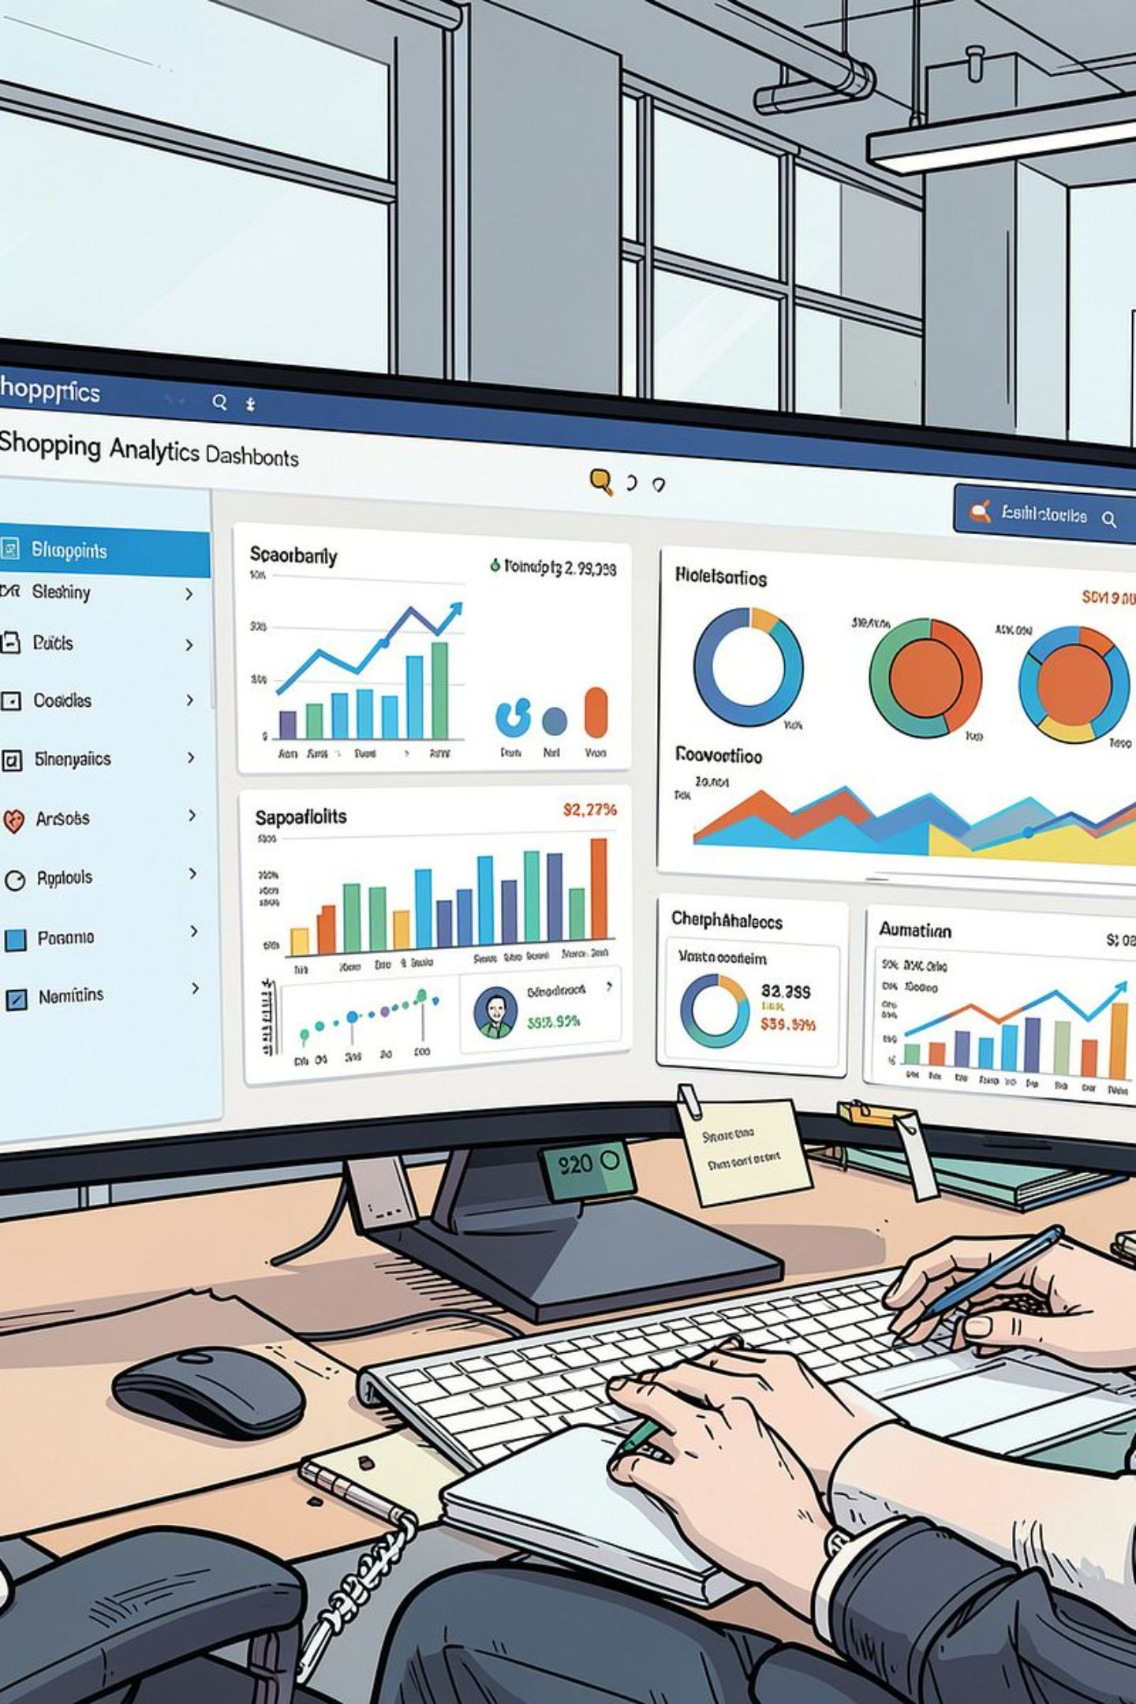
Customer Shopping Behavior Analysis
Analyzing 3,900 transactions across product categories to uncover spending patterns, customer segments, and strategic insights using Python, SQL, and Power BI.

Slide 2
Dataset at a Glance
3,900
18
Total Purchases
Features
Rows in dataset
Columns tracked
37
$59.76
Missing Values
Avg. Purchase
Review Rating column only
Mean transaction value
Key features include customer demographics (Age, Gender, Location, Subscription Status), purchase details (Item, Category, Amount, Season), and shopping behavior (Discount Applied, Previous Purchases, Review Rating, Shipping Type).

Slide 3
Data Preparation in Python
Cleaning & Standardization
Feature Engineering
Database Integration
Created age_group by binning customer ages and purchase_frequency_days from purchase data. Dropped redundant promo_code_used (duplicate of discount_applied).
Connected Python to PostgreSQL and loaded the cleaned DataFrame for SQL analysis.
Loaded data via pandas, checked structure with df.info() and .describe(), imputed missing Review Ratings using median per category, and renamed columns to snake_case.

Slide 4
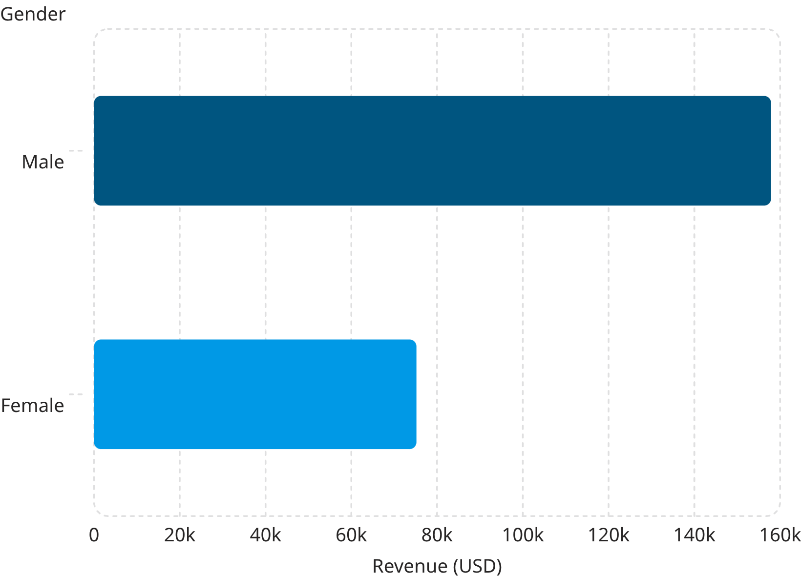
Revenue & Spending Insights (SQL)
Key Findings
Male customers generated 2× more revenue than females ($157,890 vs $75,191)
839 high-spending discount users spent above average despite using discounts
Express shipping averaged $60.48 vs Standard at $58.46
Subscribers (27% of customers) contributed $62,645 total revenue

Slide 5
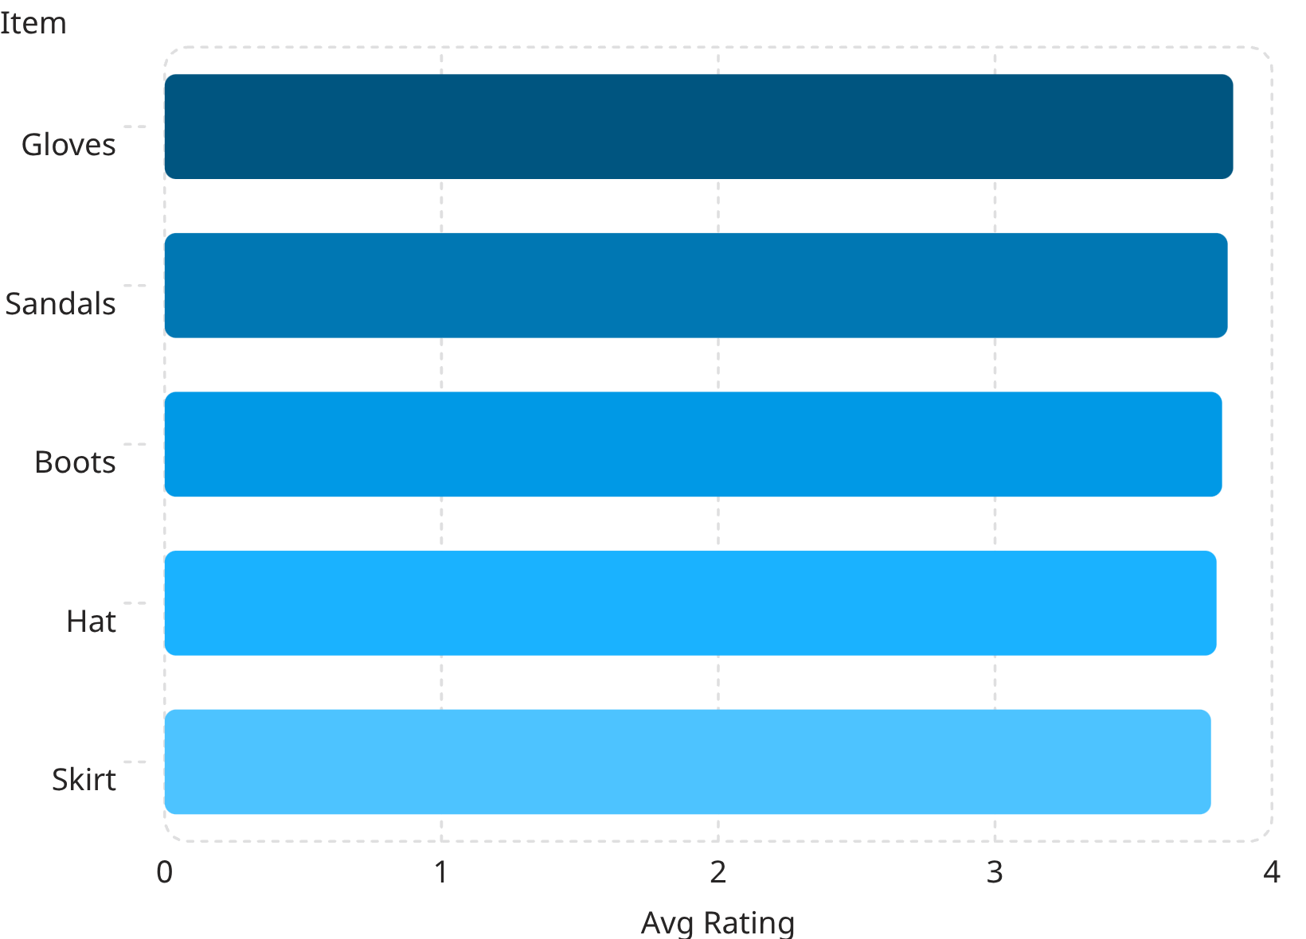
Products, Ratings & Discounts
Top 5 Products by Rating
Most Discount-Dependent Products
Hat
Sneakers
50.00% discounted
49.66% discounted
Coat
Sweater
49.07% discounted
48.17% discounted
Pants
47.37% discounted

Slide 6
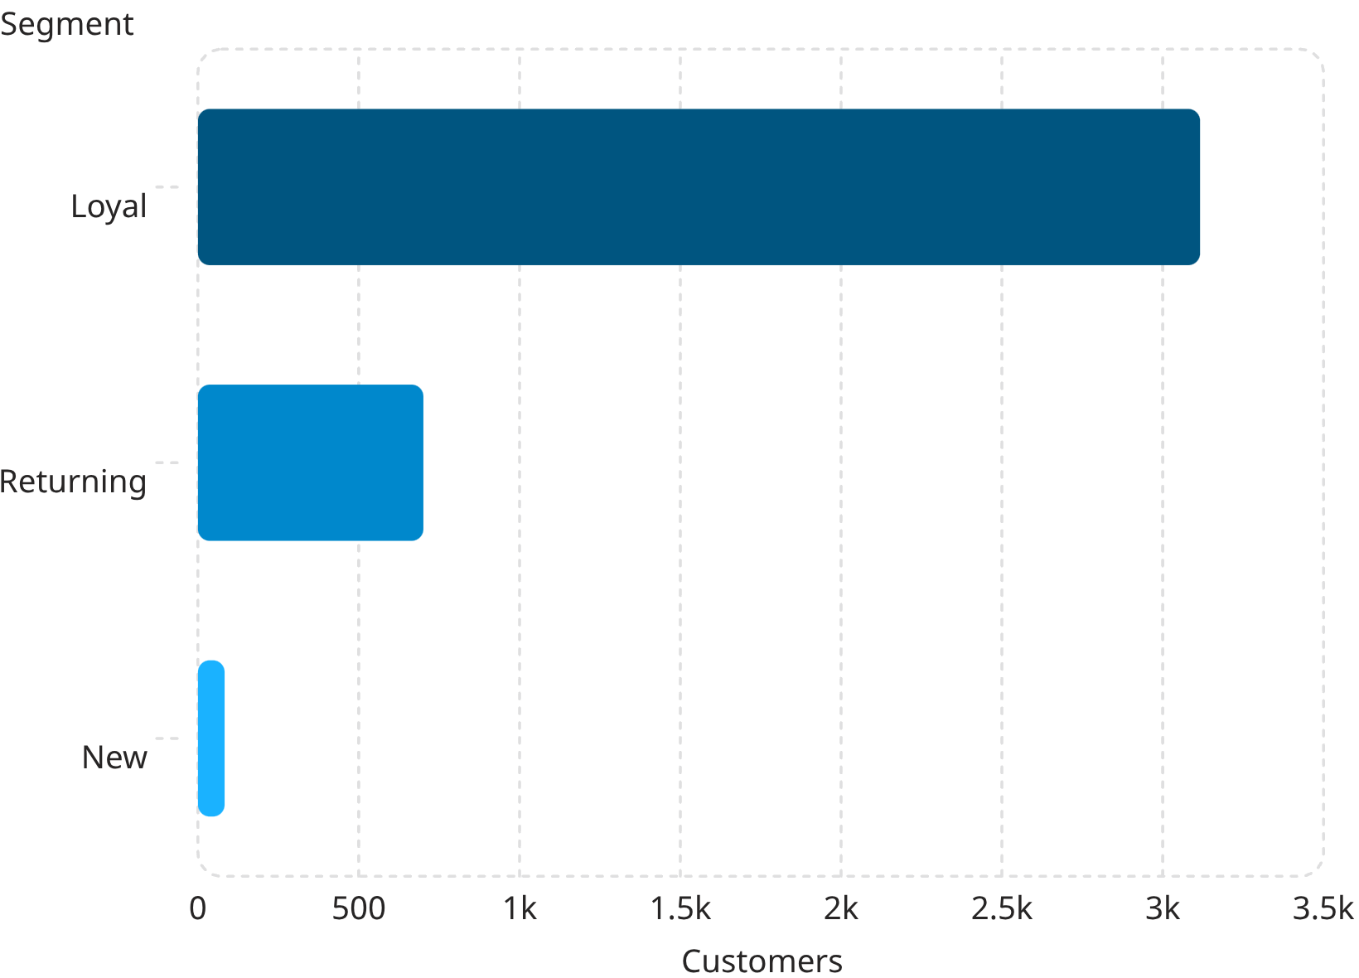

Customer Segmentation
Segment Breakdown
Customers classified as New, Returning, or Loyal based on purchase history.
Loyal (80%) — 3,116 customers with strong repeat purchase behavior
Returning (18%) — 701 customers with some purchase history
New (2%) — Only 83 first-time buyers
Of customers with 5+ purchases, 958 are subscribers vs 2,518 non-subscribers — repeat buyers show meaningful subscription uptake.

Slide 7
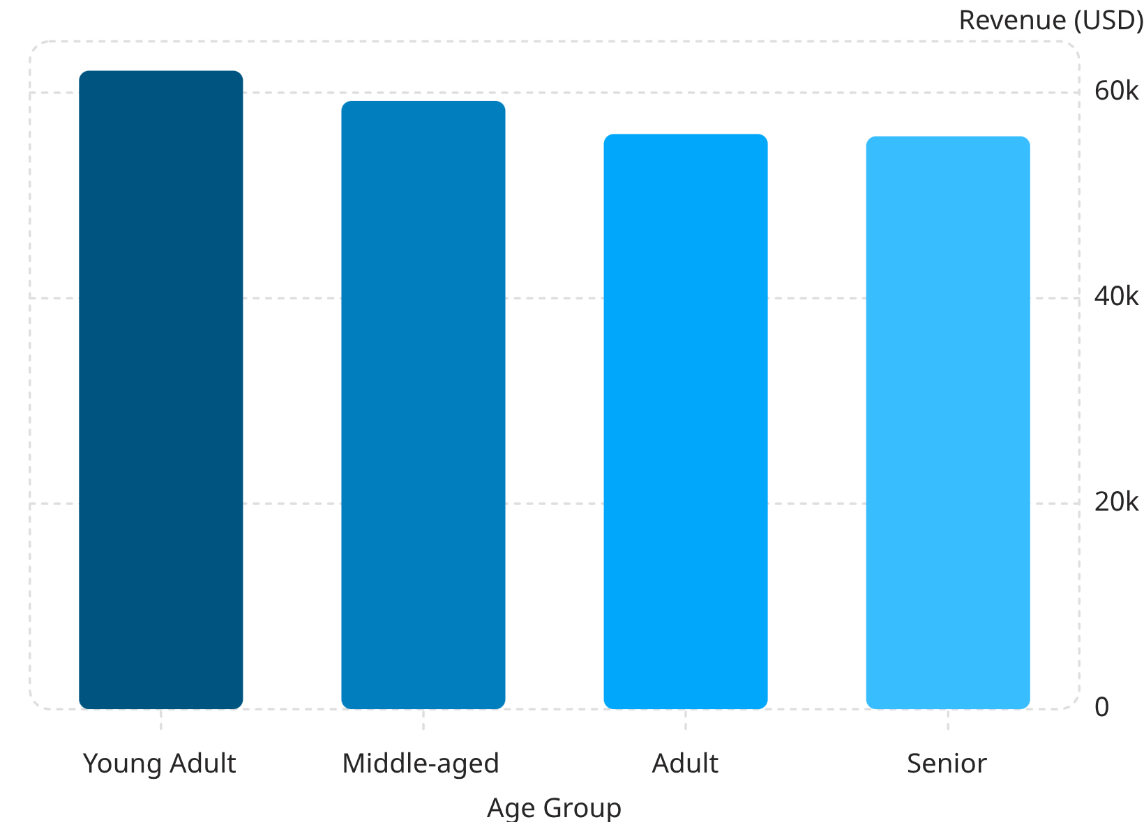
Revenue by Age Group
Age Group Insights
Revenue is relatively evenly distributed across age groups, with Young Adults leading at $62,143 and Seniors contributing the least at $55,763.
Top products by category: Jewelry (Accessories), Blouse (Clothing), Sandals (Footwear), and Jacket (Outerwear).

Slide 8

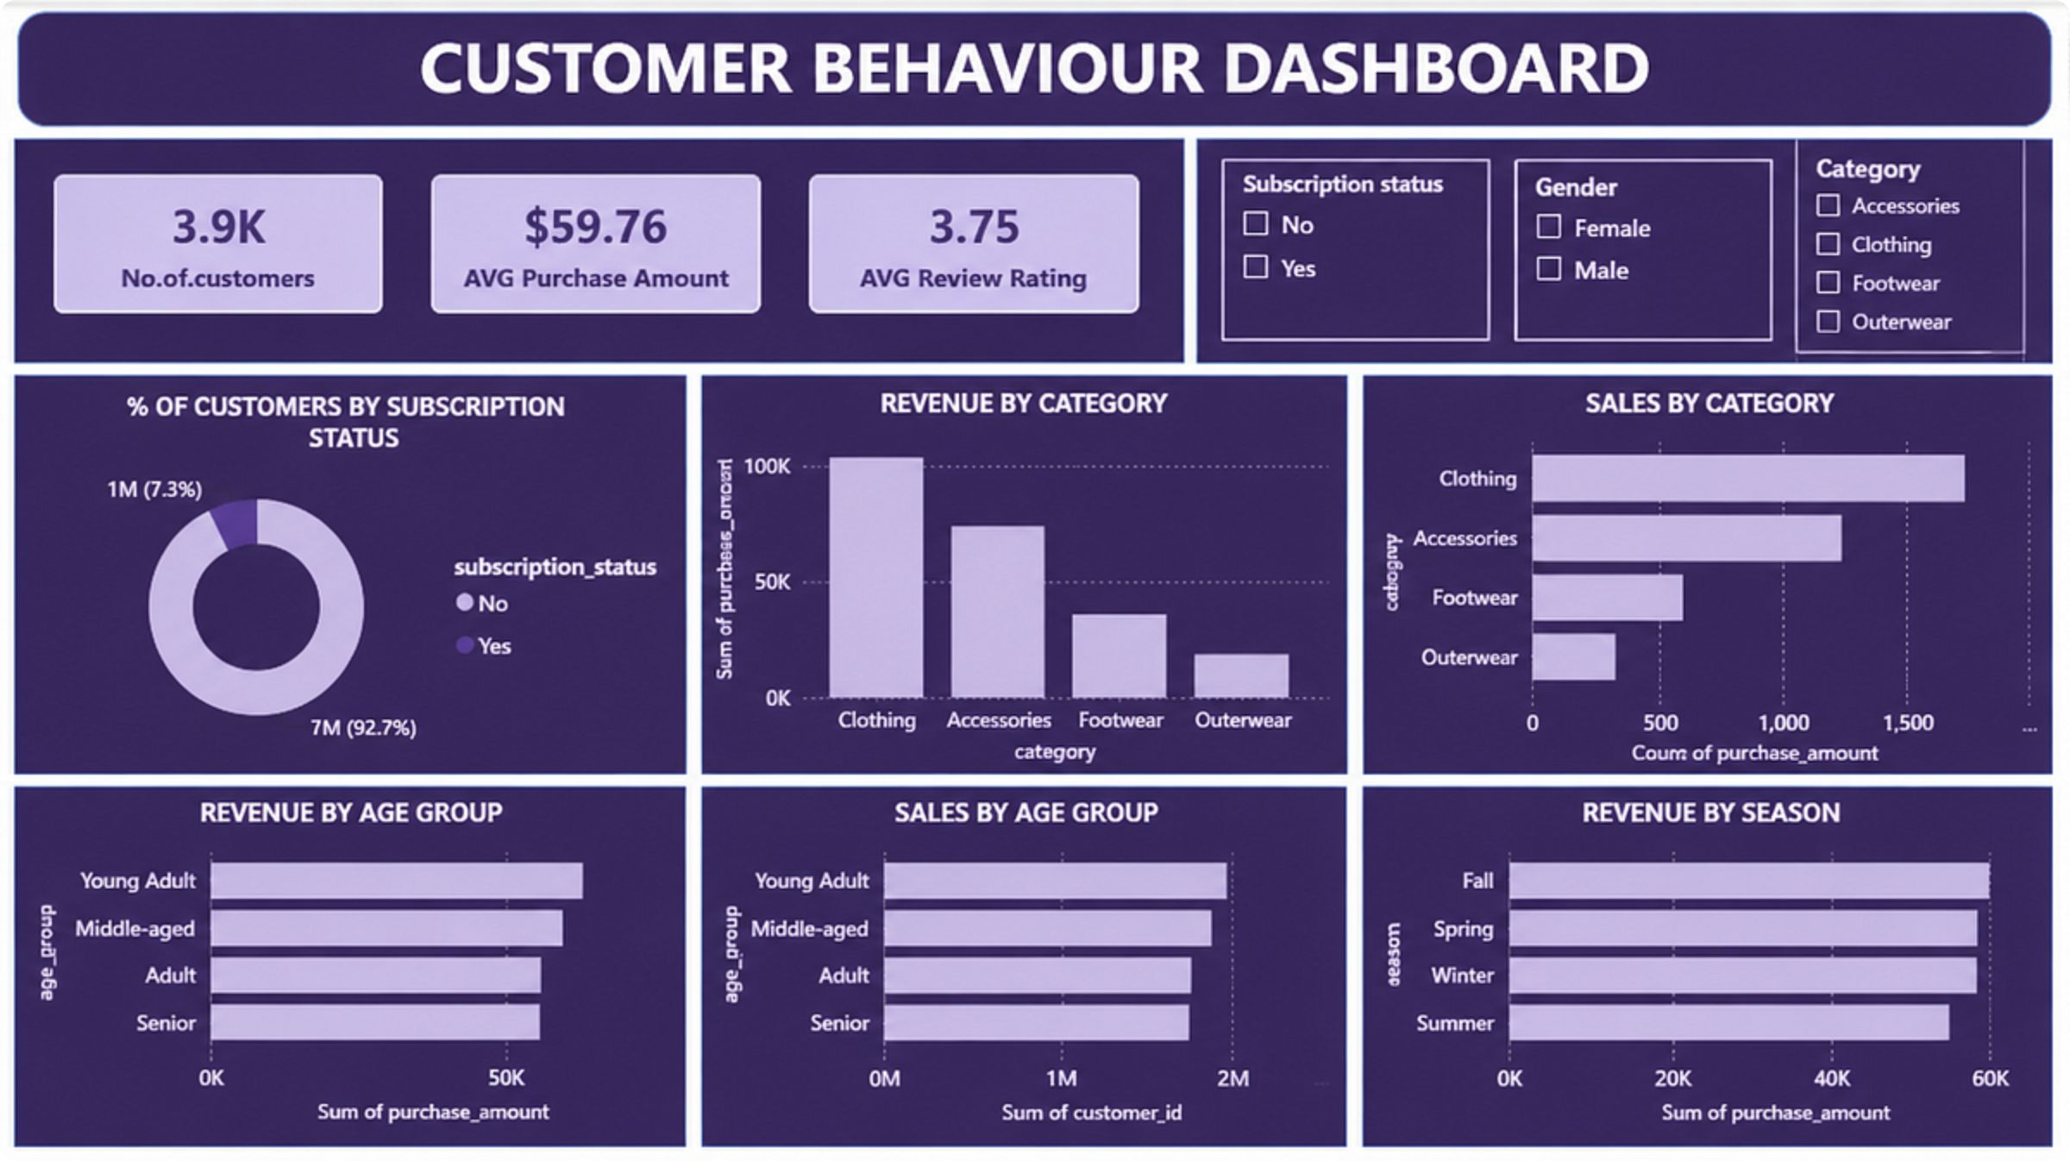
Interactive Power BI Dashboard
The Power BI dashboard provides a dynamic, at-a-glance overview of customer shopping behavior. It consolidates key metrics such as 3,900 total purchases, an average purchase value of $59.76, and an average review rating of 3.75.
Visualizations include subscription status via a pie chart, revenue breakdown by product category and age group, and sales trends across different seasons. These actionable insights are crucial for refining marketing, product, and sales strategies to boost growth and customer engagement.

Slide 9
Recommendations
Boost Subscriptions
Loyalty Programs
Promote exclusive subscriber benefits to grow the 27% base.
Reward repeat buyers to move them into the "Loyal" segment.
Review Discount Policy
Targeted Marketing
Balance sales boosts with margin control on discount-heavy items.
Focus on high-revenue age groups and express-shipping users.

