Slide 1




Research Presentation

Slide 2

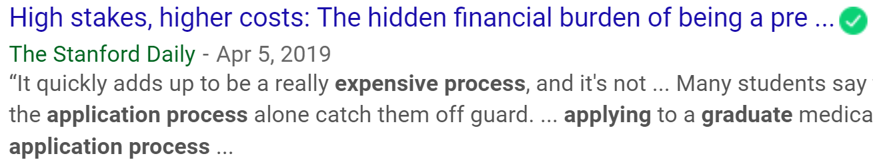
The Situation
With more than 3,000 universities and colleges in united states, the options are almost limitless. Yet, because the choices are so varied, deciding which university to attend is not an easy choice.
There’s also uncertainty about whether the student will get admitted to a university or not
The price of the admissions process often totals hundreds of dollars, accounting for the costs associated with standardized tests, test-prep resources and application fees
1. Start gathering your research using the Researcher feature in Word 2016.

Slide 3

Objective
To provide a high-quality model for the project beneficiaries in order for them to predict their chances of getting university admits at a highly accurate rate

Slide 4

Project Beneficiaries
Students Applying to an Graduate Schools and Universities
University Admission Committee
Private University Consulting Advisors helping students with Graduate school applications and admissions process
Monetary Benefit
Students Often have to spend huge amounts of money while applying to many universities not knowing where they would get accepted, also there are a plethora of University Consulting Advisors who charge a massive amount of money from Students to help them choose where to apply
This project will help students to narrow down their option , aiding them in applying to schools when their chance of admission is high, Ultimately reducing application costs

Slide 5

Data Exploration
The dataset contains 7 parameters considered important during the application for Masters Programs.
GRE Scores ( out of 340 ) , TOEFL Scores ( out of 120 ) ,University Rating ( out of 5 ) , Statement of Purpose and Letter of Recommendation Strength ( out of 5 ) , Undergraduate GPA ( out of 10 ) , Research Experience ( either 0 or 1 ) , Chance of Admit ( ranging from 0 to 1 )
Clean Dataset, No Null Records
500 Observations

Slide 6
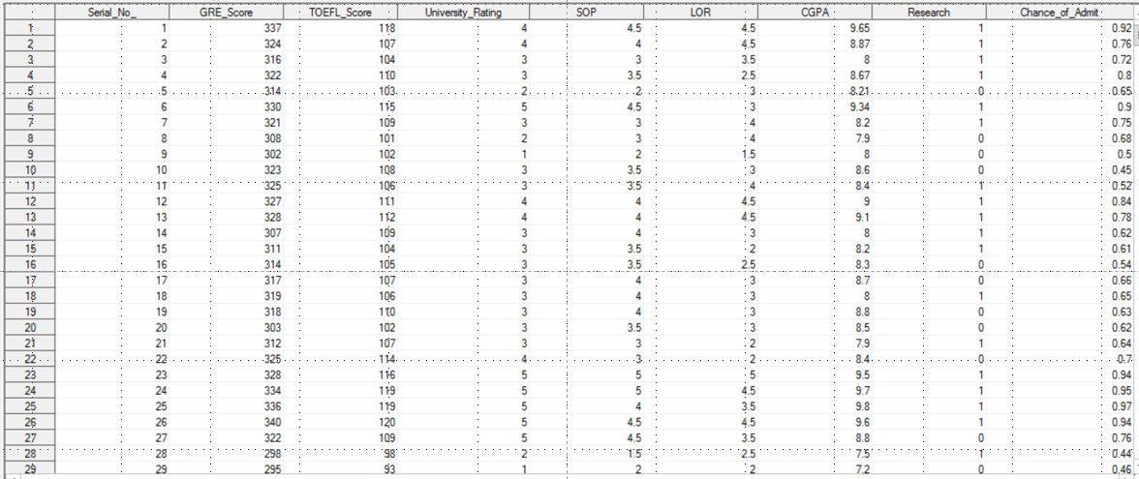

Slide 7
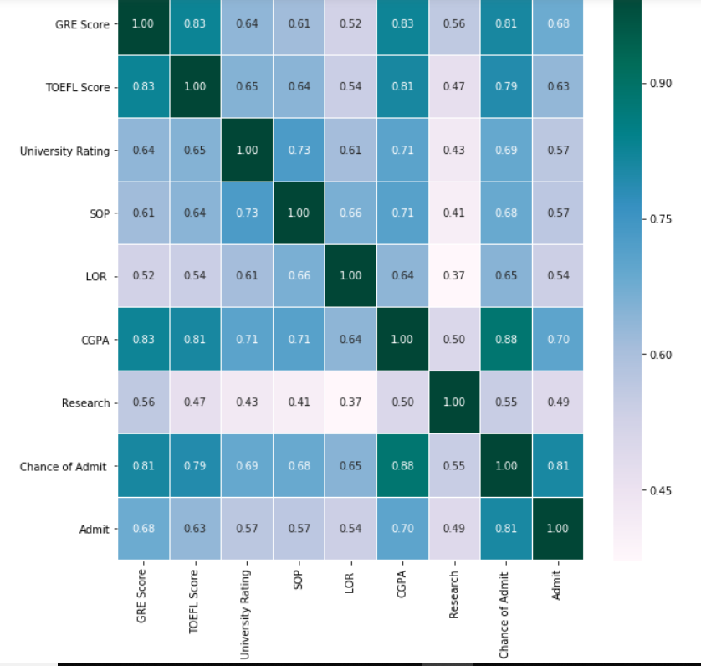
Correlation Between all Variables

Slide 8
Data Visualization

Slide 9
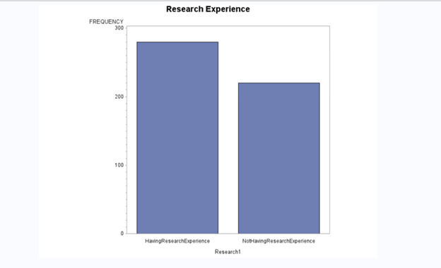

Having Research or Not
1
More number of people in the dataset has high research experience.
So, is this variable, not a most important feature to predict the Chance of Admit?
We can’t be sure of that, since Research may have more effect on other Predictors which are used mostly to predict the dependent variable.

Slide 10
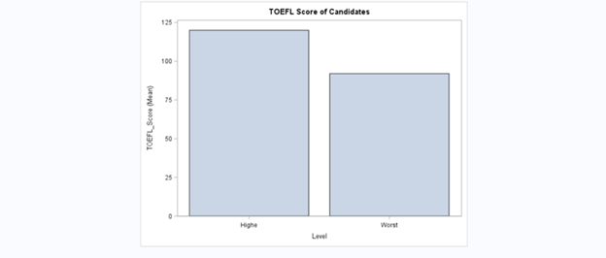
TOEFL Score
2
The highest TOEFL Score is 120 and the lowest is 92.
Good, since many students had highest score in TOEFL, many can be the chances of admit.

Slide 11
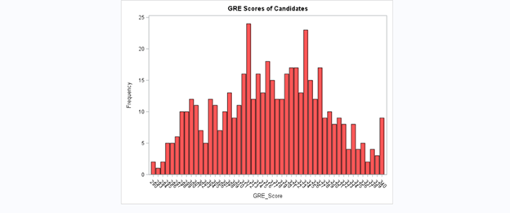

GRE Scores
This histogram shows the frequency for GRE scores.
There is a density between 310 and 330. Being above this range would be a good feature for a candidate to stand out.
So, many students have good chances for getting admit?
Notes:
When conducting research, it is easy to go to one source: Wikipedia. However, you need to include a variety of sources in your research. Consider the following sources:
Who can I interview to get more information on the topic?
Is the topic current and will it be relevant to my audience?
What articles, blogs, and magazines may have something related to my topic?
Is there a YouTube video on the topic? If so, what is it about?
What images can I find related to the topic?

Slide 12


Let’s try to get some knowledge based on the relation between any two predictors
Notes:
Once you find your sources, you will want to evaluate your sources using the following questions:
Author:
Who is the author?
Why should I believe what he or she has to say on the topic?
Is the author seen as an expert on the topic? How do you know?
Current:
How current is the information in the source?
When was the source published?
Is the information out-of-date?
Accuracy:
Is the content accurate?
Is the information presented objectively? Do they share the pros and cons?

Slide 13
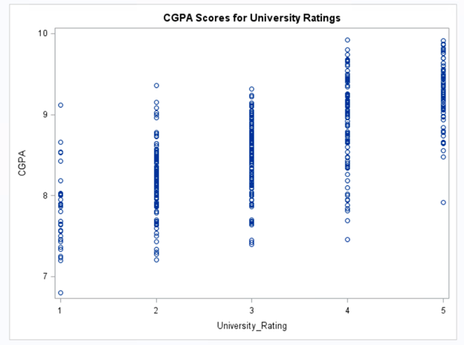
As the quality of University increases, CGPA increases.
Maybe Universities with top ratings will have good faculty, academic course etc.,
Notes:
After consulting a variety of sources, you will need to narrow your topic. For example, the topic of internet safety is huge, but you could narrow that topic to include internet safety in regards to social media apps that teenagers are using heavily. A topic like that is more specific and will be relevant to your peers. Some questions to think about to help you narrow your topic:
What topics of the research interest me the most?
What topics of the research will interest my audience the most?
What topics will the audience find more engaging? Shocking? Inspiring?

Slide 14
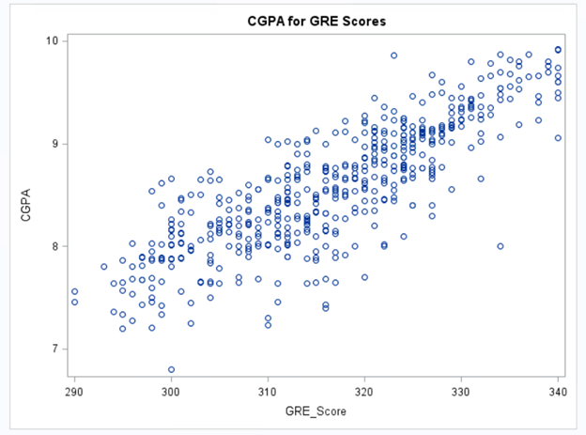
Candidates with high GRE Scores usually has high CGPA
Students who has better IQ and knowledge usually excels in everything.
Notes:
Now, that you have narrowed your topic, you will want to organize your research in a structure that works. There are some common organizational patterns based on the kind of research you are doing.
Organizational Structures:
Cause and Effect- this kind of structure is great for explaining the causes and effects of a topic
Compare and Contrast- in this pattern you highlight the similarities and differences of the topic
Explain process- this structure is great for outlining a series of steps to follow;
Definition- if you want to make sure your audience understands what something is using illustrations, meanings, clarifying misconceptions, you may want to use this structure
Classification- a common organizational structure is grouping like topics or facts from the research together. For instance, in the internet safety about social media apps, you may organize the research where you look at each social media app one at a time

Slide 15
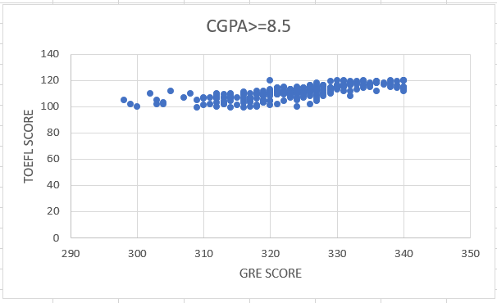
Yes, I did very well in my academics with high CGPA. So, I can easily score good in Competitive Exams
Notes:
After you’ve done your research, it’s time to put your presentation together. The first step in the process is to introduce the topic. This is a great time to connect your topic to something that your audience can relate. In other words, why should they listen to all the information you will be sharing in your research presentation? What is in it for them? You may also want to include a graphic or image to grab their attention.
Feel free to duplicate this slide by right-clicking on this slide in the slides pane to the left and select Duplicate Slide.
The next step in your presentation is to state your claim or topic clearly. Your teacher may even call this your thesis. As you state your thesis, you may find that this layout is not the best layout for your claim or topic. You can change the layout by clicking the drop-down menu next to the Layout in the Slides menu section. You can choose Two Content, Comparison, or Picture with Caption. Note: A different layout might change the look of the icons on this page.
You will also want to state your facts. You have done the research now share some of the interesting facts with your audience. Facts do not have to be boring; you can communicate facts in a variety of ways by going to the Insert Tab. In the Insert tab you can:
Insert pictures from your computer or online.
Add a chart
Create some SmartArt
Insert a variety of icons to help your facts come to life. Note: You can change the color of the icons by selecting the icon and then click on the Format tab and then Graphics Fill. From there, you will choose a color from the list or choose More Fill Colors to give you more options.
Since this research presentation is a result of your hard work and searching, you want to make sure you support the claims or points in your presentation with facts from your research findings. Make sure you give the author proper credit for helping you share your ideas. If one of your sources has a video that is relevant to your topic, you can add the video as added support. Keep in mind the length of the video and the amount of time you have for your presentation. For a 5 minute speech, the video should be no longer than 30 seconds.
Questions to consider:
How will you state the author of the source?
Will you need to cite the source on the slide?
What are some ways you can engage your audience so they feel like they are a part of the presentation? Some ideas to consider is by taking a quick poll like: by a show of hands, how many of you think school uniforms are a way to cut down on bullying? Another suggestion is to have them hold up a certain number of fingers to see if they agree or disagree. Finally, you can share a story that the audience can relate to that makes them laugh.
After all the applause, your audience may have some questions. Be prepared to answer some of their questions by making a list of questions you think they might ask. You may also want to share the presentation with them by providing the link to your presentation, if they want more information.

Slide 16
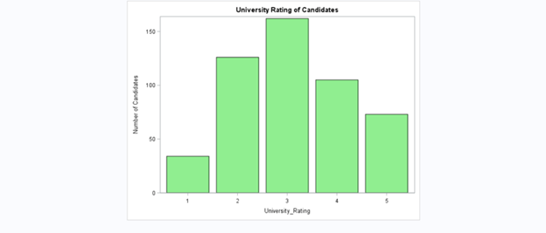
Number of Candidates from each level of University
Most of the students from our data set are from the Universities with Rating 3.
But, candidates from good universities are more fortune to get accepted.

Slide 17
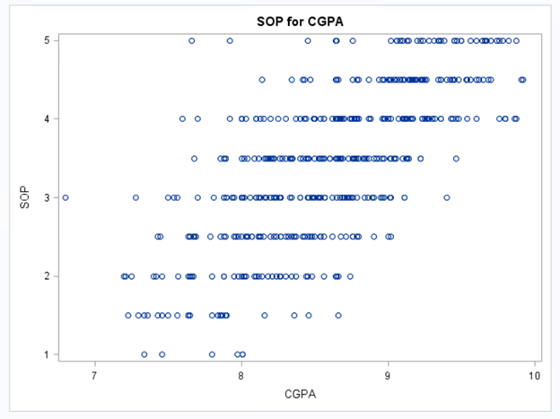
SOP for CGPA
Candidates with high CGPA usually have high SOP score.

Slide 18
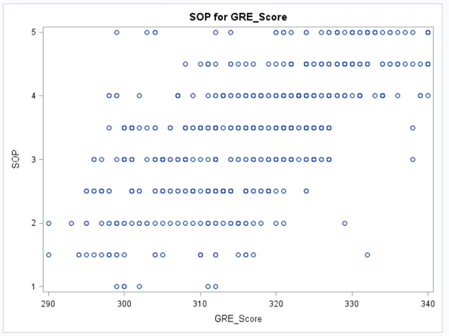

SOP for GRE Scores
Yes. Candidates with high GRE scores are expected of getting high SOP scores too.

Slide 19
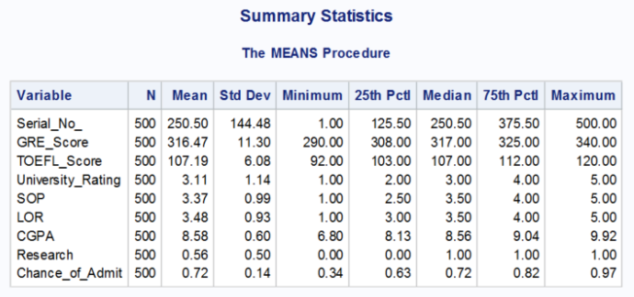
Model Selection
Summary Statistics
We observe that for GRE
Most frequent score is 317
ranges between 290-340.
mean score is 317.
For TOEFL
Most frequent score is 107
Ranges between 92-120
Mean score is 107
The means for SOP and LOR are 3.37 and 3.48 respectively
Avg chance of admit is 0.72 with a deviation of 0.14.

Slide 20
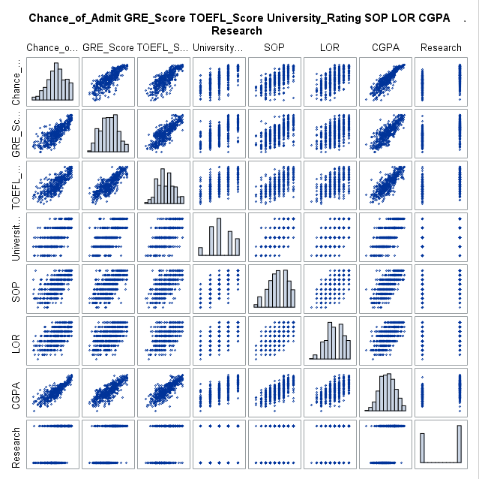
Plotting of Change of Admit against other variables to understand the trends
Looking at the image we observe that Chance_of_ Admit has a positive relationship with all the variables namely,
GRE Score
TOEFL Score
CGPA
LOR
SOP
University Rating and
Research experience.

Slide 21
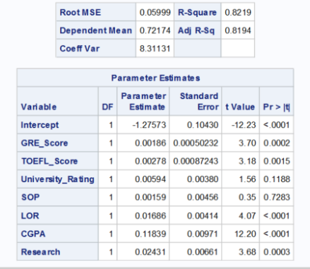
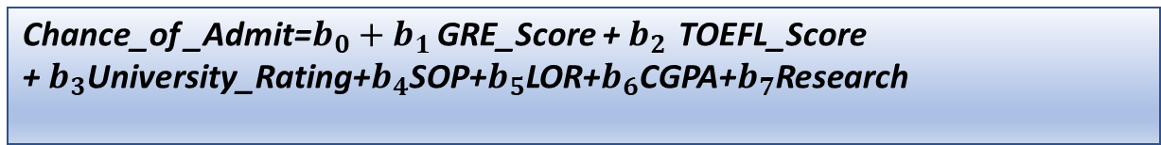
Modelling:
Linear Regression
First run a simple Linear Regression model.
We get a relatively high R square of 0.82
Results:
An increase in GRE score by a single point
raises chances of admit by 0.2 %.
Increase in TOEFL score increases it by 0.28%.
University rating and SOP turn out as
insignificant variables here
Chance_of _Admit=$b_{0}+b_{1}$ GRE_Score +${ b}_{2 }$TOEFL_Score +${ b}_{3}$University_Rating+$b_{4}$SOP+$b_{5}$LOR+$b_{6}$CGPA+$b_{7}$Research

Slide 22
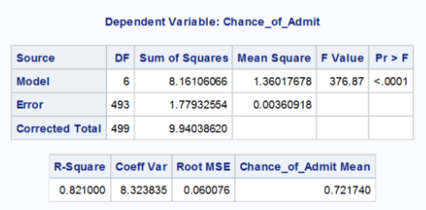
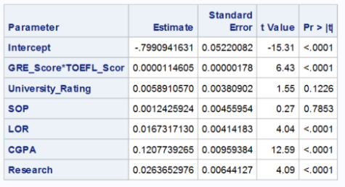

Running Linear Regression using Interaction Variables
Due to high level of correlation we introduce the interactive variable
GRE_Score*TOEFL_Score and run the regression again.
We see there is no significant increase in $R^{2}$ at 0.82 from the previous regression
Chance_of _Admit=$b_{0}+b_{1}$ GRE_Score * TOEFL_Score +${ b}_{2}$University_Rating+$b_{3}$SOP+$b_{4}$LOR
+$b_{5}$CGPA+$b_{6}$Research

Slide 23
Research Presentation
Notes:
You can use this slide as your opening or closing slide. Should you choose to use it as a closing, make sure you review the main points of your presentation. One creative way to do that is by adding animations to the various graphics on a slide. This slide has 4 different graphics, and, when you view the slideshow, you will see that you can click to reveal the next graphic. Similarly, as you review the main topics in your presentation, you may want each point to show up when you are addressing that topic.
Add animation to images and graphics:
Select your image or graphic.
Click on the Animations tab.
Choose from the options. The animation for this slide is “Split”. The drop-down menu in the Animation section gives even more animations you can use.
If you have multiple graphics or images, you will see a number appear next to it that notes the order of the animations.
Note: You will want to choose the animations carefully. You do not want to make your audience dizzy from your presentation.

