Slide 1
KAASUPAY · SURE TRUST FULL STACK BACKEND INTERNSHIP
REQUEST
Don’t Let a Slow Bank Break Our App
BREAKER
Timeouts and Circuit Breakers
BANK
A practical implementation using Node.js, Express, and Opossum.
TIMEOUT • PROTECT • RECOVER
PRESENTED BY
SINDHU NELLURI
01

Slide 2
02 · FAILURE PATH
The problem: One slow bank request needs a controlled path
The payout route validates input, protects the dependency call, then returns a clear result.
01
02
03
04
INPUT
SERVER
GUARD
DEPENDENCY
Postman
Express Server
Zod → Breaker
Fake Bank
POST payout request
Payout route receives it
Validate, then protect the call
Normal, slow, or fail
HTTP 200
HTTP 504
HTTP 503
Normal response
The bank completes normally.
Slow bank / Time Out
The breaker timeout is reached.
Failed bank / open circuit
The dependency is unavailable.
If the circuit is OPEN, the request is blocked before it reaches the fake bank.
02 / 10
Timeouts and Circuit Breakers

Slide 3
03 · DEPENDENCY BEHAVIOUR
Three fake-bank modes, three outcomes
Use these modes to test how the payout route behaves when the dependency changes.
01
MODE 01
02
MODE 02
03
MODE 03
NORMAL
SLOW
FAIL
The fake bank completes successfully.
Expected route response: HTTP 200.
The fake bank takes longer than the 3-second timeout.
Expected route response: HTTP 504.
The fake bank simulates an error.
Expected route response: HTTP 503.
REQUEST EXAMPLES
SOURCE PANEL
{"amount": 500, "mode": "normal"}
{"amount": 500, "mode": "slow"}
{"amount": 500, "mode": "fail"}
fakeBank.js was not attached. Confirm the exact simulator code before presenting it as a source excerpt.
03 / 10
Timeouts and Circuit Breakers

Slide 4
04 · DECISION CONFIGURATION
The breaker turns latency into a decision
Configuration currently used in bankCircuitBreaker.js.
TIMEOUT
3000 ms
OPOSSUM OPTIONS
Stop waiting when the bank is too slow.
const options = {
timeout: 3000,
errorThresholdPercentage: 50,
resetTimeout: 10000,
volumeThreshold: 2
};
ERROR RATE
50%
Open when failures cross the threshold.
RESET WINDOW
10000 ms
Wait before testing recovery.
MINIMUM VOLUME
2 requests
Make the decision with enough traffic.
04 / 10
Timeouts and Circuit Breakers

Slide 5
05 · WRAPPER
bankCircuitBreaker.js wraps the risky dependency
Opossum manages timeout behaviour and circuit-breaker state around the fake-bank function.
BREAKER CREATION
EVENT RAIL
A bank call failed
failure
const CircuitBreaker = require("opossum");
const { transferToBank } = require("./fakeBank");
const bankBreaker = new CircuitBreaker(
transferToBank,
options
);
The time limit was reached
timeout
New calls are blocked
open
Recovery is being tested
halfOpen
Normal calls are allowed
close
05 / 10
Timeouts and Circuit Breakers

Slide 6



06 · RECOVERY LOOP
Closed, open, half-open: the recovery loop
The circuit changes state based on failures and the recovery test.
CLOSED
OPEN
HALF-OPEN
Requests reach the fake bank.
Requests are blocked before the fake bank.
After 10 seconds, one recovery test can run.
TRANSITIONS
01
02
03
Requests reach the fake bank
Repeated failures → OPEN
OPEN → blocked before the fake bank
04
05
06
After 10 seconds → HALF-OPEN
Recovery success → CLOSED
Recovery failure → OPEN
OPEN prevents repeated calls from piling onto an unhealthy dependency.
06 / 10
Timeouts and Circuit Breakers

Slide 7
07 · INPUT GUARD
Zod validates the payout before the bank call
Invalid input should stop before the breaker is called.
DECISION PATH
PAYOUT SCHEMA
01
Request body
const payoutSchema = z.object({
amount: z.number().int().positive(),
mode: z.enum(["normal", "slow", "fail"]).optional()
});
Receive amount and optional mode.
02
Schema parse
Check the payout shape.
03
Valid continues
Proceed to the breaker.
04
Invalid stops
Validation protects the route from malformed requests.
Do not call the bank.
07 / 10
Timeouts and Circuit Breakers

Slide 8
08 · ROUTE CALL
The route delegates the call to the breaker
The route handles the successful result and maps timeout or availability errors to HTTP responses.
PAYOUT ROUTE
const bankResponse = await bankBreaker.fire({
amount,
mode
});
RESPONSE HANDLERS
HTTP 200
HTTP 504
HTTP 503
Success response
Timeout handling
Failure or open circuit
The bank call completes.
The dependency exceeds the timeout.
The service is unavailable.
08 / 10
Timeouts and Circuit Breakers

Slide 9
09 · HANDS-ON TESTS
Postman tests the three outcomes
Endpoint: POST http://localhost:3000/api/v1/payout/demo
NORMAL
SLOW
FAIL
Request
Request
Request
{"amount": 500,
"mode": "fail"}
{"amount": 500, "mode": "normal"}
{"amount": 500, "mode": "slow"}
HTTP 200
HTTP 504
HTTP 503
Bank completes normally.
Breaker timeout is reached.
Bank fails or circuit is open.
09 / 10
Timeouts and Circuit Breakers

Slide 10
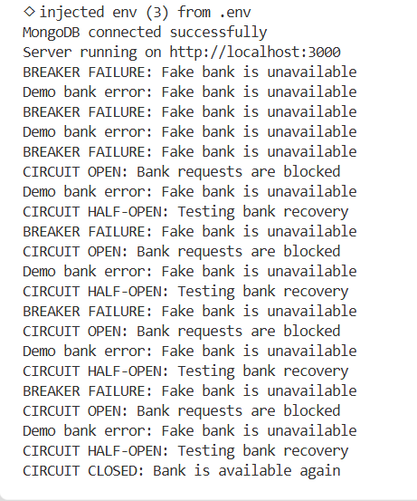
10 · TERMINAL RECAP
Terminal output mirrors the state machine
REPRESENTATIVE OUTPUT
IMPLEMENTATION LOOP
01
02
03
01
02
03
Validate
Fire breaker
Protect the API
Zod checks the payout input.
Opossum controls the bank call.
Return 200, 504, or 503 deliberately.
BREAKER FAILURE
BREAKER TIMEOUT
CIRCUIT OPEN
CIRCUIT HALF-OPEN
CIRCUIT CLOSED
10 / 10
Timeouts and Circuit Breakers

Slide 11
T H A N K
Y O U

