Slide 1



Healthcare SQL Data Analysis Project
An end-to-end SQL analysis of a real-world healthcare dataset — uncovering patient trends, billing patterns, and clinical outcomes.
Objective: Leverage SQL querying to identify patterns in patient demographics, medical conditions, hospital operations, and billing — enabling data-driven decisions for improved clinical quality and cost efficiency.

Slide 2
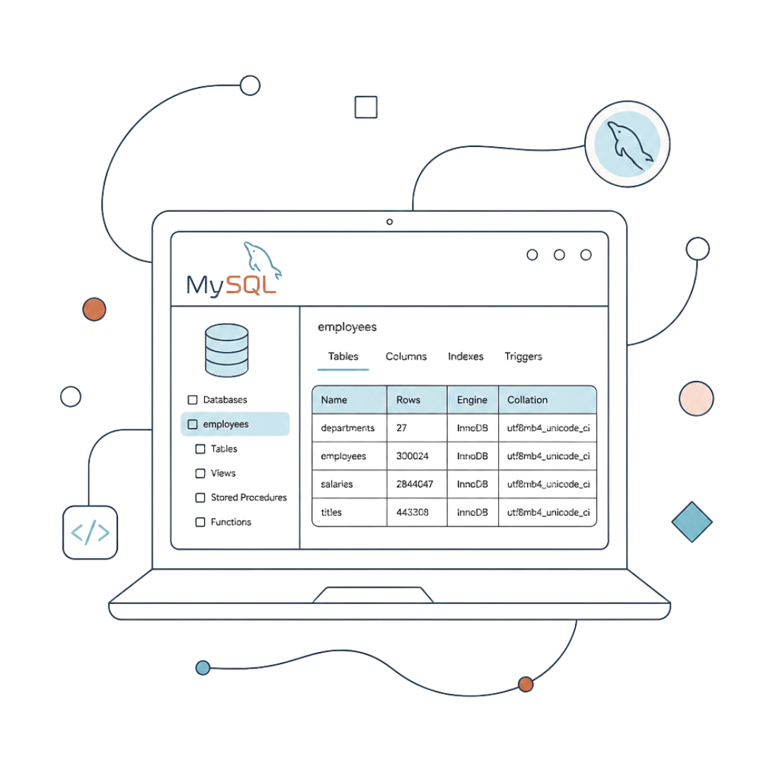
Project Overview
Tool: MySQL — database creation, data import, and multi-dimensional querying
Dataset: Healthcare patient records including demographics, diagnoses, admissions, billing, and test results
Goal: Extract actionable insights on patient health, hospital operations, and financial patterns

Slide 3
Dataset Structure
Patient Info
Clinical Data
Name
Age
Gender
Blood type
Medical condition
Admission type
Medication
Test results
Operational Data
Financial Data
Hospital & doctor
Date of admission
Discharge date
Insurance provider
Billing amount

Slide 4

Project Workflow
Setup
Segment
Create MySQL DB and import data
Query by gender, age, blood type
Explore
Operations
Preview structure with SELECT queries
Admissions, stays, doctor outcomes
Each phase builds on the last — from raw data import through to actionable clinical and financial insights.

Slide 5
Medical Conditions Analyzed
Cancer
Diabetes
Hypertension
Obesity
Arthritis
Asthma
Each condition was broken down by gender, blood type, and age group to identify which demographics are most affected and where targeted intervention is most needed.

Slide 6
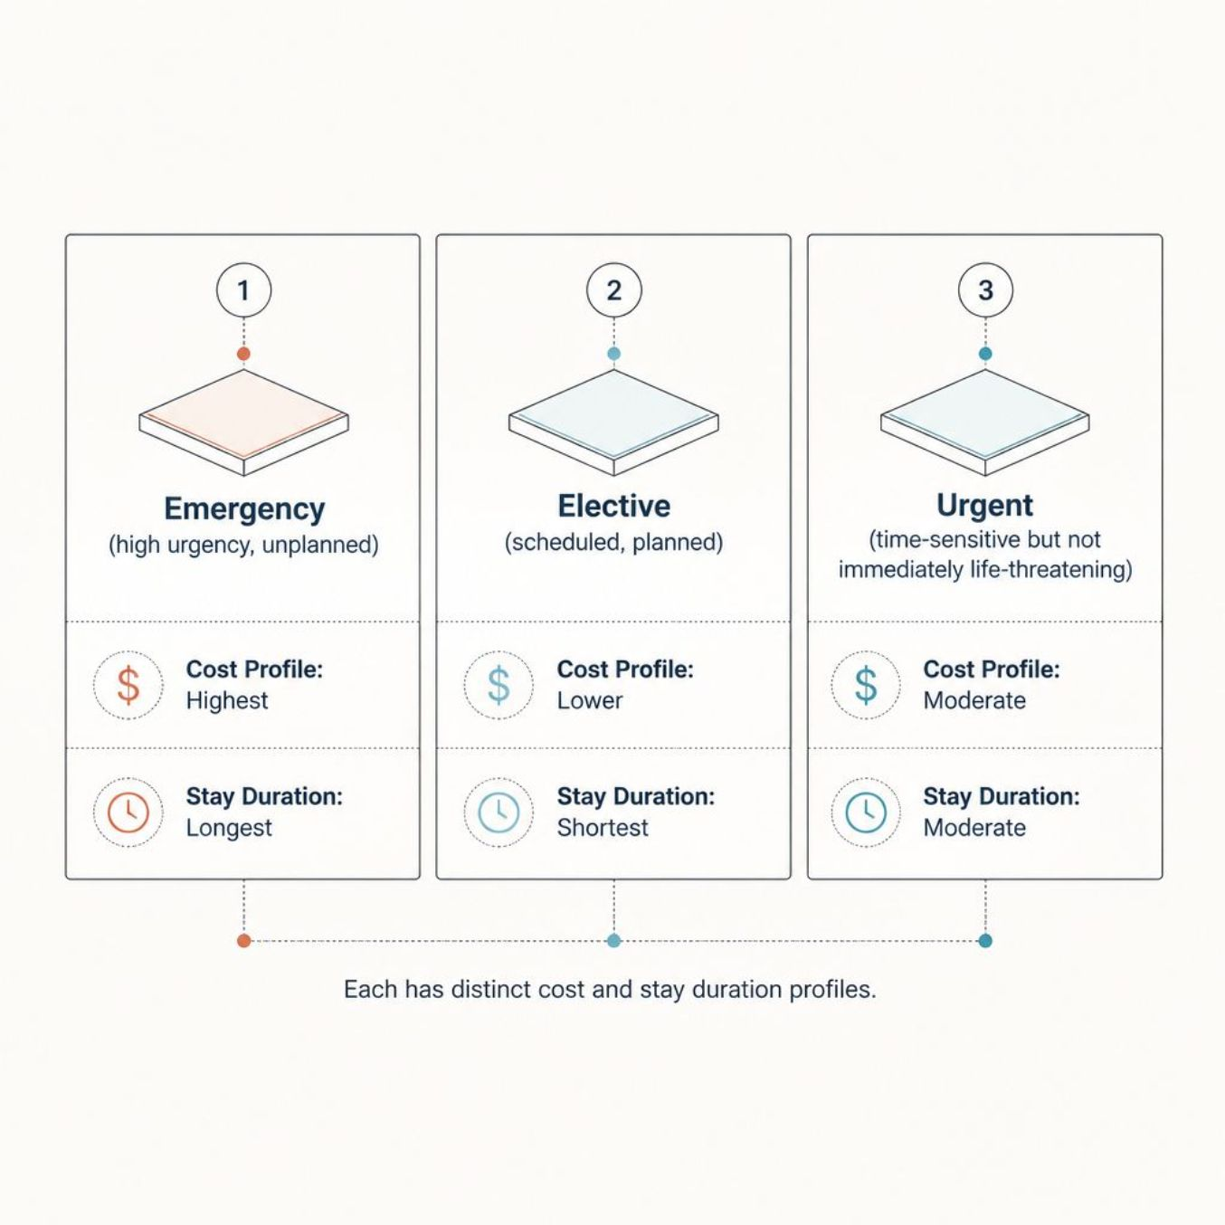
Admission & Hospital Stay Analysis
Key Analytical Approaches
Identified 3 distinct admission types: Emergency, Elective, and Urgent
Calculated average hospital stay duration using DATEDIFF(DischargeDate, DateOfAdmission)
Ranked patients by length of stay to flag prolonged admissions requiring review

Slide 7




Test Results Deep Dive
Normal
Abnormal
Inconclusive
Cases where test results fell within expected clinical ranges — the baseline for comparison.
Results outside normal parameters — counted across the full dataset to measure clinical burden.
Results that could not be definitively classified — flagged by doctor to serve as a quality-of-care signal.
Doctors with a disproportionately high share of inconclusive results were identified — a key indicator for clinical quality review.

Slide 8

Billing & Insurance Analysis
What Was Analyzed
Billing amounts segmented by admission type, medical condition, and length of stay
Most preferred insurance provider identified by patient count
Billing cross-referenced with doctor, hospital, and test results for cost-driver insights

Slide 9

SQL Techniques Used
Aggregations
Grouping & Filtering
COUNT, AVG, ROUND — for summarizing patient and billing data across groups.
GROUP BY, ORDER BY, WHERE — for segmented analysis by condition, gender, and admission type.
Date Functions
Distinct Queries
DATEDIFF — to compute hospital stay durations between admission and discharge dates.
Identifying unique conditions, insurance providers, and admission types across the dataset.

Slide 10

Key Insights
01
02
Blood Type & Condition Prevalence
Certain blood types show higher prevalence of specific conditions — suggesting targeted screening opportunities.
Age-Driven Disease Burden
Older age groups dominate cases of Cancer, Diabetes, and Hypertension across the dataset.
03
04
Inconclusive Result Concentration
A subset of doctors accounts for a disproportionate share of inconclusive test results — a quality-of-care red flag.
Billing Variation by Admission Type
Billing amounts vary significantly by admission type and stay length — emergency admissions tend to cost considerably more.

Slide 11




Recommendations
Preventive Care
Clinical Quality
Prioritize screening programs for high-risk age and blood-type groups to catch conditions earlier and reduce severity.
Review and support doctors with high inconclusive result rates through targeted training or equipment upgrades.
Cost Management
Insurance Strategy
Reduce emergency admissions via early intervention programs for chronic conditions like Diabetes and Hypertension.
Negotiate better terms with the most-used provider to reduce patient billing burden and improve financial outcomes.

