Slide 1

Efficient Task Allocation and Failure Detection in Crowdsourcing Platforms
Team Number: D6
Guide - Ms. Lekshmi S Nair
Sindhu Sahithi | AM.EN.U4CSE20326
Manikanta | AM.EN.U4CSE20370
Surya Teja | AM.EN.U4CSE20371
Anushree | AM.EN.U4CSE20375
Amrita School of Computing | Amrita Vishwa Vidyapeetham | Amritapuri

Slide 2
Introduction
Domain: Crowdsourcing
Gathering content, services, or solutions from a wide range of individuals or the public for specific purposes or goals.
Project Focus: Task allocation challenges in crowdsourcing.
Goal: Optimize worker-task matching for productivity.
Solution: Mentorship mapping.
Benefits: Efficient workforce utilization and task completion.
Motivation
Motivation: Enhance platform efficiency, client satisfaction
Challenges: Develop accurate task allocation algorithm, reduce errors, prevent task failures.
Goals: Improve efficiency and quality in task allocation.
1

Slide 3
Background Study/Related Work
Title &year | Problem | Contributions | Limitations | Open problems/Future work
Task Personalization for In expertise Workers in Incentive Based Crowdsourcing Platforms(2023) | Task recommendation model for inexpert workers in crowdsourcing. Emphasis on handling multiple skills and enhancing recommendation accuracy. | Task recommendation model for inexpert and new workers in crowdsourcing. Utilizes skill taxonomy and participation probability of expert workers. No Accuracy Mentioned | Assessing workers and tasks with skills may overlook real-world complexity. | Expand model to multi-skills, boost accuracy, and explore advanced recommendation algorithms for enhanced crowdsource task assignments. No Reassigning Tasks
Outlier Detection for Streaming Task Assignment in Crowdsourcing (2022) | Insufficient real-world validation hinders practicality in dynamic, diverse crowdsourcing environments, limiting applicability and relevance. | Enhance task assignment detection, targeting malicious workers and invalid tasks | No-real-world deployment, narrow anomaly exploration, scalability, adaptability, task impact. | Real-world validation, semi-supervised learning, diverse streaming scenarios, contextual information integration, task assignment efficiency enhancement.
2

Slide 4
Background Study/Related Work
Title &year | Problem | Contributions | Limitations | Open problems/Future work
Task Recommendation in Reward Based (2023) | Dynamic crowdsourcing task recommendations with hybrid models for improved accuracy. Exploration of user-friendly enhancements to encourage worker engagement in dynamic environments. | Introduces reward-based task recommendation model, combines implicit feedback, explicit features, outperforms matrix factorization, reduces data sparsity No Accuracy Mentioned | Scalability, generalization across platforms, and comparison with state-of-the-art methods warrant further exploration. Larger dataset evaluation needed. | Advanced set of Algorithms can be implemented, Considering different Parameters.
Failure Prediction in Crowdsourced Software Development (2017) | Emphasizes non-competitive tasks, additional failure prediction metrics, and internal threat consideration in evaluation | Proposes software crowdsourcing failure prediction framework with high accuracy, identifies key factors, offers risk management recommendations. Accuracy of 85% | Study limits to competitive tasks on Top Coder, neglecting non-competitive or collaborative ones. Further investigate competition factors, metrics, and internal threat considerations | Involves tech and worker supply-demand, social network analysis, text mining, and expanded data collection
3

Slide 5
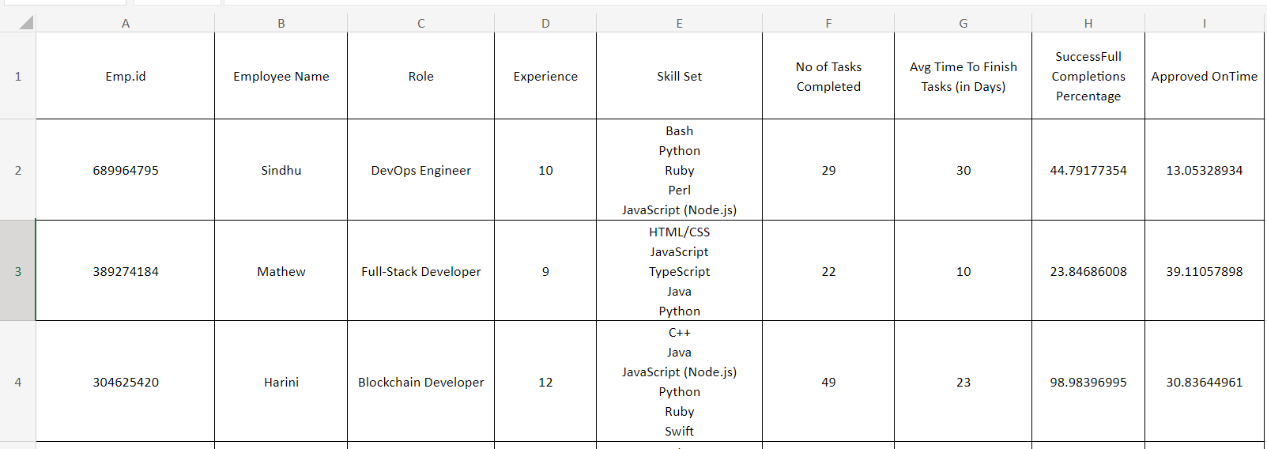
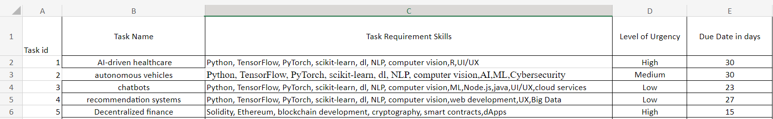
Project Contributions
Dataset Generation – Built our own Dataset
6

Slide 6
Project Contributions
Dataset Generation
Mapping In Expert Workers to the Expert Workers
Firstly, it aims to optimize the utilization of the workforce by efficiently channeling their skills and knowledge.
The primary objective is to establish a structured mentorship program where experienced workers are paired with less experienced counterparts.
Secondly, it strives to enhance task completion rates by streamlining the workflow through the introduction of this mentorship-based approach.
This mentorship arrangement aims to harness the expertise of the seasoned workers, who will assume the role of mentors, guiding and delegating tasks to their less experienced counterparts.
6

Slide 7
Project Contributions
Dataset Generation
Mapping In Expert Workers to the Expert Workers
Allocation of the New Tasks
Tasks that arise will be meticulously assigned to workers based on a comprehensive evaluation of several key factors.
These factors include the specific skill sets possessed by the workers, the precise requirements of the tasks at hand.
Subsequently, a judicious matching process will ensue, ensuring that the forthcoming tasks are allocated to workers in a manner that aligns seamlessly with these aforementioned criteria.
6

Slide 8
Project Contributions
Dataset Generation
Mapping In Expert Workers to the Expert Workers
Allocation of the New Tasks
Failure Detection
This system is designed to identify potential task failures stemming from a variety of factors, such as task overlap, impending deadlines, or the increased urgency of subsequently assigned tasks.
When a task is flagged as at risk, it is swiftly and strategically reassigned to another employee who possesses the necessary skills and capacity to ensure its successful completion.
It enhances our ability to meet urgent demands, ultimately bolstering our overall efficiency and ensuring that no task is left unattended or unfinished.
6

Slide 9
Improvements Based on First Review(If any)
What were the comments by the reviewers? | How are those addressed ?
Suggested Columns for the Task Dataset | Added a new column – level of difficulty
Change in the Mentorship Mapping Workflow | Mapping will be done according to the Similarity check as well has only to the Experts who are eligible for Mentorship. Taken a parameter consideration of the Successful completion of tasks percentage and also Approved on time submission percentage.

Slide 10
Progress After First Review
We created the datasets and a basic algorithm implementation for the First Review.
Implemented two different approaches to divide the Employees into Experts and Inexpert.
1. Using the Experience and Expert Skill Set
2. Using Experience

Slide 11
Progress After First Review
We created the datasets and a basic algorithm implementation for the First Review.
Implemented two different approaches to divide the Employees into Experts and Inexpert.
Implemented three different approaches for assigning the Mentor i.e Experts to the Mentee i.e Inexpert for the Mentorship Mapping.
1. Skill Set of Expert totally in Inexpert Skill Set and Successful completions
2. Assigning two Inexpert to each Expert
3. Skill Similarity score , Successful Submissions and Approved on Time

Slide 12
Progress After First Review
We created the datasets and a basic algorithm implementation for the First Review.
Implemented two different approaches to divide the Employees into Experts and Inexpert.
Implemented three different approaches for assigning the Mentor i.e Experts to the Mentee i.e Inexpert for the Mentorship Mapping.
Visualization of different approaches results.
Implemented the two different approaches for the task allocation for the Employees.
1. Considering skills similarity score and no limit of tasks for particular employee but maximum utilisation of available employees.
2. Considering skills similarity score and a limit of tasks for particular employee according to their level of handling tasks.

Slide 13
Persisting Challenges
Goals
Worker skills change over time.
Challenge Faced assigning Mentor Mapping.
Continuously update task allocation algorithm.
Ensure accurate task-worker matching.
Tasks may have dependencies.
Need advanced algorithms.
Ensure smooth workflow distribution.
Failed Task Not Assigned again
Previous History of Tasks done for Mentorship Mapping.
Factors of Successful submissions: Average Submission days for the Task Allocation.
For the Failure detection considers : Urgency level, Due days , Assigned Tasks , Approved percentages, Average Submission days for the Task
Reallocate the Task
We are aiming to solve
4

Slide 14
Modules High Level Design
Gathering Crowd Information
List Employee related data
Task Related data
Categorize as Expert and In Expert
Datasets
Employee Data
Task Data
Algorithms for classifying of employees
5

Slide 15
Modules High Level Design
Datasets
Gathering Crowd Information
List Employee related data
Task Related data
Categorize as Expert and In Expert
Mentorship Formation
Map In Expert to Expert
Employee Data
Task Data
Algorithms for classifying of employees
Mapping for Mentorship
Modified Dataset
5

Slide 16
Modules High Level Design
Gathering Crowd Information
List Employee related data
Task Related data
Categorize as Expert and In Expert
Mentorship Formation
Map In Expert to Expert
Task Allocation
Skill set Similarity Matching
Datasets
Employee Data
Task Data
Algorithms for classifying of employees
Skills
Find Similar Workers(Compute Similarity Measures)
Ranking Workers
Mapping for Mentorship
Modified Dataset
Skills
Assign Task
5

Slide 17
Modules High Level Design
Gathering Crowd Information
List Employee related data
Task Related data
Categorize as Expert and In Expert
Mentorship Formation
Map In Expert to Expert
Task Allocation
Skill set Similarity Matching
Failure Detection
Detect the task failed
Reallocate the Task
Datasets
Employee Data
Task Data
Algorithms for classifying of employees
Skills
Find Similar Workers(Compute Similarity Measures)
Ranking Workers
Mapping for Mentorship
Skills
Assign Task
Modified Dataset
Detected Tasks Removal from Assigned Worker
Failure Detection
5

Slide 18
Algorithms/Methodology
Datasets
Employee Data
Task Data
Get the Experience, Skills and Successful Completions Percentage of the Employees
Check For the Experience Criteria <3 is Inexpert and >3 is Expert.
Also Check if the skills are in the Expert Skill Set if it is a intersection then Expert else Inexpert
Assign for all the Employees in a new column Employee Type according to the Parameters check
Algorithms for classifying of employees
Skills
Find Similar Workers(Compute Similarity Measures)
Ranking Workers
Mapping for Mentorship
Modified Dataset
Skills
Assign Task

Slide 19
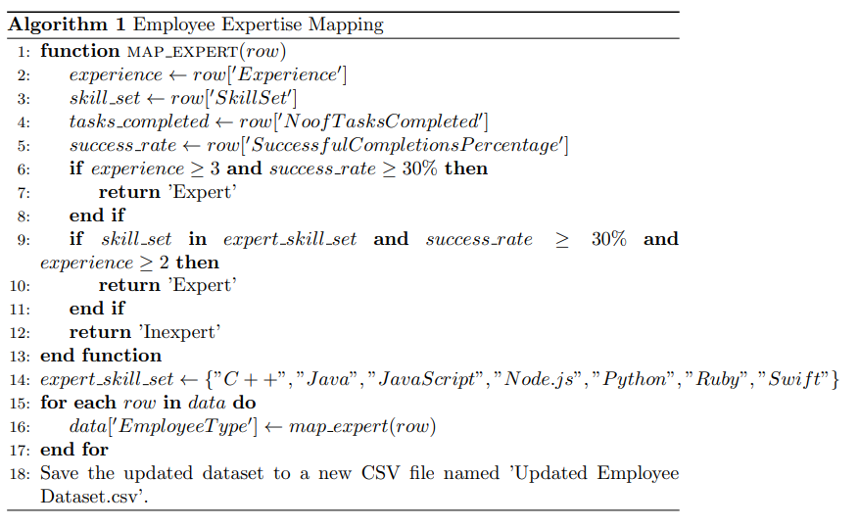
Algorithms/Methodology
Datasets
Employee Data
Task Data
Algorithms for classifying of employees
Skills
Find Similar Workers(Compute Similarity Measures)
Ranking Workers
Mapping for Mentorship
Modified Dataset
Skills
Assign Task

Slide 20
Algorithms/Methodology
Datasets
For Experts Consider the Parameters Successful Submissions and Approved on time and take out only the Eligible Mentorship Candidates.
Vectorize the Skill Sets of Both Inexperts and Experts.
Calculate the Cosine Similarity among the skill sets of the Experts and Inexperts.
Assign Mentor for the Inexperts according to their Similarity scores and check the condition that a Mentor can have only two Mentees.
Map for all the Inexperts and save the Results.
Employee Data
Task Data
Algorithms for classifying of employees
Skills
Find Similar Workers(Compute Similarity Measures)
Ranking Workers
Mapping for Mentorship
Modified Dataset
Skills
Assign Task

Slide 21
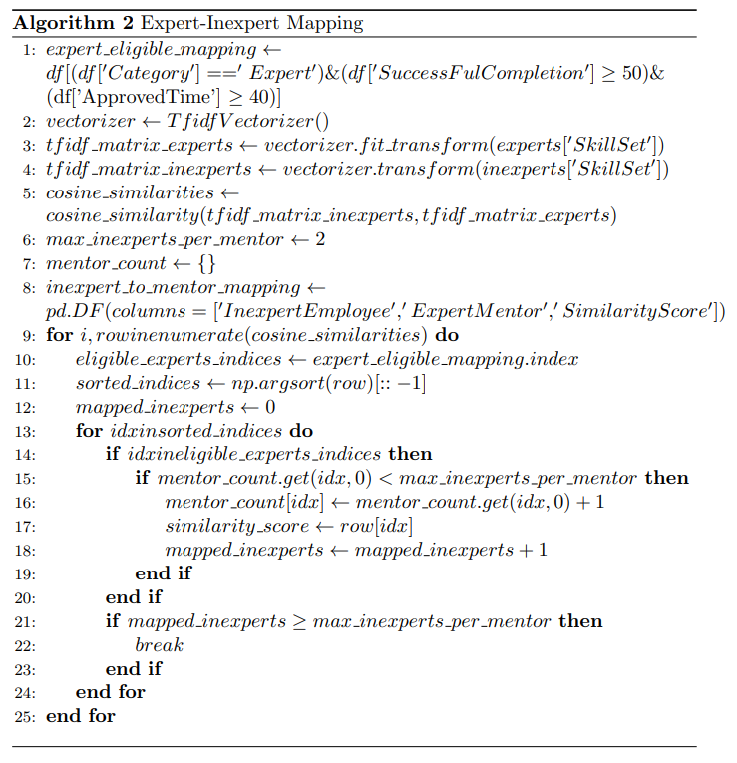
Algorithms/Methodology
Datasets
Employee Data
Task Data
Algorithms for classifying of employees
Skills
Find Similar Workers(Compute Similarity Measures)
Ranking Workers
Mapping for Mentorship
Modified Dataset
Skills
Assign Task

Slide 22
Algorithms/Methodology
Datasets
Calculate the Similarity Scores between the Employee skill sets and Task required skill sets.
Assign the each Task according to the similarity scores.
Prioritized to give the low level difficulty task to the Inexpert.
Prioritized to give High level difficulty task to the Expert
Prioritized to give the Medium level difficulty task according to the Due days for that particular Task
Employee Data
Task Data
Algorithms for classifying of employees
Skills
Find Similar Workers(Compute Similarity Measures)
Ranking Workers
Mapping for Mentorship
Modified Dataset
Skills
Assign Task

Slide 23
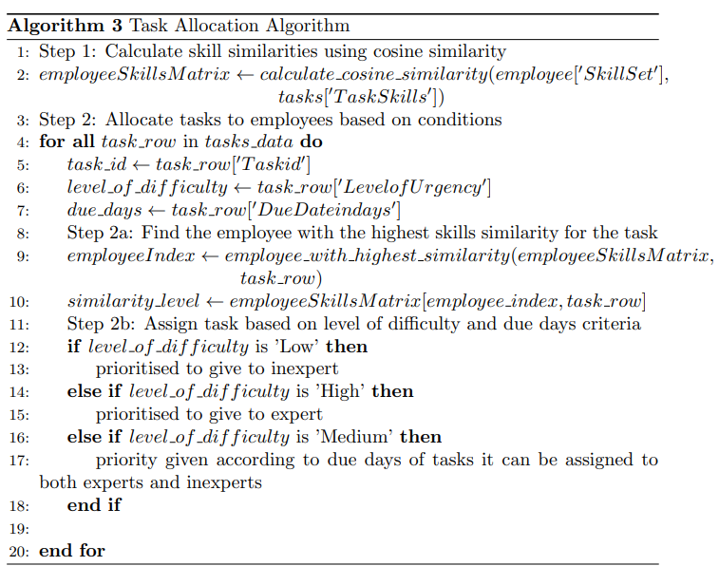
Algorithms/Methodology
Datasets
Employee Data
Task Data
Algorithms for classifying of employees
Skills
Find Similar Workers(Compute Similarity Measures)
Ranking Workers
Mapping for Mentorship
Modified Dataset
Skills
Assign Task

Slide 24
Algorithms/Methodology
Datasets
Calculate the Similarity Scores between the Employee skill sets and Task required skill sets.
Assign the each Task according to the similarity scores.
Prioritized to give the low level difficulty task to the Inexpert.
Check a Inexpert can have maximum of 2 or 3 tasks.
Prioritized to give High level difficulty task to the Expert.
Check a Expert can have maximum of 3 or 4 tasks.
Prioritized to give the Medium level difficulty task according to the Due days for that particular task.
Check Inexpert getting maximum of 3 and Expert getting 4.
Employee Data
Task Data
Algorithms for classifying of employees
Skills
Find Similar Workers(Compute Similarity Measures)
Ranking Workers
Mapping for Mentorship
Modified Dataset
Skills
Assign Task

Slide 25
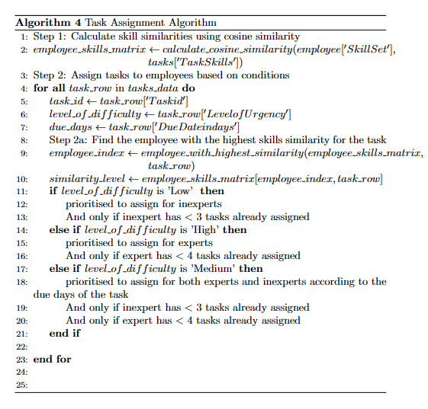
Algorithms/Methodology
Datasets
Employee Data
Task Data
Algorithms for classifying of employees
Skills
Find Similar Workers(Compute Similarity Measures)
Ranking Workers
Mapping for Mentorship
Modified Dataset
Skills
Assign Task

Slide 26
Experimental Setup
Dataset used
Gathered data from diverse online crowdsourcing platforms to ensure a comprehensive representation of employee engagement and task completion dynamics.
Included critical employee attributes such as Employee ID, Role, Experience, Skill Sets, Number of tasks completed, Average time for Task completion, Successful completion tasks on Time percentage, and metrics like approved on time for a detailed analysis.
Compiled essential information for task allocation optimization, including Task ID, Task Requirement Skills, Level of Urgency, and Due Days Left, to gain insights into task nature, urgency levels, and specific skill sets required for successful completion.
Acknowledged the dynamic nature of crowdsourcing platforms, aiming to develop algorithms that adapt to the ever-changing dynamics, optimizing the utilization of skills and resources.
Paid special attention to the urgency levels of tasks and the days left for their completion, recognizing their significance in the development and evaluation of task allocation algorithms.

Slide 27
Experimental Setup
Module – Mentorship Mapping
Approach 1
Here, expert skills are totally at the intersection of inexpert skills.
Approach 2
Here we are assigning two inexpert workers to expect workers.
Approach 3
We will be considering successful submissions, approved on-time submissions, and mapping workers based on similarity scores.
Module – Task Allocation
Approach 1
By considering similarity scores, we will be assigning tasks to employees without considering the limit on the number of tasks assigned.
Approach 2
By considering similarity scores, we will be assigning tasks to employees considering the limit on the number of tasks assigned to employees.

Slide 28
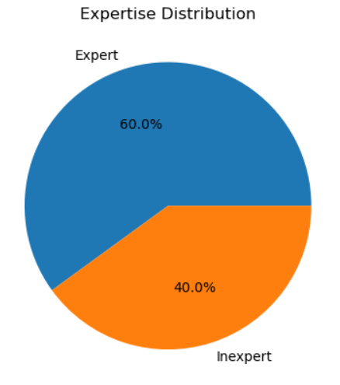
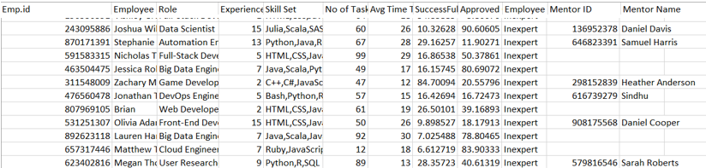
Experiment Results
Module – Mentorship Mapping (Expert skill totally in Inexpert and Successful submissions)

Slide 29
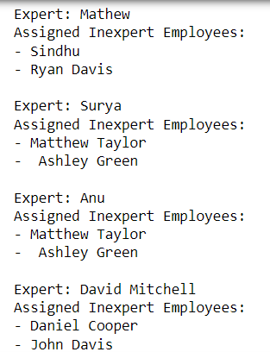
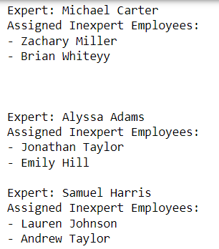
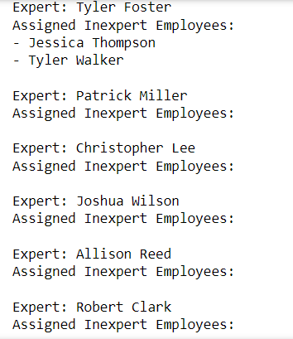
Experiment Results
Module – Mentorship Mapping (Assign two Inexpert to Expert)

Slide 30
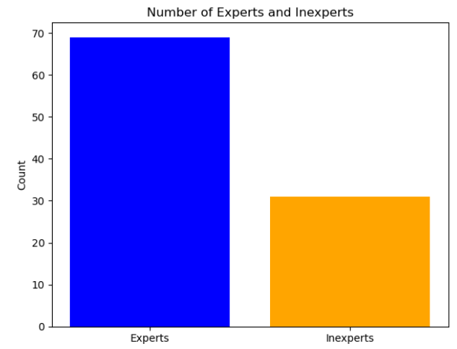
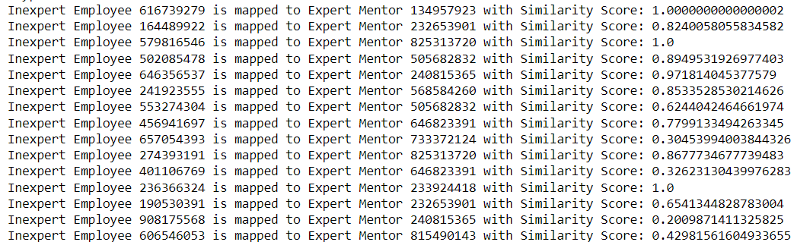
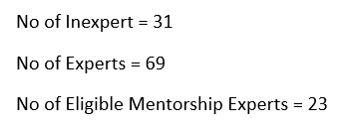
Experiment Results
Module – Mentorship Mapping (Similarity scores ,Successful submissions, On time approvals)

Slide 31
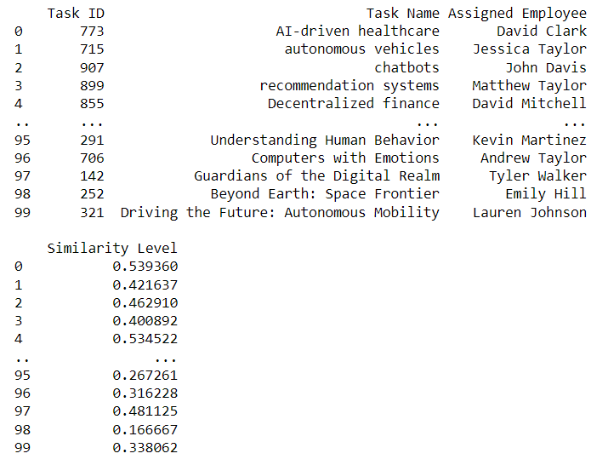
Experiment Results
Module – Task Allocation (Similarity scores ,No limit in tasks assigning to a Employee)

Slide 32
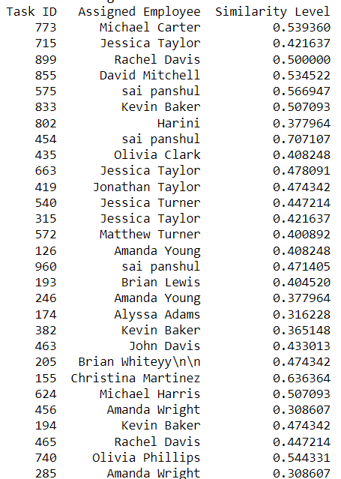
Experiment Results
Module – Task Allocation (Similarity scores ,limit in tasks assigning to a Employee)

Slide 33
Findings
For the first module (Mentorship Mapping) we approached with three different methods.
Where the method which is considering the parameters similarity scores and considering only the Eligible expert employee for the mentorship mapping gives more significant outcome than other approaches.
For the first approach we cant say that the exact all the skills will be present in a inexpert in which the expert is possessing so very few gets mapped and the main goal is to get maximum work done will not be satisfied.
For the second approach we cant simply assign the two inexpert to a expert as there is a chance that their skills are totally different that expert cant mentor their mentee.

Slide 34
Findings
For the second module (Task Allocation) we approached with two different methods.
Where the method which is considering to assign a limited tasks to a employee is providing a better outcome when compared to the unlimited assigned tasks approach. As it can make more employees utilization it improves overall growth.
For the unlimited tasks assign method , complicated and less due tasks all may get assigned to a single employee.

Slide 35
Paper Status
Drafted the Conference Paper

Slide 36
Conclusion
We introduced a pioneering task recommendation model tailored for crowdsourcing systems, specifically addressing the requirements of newly hired and inexperienced workers.
It innovates mentorship mapping and dynamic task allocation, which contribute to a more efficient and productive crowdsourcing ecosystem.
The algorithms involves such as TF-IDF, Count Vectorizer and Cosine Similarity to assess skill similarity between experienced and inexperienced workers.
Our findings show that this technique is effective in task recommendations for greater collaboration and knowledge transfer inside crowdsourcing platforms.
Work Remaining – Extending for doing the Failure Detection of the tasks and then Reassigning to the Employees.

Slide 37
References
[1] Ayswarya R Kurup and G P Sajeev, “Task Personalization for In expertise Workers in Incentive Based Crowdsourcing Platforms, ” in 2018 International Conference on Advances in Computing, Communications and Informatics (ICACCI), Bangalore, India, Sep. 2018.
[2] K. Li, J. Xiao, Y. Wang, and Q. Wang, “Analysis of the key factors for software quality in crowdsourcing development: An empirical study on top coder. com,” in Computer Software and Applications Conference (COMPSAC), 2013 IEEE 37th Annual. IEEE, 2013, pp. 812–817.
[3] A. R. Kurup and G. P. Sajeev, “Task recommendation in Reward-Based crowdsourcing systems,” in Fifth International Symposium on Women in Computing and Informatics (WCI-2017), Manipal, Mangalore, India, Sep. 2017, pp. 1511–1518.
[4] A. R. Kurup and G. P. Sajeev, ‘‘A task recommendation scheme for crowdsourcing based on expertise estimation,’’ Electron. Commerce Res. Appl., vol. 41, May 2020, Art. no. 100946
[5] Wei Dai, Yufeng Wang, Jianhua Ma, and Qun Jin.Btr: A feature-based bayesian task recommendation scheme for crowdsourcing system. IEEE Transactions on Computational Social Systems, 7(3):780–789, 2020. doi:10.1109/TCSS.2020.2986836.
[6] Salma Imtiaz and Naveed Ikram. Framework for task allocation in global software development. IEEE Access, 8:206235–206247, 2020. doi:10.1109/ACCESS.2020.3035410
11

Slide 38
Link to the Project Demo The code is uploaded in GitHub.
Link to Repo

Slide 39
Thank You

