Slide 1

Efficient Task Allocation and Failure Detection in Crowdsourcing Platforms
Team Number: D6
Guide - Ms. Lekshmi S Nair
Sindhu Sahithi | AM.EN.U4CSE20326
Manikanta | AM.EN.U4CSE20370
Surya Teja | AM.EN.U4CSE20371
Anushree | AM.EN.U4CSE20375
Amrita School of Computing | Amrita Vishwa Vidyapeetham | Amritapuri

Slide 2
Introduction
Domain: Crowdsourcing
Gathering ideas, content, services, or solutions from a wide range of individuals or the public for specific purposes or goals.
Project Focus: Task allocation challenges in crowdsourcing.
Goal: Optimize worker-task matching for productivity.
Solution: Mentorship mapping.
Benefits: Efficient workforce utilization and task completion.
Motivation
Motivation: Enhance platform efficiency, client satisfaction
Challenges: Develop accurate task allocation algorithm, reduce errors, prevent task failures.
Goals: Improve efficiency and quality in task allocation.
1

Slide 3
Background Study/Related Work
Title &year | Problem | Contributions | Limitations | Open problems/Future work
Task Personalization for In expertise Workers in Incentive Based Crowdsourcing Platforms(2023) | Task recommendation model for inexpert workers in crowdsourcing. Emphasis on handling multiple skills and enhancing recommendation accuracy. | Task recommendation model for inexpert and new workers in crowdsourcing. Utilizes skill taxonomy and participation probability of expert workers. No Accuracy Mentioned | Assessing workers and tasks with skills may overlook real-world complexity. | Expand model to multi-skills, boost accuracy, and explore advanced recommendation algorithms for enhanced crowdsource task assignments. No Reassigning Tasks
Outlier Detection for Streaming Task Assignment in Crowdsourcing (2022) | Insufficient real-world validation hinders practicality in dynamic, diverse crowdsourcing environments, limiting applicability and relevance. | Enhance task assignment detection, targeting malicious workers and invalid tasks | No-real-world deployment, narrow anomaly exploration, scalability, adaptability, task impact. | Real-world validation, semi-supervised learning, diverse streaming scenarios, contextual information integration, task assignment efficiency enhancement.
2

Slide 4
Background Study/Related Work
Title &year | Problem | Contributions | Limitations | Open problems/Future work
Task Recommendation in Reward Based (2023) | Dynamic crowdsourcing task recommendations with hybrid models for improved accuracy. Exploration of user-friendly enhancements to encourage worker engagement in dynamic environments. | Introduces reward-based task recommendation model, combines implicit feedback, explicit features, outperforms matrix factorization, reduces data sparsity No Accuracy Mentioned | Scalability, generalization across platforms, and comparison with state-of-the-art methods warrant further exploration. Larger dataset evaluation needed. | Advanced set of Algorithms can be implemented, Considering different Parameters.
Failure Prediction in Crowdsourced Software Development (2017) | Emphasizes non-competitive tasks, additional failure prediction metrics, and internal threat consideration in evaluation | Proposes software crowdsourcing failure prediction framework with high accuracy, identifies key factors, offers risk management recommendations. Accuracy of 85% | Study limits to competitive tasks on Top Coder, neglecting non-competitive or collaborative ones. Further investigate competition factors, metrics, and internal threat considerations | Involves tech and worker supply-demand, social network analysis, text mining, and expanded data collection
3

Slide 5
Persisting Challenges
Goals
Worker skills change over time.
Challenge Faced assigning Mentor Mapping.
Continuously update task allocation algorithm.
Ensure accurate task-worker matching.
Tasks may have dependencies.
Need advanced algorithms.
Ensure smooth workflow distribution.
Failed Task Not Assigned again
Previous History of Tasks done for Mentorship Mapping.
Factors of Successful submissions: Average Submission days for the Task Allocation.
For the Failure detection considers : Urgency level, Due days , Assigned Tasks , Approved percentages, Average Submission days for the Task
Reallocate the Task
We are aiming to solve
4

Slide 6
Modules High Level Design
Gathering Crowd Information
List Employee related data
Task Related data
Datasets
Employee Data
Task Data
5

Slide 7
Modules High Level Design
Gathering Crowd Information
List Employee related data
Task Related data
Categorize as Expert and In Expert
Datasets
Employee Data
Task Data
Algorithms for classifying of employees
5

Slide 8
Modules High Level Design
Datasets
Gathering Crowd Information
List Employee related data
Task Related data
Categorize as Expert and In Expert
Mentorship Formation
Map In Expert to Expert
Employee Data
Task Data
Algorithms for classifying of employees
Mapping for Mentorship
Modified Dataset
5

Slide 9
Modules High Level Design
Gathering Crowd Information
List Employee related data
Task Related data
Categorize as Expert and In Expert
Mentorship Formation
Map In Expert to Expert
Task Allocation
Skill set Similarity Matching
Datasets
Employee Data
Task Data
Algorithms for classifying of employees
Skills
Find Similar Workers(Compute Similarity Measures)
Ranking Workers
Mapping for Mentorship
Modified Dataset
Skills
Assign Task
5

Slide 10
Modules High Level Design
Gathering Crowd Information
List Employee related data
Task Related data
Categorize as Expert and In Expert
Mentorship Formation
Map In Expert to Expert
Task Allocation
Skill set Similarity Matching
Failure Detection
Detect the task failed
Reallocate the Task
Datasets
Employee Data
Task Data
Algorithms for classifying of employees
Skills
Find Similar Workers(Compute Similarity Measures)
Ranking Workers
Mapping for Mentorship
Skills
Assign Task
Modified Dataset
Detected Tasks Removal from Assigned Worker
Failure Detection
5

Slide 11
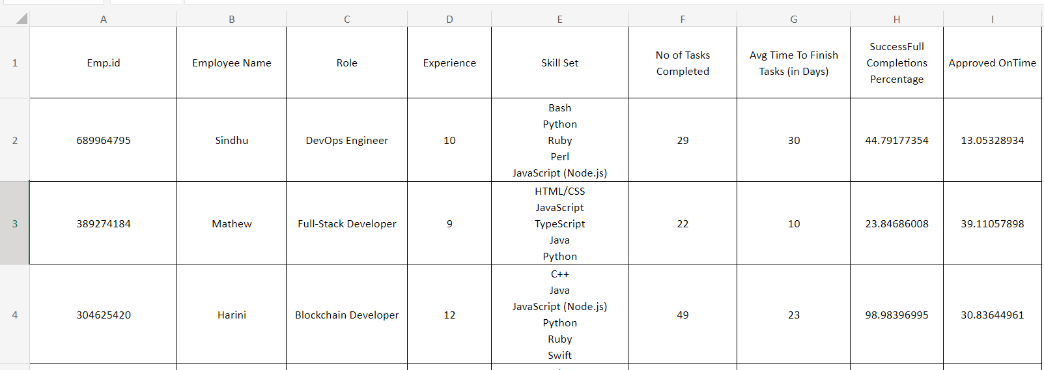
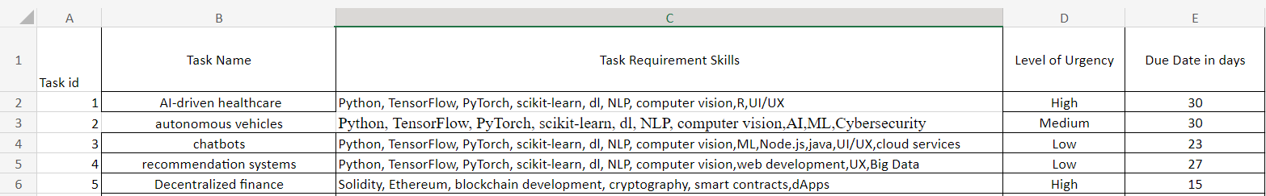
Project Contributions
Dataset Generation – Built our own Dataset
6

Slide 12
Project Contributions
Dataset Generation
Mapping In Expert Workers to the Expert Workers
Firstly, it aims to optimize the utilization of the workforce by efficiently channeling their skills and knowledge.
The primary objective is to establish a structured mentorship program where experienced workers are paired with less experienced counterparts.
Secondly, it strives to enhance task completion rates by streamlining the workflow through the introduction of this mentorship-based approach.
This mentorship arrangement aims to harness the expertise of the seasoned workers, who will assume the role of mentors, guiding and delegating tasks to their less experienced counterparts.
6

Slide 13
Project Contributions
Dataset Generation
Mapping In Expert Workers to the Expert Workers
Allocation of the New Tasks
Tasks that arise will be meticulously assigned to workers based on a comprehensive evaluation of several key factors.
These factors include the specific skill sets possessed by the workers, the precise requirements of the tasks at hand.
Subsequently, a judicious matching process will ensue, ensuring that the forthcoming tasks are allocated to workers in a manner that aligns seamlessly with these aforementioned criteria.
6

Slide 14
Project Contributions
Dataset Generation
Mapping In Expert Workers to the Expert Workers
Allocation of the New Tasks
Failure Detection
This system is designed to identify potential task failures stemming from a variety of factors, such as task overlap, impending deadlines, or the increased urgency of subsequently assigned tasks.
When a task is flagged as at risk, it is swiftly and strategically reassigned to another employee who possesses the necessary skills and capacity to ensure its successful completion.
It enhances our ability to meet urgent demands, ultimately bolstering our overall efficiency and ensuring that no task is left unattended or unfinished.
6

Slide 15
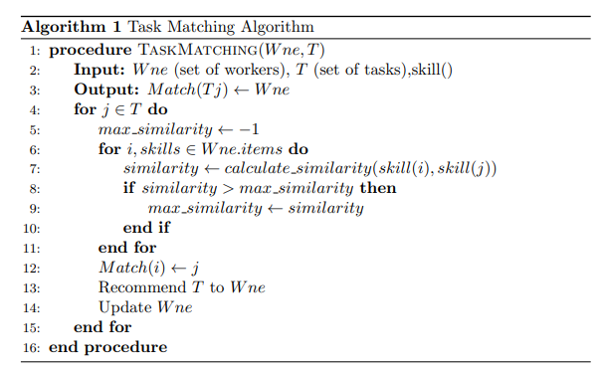
Algorithms
This Algorithm Used to Allocate the Tasks For the Employee (Input: W_{ne} , set of tasks T, skill() Output: Match(T_{j} ) ← W_{ne} ) W_{ne} → set of workers
7

Slide 16
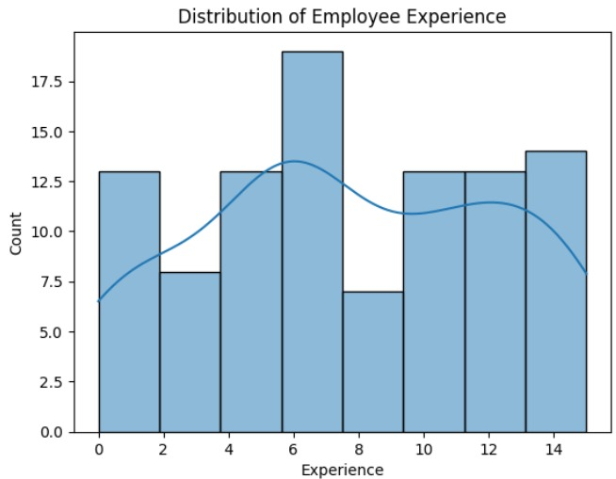
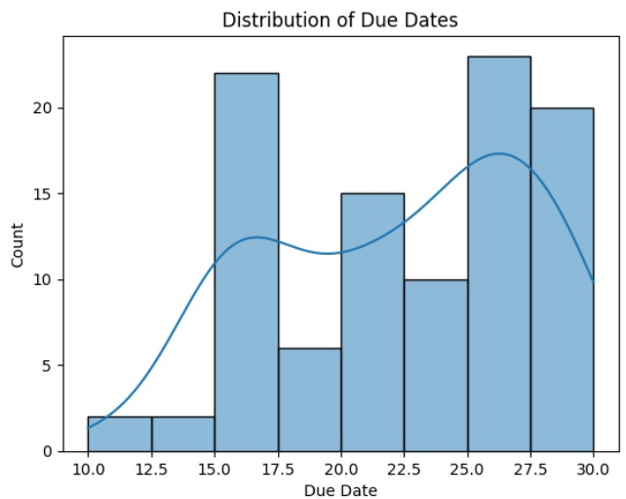
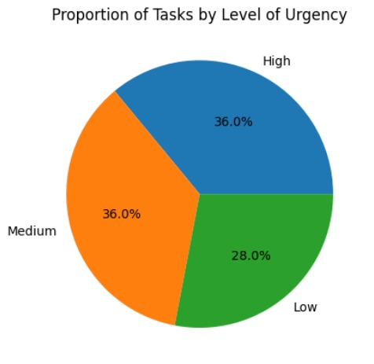
Sample Output
8

Slide 17
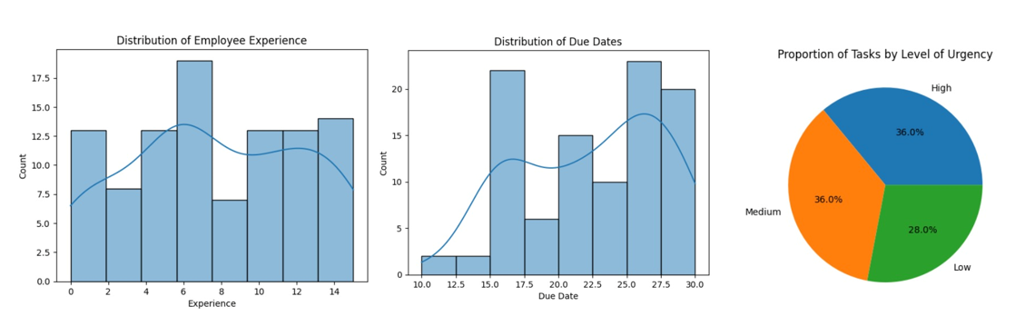
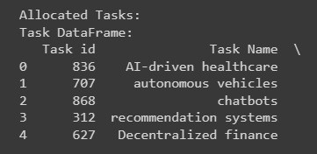
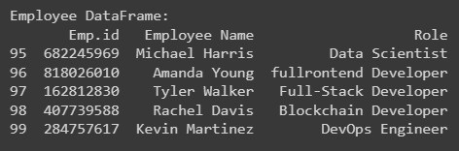
Sample Output
Task Allocated
8

Slide 18
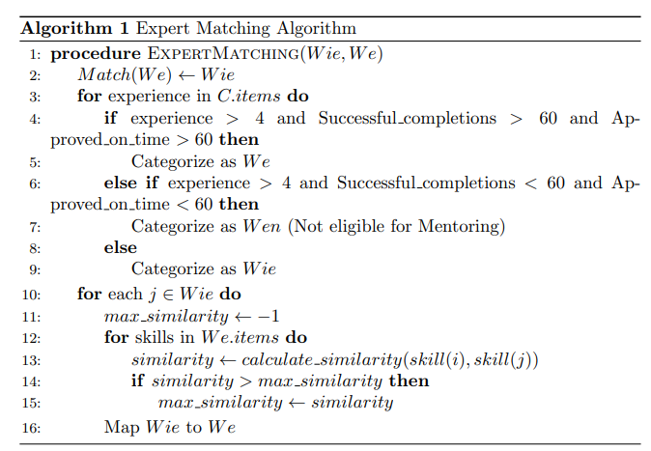
Algorithms
This Algorithm is to Categorize the Employees and Mentorship Mapping ( Input: W_{ie} → set of inexpert workers and W_{e} → set of expert workers Output: Match(W_{e}) ← W_{ie})
9

Slide 19
Current status
Identifying the Attributes of the dataset
Creating the dataset
Implementing an algorithm
10

Slide 20
References
[1] Ayswarya R Kurup and G P Sajeev, “Task Personalization for In expertise Workers in Incentive Based Crowdsourcing Platforms, ” in 2018 International Conference on Advances in Computing, Communications and Informatics (ICACCI), Bangalore, India, Sep. 2018.
[2] K. Li, J. Xiao, Y. Wang, and Q. Wang, “Analysis of the key factors for software quality in crowdsourcing development: An empirical study on top coder. com,” in Computer Software and Applications Conference (COMPSAC), 2013 IEEE 37th Annual. IEEE, 2013, pp. 812–817.
[3] A. R. Kurup and G. P. Sajeev, “Task recommendation in Reward-Based crowdsourcing systems,” in Fifth International Symposium on Women in Computing and Informatics (WCI-2017), Manipal, Mangalore, India, Sep. 2017, pp. 1511–1518.
[4] A. R. Kurup and G. P. Sajeev, ‘‘A task recommendation scheme for crowdsourcing based on expertise estimation,’’ Electron. Commerce Res. Appl., vol. 41, May 2020, Art. no. 100946
11

Slide 21
Thank You

