Slide 1


US CENSUS INCOME
Group#3
Neelanjan Mitra
Sindhu Sundararajan
Yunhui Wu

Slide 2

INTRODUCTION
The "Adult" dataset from the UCI Machine Learning Repository is a widely used resource for predictive modeling and classification.
Data extracted from the 1994 Census bureau database by Ronny Kohavi and Barry Becker.
Based on these attributes, the dataset's objective is to predict if an individual's income exceeds 50K yearly.
It is an excellent tool for understanding and applying machine learning algorithms in real-world scenarios, particularly for binary classification tasks.

Slide 3
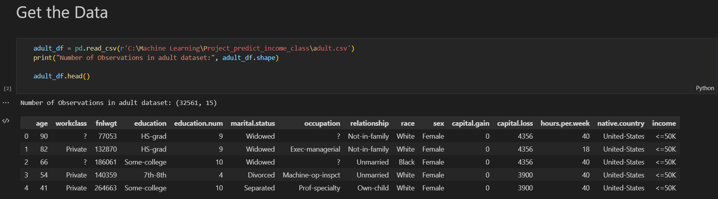
DATASET
Comprehensive features: personal attributes, educational background, occupation, and income.

Slide 4
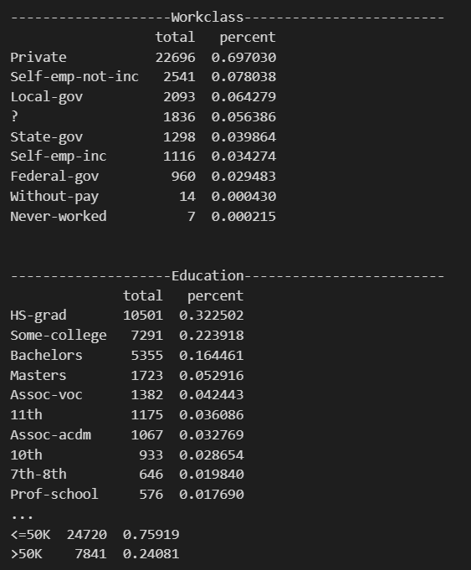
Data Exploration and Visualization
The code separates the categorical and numerical columns in the given dataset, iterates over the categorical columns, prints the column name, and calculates each unique value's total count and percentage.

Slide 5
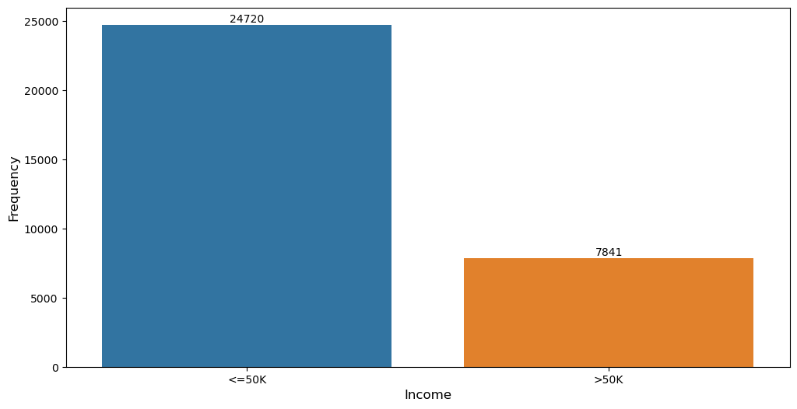
Plotting Income Distribution

Slide 6
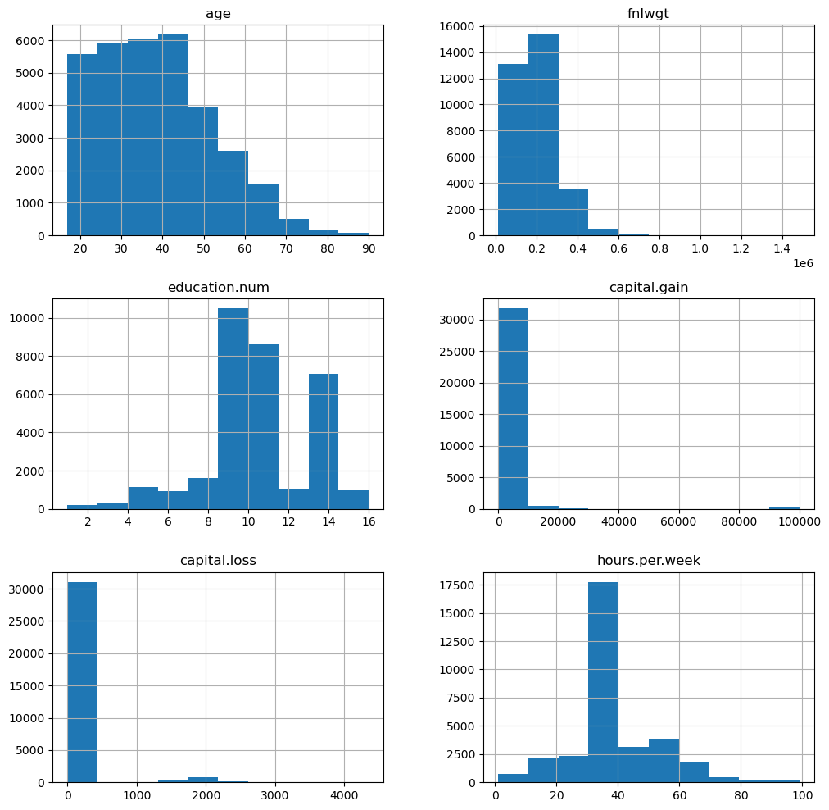
HISTOGRAMS FOR NUMERICAL COLUMNS
AGE: In our dataset People from age group of 18 to 50 can be observed.
HOURS PER WEEK: Generally, people can be seen working for 30 hours to 40 hours per week.
EDUCATION: people above 8th grade are more in our dataset.
Our dataset is highly skewed and we should consider scaling it for better performance of our models.

Slide 7
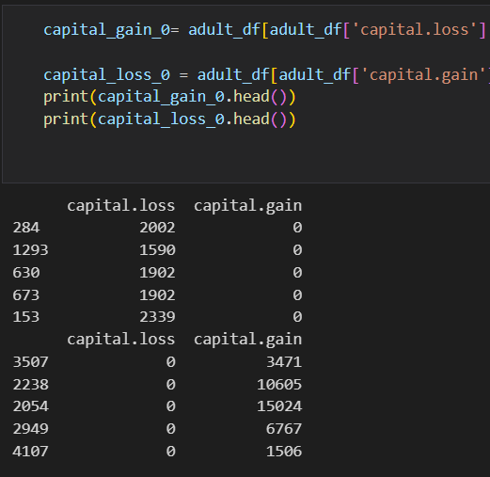
EXPLORING INDIVIDUALS WITH CAPITAL LOSS AND CAPITAL GAIN GREATER THAN ZERO
According to the data, it appears that 92% of individuals did not experience any capital gain.
Possibilities for capital gain and capital loss
Both capital gain and capital loss can be zero
If the capital gain is zero, there is the possibility of capital loss being high or above zero.
If a capital loss is zero, capital gain can be high or above zero.

Slide 8
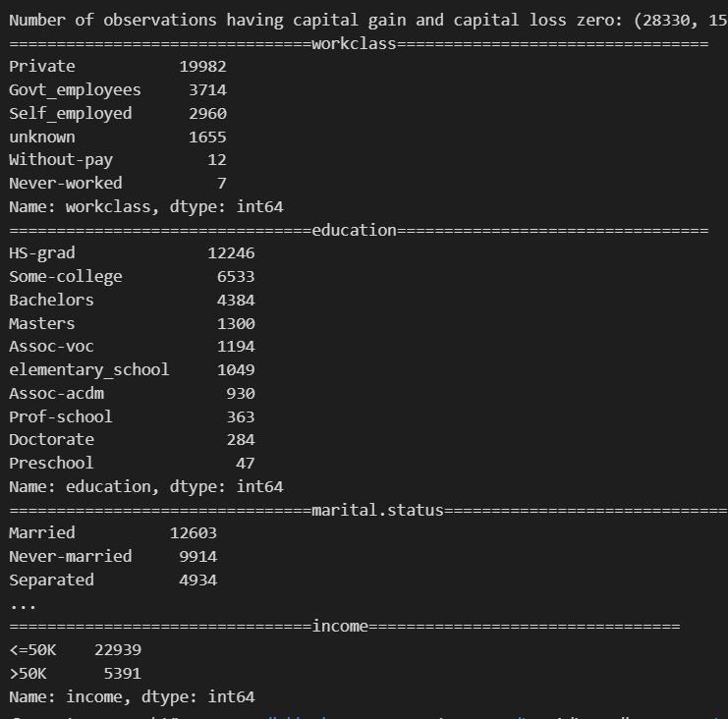
CONT’D
According to our dataset, 88% of individuals have reported a capital gain and loss of zero.
Based on our analysis, we have found that capital gain and capital loss exhibit a significant degree of skewness and contain outliers that require attention.
Workclass contains unknown values.

Slide 9
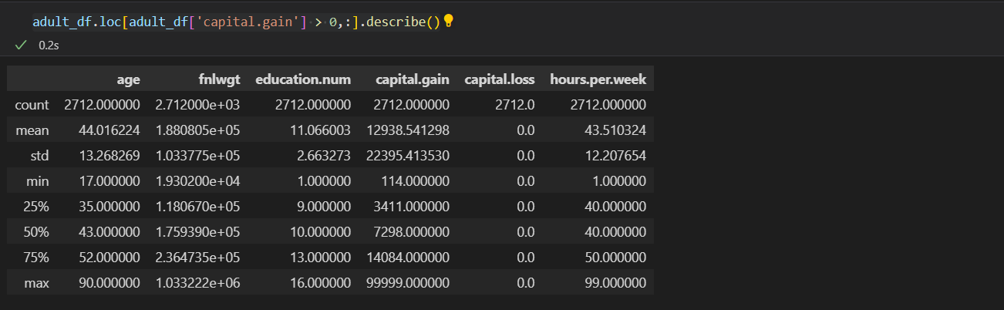
ANALYZING CAPITAL GAIN EXCLUDING ZERO VALUES
Maximum value of capital gain is 99999, which is far above the 75% quartile range. This is an outlier. Let’s try and understand more about this maximum value of 99999.

Slide 10
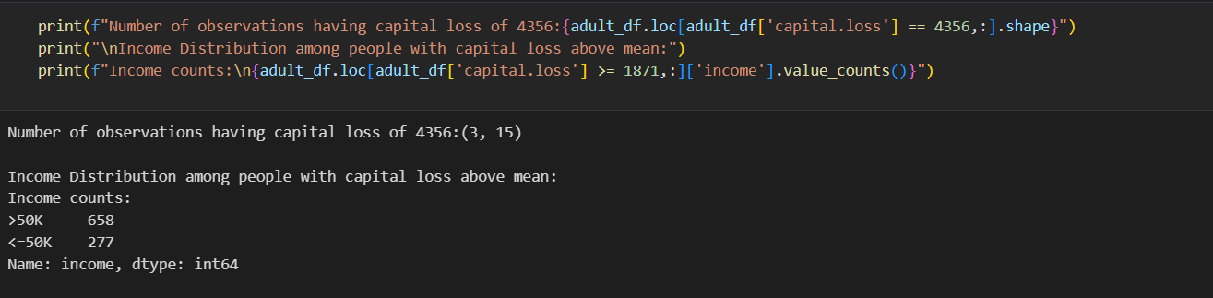
People with Income above 50K have capital loss above mean value.
It shows there are some other parameters affecting their loss irrespective of high salary.

Slide 11
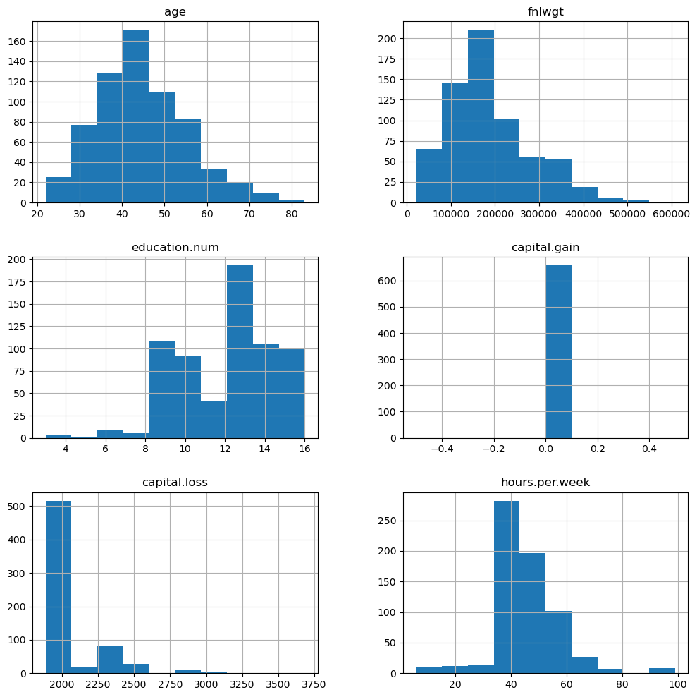
CHARACTERISTICS OF INDIVIDUALS WITH CAPITAL LOSS GREATER THAN MEAN AND INCOME > 50K
Education and hours per week are significantly high.

Slide 12
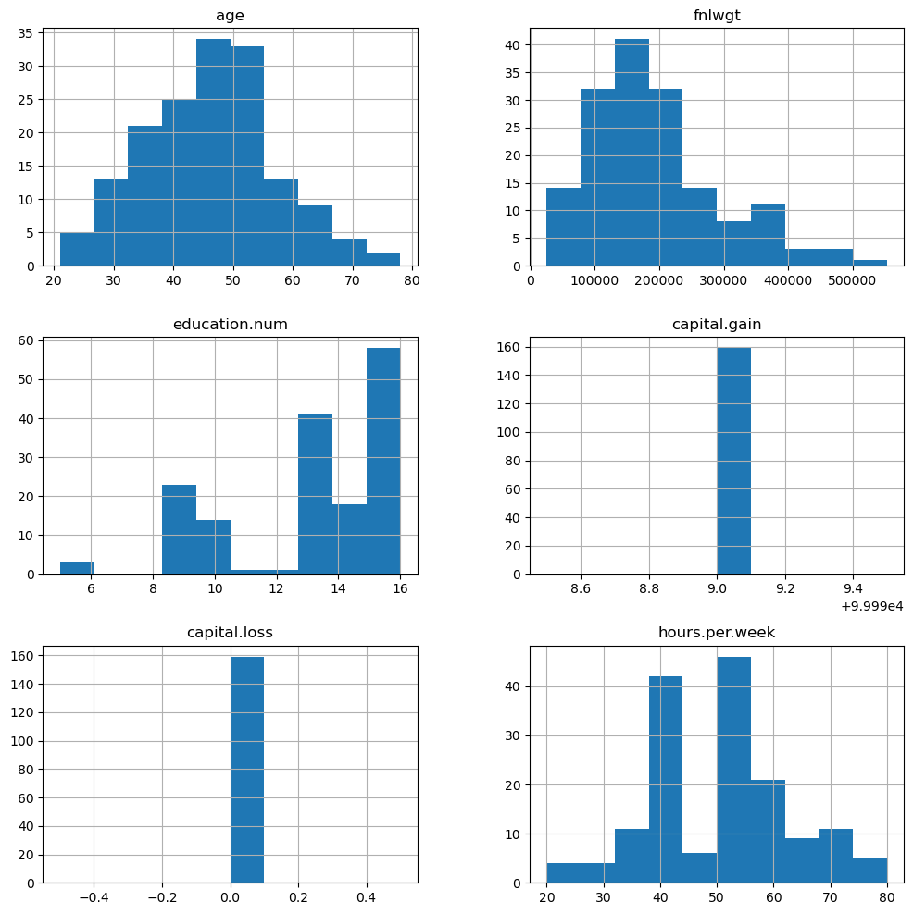
Age group and hours per week are distributed for a capital gain of 99999.

Slide 13
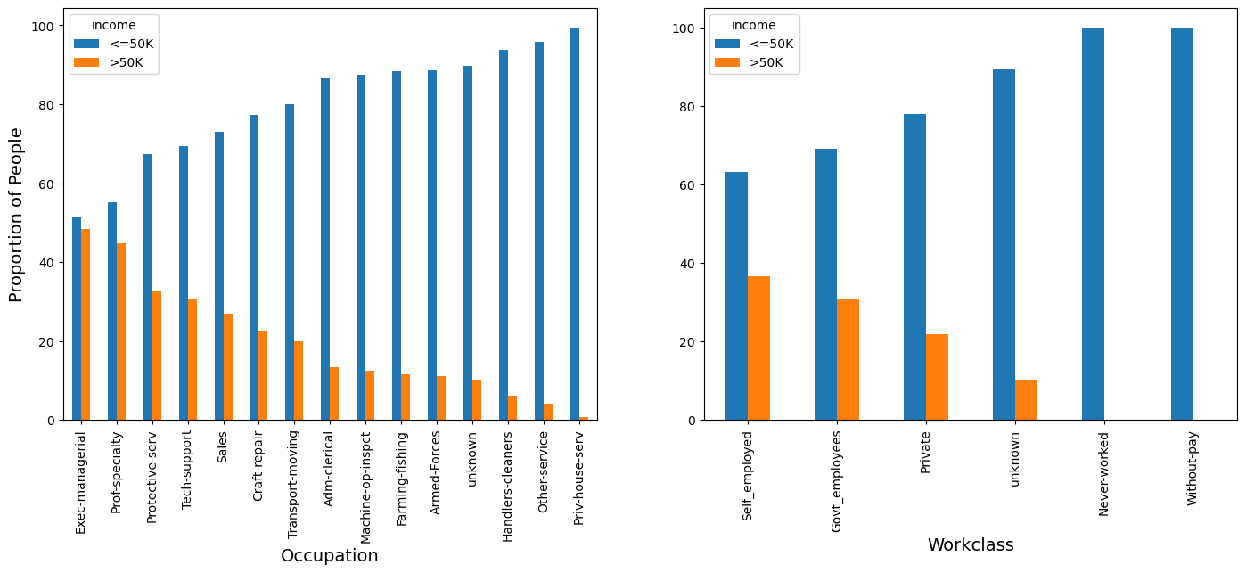
PROPORTION OF INCOME BY OCCUPATION AND WORKCLASS

Slide 14
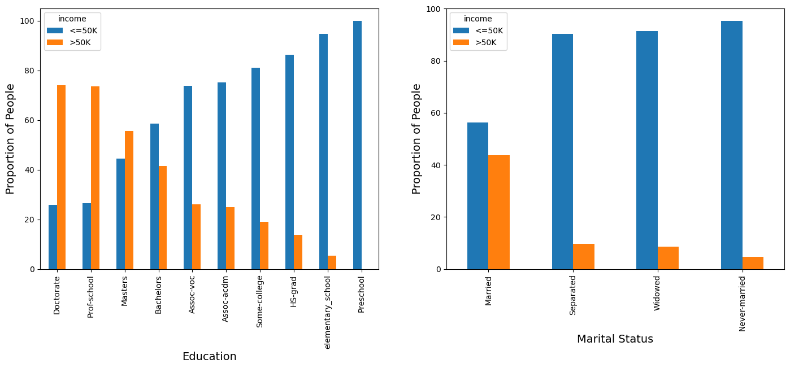
PROPORTION OF INCOME BY EDUCATION AND MARITAL STATUS

Slide 15
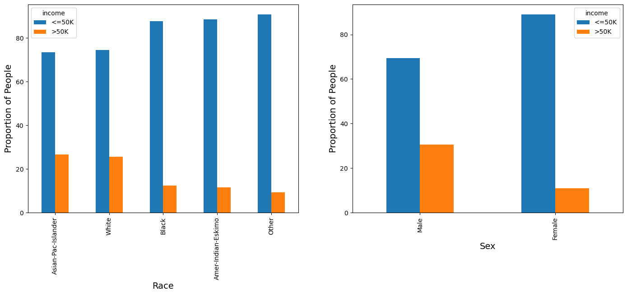
PROPORTION OF INCOME BY RACE AND SEX

Slide 16
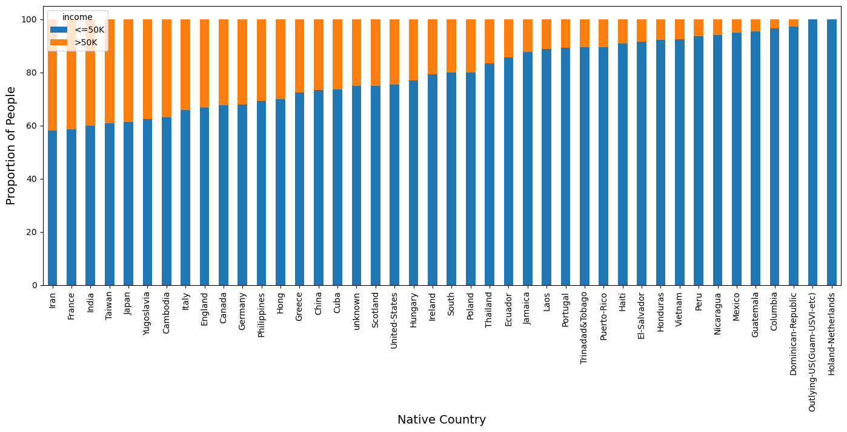
PROPORTION OF PEOPLE WITH INCOME LEVELS BY NATIVE COUNTRY

Slide 17
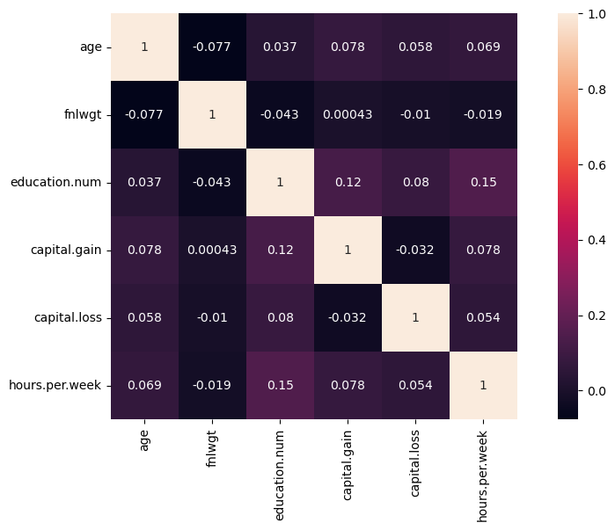
CORRELATION BETWEEN NUMERICAL FETATURES
strong correlation.
Age and Hours per week
capital gain and hours per week
Moderate Correlation
capital loss and age

Slide 18
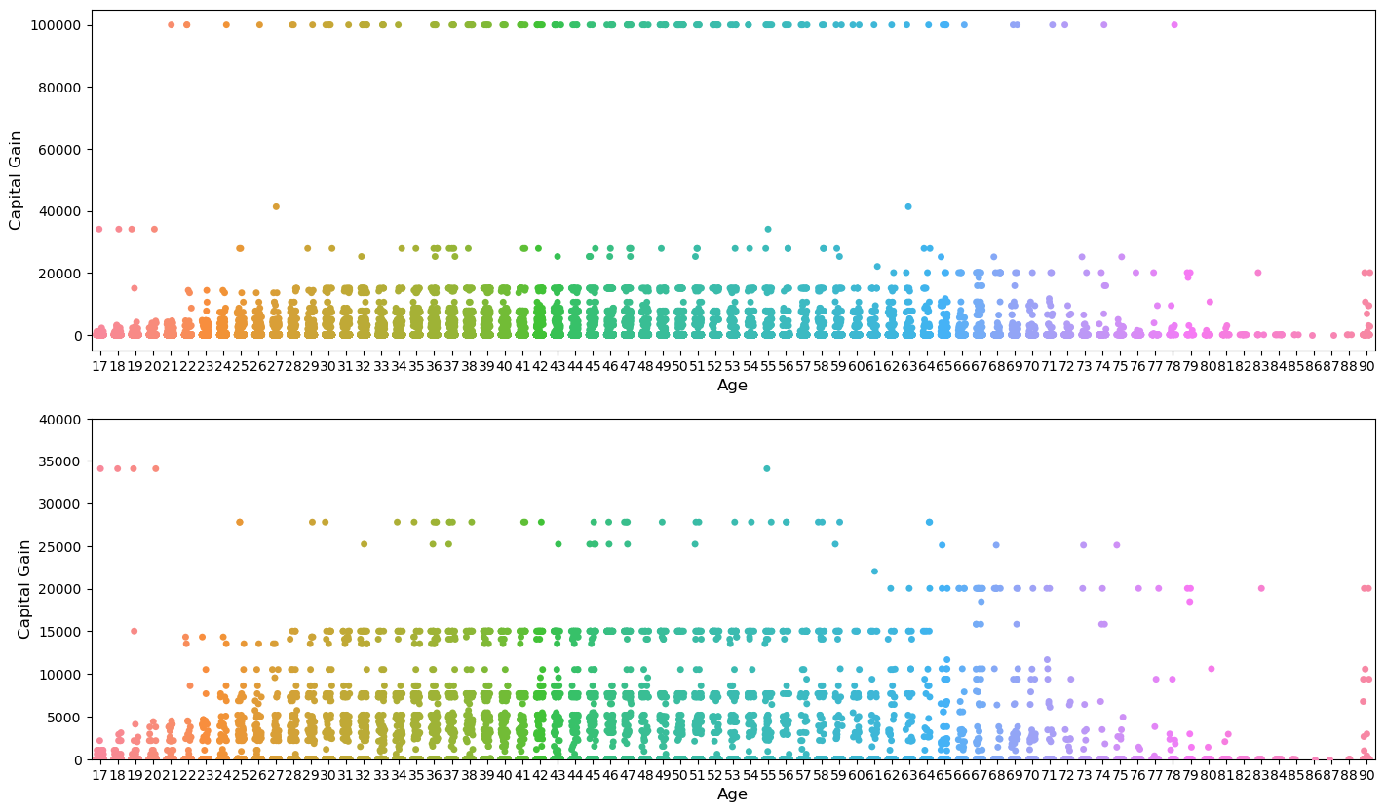
RELATIONSHIP BETWEEN AGE AND CAPITAL GAIN IN THE ADULT DATASET
Between ages 28 and 64, capital gain is upto 15000 and after that, it decreases and again increments at age 90
Age 90 doesn't follow the pattern.
Capital.gain of 99999 is clearly an outlier let's remove it.

Slide 19
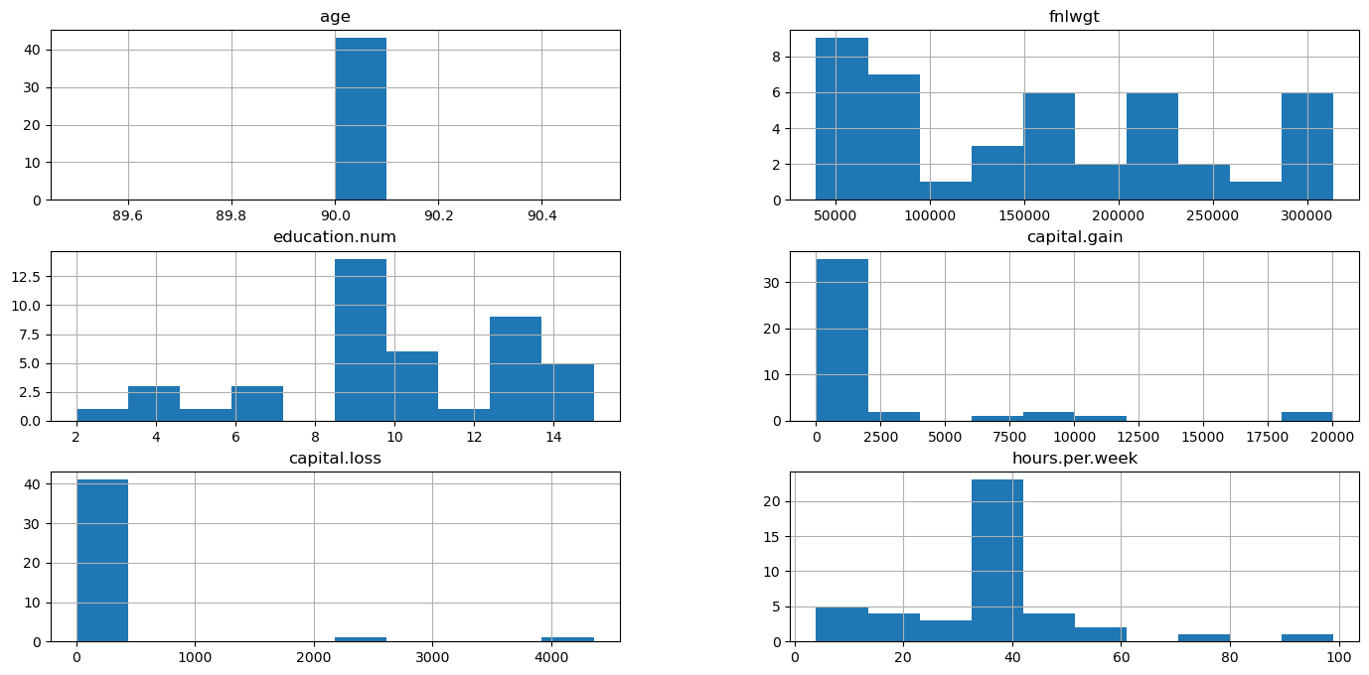
DISTRIBUTION OF VARIABLES FOR INDIVIDUALS AGED 90 IN THE ADULT DATASET

Slide 20
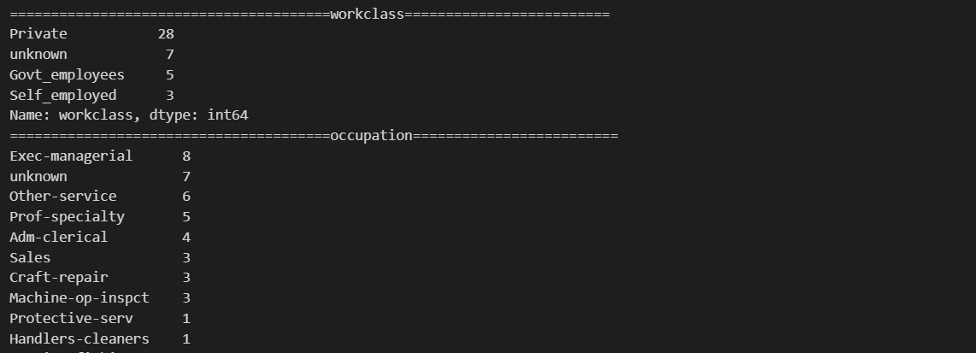
Categorical Variables Analysis for Individuals Aged 90 in the Adult Dataset
At age 90 people can't work in the government or private sectors
Moreover, it shows the peak working hours as 40.

Slide 21
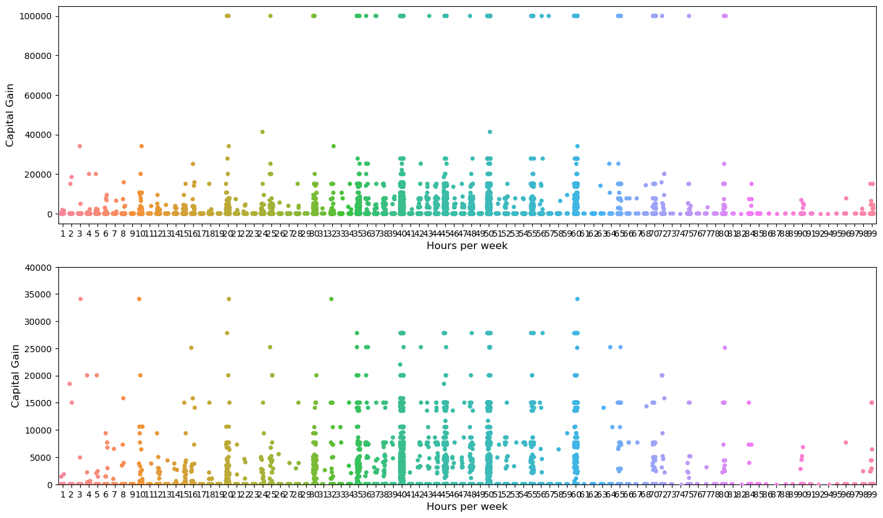
RELATIONSHIP BETWEEN HOURS PER WEEK AND CAPITAL GAIN IN THE ADULT DATASET
Majority of people can be seen working for 40,50 and 60 hours per week and capital gain seems to be increasing.
There are few people working for 99 hours per week but don’t seem to make a high capital gain. Conversely, people working below 40 hours per week are making high capital gains.

Slide 22
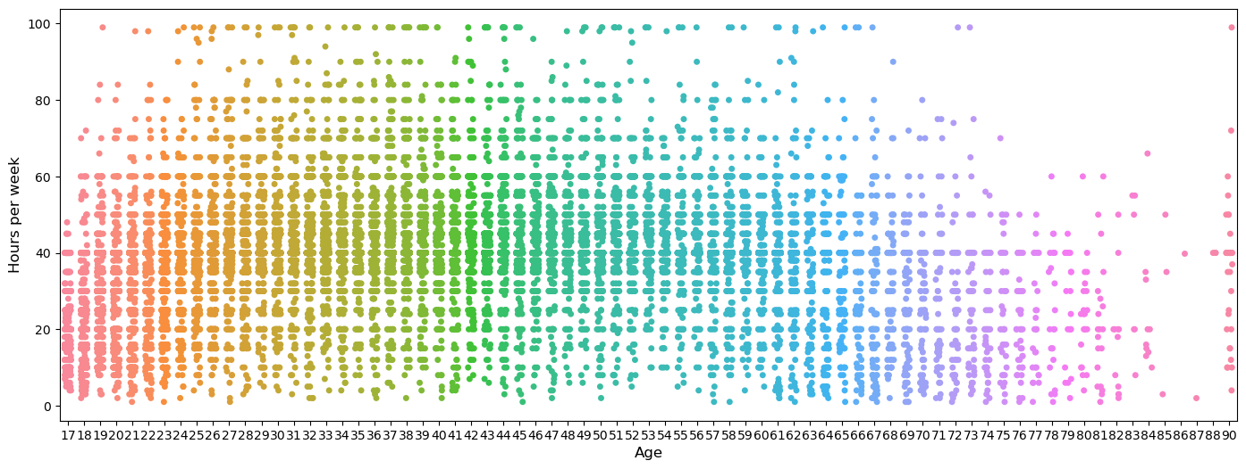
RELATIONSHIP BETWEEN AGE AND HOURS WORKED PER WEEK IN THE ADULT DATASET

