Slide 1

Boston Rentals
ALY6015: Intermediate Analysis
Group 4
Shubham Nilesh Palande
Venkata Naga Sai Neeharika
Swetha Lakshmana Perumal
Sindhu Sundararajan
February 15, 2023

Slide 2
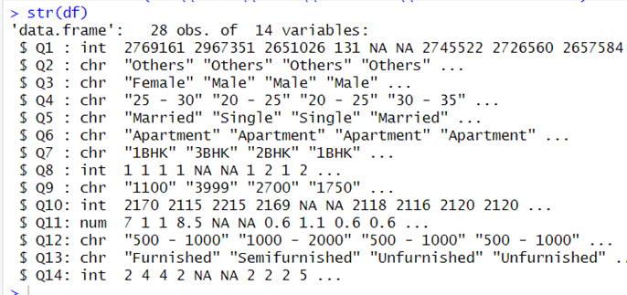
Introduction
The dataset used is a survey conducted based on the housing rentals in Boston for Northeastern University students.
The dataset contains 28 observations with 14 attributes.
The atrributes are of NUID, House_Location, Gender, Age, Marital_Status, Apartment_Type, No_of_Bedrooms, No_of_Bathrooms, Rent, Zipcode, Distance_from_University, House_Sqft, Furnished_Type, and No_of_Tenants.

Slide 3
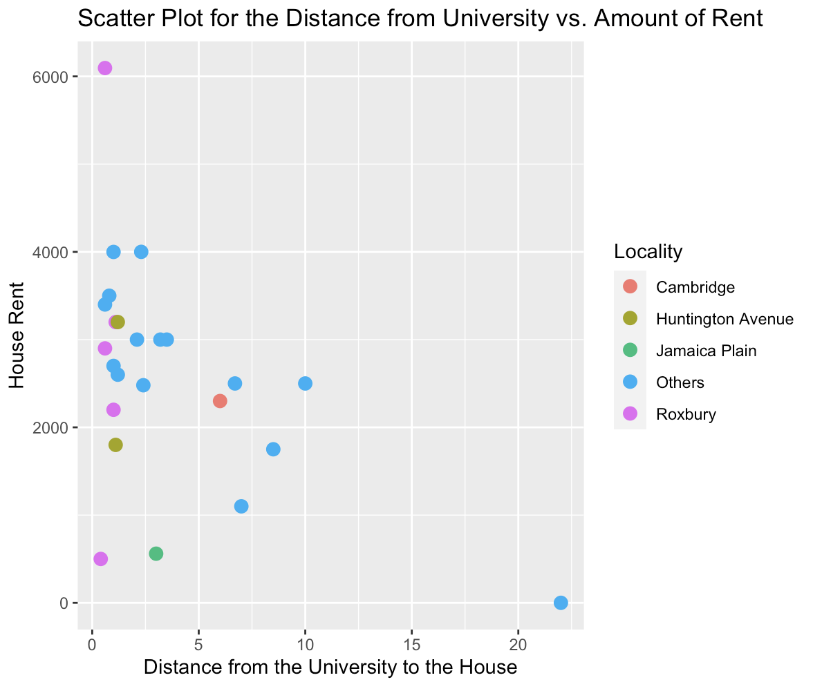
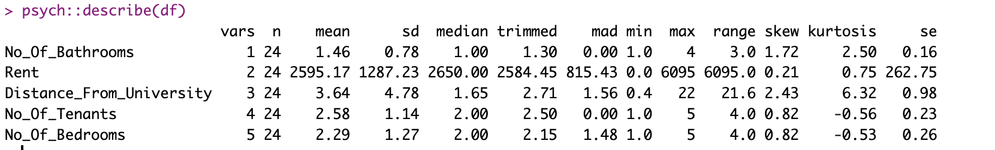
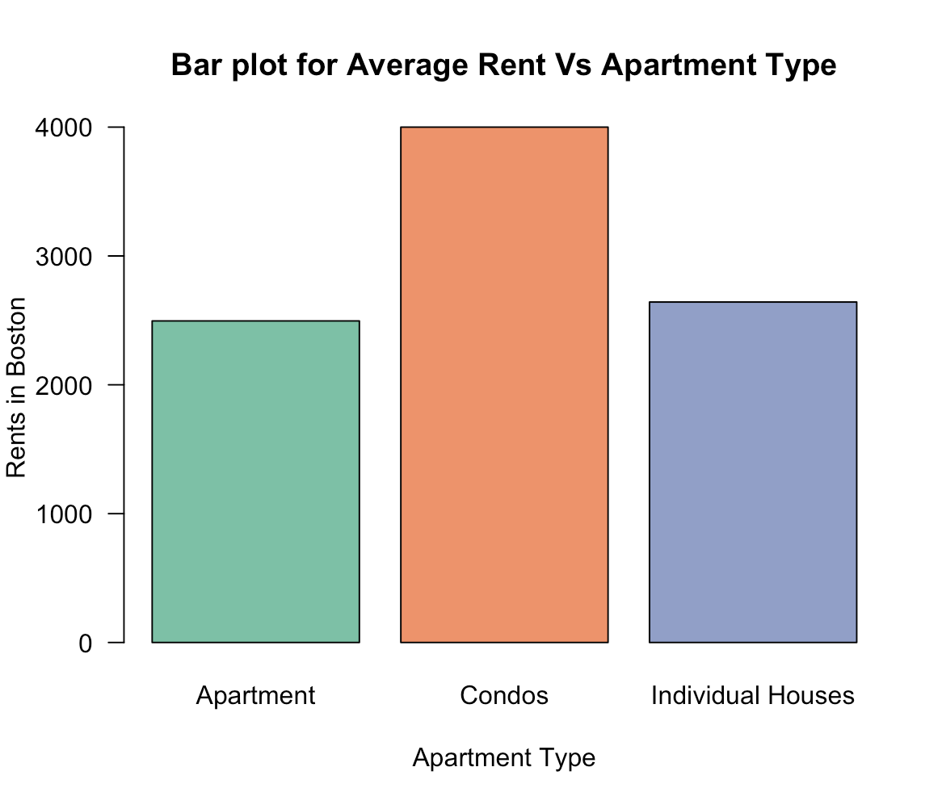
Descriptive Analysis

Slide 4
Business Questions
Do the people who live close to the university pay higher or lower rent than those who lives farther away by comparing the two groups of people?
Is the apartment or individual housing expensive to rent when there are the same number of bedrooms?
Is the number of tenants directly proportional to the average rent?
Is the rent for a fully furnished house expensive?

Slide 5
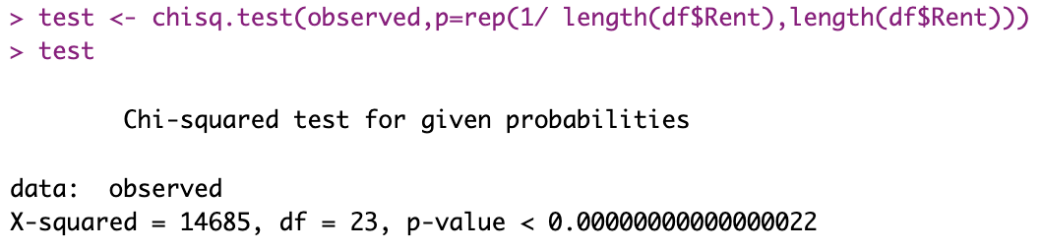
Chi-Square Test for Rents in Boston
Null Hypothesis: The rent of all areas in Boston is the same.
Alternative Hypothesis: The rent of all areas in Boston is not the same
Conclusion: As the p-value is less than 0.05, the null hypothesis can be rejected and can be concluded that rents across all over Boston is not the same.

Slide 6
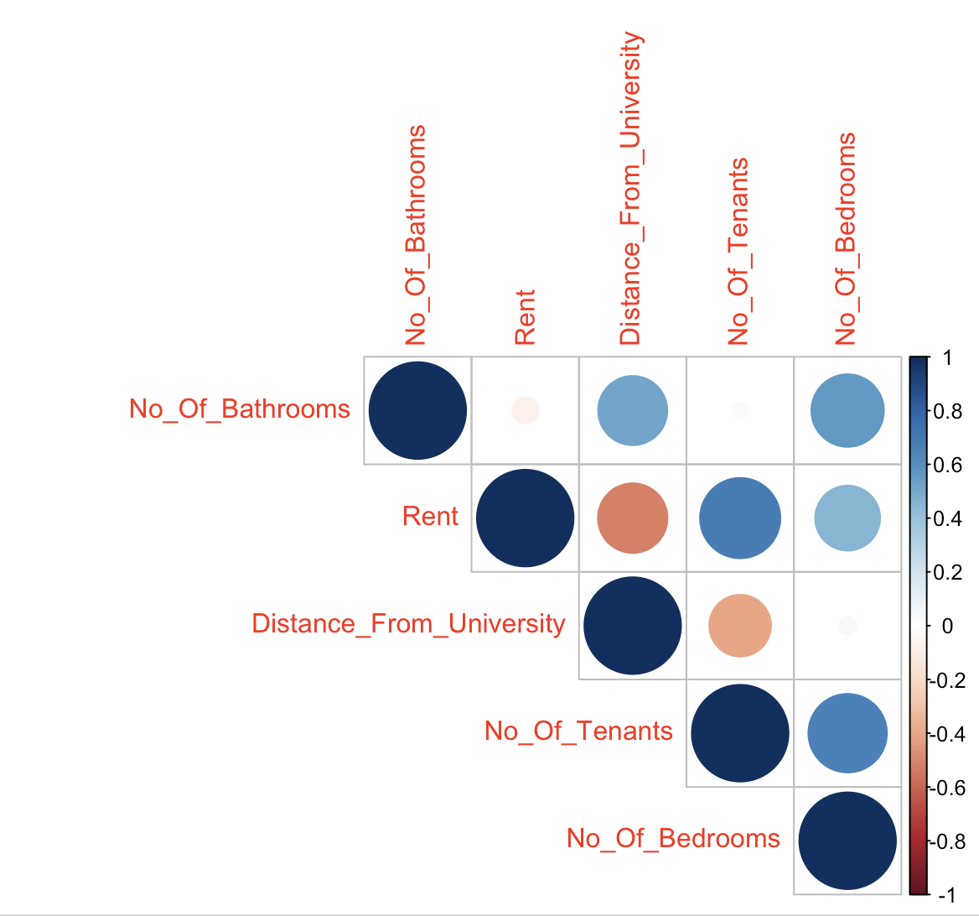
Correlation For Numerical Attributes
The highest positive correlation can be observed in our target variable “Rent” and “Number of Tenants” which is around 0.689
The highest negative correlation can be observed between ”Rent” and “Distance From University” which is around -0.518

Slide 7
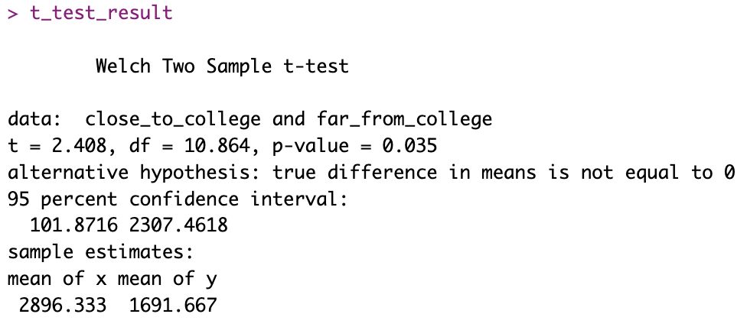
Question 1: Do the people who live close to the university pay higher or lower rent than those who lives farther away by comparing the two groups of people?
Null Hypothesis: The mean differences of rent for houses closer to college is same as the houses far from the college
Alternative Hypothesis: The mean differences of rent for houses closer to college is not same as the houses far from the college
Conclusion: The p-value of 0.035 is less than the alpha value of 0.05, hence rejecting the null hypothesis. It can be concluded that, the mean differences of rent for houses closer to college is more than, that of the houses far from the college

Slide 8
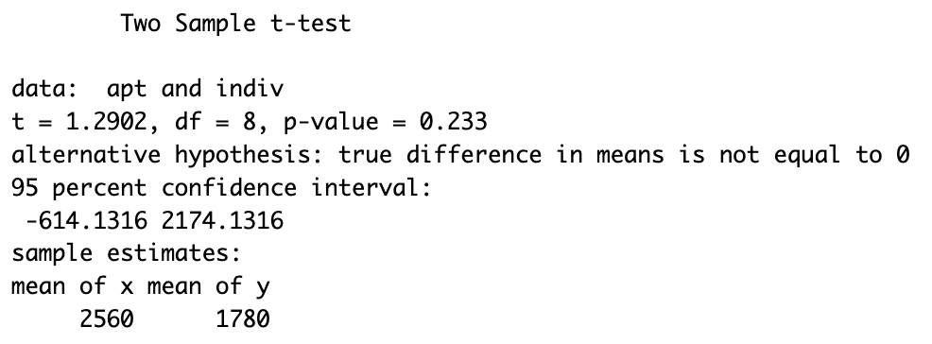
Question 2: Is the apartment or individual housing expensive to rent when there are the same number of bedrooms?
Null Hypothesis: The rent for the apartment is same as that of individual houses for 2BHKs
Alternative Hypothesis: The rent for the apartment is different as that of individual houses for 2BHKs
As p-value of 0.233 is greater than 0.05, we can conclude that we are failed to reject the null hypothesis, and the rent of apartment is equally expensive as of the individual houses.

Slide 9
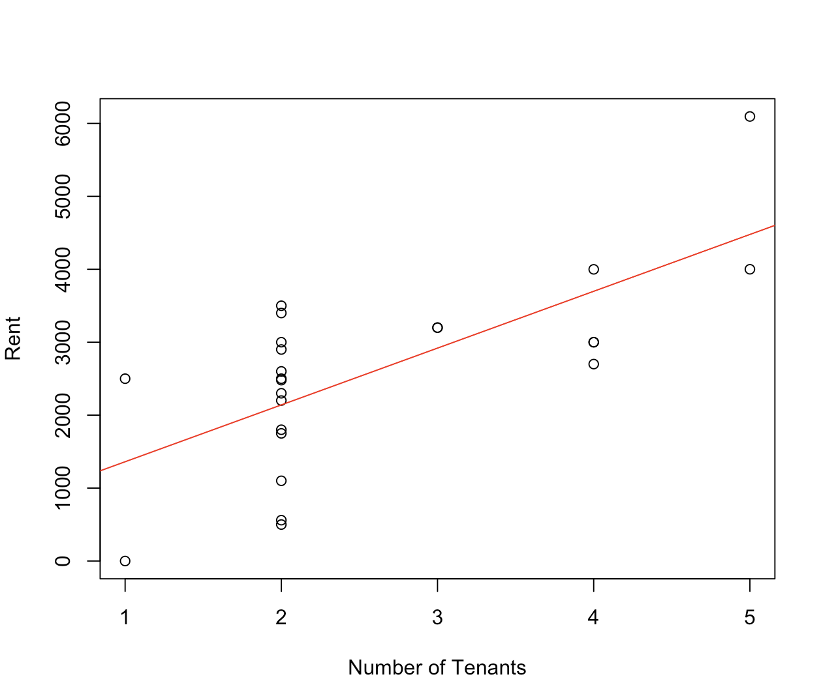
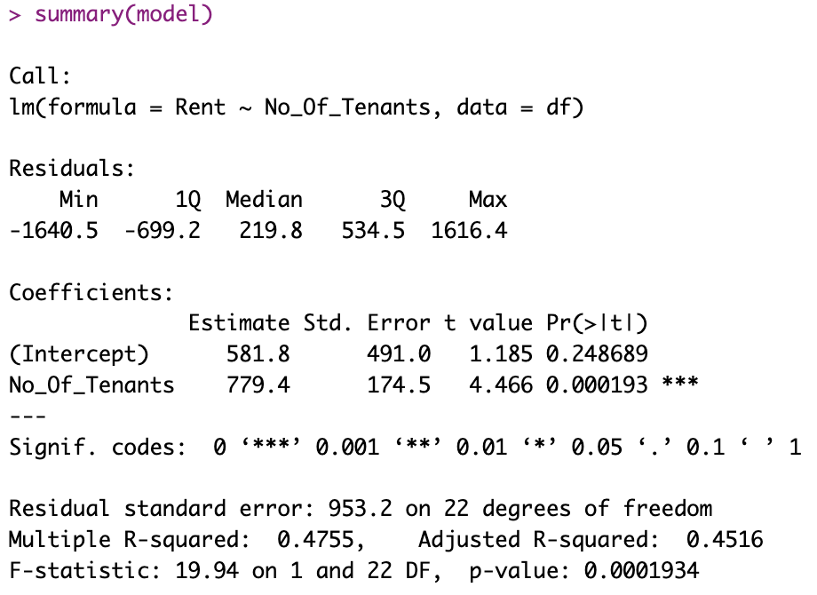
Question 3: Is the number of tenants directly proportional to the average rent?
There is a relation between the rent and number of tenants, as the slope of the graph is positive, it can be concluded that as the number of tenants are more, the rent is increasing.

Slide 10
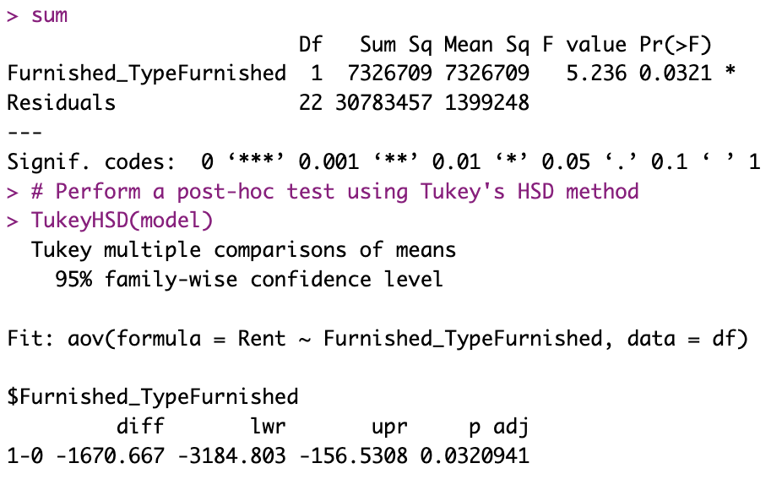
Question 4: Does the rent change with respect to the furnishing type?
Null Hypothesis: The variances of rents for furnished, semi furnished and fully furnished houses are same
Alternative Hypothesis: The variances of rents for furnished, semi furnished and fully furnished houses are different
From this, we can conclude that rent are varying when compared to furnished, semi furnished and fully furnished houses

Slide 11
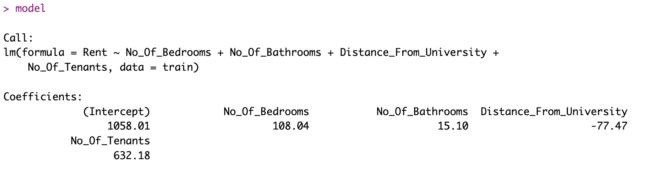
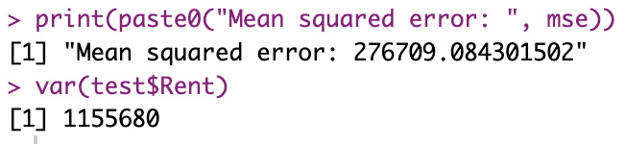
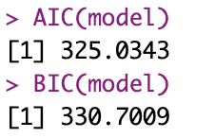
Linear Regression Model and Predictions
Rent = 1058.01 + (108.04 * No_Of_Bedrooms) + (15.10 * No_Of_Bathrooms) - (77.47 * Distance_From_University) + (632.18 * No_Of_Tenants)
Based on AIC, BIC values, MSE values which is less than variance of the outcome variable, for which it can concluded that the model is a good fit

Slide 12

Conclusion
The rent for the houses closer to the university are higher as compared to that of houses far from the university.
The rent of apartment is equally expensive as of the individual houses across Boston in 2BHK.
The rent is increasing for the increasing number of tenants.
The rents are varying when compared to any furnishment level starting from furnished to fully furnished.

Slide 13
References
Bevans, R. (2020, February 25). Linear Regression in R | A Step-by-Step Guide & Examples. In Scribbr. https://www.scribbr.com/statistics/linear-regression-in-r/
R Handbook: Hypothesis Testing and p-values. (n.d.). In R Handbook: Hypothesis Testing and p-values. https://rcompanion.org/handbook/D_01.html
Kabacoff, R. (2015, June 4). R in Action.
How to do a t-test or ANOVA for more than one variable at once in R? (2020, March 19). How to Do a T-test or ANOVA for More Than One Variable at Once in R? - Stats and R. https://statsandr.com/blog/how-to-do-a-t-test-or-anova-for-many-variables-at-once-in-r-and-communicate-the-results-in-a-better-way/

Slide 14
Thank You!

