Slide 1
Residential Apartments:
An Analytical Investigation
Reha Patel, Niraj Prasad, Sindhu Swaroop

Slide 2
Data Wrangling Summary
Key columns: price, square feet, address, presence of specific features.
Discovered some apartments were listed multiple times with different prices.
Changed column types.
Created a new column for view of a sunrise/sunset.
Used the zip code in the address to created a longitude and latitude column.
Corrected misspelled column name.
Checked for NA values.

Slide 3
Business Questions
Questions that may be relevant for property owners and renters.

Slide 4
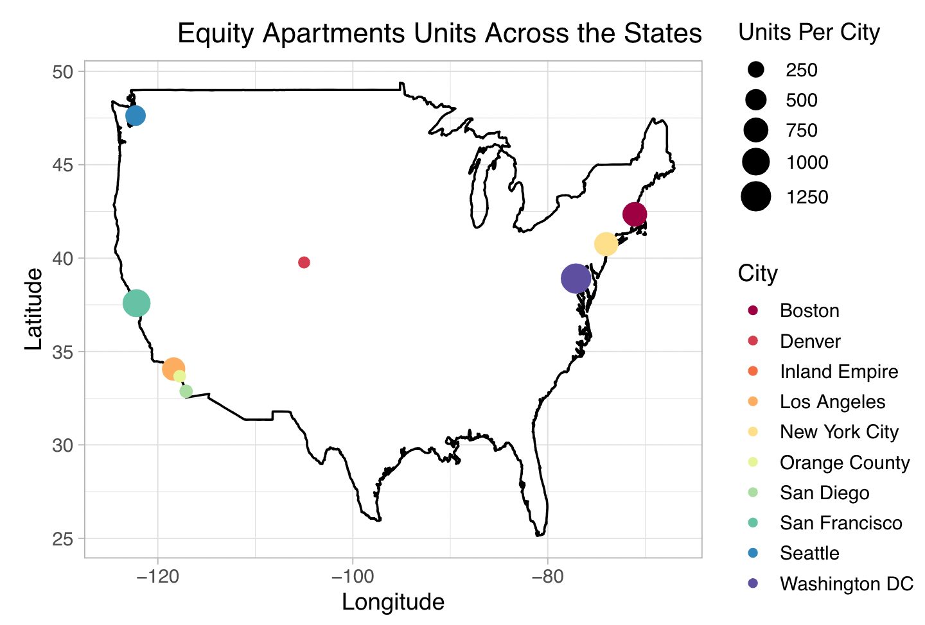
Business Question 1
Equity Apartments has properties in multiple cities throughout the United States. Plot the number of apartments by city to determine where the most apartments are located. Plotting on a US map will help renters visualize where in the country their options are if they would like to rent from Equity Apartments.

Slide 5
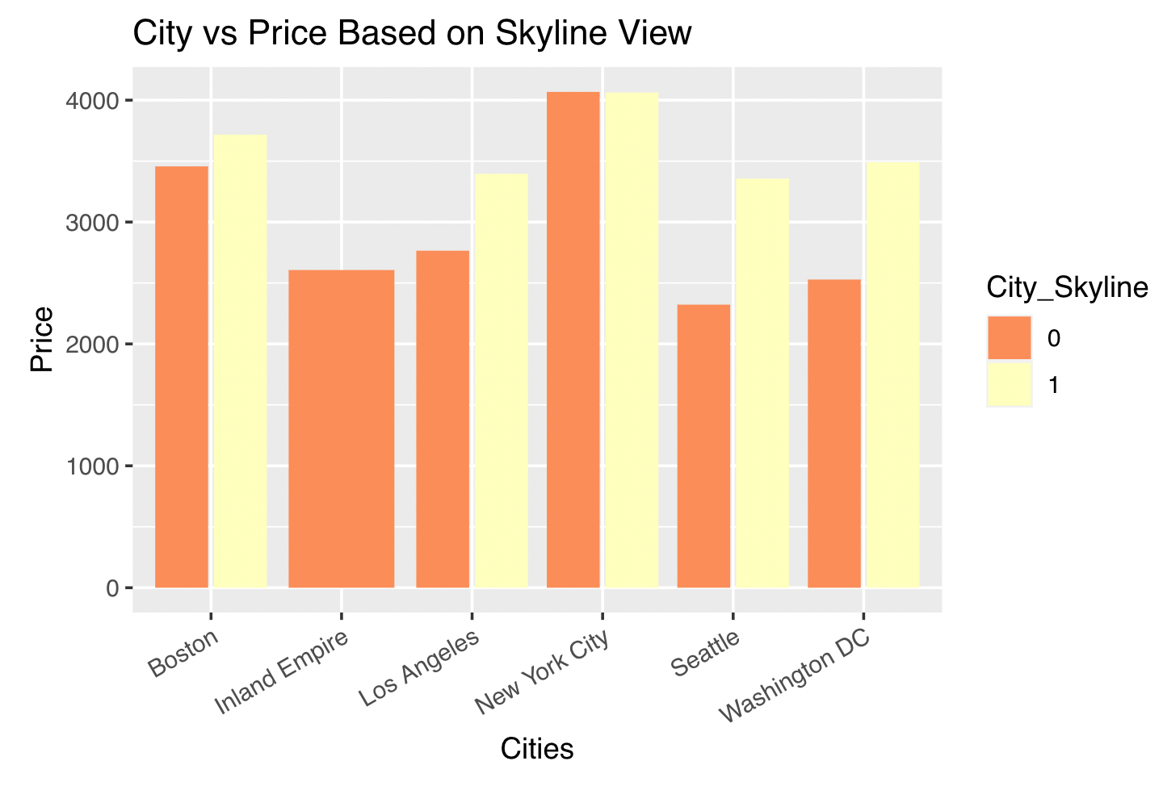
Business Question 2
Does having a city skyline view impact the price of the apartment? If it does, property owners will be able to charge a greater amount of rent for apartments with a skyline view.

Slide 6
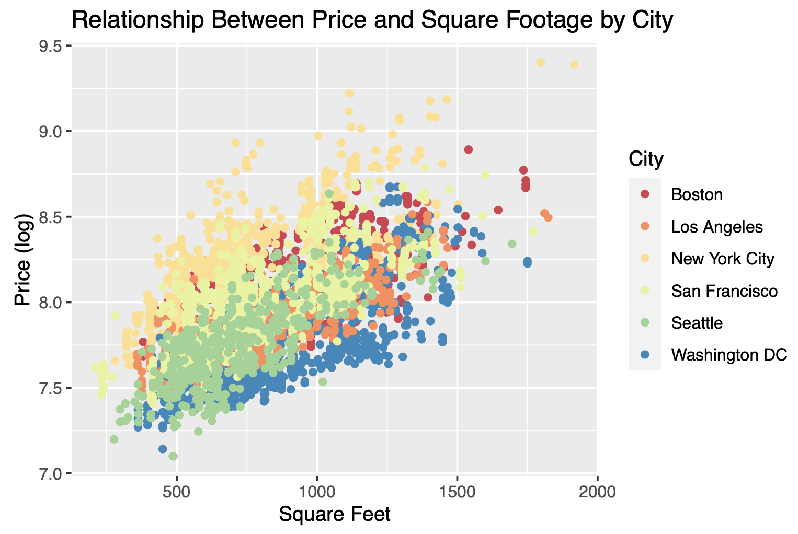
Business Question 3
What is the relationship between the square footage of an apartment and the price of it? In different cities, the price per square foot can vary greatly. Landlords and property owners should be aware of the relationship between price of the apartment and the total square footage so they can charge rent accordingly.

Slide 7
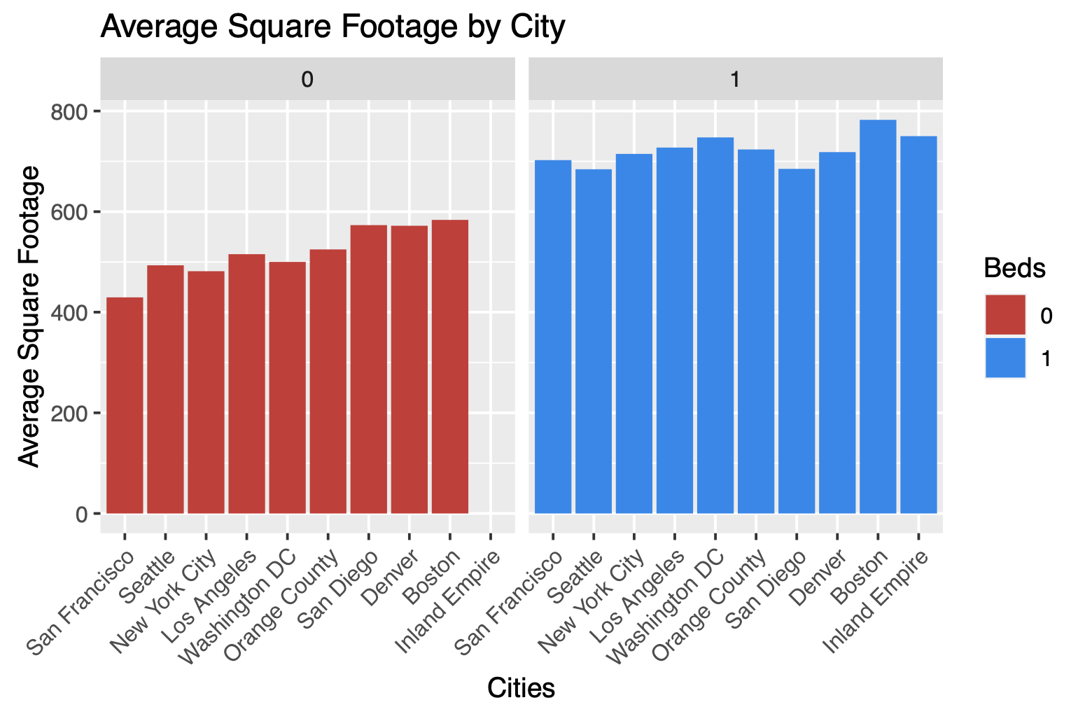
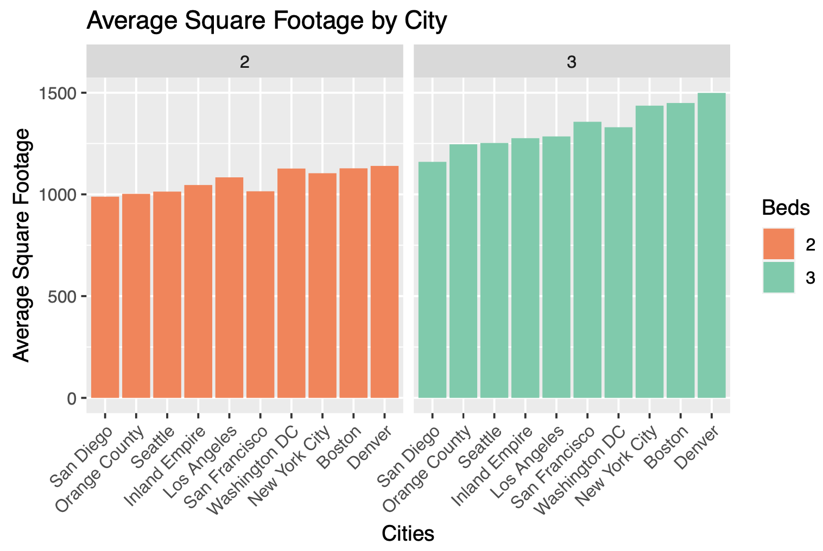
Business Question 4
Which cities have apartments with higher square footage? Renters may want to live in cities with specific square footages so it is important for them to be aware of where they will find the right sized apartment.

Slide 8
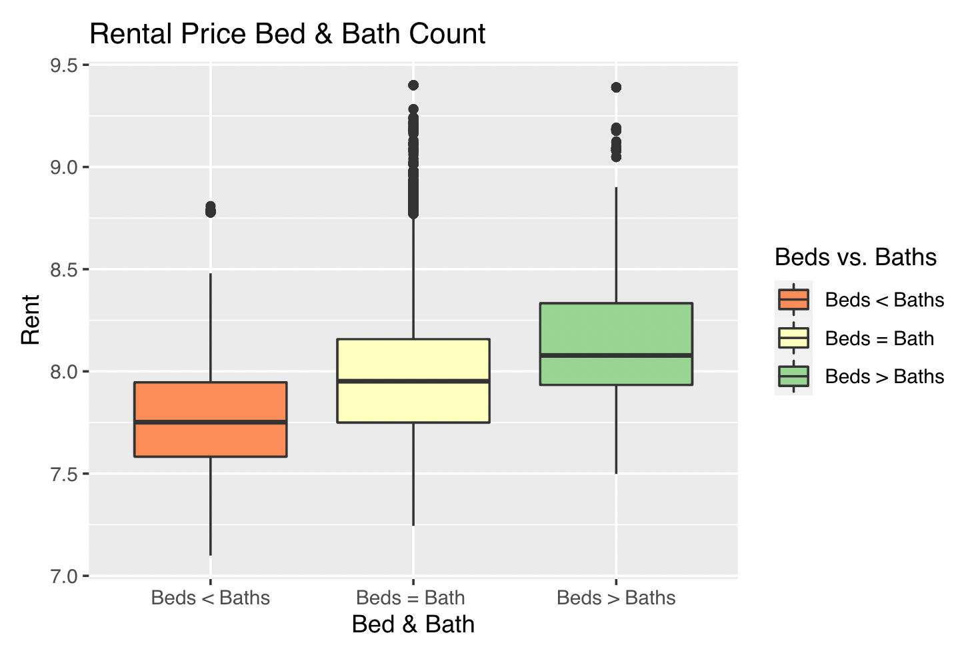
Business Question 5
An apartment having a private bathroom means it has the same number of bedrooms and bathrooms. While many apartment have the same number of bathrooms as bedrooms, some have a greater number of bathrooms or bedrooms. So, does an apartment having a private bathroom make it more expensive than an apartment without one?

Slide 9
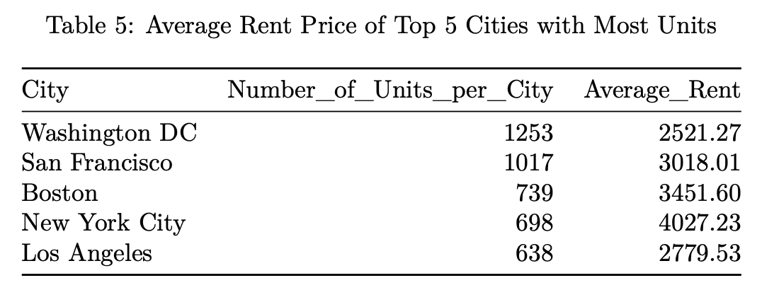
Business Question 6
For each of the top 5 cities with the most units in the dataset, what is the average rent price? For new renters trying to lease with Equity Apartments, they should know the cities in which they will have the most options within their price range.

Slide 10
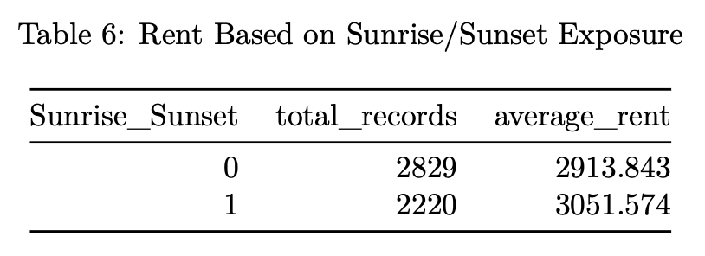
Business Question 7
Often times, having a good view can impact the price a tenant will pay for an apartment leading landlords and property owners to make more per month off a listing. Depending on if an apartment has eastern (sunrise) or western (sunset) exposure, does Equity Apartments see a difference in average rent price?

Slide 11
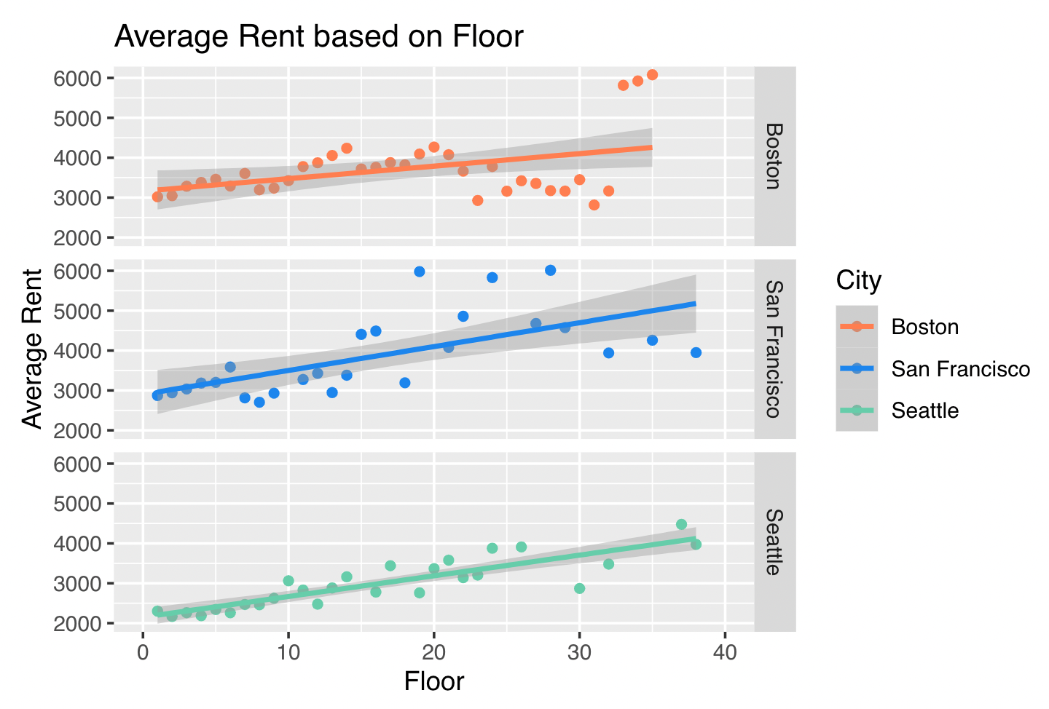
Business Question 8
Sometimes having an apartment on a higher floor can mean having a better view, or other times the units on the highest floors are even considered penthouse suites. What relationship does the floor an apartment is on have on the price of the apartment?

Slide 12
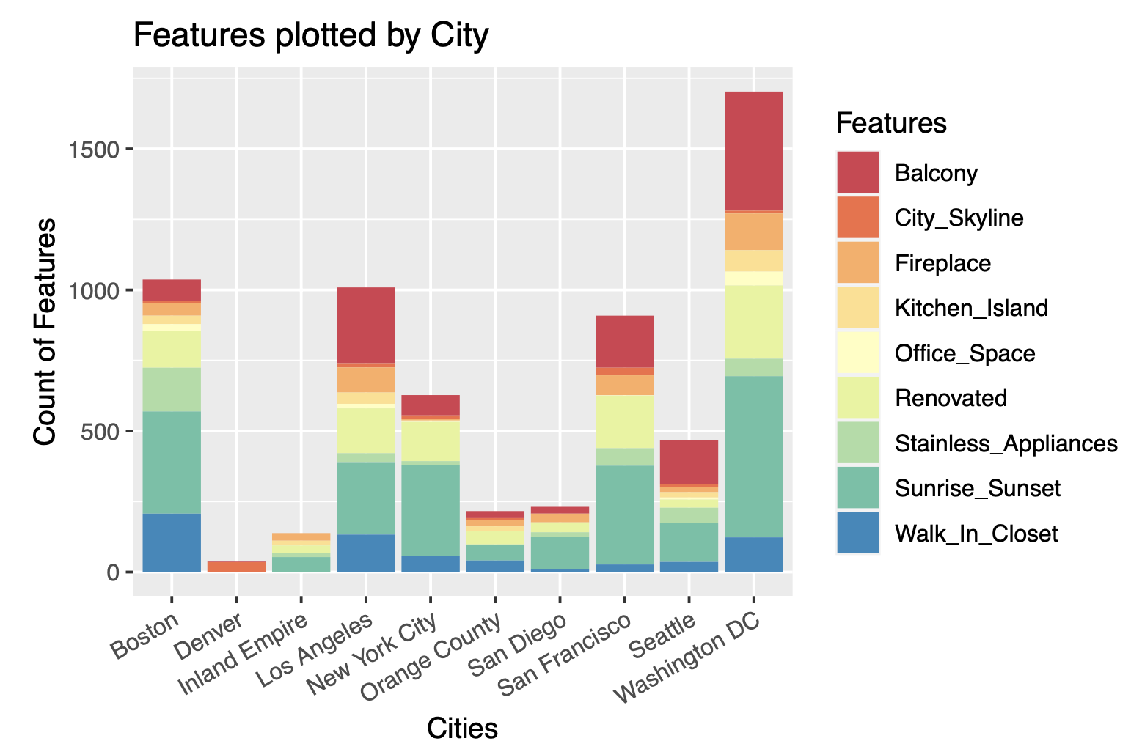
Business Question 9
What specific apartment features does each city offer as a whole? Knowing which features are most common in specific cities can help renters get an idea of what features their potential apartments may have.

Slide 13
Key Insights & Takeaways
Equity Residential is primarily on the West Coast.
New York City tends to have the highest rent and Washington DC tends to have the lowest rent among the major cities.
New York City does not have nearly as many features as Washington DC or Boston.
For studios and 1 bedroom apartments, Boston has the largest sized units.
Apartments facing East or West tend to be more expensive than those facing North or South.
Rent tends to increase on higher floors.

Slide 14

Thanks!
Any questions?

