Slide 1
Learning in the Limit
Gold’s Theorem

Slide 2
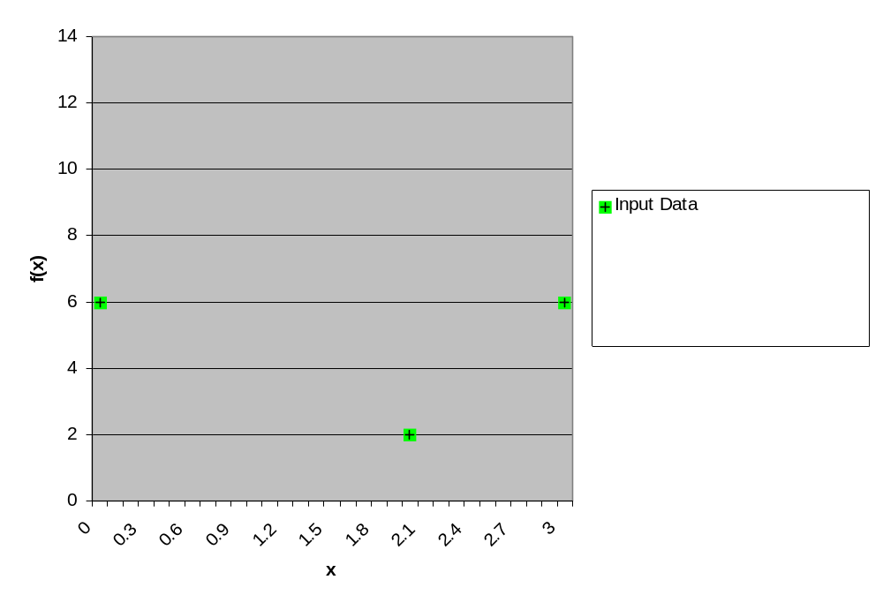
Observe some values of a function

Slide 3
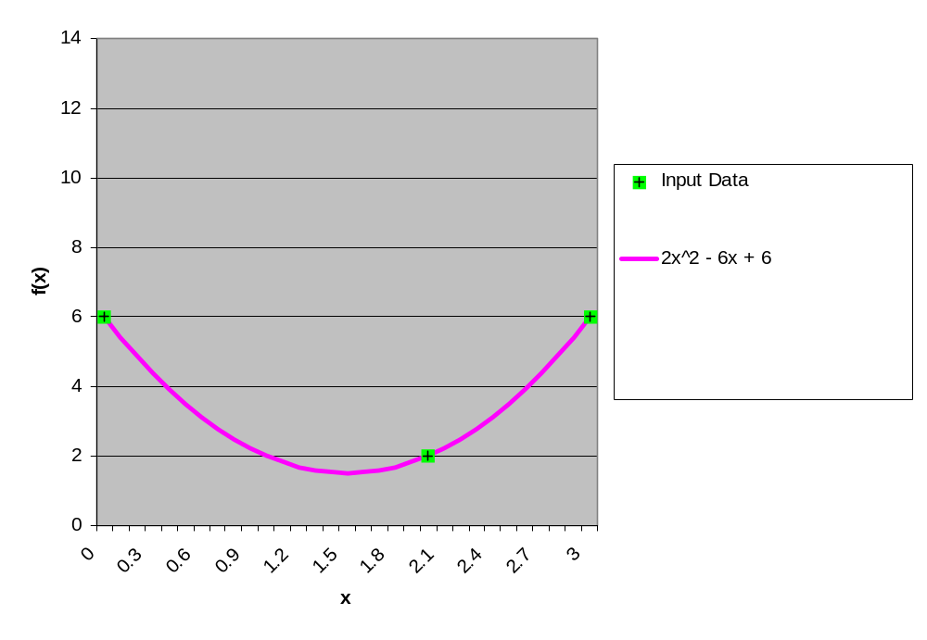
Guess the whole function

Slide 4
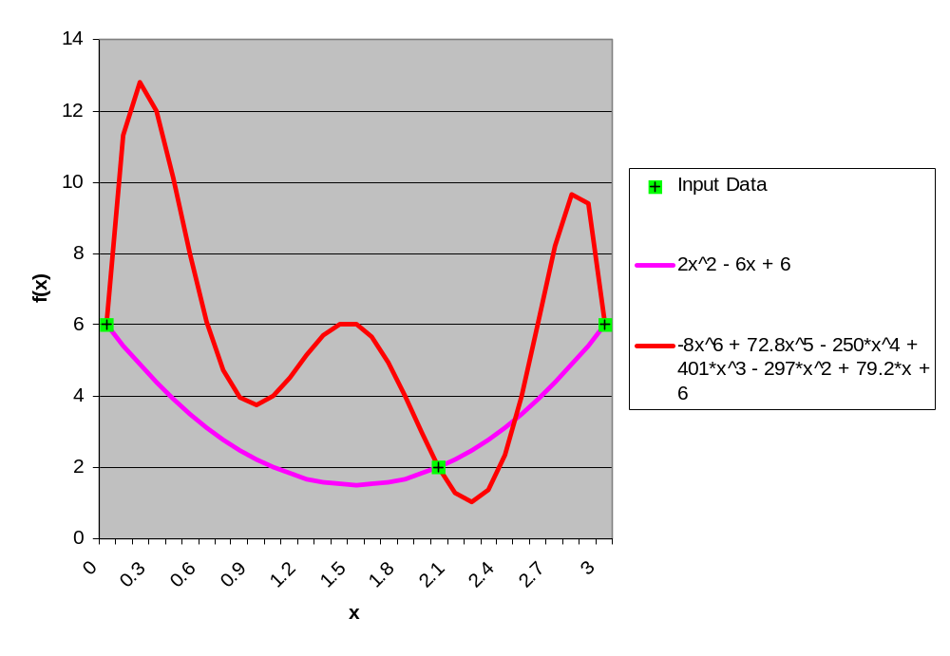
Another guess: Just as good?

Slide 5
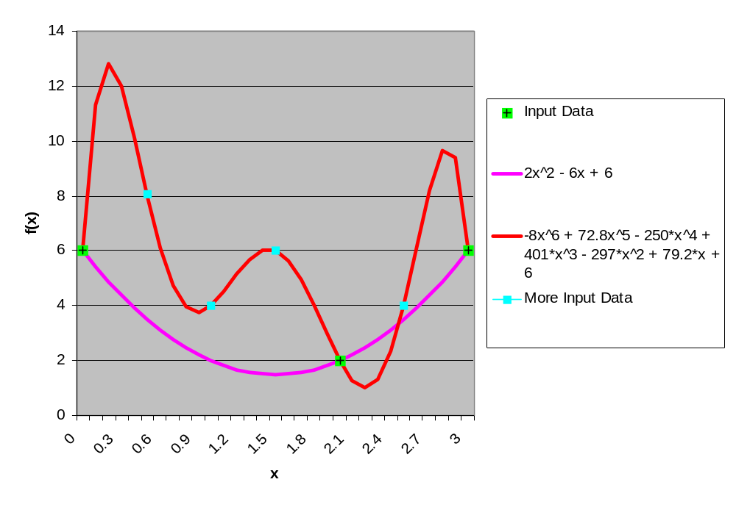
More data needed to decide

Slide 6
Poverty of the Stimulus
Never enough input data to completely determine the polynomial …
  Always have infinitely many possibilities
… unless you know the order of the polynomial ahead of time.
  2 points determine a line
  3 points determine a quadratic
  etc.
In language learning, is it enough to know that the target language is generated by a CFG?
  without knowing the size of the CFG?

Slide 7
Language learning:
What kind of evidence?
Children listen to language [unsupervised]
Children are corrected?? [supervised]
Children observe language in context
Children observe frequencies of language
Remember: Language = set of strings

Slide 8
Poverty of the Stimulus (1957)
Chomsky: Just like polynomials: never enough data unless you know something in advance. So kids must be born knowing what to expect in language.
Children listen to language
Children are corrected??
Children observe language in context
Children observe frequencies of language

Slide 9
Gold’s Theorem (1967)
a simple negative result along these lines:
kids (or computers) can’t learn much
without supervision, inborn knowledge, or statistics
Children listen to language
Children are corrected??
Children observe language in context
Children observe frequencies of language

Slide 10
The Idealized Situation
Mom talks
Baby listens
1. Mom outputs a sentence
2. Baby hypothesizes what the language is
(given all sentences so far)
3. Goto step 1
Guarantee: Mom’s language is in the set of hypotheses that Baby is choosing among
Guarantee: Any sentence of Mom’s language is eventually uttered by Mom (even if infinitely many)
Assumption: Vocabulary (or alphabet) is finite.

Slide 11
Can Baby learn under these conditions?
Learning in the limit:
  There is some point at which Baby’s hypothesis is correct and never changes again. Baby has converged!
  Baby doesn’t have to know that it’s reached this point – it can keep an open mind about new evidence – but if its hypothesis is right, no such new evidence will ever come along.
A class C of languages is learnable in the limit if one could construct a perfect C-Baby that can learn any language L ∈ C in the limit from a Mom who speaks L.
Baby knows the class C of possibilities, but not L.
Is there a perfect finite-state Baby?
Is there a perfect context-free Baby?

Slide 12
Languages vs. Grammars
Does Baby have to get the right grammar?
(E.g., does VP have to be called VP?)
Assumption: Finite vocabulary.

Slide 13
Conservative Strategy
Baby’s hypothesis should always be smallest language consistent with the data
Works for finite languages? Let’s try it …
  Language 1: {aa,ab,ac}
  Language 2: {aa,ab,ac,ad,ae}
  Language 3: {aa,ac}
  Language 4: {ab}
Mom
Baby
aa
L3
ab
L1
ac
L1
ab
L1
aa
L1
…

Slide 14
Conservative Strategy
Baby’s hypothesis should always be smallest language consistent with the data
Works for finite languages? Let’s try it …
  Language 1: {aa,ab,ac}
  Language 2: {aa,ab,ac,ad,ae}
  Language 3: {aa,ac}
  Language 4: {ab}
aa
ac
ae
ab
ad
Mom
Baby
aa
L3
ab
L1
ac
L1
ab
L1
aa
L1
…

Slide 15
Evil Mom
To find out whether Baby is perfect, we have to see whether it gets 100% even in the most adversarial conditions
Assume Mom is trying to fool Baby
  although she must speak only sentences from L
  and she must eventually speak each such sentence
Does Baby’s strategy work?

Slide 16
An Unlearnable Class
Class of languages:
  Let L_{n} = set of all strings of length < n
  What is L₀?
  What is L₁?
  What is L∞?
    If the true language is L∞, can Mom really follow rules?
    Must eventually speak every sentence of L∞. Possible?
    Yes: ε; a, b; aa, ab, ba, bb; aaa, aab, aba, abb, baa, …
  Our class is C = {L₀, L₁, … L∞}

Slide 17
An Unlearnable Class
Let L_{n} = set of all strings of length < n
  What is L₀?
  What is L₁?
  What is L∞?
Our class is C = {L₀, L₁, … L∞}
A perfect C-baby will distinguish among all of these depending on the input.
But there is no perfect C-baby …

Slide 18
An Unlearnable Class
Our class is C = {L₀, L₁, … L∞}
Suppose Baby adopts conservative strategy, always picking smallest possible language in C.
So if Mom’s longest sentence so far has 75 words, baby’s hypothesis is L₇₆.
This won’t always work: What language can’t a conservative Baby learn?

Slide 19
An Unlearnable Class
Our class is C = {L₀, L₁, … L∞}
Could a non-conservative baby be a perfect C-Baby, and eventually converge to any of these?
Claim: Any perfect C-Baby must be “quasi-conservative”:
  If true language is L₇₆, and baby posits something else, baby must still eventually come back and guess L₇₆ (since it’s perfect).
  So if longest sentence so far is 75 words, and Mom keeps talking from L₇₆, then eventually baby must actually return to the conservative guess L₇₆.
  Agreed?

Slide 20
Mom’s Revenge
  If longest sentence so far is 75 words, and Mom keeps talking from L₇₆, then eventually a perfect C-baby must actually return to the conservative guess L₇₆.
Suppose true language is L∞.
Evil Mom can prevent our supposedly perfect C-Baby from converging to it.
If Baby ever guesses L∞, say when the longest sentence is 75 words:
  Then Evil Mom keeps talking from L₇₆ until Baby capitulates and revises her guess to L₇₆ – as any perfect C-Baby must.
  So Baby has not stayed at L∞ as required.
Then Mom can go ahead with longer sentences. If Baby ever guesses L∞ again, she plays the same trick again.

Slide 21
Mom’s Revenge
  If longest sentence so far is 75 words, and Mom keeps talking from L₇₆, then eventually a perfect C-baby must actually return to the conservative guess L₇₆.
Suppose true language is L∞.
Evil Mom can prevent our supposedly perfect C-Baby from converging to it.
If Baby ever guesses L∞, say when the longest sentence is 75 words:
  Then Evil Mom keeps talking from L₇₆ until Baby capitulates and revises her guess to L₇₆ – as any perfect C-Baby must.
  So Baby has not stayed at L∞ as required.
Conclusion: There’s no perfect Baby that is guaranteed to converge to L₀, L₁, … or L∞ as appropriate. If it always succeeds on finite languages, Evil Mom can trick it on infinite language.

Slide 22
Implications
We found that C = {L₀, L₁, … L∞} isn’t learnable in the limit.
How about class of finite-state languages?
  Not unless you limit it further (e.g., # of states)
  After all, it includes all languages in C, and more, so learner has harder choice
How about class of context-free languages?
  Not unless you limit it further (e.g., # of rules)

Slide 23
Punchline
But class of probabilistic context-free languages is learnable in the limit!!
If Mom has to output sentences randomly with the appropriate probabilities,
  she’s unable to be too evil
  there are then perfect Babies that are guaranteed to converge to an appropriate probabilistic CFG
I.e., from hearing a finite number of sentences, Baby can correctly converge on a grammar that predicts an infinite number of sentences.
  Baby is generalizing! Just like real babies!

Slide 24
Perfect fit to perfect, incomplete data

Slide 25
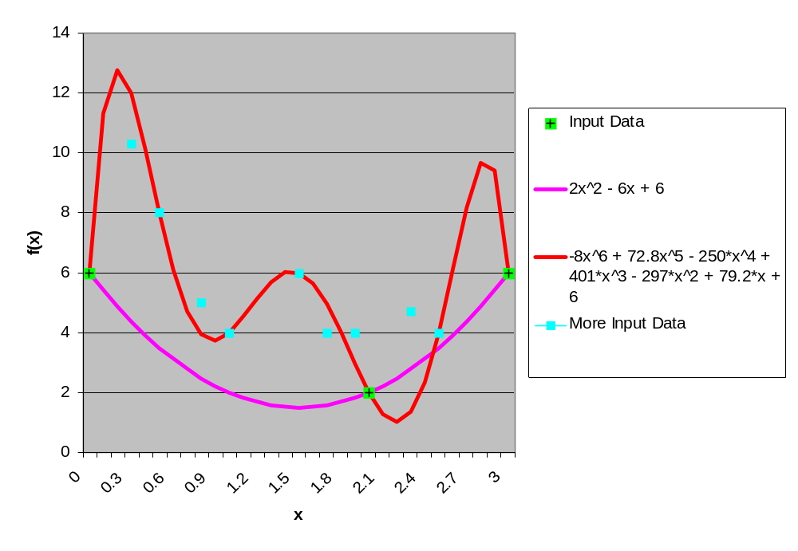
Imperfect fit to noisy data
Will an ungrammatical sentence ruin baby forever?
(yes, under the conservative strategy ...)
Or can baby figure out which data to (partly) ignore?
Statistics can help again ... how?

