Slide 1
Syntactic Attributes
Morphology, heads, gaps, etc.
Note: The properties of nonterminal symbols are often called “features.”
However, we will use the alternative name “attributes.”
(We’ll use “features” to refer only to the features that get
weights in a machine learning model, e.g., a log-linear model.)
600.465 - Intro to NLP - J. Eisner
1

Slide 2
3 views of a context-free rule
generation (production): S → NP VP
parsing (comprehension): S ← NP VP
verification (checking): S = NP VP
Today you should keep the third, declarative perspective in mind.
Each phrase has
  an interface (S) saying where it can go
  an implementation (NP VP) saying what’s in it
To let the parts of the tree coordinate more closely with one another, enrich the interfaces:
S[attributes…] = NP[attributes…] VP[attributes…]
600.465 - Intro to NLP - J. Eisner

Slide 3
Examples
Verb → thrills
VP→ Verb NP
S → NP VP
S
NP
VP
Verb
NP
A roller coaster thrills every teenager
600.465 - Intro to NLP - J. Eisner

Slide 4
3 Common Ways to Use Attributes
morphology of a single word:
Verb[head=thrill, tense=present, num=sing, person=3,…] → thrills
projection of attributes up to a bigger phrase
VP[head=α, tense=β, num=γ…] → V[head=α, tense=β, num=γ…] NP
  provided α is in the set TRANSITIVE-VERBS
agreement between sister phrases:
S[head=α, tense=β] → NP[num=γ,…] VP[head=α, tense=β, num=γ…]
600.465 - Intro to NLP - J. Eisner

Slide 5
3 Common Ways to Use Attributes
Verb[head=thrill, tense=present, num=sing, person=3,…] → thrills
VP[head=α, tense=β, num=γ…] → V[head=α, tense=β, num=γ…] NP
S[head=α, tense=β] → NP[num=γ,…] VP[head=α, tense=β, num=γ…]
S
(generation
perspective)
NP
VP
num=sing
num=sing
Verb
NP
num=sing
A roller coaster thrills every teenager
thrills
600.465 - Intro to NLP - J. Eisner

Slide 6
3 Common Ways to Use Attributes
Verb[head=thrill, tense=present, num=sing, person=3,…] → thrills
VP[head=α, tense=β, num=γ…] → V[head=α, tense=β, num=γ…] NP
S[head=α, tense=β] → NP[num=γ,…] VP[head=α, tense=β, num=γ…]
S
(comprehension
perspective)
NP
VP
num=sing
num=sing
Verb
NP
num=sing
A roller coaster thrills every teenager
thrills
600.465 - Intro to NLP - J. Eisner

Slide 7
S
NP
VP
Det
The
N
V
has
VP
N
plan
VP
V
been
VP
to
VP
V
thrilling
NP
Otto
V
swallow
NP
Wanda

Slide 8
S→ NP[n=1] VP[n=1]
VP[n=1] → V[n=1] VP
V[n=1] → has
S
NP
[num=1]
VP
[num=1]
Det
The
N
[num=1]
V
has
[num=1]
VP
N
plan
[num=1]
VP
V
been
VP
to
VP
V
thrilling
NP
Otto
NP[n=1] → Det N[n=1]
N[n=1] → N[n=1] VP
N[n=1] → plan
V
swallow
NP
Wanda

Slide 9
S→ NP[n=α] VP[n=α]
VP[n=α] → V[n=α] VP
V[n=1] → has
S
NP
[num=1]
VP
[num=1]
Det
The
N
[num=1]
V
has
[num=1]
VP
N
plan
[num=1]
VP
V
been
VP
to
VP
V
thrilling
NP
Otto
NP[n=α] → Det N[n=α]
N[n=α] → N[n=α] VP
N[n=1] → plan
V
swallow
NP
Wanda

Slide 10
S
NP
VP
[head=plan]
Det
The
N
V
has
VP
[head=plan]
N
plan
VP
V
been
VP
[head=plan]
to
VP
V
thrilling
NP
Otto
NP[h=α] → Det N[h=α]
N[h=α] → N[h=α] VP
N[h=plan] → plan
V
swallow
NP
Wanda

Slide 11
S
[head=thrill]
NP
VP
[head=plan]
[head=thrill]
Det
The
N
V
has
VP
[head=plan]
[head=thrill]
N
plan
VP
V
been
VP
[head=plan]
[head=swallow]
[head=thrill]
to
VP
V
thrilling
NP
Otto
[head=swallow]
[head=thrill]
[head=Otto]
NP[h=α] → Det N[h=α]
N[h=α] → N[h=α] VP
N[h=plan] → plan
V
swallow
NP
Wanda
[head=swallow]
[head=Wanda]

Slide 12
Why use heads?
S
[head=thrill]
Morphology (e.g.,word endings)
N[h=plan,n=1] → plan
N[h=plan,n=2+] → plans
N[h=thrill,tense=prog] → thrilling
N[h=thrill,tense=past] → thrilled
N[h=go,tense=past] → went
NP
VP
[head=plan]
[head=thrill]
Det
The
N
V
has
VP
[head=plan]
[head=thrill]
N
plan
VP
V
been
VP
[head=plan]
[head=swallow]
[head=thrill]
to
VP
V
thrilling
NP
Otto
[head=swallow]
[head=thrill]
[head=Otto]
NP[h=α] → Det N[h=α]
N[h=α] → N[h=α] VP
N[h=plan] → plan
V
swallow
NP
Wanda
[head=swallow]
[head=Wanda]

Slide 13
Why use heads?
S
[head=thrill]
Subcategorization (i.e., transitive vs. intransitive)
When is VP → V NP ok?
VP[h=α] → V[h=α] NP
restrict to α ∈ TRANSITIVE_VERBS
When is N → N VP ok?
N[h=α] → N[h=α] VP
restrict to α ∈ {plan, plot, hope,…}
NP
VP
[head=plan]
[head=thrill]
Det
The
N
V
has
VP
[head=plan]
[head=thrill]
N
plan
VP
V
been
VP
[head=plan]
[head=swallow]
[head=thrill]
to
VP
V
thrilling
NP
Otto
[head=swallow]
[head=thrill]
[head=Otto]
NP[h=α] → Det N[h=α]
N[h=α] → N[h=α] VP
N[h=plan] → plan
V
swallow
NP
Wanda
[head=swallow]
[head=Wanda]

Slide 14
Why use heads?
S
[head=thrill]
Selectional restrictions
VP[h=α] → V[h=α] NP
I.e., VP[h=α] → V[h=α] NP[h=β]
Don’t fill template in all ways:
VP[h=thrill] → V[h=thrill] NP[h=Otto]
*VP[h=thrill] → V[h=thrill] NP[h=plan]
NP
VP
[head=plan]
[head=thrill]
Det
The
N
V
has
VP
[head=plan]
[head=thrill]
leave out, or low prob
N
plan
VP
V
been
VP
[head=plan]
[head=swallow]
[head=thrill]
to
VP
V
thrilling
NP
Otto
[head=swallow]
[head=thrill]
[head=Otto]
NP[h=α] → Det N[h=α]
N[h=α] → N[h=α] VP
N[h=plan] → plan
V
swallow
NP
Wanda
[head=swallow]
[head=Wanda]

Slide 15
Log-Linear Models of Rule Probabilities
What is the probability of this rule?
S[head=thrill, tense=pres, …] →
NP[head=plan, num=1, animate=no…]
VP[head=thrill, tense=pres, num=1, …]
We have many related rules.
p(NP[…] VP[…] | S[…])
= (1/Z) exp Σ_{k} θ_{k} ⋅ f_{k}(S[…] → NP[…] VP[…])
We are choosing among all rules that expand S[…].
If a rule has positively-weighted features, they raise its probability. Negatively-weighted features lower it.
Which features fire will depend on the attributes!

Slide 16
Log-Linear Models of Rule Probabilities
S[head=thrill, tense=pres, …] →
NP[head=plan, num=1, animate=no, …]
VP[head=thrill, tense=pres, num=1, …]
Some features that might fire on this …
  The raw rule without attributes is S → NP VP.
    Is that good? Does this feature have positive weight?
  The NP and the VP agree in number. Is that good?
  The head of the NP is “plan.” Is that good?
  The verb “thrill” will get a subject.
  The verb “thrill” will get an inanimate subject.
  The verb “thrill” will get a subject headed by “plan.”
    Is that good? Is “plan” a good subject for “thrill”?

Slide 17
Post-Processing
You don’t have to handle everything with tons of attributes on the nonterminals
Sometimes easier to compose your grammar with a post-processor:
  Use your CFG + randsent to generate some convenient internal version of the sentence.
  Run that sentence through a post-processor to clean it up for external presentation.
  The post-processor can even fix stuff up across constituent boundaries!
  We’ll see a good family of postprocessors later: finite-state transducers.

Slide 18
Simpler Grammar + Post-Processing
ROOT
ROOT → CAPS S .
NP_{proper} → CAPS smith
S
VP
NP
NP
NP
Verb
NP_{proper}
Appositive
Appositive
CAPS we will meet CAPS smith , 59 , , the chief , .
Smith
,
We
’ll
meet
,
59
the chief
.

Slide 19
Simpler Grammar + Post-Processing
ROOT
S
VP
VP
NP
NP_{proper}
Adverb
Verb
NP_{genitive}
NP
CAPS CAPS smith already meet -ed me ’s child -s .
Smith
already
met
my
.
children

Slide 20
What Do These Enhancements Give You?
And What Do They Cost?
In a sense, nothing and nothing!
  Can automatically convert our new fancy CFG to an old plain CFG.
This is reassuring …
  We haven’t gone off into cloud-cuckoo land where
  “ooh, look what languages I can invent.”
    Even fancy CFGs can’t describe crazy non-human languages such as the language consisting only of prime numbers.
    Because we already know that plain CFGs can’t do that.
  We can still use our old algorithms, randsent and parse.
    Just convert to a plain CFG and run the algorithms on that.
But we do get a benefit!
  Attributes and post-processing allow simpler grammars.
  Same log-linear features are shared across many rules.
  A language learner thus has fewer things to learn.

Slide 21
Analogy: What Does Dyna Give You?
In a sense, nothing and nothing!
  We can automatically convert our fancy Dyna program to plain old machine code.
This is reassuring …
  A standard computer can still run Dyna.
  No special hardware or magic wands are required.
But we do get a benefit!
  High-level programming languages allow shorter programs that are easier to write, understand, and modify.

Slide 22
What Do These Enhancements Give You?
And What Do They Cost?
In a sense, nothing and nothing!
  We can automatically convert our new fancy CFG to an old plain CFG.
Nonterminals with attributes ➔ more nonterminals
  S[head=α, tense=β] → NP[num=γ,…] VP[head=α, tense=β, num=γ…]
  Can write out versions of this rule for all values of α, β, γ
  Now rename NP[num=1,…] to NP_num_1_...
  So we just get a plain CFG with a ton of rules and nonterminals
Post-processing ➔ more nonterminal attributes
  Example: Post-processor changes “a” to “an” before a vowel
  But we could handle this using a “starts with vowel” attribute instead
    The determiner must “agree” with the vowel status of its Nbar
  This kind of conversion can always be done! (automatically!)
    At least for post-processors that are finite-state transducers
  And then we can convert these attributes to nonterminals as above

Slide 23
Part of the English Tense System
 | Present | Past | Future | Infinitive
Simple | eats | ate | will eat | to eat
Perfect | has eaten | had eaten | will have eaten | to have eaten
progressive | is eating | was eating | will be eating | to be eating
Perfect+ progressive | has been eating | had been eating | will have been eating | to have been eating
600.465 - Intro to NLP - J. Eisner

Slide 24
Tenses by Post-Processing: “Affix-hopping” (Chomsky)
Mary jumps | Mary [–s jump]
Mary has jumped | Mary [-s have] [-en jump]
Mary is jumping | Mary [-s be] [-ing jump]
Mary has been jumping | Mary [-s have] [-en be] [-ing jump]
Agreement, meaning
where
-s denotes “3rd person singular present tense”
on following verb (by an –s suffix)
-en denotes “past participle” (often uses –en or –ed suffix)
-ing denotes “present participle” Etc.
Could we instead describe the patterns via attributes?

Slide 25
S
[tense=pres,head=thrill]
NP
VP
[head=plan]
[tense=pres,head=thrill]
The plan …
V
has
VP
[tense=perf,head=thrill]
V
been
VP
[tense=prog,
head=thrill]
Let’s distinguish the different kinds of VP by tense …
V
thrilling
NP
Otto
[tense=prog,head=thrill]
[head=Otto]

Slide 26
past
S
[tense=pres,head=thrill]
NP
past
VP
[head=plan]
[tense=pres,head=thrill]
The plan …
past
V
thrills
NP
Otto
[tense=pres,head=thrill]
[head=Otto]
thrilled
Past
Present tense

Slide 27
past
S
eat
[tense=pres,head=thrill]
NP
past
VP
eat
[head=plan]
[tense=pres,head=thrill]
The plan …
past
V
thrills
NP
Otto
[tense=pres,head=thrill]
[head=Otto]
thrilled
ate
Past
Present tense

Slide 28
S
[tense=pres,head=thrill]
NP
VP
[head=plan]
[tense=pres,head=thrill]
The plan …
V
thrills
NP
Otto
[tense=pres,head=thrill]
[head=Otto]
Present tense (again)

Slide 29
S
[tense=pres,head=thrill]
NP
VP
[head=plan]
[tense=pres,head=thrill]
The plan …
V
has
VP
[tense=pres,head=have]
[tense=perf,head=thrill]
V
thrilled
NP
Otto
[tense=perf,head=thrill]
[head=Otto]
Present perfect tense

Slide 30
S
[tense=pres,head=thrill]
NP
VP
[head=plan]
[tense=pres,head=thrill]
The plan …
V
has
VP
[tense=pres,head=have]
[tense=perf,head=thrill]
V
thrilled
NP
Otto
[tense=perf,head=thrill]
[head=Otto]
Present perfect tense

Slide 31
S
eat
[tense=pres,head=thrill]
NP
VP
eat
[head=plan]
[tense=pres,head=thrill]
The plan …
V
has
VP
eat
[tense=pres,head=have]
[tense=perf,head=thrill]
eat
V
thrilled
NP
Otto
[tense=perf,head=thrill]
[head=Otto]
Present perfect tense
eaten
The yellow material makes it a perfect tense – what effects?
not ate – why?

Slide 32
past
S
[tense=pres,head=thrill]
NP
past
VP
[head=plan]
[tense=pres,head=thrill]
The plan …
past
V
has
VP
[tense=pres,head=have]
[tense=perf,head=thrill]
had
V
thrilled
NP
Otto
[tense=perf,head=thrill]
[head=Otto]
Past
Present perfect tense

Slide 33
S
[tense=pres,head=thrill]
NP
VP
[head=plan]
[tense=pres,head=thrill]
The plan …
V
thrills
NP
Otto
[tense=pres,head=thrill]
[head=Otto]
Present tense (again)

Slide 34
S
[tense=pres,head=thrill]
NP
VP
[head=plan]
[tense=pres,head=thrill]
The plan …
V
is
VP
[tense=pres,head=be ]
[tense=prog,head=thrill]
V
thrilling
NP
Otto
[tense=prog,head=thrill]
[head=Otto]
Present progressive tense

Slide 35
past
S
[tense=pres,head=thrill]
NP
past
VP
[head=plan]
[tense=pres,head=thrill]
The plan …
past
V
is
VP
[tense=pres,head=be ]
[tense=prog,head=thrill]
was
V
thrilling
NP
Otto
[tense=prog,head=thrill]
[head=Otto]
Past
Present progressive tense

Slide 36
S
[tense=pres,head=thrill]
NP
VP
[head=plan]
[tense=pres,head=thrill]
The plan …
V
has
VP
[tense=pres,head=have]
[tense=perf,head=thrill]
V
thrilled
NP
Otto
[tense=perf,head=thrill]
[head=Otto]
Present perfect tense (again)

Slide 37
S
[tense=pres,head=thrill]
NP
VP
[head=plan]
[tense=pres,head=thrill]
The plan …
V
has
VP
[tense=pres,head=have]
[tense=perf,head=thrill]
V
been
VP
[tense=perf,head=be]
[tense=prog,
head=thrill]
Present perfect progressive tense
V
thrilling
NP
Otto
[tense=prog,head=thrill]
[head=Otto]

Slide 38
S
[tense=pres,head=thrill]
NP
VP
[head=plan]
[tense=pres,head=thrill]
The plan …
V
has
VP
[tense=pres,head=have]
[tense=perf,head=thrill]
V
been
VP
[tense=perf,head=be]
[tense=prog,
head=thrill]
Present perfect progressive tense
V
thrilling
NP
Otto
[tense=prog,head=thrill]
[head=Otto]

Slide 39
past
S
[tense=pres,head=thrill]
NP
past
VP
[head=plan]
[tense=pres,head=thrill]
The plan …
past
V
has
VP
[tense=pres,head=have]
[tense=perf,head=thrill]
had
V
been
VP
[tense=perf,head=be]
[tense=prog,
head=thrill]
Past
Present perfect progressive tense
V
thrilling
NP
Otto
[tense=prog,head=thrill]
[head=Otto]

Slide 40
cond
S
[tense=pres,head=thrill]
NP
cond
VP
[head=plan]
[tense=pres,head=thrill]
The plan …
V
would
VP
[tense=cond,head=will]
[tense=stem,head=thrill]
stem
V
has
VP
[tense=pres,head=have]
[tense=perf,head=thrill]
Conditional
Present perfect progressive tense
have
V
been
VP
[tense=perf,head=be]
[tense=prog,
head=thrill]
V
thrilling
NP
Otto
[tense=prog,head=thrill]
[head=Otto]

Slide 41
VP
[tense=pres,head=thrill]
So what pattern do all progressives follow?
V
is
VP
[tense=pres,head=be]
[tense=prog,
head=thrill]
V
thrilling
NP
Otto
[tense=prog,head=thrill]
[head=Otto]
VP
[tense=past,head=eat]
V
was
VP
[tense=past,head=be]
[tense=prog,
head=eat]
VP
[tense=perf,head=thrill]
V
eating
NP
Otto
[tense=prog,head=eat]
[head=Otto]
V
been
VP
[tense=perf,head=be]
[tense=prog,
head=thrill]
V
thrilling
NP
Otto
[tense=prog,head=thrill]
[head=Otto]

Slide 42
VP
[tense=pres,head=thrill]
So what pattern do all progressives follow?
V
is
VP
[tense=pres,head=be]
[tense=prog,
head=thrill]
V
thrilling
NP
Otto
[tense=prog,head=thrill]
[head=Otto]
VP
[tense=past,head=eat]
V
was
VP
[tense=past,head=be]
[tense=prog,
head=eat]
VP
α
β
[tense=perf,head=thrill]
V
eating
NP
Otto
[tense=prog,head=eat]
[head=Otto]
α
V
been
VP
[tense=perf,head=be]
[tense=prog,
head=thrill]
β
V
-ing
NP
Otto
β
[tense=prog,head=thrill]
[head=Otto]

Slide 43
Progressive: VP[tense=α, head=β, …] → V[tense=α, stem=be …]
VP[tense=prog, head=β …]
Perfect: VP[tense=α, head=β, …] → V[tense=α, stem=have …]
VP[tense=perf, head=β …]
Future or VP[tense=α, head=β, …] → V[tense=α, stem=will …]
conditional: VP[tense=stem, head=β …]
Infinitive: VP[tense=inf, head=β, …] → to
VP[tense=stem, head=β …]
Etc.
As well as the “ordinary” rules:
VP[tense=α, head=β, …]
→ V[tense=α, head=β, …] NP
V[tense=past, head=have …] → had
VP
α
β
[tense=perf,head=thrill]
α
V
been
VP
[tense=perf,head=be]
[tense=prog,
head=thrill]
β
V
-ing
NP
Otto
β
[tense=prog,head=thrill]
[head=Otto]

Slide 44
Gaps (“deep” grammar!)
Pretend “kiss” is a pure transitive verb.
Is “the president kissed” grammatical?
  If so, what type of phrase is it?
the sandwich that
I wonder what
What else has
the president kissed
e
Sally said the president kissed e
Sally consumed the pickle with e
Sally consumed e with the pickle
600.465 - Intro to NLP - J. Eisner

Slide 45
Gaps
Object gaps:
the sandwich that
I wonder what
What else has
the president kissed e
Sally said the president kissed e
Sally consumed the pickle with e
Sally consumed e with the pickle
[how could you tell the difference?]
Subject gaps:
the sandwich that
I wonder what
What else has
e kissed the president
Sally said e kissed the president
600.465 - Intro to NLP - J. Eisner

Slide 46
Gaps
All gaps are really the same – a missing NP:
the sandwich that
I wonder what
What else has
the president kissed e
Sally said the president kissed e
Sally consumed the pickle with e
Sally consumed e with the pickle
e kissed the president
Sally said e kissed the president
Phrases with missing NP:
X[missing=NP]
or just X/NP for short
600.465 - Intro to NLP - J. Eisner

Slide 47
VP
VP
V
wonder
CP
[wh=yes]
V
wonder
CP
[wh=yes]
[wh=yes]
NP
what
S
/NP
NP
what
[wh=yes]
S/NP
NP
/NP
VP
what else
could go
here?
NP
he
VP/NP
e
V
was
VP
V
was
VP/NP
V
kissing
NP
him
V
kissing
NP/NP
e
what else could go here?

Slide 48
VP
NP
NP
the sandwich
/NP
[wh=no]
V
wonder
CP
[wh=yes]
CP
Comp
that
S
/NP
NP
what
[wh=yes]
S/NP
NP
he
VP
/NP
what else
could go
here?
NP
he
VP/NP
V
was
VP
/NP
V
was
VP/NP
V
kissing
NP
/NP
e
V
kissing
NP/NP
e
what else could go here?

Slide 49
VP
VP
V
wonder
CP
[wh=yes]
V
believe
CP
[wh=no]
Comp
that
S
NP
what
[wh=yes]
S/NP
NP
he
VP
what else
could go
here?
NP
he
VP/NP
V
was
VP
V
was
VP/NP
NP
the
sandwich
V
kissing
V
kissing
NP/NP
e
what else could go here?

Slide 50
To indicate what fills a gap, people sometimes “coindex” the gap and its filler.
NP
NP
the sandwich
/NP
[wh=no]
i
CP
i
Comp
that
S
/NP
i
Each phrase has a unique index such as “i”.
In some theories, coindexation is used to help extract a meaning from the tree.
In other theories, it is just an aid to help you follow the example.
NP
he
VP
/NP
i
V
was
VP
/NP
i
V
kissing
NP
/ NP
i
e
i
the money_{i} I spend e_{i} on the happiness_{j} I hope to buy e_{j}
which violin_{i} is this sonata_{j} easy to play e_{j} on e_{i}

Slide 51
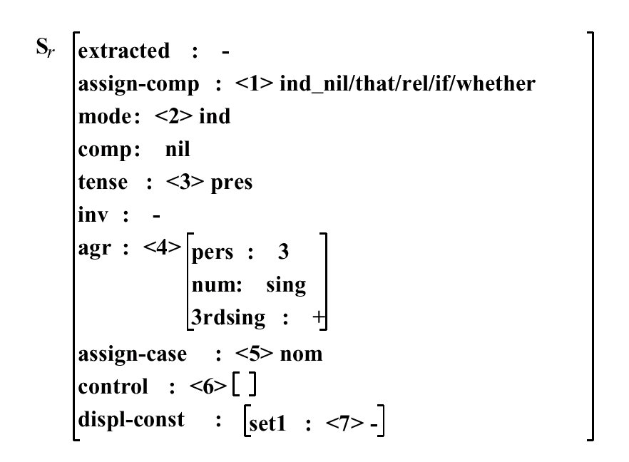

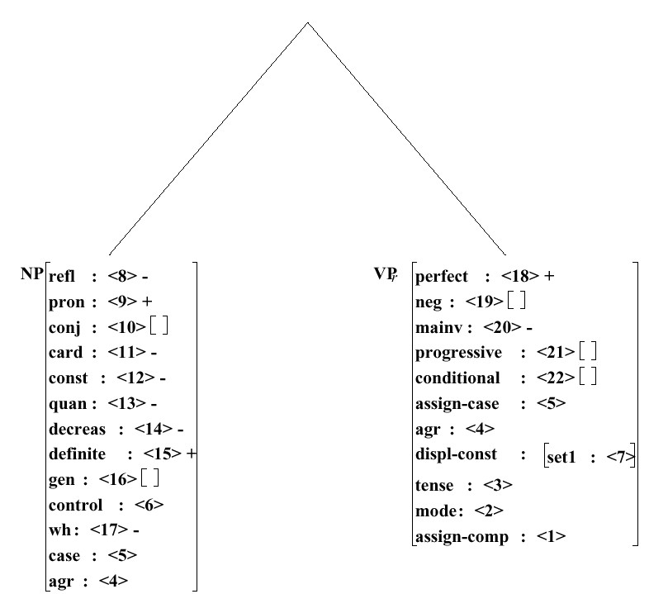
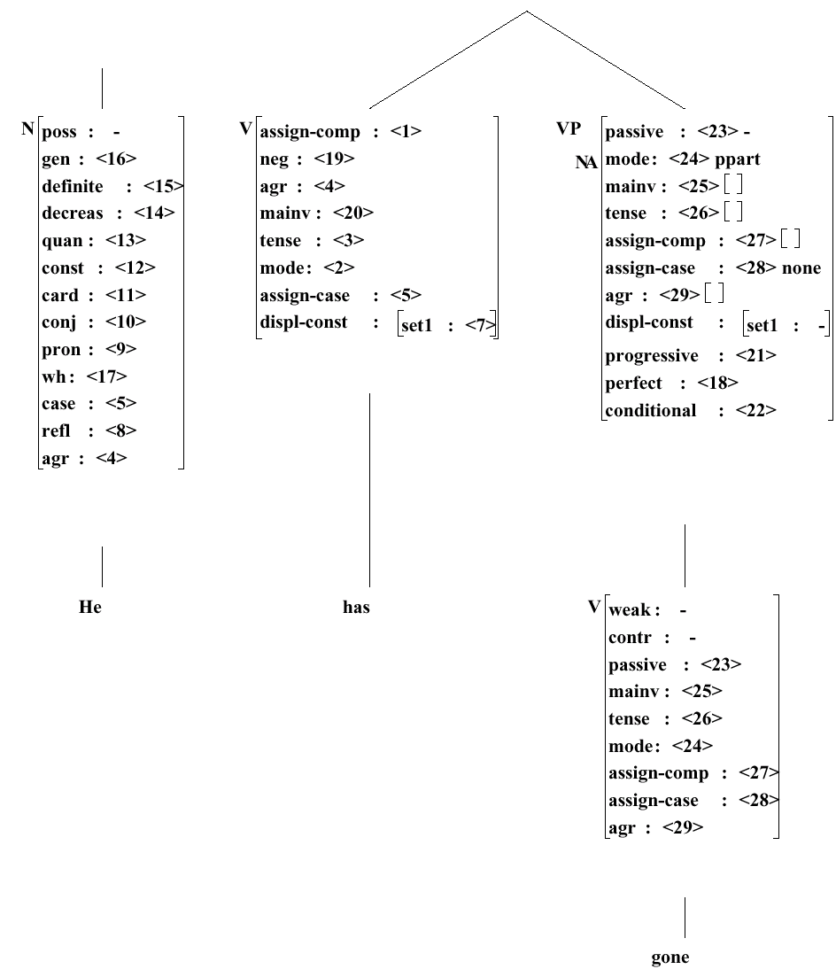
Lots of attributes
(tense, number, person, gaps, vowels, commas, wh, etc., etc....)
Help!
He
has
Sorry, that’s just how language is …
You know too much to write it down easily!
gone

