Slide 1

UNIVERSITY OF NORTH TEXAS
CSCE 5430 - SOFTWARE ENGINEERING
TEAM EMERALD PROJECT
“ARGO”
GROUP MEMBERS :
POLINA NEMKOVA
DIWASH HUMAGAIN
VRUSHABH DESAI
KAVYA KUNDURI
SINDHUVYSHNAVI KODAKANDLA
THREEBHUVANA VAJRALA
CHUKKA SAI MEGHANA REDDY
SOUJANYA VANTERU

Slide 2

PROJECT DESCRIPTION
Web Application helping Legal NGO clinic to file document for Afghan refugees in the US
(actual project for existing NGO)
There is a legal NGO clinic that helps refugees in the US with their immigration status
OBJECTIVE :
Help with filing asylum forms for refugees from Afghanistan (and other places) i-589 form + supplemental materials
Help with filing immigration form for refugees status adjustment (green card) - i-485 form + supplemental materials
Help with filing immigration documents for Afghans who worked for the US military - ds157 form.

Slide 3


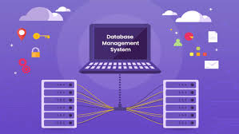


FUNCTIONS :
Chatbot with basic immigration questions (in English and in other specified languages)
Account creation
Document upload/download
Automatic filing/tracking application status
Resources/chat, QA postings, Discussion forum, and more as required by the Org and target audience.
DEVELOPMENT TOOLS :
PYTHON
C#
VISUAL STUDIO
SUITABLE DATABASE

Slide 4
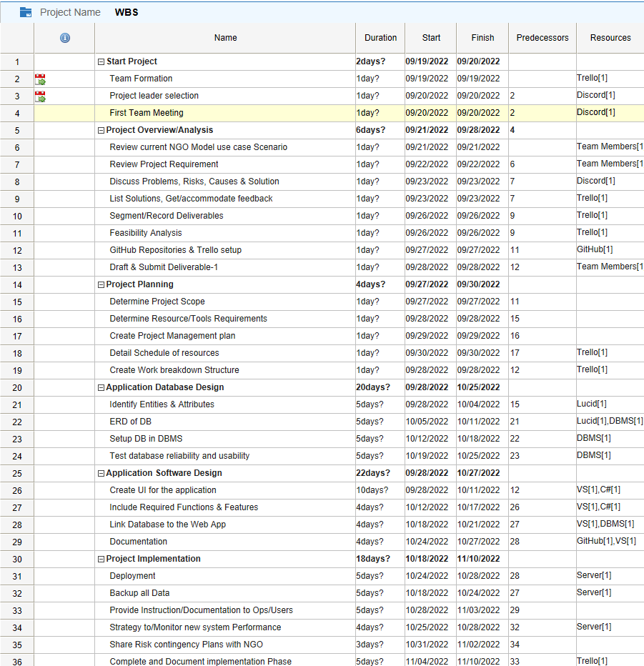

Work-breakdown Structure & Milestones :

Slide 5
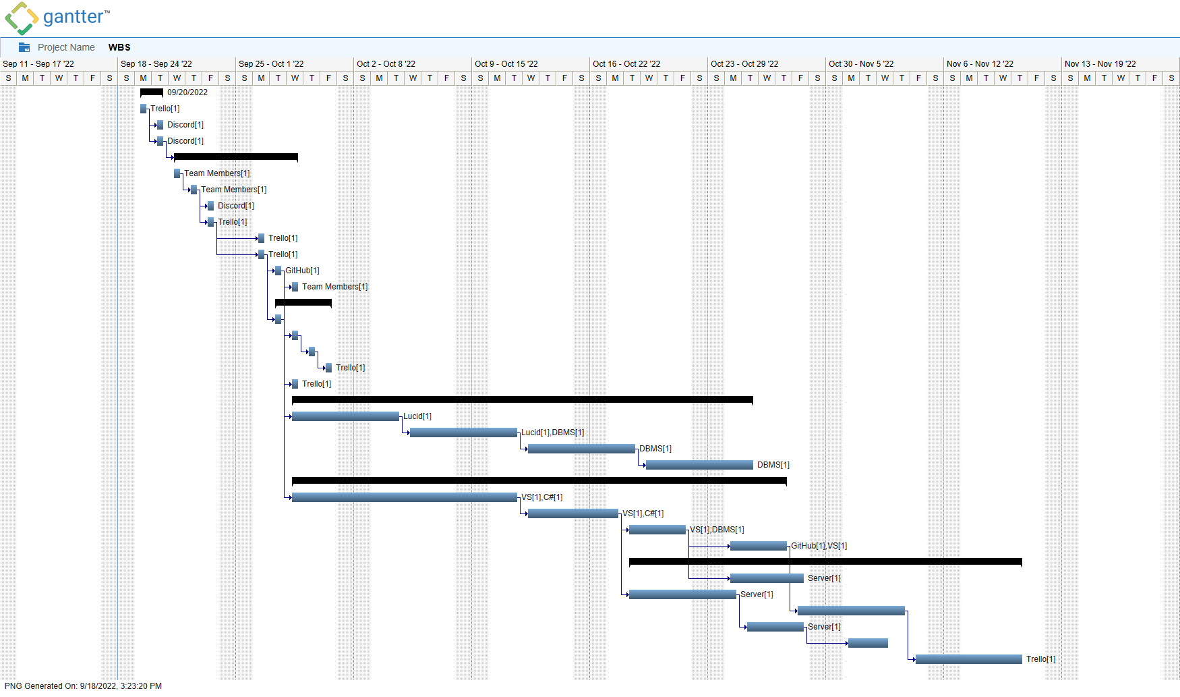
GANTT Chart :

Slide 6

CHALLENGES :
Many of the refugees don't speak English. So, we need to do this for the following languages: a. Pashto b. Dari c. Arabic d. Ukrainian

Slide 7
RISK FACTORS AND CONTIGENCY PLANS
1. Too many decision makers can cause bottlenecks in the decision and approval process. This can result in a conflict of opinion for the people and it will result in delay of the time required for each decision and in turn it results in overall delay of the project.
Contingency plan : Ensuring every team member is sufficiently empowered and supported to think and make their own decisions.
2. Underestimation of the time/resource commitment: Developers underestimate the time they need to invest in the project to keep moving forward promptly.
Contingency plan : All project members need to be granted sufficient time to continue progressingon a progressive scale with the project and perform required duties.
3. Data migration/population: Time and effort are typically underestimated to source and populate the new site with that content. Moreover, having a predetermined number of refugees is hard to keep up with since it often varies with the conditions.
Contingency plan : It should be taken care to fully identify and specify all data that is to be supplied for the new site, whether it exists yet, who has it, what format it’s in.

Slide 8
TEAM MEMBERS ROLES AND RESPONSIBILITIES :
ROLES & RESPONSIBILITIES | MAIN LEAD | SUPPORT
Project Management Lead | Polina Nemkova | Vrushabh desai
Requirements Lead | Polina Nemkova | Threebhuvana vajrala
Design Lead | Diwash Humagain | Sindhuvyshnavi Kodakandla
Implementation Lead for front end | Chukka Sai Meghana Reddy | Diwash Humagain
Implementation lead for back end | Vrushabh desai | Chukka Sai Meghana Reddy
Configuration Management Lead | Kavya kunduri | Diwash Humagain
Testing Lead | Polina Nemkova | Threebhuvana vajrala
Documentation Lead | Sindhuvyshnavi Kodakandla | Soujanya vanteru
Demo and Presentation Lead | Soujanya vanteru | Sindhuvyshnavi Kodakandla
System Administrator Lead | Vrushabh desai | Kavya kunduri

Slide 9


