Slide 1
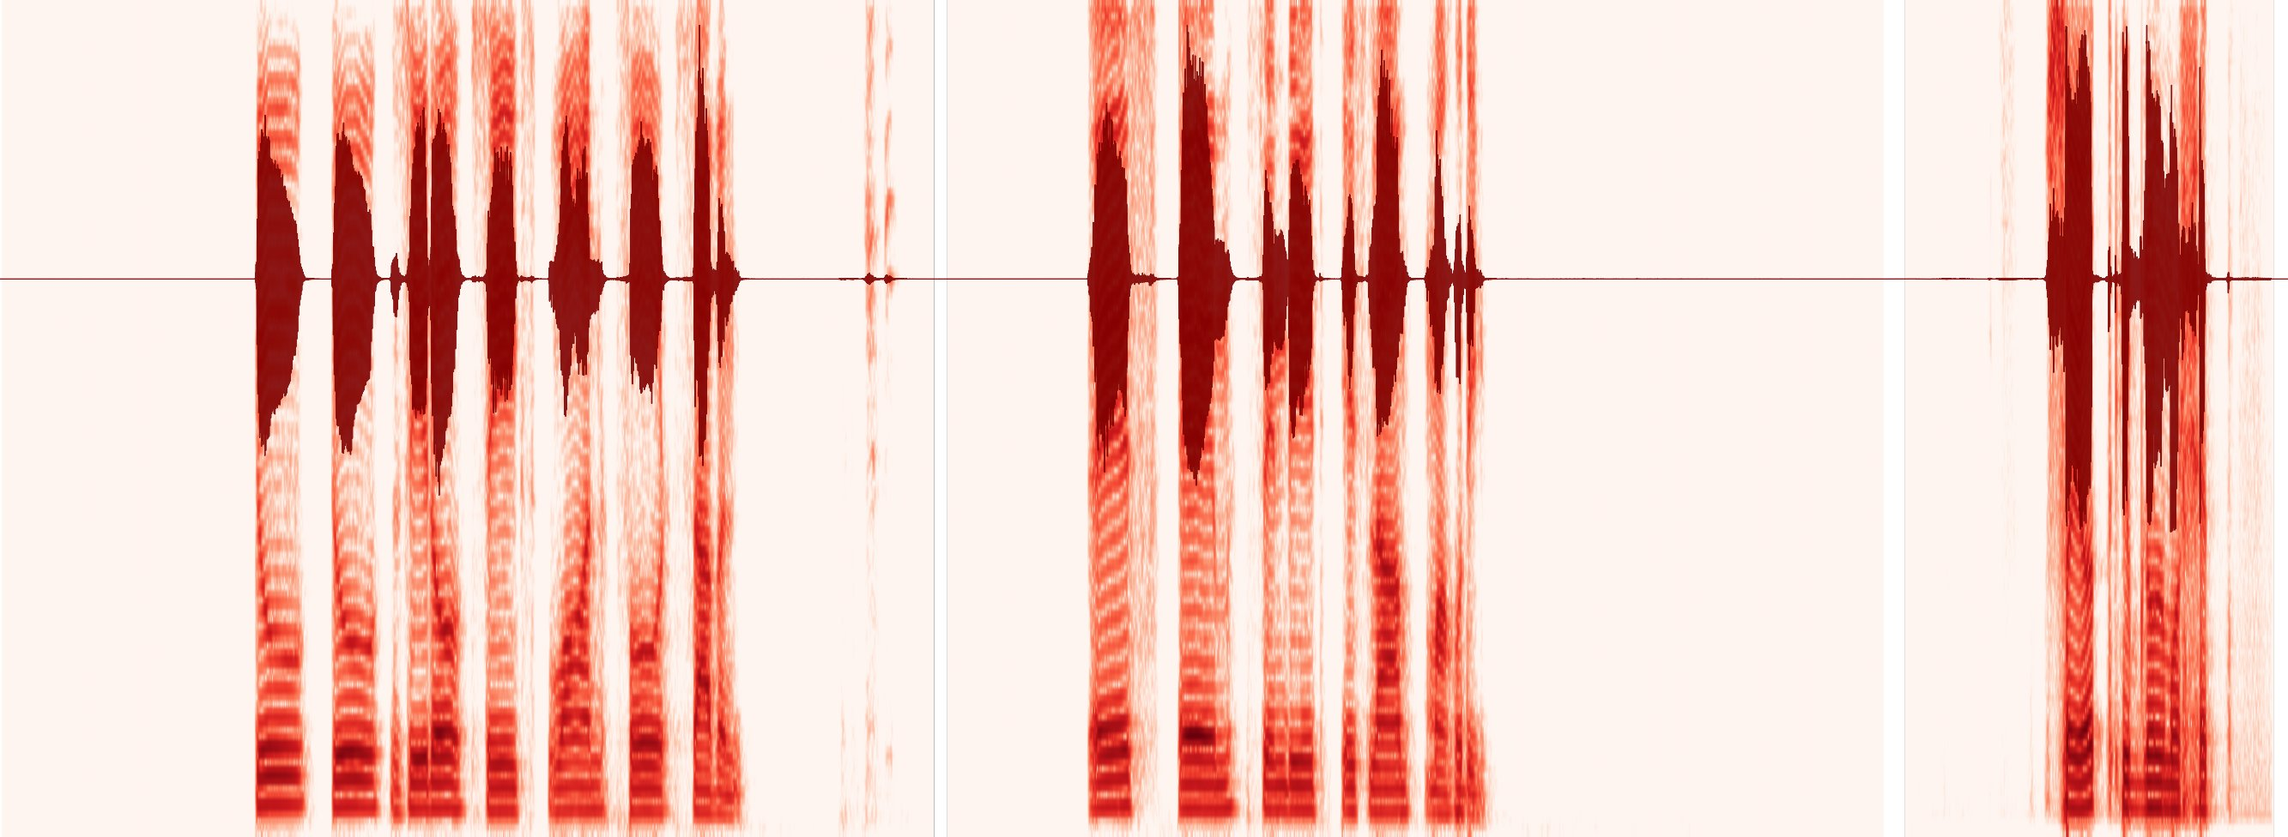




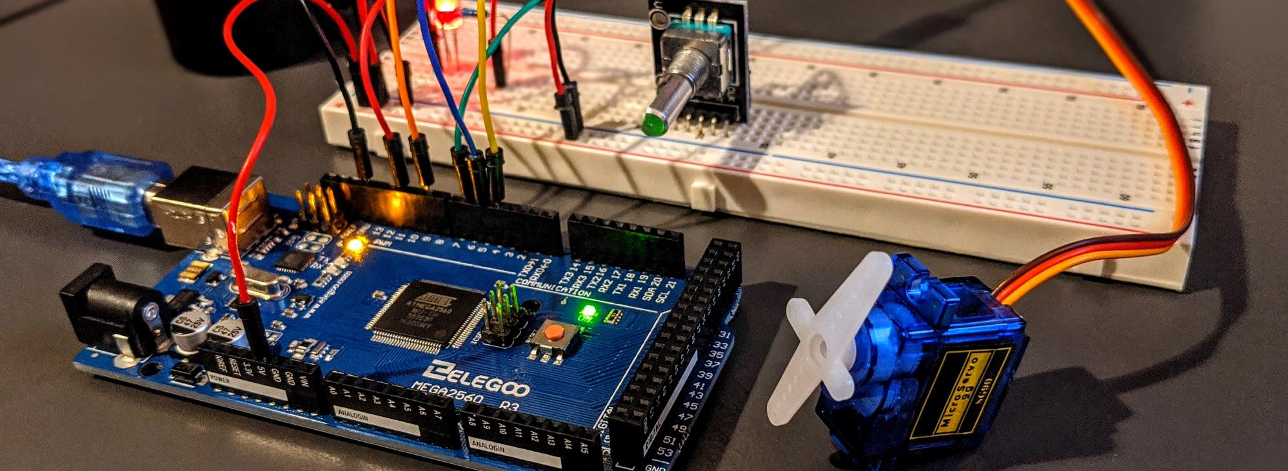
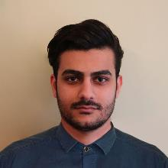
Voice-Based Meal Verification System for Hall Dining
Submitted by – Group 07 (Section C1)
Samin Zahan Khan
2206135
Syed Ibnul Morshed
2206141
S M Sindid Islam Mahodi
2206147
Abdullah Al Rohan
2206150

Slide 2
Outline
1
2
3
4
5
Summary / Abstract
Introduction
Design: theory, mathematics, algorithms, code
Implementation and demonstration
Design analysis and evaluation
6
7
8
9
10
Reflection on individual and team work
Communication to stakeholders
Project management and cost
Future work
References
Presented by: 2206135

Slide 3
1. Summary / Abstract
A touchless hall-dining counter in MATLAB: a student says his Student ID and full name; the system decides who spoke, checks the monthly roster and the meal window, and logs the meal.
Starting point: the seniors' "Hall Entry" baseline (44.1 kHz, 8-codeword VQ). Our v4.1.4 refused most genuine students in the hall (e.g. 2206147).
v4.1.4_claude needs two independent kinds of evidence: WHAT was said (DTW on roll number + name) and WHO said it (GMM-UBM voice).
It names the likely imposter and blocks recordings with a random 3-digit challenge and a replay memory.
98.3 %
0/116
genuine accepted, all mics
unknown speakers accepted
7 / 7
0 / 18
demo attack cases correct
replays passed the challenge
Signal conditioning
Two-evidence identity
Security layers
8 kHz rational resampling, spectral subtraction, speech mask, MFCC + Δ with CMVN (removes the microphone).
Every take enrolled; cohort-normalised DTW for the words + 64-mixture GMM-UBM for the voice; one fused decision.
Imposter identification, 3-digit challenge with 27 decoys, splice guard, replay memory, sub-200 Hz advisory.
Presented by: 2206135

Slide 4
2. Introduction
Problem: hall dining uses paper meal cards and a manual register. Cards are shared, lost and traded, and proxy meals drain the hall's budget.
Idea: the student's own voice is the meal card — nothing to carry, nothing to touch.
Seniors' baseline: fixed 3 s recording, 12 MFCC+Δ+ΔΔ, one 8-codeword VQ codebook per phrase; accept when the nearest ID and name codebooks agree. No threshold, no noise or channel normalisation, no anti-spoofing, no meal logic.
Our v4.1.4: added resampling, spectral subtraction, endpointing, DTW and the dining rules, but in the hall it refused most live users.
25.9 %
seniors' baseline: genuine students accepted on a different microphone
15.4 %
seniors' baseline: unknown (not enrolled) speakers accepted
Design goal: accept every enrolled student on any microphone, refuse strangers, name the imposter, and refuse recordings — using only DSP taught in EEE 311/312.
74 %
our v4.1.4: live attempts refused (48/65, VerificationAttempts.csv)
Presented by: 2206135

Slide 5
3.1 Design: Problem Formulation (PO(b))
3.1.1 Identification of Scope
Users and data
Threats
32 enrolled students (2206131–2206164).
Spoken roll number + full name, 3–15 takes each; isolated digits 0–9.
Three microphones: the database mic, a second USB microphone and our laptop mic.
Proxy student speaks for a friend (imposter).
A phone replays a friend's recording.
A stored enrolment file is injected digitally.
Constraints
Out of scope
Software only: existing laptop / hall PC and microphone.
A few seconds per student at a busy counter.
Noisy dining hall, any microphone, Bangla and English names.
Speech synthesis / voice conversion trained on a student (ASVspoof logical access).
Payment and hall-office records (roster is a CSV).
Presented by: 2206135

Slide 6
3.1 Design: Problem Formulation (PO(b))
3.1.2 Literature Review
Topic | Key work | What we took from it
Cepstral features | Davis & Mermelstein (1980); Furui (1986) | MFCC c1–c12 + Δ describe the words
Time alignment | Sakoe & Chiba (1978) | DTW with a band: the same word spoken faster or slower
Noise | Boll (1979) | Power spectral subtraction before feature extraction
Channel | Atal (1974); Furui (1981) | Cepstral mean (and variance) normalisation removes the microphone
Score normalisation | Rosenberg et al. (1992) | Cohort ratio instead of a fixed raw-distance limit
Voice model | Reynolds, Quatieri & Dunn (2000) | GMM-UBM with MAP adaptation from little enrolment speech
Anti-replay | Matsui & Furui (1993); Wu et al. ASVspoof (2017) | Text-prompted random digits; replay threat model
Starting point | Seniors' baseline: Hall Entry (VQ-LBG) | Two-phrase idea (ID + name), MATLAB GUI
Presented by: 2206135

Slide 7
3.1 Design: Problem Formulation (PO(b))
3.1.3 Formulation of Problem
Input: x_ID[n], x_name[n] from any microphone (44.1/48 kHz), an optional typed ID, then 3 random digits x_ch[n].
(i)
(ii)
(iii)
(iv)
Which enrolled student k* was named — or nobody?
Is the voice really k*'s — or whose is it?
Is the speech live and fresh — not a recording?
Is k* on this month's roster, inside a meal window, not yet served?
SERVE ⇔ phrase gate ∧ voice gate ∧ ¬ imposter ∧ challenge passed ∧ ¬ stored copy ∧ roster & meal OK
Every "no" must carry a reason the operator can act on: IMPOSTER (with the suspect's ID), UNKNOWN, REPLAY or RETRY.
Performance targets: genuine acceptance (GAR) high on every microphone; false acceptance (FAR) of strangers and imposters ≈ 0.
Presented by: 2206135

Slide 8
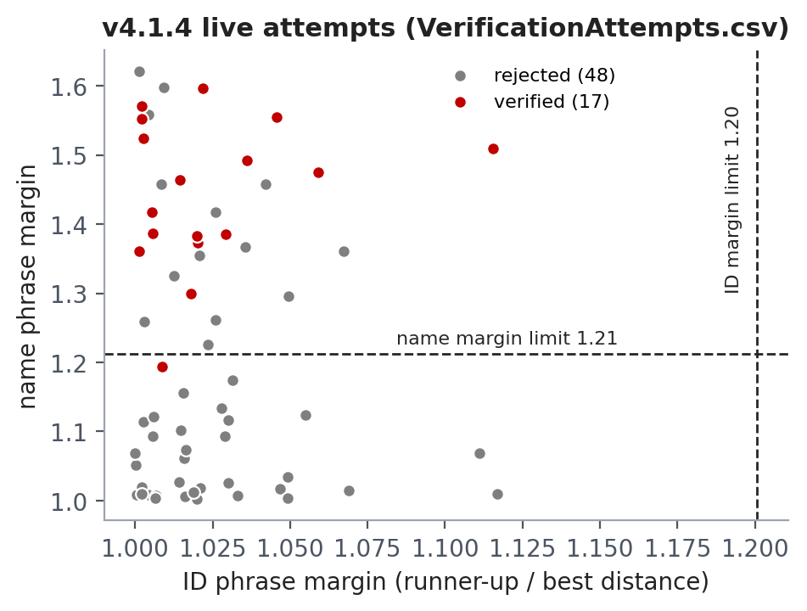
3.1 Design: Problem Formulation (PO(b))
3.1.4 Analysis: why v4.1.4 refused genuine students
Root cause found in the code | Effect
apply_voice_calibration forced enrollmentTemplateFileNames = {'1.wav'} | One template per student, from one mic
Frozen calibration: mfcc.CmsNormalise = 0 | Microphone H(ω) left in every MFCC
Roll numbers 2206xxx share 4–5 of 7 digits | ID margin ≈ 1.00–1.05 for everyone
Rule: ID top-1 must equal name top-1 | A random ID winner vetoed a correct name
Fixed raw DTW ceilings 31.35 / 30.35 | A new mic raises all distances: all refused
8-mixture GMM on 1 take, not in the decision | No voice evidence at all
All 65 logged live attempts had an ID margin below the 1.20 limit (median 1.02).
Presented by: 2206135

Slide 9
3.2 Design Methods (PO(a))
Design alternatives and the trade-offs we resolved
Decision | Options considered | Chosen and why
Sampling rate | 44.1 kHz (baseline) vs 16 kHz vs 8 kHz | 8 kHz: formants < 4 kHz, 5.5× less computation
Word matching | VQ codebook vs HMM vs DTW | DTW: works with 3–15 takes, no training, keeps timing
Thresholds | Fixed raw distance vs cohort ratio | Cohort ratio: invariant to a microphone gain / shift
Voice model | None vs GMM per student vs GMM-UBM | GMM-UBM + MAP: robust with 10–20 s per student
Acceptance | Lower the threshold vs rank-1 lead ("clear winner") | Clear winner: +3.5 pts GAR, no new stranger accepts
Anti-replay | Loudspeaker detector vs text challenge | Random digits: a recording cannot know the code
Challenge length | 2 vs 3 vs 4 digits | 3 digits: 1000 codes, ≈3 s, 27 one-digit decoys
Every choice trades security (FAR) against convenience (GAR) and speed; the numbers behind each choice are in Section 5.3.
Presented by: 2206141

Slide 10
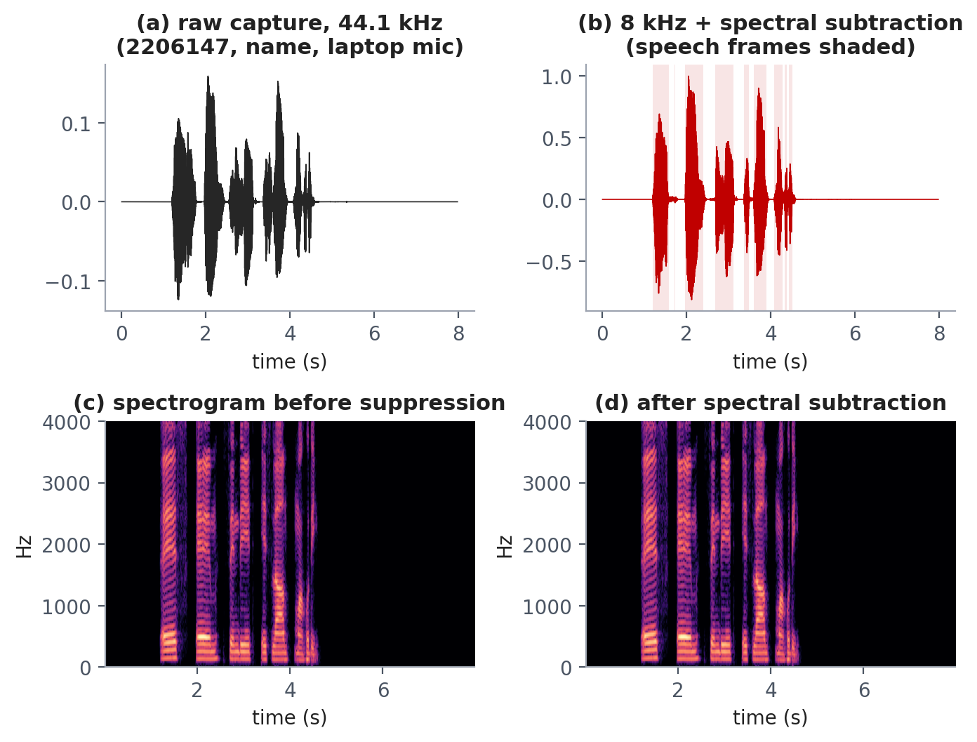
3.2 Design Methods (PO(a))
Fundamental theory: resampling, spectral subtraction, speech mask
Speech formants lie below 4 kHz, so by Nyquist fs = 8 kHz is enough.
44.1 → 8 kHz uses L/M = 80/441 (48 kHz: 1/6): up-sample by L, polyphase FIR low-pass at π/max(L, M), down-sample by M.
Power spectral subtraction:
|Ŝ(k)|² = max(|Y(k)|² − α·P̂_N(k), β·|Y(k)|²), α = 2, β = 0.02.
P̂_N is estimated from the quietest 10 % of 32 ms Hann frames, so it works even when a student speaks at once.
Speech mask: keep frames within 30 dB of the loudest frame.
Presented by: 2206141

Slide 11
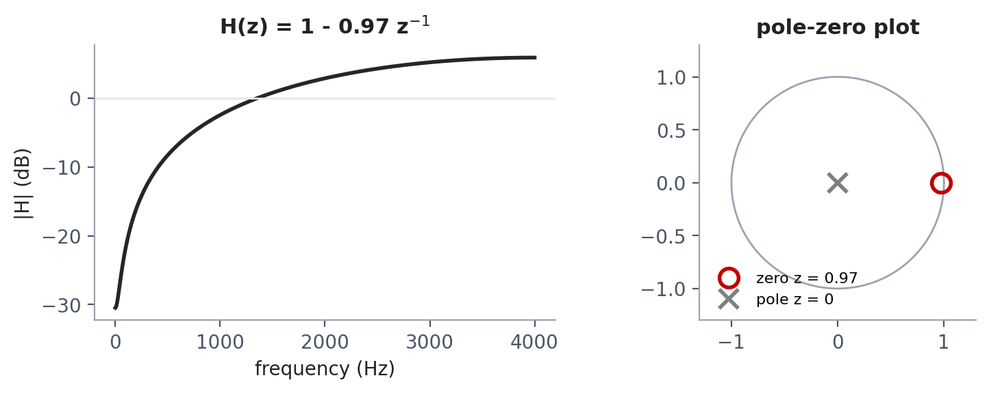
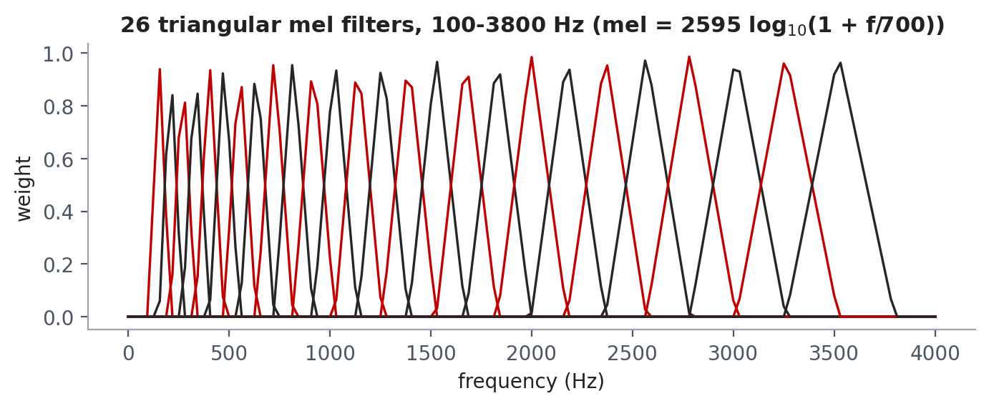
3.2 Design Methods (PO(a))
Fundamental theory: pre-emphasis, windowed framing, MFCC
Pre-emphasis H(z) = 1 − 0.97 z⁻¹ (zero at z = 0.97) lifts the weak F3/F4 formants (speech falls ≈ −6 dB/octave).
25 ms Hamming frames (200 samples), 10 ms hop:
w[n] = 0.54 − 0.46 cos(2πn/(N−1)), then a 256-point FFT.
Mel scale: mel(f) = 2595 log₁₀(1 + f/700); 26 triangular filters, 100–3800 Hz.
Cepstrum (DCT-II): cₙ = Σₘ log Eₘ · cos(πn(m − ½)/M). Keep c1…c12 (c0 = loudness), lifter 22.
Presented by: 2206141

Slide 12
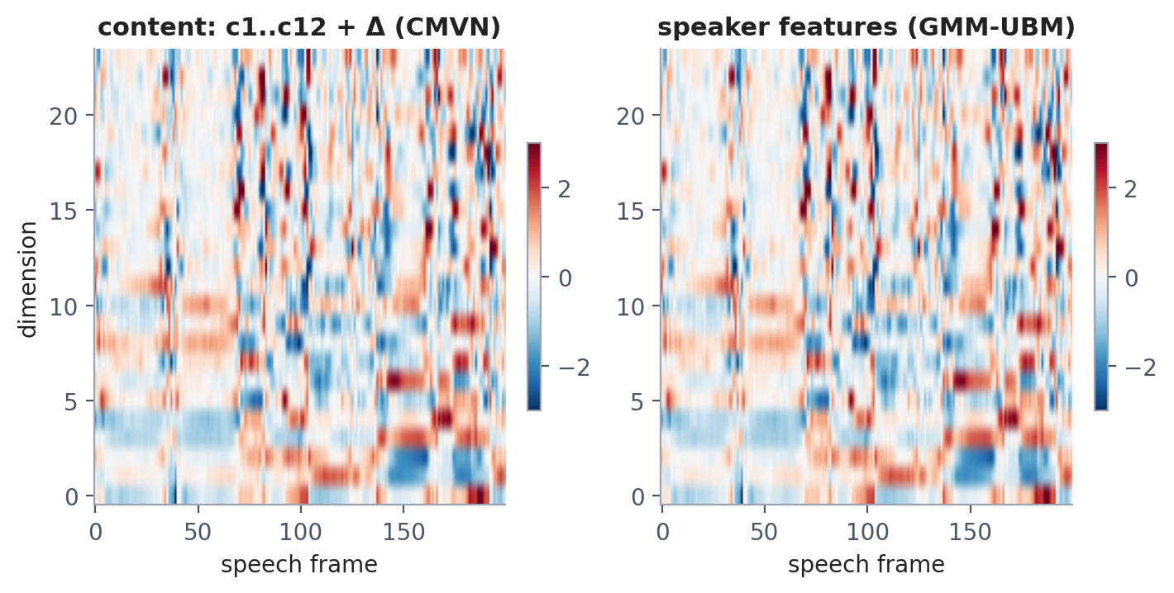
3.2 Design Methods (PO(a))
Mathematical justification: why a new microphone broke v4.1.4
Microphone / room = LTI filter
Y(ω) = X(ω)·H(ω) ⇒ log|Y| = log|X| + log|H|
After the DCT
c_y[t] = c_x[t] + c_h (c_h constant over the utterance)
CMS / CMVN
c_y[t] − mean_t(c_y) = c_x[t] − mean_t(c_x) ⇒ H(ω) cancels exactly
Delta (FIR differentiator)
Content features (left) drive the DTW word match; speaker features (right) drive the GMM voice model. Both are zero-mean and unit-variance per utterance, whichever microphone recorded them.
Δc[t] = Σₙ n·(c[t+n] − c[t−n]) / (2Σₙ n²), N = 2 — blind to any offset
v4.1.4's frozen calibration set CmsNormalise = 0 and enrolled only 1.wav, so the channel stayed inside every feature.
Presented by: 2206141

Slide 13
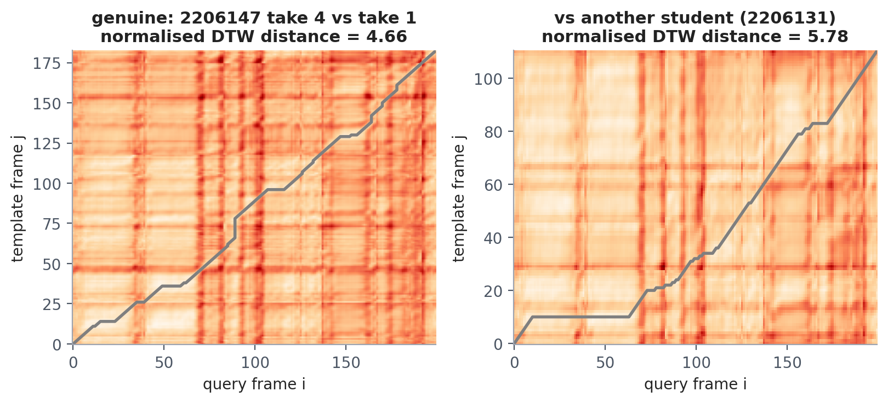
3.2 Design Methods (PO(a))
Modification: multi-template DTW with cohort normalisation
D(i,j) = ‖aᵢ − bⱼ‖ + min{D(i−1,j−1), D(i−1,j), D(i,j−1)}, band |i − j| ≤ 0.4·max(n, m); distance = D(n,m)/K (path length).
Every usable take of every student is a template: dₖ = min over student k's takes (v4.1.4 used only 1.wav).
Cohort score:
P(k) = ln [ mean of the 5 smallest dⱼ (j ≠ k) / dₖ ]
A new microphone scales all dⱼ together; the ratio cancels it. P > 0 ⇔ closer to k than to k's nearest rivals.
The genuine take follows a near-diagonal low-cost valley. Another student's template forces long detours (warping) and a 24 % higher mean frame distance; the cohort ratio turns this gap into P_name.
Presented by: 2206141

Slide 14
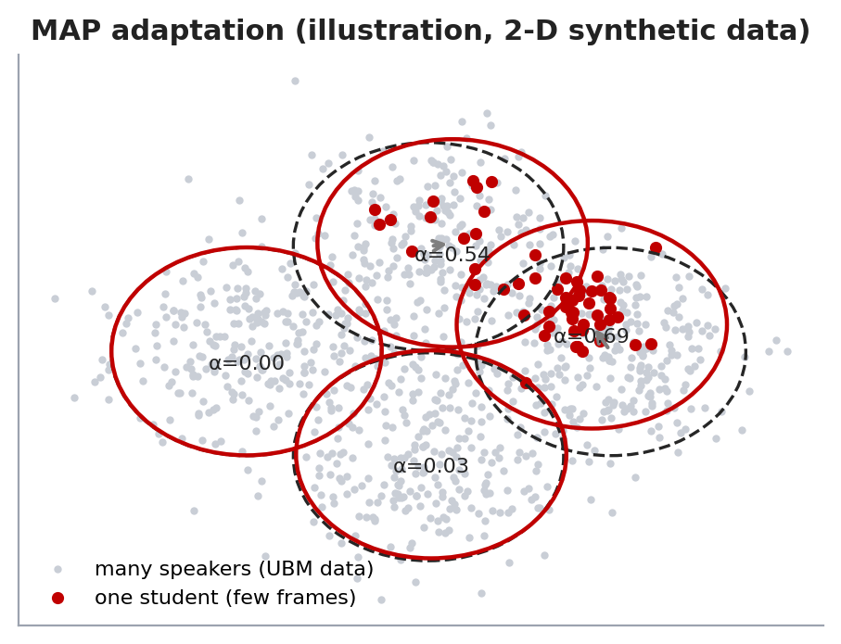
3.2 Design Methods (PO(a))
Modification: GMM-UBM voice biometrics with MAP adaptation
p(x|λ) = Σₖ wₖ N(x; μₖ, diag σₖ²), K = 64. The UBM is trained by EM on every student's digit speech — never on a test phrase.
MAP (means only): nₖ = Σₜ γₜ(k), Eₖ[x] = Σₜ γₜ(k)xₜ / nₖ, αₖ = nₖ/(nₖ + 16), μ̂ₖ = αₖEₖ[x] + (1 − αₖ)μₖ
LLR(k) = (1/T) Σₜ [ln p(xₜ|λₖ) − ln p(xₜ|UBM)]; V(k) = LLR(k) − mean of the 5 best other LLRs.
Text independent: ID + name frames (3–5 s) and the challenge digits all give voice evidence.
Why a UBM?
Only components a student used move away from the UBM, so little speech cannot over-fit; the UBM term removes what all speakers share (phrase, room, mic).
Presented by: 2206141

Slide 15
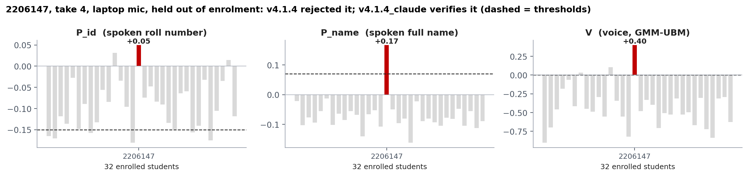
3.2 Design Methods (PO(a))
Algorithm: fused decision, imposter identification, unknown speaker
Fuse
F(k) = 0.5·P_id(k) + 1.0·P_name(k) + 0.25·V(k); candidate c = argmax F (or the typed ID).
VERIFIED
P_name(c) ≥ 0.07, P_id(c) ≥ −0.15, V(c) ≥ 0, and c is the rank-1 voice.
IMPOSTER
Words name X = argmax(P_id + P_name), voice says Y = argmax V: Y ≠ X, V(Y) − V(X) ≥ 0.15, V(Y) ≥ 0.20 → report "likely imposter = Y".
UNKNOWN
max V < 0 and max P_name < 0.07: the speaker is not enrolled.
Presented by: 2206141

Slide 16
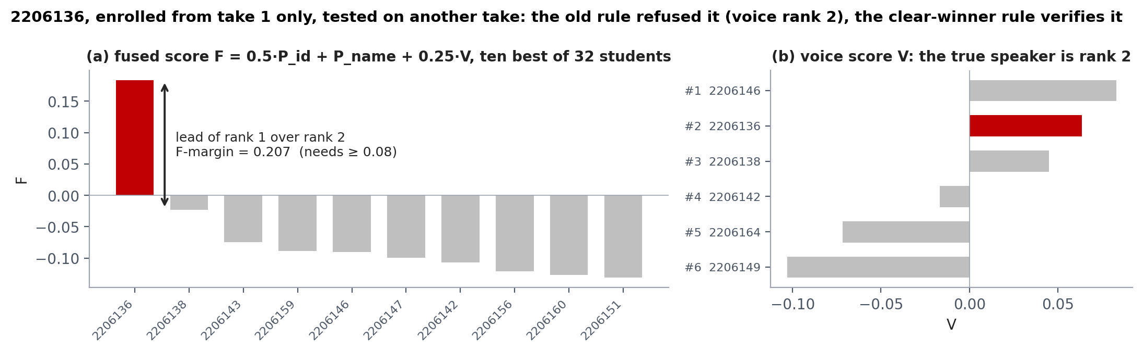
3.2 Design Methods (PO(a))
New in v1.1: the "clear winner" ranking rule
Counter question: rank 1 is the right student, yet access is refused. Lower the threshold, or accept a clear rank-1 lead?
Enrol take 1, test other takes | v1.0 | v1.1
Genuine accepted | 91.8 % | 95.3 %
Unknown speaker accepted | 0.9 % | 0.9 %
Perfect-words imposter accepted | 0.08 % | 0.25 %
Also accept c (voice not rank 1) when
F(c) − F(rank 2) ≥ 0.08 (clear lead)
P_name(c) ≥ 0.12 (strong name match)
voice rank of c ≤ 3 and V(c) ≥ −0.10
P_id(c) ≥ −0.15 and no imposter conflict
Lowering P_name to 0.05 instead was measured to admit 2.6 % of unknown speakers, so it was rejected (Python mirror: 85 genuine / 117 unknown / 3627 mimic trials).
Presented by: 2206141

Slide 17
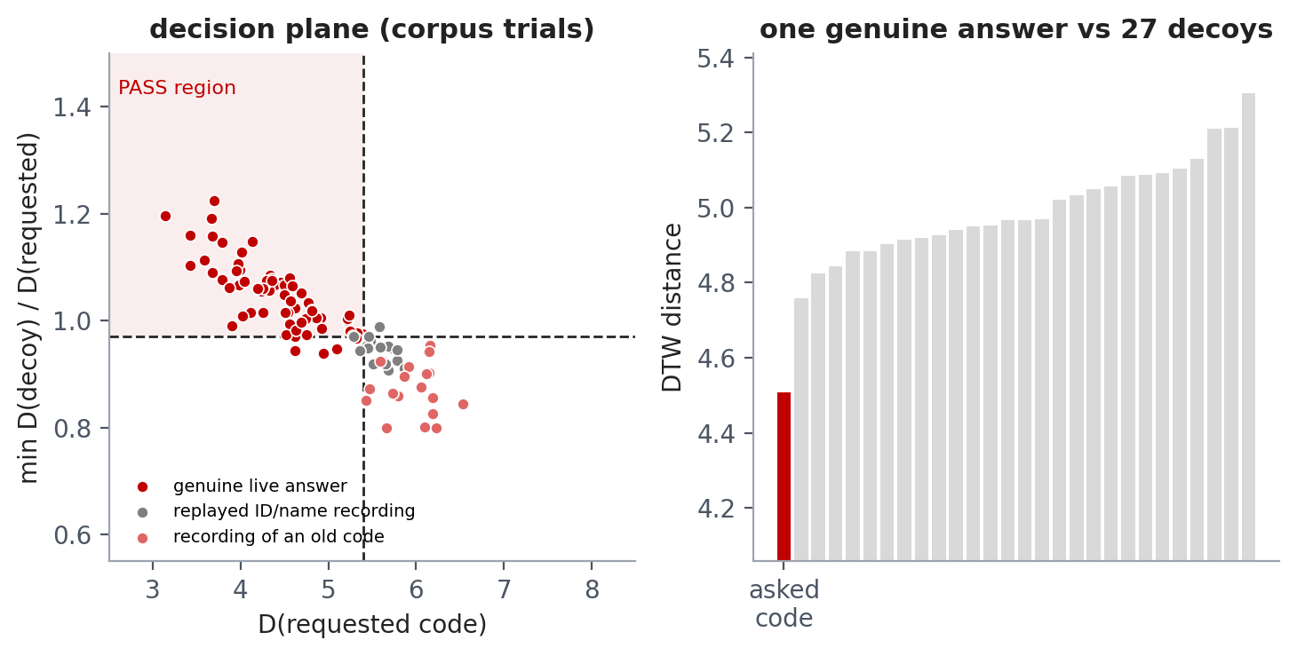
3.2 Design Methods (PO(a))
Modification: replay-attack prevention in three layers
L1 Random challenge
3 random digits; reference = the claimed student's own digits, DTW-compared with 27 one-digit decoys. PASS if D_req ≤ 5.40, min D_decoy / D_req ≥ 0.97, voice gap < 0.40. Two attempts.
Splice guard
D_req < 2.0 ⇒ pasted from the stored digit files (smallest genuine value 3.58).
L2 Replay memory
DTW < 1.0 to any stored take or the last 20 accepted takes ⇒ digital copy (natural repeats ≥ 2.41).
Corpus trials: genuine live answers pass 93 % per attempt; replayed ID/name recordings 0/18; old-code recordings 0/18. A recording cannot contain digits chosen one second ago.
L3 Sub-200 Hz ratio
The proposal's loudspeaker cue, kept as a logged advisory (no labelled replay corpus to calibrate it).
Presented by: 2206141

Slide 18
3.3 Design: System Block Diagram
Software signal chain (replaces the circuit diagram: no custom hardware)
Words (DTW)
P_id, P_name vs all takes
Microphone
ID + name · 0.5 s ambient · auto-stop
Front-end
8 kHz · spectral subtr. · MFCC+Δ · CMVN
Fused decision
VERIFIED · IMPOSTER (who) · UNKNOWN · RETRY
Voice (GMM-UBM)
V = cohort-normalised LLR
Replay memory
exact copy of a stored take?
SERVE + log
CSV audit · self-adapt to a new mic
Roster + meal window
this month · one meal per window
Random 3-digit challenge
right digits · same voice · not spliced
Any failed gate ends the transaction with a named reason; every attempt is logged to VerificationAttempts.csv.
Presented by: 2206147

Slide 19
3.4 Design: Simulation – Key Code (1/2)
vsd_decide.m: fused decision, imposter identification, clear winner
MATLAB · vsd_decide.m (condensed)
How it works
F = c.WeightID*Pid + c.WeightName*Pn + c.Lambda*V;
[~, order] = sort(F, 'descend'); cidx = order(1);
if ~isempty(claimedId), cidx = claimIdx; end
[~, vorder] = sort(V, 'descend');
vrank = find(vorder == cidx, 1);
[~, X] = max(Pid + Pn); % who the WORDS name
Y = vorder(1); % whose VOICE it is
Gphrase = Pn(cidx) >= c.MinPname && Pid(cidx) >= c.MinPid;
Gvoice = V(cidx) >= c.MinVoice && vrank <= c.VoiceRankMax;
isImp = (Y ~= X) && (V(Y) - V(X) >= c.ImpGap) ...
&& (V(Y) >= c.ImpMinVoice);
cw = Pn(cidx) >= 0.12 && R.FMargin >= 0.08 ...
&& vrank <= 3 && V(cidx) >= -0.10; % clear winner
if isImp
R.Decision = 'IMPOSTER'; R.ImposterSuspect = st{Y};
elseif (Gphrase && Gvoice) || cw
R.Decision = 'VERIFIED'; R.Student = st{cidx};
elseif max(V) < c.MinVoice && max(Pn) < c.MinPname
R.Decision = 'UNKNOWN'; % not enrolled
else
R.Decision = 'RETRY'; % names the weak gate
end
One score per student joins what was said (P_id, P_name) and who said it (V).
The roll number gets half weight: 2206xxx is almost the same for everyone.
X and Y are computed independently; a strong disagreement names the real speaker Y.
The clear-winner test accepts a far-ahead rank 1 whose voice is in the top 3.
Every branch sets a Stage and a Reason for the GUI gate table and the CSV log.
Presented by: 2206147

Slide 20
3.4 Design: Simulation – Key Code (2/2)
CMVN front-end, MAP adaptation and the random-digit check
% vsd_frontend.m -- remove the microphone
content = [cs ds]; % c1..c12, delta
mu = mean(content,1); sd = std(content,1,1);
U.Content = (content - mu) ./ sd; % CMVN
% vsd_gmm.m -- MAP adaptation of UBM means
P = exp(L - max(L,[],2)); P = P./sum(P,2);
n = sum(P,1).'; % soft counts
Ex = (P.'*X) ./ max(n,1e-10); % 1st-order stats
a = n ./ (n + r); % r = 16
mu = a.*Ex + (1-a).*ubm.mu;
% vsd_challenge.m -- fresh digits only
codes = [code; neighbours(code)]; % + 27 decoys
for k = 1:size(codes,1)
T = template(M.Digits{s}, codes(k,:), c);
D(k) = vsd_dtw(U.Content, T.Content, 0.4);
end
margin = min(D(2:end)) / D(1);
splice = D(1) < c.Challenge.MinDist;
pass = D(1) <= 5.40 && margin >= 0.97 && ~splice;
% + voice of the digits: gap < 0.40
CMVN is the microphone fix: the per-utterance mean removes log|H(ω)|; the std equalises level.
MAP moves each UBM mean toward the student in proportion to the data it explains, α = n/(n+16).
The asked code must beat all 27 codes that differ by one digit — the hardest confusions.
An answer too close to the stored digits (D < 2.0) is a paste-up, not speech.
Presented by: 2206147

Slide 21
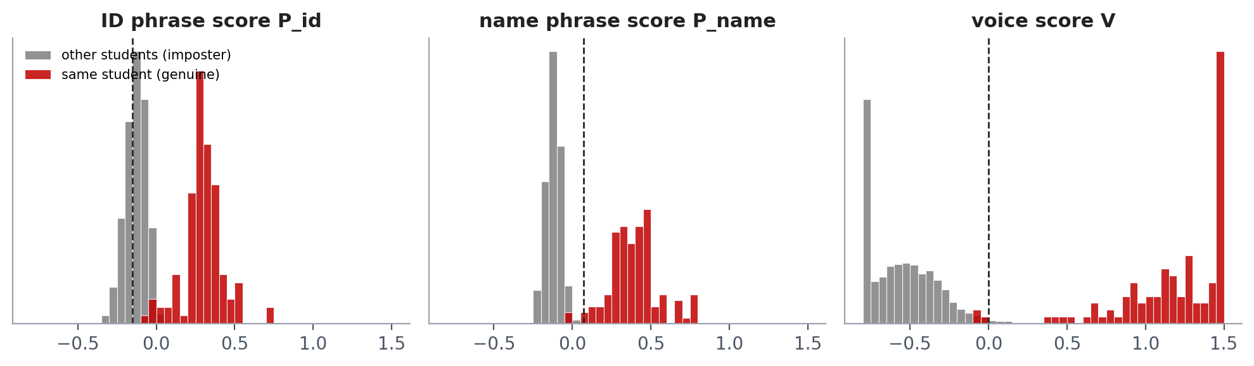
3.4 Design: Simulation Results
Genuine vs imposter score distributions (all corpus trials)
Name and voice separate cleanly: genuine medians +0.40 and +1.28, while 99 % of imposter scores lie below −0.01 and 0.00. Dashed lines = deployed thresholds.
The ID phrase alone overlaps heavily — why v4.1.4's "ID must match first" rule failed, and why P_id now only has a veto at −0.15.
Presented by: 2206147

Slide 22
4 Implementation: Demonstration
Working process: one counter transaction, step by step
1 Capture
2 Front-end
3 Score all
4 Decide
ID then name; 0.5 s ambient, 3-2-1 cue, auto-stop after 0.8 s silence
resample, noise subtraction, speech mask, MFCC+Δ, CMVN
DTW vs every take + GMM-UBM LLR for all 32 students
fused score, gates, clear winner, imposter X≠Y, unknown
8 Serve & learn
7 Roster & meal
6 Challenge
5 Replay memory
log CSV, speak welcome, store confident takes (new mic)
assigned this month, meal window open, not served yet
"say four seven two": digits + voice + splice guard
refuse exact copies of stored or accepted takes
Presented by: 2206147

Slide 23
4 Implementation: Demonstration
Software modules (MATLAB, runs with RUN_ME)
Module | Function | DSP content
vsd_frontend.m | Resample, spectral subtraction, speech mask, MFCC+Δ, CMVN | Exp. 1–5: sampling, DFT, FIR, windowing
vsd_dtw.m | Anti-diagonal vectorised DTW, Sakoe-Chiba band | Dynamic programming
vsd_gmm.m, vsd_build_models.m | 64-mixture UBM (EM), MAP adaptation, incremental cache | Statistical modelling
vsd_score_query.m, vsd_decide.m | Cohort scores, fused decision, clear winner, imposter / unknown | Normalisation, hypothesis test
vsd_challenge.m, vsd_replay_guard.m | Random digits + 27 decoys, splice guard, replay memory | Anti-spoofing
vsd_verify_transaction.m, verify_meal_workflow.m | Counter transaction, roster, meal window, CSV logs | System integration
meal_verification_gui.m | 6-gate table, IMPOSTER / REPLAY banners, digit recorder | App Designer GUI
>> RUN_ME % counter GUI >> RUN_ME('demo') % 7 genuine / attack cases
>> RUN_ME('evaluate') % every stored voice >> RUN_ME('rebuild') % retrain the voice models
Presented by: 2206147

Slide 24
4 Implementation: Demonstration
RUN_ME('demo'): seven complete transactions from stored recordings
Case | Input | Engine decision | Gate that acted
1 Genuine | 2206147 says own ID + name (take 4, laptop mic, held out) + live digits | VERIFIED 2206147 | all gates passed
2 Imposter | 2206147 types 2206141's ID and speaks | IMPOSTER → 2206147 | 4 Imposter check
3 Imposter | 2206147 says 2206141's roll number + plays his name | IMPOSTER → 2206147 | 4 Imposter check
4 Replay | 2206141's stored enrolment files injected | REPLAY | 5 Replay memory
5 Replay | 2206141 played through a phone speaker | RETRY (refused) | 2 Phrase content
6 Stale code | recording of an old code 2-1-9 for asked 5-6-6 | REPLAY | 5 Challenge
7 Splice | 2206141's enrolled digit files pasted as the answer | REPLAY | 5 Splice guard
All 7 cases behave as designed. Offline sweep, one full transaction per student with the challenge: 30 of 32 students verified end-to-end.
Presented by: 2206147

Slide 25
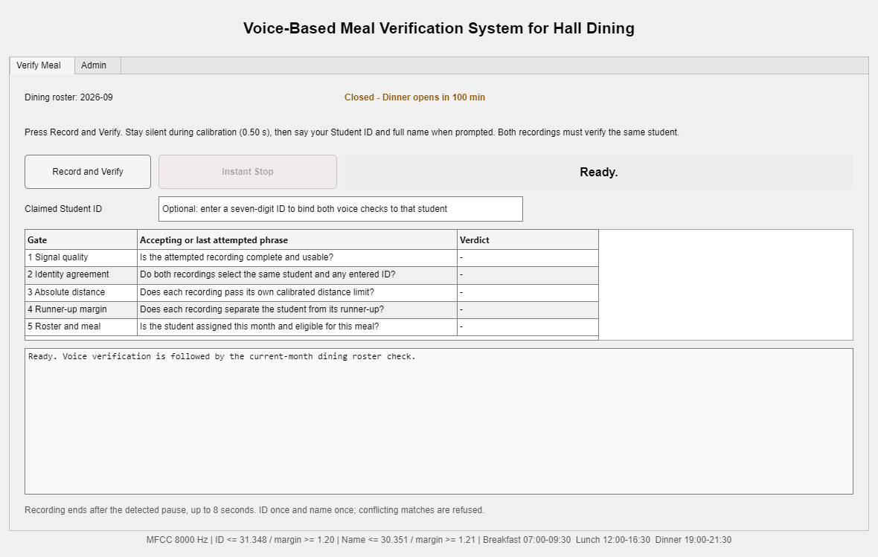
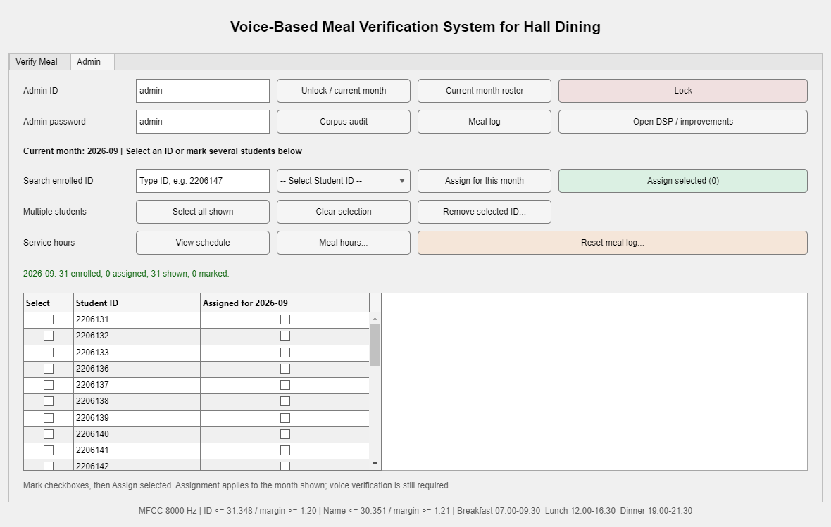
4.1 Implementation: Photo Gallery
Working process, captured (1/2)
Counter GUI: Verify tab (v4.1.4 shell; v4.1.4_claude adds 6 security gates)
Admin workspace: monthly roster and meal hours
Presented by: 2206147

Slide 26
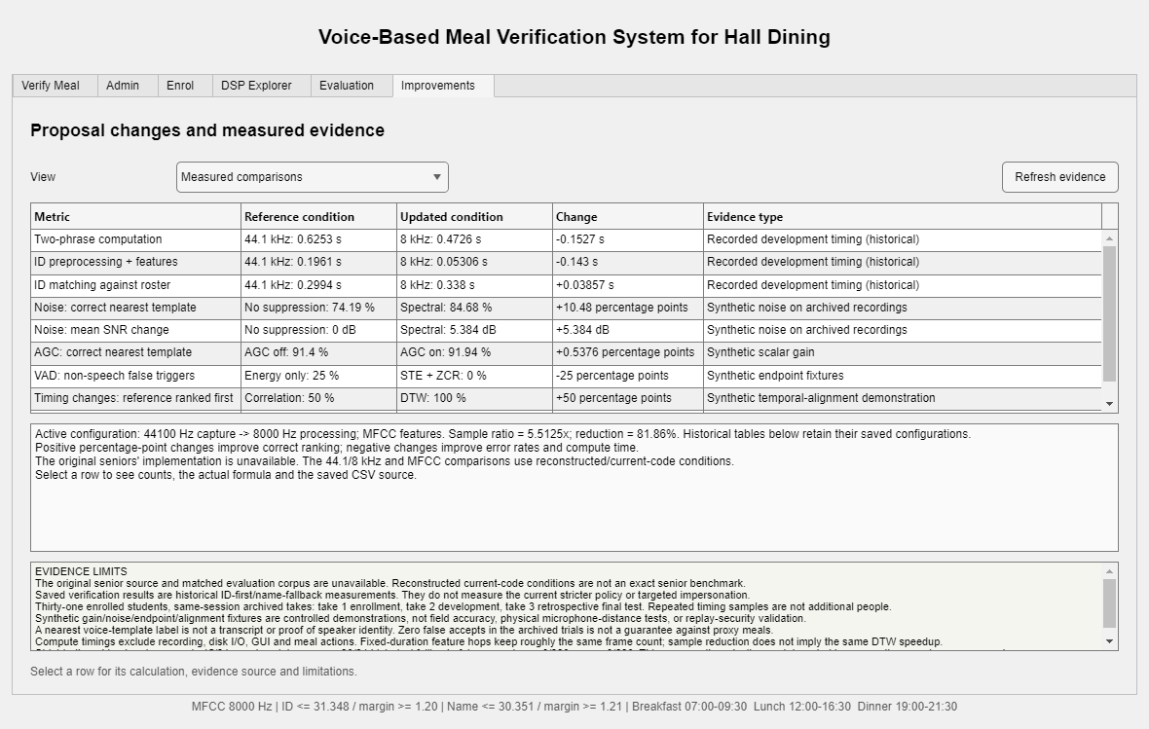
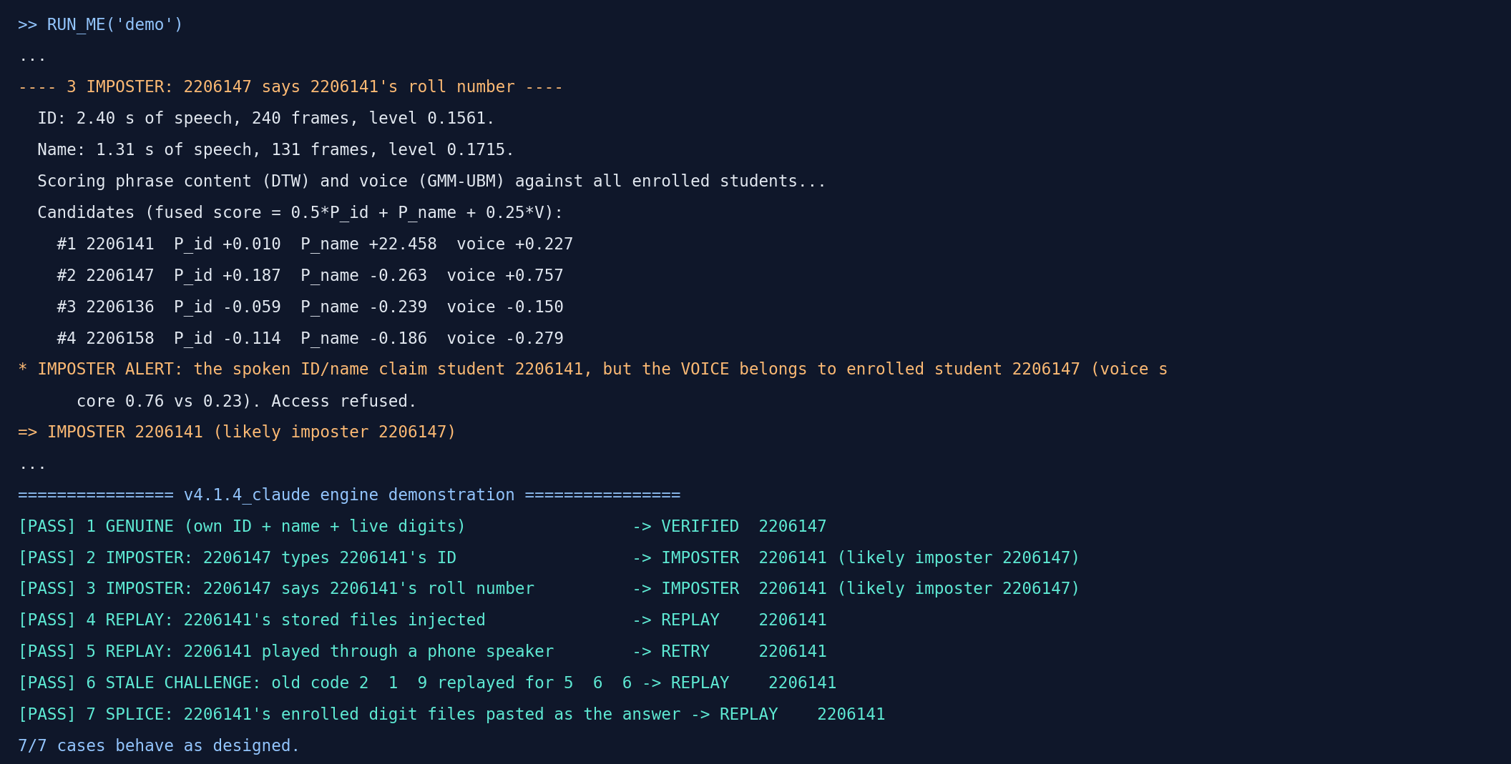
4.1 Implementation: Photo Gallery
Working process, captured (2/2)
RUN_ME('demo'): actual engine output of the 7 test transactions
Admin workspace: measured-improvements evidence tab
Presented by: 2206147

Slide 27
5. Design Analysis and Evaluation
5.1
5.2
5.3
5.4
Novelty vs the seniors' baseline
Design Considerations (PO(c))
Investigations (PO(d))
Limitations of Tools (PO(e))
5.5
5.6
5.7
CO
Impact Assessment (PO(f))
Sustainability Evaluation (PO(g))
Ethical Issues (PO(h))
CO–PO attainment
Presented by: 2206150

Slide 28
5.1 Novelty
Modifications from the seniors' baseline (1/2)
Component | Seniors' baseline (Hall Entry, VQ) | Ours: v4.1.4_claude
Acquisition | Fixed 3 s blocking recording at 44.1 kHz | 0.5 s ambient + auto-stop (0.8 s silence, 8 s cap)
Sampling | 44.1 kHz for all processing | Rational resampling to 8 kHz (L/M = 80/441), 5.5× fewer samples
Noise | None (a Wiener file existed but was unused) | Power spectral subtraction, noise from the quietest 10 % of frames
Pre-emphasis / framing | 1 − 0.99 z⁻¹; block-energy silence remover | 1 − 0.97 z⁻¹; 25 ms Hamming, 10 ms hop; 30 dB speech mask
Features | 12 MFCC + Δ + ΔΔ, 50–7000 Hz, no normalisation | c1–c12 + Δ, 100–3800 Hz, CMVN (cancels the mic)
Templates | One 8-codeword LBG-VQ codebook per phrase | Every take as a DTW template + adaptive store for new mics
Presented by: 2206150

Slide 29
5.1 Novelty
Modifications from the seniors' baseline (2/2)
Component | Seniors' baseline (Hall Entry, VQ) | Ours: v4.1.4_claude
Matching | Nearest VQ codebook (Euclidean distortion) | DTW (Sakoe-Chiba) + cohort score P = ln(rivals / own)
Voice model | None | 64-mixture GMM-UBM, MAP r = 16, cohort-normalised LLR
Decision | Accept if ID and name codebooks agree; no threshold | Fused F, phrase + voice gates, clear-winner rule, UNKNOWN
Imposter | Not detected (any voice saying a name is accepted) | Words-vs-voice conflict: refuse and name the likely imposter
Replay | None | Random 3-digit challenge (27 decoys), splice guard, replay memory
Application | Gate attendance only | Monthly roster, meal windows, one meal per window, CSV audit, GUI
Presented by: 2206150

Slide 30
5.2 Design Considerations (PO(c))
5.2.1 Public health and safety
5.2.2 Environment
5.2.3 Cultural and societal needs
Touchless: no shared meal card, keypad or pen.
A refusal always states the reason and the next step, so no argument builds at a busy queue.
The typed ID is optional.
Software only: existing PC and microphone, no new hardware.
No printed monthly meal cards or coupons.
8 kHz processing cuts computation (and power) about 5.5×.
Works with Bangla and English names: words are matched with the student's own templates, not a language model.
Stops proxy meals, protecting the food budget of paying residents.
Trade-off we accepted: the 3 s digit challenge costs a little speed at the counter but is what makes a phone recording useless; everything else runs on hardware the hall already owns.
Presented by: 2206150

Slide 31
5.3 Investigations (PO(d))
Same data, same protocol: enrol take 1, test every other take
Reading the chart
Same mic: 100.0 % vs 87.9 % (seniors).
Other mic — the hall complaint: 85.2 % vs 25.9 % (seniors) and 7.4 % (v4.1.4).
Unknown speakers: 0.9 % vs 15.4 % (seniors).
Trials: 58 same-mic + 27 other-mic genuine, 117 unknown-speaker.
Presented by: 2206150

Slide 32
5.3 Investigations (PO(d))
Deployed configuration v1.1: all takes enrolled, measured in MATLAB/Octave
98.3 %
90.0 %
0.0 %
0.22 %
genuine accepted, leave-one-take-out (114/116), all mics
genuine accepted, enrolled on the database mic only, tested on other mics (18/20)
unknown speakers accepted (0/116, each student removed in turn)
perfect-words imposters accepted (8 of 3596 trials)
Wrong-student accepts: 0 in all genuine protocols. When the words claim X but the voice is enrolled student Y, Y is named as the likely imposter in 97.4 % of mimic trials.
Replay: every stored file injected digitally was blocked (DTW 0.00 < 1.0). Replayed or stale recordings passed the challenge 0/18; a spliced answer (distance 0.01) was caught.
Full transaction sweep (challenge included): 30 of 32 students verified end-to-end; demo 7/7.
Presented by: 2206150

Slide 33
5.3 Investigations (PO(d))
Which modification produced which gain (ablation, one change at a time)
Configuration (same features, same trials) | Genuine accepted (LOTO) | Genuine accepted (cross-mic) | Unknown speaker accepted
Words only: ID and name must agree (v4.1.4 rule) | 95.7 % | 65.2 % | 13.7 %
Words only: fused P_id + P_name, gates | 97.4 % | 78.3 % | 6.0 %
Voice only: GMM-UBM, V ≥ 0 | 97.4 % | 78.3 % | 100.0 %
Agreement rule + voice gate | 95.7 % | 65.2 % | 6.0 %
Deployed: fused words + voice + imposter check | 97.4 % | 78.3 % | 0.0 %
Rejected variant: CMS-only voice features (no variance norm.) | 97.4 % | 60.9 % | —
Rejected variant: 20 cepstra instead of 12 | 96.6 % | 52.2 % | —
Rejected variant: 32 mixtures instead of 64 | 96.6 % | 65.2 % | —
Python mirror, identical trials (v1.0 decision rules). Voice alone accepts every stranger, words alone let 6 % through; only the fusion reaches 0 %. The last rows are variants we tried and rejected.
Presented by: 2206150

Slide 34
5.3 Investigations (PO(d))
Field log: 2206141 ranked first but was refused — diagnosis and fix
v4.1.4 counter log | Try 1 | Try 2
ID phrase best match | 2206157 | 2206144
Name phrase best match | 2206141 | 2206141
Name lead (runner-up ÷ best) | 1.209 | 1.194
Required fixed margin | 1.212 | 1.212
Joint margin for 2206141 | 1.13× | 1.09×
v4.1.4 decision | REFUSED | REFUSED
Option (enrol take 1) | GAR | FAR unknown | Mimic
v1.0 rules | 91.8 % | 0.9 % | 0.08 %
A: lower P_name 0.07 → 0.05 | 91.8 % | 3.4 % | 0.08 %
B: P_id veto −0.10 → −0.15 | 92.9 % | 0.9 % | 0.08 %
C: clear-winner rule | 94.1 % | 0.9 % | 0.25 %
v1.1 deployed = B + C | 95.3 % | 0.9 % | 0.25 %
Enrol take 1 only; with all takes enrolled, A admits 2.6 % of unknown speakers, the others 0 %
The ID phrase is a near-tie for everyone, so its top-1 is random and vetoed the correct name.
The name ranked the right student first, only 0.3 % and 1.5 % short of a fixed margin.
Applied: v1.1 engine (B + C) and, for the old v4.1.4 matcher, a relative "clear winner" rescue: name rank 1 with lead ≥ 1.12, joint margin ≥ 1.08, ID within 12 % of the best, voice in the top 3 — and every legacy accept must now pass the GMM-UBM voice veto.
Presented by: 2206150

Slide 35
5.3 Investigations (PO(d))
Field log: 2206147 said 2206150's roll number and name — and got in
v4.1.4 counter log (old matcher) | Value
Joint rank 1 / rank 2 | 2206150 1.13 / 2206163 1.21
Lead of rank 1 (ratio) | 1.07× (weak)
ID phrase best match | 2206158 (2206150 only rank 3)
ID distance / fixed limit | 32.15 / 31.35 (above)
Name distance / fixed limit | 35.56 / 30.35 (above)
Voice check | 8-mixture GMM from one take: did not stop it
Decision | VERIFIED 2206150 — meal served to an imposter
2206147's held-out takes, words forced to 2206150 | V(2206150) | Best voice | Decision
take 1 (database mic) | −0.82 (#28) | 2206147 +1.36 | IMPOSTER
take 2 (database mic) | −0.85 (#28) | 2206147 +1.40 | IMPOSTER
take 3 (database mic) | −0.84 (#28) | 2206147 +1.47 | IMPOSTER
take 4 (laptop mic) | −0.46 (#16) | 2206147 +0.26 | IMPOSTER
v4.1.4_claude engine: refuses and names "likely imposter = 2206147" in 4 / 4 takes (voice gap ≥ 0.72 ≫ 0.15).
Legacy matcher in v4.1.4_claude: now vetoed by the same GMM-UBM voice check (vsd_voice_veto.m) before any meal is served.
Corpus-wide: 0.22 % of perfect-words imposters accepted; the real speaker named in 97.4 %.
The old matcher only compares the WORDS. Anyone who says the right roll number and name sounds like the owner to it.
Presented by: 2206150

Slide 36
5.3 Investigations (PO(d))
Interpretation of the improvements
Observed improvement | Cause (theory) | Evidence
2206147 and others accepted on the laptop mic | CMVN removes log|H(ω)|; all takes enrolled; the cohort ratio cancels the common distance shift | Other-mic acceptance 7.4 % → 85.2 % (take 1), 92.9 % (26/28) (all takes)
No more "ID and name disagree" refusals | The ID phrase has half weight and a −0.15 veto instead of top-1 agreement | Live ID margin median 1.02
Clear winners accepted | A large rank-1 lead is strong evidence even if the voice is only rank 2–3 | Take-1 GAR 91.8 % → 95.3 %, FAR unchanged
Unknown speakers refused | Voice gate V ≥ 0 / top rank: a stranger is never the best voice | FAR 15.4 % (seniors) → 0.0 %
Imposter named, not only refused | Independent X (words) vs Y (voice) with a gap test | 97.4 % of mimic trials named
Recordings refused | Digits unknown in advance; digital copies have DTW ≈ 0 | Replay 0 %, stale code 0 %
Presented by: 2206150

Slide 37
5.4 Limitations of Tools (PO(e))
The corpus has 32 speakers and 3–15 takes each; only 28 genuine test pairs were recorded on non-database microphones, so cross-mic rates carry wide confidence intervals (±10–15 %).
No labelled corpus of real loudspeaker replays exists, so the sub-200 Hz cue could not be calibrated; replay tests used simulated phone playback.
8 kHz sampling limits the band to 4 kHz: high-band replay artefacts (e.g. CQCC cues above 4 kHz) are not observable.
MATLAB and Octave resample() use different anti-alias filters (feature difference ≈ 0.005); thresholds were checked in both.
Audio devices report no calibration, so only relative (normalised) quantities can be trusted.
DTW is O(N·M) per template and grows with the roster: 32 students × ~5 takes × 2 phrases ≈ 300 alignments per transaction.
Presented by: 2206150

Slide 38
5.4 Limitations of Tools (PO(e))
Limitations of the current system and how they are handled
Limitation | Measured effect | Mitigation in v4.1.4_claude / next step
Enrolled on one microphone, tested on another | 90.0 % genuine accepted cross-mic | Self-adaptation stores the first confident accept on a new mic; record one enrolment take per mic
Digit challenge takes time | ≈3 s per student; ≈1 code in 6 needs a 2nd try | Two attempts allowed; 2206145 still failed both in the sweep
Three students have no isolated digits | 2206135, 2206148, 2206149 | Challenge falls back to cohort templates; record digits in the Enrol tab
Clear-winner rule | Mimic acceptance 0.08 % → 0.22 % | Accepted as the price of +3.5 points GAR; imposter check still runs first
Voice synthesis / conversion, identical twins | Not tested | Out of scope; learned countermeasure in future work
Presented by: 2206150

Slide 39
5.5 Impact Assessment (PO(f))
5.5.1 Societal and cultural issues
5.5.2 Health and safety issues
5.5.3 Legal issues
Fair, fast access to meals.
Proxy dining and meal-card trading become detectable, so hall funds serve residents who paid.
No shared cards or surfaces at the counter.
Each refusal is explained aloud and on screen, so no queue forms over an unexplained "no".
A voiceprint is biometric personal data: informed consent, storage on the hall PC only, deletion on leaving the hall.
Admin-only, password-gated workspace.
Assessment: positive for fairness and hygiene; the legal risk (biometric data) is controlled by consent, local storage and admin-only access.
Presented by: 2206150

Slide 40
5.6 Sustainability Evaluation (PO(g))
Paper-free
No new hardware
Incremental
Replaces printed monthly meal cards and coupons with a CSV roster.
Runs on an existing PC and microphone; a full model rebuild takes about a minute.
Adding a student re-processes only the new files; the UBM is reused.
Long life
Re-usable
Low energy
Self-adaptation keeps accuracy when the hall replaces its microphone.
Modular vsd_*.m code can move to other halls, libraries or exam attendance.
8 kHz features: ~5.5× fewer samples than the 44.1 kHz baseline.
Presented by: 2206150

Slide 41
5.7 Ethical Issues (PO(h))
Consent
Data stays local
Suspicion, not proof
Informed consent for every recording; the voices are used only for this course project.
Templates and logs stay on the hall PC; the log stores scores, never audio (except 3 adaptive takes per student).
A "likely imposter" is a hint for the hall office; a human decides any action.
Honest reporting
Credit to prior work
Fair peer evaluation
Failures (2 of 32 in the sweep, cross-mic limits, the imposter cost of the clear-winner rule) and simulated replay tests are stated as such.
The seniors' Hall Entry baseline and the literature in the references are acknowledged.
Objective, ethical evaluation of every member's contribution.
Presented by: 2206150

Slide 42
Course Outcomes and Program Outcomes (CO–PO)
CO | CO statement (EEE 312) | PO | Level | Where in this project
CO1 | Understand DSP algorithms and implement them in software | PO(a), PO(e) | P1, P4 | Resampling, spectral subtraction, windowing, MFCC, FIR Δ, DTW, GMM in MATLAB (3.2)
CO2 | Compare theoretical and experimental results | PO(d) | C5 | CMVN channel cancellation, score distributions, before/after evaluation (3.4, 5.3)
CO3 | Design filters and systems to specification; individual and team work | PO(c), PO(i) | C6, A3 | Front-end and fused decision tuned to GAR / FAR targets (3.2, 5.3)
CO4 | Design a digital system with health, safety, societal, cultural and environmental considerations | PO(c), PO(l) | P7 | Touchless, proxy-proof dining with replay protection; literature review (3.1, 5.2)
CO5 | Apply ethical principles; evaluate peers ethically | PO(h) | A3 | Consent, biometric-data handling, honest reporting (5.7)
CO6 | Work effectively as an individual and a team member | PO(i) | P4 | Module ownership, joint integration and testing (6)
CO7 | Report effectively: presentation, user manual, detailed report | PO(j) | A3 | This deck, project guide (PDF/HTML), README, demo video (7)
Presented by: 2206150

Slide 43
6. Reflection on Individual and Team work
6.1
6.2
6.3
Individual Contribution of Each Member
Mode of TeamWork and Diversity
Logbook of Project
Presented by: 2206135

Slide 44
6.1 Individual Contribution of Each Member
Member | Module(s) owned | Responsibilities
Samin Zahan Khan (2206135) | [fill in] | [fill in]
Syed Ibnul Morshed (2206141) | [fill in] | [fill in]
S M Sindid Islam Mahodi (2206147) | [fill in] | [fill in]
Abdullah Al Rohan (2206150) | [fill in] | [fill in]
All four members' own voices are part of the 32-speaker evaluation corpus.
Shared: data collection, dining rules (roster, meal windows), counter testing and documentation.
Presented by: 2206135

Slide 45
6.2 Mode of TeamWork and Diversity
How we worked
Diversity
Weekly lab sessions for integration and live counter tests.
One owner per module; changes merged through versioned folders (v3 → v4.1.4 → v4.1.4_claude).
Evaluation scripts shared so every member could re-run the numbers.
Four members with different strengths: signal processing, statistics, GUI and testing.
Different voices, accents and microphones in the team — the corpus itself tests the diversity the system must handle.
[Add a team photo or working-session pictures here]
Presented by: 2206135

Slide 46
6.3 Logbook of Project
When | Version / milestone | What was done
24 Jul 2026 | Revised proposal | Seniors' Hall Entry baseline studied; five modifications proposed (Exp. 1–4 + business logic)
After proposal | v3 → v4 | Spoken 7-digit ID as the key, name as fallback, 0.5 s ambient profile, 3-2-1 countdown
Before 27 Sep | v4.1 – v4.1.3 | Instant Stop, rollback, discard profile, meal-log reset, similarity display
27–28 Sep 2026 | v4.1.4 | Admin meal hours, monthly roster; corpus experiments and security checks
30 Sep 2026 | v4.1.4_claude 1.0 | Root-cause analysis of live refusals; VSD engine, imposter ID, anti-replay; full evaluation
30 Sep 2026 | v4.1.4_claude 1.1 | Field-log diagnosis; clear-winner ranking rule and relaxed ID veto; re-validation
Add the exact dates of the v3–v4.1.3 rows from the lab logbook.
Presented by: 2206135

Slide 47
7 Communication to External Stakeholders (PO(j))
GitHub link
YouTube link
[add repository URL]
[add video URL]
Video title: Voice-Based Meal Verification System for Hall Dining | C1.07 | EEE 312 (2026) Final Project | Dept of EEE, BUET
Project guide
User manual
Live demo
Full HTML / PDF guide: theory, maths, diagrams, code, outputs, viva questions.
README + RUN_ME modes: gui, demo, evaluate, rebuild.
Counter GUI with the 6-gate security table and IMPOSTER / REPLAY banners.
Presented by: 2206135

Slide 48
8. Project Management and Cost Analysis (PO(k))
Bill of materials (prototype) | Purpose | Cost
MATLAB (+ GNU Octave) | DSP, GUI, evaluation | University licence / free
Laptop / hall PC | Processing, counter kiosk | Existing
Microphones (laptop + USB) | Enrolment, cross-mic tests | Existing
Smartphone | Replay experiments | Existing
Per-unit cost of prototype |  | No new purchase
Mass-produced unit | Mini-PC or single-board computer + USB mic + small display | [fill in local prices]
Timeline of project implementation
1
Proposal and seniors' baseline study
2
DSP modules + GUI (v4.x)
3
Roster and meal logic
4
Corpus evaluation, root causes
5
VSD engine v1.0 → v1.1, guide, slides
Presented by: 2206135

Slide 49
9. Future Work (PO(l))
Enrolment on the hall mic
Learned replay detector
Larger halls
Record 1–2 takes per student on the actual counter microphone, and the digits for 2206135, 2206148, 2206149.
Collect a labelled replay corpus (phones, Bluetooth speakers) and train CQCC/LFCC-GMM so the sub-200 Hz advisory becomes a gate.
i-vector / x-vector embeddings and voice-based pre-selection before DTW for hundreds of residents.
Score calibration
Kiosk deployment
Better UX
Per-microphone Z/T-norm and an adaptive threshold that tracks the counter's noise level.
Single-board computer with a USB mic; link the roster to the hall office's payment records.
Spoken prompts in Bangla, shorter challenge for low-risk hours, dashboard for the hall office.
Presented by: 2206150

Slide 50
10. References
[1] S. Davis and P. Mermelstein, "Comparison of parametric representations for monosyllabic word recognition," IEEE Trans. ASSP, 28(4), 1980.
[2] H. Sakoe and S. Chiba, "Dynamic programming algorithm optimization for spoken word recognition," IEEE Trans. ASSP, 26(1), 1978.
[3] S. Furui, "Cepstral analysis technique for automatic speaker verification," IEEE Trans. ASSP, 29(2), 1981.
[4] D. A. Reynolds, T. F. Quatieri and R. B. Dunn, "Speaker verification using adapted Gaussian mixture models," Digital Signal Processing, 10, 2000.
[5] A. E. Rosenberg et al., "The use of cohort normalized scores for speaker verification," Proc. ICSLP, 1992.
[6] T. Matsui and S. Furui, "Concatenated phoneme models for text-variable speaker recognition," Proc. ICASSP, 1993.
[7] Z. Wu et al., "ASVspoof: the automatic speaker verification spoofing and countermeasures challenge," IEEE JSTSP, 11(4), 2017.
[8] S. Boll, "Suppression of acoustic noise in speech using spectral subtraction," IEEE Trans. ASSP, 27(2), 1979.
[9] A. V. Oppenheim, R. W. Schafer and J. R. Buck, Discrete-Time Signal Processing, 3rd ed., Pearson, 2009.
[10] J. G. Proakis and D. G. Manolakis, Digital Signal Processing: Principles, Algorithms, and Applications, 5th ed., 2022.
[11] Seniors' baseline: "Hall Entry" voice attendance project (VQ-LBG), EEE 312, BUET.
[12] EEE 312 course outline, Department of EEE, BUET: https://eee.buet.ac.bd
Presented by: 2206150

Slide 51
Thank You
Questions?
Live demo: RUN_ME · RUN_ME('demo') · RUN_ME('evaluate')
Presented by: 2206150

