Slide 1

ODP test file
Purpose: Provide example of this file type
Document file type: ODP
Version: 1.0
Remark: Including some simple transitions
File created by http://www.online-convert.com
More example files: http://www.online-convert.com/file-type
Text of “Example content”: Wikipedia (http://en.wikipedia.org/wiki/John_Doe)
License: Attribution-ShareAlike 3.0 Unported
(http://creativecommons.org/licenses/by-sa/3.0/)
Feel free to use and share the file according to the license above.

Slide 2
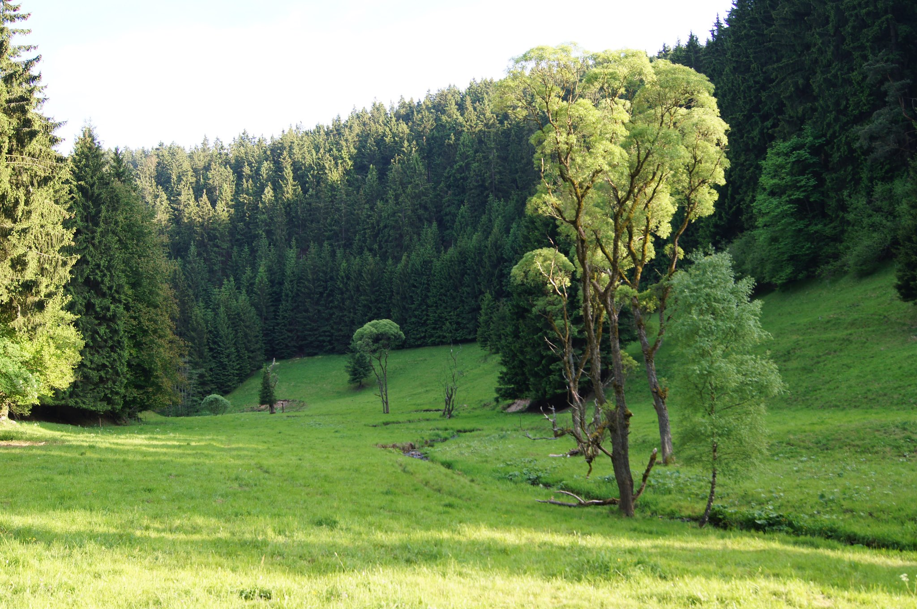
Example content:
The names "John Doe" for males, "Jane Doe" or "Jane Roe" for females, or "Jonnie Doe" and "Janie Doe" for children, or just "Doe" non-gender-specifically are used as placeholder names for a party whose true identity is unknown or must be withheld in a legal action, case, or discussion. The names are also used to refer to acorpse or hospital patient whose identity is unknown. This practice is widely used in the United States and Canada, but is rarely used in other English-speaking countries including the United Kingdom itself, from where the use of "John Doe" in a legal context originates.

