Slide 1


Here's your outline to get started
Key facts about your topic
A volcano is a rupture in the crust of a planetary-mass object, such as Earth, that allows hot lava, volcanic ash, and gases to escape from a magma chamber below the surface. Earth's volcanoes occur because its crust is broken into 17 major, rigid tectonic plates that float on a hotter, softer layer in its mantle. Therefore, on Earth, volcanoes are generally found where tectonic plates are diverging or converging, and most are found underwater. For example, a mid-oceanic ridge, such as the Mid-Atlantic Ridge, has volcanoes caused by divergent tectonic plates whereas the Pacific Ring of Fire has volcanoes caused by convergent tectonic plates. Volcanoes can also form where there is stretching and thinning of the crust's plates, e.g., in the East African Rift and the Wells Gray-Clearwater volcanic field and Rio Grande Rift in North America. This type of volcanism falls under the umbrella of "plate hypothesis" volcanism. Volcanism away from plate boundaries has also been explained as mantle plumes. These so-called "hotspots", for example Hawaii, are postulated to arise from upwelling diapirs with magma from the core–mantle boundary, 3,000 km deep in the Earth. Volca...
en.wikipedia.org - Text under CC-BY-SA license
See more: Open the Notes below for more information.
Notes:
QuickStarter has created an outline to help you get started on your presentation. Some slides include information here in the notes to provide additional topics for you to research.
Summary:
A volcano is a rupture in the crust of a planetary-mass object, such as Earth, that allows hot lava, volcanic ash, and gases to escape from a magma chamber below the surface. Earth's volcanoes occur because its crust is broken into 17 major, rigid tectonic plates that float on a hotter, softer layer in its mantle. Therefore, on Earth, volcanoes are generally found where tectonic plates are diverging or converging, and most are found underwater. For example, a mid-oceanic ridge, such as the Mid-Atlantic Ridge, has volcanoes caused by divergent tectonic plates whereas the Pacific Ring of Fire has volcanoes caused by convergent tectonic plates. Volcanoes can also form where there is stretching and thinning of the crust's plates, e.g., in the East African Rift and the Wells Gray-Clearwater volcanic field and Rio Grande Rift in North America. This type of volcanism falls under the umbrella of "plate hypothesis" volcanism. Volcanism away from plate boundaries has also been explained as mantle plumes. These so-called "hotspots", for example Hawaii, are postulated to arise from upwelling diapirs with magma from the core–mantle boundary, 3,000 km deep in the Earth. Volcanoes are usually not created where two tectonic plates slide past one another.

Slide 2
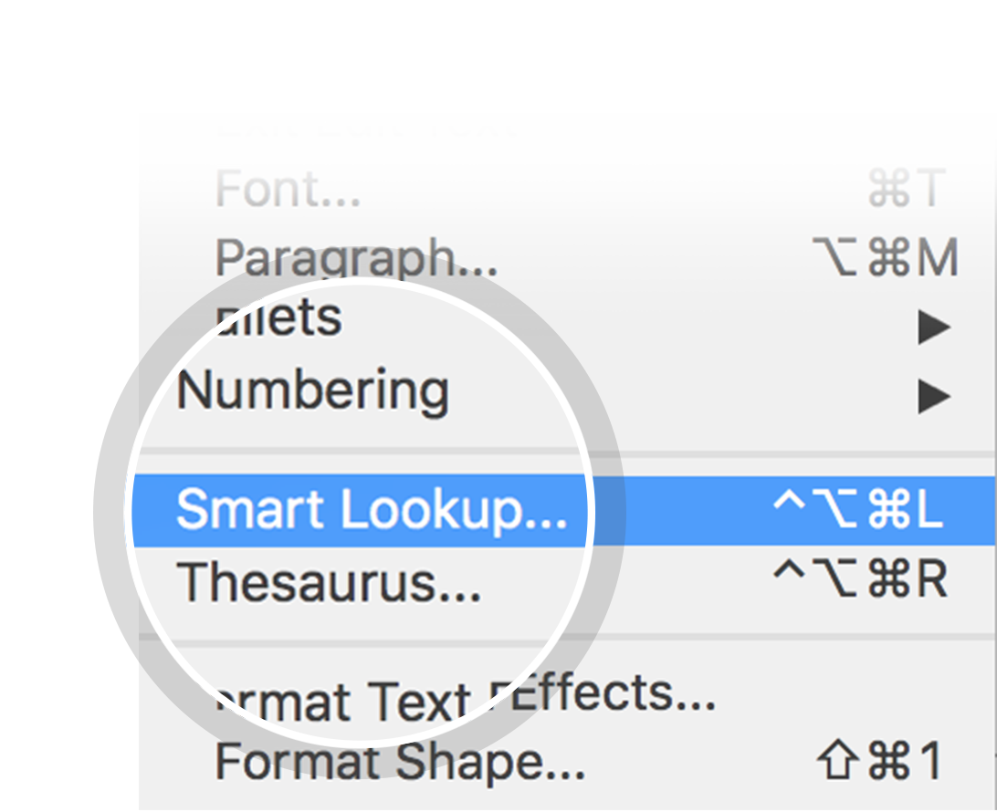
Related topics to research
Earthquake
Tsunami
Ring of Fire
Flood
Mount Vesuvius
Kīlauea
Supervolcano
Natural disaster
Mount St. Helens
Use Smart Lookup to learn more
1
Highlight one of the related topics
Right-click on the topic
Choose "Smart Lookup"
2
3

Slide 3
VOLCANO

Slide 4
CONTENTS
Etymology
Plate tectonics
Volcanic features
Erupted material
Volcanic activity
Decade volcanoes
Effects of volcanoes
Volcanoes on other celestial bodies
Traditional beliefs about volcanoes

Slide 5

ETYMOLOGY

Slide 6
PLATE TECTONICS
Look in the slide notes below for topics to consider talking about
Notes:
Consider talking about:
Divergent plate boundaries
Convergent plate boundaries
Hotspots

Slide 7
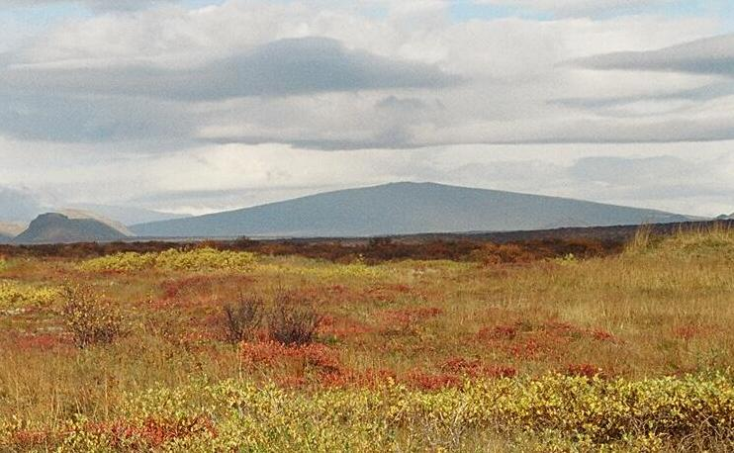
VOLCANIC FEATURES
Look in the slide notes below for topics to consider talking about
PHOTO BY USER:REYKHOLT / CC BY-SA 3.0
Notes:
Consider talking about:
Fissure vents
Shield volcanoes
Lava domes
Cryptodomes
Volcanic cones (cinder cones)
Stratovolcanoes (composite volcanoes)
Supervolcanoes
Underwater volcanoes
Subglacial volcanoes
Mud volcanoes

Slide 8
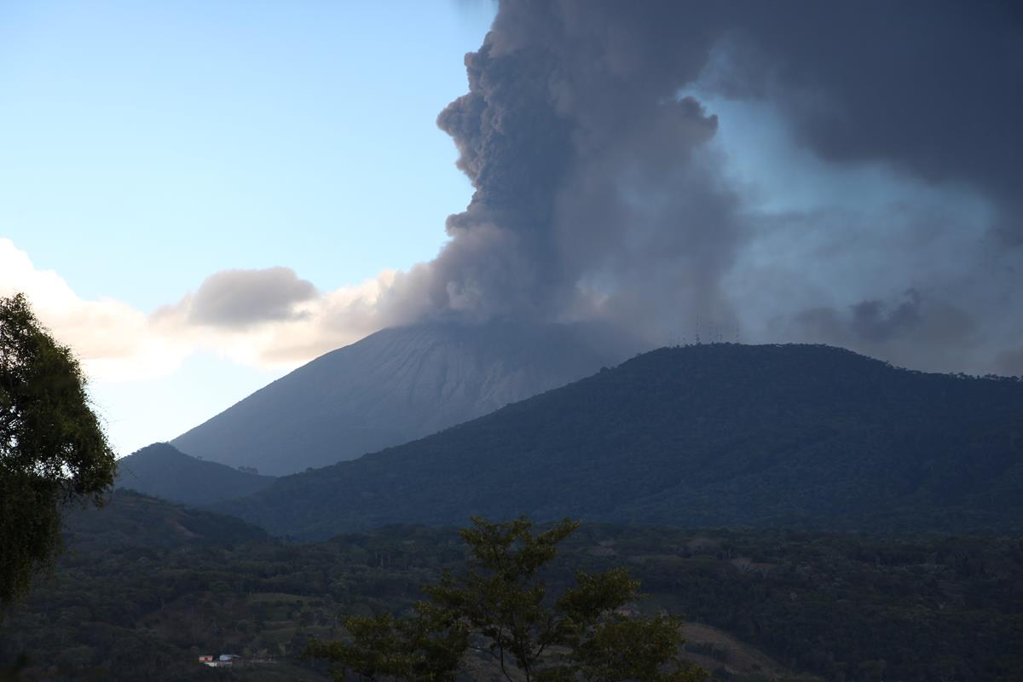
ERUPTED MATERIAL
Look in the slide notes below for topics to consider talking about
PHOTO BY MBURCH / CC BY-SA 3.0
Notes:
Consider talking about:
Lava composition
Lava texture

Slide 9
VOLCANIC ACTIVITY
Look in the slide notes below for topics to consider talking about
Notes:
Consider talking about:
Popular classification of volcanoes
Technical classification of volcanoes

Slide 10
DECADE VOLCANOES

Slide 11
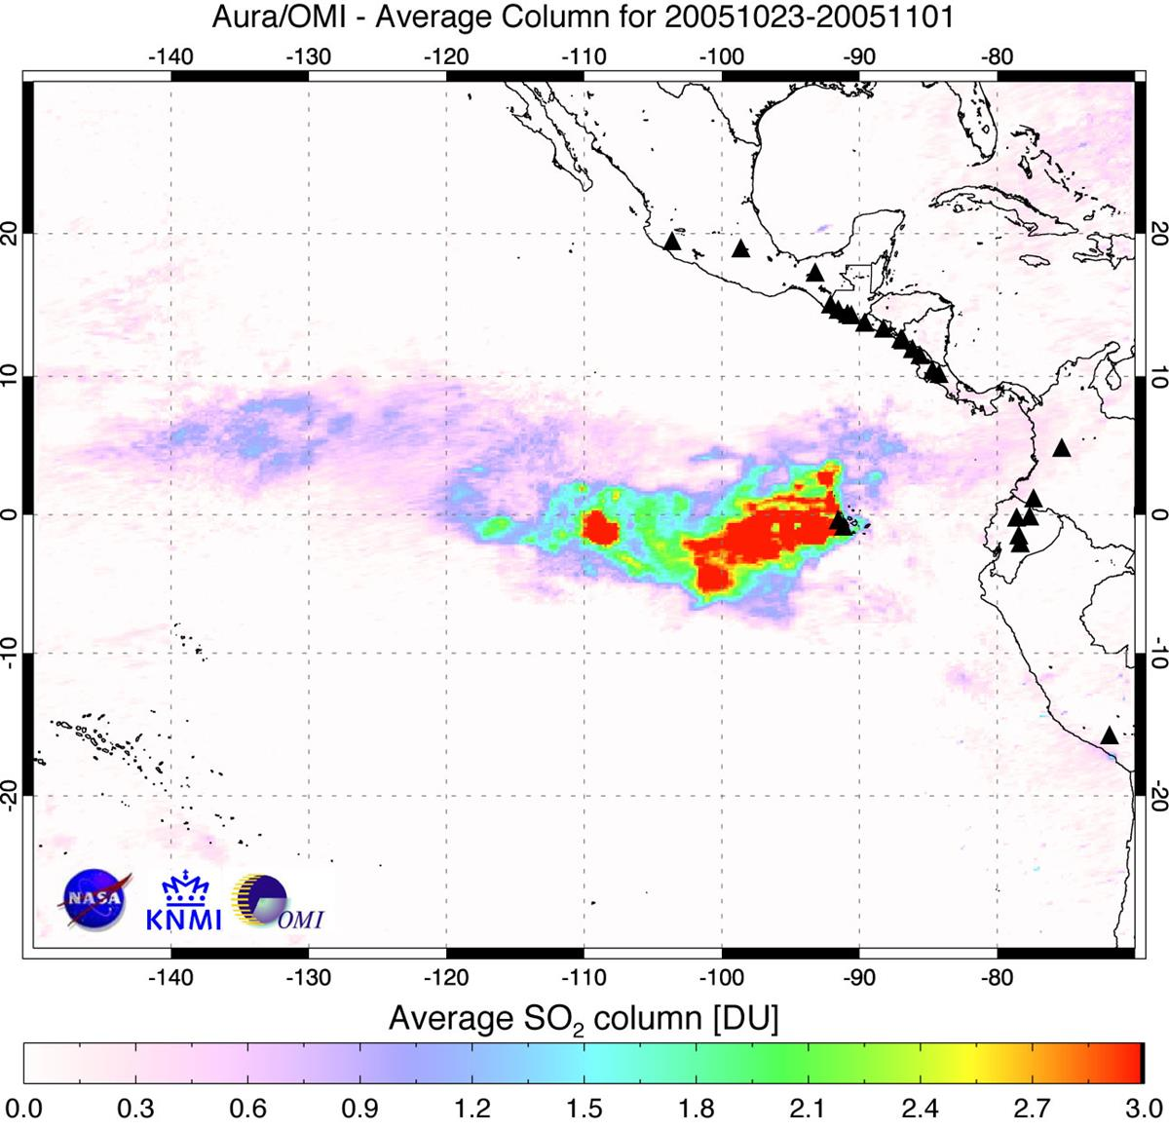
EFFECTS OF VOLCANOES
Look in the slide notes below for topics to consider talking about
PHOTO BY ENGLISH: THE OMI INSTRUMENT IS A DUTCH-FINNISH INSTRUMENT, PROVIDED TO THE EOS/AURA MISSION BY THE NETHERLANDS AND FINLAND. NIVR (THE DUTCH SPACE AGENCY) IS THE OVERALL PROGRAM MANAGER, IN COORDINATION WITH FMI (THE FINNISH METEOROLOGICAL INSTITUTE). THE ROYAL NETHERLANDS METEOROLOGICAL INSTITUTE (KNMI) IS THE PRINCIPAL INVESTIGATOR INSTITUTE. / PUBLIC DOMAIN
Notes:
Consider talking about:
Volcanic gases
Significant consequences
Acid rain
Hazards

Slide 12
VOLCANOES ON OTHER CELESTIAL BODIES

Slide 13
TRADITIONAL BELIEFS ABOUT VOLCANOES

Slide 14
WORKS CITED

