Slide 1
Loan Eligibility Prediction
Introduction
Overview
Banks fundamental business model rely on financial intermediation by raising finance and lending (mortgage, real estate, consumer and companies loans). the latter is the major source of credit risk composed from 2 main points loan approval and fraud.
Purpose
The main aim of use-case is to build the predictive model to predict if a applicant is able to repay the loan or not

Slide 2
LITERATURE SURVEY
Existing problem
The existing approach to solve this problem is to employ a person and do the background checks needed to make sure that the customer is eligible for the loan based on customer detail provided while filling online application form
Proposed Solution
Logistic regression and decision trees are both popular classification techniques (supervised learning) used to build behavioral scorecards, they are statistical methods that analyse a dataset to bring out the relationship between “predictors” (or explanatories) that are independent variables and a “response” (or Outcome variable) that is a dependent variable. In our case we try to estimate the probability of granting a loan .

Slide 3
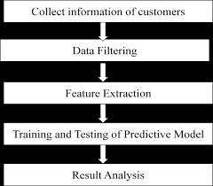
THEORITICAL ANALYSIS
Block diagram of loan eligibility prediction

Slide 4
Hardware/software requirements
Software Requirements
Java jdk 10
Weka
Eclipse ide
Hardware Requirements
Processor-i5
Min hardDisk-4GB
Min Memory-4GBRAM

Slide 5
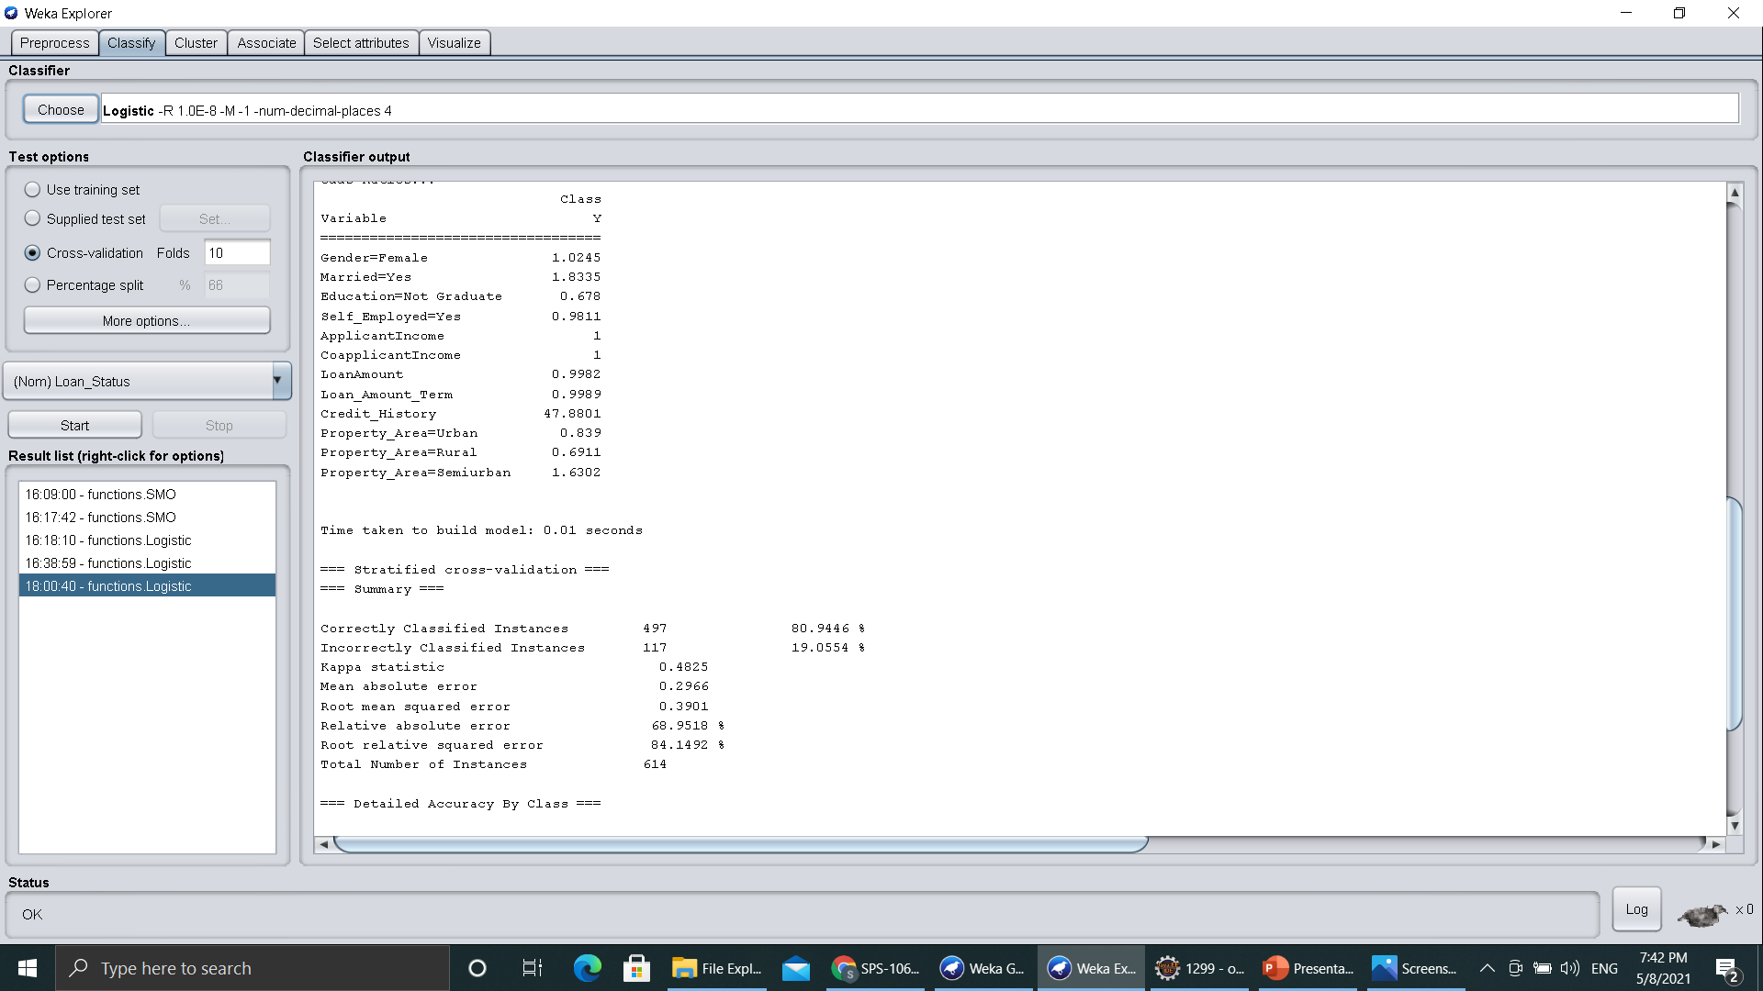

Slide 6
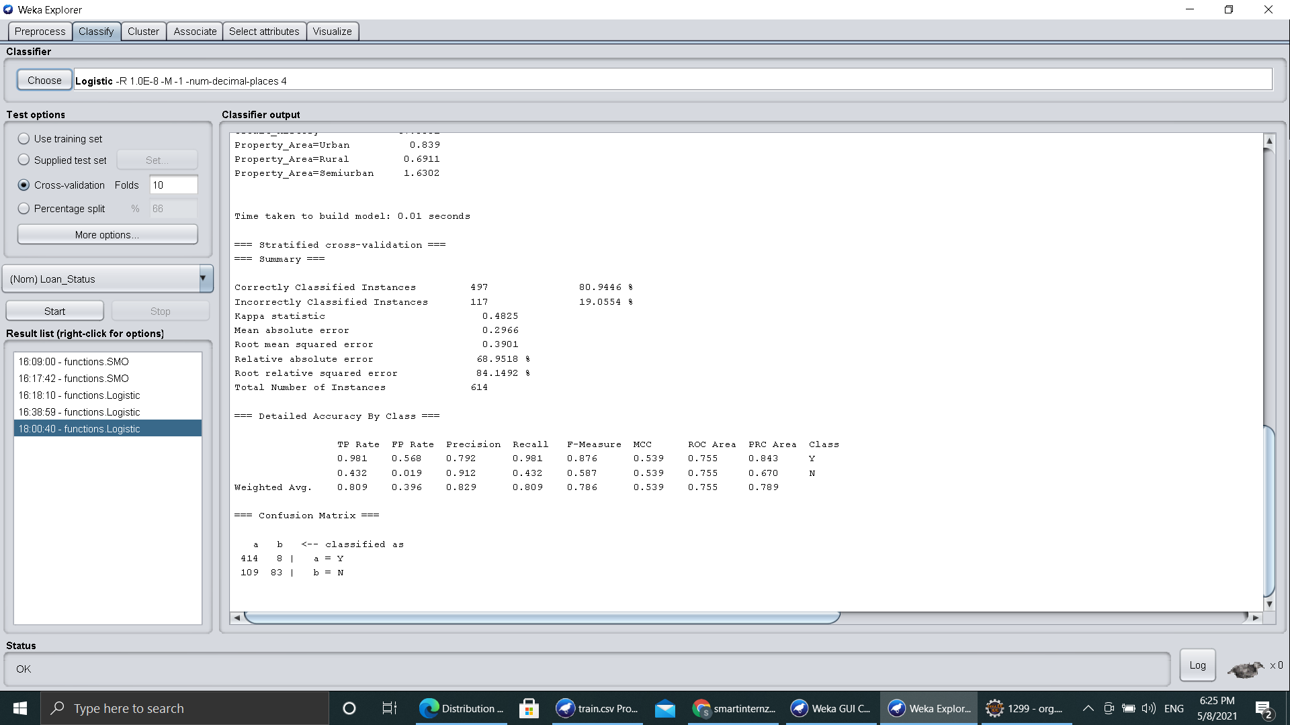

Slide 7
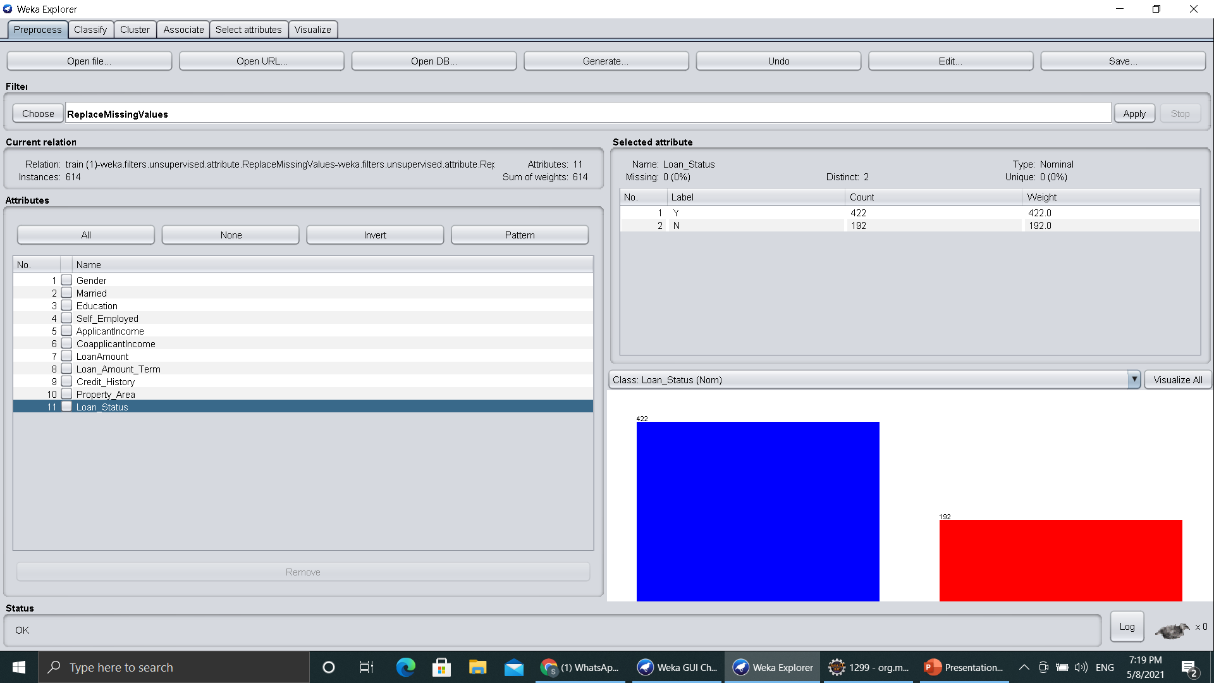

Slide 8
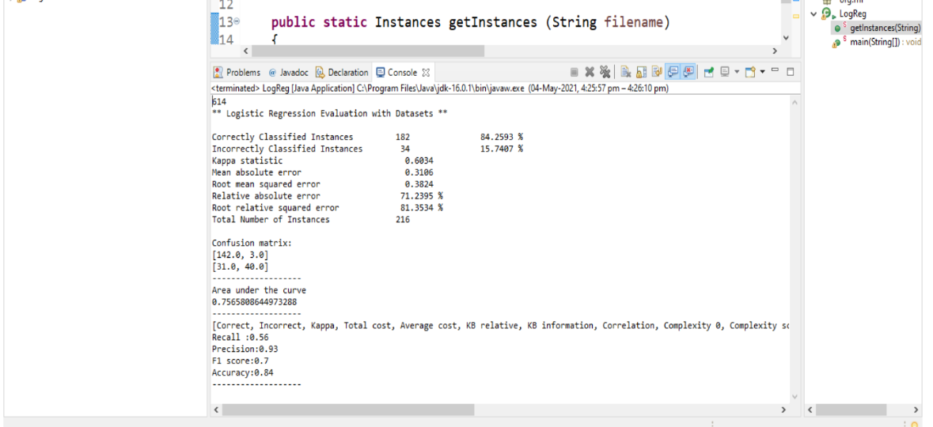

Slide 9
ADVANTAGES AND DISADVANTAGES
Advantages
The proposed model has automated the loan eligibility process of the customer
Logistic regression proved to the best algorithm to build the model.
A loan company can use this algorithm without any concerns
Disadvantages
The loan companies grant the loan after an intensive process of verification and validation.however they still don’t have assurance if the applicant is able to repay the loan with no difficulties.

Slide 10
Conclusion
The conclusion that can be dervided from the project are
The project is more useful in predicting the loan eligibility status of customer.
The accuracy is 84%
with just limited data we can predict status of any customer

