Slide 1
Café Chain Analysis
MARKETING AND RETAIL ANALYTICS
- SINDUJA R S

Slide 2
Project Objective
The data set provided constitutes the data of a Café Chain for one of its restaurants. We need to do a thorough analysis of the data and come up with the following analysis:
Exploratory Analysis
Menu Analysis
PROBLEM STATEMENT
The owner of the restaurant wants you to use this data to come up with a set of recommendations that can help his Café Chain increase its revenues and launch loyalty program for customers.
He is able to provide you with a data set for POS (point of sale data) for one of his chains.
We do not have customer level information and have only POS data for one of the chains.

Slide 3
Exploratory Data Analysis
Refer the below Tableau Public Link
https://public.tableau.com/app/profile/sinduja.r.s/viz/MRA-Exploratory/Menuanalysis?publish=yes

Slide 4
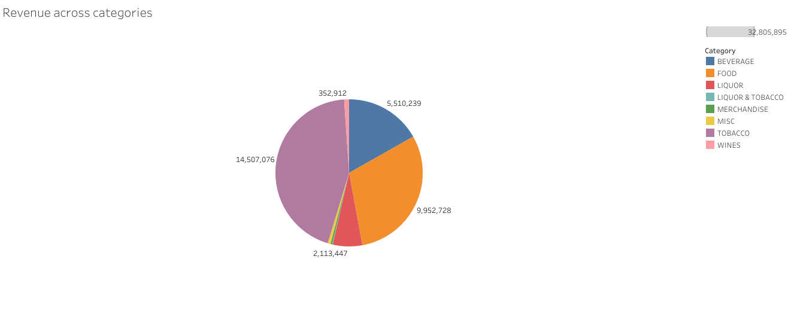
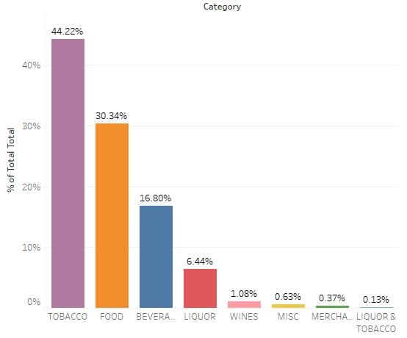
There are 8 item categories available at Café.
Tobacco sales is highest making 44% of total revenue followed by Food at 33% and Beverage at 16%.
Merchandise and Liquor & Tobacco make the least revenue.

Slide 5
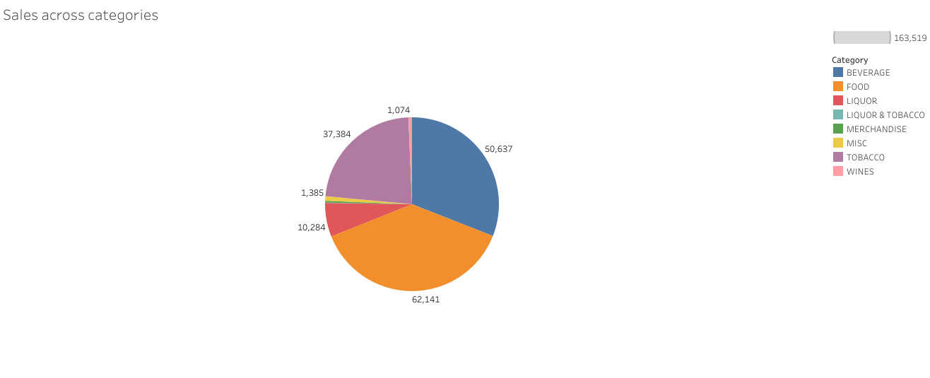
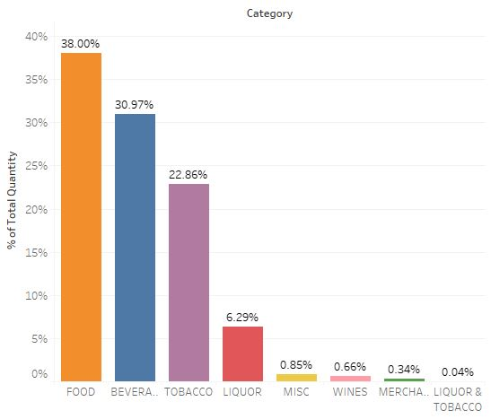
Number of orders are 38% for Food followed by Beverages 31% and Tobacco 23%.
Merchandise and Liquor & Tobacco make the least revenue.

Slide 6
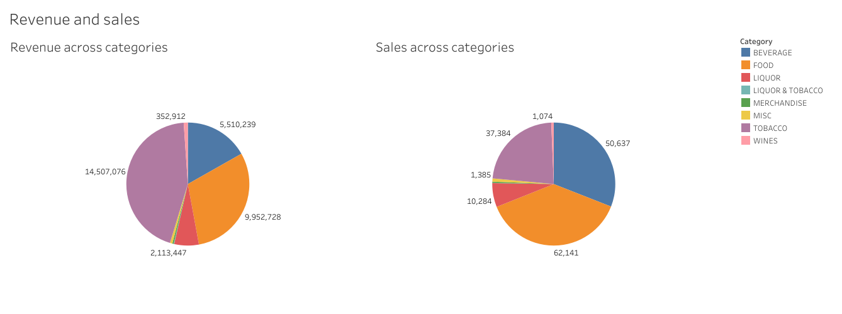
Top 3 (Revenue): Tobacco > Food > Beverage
Top 3 (Sales): Food > Beverage > Tobacco
There are 8 item categories available at Café.
Tobacco sales is highest making 44% of total revenue followed by Food at 33% and Beverage at 16%.
Merchandise and Liquor & Tobacco make the least revenue.
Number of orders are 38% for Food followed by Beverages 31% and Tobacco 23%.
Merchandise and Liquor & Tobacco make the least revenue.

Slide 7
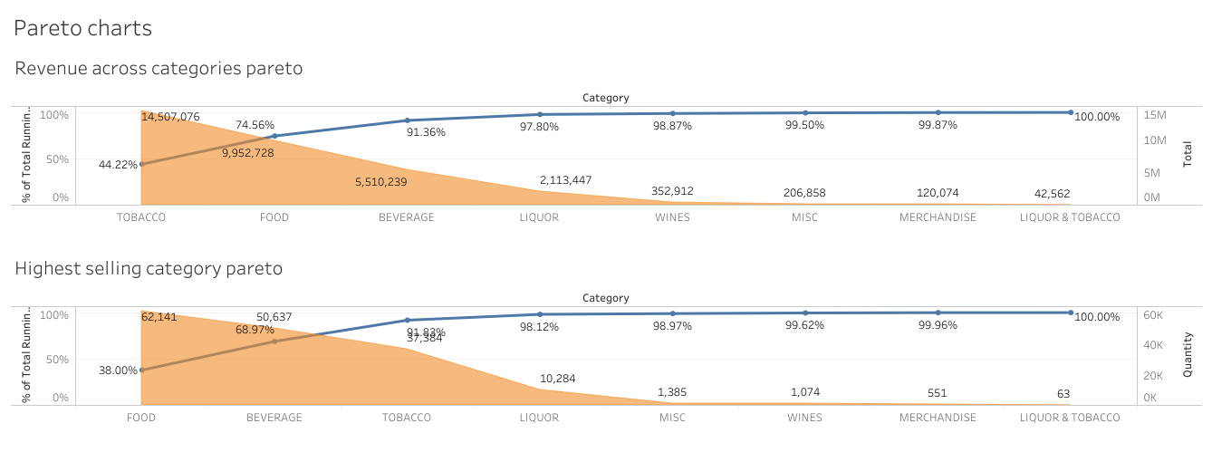
Pareto charts: In terms of revenue, tobacco has the highest revenue of 14507000 which has 44.22% of running total.
In terms of sales, food is the highest of 62,141 and 38% of running total.

Slide 8
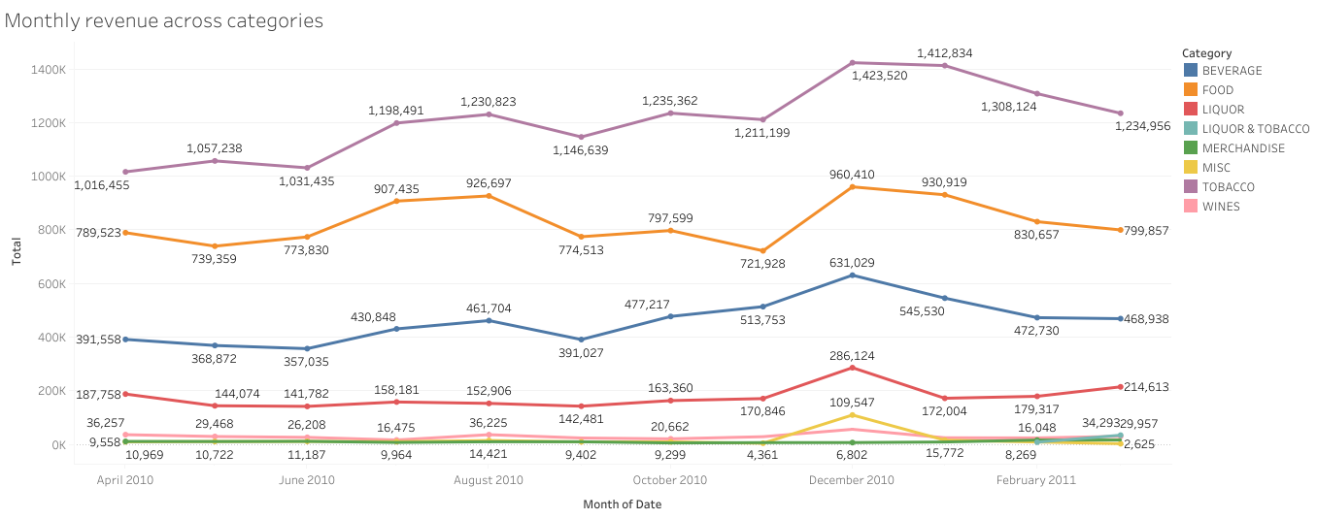
Monthly Revenue Trend - December is the month with highest revenue

Slide 9
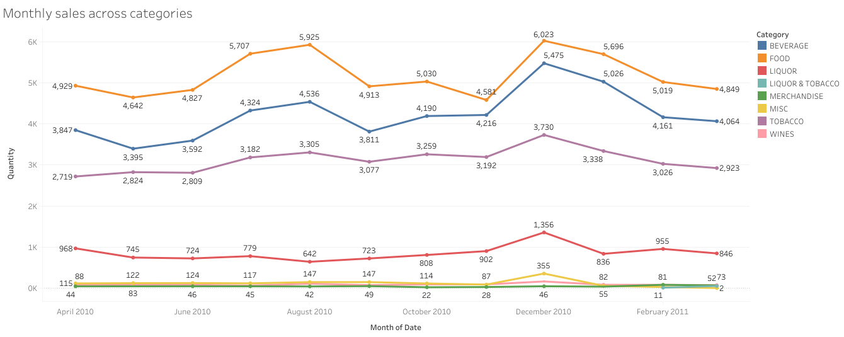
Monthly Sales Trend - December is the month with highest sales

Slide 10
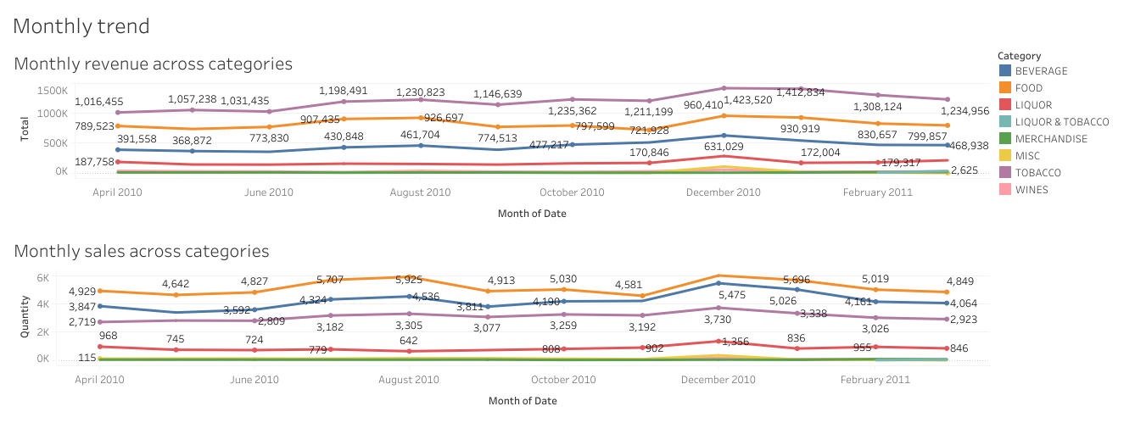
Sales of products increases from June and peak up in Dec month.
From Jan till June sales usually is low for all the products.
The months of July and August notice sharp increase in sales for Food and Beverage.
Liquor and Tobacco shows contrasting trends for other months except December when the sale peaks up for both alike.

Slide 11
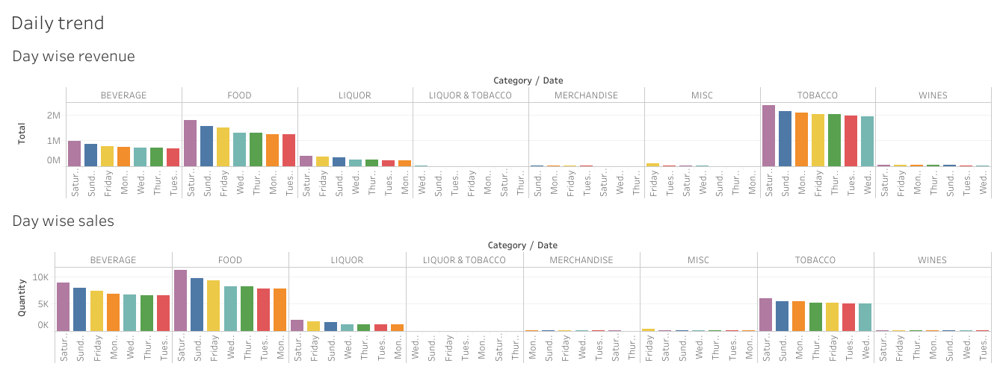
Sales peak over the weekend (Friday to Sunday) and it reaches the peak on Saturday.
Transactions are higher on Saturday.
Though Sales are higher on Saturday, it is even distributed across the week with no sharp peaks.

Slide 12
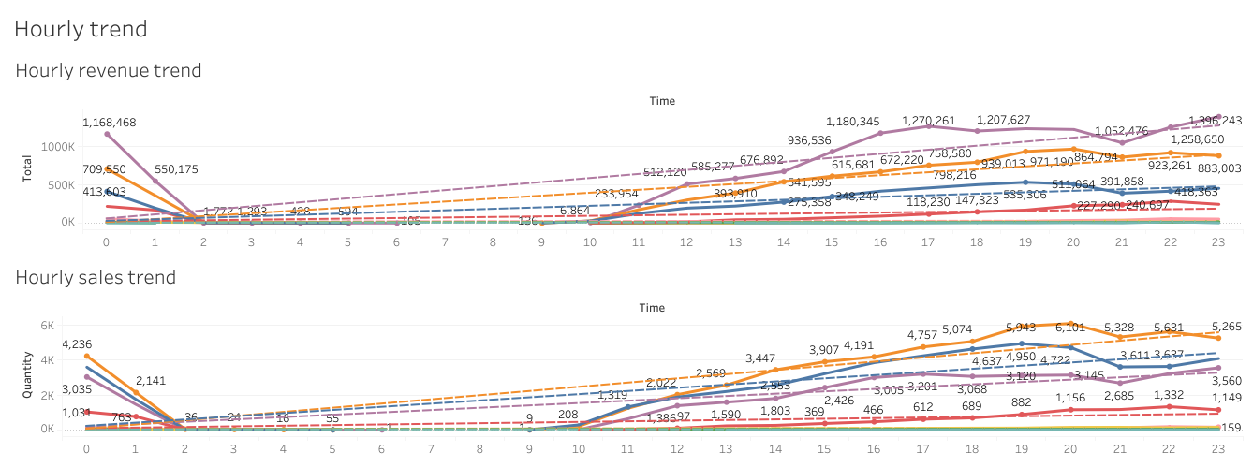
Sales shows steady progress from 11:00 hours onwards. Restaurant makes max sales in the evenings between 19:00-23:00 hours.
Peak time of selling Beverages are from 4PM to 8PM. Peak time for selling Food items is from 4PM to midnight.
Peak time for selling Liquor is from 8AM till midnight. Peak time for selling Tobacco is from 8PM to midnight.
Tobacco and Wine are sold throughout the day but increases up in night.
Merchandise, Miscellaneous and Liquor and tobacco are the categories of product sold mostly in night.

Slide 13
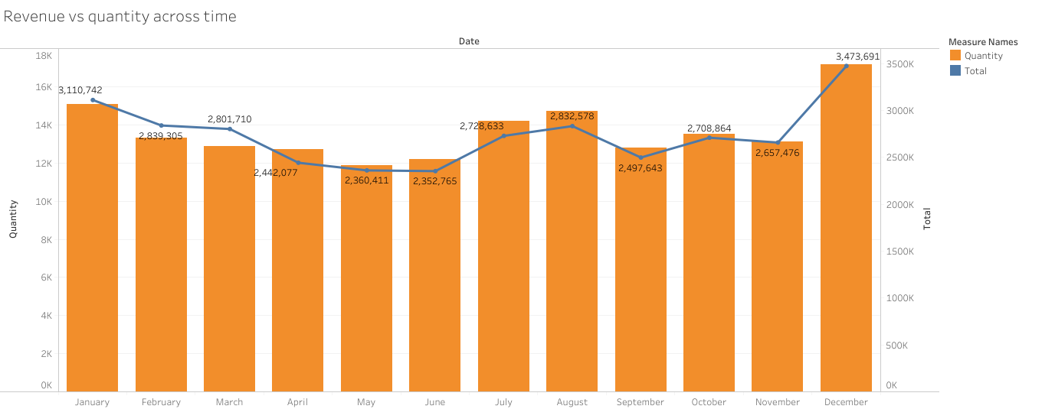
Both Sales and Revenue are the highest in the month of December followed by January across all categories.
July and August also show a good amount of sales but revenue is lesser than sales.
May and June show the lowest of sales and revenue.

Slide 14
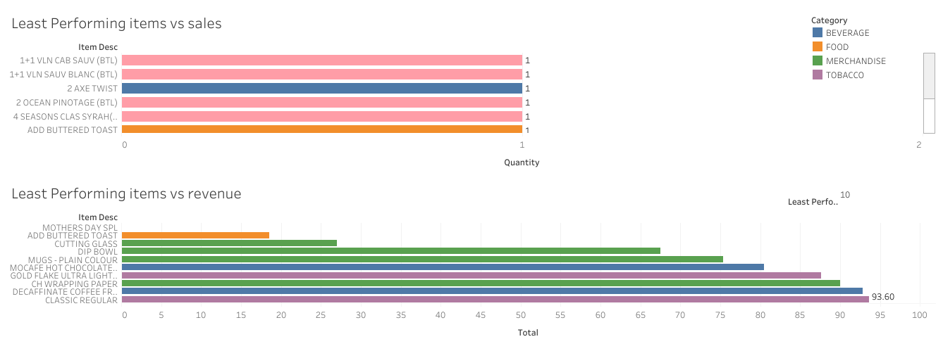
In terms of sales, wines and beverages are performing low which are sold in single digits.
In terms of revenue, merchandise, beverages and tobacco are performing low which barely make any profit.
Liquor and tobacco make very less amount of sales and revenue.

Slide 15
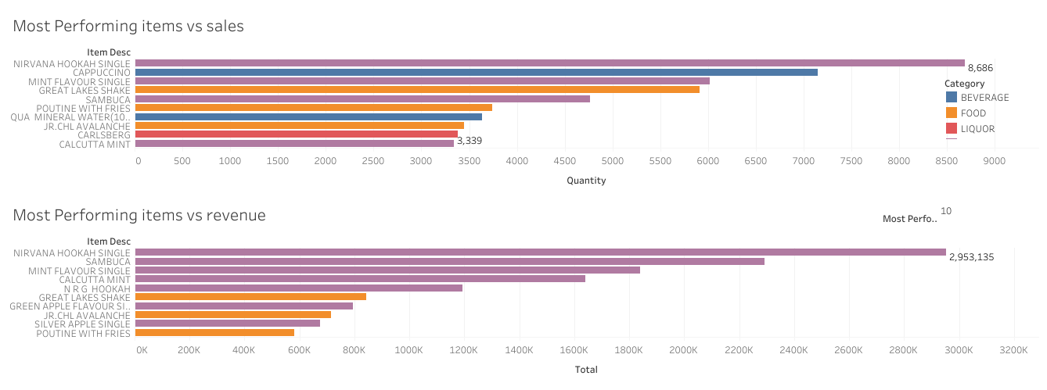
Beverage, tobacco and liquor make the highest sales and revenue.
Nirvana hookah single is the most sold tobacco product of 8686 sales and a revenue of 29,53,135.
Food products like great lakes shake, poutine fries and Jr.Chl.Avalanche also make good sales and revenue.

Slide 16
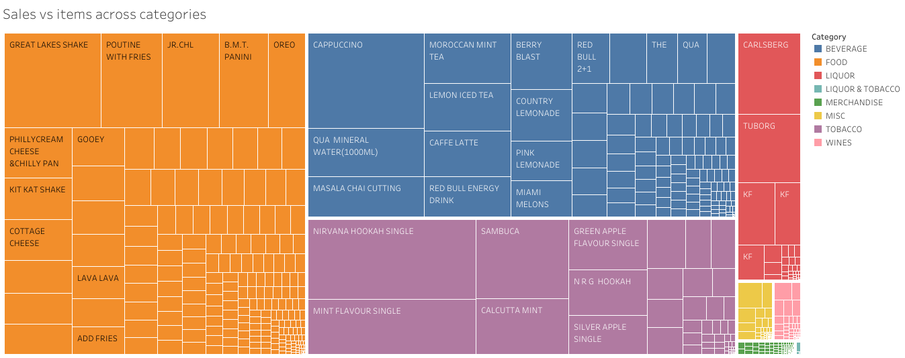
Most frequently bought items from different categories are as follows, FOOD: Great Lakes Shake, Poutine with fries, Jr.Chl.Avalanche and BMT.Panini.
BEVERAGES: Cappucino, Qua Mineral Water and Masala Chai Cutting.
TOBACCO: Nirvana Hookah Single, Mint Flavour Single and Sambuca. LIQUOR: Carlsberg and Tuborg.

Slide 17
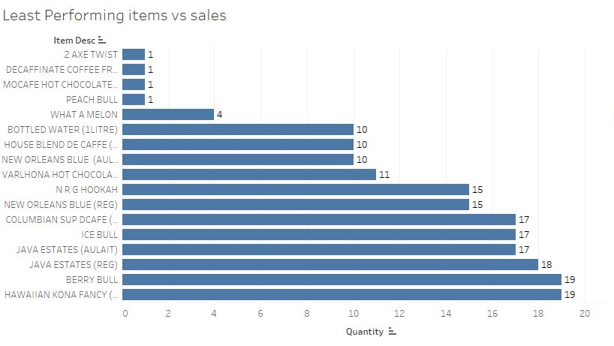
Menu Delisting – All items where sales is less than 20 should be delisted from the menu.
BEVERAGES – 17 ITEMS

Slide 18
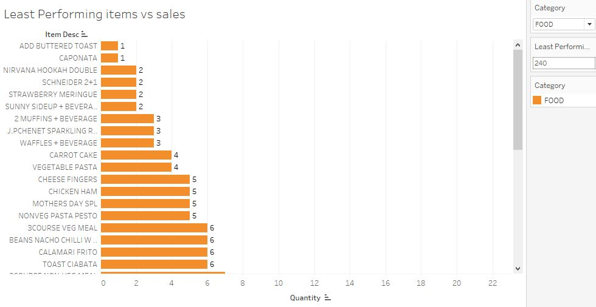
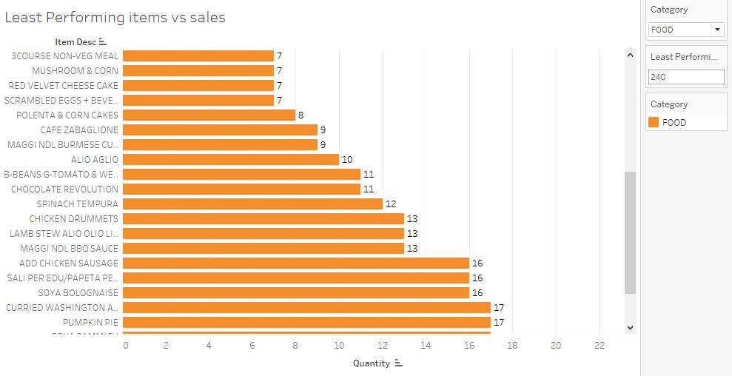
FOOD – 41 ITEMS including Andalusian sausages and Mexican chill crepes

Slide 19
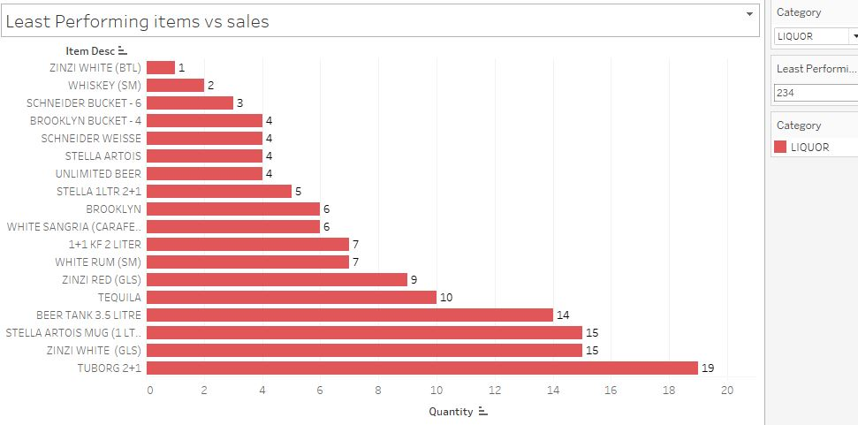
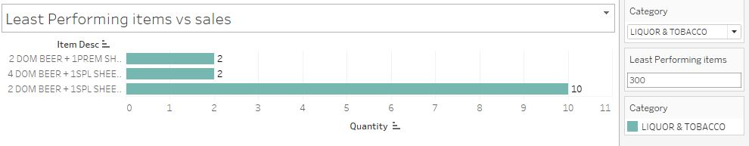
LIQUOR – 18 ITEMS LIQUOR AND TOBACCO – 3 ITEMS

Slide 20
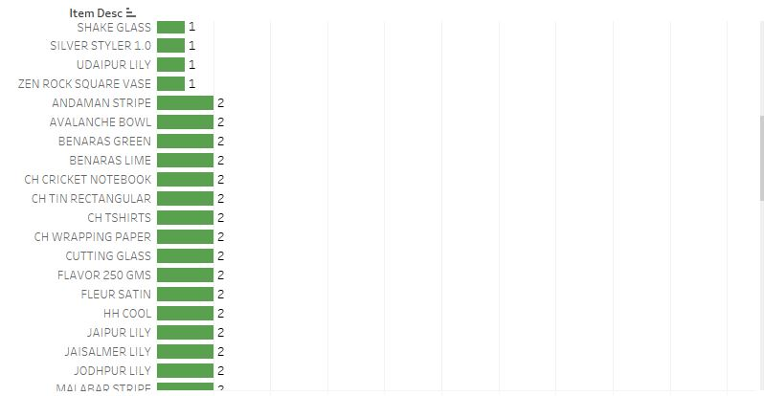
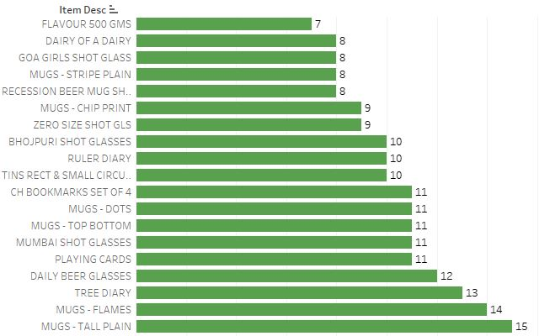
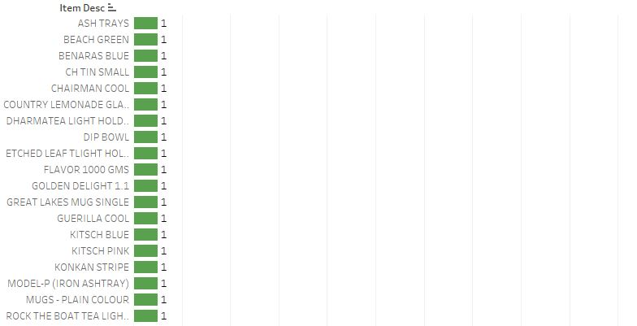
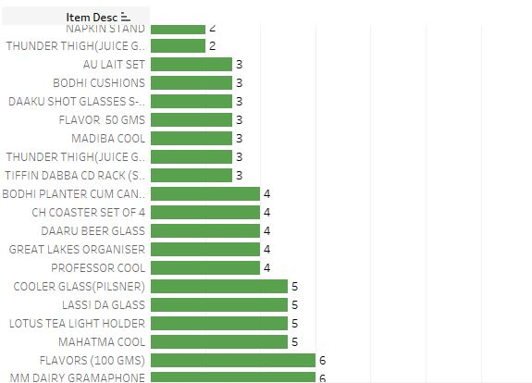
MERCHANDISE – 81 ITEMS WHOCH INCLUDES Mugs with circle design, Rockstar toothpick holder and Sandass.

Slide 21
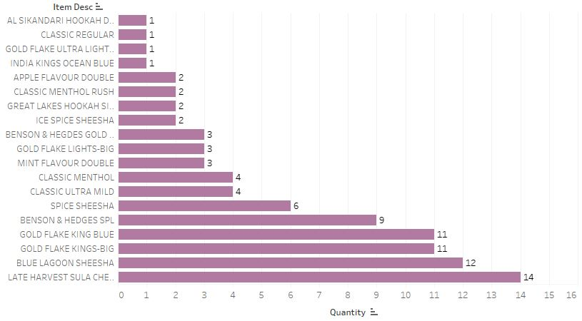
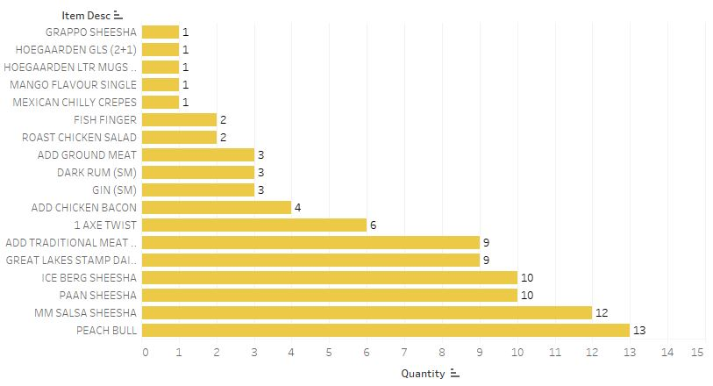
TOBACCO – 19 ITEMS MISC – 18 ITEMS

Slide 22
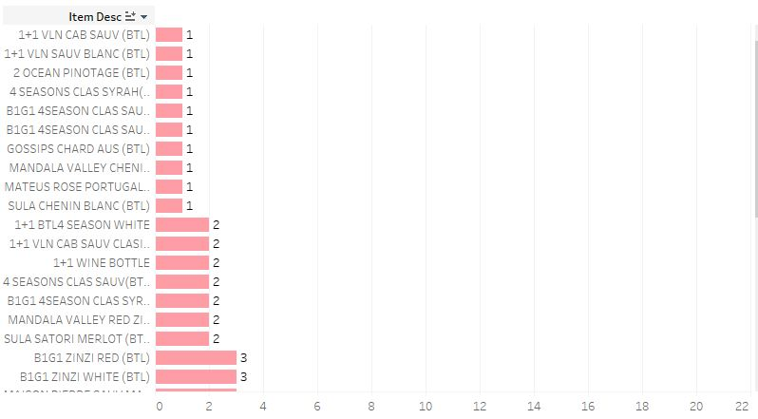
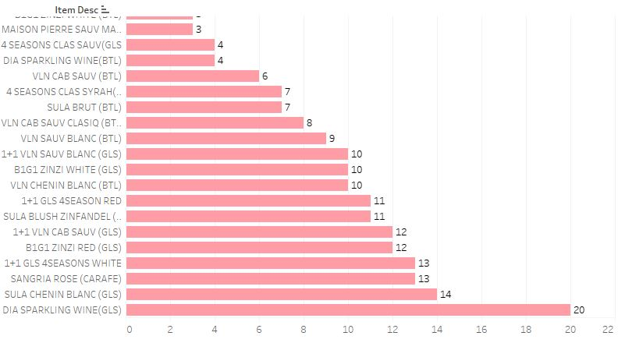
WINES – 38 ITEMS

Slide 23
Summary
One-year of data:
Analysis is performed on single financial year data starting 1st Apr 2010 to 31stMar 2011 for the Café Chain
No Significant trend/seasonality visible
The data is constant across weekdays and across months with 20% increase in sales on Saturdays which will be due to weekend rush.
Sales gradually increase from Friday, reach a peak on Saturday and is high on Sunday and is constant across weekdays.
Café Opening Hours:
Café opening hours can be brought down to 16 hours instead of all day as the sales just contribute to 0.2% during few hours in a day. (10am to 2am)
Tobacco Contribution is higher:
Almost 40% of the sales and Revenue is from Tobacco.
Top Categories:
Food, Tobacco and Beverages are the top selling categories. These can be considered for combo selection to increase sales.
Discounts:
Discounts can be given for bills of higher value and also to customers who frequent the café to ensure they visit again.

Slide 24
RECOMMENDATIONS
Remove
Remove the items which has very less sales across the year, it will reduce the inventory & supply chain cost for items which are not generating revenue.
Give
Give happy hour discounts on liquor from 12 – 6 PM to promote sales.
Offer
Offer discounted prices during weekdays to promote average sales to boost the revenue.
Increase
Increase the sales of merchandise & miscellaneous items by providing them as combo items with Food, Liquor & Beverage.
Add
Add more breakfast items to the menu in place of discontinued items to increase the sales from 7 – 11 AM.
Be
Cappuccino can be sold with the top four tobacco flavours as combo meals.
Be
Carlsberg can be sold with the top four tobacco flavours as combo meals.
Add
Add summer cocktails such as Mojito, Pina colada etc to liquor/beverage section for boosting the sales of liquor in summer months.

Slide 25
Menu Analysis

Slide 26
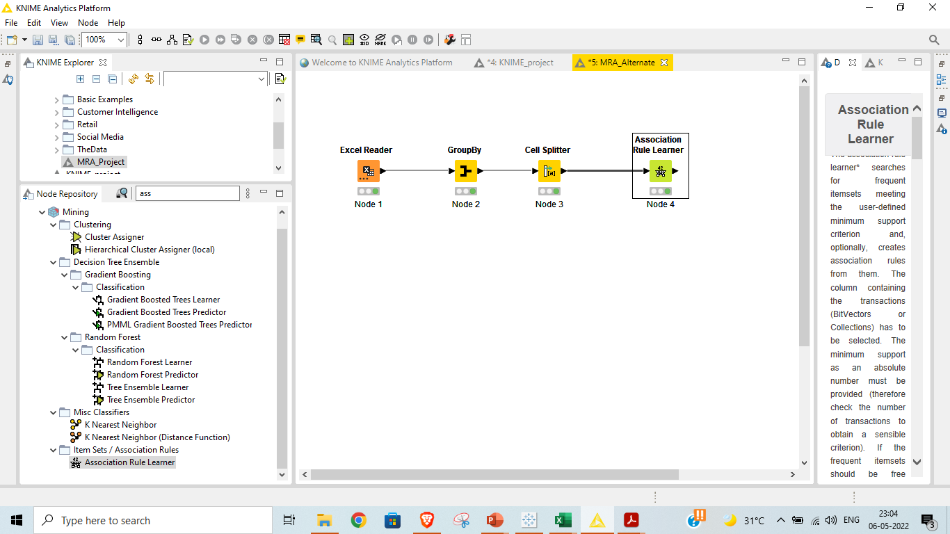
Market Basket Analysis
We have used Knime’s Association Rule learner to perform the market basket analysis to arrive at the result.

Slide 27
ASSOCIATION RULE:
Association rule finds interesting associations and relationships among large sets of data items.
This rule shows how frequently a itemset occurs in a transaction. A typical example is Market Based Analysis.
Market Based Analysis is one of the key techniques used by large relations to show associations between items. It allows retailers to identify relationships between the items that people buy together frequently.
Given a set of transactions, we can find rules that will predict the occurrence of an item based on the occurrences of other items in the transaction.
RULE EVALUATION METRICS:
Support
The number of transactions that include items in the {X} and {Y} parts of the rule as a percentage of the total number of transactions. It is a measure of how frequently the collection of items occur together as a percentage of all transactions. Supp(X+Y) = (X+Y)/Total
Confidence
It is the ratio of the no of transactions that includes all items in {B} as well as the no of transactions that includes all items in {A} to the no of transactions that includes all items in {A}. Conf(X+Y) = supp(X+Y)/supp(X)
Lift
The lift of the rule X=>Y is the confidence of the rule divided by the expected confidence, assuming that the item sets X and Y are independent of each other. The expected confidence is the confidence divided by the frequency of {Y}. Lift(X+Y) = Conf(X+Y)/ Supp(X+Y)

Slide 28
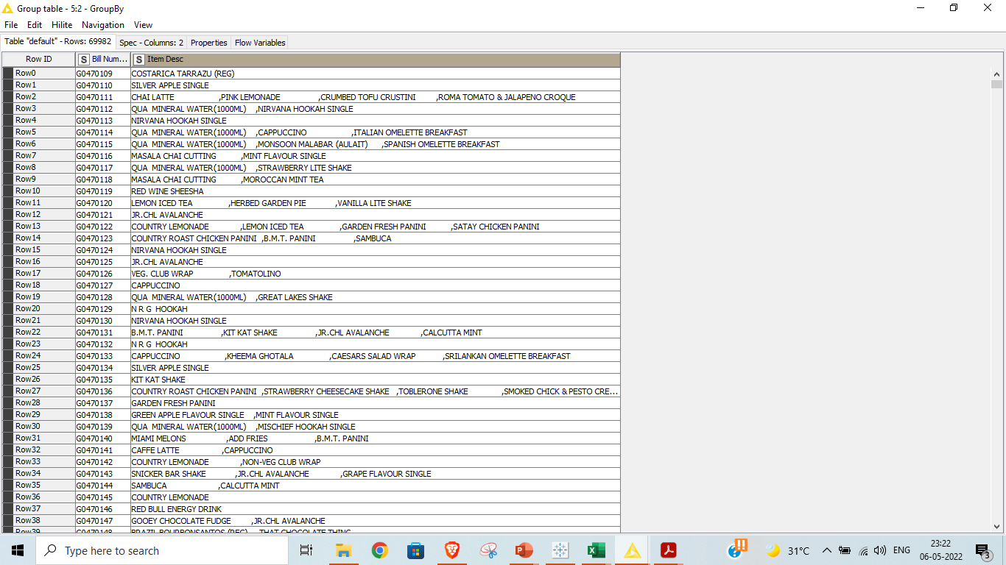
We have grouped the data using the Bill Number

Slide 29
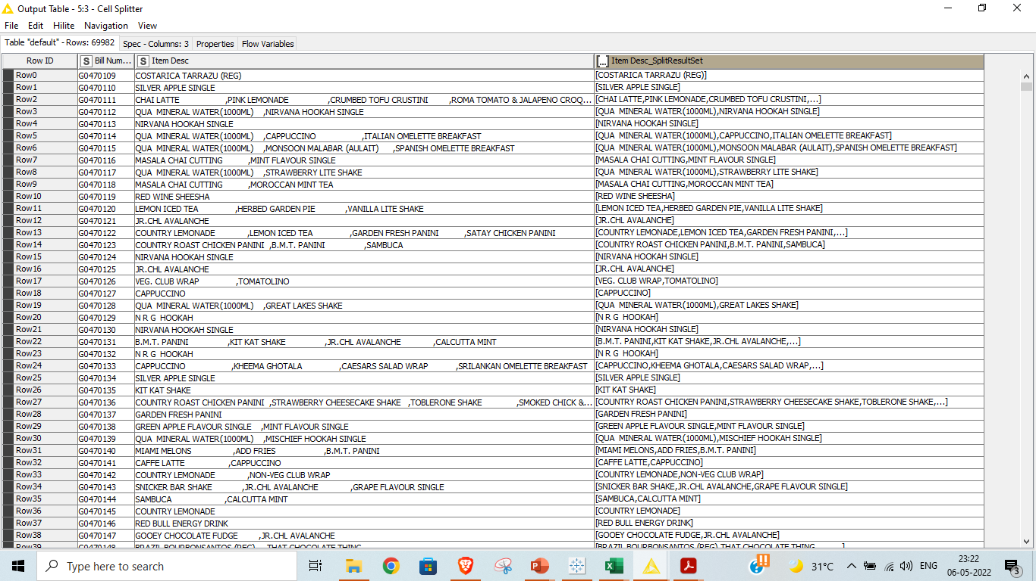
We have split the items and enclosed in a set using the cell splitter node.

Slide 30
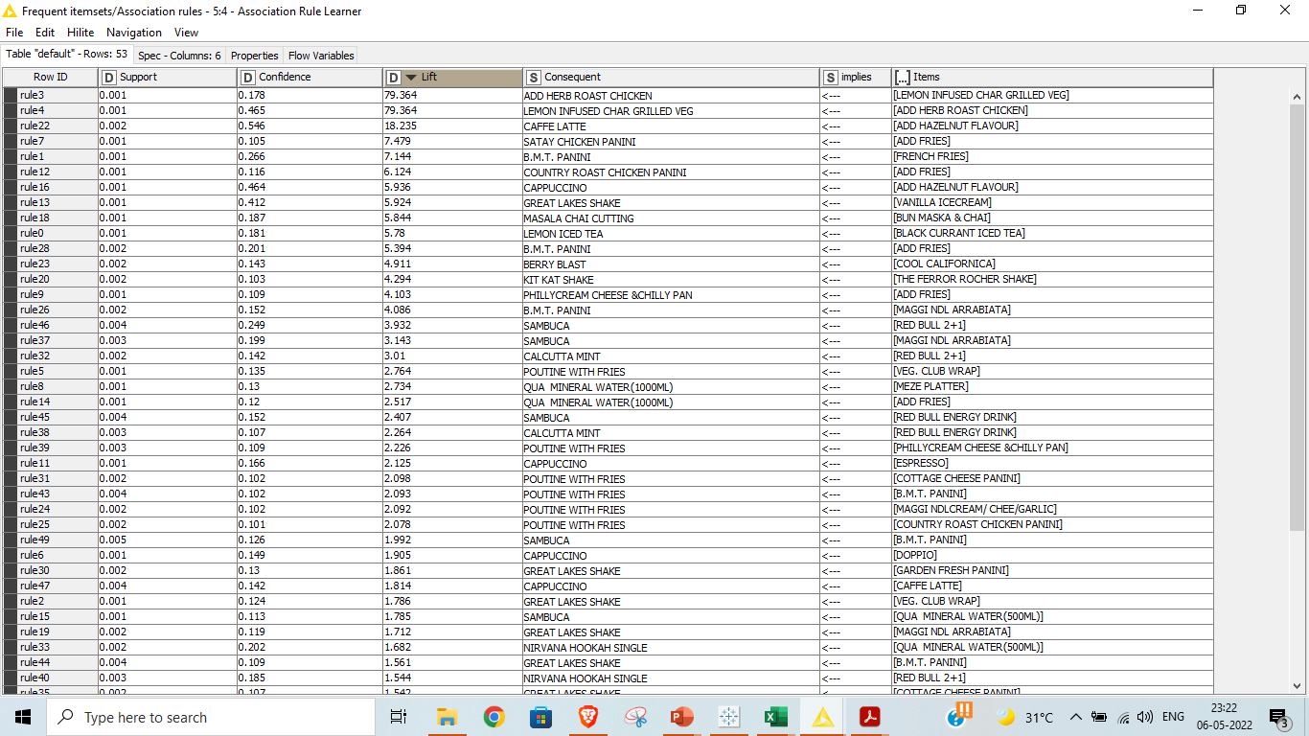
Using 0.001 as support and 0.01 as confidence, we have got 53 rules.

Slide 31
Recommendations
Most bought Food items are Poutine with Fries (3464 times) and Great Lakes Shake (4895 times).
Cost of Poutine with Fries is 125 and the Shake is 110.
Either of them can be combined with a Tobacco alongside a beverage and 20 to 25% discount can be applied for the combo to see a bigger turnout.
JR.CHL.Avlanche also seems to be popular (3,314 times)
Either of them can be combined with a Cappuccino and 15% discount can be applied for the combo to see a bigger turnout.

Slide 32
According to the association rules, there are several items recommended for each item purchased by the customer.
For example, the past data has shown five recommended items such as SATAY CHICKEN PANINI, COUNTRY ROAST CHICKEN PANINI, B.M.T. PANINI, PHILLY CREAMCHEESE & CHILLY PAN AND MINERAL WATER for the item ADD FRIES
But according to the Lift values, SATAY CHICKEN PANINI is recommended first as it has the highest lift value among all recommendations.
Similarly, CAFFÉ LATTE and CAPPUCINO are recommended for the item ADD HAZELNUT FLAVOUR but Caffe Latte is the first recommendation shown to the customer.
37,384 of the bills belong to Tobacco which is alarming and would suggest restricting tobacco Sales to only nights to act socially responsible.
Combo Introductions can drive people towards choosing food thereby bringing down tobacco orders.
There are hours across the day where sales contribute to less than 0.2% of the total and hence Café can consider revisiting the open hours (close it during off peak hours) and it can save big on resourcing.
There are several items which are sold less than 50 times across a year and all of them can be removed as they are not moving as expected.
Here I have selected items that were sold less than 20 times for delisting but this can be expanded to at least 50 as they are not contributing much to the revenue.
Maintain Customer database to communicate the change in orders and also offer special discounts for loyal customers to promote the Cafe.

