Slide 1

FormAutomation
By Group S

Slide 2

MEMBER
Daniel Krisnanto (0970356131-36)

Slide 3

IDEA
Membuat Form Komitmen dan Form PertanggungJawaban dari data karyawan / peserta pelatihan

Slide 4
Package / library
Flask
SQLite
FPDF

Slide 5
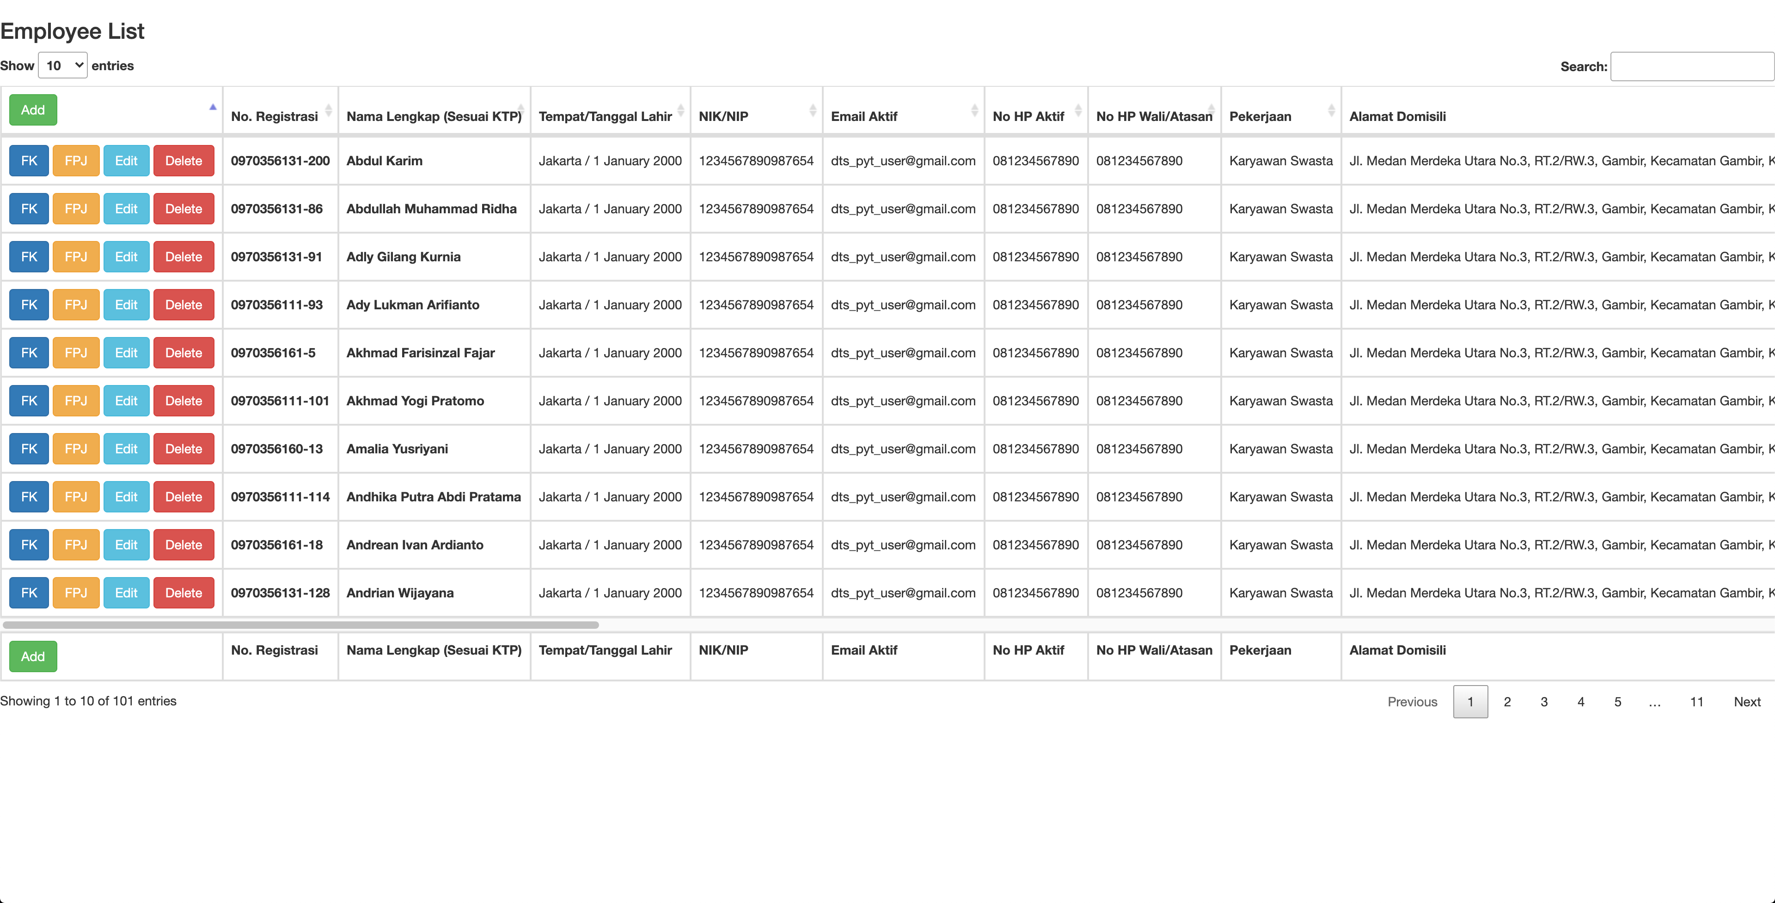
list

Slide 6
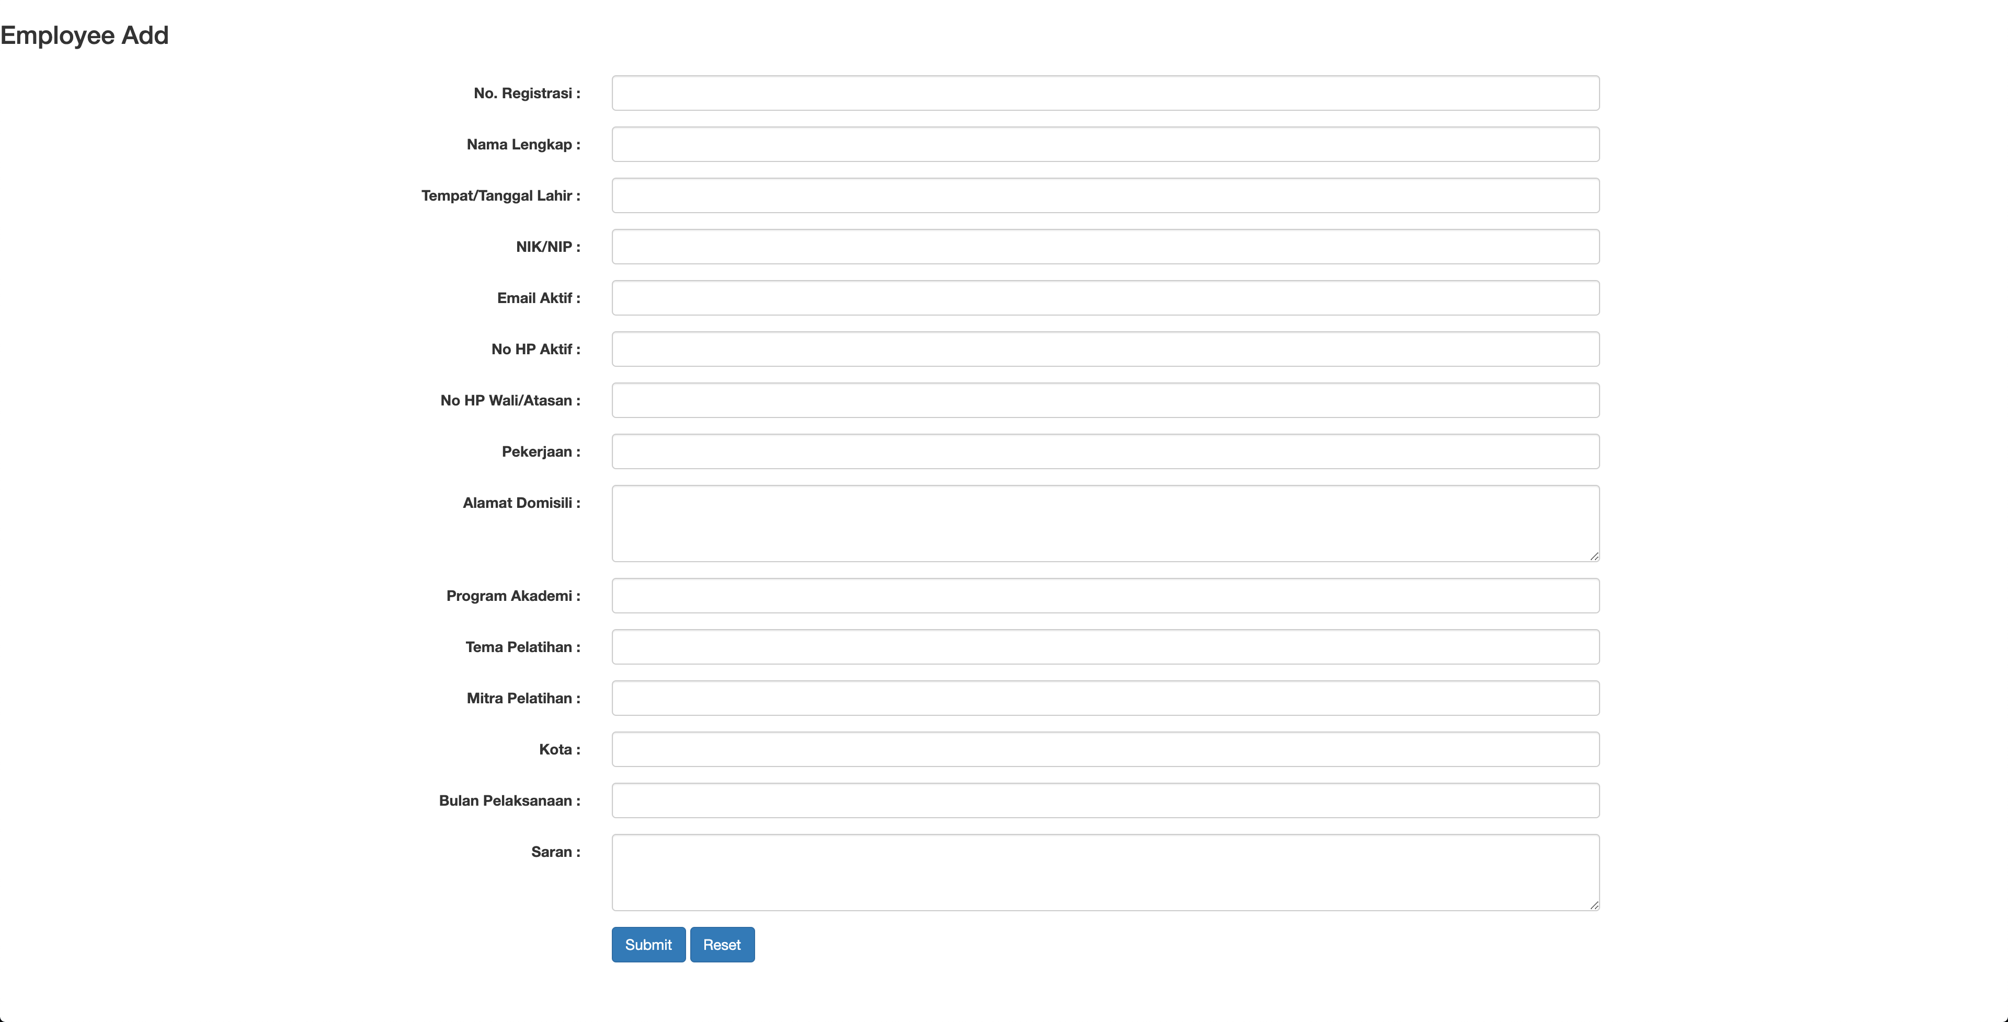
Add

Slide 7
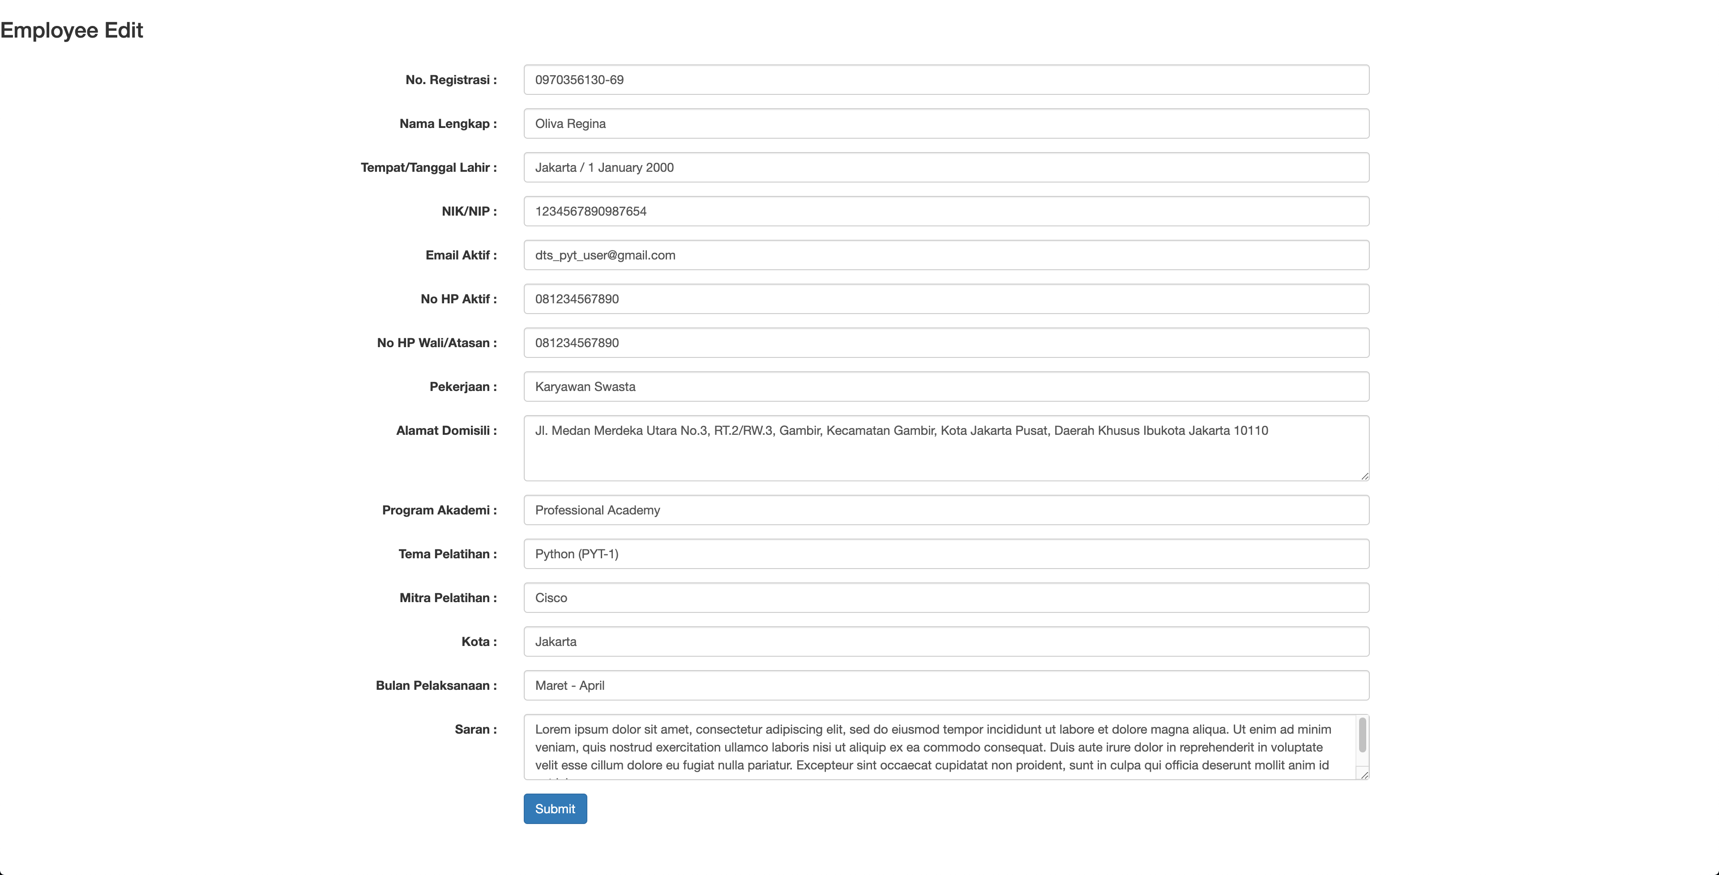
edit

Slide 8
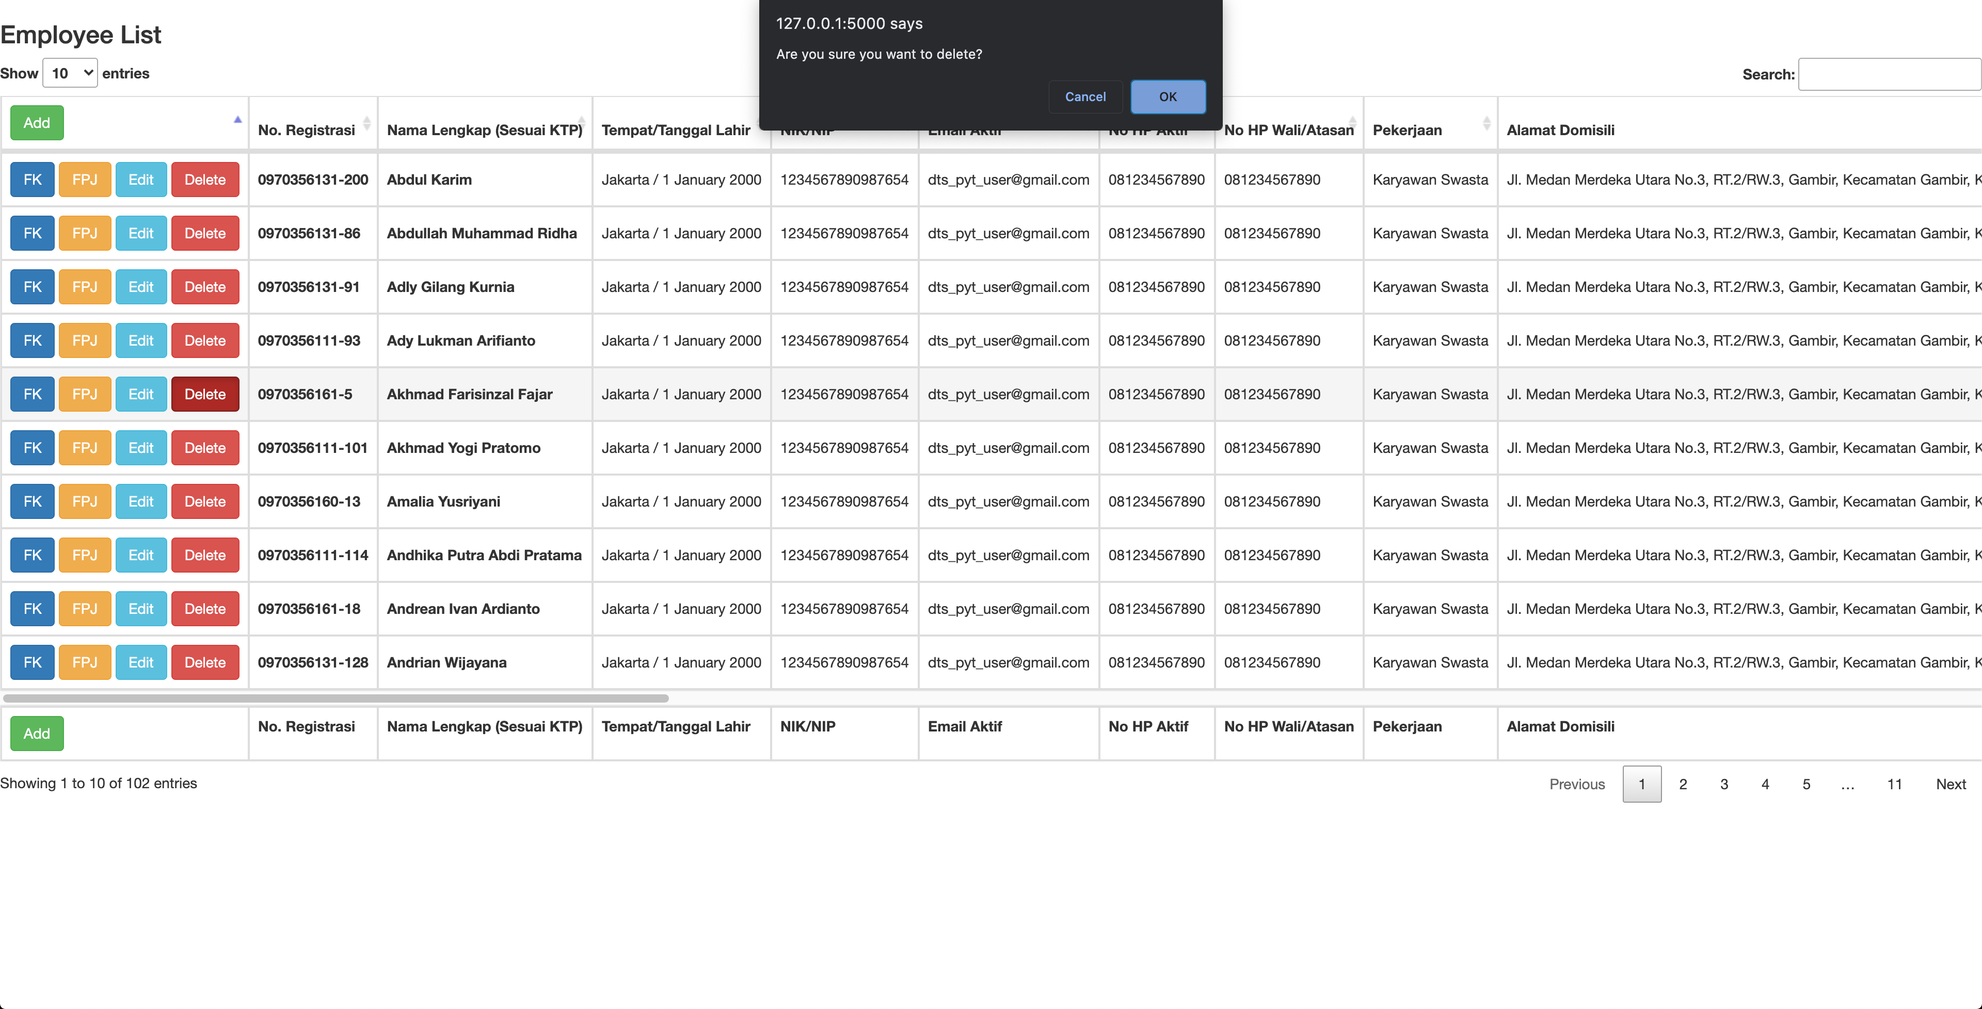
delete

Slide 9
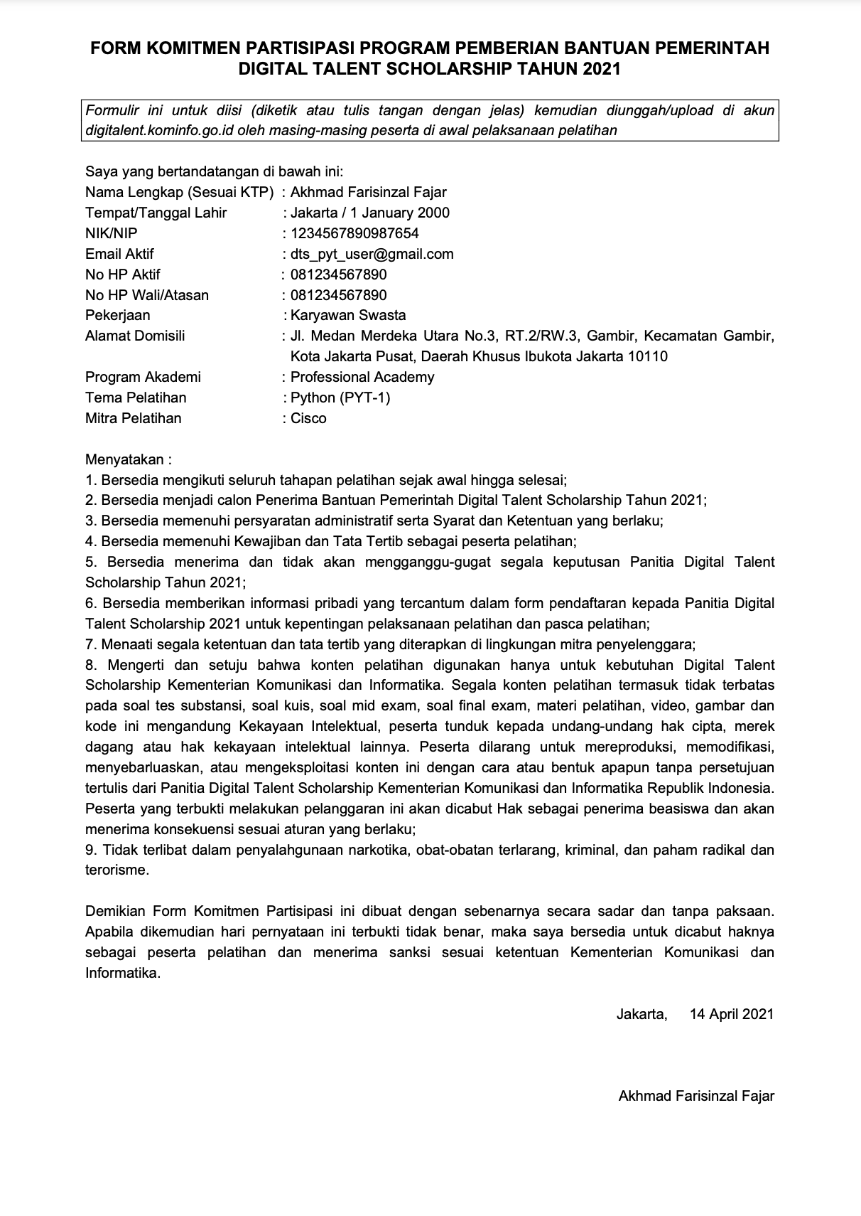
form komitmen

Slide 10
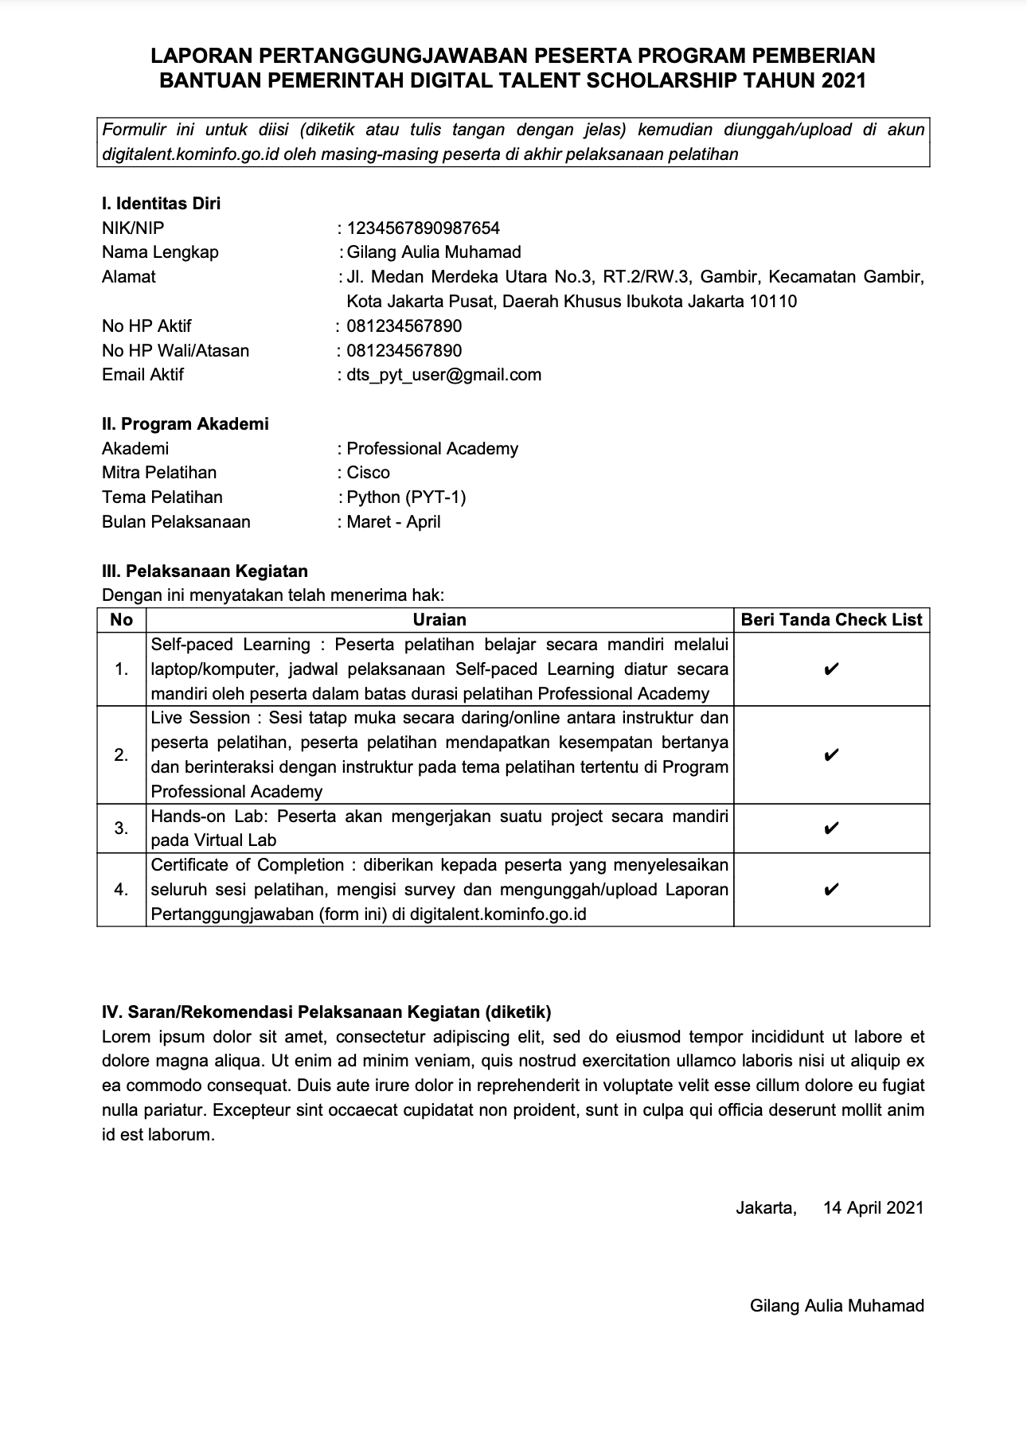
form pertanggungjawaban

Slide 11

thank you
https://github.com/sindweller2/FormAutomation

