Slide 1
Summation

Slide 2
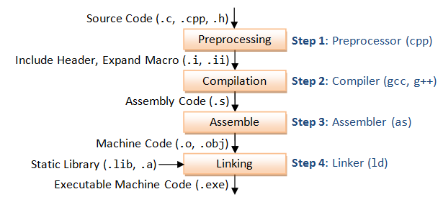
Compilation process
Back in the 1970s, compilers were a new thing
So, the question was wrong
The first operating system was assembled, not compiled.

Slide 3
$ git pull your code
$ git clone https://github.com/singam-sanjay/ACM-BPHC_IntroToParProg

Slide 4
Basic Code Block
sum = 0;
for( i = 1 -> N )
{
sum = sum + arr[i];
}

Slide 5
Improve sequential code
Can we execute 2 iterations at once ?
Whaa ??
while( i <= N )
sum = sum + arr[i] + arr[i+1] + arr[i+2] + arr[i+3]
i = i + 4;
^ This is called loop unrolling
You unroll the parchment to read more
What’s the optimisation ?
sum +=
i += 1
sum +=
sum +=
sum += sum +=
i += 4

Slide 6
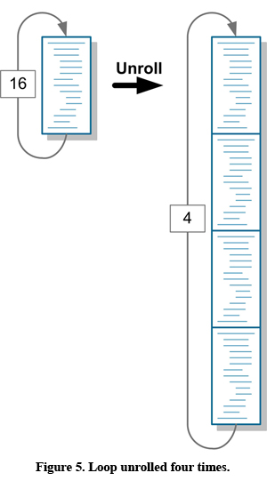
Loop Unrolling
What did we gain ?
We don’t have to do an i++ for each loop
Loop iterator is incremented at one shot for multiple loops
Let’s see it for ourselves
Notes:
Compile normal code and make them write unrolled code. malloc the array to get random values. Tell them about the random number generator, if they’re getting a zero.

Slide 7
Benchmarking
We compare programs by looking at the time taken
Wall clock time
Actual time taken by the program
Count the seconds that elapsed
In MATLAB
tic;
/*Code*/
toc;
toc prints the time taken or elapsed time from the last tic.
$ time ./a.out

Slide 8
Benchmarking
Run it for different
lengths of unrolling
array sizes
If the array size to test with is too large to fit into the memory, then repeat the same operation on arrays with smaller size a large number of times.
Data types ( int Vs float )
Note
Declaring sum as register sum would make accesses to sum faster.
Temporal locality

Slide 9
Loop Unrolling
Is there a difference between,
sum += arr[i]; sum += arr[i+1];…
sum += arr[i] + arr[i+1] + arr[i+2];…
Software pipelining : allows compiler to exploit pipelining
Intrinsic Compiler optimisations
gcc’s -funroll-loop can identify and include loop unrolling automatically
$ gcc main.c –funroll-loop

Slide 10

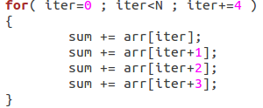
Loop Unrolling
Vs
The one on the right has more memory accesses, at most 4 time slower than the one on the left.
Remember, we were running these programs with sum declared in the memory
The run times don’t make much of a difference if sum is declared as register.

Slide 11
CPU Time

Slide 12
Loop unrolling
Scalability
Code get’s bigger as you unroll more
How large can you go ?
Generalisation
N can only be a multiple of the unroll length
N = #adds_in_one_iter * Some_natural_number (C)
What can we do to handle any N ?

Slide 13
Generalised Loop unrolling
Modulo %
Before, N = C*unroll_length
Now, (Any) N = C*unroll_length + whats_remaining
whats_remaining = N % unroll_length
We'll now have 2 loops
An unrolled loop
A usual for loop that takes care of the what's remaining (since what's remaining can be anything from 0 to N-1 ).

Slide 14
Generalised Loop Unrolling
Consider a loop of unroll-length 4
In this case, N can only be a multiple of 4, i.e 4,8,12,16,20,24,…
How would you handle N = 5, 7, 11, 3, 26 ?
We split it into a multiple of 4 and the remaining is not a multiple of 4.
5 = 4 + 1
7 = 4 + 3
11 = 8 + 3 = 4 + 4 + 3 = 2*4 + 3 ( 2 iterations of the unrolled loop, normal loop runs thrice)
3 = 0 + 3 ( the unrolled loop never runs )
26 = 24 + 2 = 6*4 + 2 ( unrolled loop runs 6 times, normal loop runs twice )

Slide 15
Generalised Loop Unrolling
11 = 3 + 4 + 4
iter = 0 1 2 3-7 8-10
iter = 0 1 2 executed by the normal loop
iter = 3-7 and 8-10 executed in 2 iterations by the unrolled loop of length 4.
Screen shot of normal loop and unrolled loop here.

Slide 16
Duff’s Device
An unrolled loop and the usual loop put together.
Uses loopholes C/C++ syntax.
Advantages
Generalised unrolling limited to one loop.
Avoid extra iteration boundary checks ( i.e. iter<N )
Disadvantages
Repetitive iterator update
Compiler can’t perform software pipelining.

Slide 17
Introduction to OpenMP
Program with Compiler directives
C/C++ : #pragma
Direct the compiler to use the parallelism
#pragma omp parallel
Simple directives
Parallel for Loop : #pragma omp parallel for
Each iteration should be independent, so that running them in parallel wouldn’t

Slide 18
What have we lost with parallelism ?

