Slide 1
Introduction to Parallel Programming
Singapuram Sanjay Srivallabh
ACM BPHC Chapter

Slide 2
What is CS ?
Computer Science ?
CS = Common Sense for Computers
Making them, think like us

Slide 3
Parallelism in our daily lives
Mutlitasking
  When you take your bath, you'd probably
    Fill your bucket
    Brush your teeth
  At the same time
Team Effort
  You split the project work among your team-mates

Slide 4
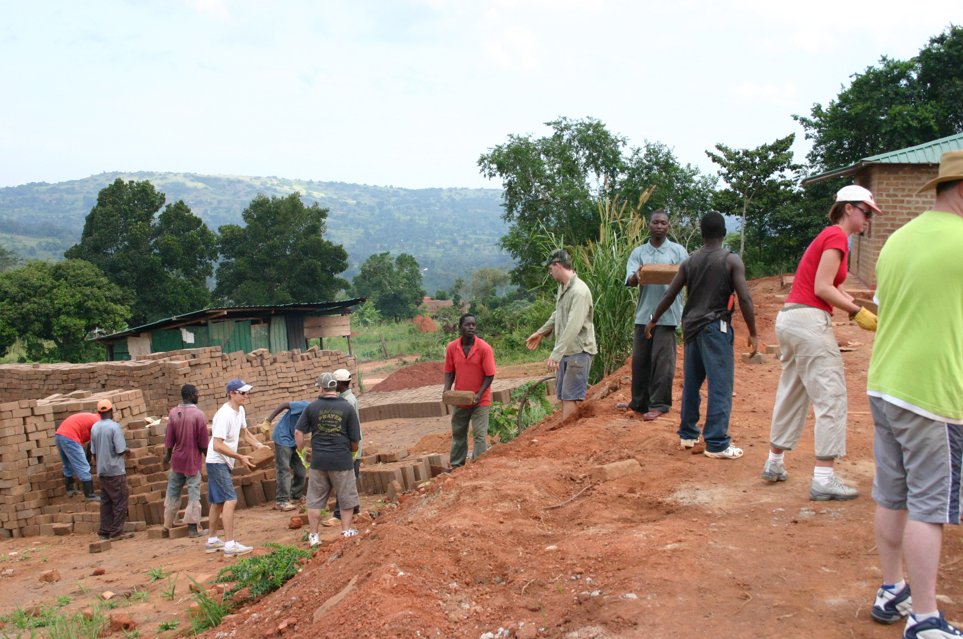

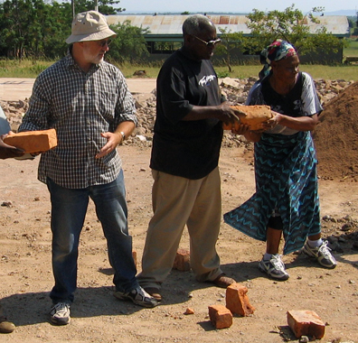
A subtle example
Pipelining

Slide 5
The Necessity
Why do we need it NOW ?
  The problems we're trying to solve
    are BIGGER
    more COMPLEX
    get BIGGER by the day
  Solutions to such problems
    Must be able to HANDLE HUGE VOLUMES of data
    Must be written in languages that can EXPRESS the COMPLEXITY in an EASY WAY
    Must be able to ADAPT to LARGER problems quickly (scaling)
  Google has thousands of servers around the world to cater to its users
    Each server responds to a request in a parallel fashion.
But, why not build a BIG computer ?

Slide 6
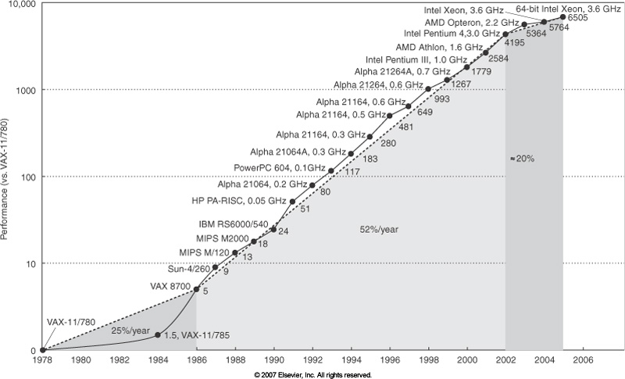
Le usual processor graph from a Comp Arch lecture

Slide 7
HW issues
Faster processors tend to lose heat slower
  Complex cooling systems
  We've reached a limit of ~3.6 GHz
Shrinking the size of processors requires to pack the components together
  Hot components are closer together
  Lesser chance of heat escaping
Quantum Tunneling
  Didn't see this coming ? Did ya ?
  There's limit to how close components can packed to behave the usual laws of semiconductors

Slide 8
The Solution
Build a computer with smaller computers inside it (multi core)
Then connect these computers together(distributed computing)
How do you program them ?

Slide 9
Parallel Programming Languages
Historically, languages designed without parallelism in mind.
Extended to include parallelism
  C/C++ : OpenMP / Pthreads / Cilk / CUDA
  FORTRAN : OpenMP / CUDA
  Java/Python/C++11 : Native multi threading libraries
    <thread>
    java.lang.Thread
Now, they are designed with parallelism as a guiding principle
  Julia
  Chapel ( from Cray Inc. )
  Many functional languages e.g. Haskell, ML

Slide 10
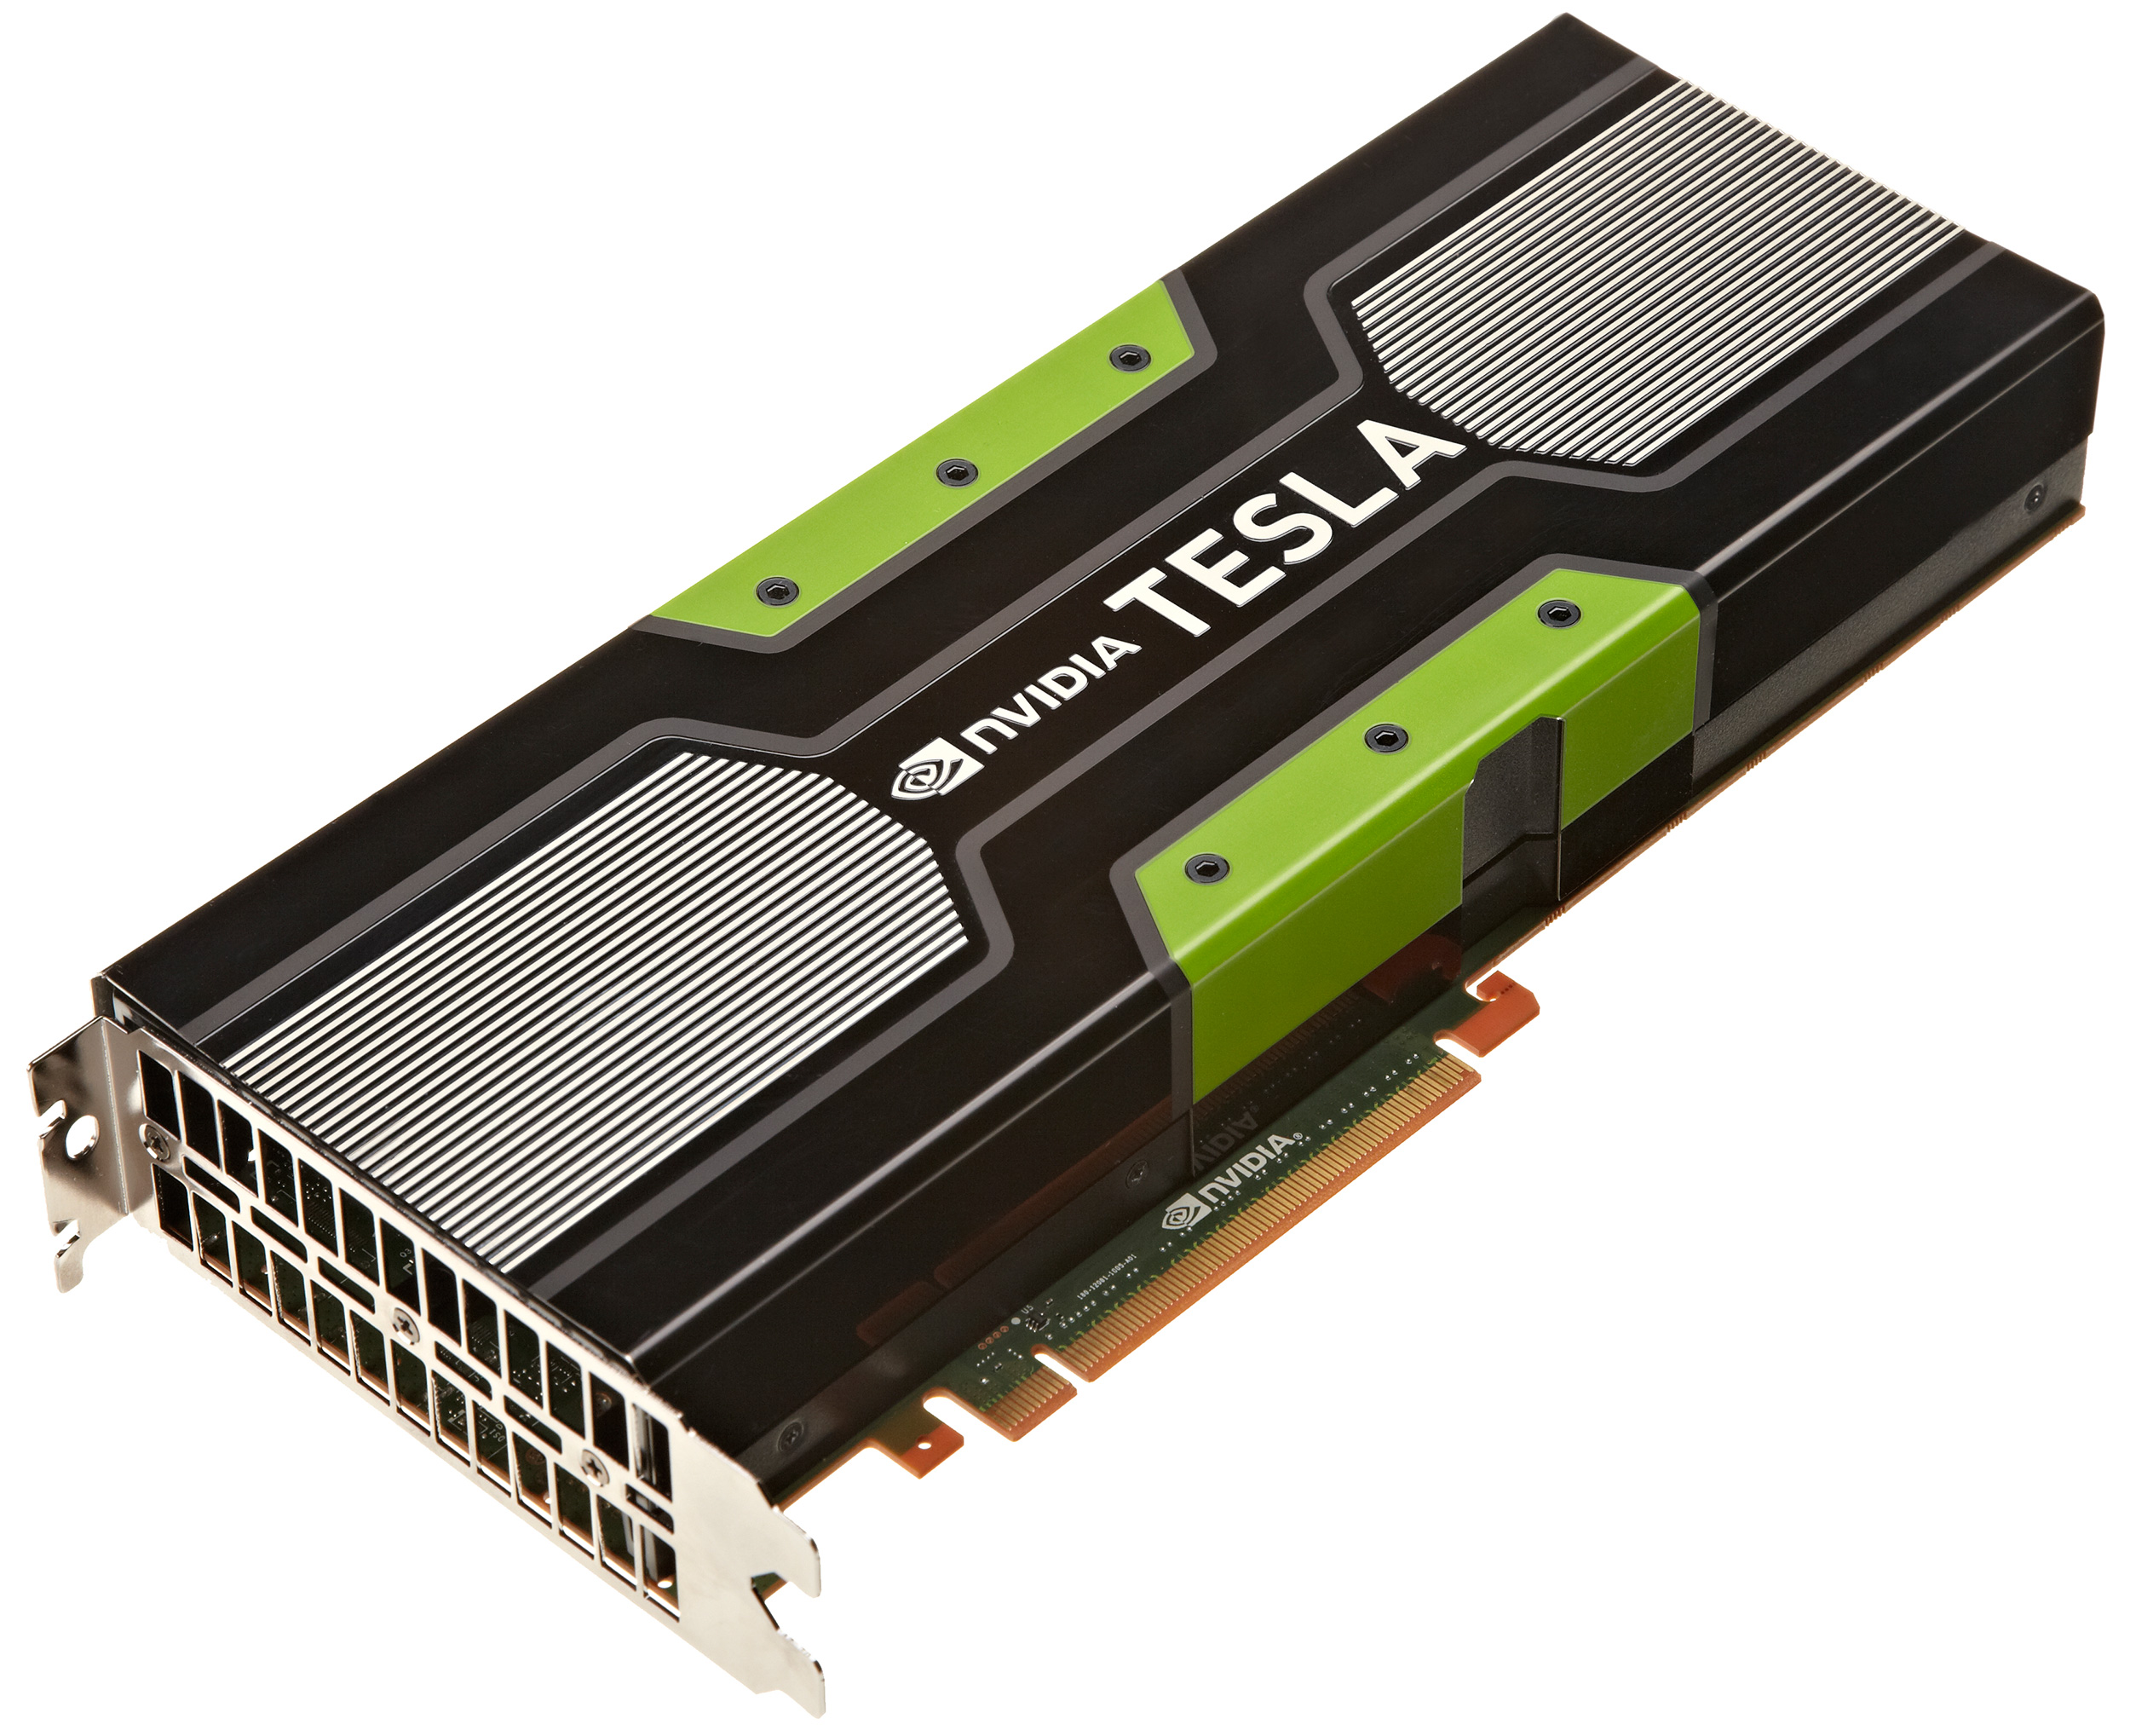
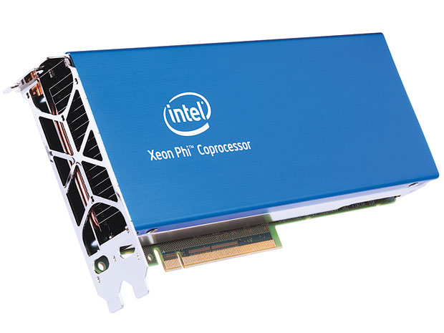
Trends in Parallel HW
Pipelining and high clock rate: Intel Pentium 4 (2000)
Dual/Quad/Octa Core : Core 2 (2006)
Embarrassingly/Highly Parallel : Intel Xeon Phi, NVIDIA Tesla

Slide 11
What are we going to learn here ?
This workshop would focus on figuring out parallelism in simple algorithms and implementing them in a variety of constructs.
We would focus less on the technical nomenclature

Slide 12
What are we going to learn here ?
Parallel Constructs
  OpenMP
  Cilk
  SSE
Not just that
  Git
  Compiling *NIX programs from source
    Makefiles
  Benchmarking

Slide 13
HW and SW requirements
Any Linux distribution
Multicore machine ( preferably 4 )
2 GB RAM

Slide 14
It's a tool, end of the day
What can YOU do with it ?
  Machine learning
  IR
Better understand CDCs
  MicroP
  Comp Arch
  OS

Slide 15
Food for thought
You need a compiler to create programs from source code.
The compiler has to be installed on an OS
The OS is itself a (BIG) program
The first OS was compiled by a compiler
Then where was the first compiler installed ?

Slide 16
Q ?

