Slide 1
Summation

Slide 2
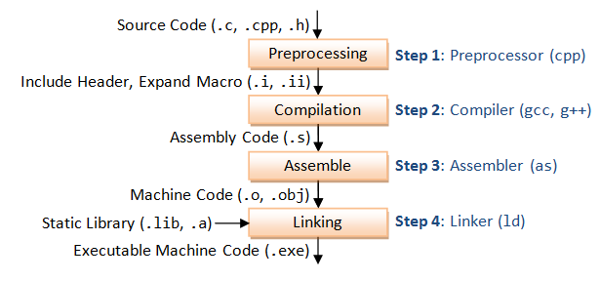
Compilation process
Back in the 1970s, compilers were a new thing
So, the question was wrong
The first operating system was assembled, not compiled.

Slide 3
$ git pull your code
$ git clone https://github.com/singam-sanjay/ACM-BPHC_IntroToParProg

Slide 4
Basic Code Block
sum = 0;
for( i = 1 -> N )
{
sum = sum + arr[i];
}

Slide 5
Improve sequential code
Can we execute 2 iterations at once ?
  Whaa ??
while( i <= N )
  sum = sum + arr[i] + arr[i+1] + arr[i+2] + arr[i+3]
  i = i + 4;
^ This is called loop unrolling
  You unroll the parchment to read more
What’s the optimisation ?
sum +=
i += 1
sum +=
sum +=
sum += sum +=
i += 4

Slide 6
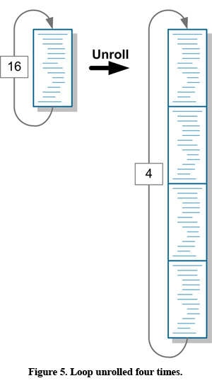
Loop Unrolling
What did we gain ?
  We don’t have to do an i++ for each loop
  Loop iterator is incremented at one shot for multiple loops
Let’s see it for ourselves

Slide 7
Benchmarking
We compare programs by looking at the time taken
Wall clock time
  Actual time taken by the program
  Count the seconds that elapsed
In MATLAB
  tic;
  /*Code*/
  toc;
  toc prints the time taken or elapsed time from the last tic.
$ time ./a.out

Slide 8
Benchmarking
Run it for different
  lengths of unrolling
  array sizes
    If the array size to test with is too large to fit into the memory, then repeat the same operation on arrays with smaller size a large number of times.
  Data types ( int Vs float )
Note
  Declaring sum as register sum would make accesses to sum faster.
    Temporal locality

Slide 9
Loop Unrolling
Is there a difference between,
  sum += arr[i]; sum += arr[i+1];…
  sum += arr[i] + arr[i+1] + arr[i+2];…
    Software pipelining : allows compiler to exploit pipelining
Intrinsic Compiler optimisations
  gcc’s -funroll-loop can identify and include loop unrolling automatically
    $ gcc main.c –funroll-loop

Slide 10

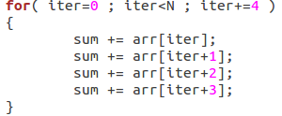
Loop Unrolling
Vs
The one on the right has more memory accesses, at most 4 time slower than the one on the left.
  Remember, we were running these programs with sum declared in the memory
  The run times don’t make much of a difference if sum is declared as register.

Slide 11
Loop unrolling
Scalability
  Code get’s bigger as you unroll more
  How large can you go ?
Generalisation
  N can only be a multiple of the unroll length
      N = #adds_in_one_iter * Some_natural_number (C)
  What can we do to handle any N ?

Slide 12
Generalised Loop unrolling
Modulo %
  Before, N = C*unroll_length
  Now, (Any) N = C*unroll_length + whats_remaining
  whats_remaining = N % unroll_length
We'll now have 2 loops
  An unrolled loop
  A usual for loop that takes care of the what's remaining.

