Slide 1

Operations Survey in Business Finance
Data Science Toolbox: Python Programming
Project by: S. Surendranath Reddy
Reg. No: 12303218 | INT375
Guide: Mrs. Aashima (UID: 28968)
Discipline: CSE/IT
Lovely Professional University Phagwara, Punjab

Slide 2

Introduction
Data analysis supports business decisions.
It reveals customer trends and financial performance.
This project focuses on business transactions.
Tools used: Python, Pandas, NumPy, Matplotlib, Seaborn.
Goal: Extract insights and visualize data.
Enable better decisions using EDA methods.
Help in optimizing operations and growth.

Slide 3
Objective & Dataset Source
Objective: Clean, explore, and analyze data.
Support decisions using insights from financial data.
Dataset: 'python_project.csv' from stats.govt.nz.
Format: ISO-8859-1 encoded CSV.
Attributes: industry, size, value, level, etc.
Loaded and explored using Pandas.
Initial cleaning addressed missing values and formats.

Slide 4
Understanding EDA
EDA = Exploratory Data Analysis.
Identifies trends, patterns, and outliers.
Visual tools: histograms, boxplots, scatter plots.
Reveals key relationships in data.
Helps with cleaning and feature engineering.
Supports strategic decision-making.
Improves understanding before modeling.

Slide 5
Data Cleaning
Replaced encoding issues in 'size'.
Filled missing values using mean/mode.
Removed duplicates using drop_duplicates().
Outliers removed using z-score filtering.
Ensured data is consistent and reliable.
Prepared for accurate analysis and visualizations.

Slide 6
Dataset Overview
Numerical fields: level, value.
Categorical fields: industry, size, line_code.
Each row = one transaction record.
Focus on business revenue and classification.
Mix of small to large-sized businesses.
Used describe(), groupby(), and aggregation.

Slide 7
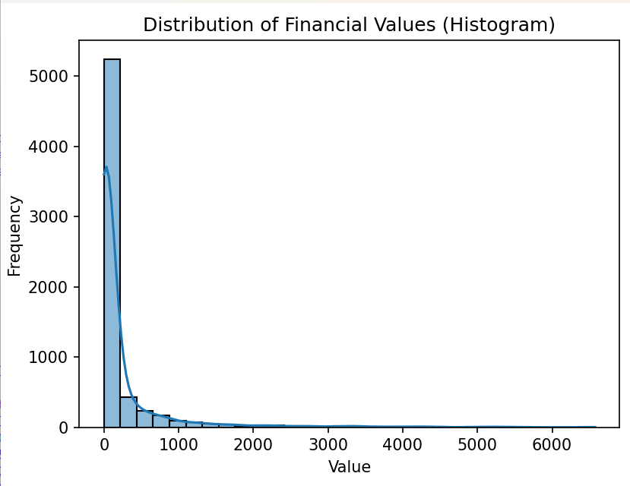
Histogram - Value Distribution
Histogram shows skewed financial data.
Positive skew due to high-value outliers.
Most transactions are mid to low value.
Reveals overall revenue spread.
Used seaborn histplot with KDE curve.

Slide 8
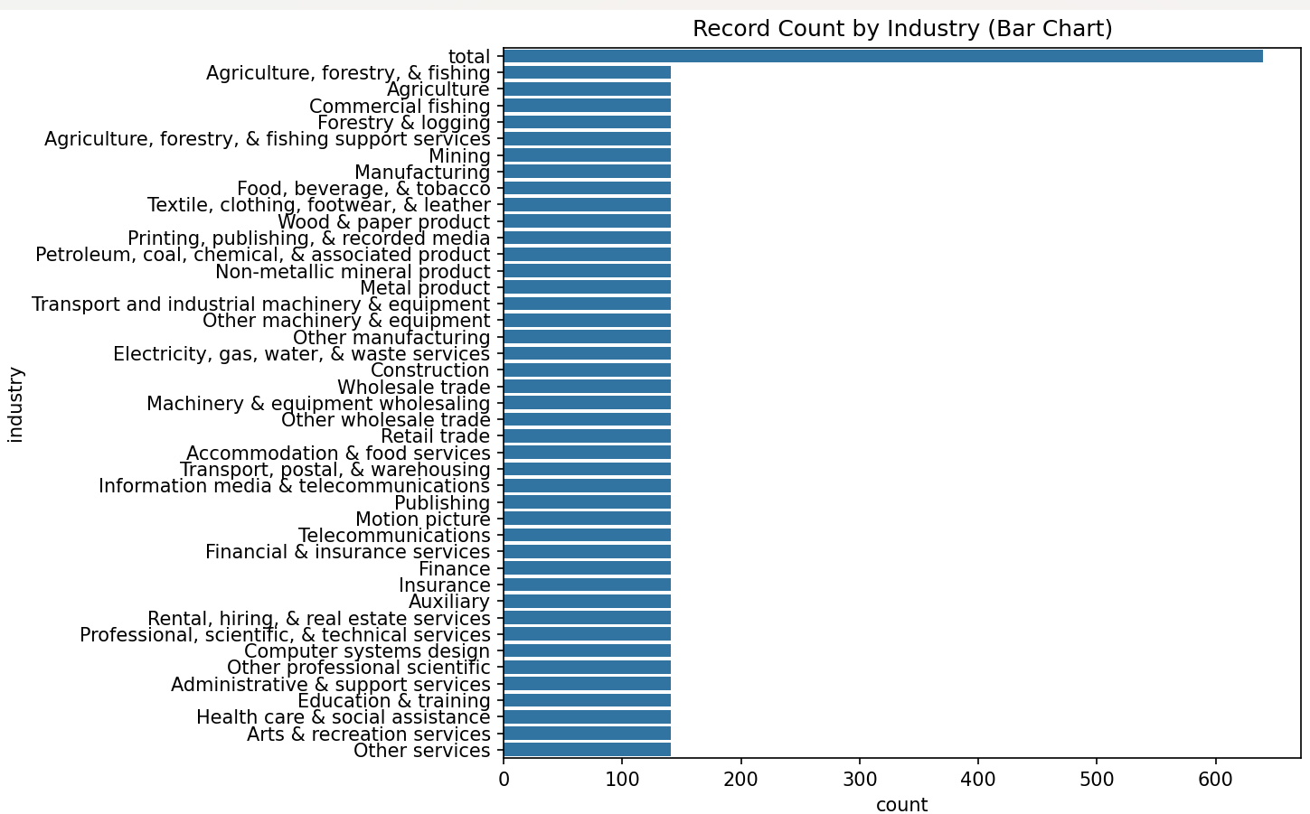
Bar Chart - Industry Count
Bar chart ranks industries by record count.
Highlights top-performing industries.
Used countplot for visualization.
Identifies high-activity business sectors.
Useful for market targeting strategies.

Slide 9
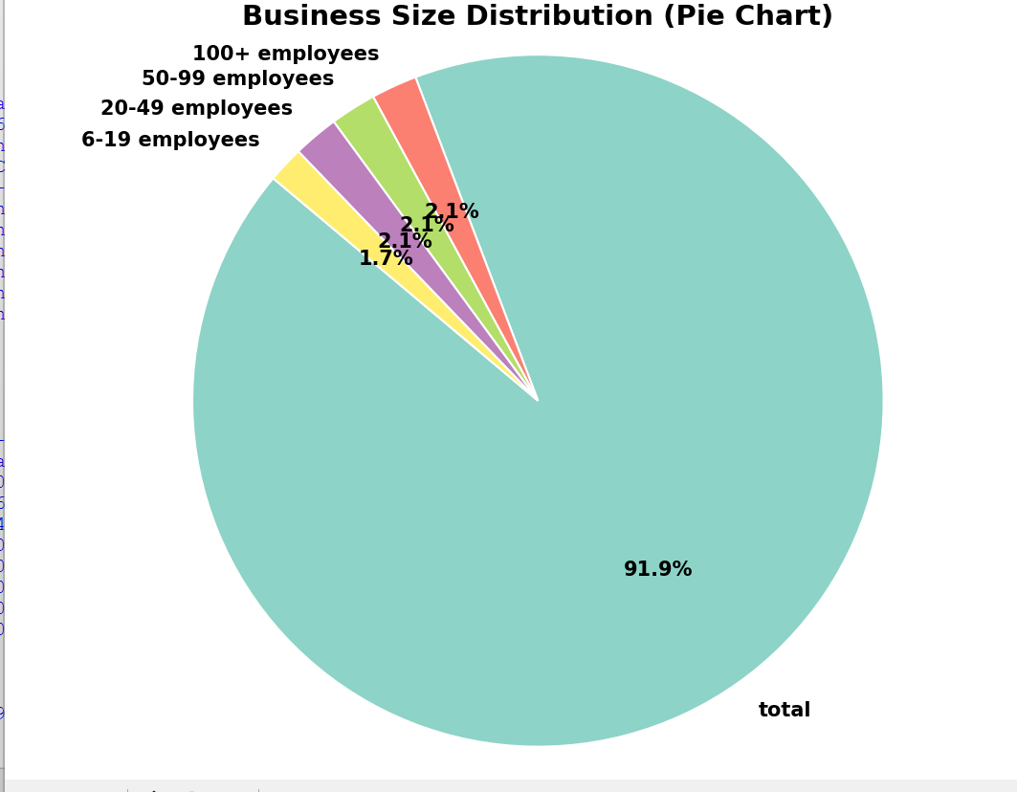
Pie Chart - Business Size
Pie chart shows size-wise distribution.
Large and medium businesses dominate in value.
Small businesses are more frequent.
Supports size-based market segmentation.
Each size group needs tailored strategies.

Slide 10
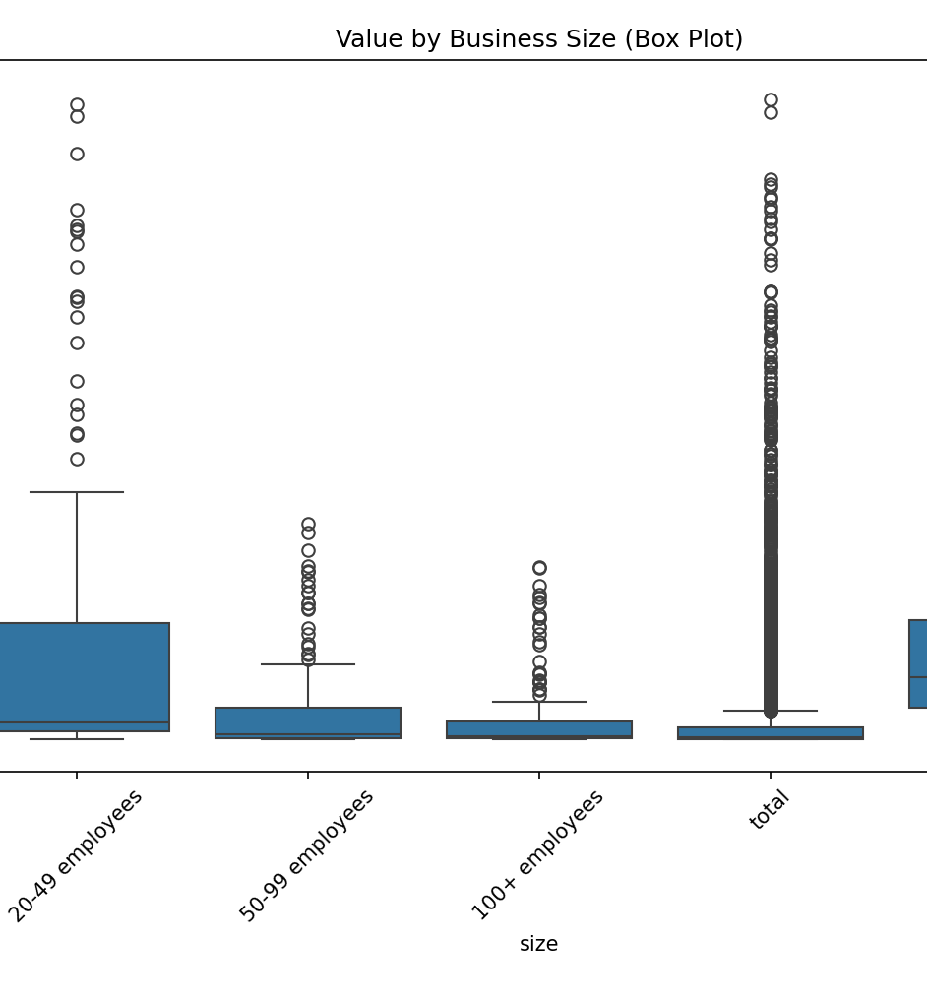
Box Plot - Size vs Value
Box plot compares transaction values by size.
Large businesses show wider spread and higher values.
Outliers highlight major transactions.
Insights into business performance by size.

Slide 11
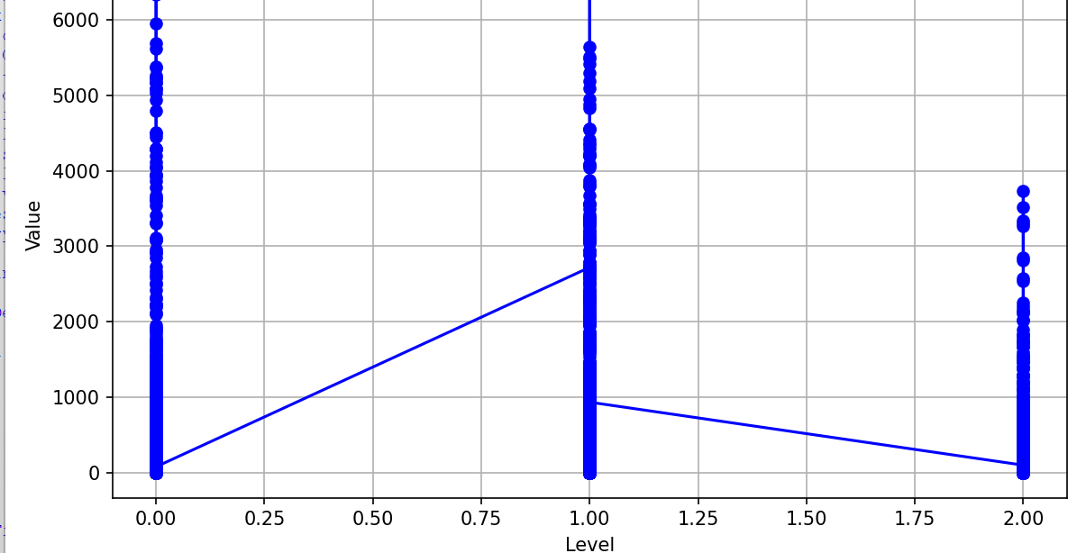
Line Graph - Level vs Value
Line graph tracks value against level.
Higher levels often indicate higher values.
Useful for service tier comparisons.
Shows performance across business hierarchy.

Slide 12
Business Decision Support
Top industries identified by revenue.
01
Focus marketing on high-revenue sectors.
02
Top line_codes analyzed for profitability.
03
Expand strong business lines.
04
Tailor services to business size.
05
Optimize investments using insights.
06

Slide 13
Conclusion
EDA led to meaningful insights.
High revenue industries and line codes revealed.
Large businesses contribute most financially.
Supports strategic growth and marketing.
Visualizations helped communicate results effectively.

Slide 14

Thank You

