Slide 1
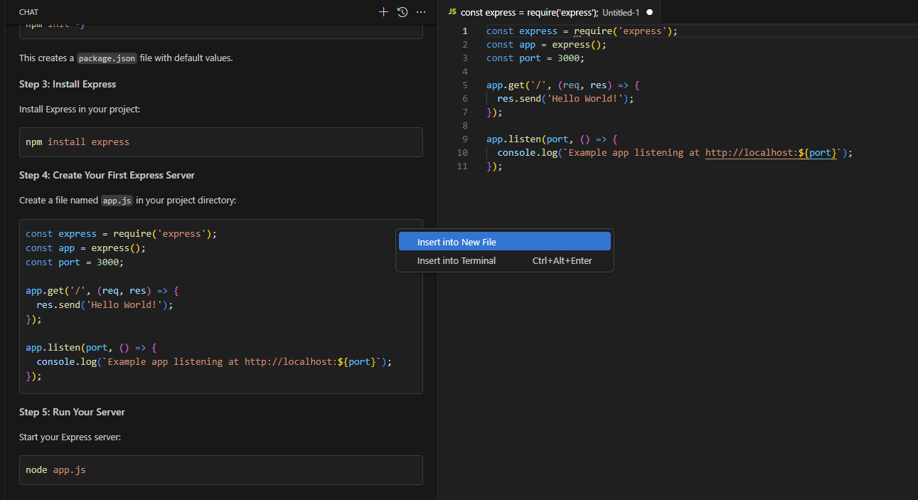
Insert to a new file from the co-pilot chat

Slide 2
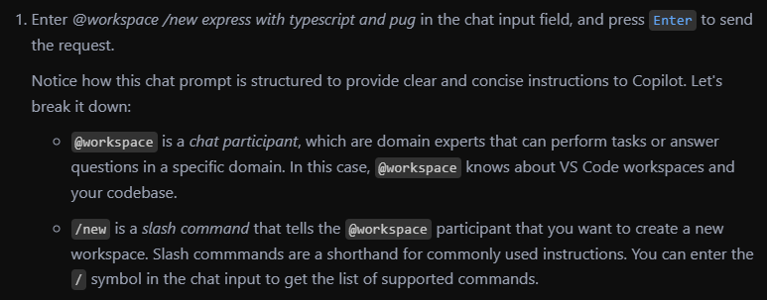
Chat participants

Slide 3
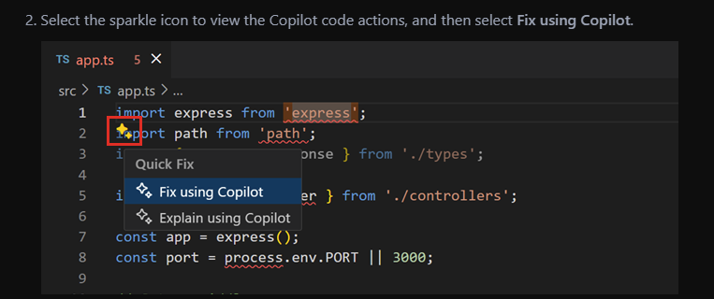
Smart Actions
https://code.visualstudio.com/docs/copilot/getting-started-chat

Slide 4
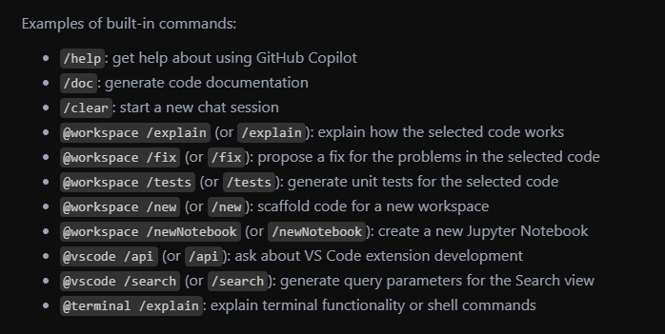

Slide 5
Github Co-Pilot Introductions
AI Pair Programmer - helps write code faster there by increase productivity
Code Completion, Context Aware suggestions

Slide 6
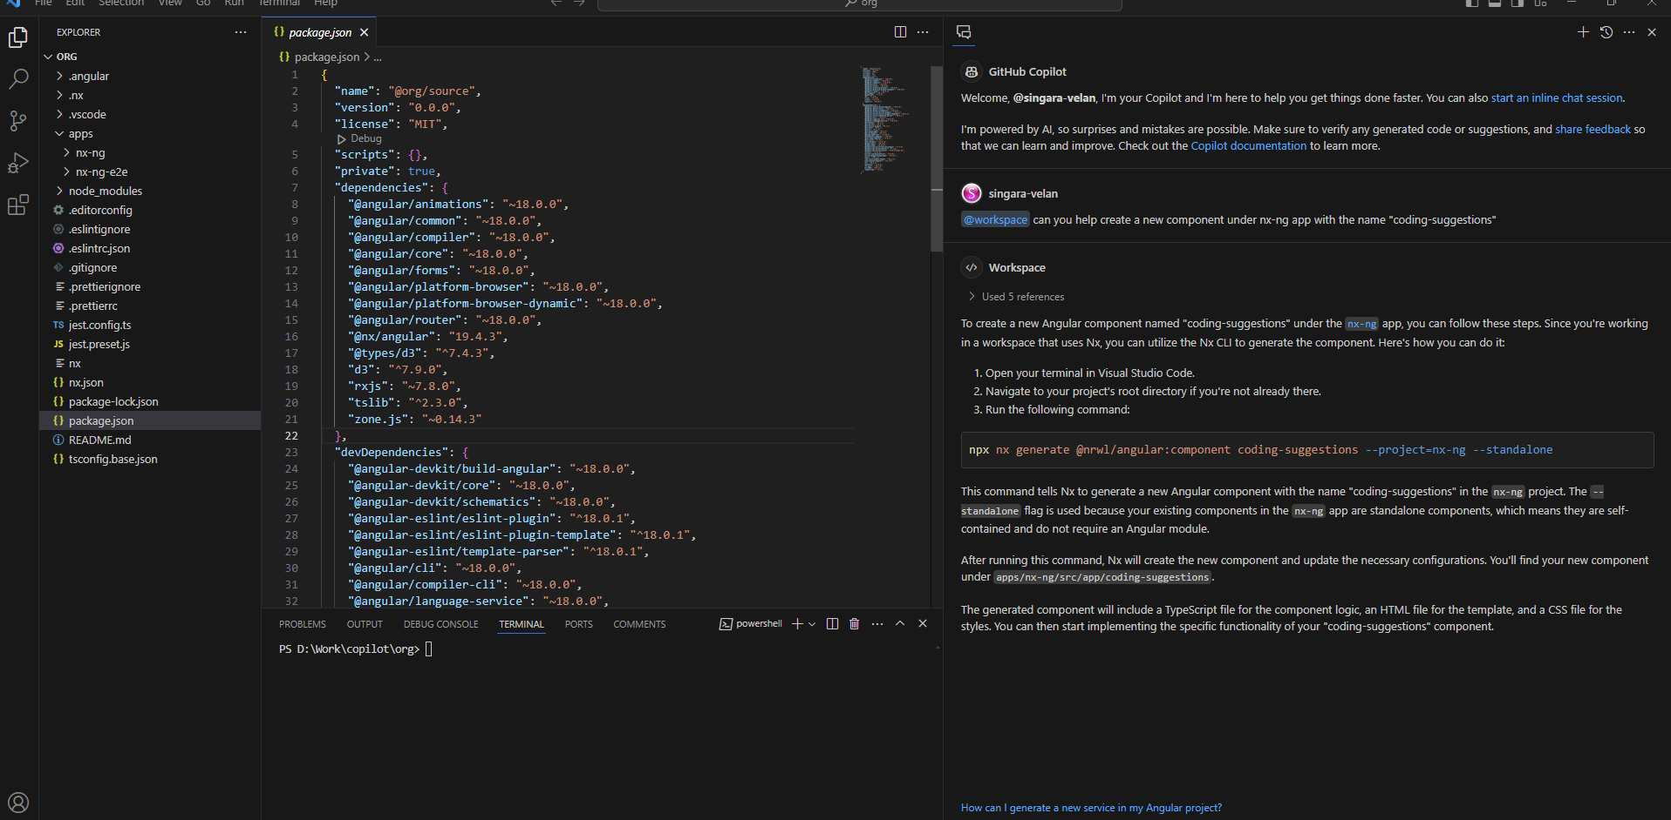
Context aware suggestions

Slide 7
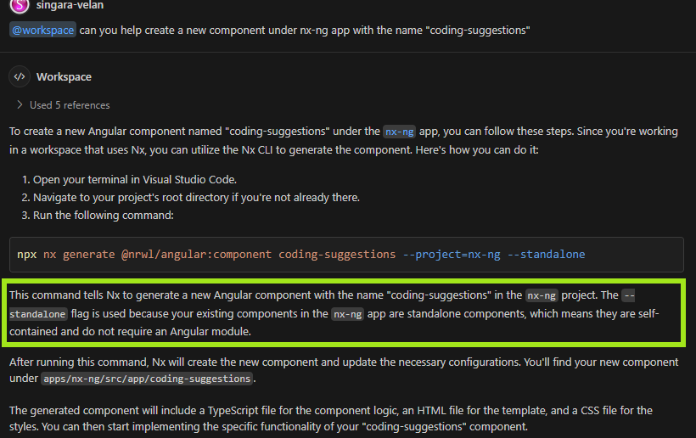

Slide 8
Ctrl +I prompt to create form

Slide 9
Open github co-pilot chat to create html
Talk about context and file updates.

Slide 10
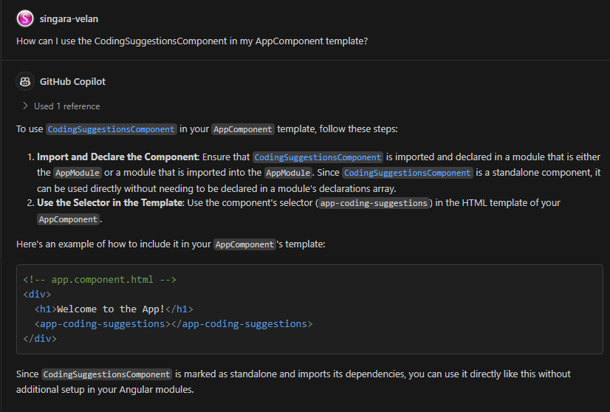
Asking question about normal vs workspace

