Slide 1
Introductory Econometrics
Using Excel

Slide 2
Outline
Generate Scatter plot Figure 4.3 page 161 of Stock and Watson book.
Generate Table 4.1 page 161 of the book.
Linear regression: Regression Statistics, ANOVA, coefficients, p-value, standard error, confidence intervals, etc.
Fit a trend line Figure 4.3 in page 164
Change plot style and colour.
Prediction
Sensitivity of OLS to large outliers
Exercise

Slide 3
Objective: Generate Figure 4.2 page 161 of the book.

Slide 4
You will find the data and description file here. Use the data caschool.xlsx.

Slide 5
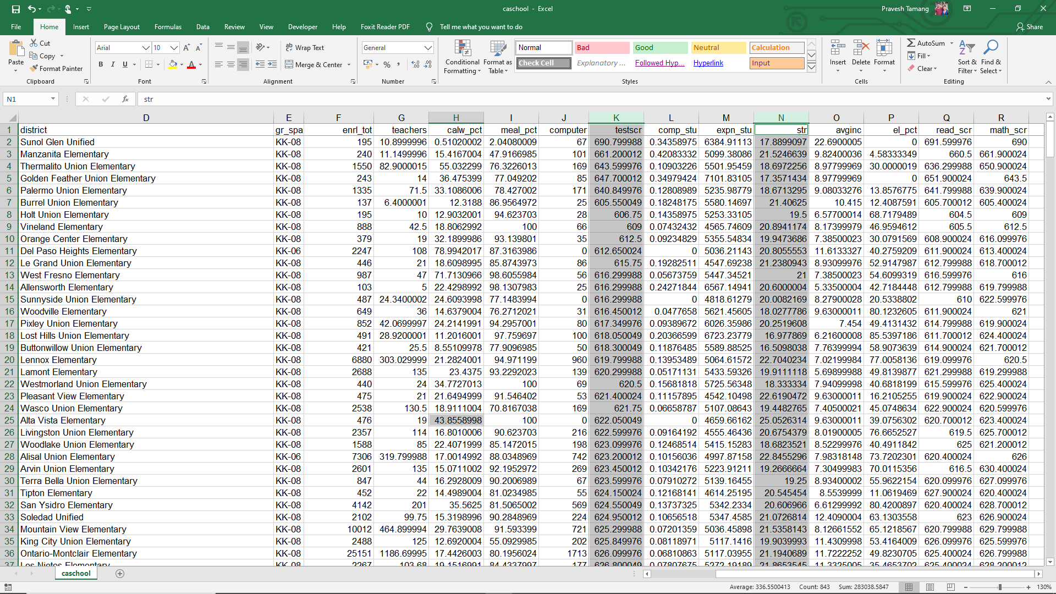
1

Slide 6
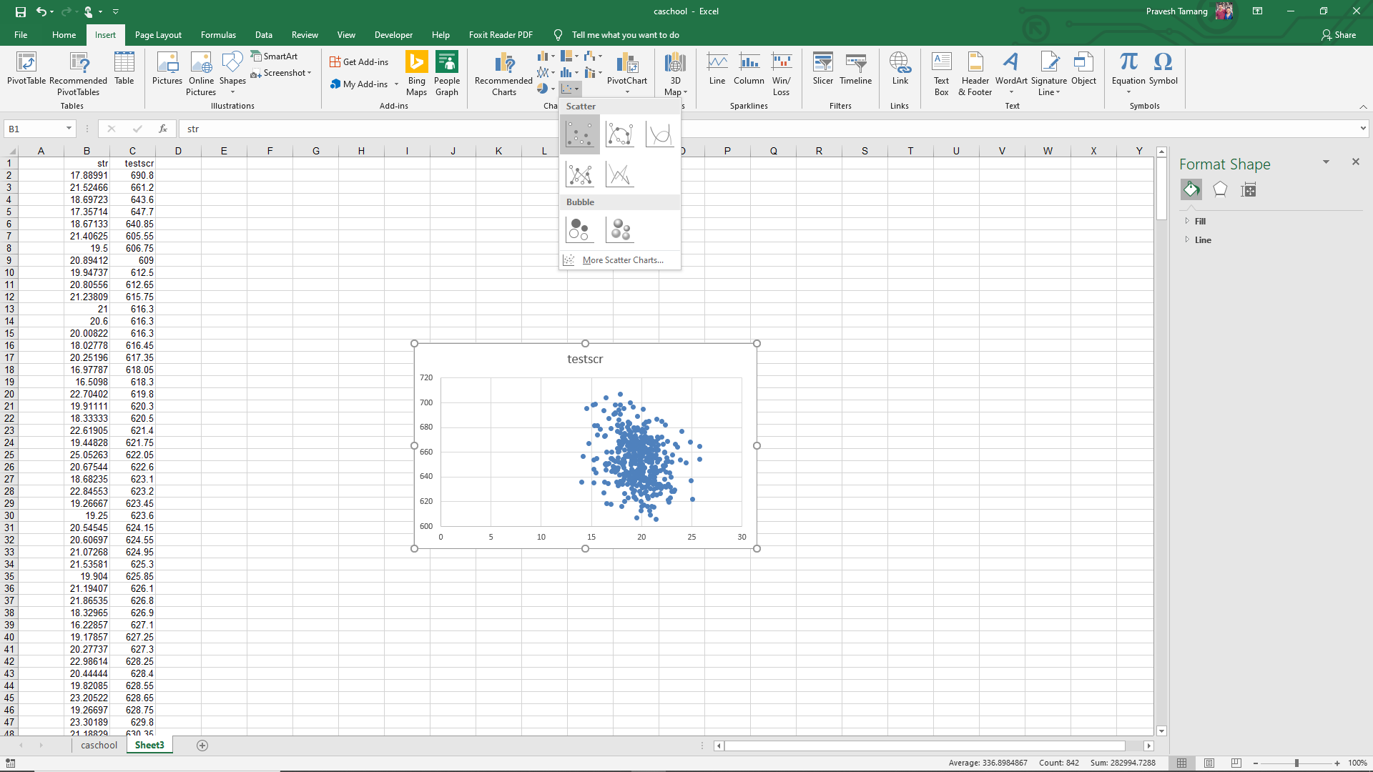
3
Make sure str is in the 1st column
2

Slide 7
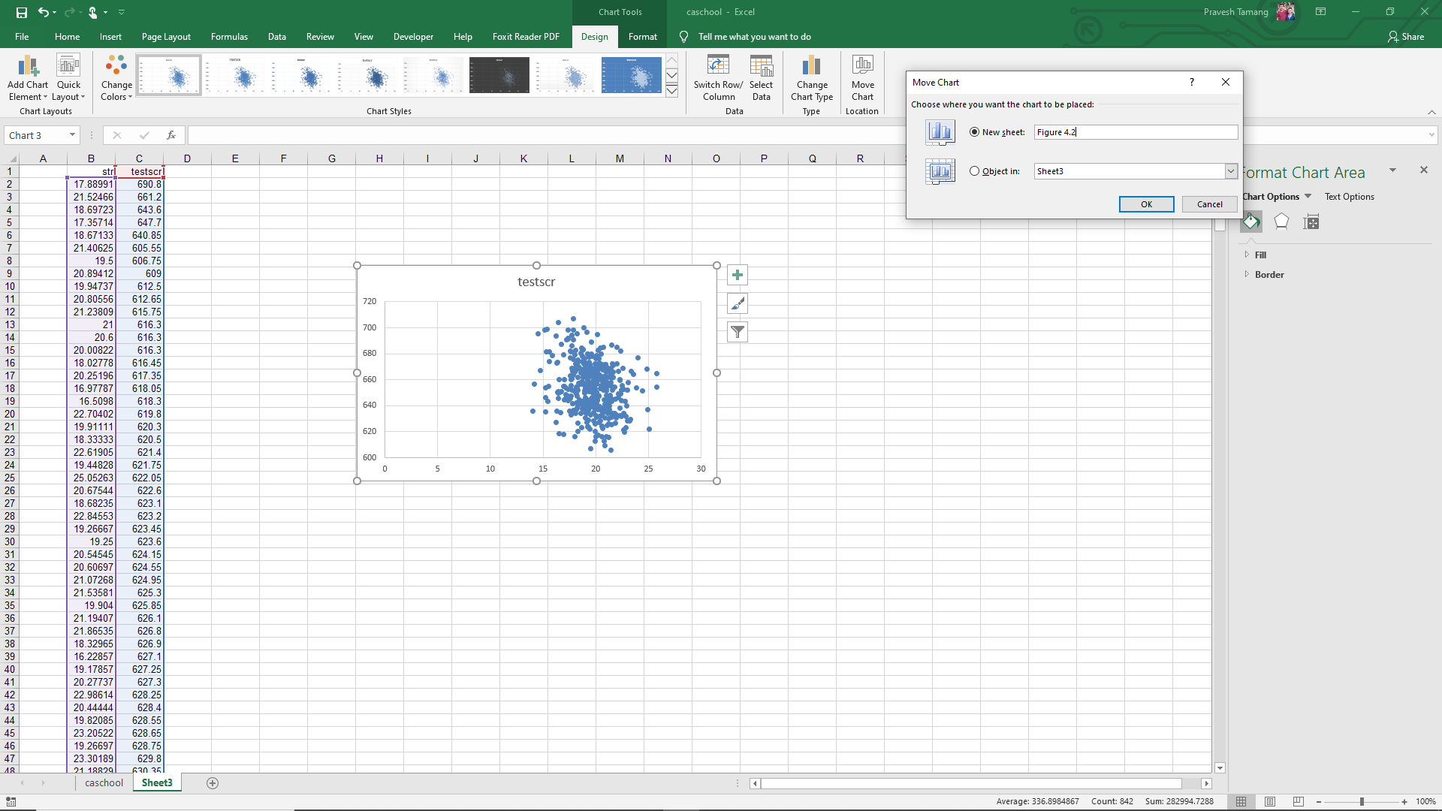
4
5

Slide 8
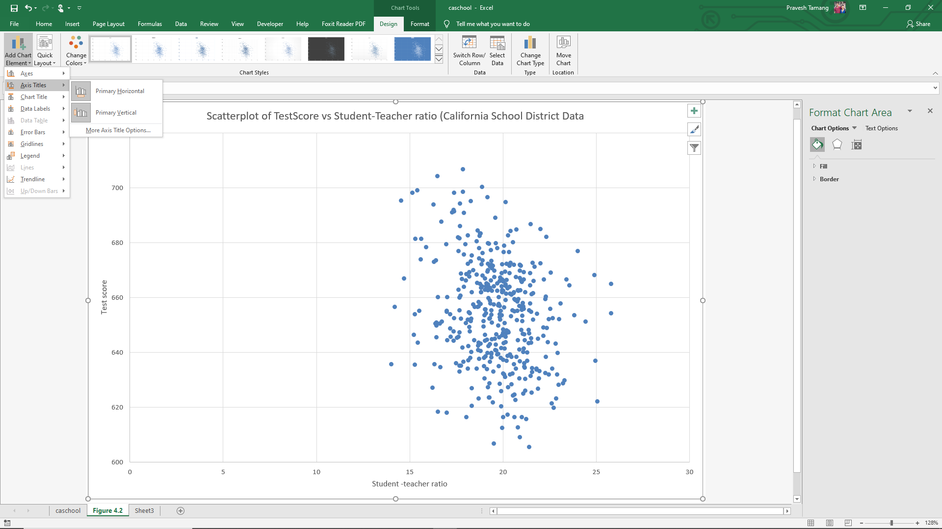
7
6
9
8

Slide 9
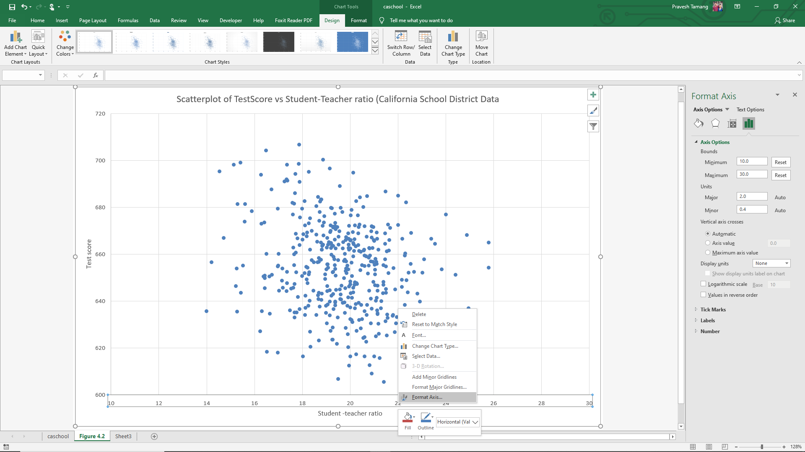
11
Right click on the axis
10

Slide 10
Objective: Generate Table 4.1 page 161 of the book.

Slide 11
Objective: Generate Table 4.1 page 161 of the book.
 |  |  | Percentile
 | Average | Standard Deviation | 10% | 25% | 50% (Median) | 60% | 75% | 90%
Student Teacher Ratio | 19.64 | 1.88 | 17.34 | 18.58 | 19.72 | 20.07 | 20.87 | 21.86
Test Score | 654.15 | 19.03 | 630.39 | 640.05 | 654.44 | 659.4 | 666.66 | 678.86

Slide 12
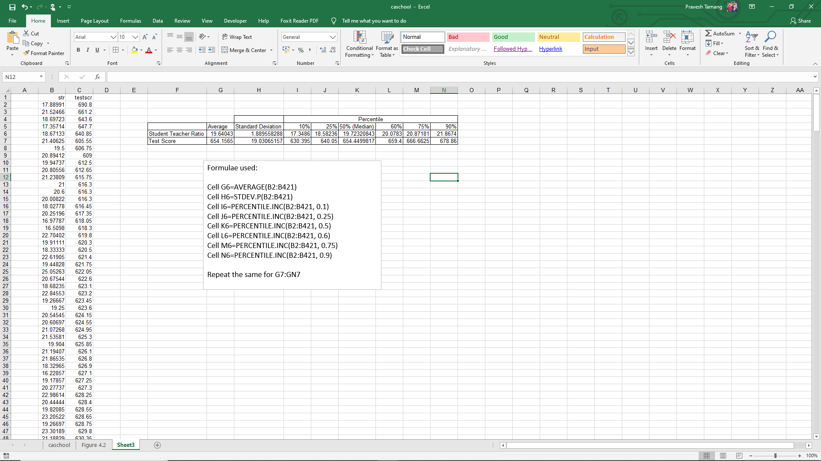

Slide 13
Linear regression
Regression Statistics, ANOVA, coefficients, p-value, standard error, confidence intervals, etc.

Slide 14
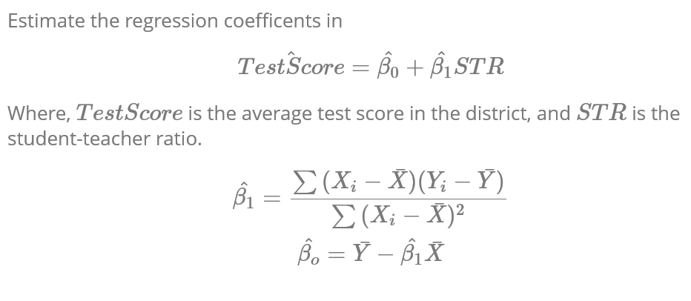

Slide 15
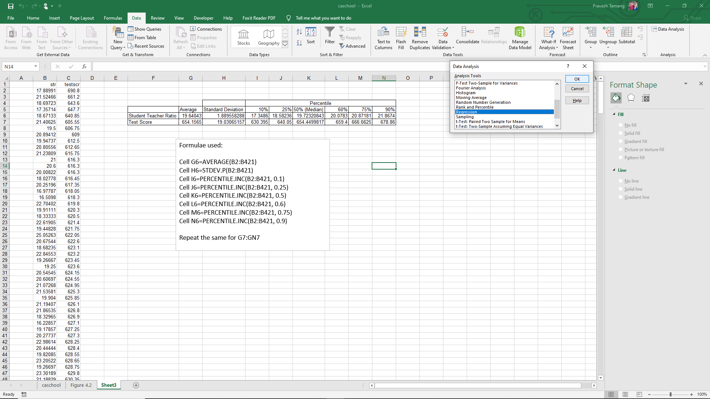
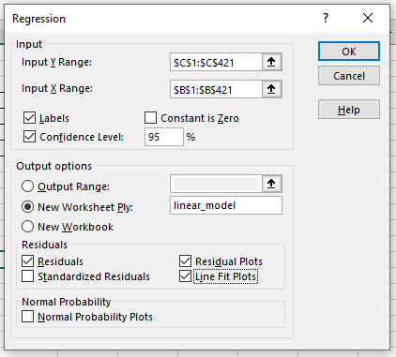
1
2
3
4
5
6

Slide 16
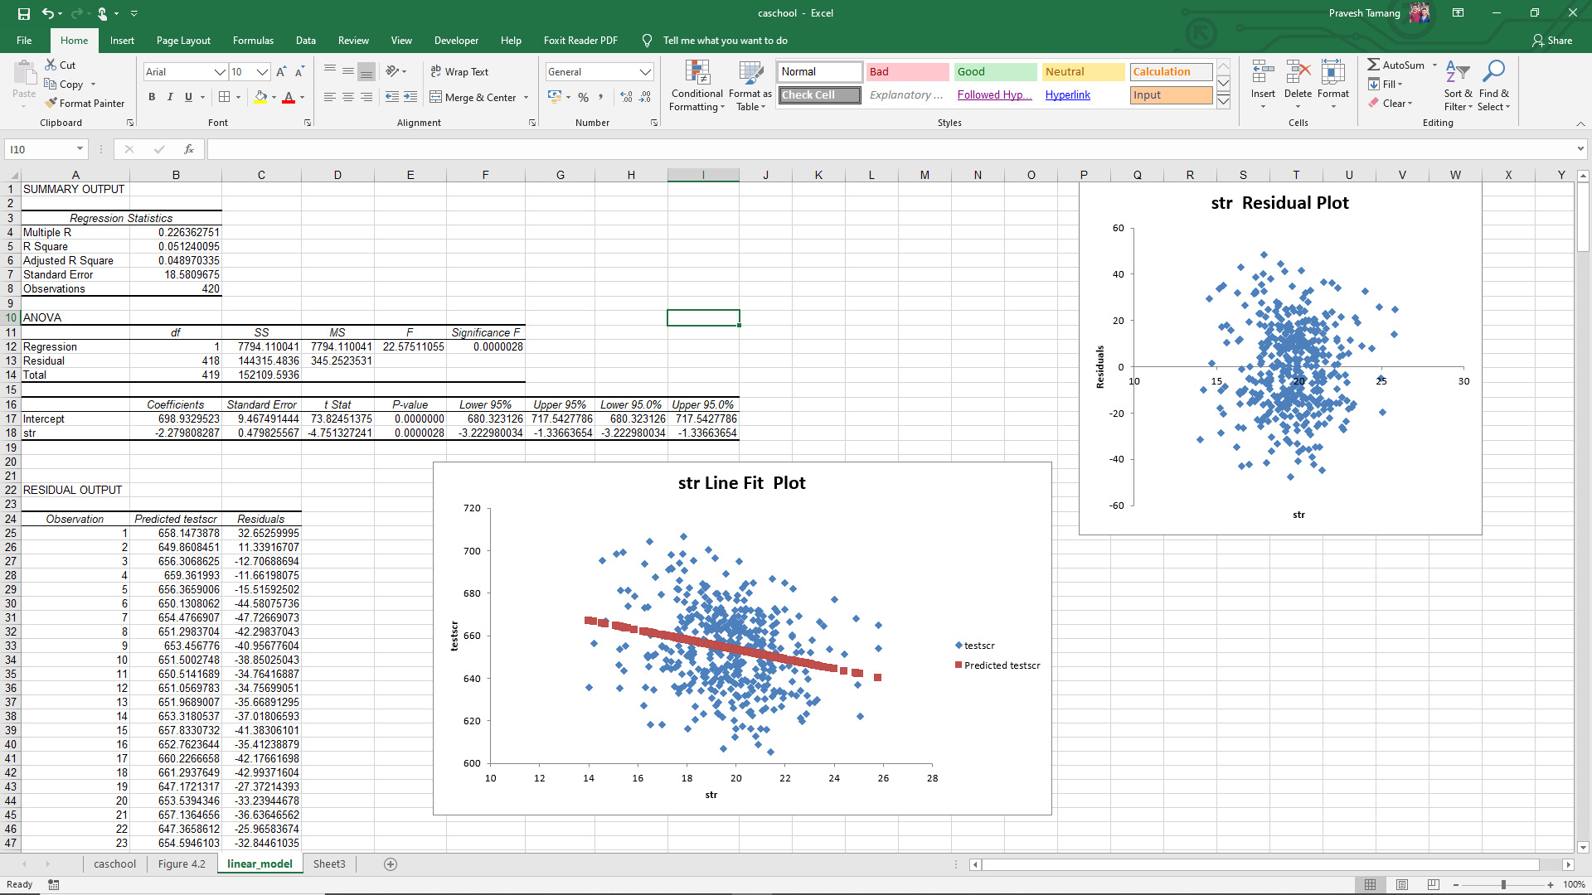

Slide 17
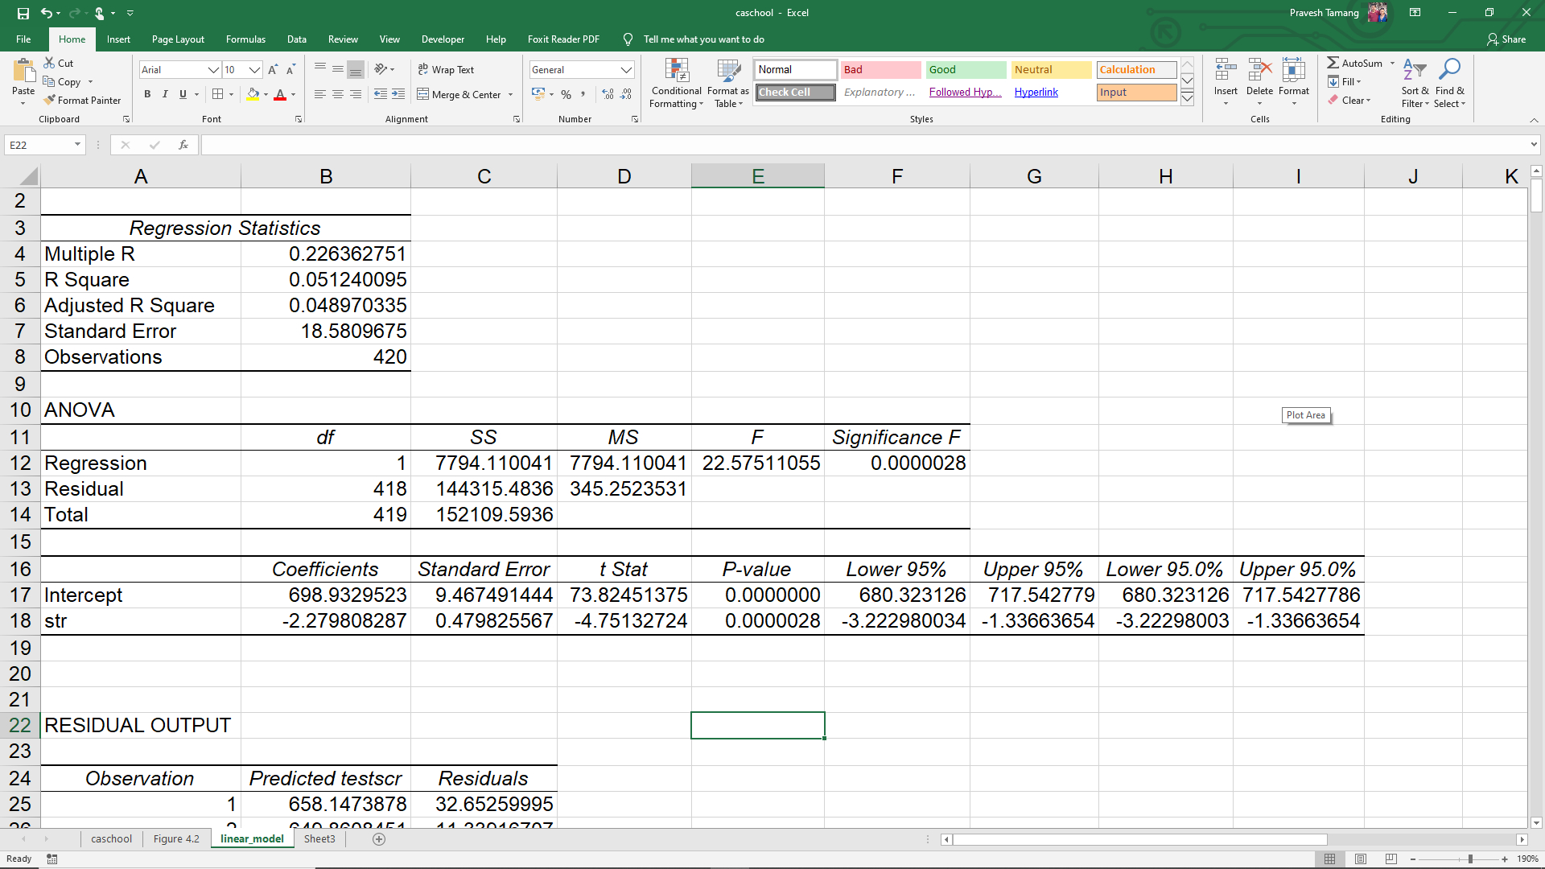

Slide 18
Fit a trend line Figure 4.3 in page 164

Slide 19
Fit a trend line Figure 4.3 in page 164

Slide 20
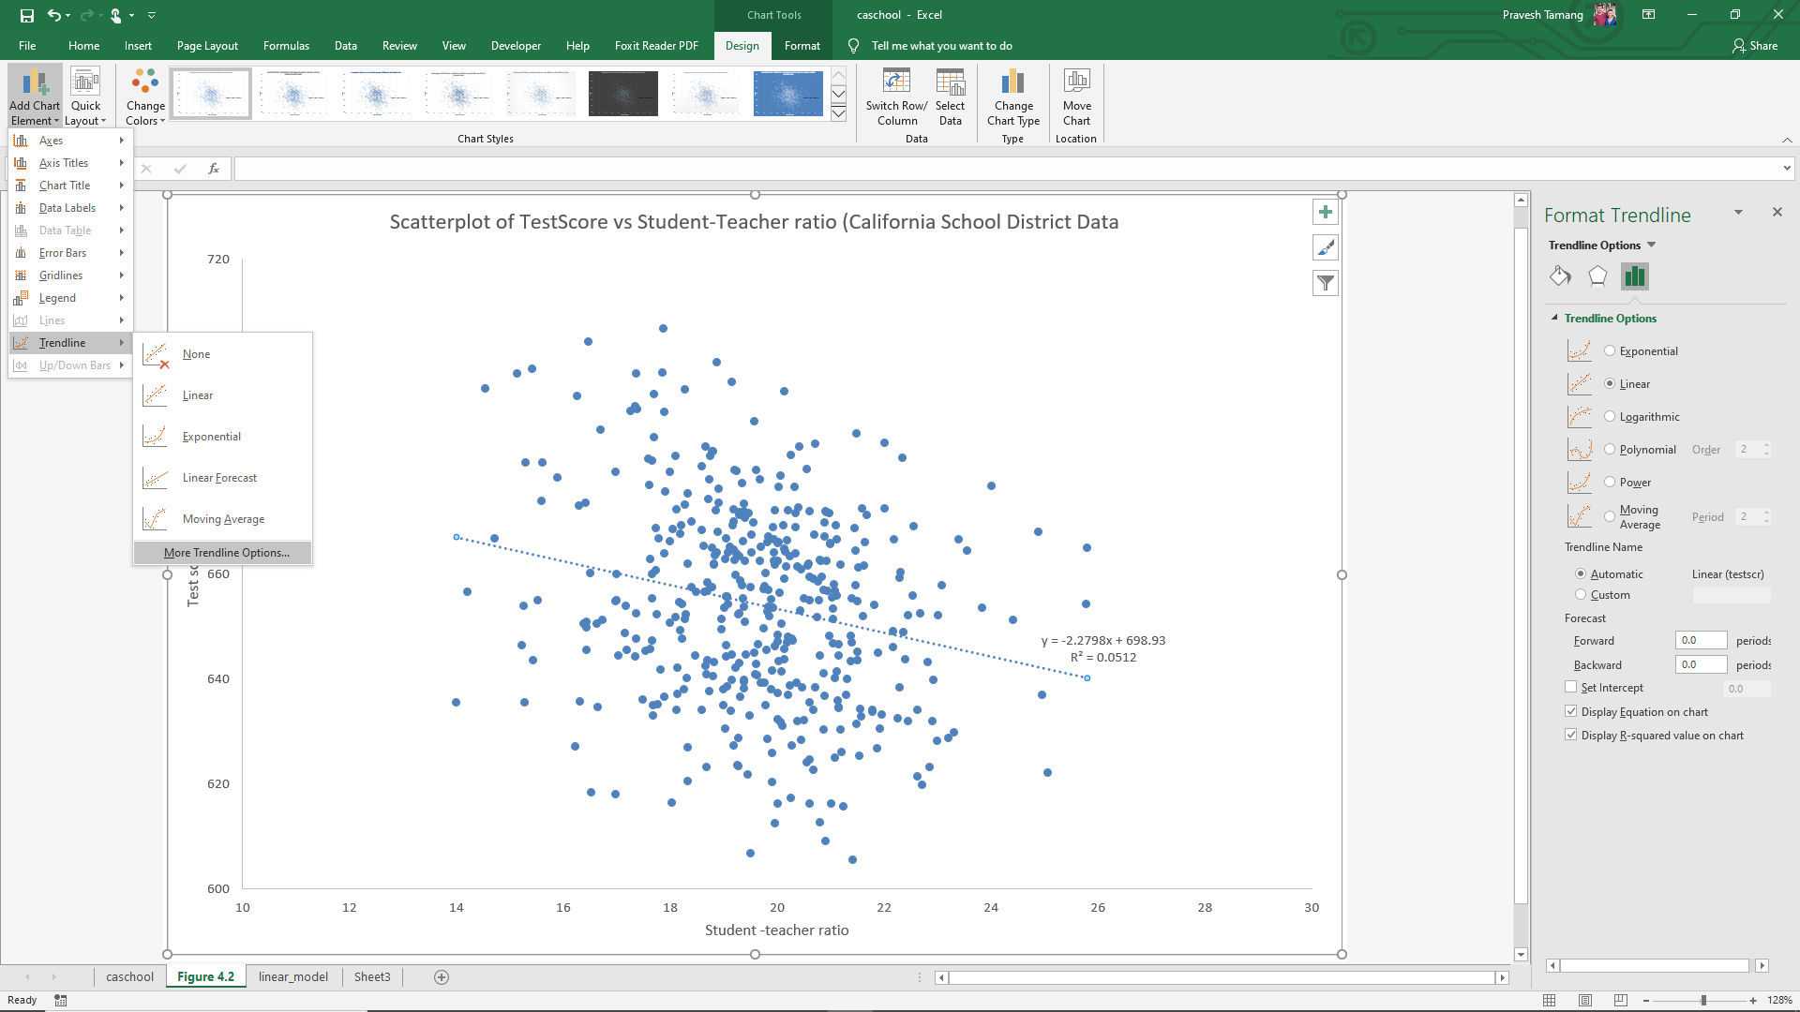
1
3
2
4

Slide 21
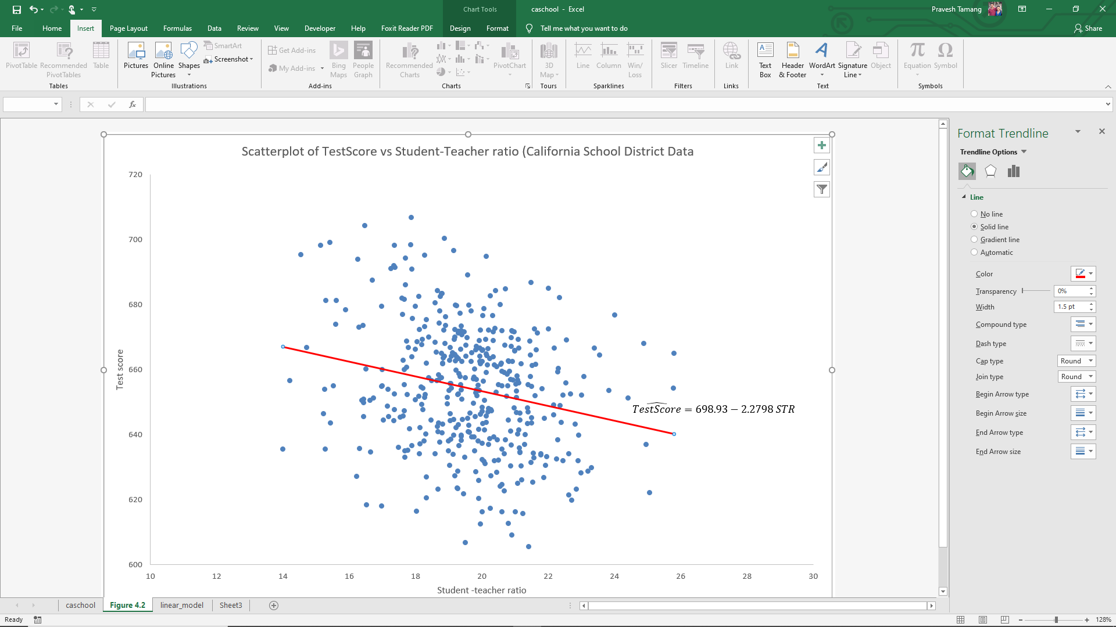
6
Use Insert Text Box and then Equation
7
8
5
Double click on the line

Slide 22
Changing the plot colour and style

Slide 23
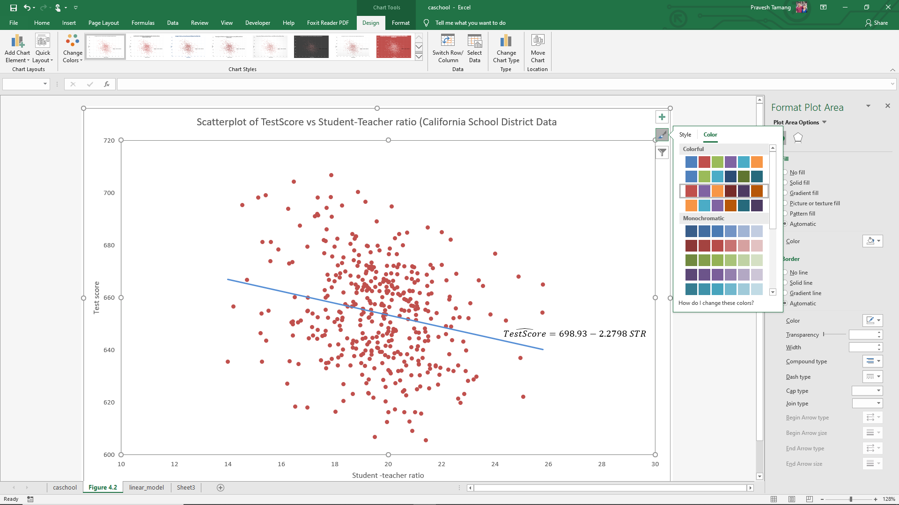
Changing the plot colour and style

Slide 24
Prediction

Slide 25
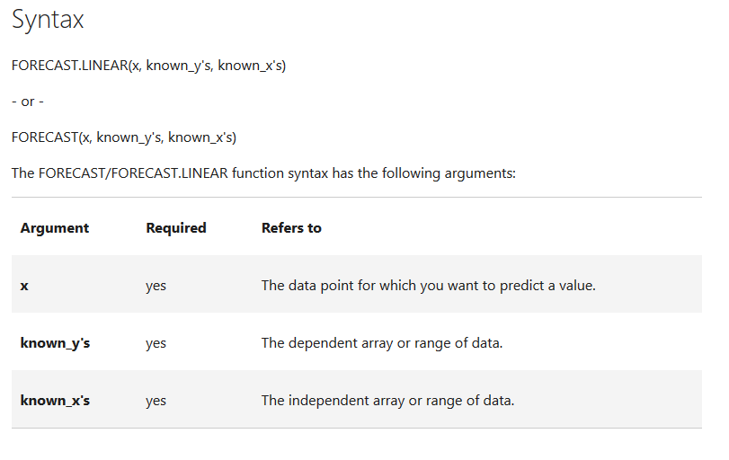

Slide 26
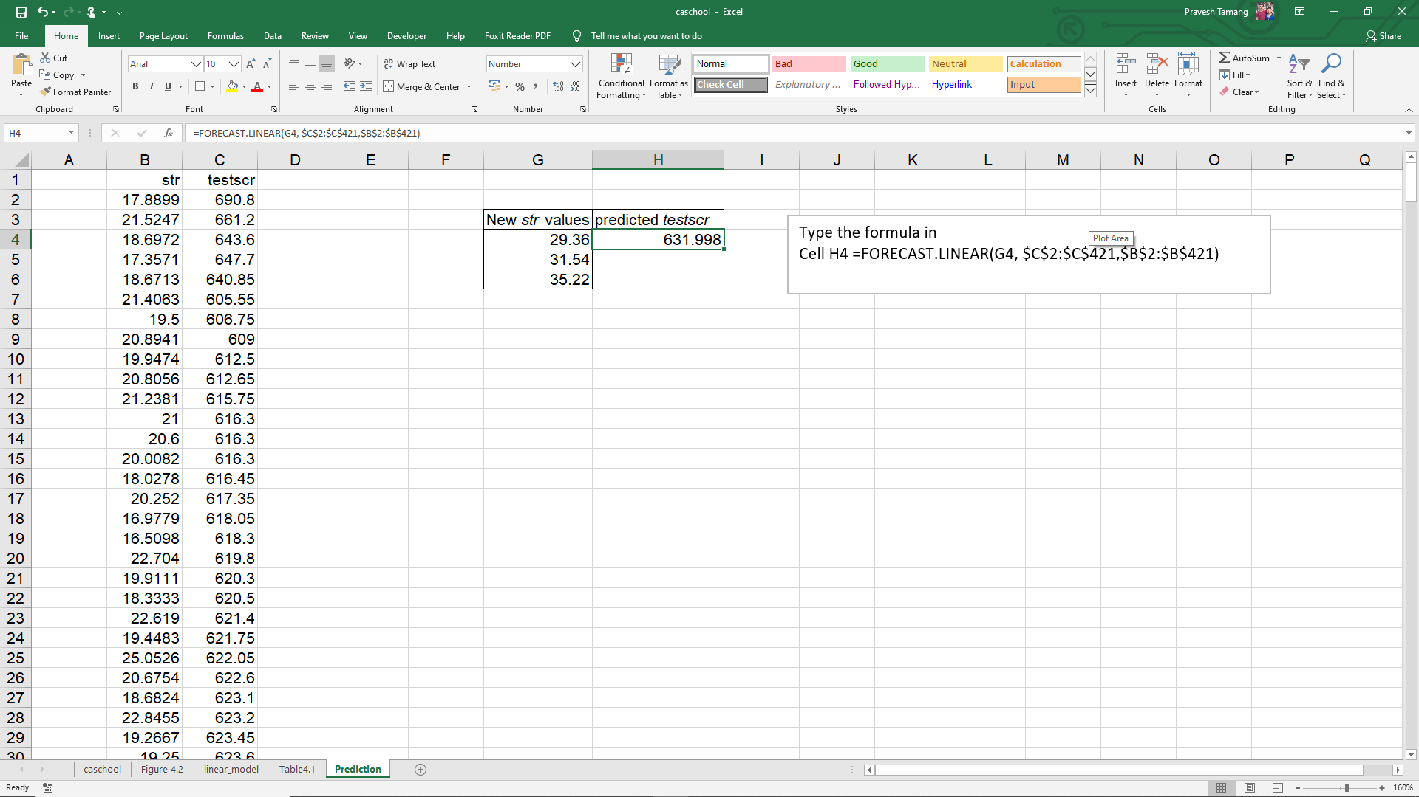
1
2
Drag the formula to the other cells

Slide 27
The sensitivity of OLS to large outliers

Slide 29
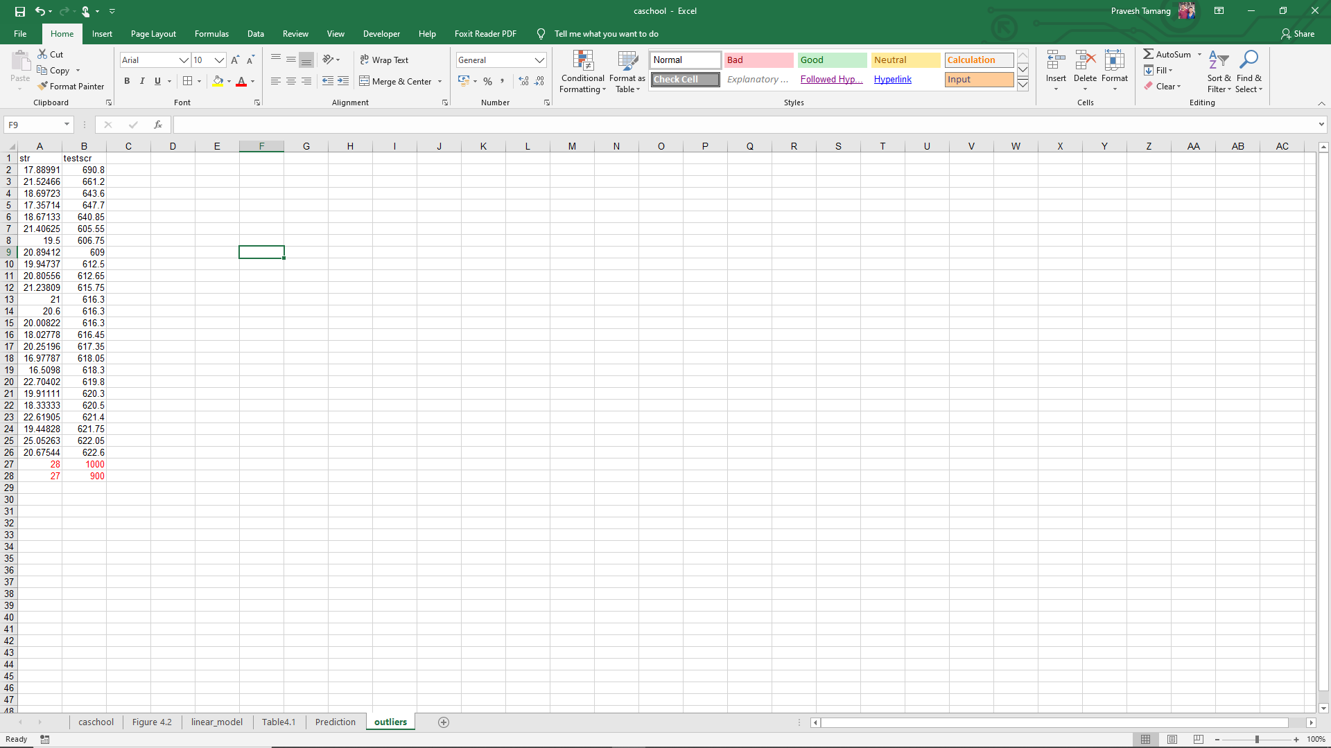
1
Copy and paste the first 25 rows of the data
2
Add 2 new rows of data

Slide 30
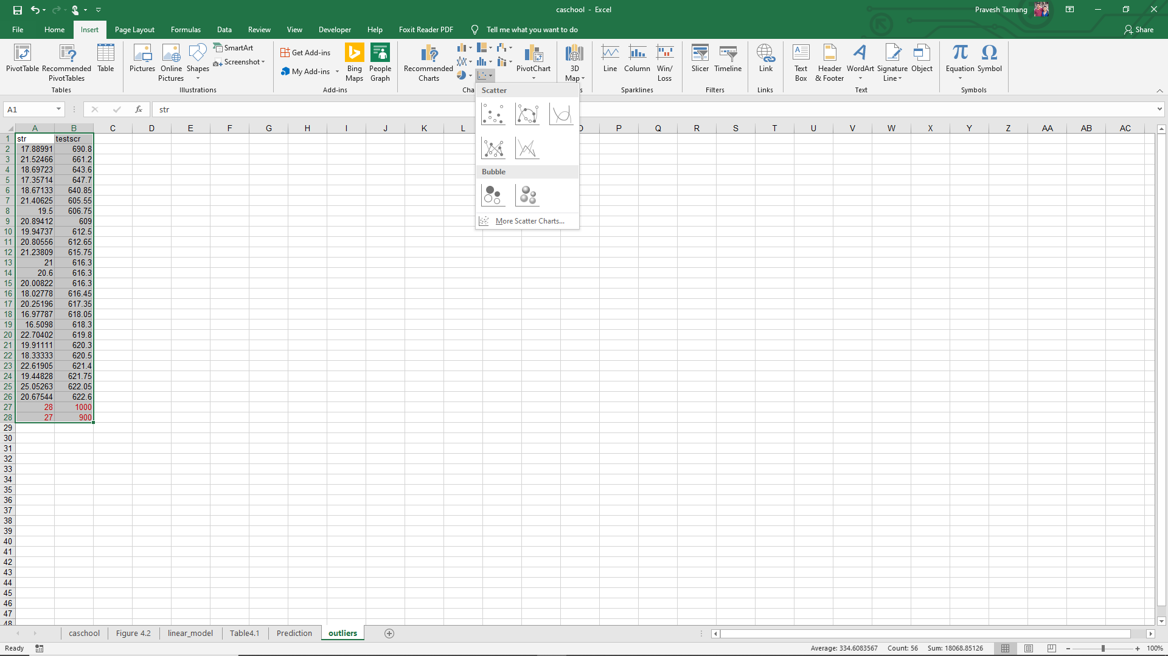
4
3

Slide 31
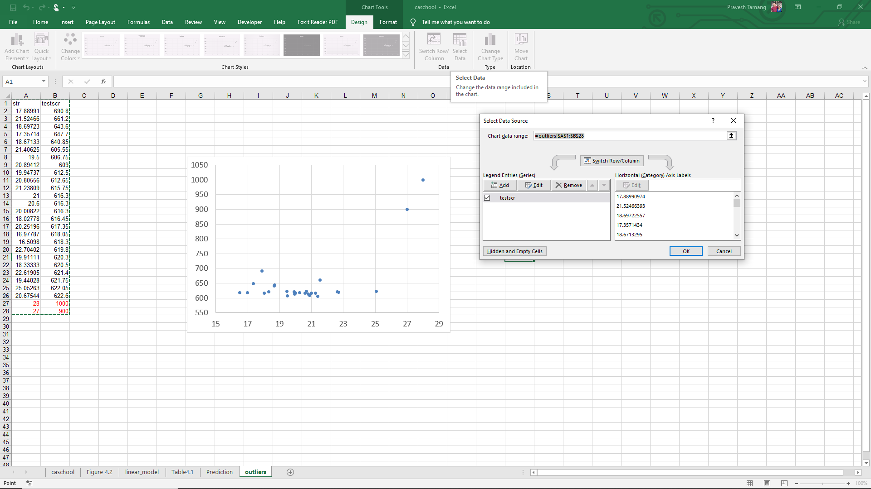
7
8
5
Adjust the limits of both the axis
6

Slide 32
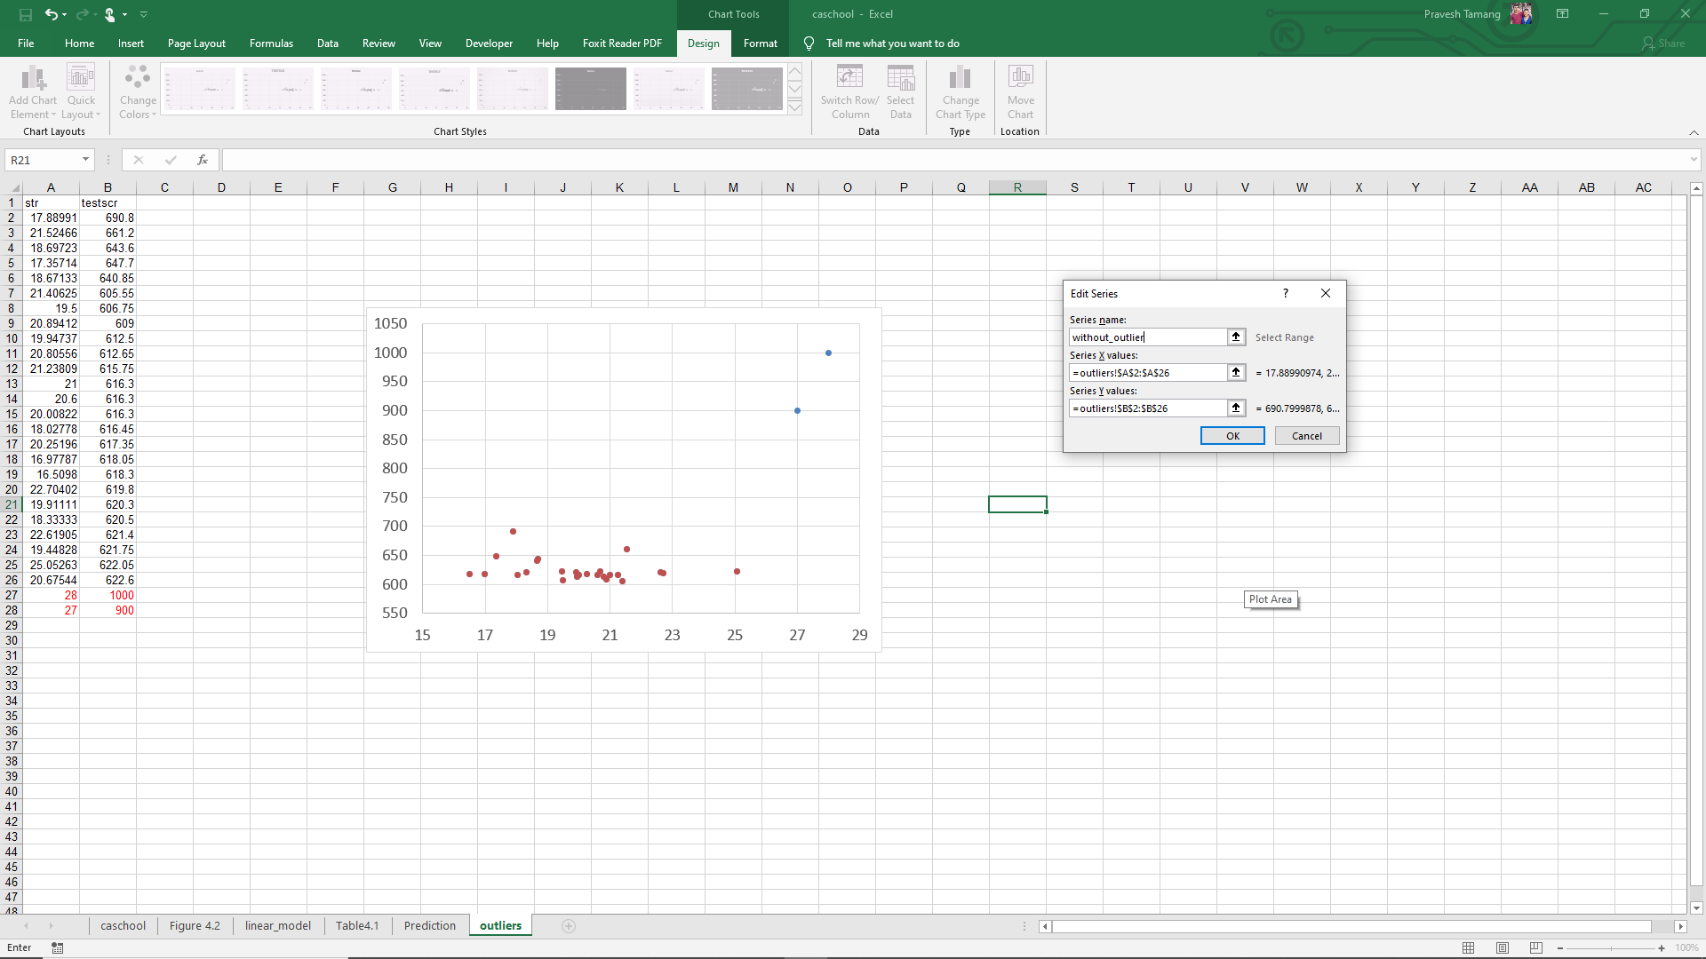
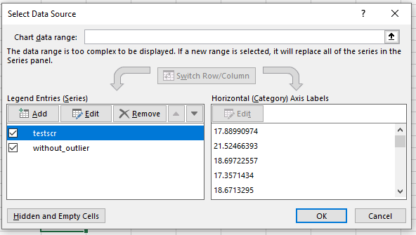
9
10

Slide 33
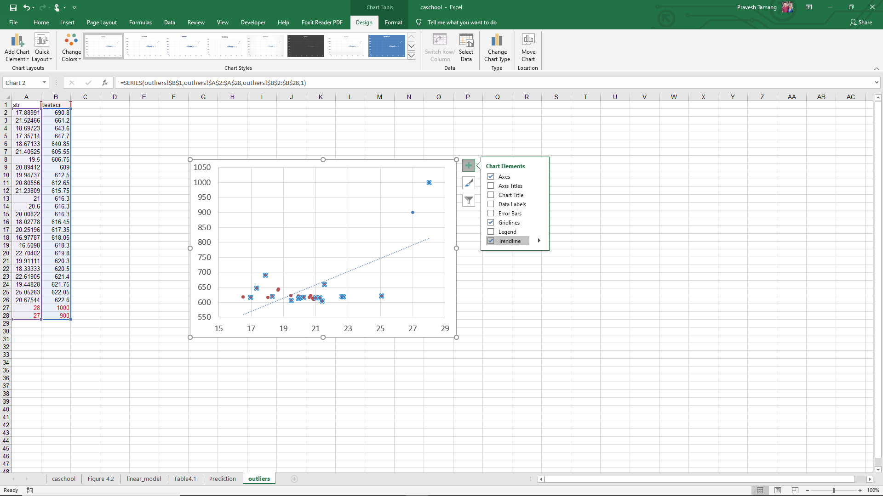
Click on the blue point
11
12

Slide 34
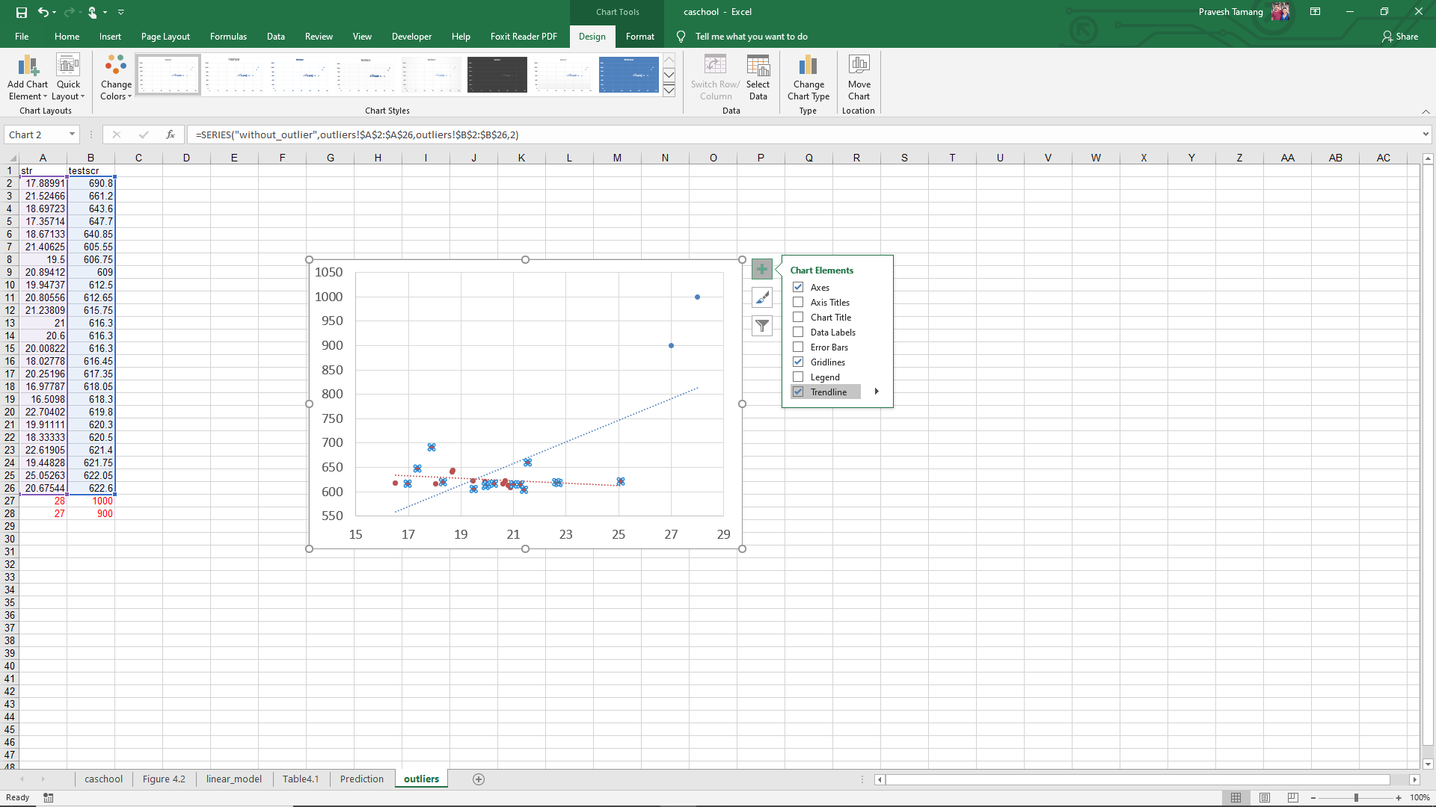
14
13
Click on the red point

Slide 35
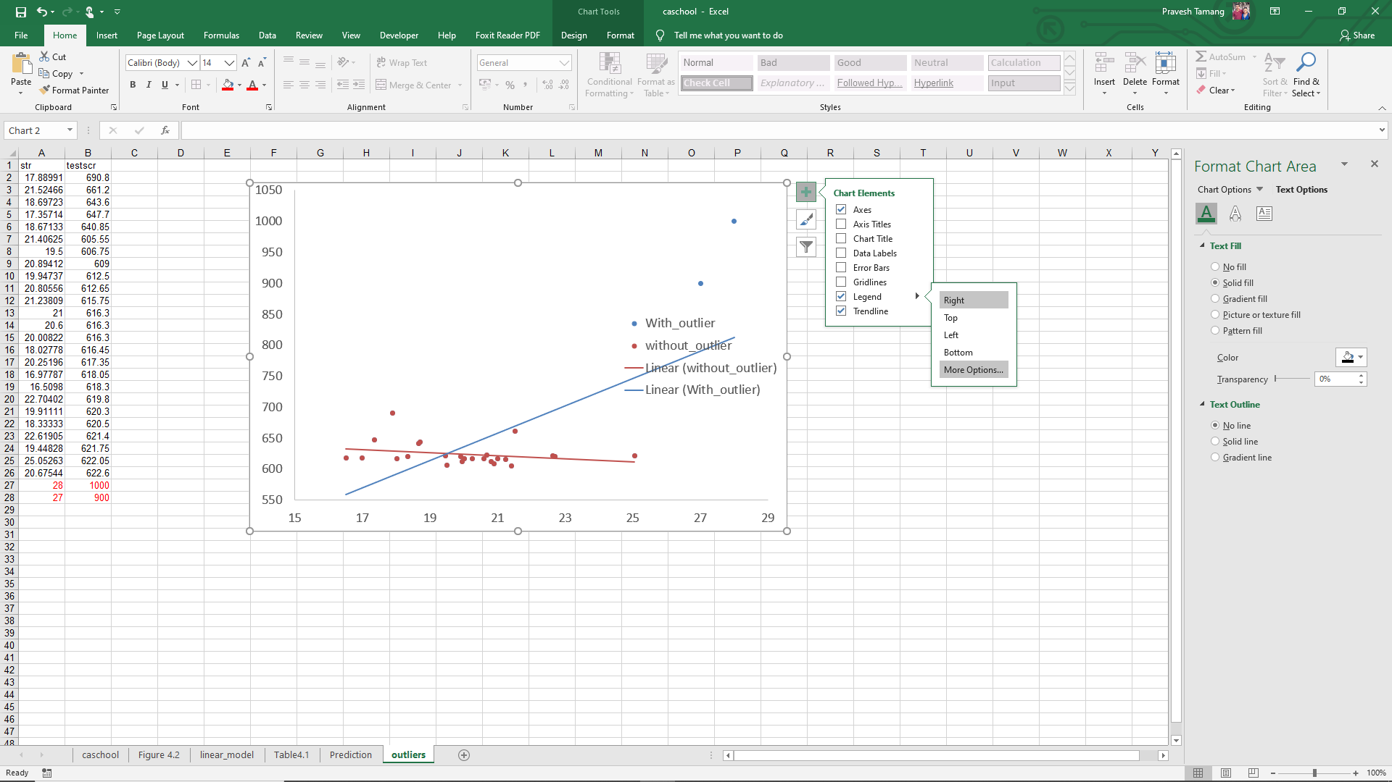
15
16

Slide 36
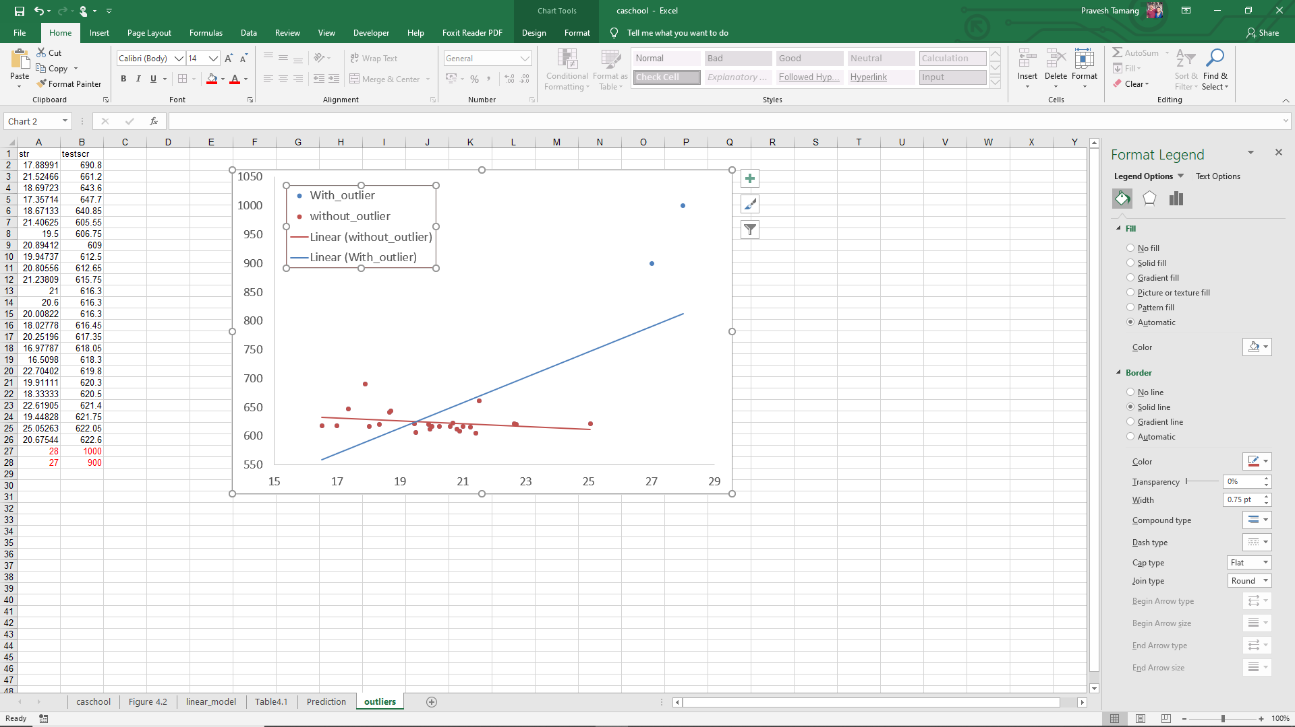
Drag and move the legend
16
17

Slide 37
Exercise

Slide 38
E4.1 You will find the data and description file here. Use the data Growth.xlsx.
Construct a scatterplot of average annual growth rate (Growth) on the average trade share (TradeShare). Does there appear to be a relationship between the variables?
One country, Malta, has a trade share much larger than the other countries. Find Malta on the scatterplot. Does Malta look like an outlier?
Using all observations, run a regression of Growth on TradeShare. What is the estimated slope? What is the estimated intercept? Use the regression to predict the growth rate for a country with a trade share of 0.5 and with a trade share equal to 1.0.
Estimate the same regression, excluding the data from Malta. Answer the same questions in (c).
Plot the estimated regression functions from (c) and (d). Using the scatterplot in (a), explain why the regression function that includes Malta is steeper than the regression function that excludes Malta.
Where is Malta? Why is the Malta trade share so large? Should Malta be included or excluded from the analysis?

Slide 39
E4.2 You will find the data and description file here. Use the data Earnings_and_Height.xlsx.
What is the median value of height in the sample?
(i). Estimate average earnings for workers whose height is at most 67 inches.
(ii). Estimate average earnings for workers whose height is greater than 67 inches.
(iii). On average, do taller workers earn more than shorter workers? How much more? What is a 95% confidence interval for the difference in average earnings?
Construct a scatterplot of annual earnings (Earnings) on height (Height). Notice that the points on the plot fall along horizontal lines. (There are only 23 distinct values of Earnings). Why? (Hint: Carefully read the detailed data description.)
Run a regression of Earnings on Height.
(i). What is the estimated slope?
(ii). Use the estimated regression to predict earnings for a worker who is 67 inches tall, for a worker who is 70 inches tall, and for a worker who is 65 inches tall.
Suppose height were measured in centimeters instead of inches. Answer the following questions about the Earnings on Height (in cm) regression.
(i). What is the estimated slope of the regression?
(ii). What is the estimated intercept?
(iii). What is the R2?
(iv). What is the standard error of the regression?

Slide 40
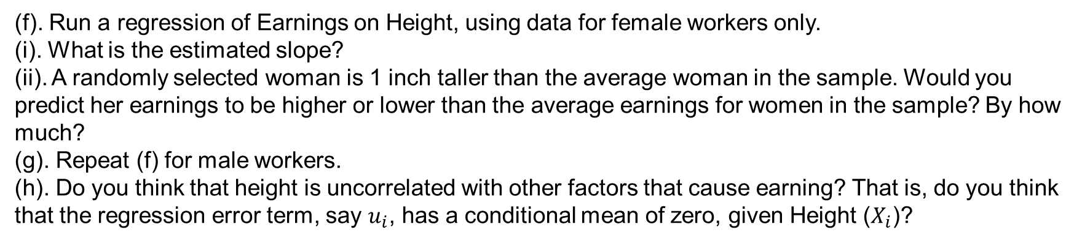
(f). Run a regression of Earnings on Height, using data for female workers only.
(i). What is the estimated slope?
(ii). A randomly selected woman is 1 inch taller than the average woman in the sample. Would you predict her earnings to be higher or lower than the average earnings for women in the sample? By how much?
(g). Repeat (f) for male workers.
(h). Do you think that height is uncorrelated with other factors that cause earning? That is, do you think that the regression error term, say $u_{i}$, has a conditional mean of zero, given Height ($X_{i}$)?

