Slide 1

Basic OSB Basic Overview

Slide 2
Objectives
Introduction OSB
OSB Installation within integrated server
Introduction to proxy services
Introduction to business services
OSB Integration between Java Library, SOAP Webservices, EJB, JMS
Basic message transformation

Slide 3
OSB Basic Overview
Service Oriented Architecture
Service Oriented Architecture
A service-oriented architecture (SOA) is a style of software design where services are provided to the other components by application components
A paradigm to organizing and utilizing distributed functions that may be under the control of different ownership domains in enterprise applications. These functions will be interoperable, standard-based services to be combined and reused.
SOA are a way to “properly” evolve from semi-monoliths to a more diversified architecture

Slide 4
OSB Basic Overview
Service Oriented Architecture
Why ??
Reuse of functionality across different organization and processes.
Integration between different system by following a standard-based approach.
Agile development that adapts business changes through discrete functions and standardized interfaces

Slide 5
OSB Basic OSB Basic Overview
Service Oriented Architecture
When??
When there are more than one application that want to communicate each other.
When there are different system / platform that want to talk each other.
When we want to hide the service implementation from the service consumer

Slide 6
OSB Basic OSB Basic Overview
Service Oriented Architecture
Service
Handles a business process
Can access another service and, with the appropriate runtime technology
Relatively independent of other software so that changes to a requester require few or no changes to the service
The relative independence of the service and other software is called loose coupling. The flexibility offered by loose coupling protects your company from excessive costs when business or technical requirements change.

Slide 7
Installation
Below are basic prerequisites for this training
Oracle Enterprise Pack for Eclipse (IDE)
Weblogic Application Server 11
Oracle Fusion Middleware – OSB Plugins
Your favorite JAVA IDE & Text Editor

Slide 8
Day 1
Objectives
Introduction to Oracle Services Bus
Installation
Introduction to proxy services, java callout and data manipulation
Flow Control

Slide 9
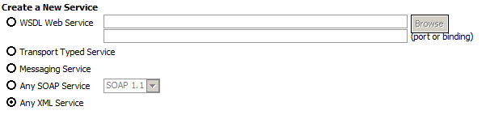
OSB Basic Overview
Day 1
Proxy Service
Contains the message processing logic for request and optional response message
A proxy service is configured by specifying its interface, type of transport, and its associated message processing logic. Message flow definitions are used to define the proxy service message handling capabilities
Interface that the service consumer call

Slide 10
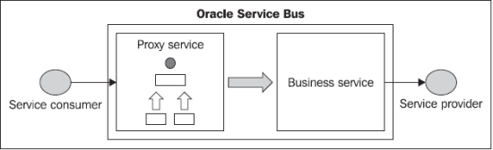
OSB Basic Overview
Day 1
Business Service
The definition of a business service is similar to that of a proxy service, however, the business services does not have a message flow definition.
Proxy Service exposed to source system or calling applications or services, which means, this is the service provided to the source system. Business service used to connect to target system, which means it's used to fetch the data from JMS, DB or any other third party system etc. and provide the data to the proxy service.

Slide 11


OSB Basic Overview
Day 1 – Chapter 1
Java Callout
Java callouts are static operations implemented in Java and packaged in a jar file. The jar file and all dependencies have to be included into the OSB project. Then it is possible to select the operation in the java callout node.
Basic types like int and String are supported for the parameters and the return value of the callout
OSB everything is about XML processing, is to use XML snippets for parameter and return value.

Slide 12
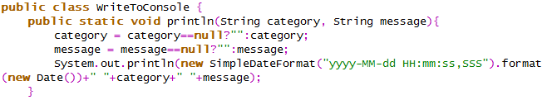
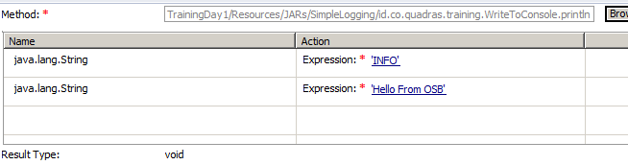
OSB Basic Overview
Day 1 – Chapter 1
Java Callout
1
2
3
4

Slide 13
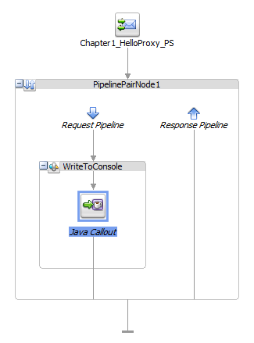
OSB Basic Overview
Day 1 – Chapter 1
Java Callout

Slide 14
OSB Basic Overview
Day 1 – Chapter 2
XML and XPath
XPath is a syntax for defining parts of an XML document
XPath contains a library of standard functions
XPath is a major element in XSLT and in XQuery
XPath is a W3C recommendation
XPath uses path expressions to select nodes or node-sets in an XML document.
XPath expressions can be used in JavaScript, Java, XML Schema, PHP, Python, C and C++, and lots of other languages.

Slide 15
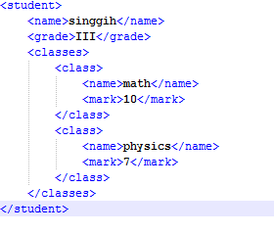
OSB Basic Overview
Day 1 – Chapter 2
XML and XPath
XML Example :
Question are :
How we can get student name?
How we can get mark of class with name “math”?
How we can get first row of class?
Answer :
/student/name
//student/classes/class[name='math']/mark
/student/classes/class[1]/name

Slide 16
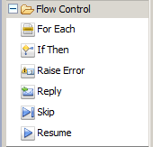
OSB Basic Overview
Day 1 – Chapter 2
Message Flow Control
Iterate over a sequence of values and execute a block of actions
Perform an action or set of actions conditionally, based on the Boolean result of an XQuery expression.
Raise an exception with a specified error code (a string) and description.
Specify that an immediate reply be sent to the invoker.
Resume message flow after an error is handled by an error handler.
The execution of the current stage is skipped and the processing proceeds to the next stage

Slide 17
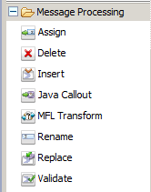
OSB Basic Overview
Day 1 – Chapter 2
Message Flow Control
Assign the result of an XQuery expression to a context variable.
Delete a context variable or a set of nodes specified by an XPath expression.
Insert the result of an XQuery expression at an identified place relative to nodes selected by an XPath expression
Invoke a Java method from the pipeline.
Convert non-XML to XML or XML to non-XML in the pipeline.
Rename elements selected by an XPath expression without modifying the contents of the element.
Replace a node or the contents of a node specified by an XPath expression
Validate elements selected by an XPath expression against an XML schema element or a WSDL resource.

Slide 18
Day 2
Objectives
Create SOAP Web Services using OSB
Create multiple SOAP Web Services using OSB
Call SOAP Web Services

Slide 19
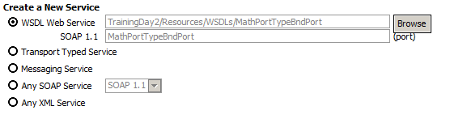
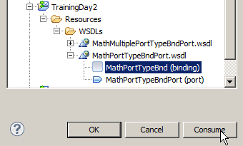
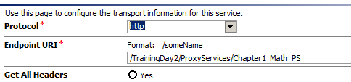
OSB Basic Overview
Day 2 – Chapter 1
WSDL Web Services
1
2
3

Slide 20
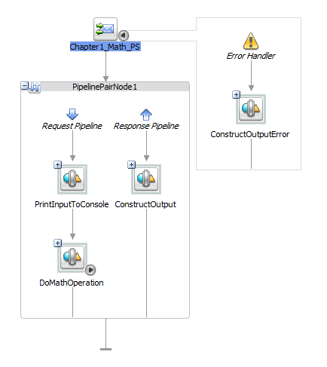
OSB Basic Overview
Day 2 – Chapter 1
WSDL Web Services
4

Slide 21


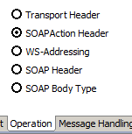
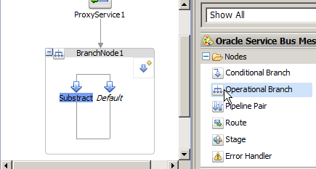
OSB Basic Overview
Day 2 – Chapter 2
WSDL Web Services
1
2
3
4

Slide 22
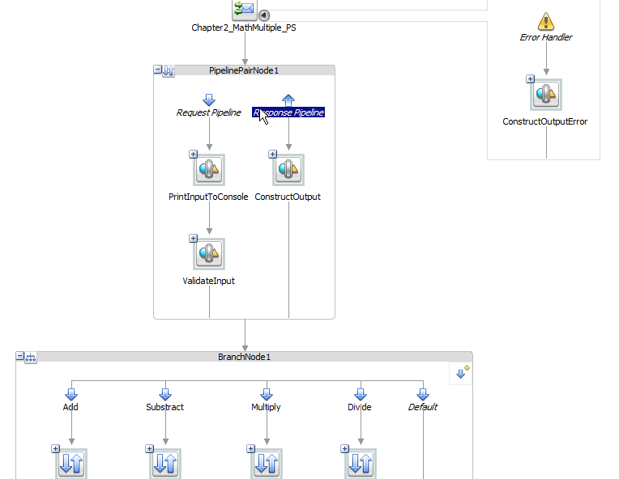
OSB Basic Overview
Day 2 – Chapter 2
WSDL Web Services
5

Slide 23
Day 3
Objectives
Introduction to JNDI Provider
Create Call EJB Business Service, Publish To JMS Business Service
Call EJB Proxy, Publish and Subscribe Message through JMS

Slide 24
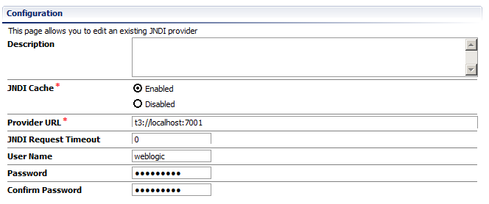
OSB Basic Overview
Day 3 – Chapter 1
JNDIProvider
JNDI provider resources perform the JNDI lookups for Service Bus projects, providing the protocols and security credentials required for accessing remote servers.

Slide 25

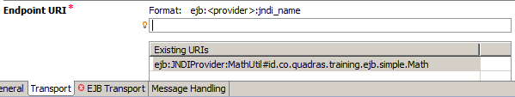
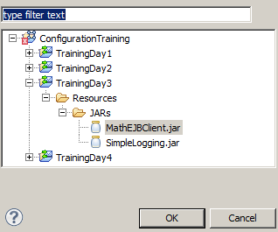
OSB Basic Overview
Day 3 – Chapter 1
EJB Business Service
1
2
3

Slide 26
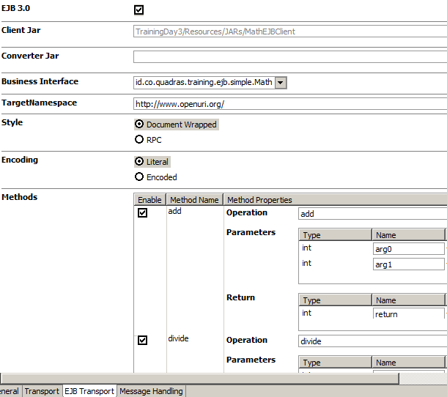
OSB Basic Overview
Day 3 – Chapter 1
EJB Business Service
4

Slide 27

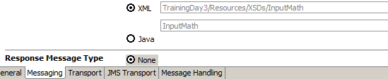
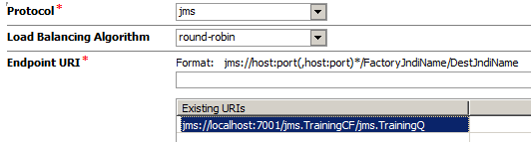
OSB Basic Overview
Day 3 – Chapter 1
Messaging Business Service
1
2
3

Slide 28

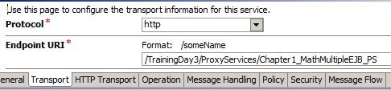
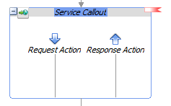
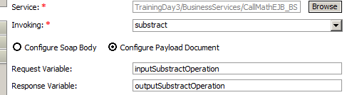

OSB Basic Overview
Day 3 – Chapter 1
EJB Service Callout
1
2
3
4
5

Slide 29
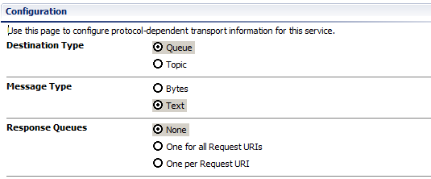
OSB Basic Overview
Day 2 – Chapter 2
EJB Service Callout
4

Slide 30
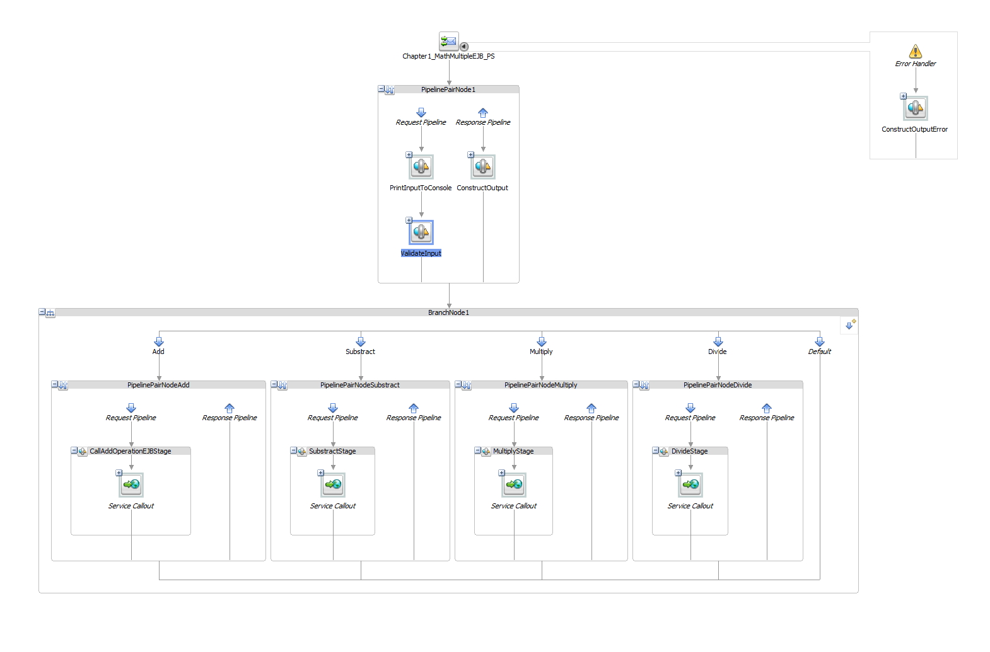
OSB Basic Overview
Day 3 – Chapter 1
EJB Service Callout

Slide 31



OSB Basic Overview
Day 3 – Chapter 2
Publish to JMS
1
2
3

Slide 32
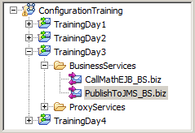
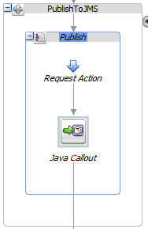
OSB Basic Overview
Day 3 – Chapter 2
Publish to JMS
4
5

Slide 33
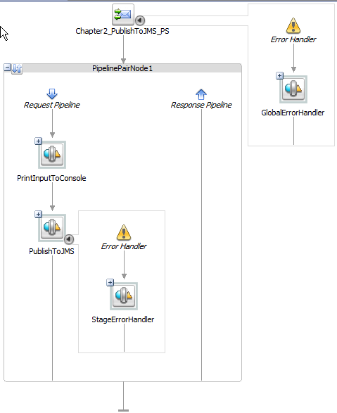
OSB Basic Overview
Day 3 – Chapter 2
Publish to JMS
6

Slide 34

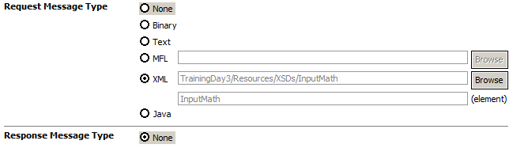
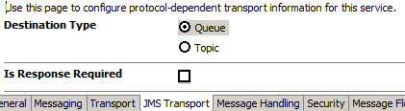
OSB Basic Overview
Day 3 – Chapter 2
JMS Listener
1
2
3

Slide 35
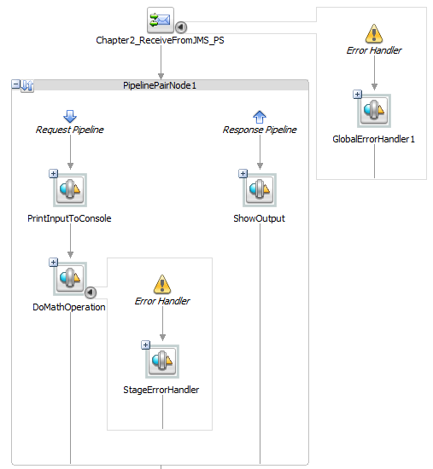
OSB Basic Overview
Day 3 – Chapter 2
JMS Listener
3

Slide 36
Day 4
Objectives
Introduction to Xquery Transformation
Introduction to MFL Transformation
Convert MFT to XML, vice versa
Publish to file

Slide 37
OSB Basic Overview
Day 4– Chapter 1
Xquery Transformation
XQuery helps in querying XML data from XML documents
XQuery transformation maps describe the mapping between two data types. XQuery maps describe mappings between XML documents with different schemas.
Service Bus can process XML documents and transform document data from one XML schema to another
You use XQuery expressions to create the data content for the message context variables (or part of a message context variable) during the execution of the message flow

Slide 38
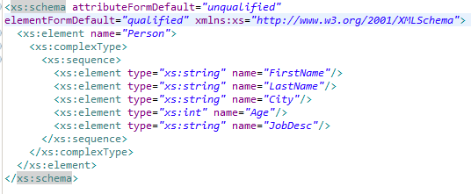
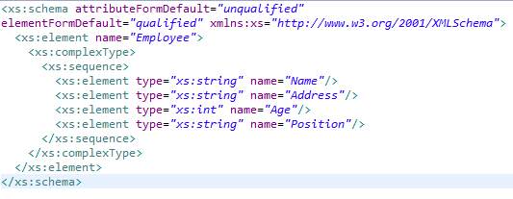
OSB Basic Overview
Day 4– Chapter 1
Xquery Transformation
???

Slide 39
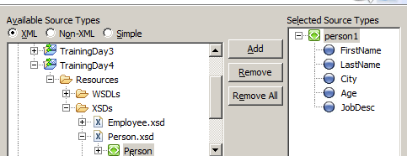
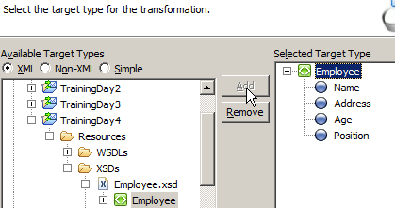
OSB Basic Overview
Day 4 – Chapter 1
Xquery Transformation
1
2
3

Slide 40
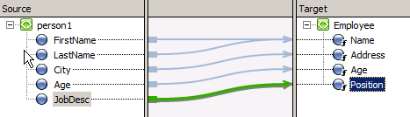

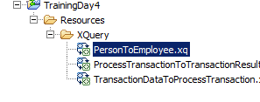
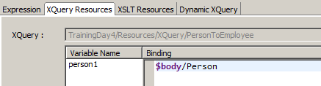
OSB Basic Overview
Day 4 – Chapter 1
Xquery Transformation
3
4
5
6

Slide 41
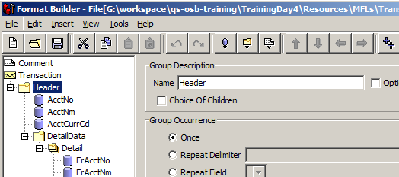
OSB Basic Overview
Day 4– Chapter 1
Message Format Language
Message Format Language (MFL) document is a specialized XML document used to describe the layout of binary data
Oracle proprietary language.
You can select MFL types as the request message type or the response message type of the service.

Slide 42
OSB Basic Overview
Question ??

