Slide 1

World of Internet
Presented by:-
Akash Singh
Ganesh Sawant
Nishant Patil
Asif Shaikh
Siddesh Shewale

Slide 2
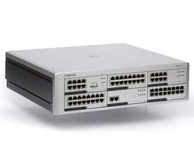

What is Internet?
The Internet, sometimes called simply "the Net," is a worldwide system of computer networks -- a network of networks in which users at any one computer can, if they have permission, get information from any other computer (and sometimes talk directly to users at other computers).
Accessing
Connection

Slide 3
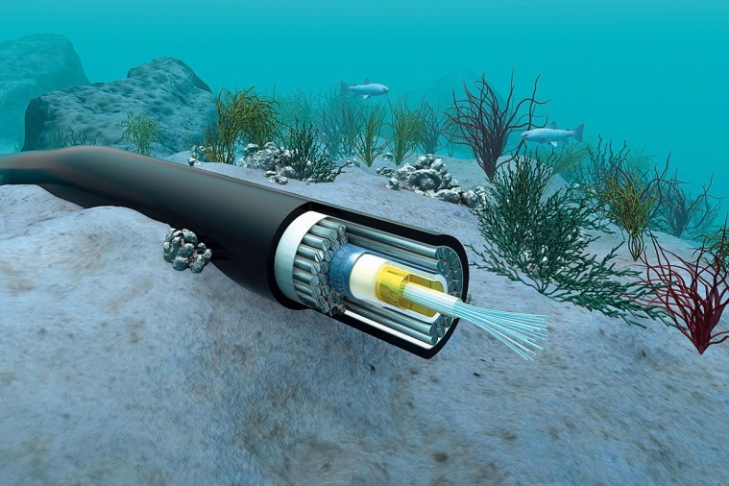
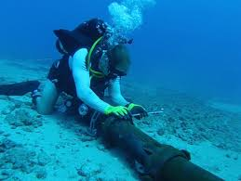
How internet works?
Submarine cables
99% working of Internet is done by submarine cable.
All wires are size of hair which contain 100 gbps data transferred rate.

Slide 4
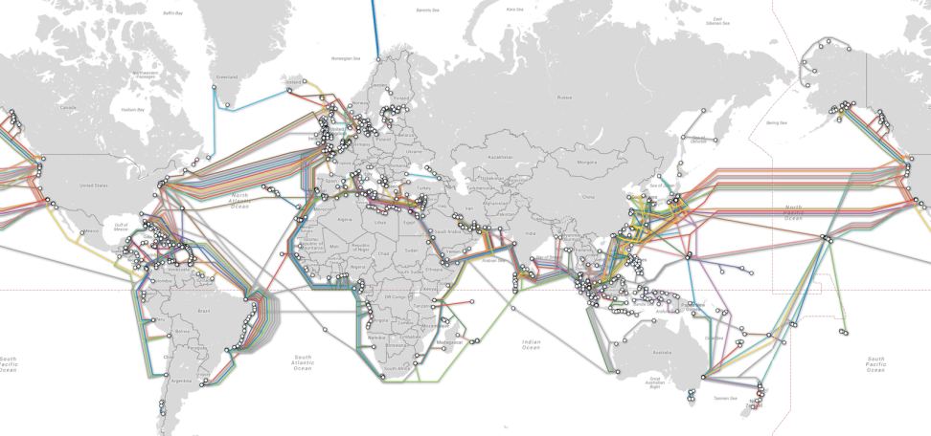
Submarine cable map

Slide 5
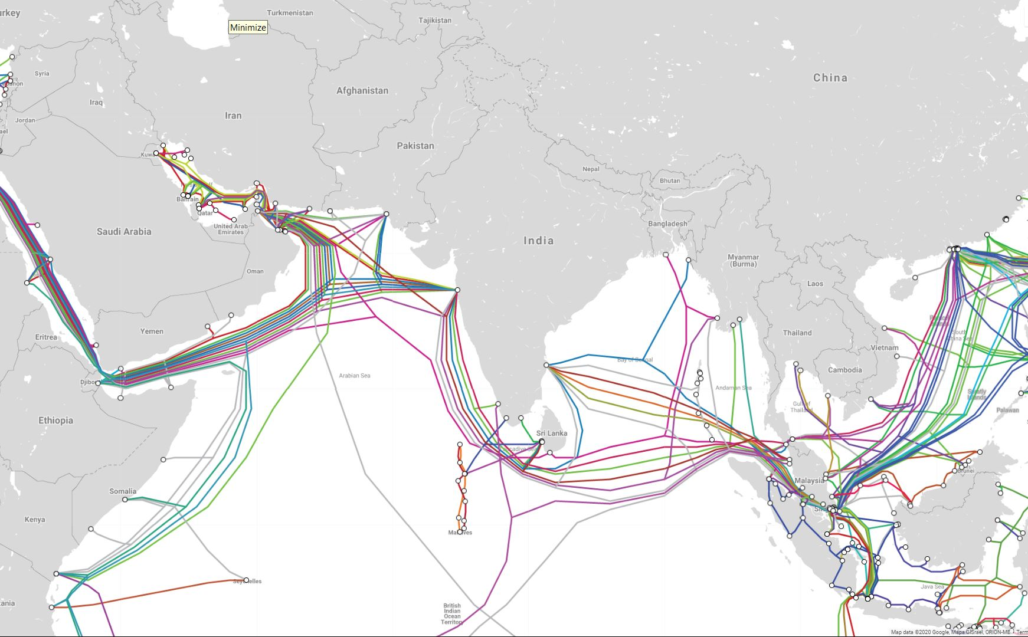
Submarine cable map of India

Slide 6
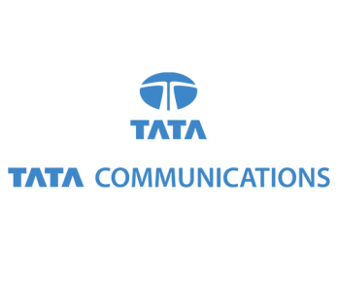
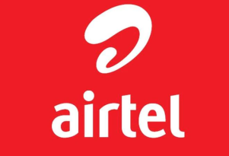


Companies for Internet services
Tier 1
Tier 2
Tier 3

Slide 7
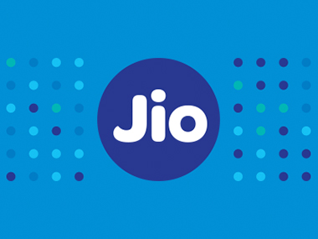
Jio case study
Jio have their own submarine cable in Asia-Africa-Europe.
Hence, It doesn’t give much amount to Tier 1 company.
This is the main reason behind free internet in starting days of jio.

Slide 8
Conclusion
Average lifeline of submarine cables are 25 years and their maintenance have high cost.
Tier 1 company charges amount from Tier 2 and Tier 3 company for these maintenance.
Tier 2 and Tier 3 companies charges fee from their respective customers.
Hence, Internet cost = submarine cable’s cost + it’s maintenance cost.

Slide 9
Thank You

