Slide 1
Passive vehicle suspension system
Akhil Singh
2005150

Slide 2
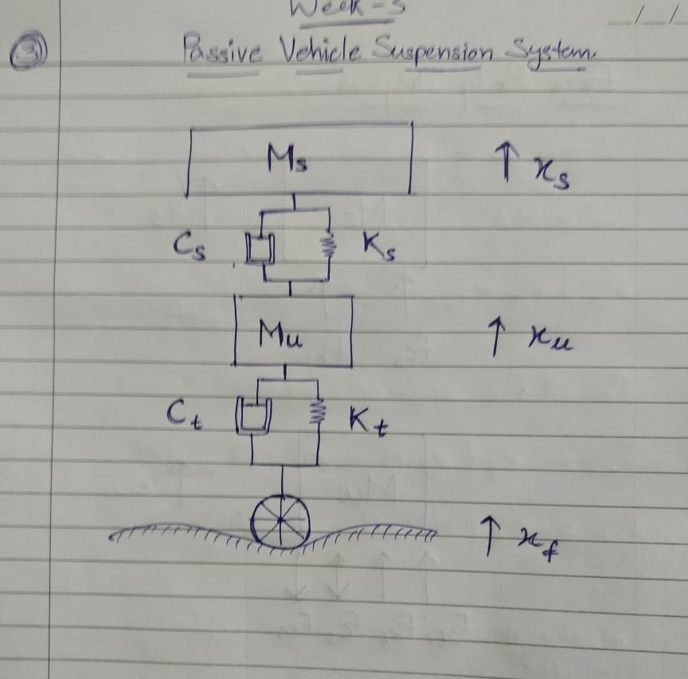
Basic Structure of the model

Slide 3
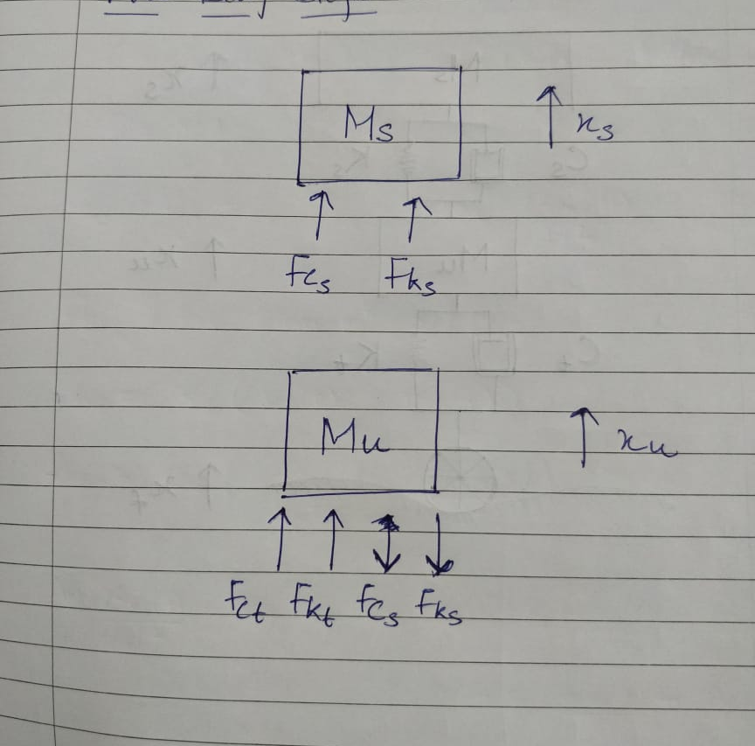
Free Body Diagram

Slide 4
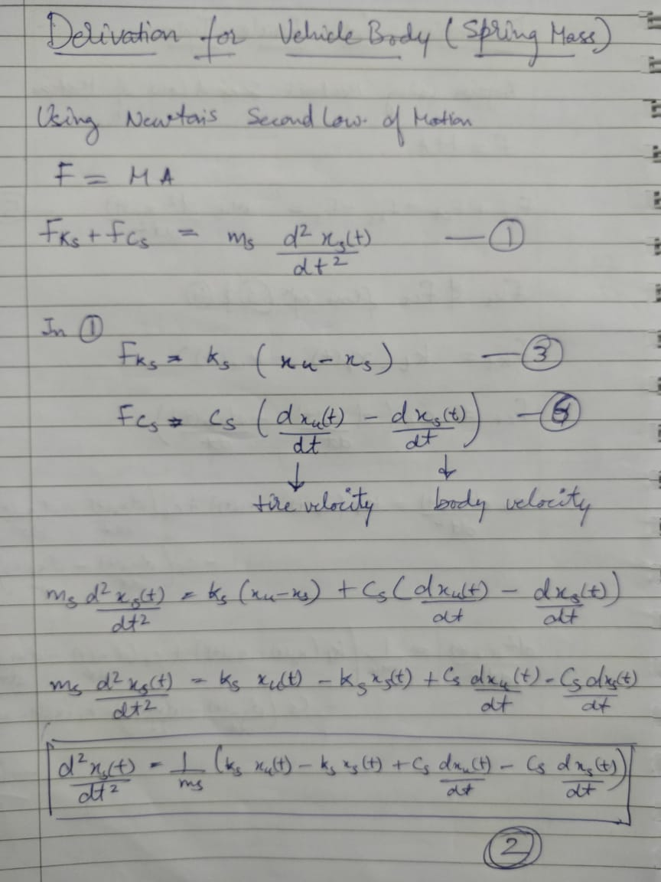
Derivation for vehicle body

Slide 5
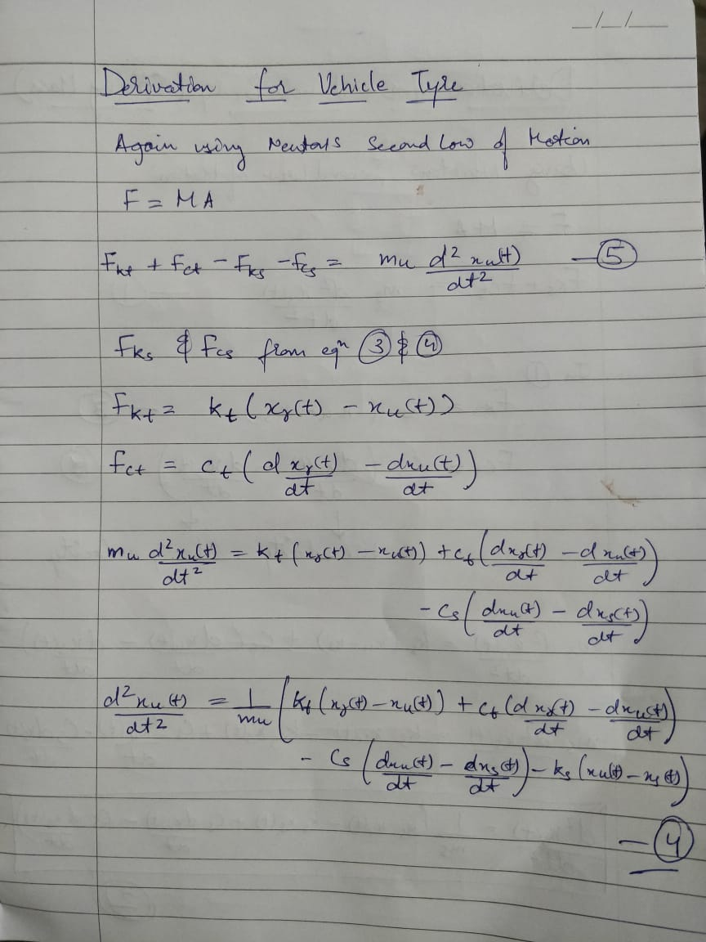
Derivation for vehicle tire

Slide 6
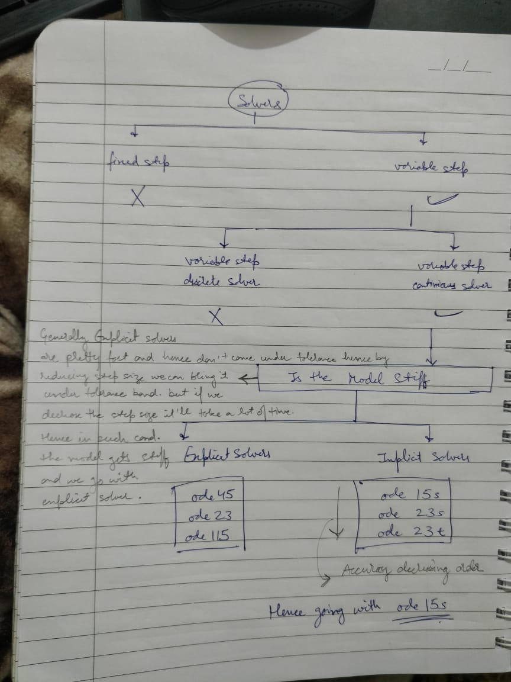
While choosing solvers I went for variable step continuous solver. After that I had to choose between explicit solvers or implicit solvers; Generally explicit solvers are pretty fast and hence don’t come under tolerance hence by reducing step size we can bring them under tolerance band. But if we decrease the step size it’ll take a lot of time . Hence in such condition the model gets stiff and we go with explicit solver. Hence , we go with implicit solvers as the model isn’t stiff. After choosing implicit model we have 3 options of ode15s,ode23s and ode23t. The accuracy of the solvers decrease from ode15s to ode23t. After realizing the output with all the solvers ,I chose ode15s for higher accuracy

Slide 7
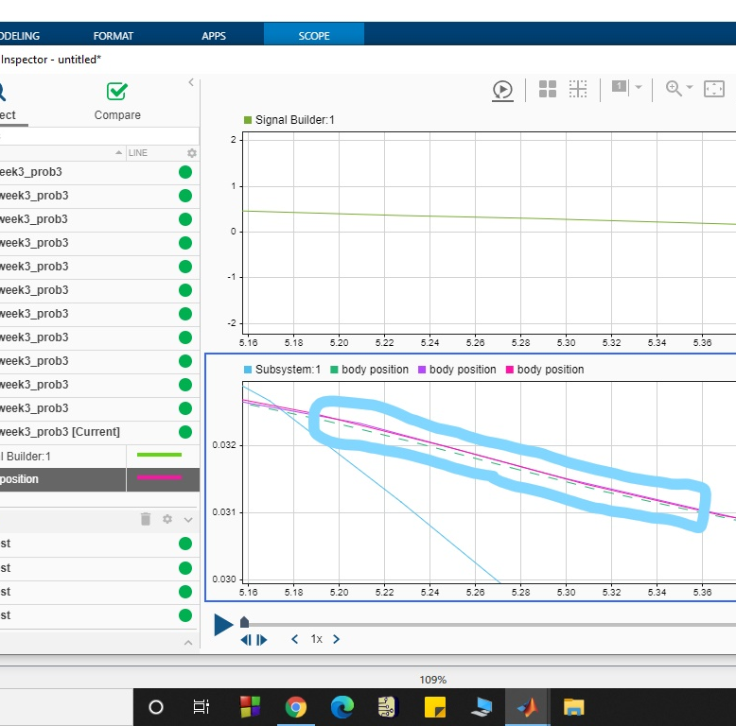
Output with 3 different ode used

Slide 8
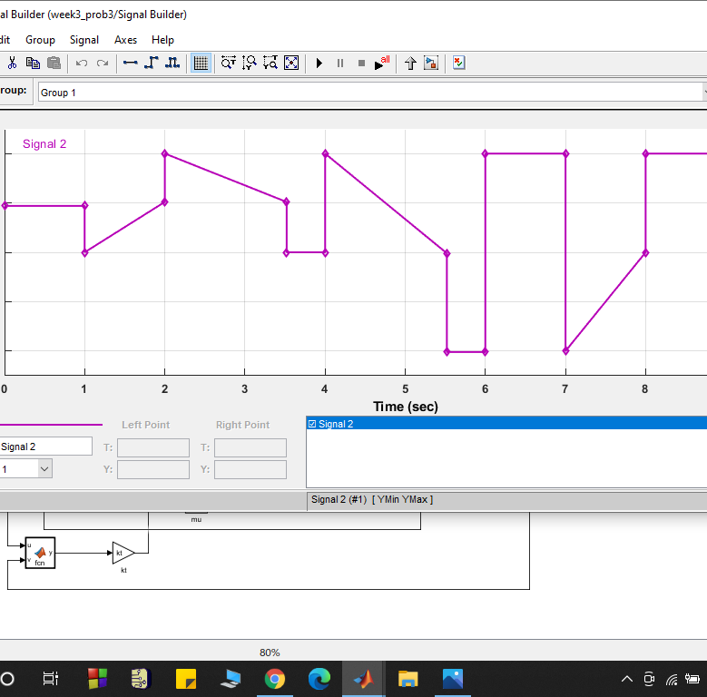
Input signal with the help of signal builder

Slide 9
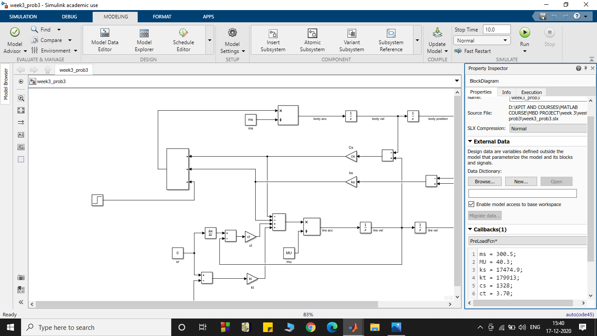
Model callback

Slide 10
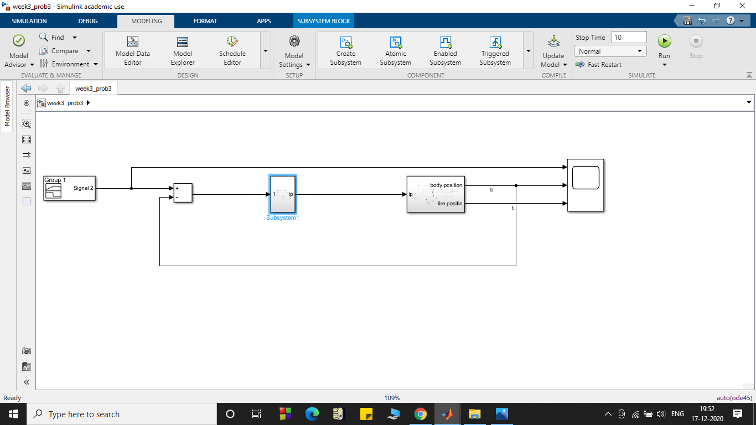
Final model

Slide 11
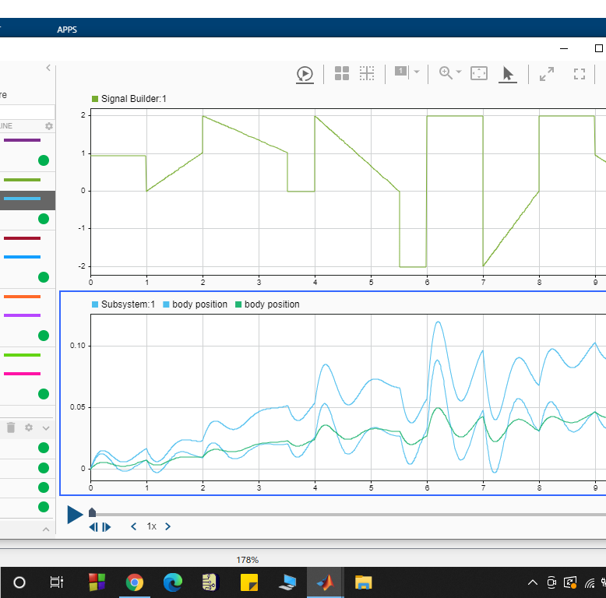
Data inspector with output from diff odes.

Slide 12
THANK YOU

