Slide 1
Deidentification of clinical notes (MIMIC-III) using pre-trained SciBERT (bi-directional transformer model trained on scientific corpora)
Abrar Majeedi
Ashish Singh

Slide 2
Problem Statement
Automated deidentification of clinical notes using state of the art language model for Natural Language Processing.
Deidentification of the PHI in Medical Data is a very important step to enhance biomedical research while maintaining individual privacy.
Challenges:
The process to obtain such data is painstakingly slow and convoluted. This has slowed down data-driven medical research.
Due to the HIPAA compliance, access to only non-individually identifiable data is available.

Slide 3
Dataset used for this project
MIMIC-III: 2,434 nursing notes collected from patients admitted to intensive care units at the Beth Israel Deaconess Medical Center, Boston, MA, USA.
MIMIC-III is a very commonly used dataset. Though, it affects generalizability but it also makes it perfect for benchmarking performance.
Contains over 3.8B characters (currently utilizing 500 million).

Slide 4
Data pre-processing: Steps involved in re-identification
Used regex and basic string matching to find the de-identifed PHI locations.
Imputed the names, ages, dates, locations, hospitals, contact numbers, unique IDs as mentioned below: - Names: Made a list of the 600 most common first and last names in the US, and then randomly selected from that list. - Hospitals: Imputed from a list of Hospitals in US. - Locations: Utilized a fake address generator. - Others: For instance, Date is replaced using python random functions with proper formatting.

Slide 5
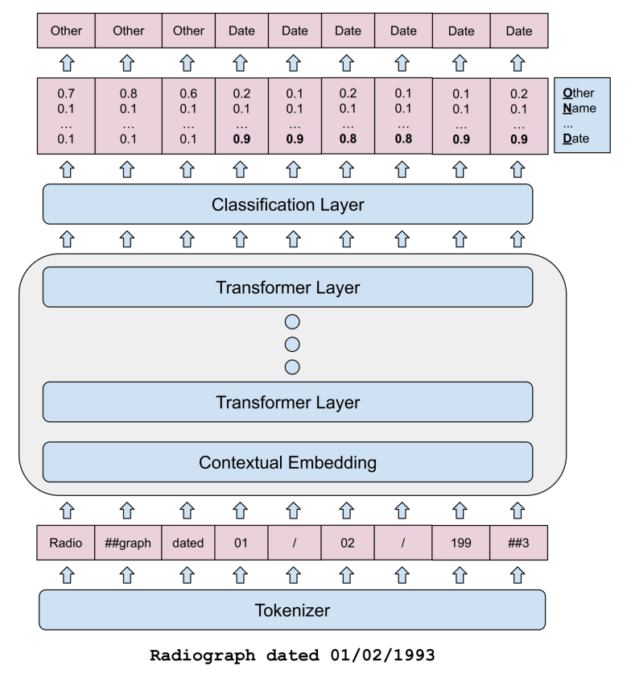
Architecture
Model: SciBERT, which was trained on a scientific corpus.
Steps involved- 1) Tokenization 2) Transformation 3) Classification using a single layer NN on top of the BERT model.
For the time being, problem is addressed as binary classification with labels as PHI and Non-PHI.

Slide 6
Preliminary Results
F1 score is varying between 0.51-0.55.
The performance is just above the random classification and needs to improvement

