Slide 1
What Is Computer Vision?
To simplify the answer to this – Let us consider a scenario.
We all use Facebook, correct? Let us say you and your friends went on a vacation and you clicked a lot of pictures and you want to upload them on Facebook and you did. But now, wouldn’t it take so much time just to find your friends faces and tag them in each and every picture? Well, Facebook is intelligent enough to actually tag people for you.
So, how do you think the auto tag feature works? In simple terms, it works on computer vision.
Computer Vision is an interdisciplinary field that deals with how computers can be made to gain a high-level understanding from digital images or videos.
The idea here is to automate tasks that the human visual systems can do. So, a computer should be able to recognize objects such as that of a face of a human being or a lamppost or even a statue.

Slide 2
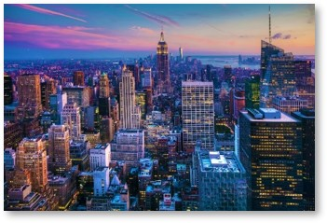
How Does A Computer Read An Image?
Consider the below image:

Slide 3
We can figure out that it is an image of the New York Skyline. But, can a computer find this out all on its own? The answer is no!
The computer reads any image as a range of values between 0 and 255.
For any color image, there are 3 primary channels – Red, green and blue. How it works is pretty simple.
A matrix is formed for every primary color and later these matrices combine to provide a Pixel value for the individual R, G, B colors.
Each element of the matrices provide data pertaining to the intensity of brightness of the pixel.

Slide 4
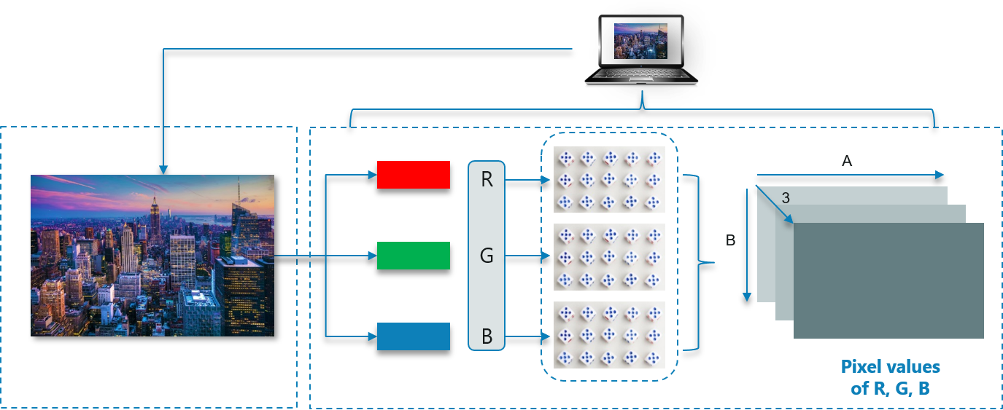
Consider the following image:

Slide 5
As shown, the size of the image here can be calculated as B x A x 3.
Note: For a black-white image, there is only one single channel.

Slide 6
What Is OpenCV?
OpenCV is a Python library which is designed to solve computer vision problems. OpenCV was originally developed in 1999 by Intel but later it was supported by Willow Garage.
OpenCV supports a wide variety of programming languages such as C++, Python, Java etc. Support for multiple platforms including Windows, Linux, and MacOS.
OpenCV Python is nothing but a wrapper class for the original C++ library to be used with Python. Using this, all of the OpenCV array structures gets converted to/from NumPy arrays.
This makes it easier to integrate it with other libraries which use NumPy. For example, libraries such as SciPy and Matplotlib.

Slide 7
Loading an image using OpenCV:
Import cv2
# colored Image
Img = cv2.imread (‘1.jpg’,1)
# Black and White (gray scale)
Img_1 = cv2.imread (‘1.jpg’,0)

Slide 8
Image Shape/Resolution:
Import cv2
# Black and White (gray scale)
Img = cv2.imread (“1.jpg”,0)
Print(img.shape)
By shape of the image, we mean the shape of the NumPy array. As you see from executing the code, the matrix consists of 768 rows and 1024 columns.

Slide 9
Displaying the image:
import cv2
import img as img
# Black and White (gray scale)
Img = cv2.imread('bill.png', 0)
print(Img)
cv2.imshow('bill', Img)
cv2.waitKey(0)
cv2.waitKey(2000)
cv2.destroyAllWindows()

Slide 10
Explanation:
As you can see, we first import the image using imread. We require a window output to display the images, right?
We use the imshow function to display the image by opening a window. There are 2 parameters to the imshow function which is the name of the window and the image object to be displayed.
Later, we wait for a user event. waitKey makes the window static until the user presses a key. The parameter passed to it is the time in milliseconds.
And lastly, we use destroyAllWindows to close the window based on the waitForKey parameter.

Slide 11
Resizing the image:
import cv2
# Black and White (gray scale)
img = cv2.imread('bill.png', 0)
resized_image = cv2.resize(img, (650, 500))
cv2.imshow('bill', resized_image)
cv2.waitKey(0)
cv2.destroyAllWindows()

Slide 12
Explanation:
Here, resize function is used to resize an image to the desired shape. The parameter here is the shape of the new resized image.
Later, do note that the image object changes from img to resized_image, because of the image object changes now.
Rest of the code is pretty simple to the previous one, correct?

Slide 13
Way to resize:
Resized_image = cv2.resize(img, int(img.shape[1]*2), int(img.shape[0]*2)))
Here, we get the new image shape to be half of that of the original image.

Slide 14
Face Detection Using OpenCV
This seems complex at first but it is very easy. Let me walk you through the entire process and you will feel the same.
Step 1: Considering our prerequisites, we will require an image, to begin with. Later we need to create a cascade classifier which will eventually give us the features of the face.
Step 2: This step involves making use of OpenCV which will read the image and the features file. So at this point, there are NumPy arrays at the primary data points.
All we need to do is to search for the row and column values of the face NumPy ndarray. This is the array with the face rectangle coordinates.

Slide 15
Continue…
Step 3: This final step involves displaying the image with the rectangular face box.
Check out the following image, here I have summarized the 3 steps in the form of an image for easier readability:
Pretty straightforward, correct?

Slide 16
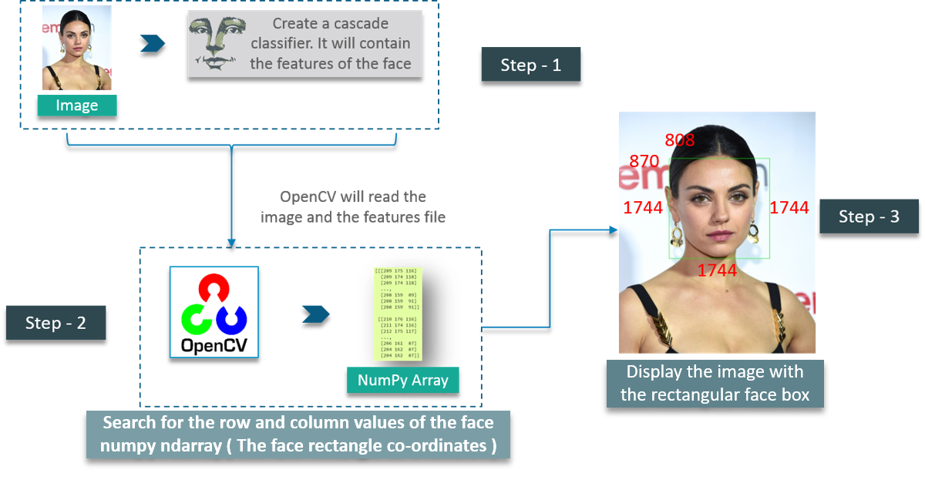

Slide 17
Explanation:
First, we create a CascadeClassifier object to extract the features of the face as explained earlier. The path to the XML file which contains the face features is the parameter here.
The next step would be to read an image with a face on it and convert it into a black and white image using COLOR_BGR2GREY. Followed by this, we search for the coordinates for the image. This is done using detectMultiScale.
What coordinates, you ask? It’s the coordinates for the face rectangle. The scaleFactor is used to decrease the shape value by 5% until the face is found. So, on the whole – Smaller the value, greater is the accuracy.
Finally, the face is printed on the window.

Slide 18
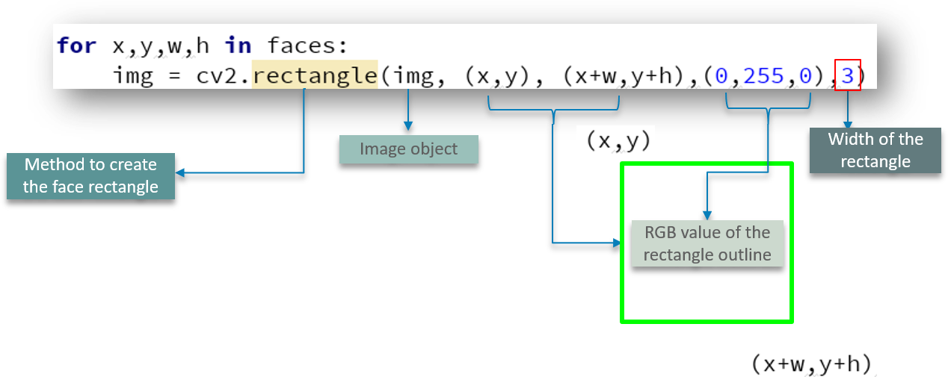
Adding the rectangular face box:

Slide 19
Explanation:
We define the method to create a rectangle using cv2.rectangle by passing parameters such as the image object, RGB values of the box outline and the width of the rectangle.
Let us check out the entire code for face detection:

Slide 20
Face detection code
import cv2
# Create a CascadeClassifier Object
face_cascade = cv2.CascadeClassifier('cascade_frontface_default.xml')
# Reading the image as it is
img = cv2.imread('bill.png')
# Reading the image as gray scale image
gray_img = cv2.cvtColor(img, cv2.COLOR_BGR2GRAY)
print(gray_img)

Slide 21
# Search the co-ordintes of the image
faces = face_cascade.detectMultiScale(gray_img, scaleFactor=1.05, minNeighbors=5)
for x, y, w, h in faces:
img = cv2.rectangle(img, (x, y), (x + w, y + h), (0, 255, 0), 3)
resized = cv2.resize(img, (int(img.shape[1] / 2), int(img.shape[0] / 2)))
cv2.imshow("Gray", resized)
cv2.waitKey(0)
cv2.destroyAllWindows()

Slide 22
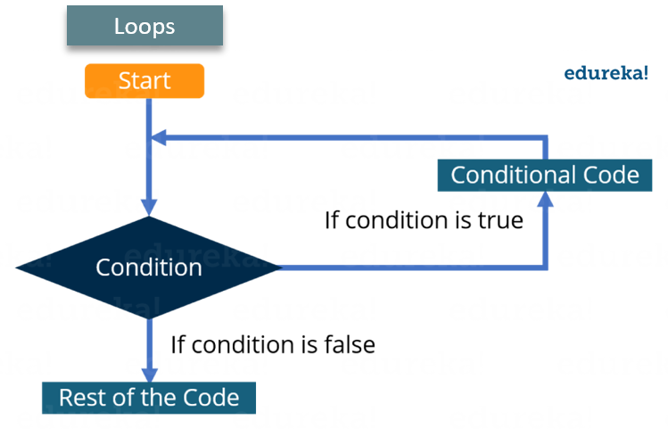
Capturing Video Using OpenCV

Slide 23
Explanation:
The images are read one-by-one and hence videos are produced due to fast processing of frames which makes the individual images move.

Slide 24
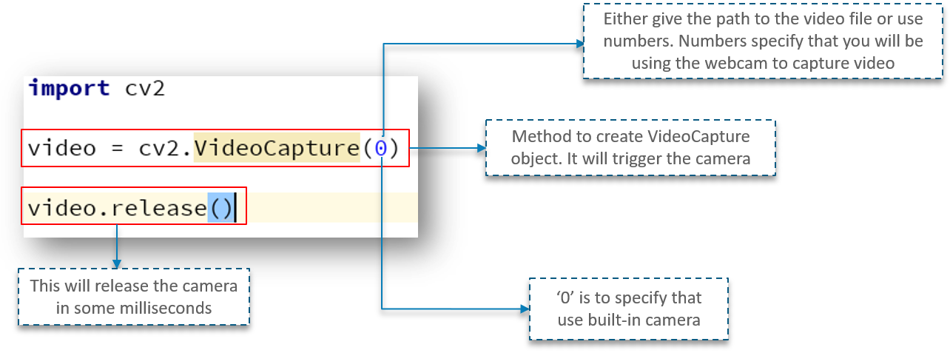
Capturing Video:

Slide 25
Explanation:
First, we import the OpenCV library as usual. Next, we have a method called VideoCapture which is used to create the VideoCapture object. This method is used to trigger the camera on the user’s machine. The parameter to this function denotes if the program should make use of the built-in camera or an add-on camera. ‘0’ denotes the built-in camera in this case.
And lastly, the release method is used to release the camera in a few milliseconds.
When you go ahead and type in and try to execute the above code, you will notice that the camera light switches on for a split second and turns off later. Why does this happen?
This happens because there is no time delay to keep the camera functional.

Slide 26
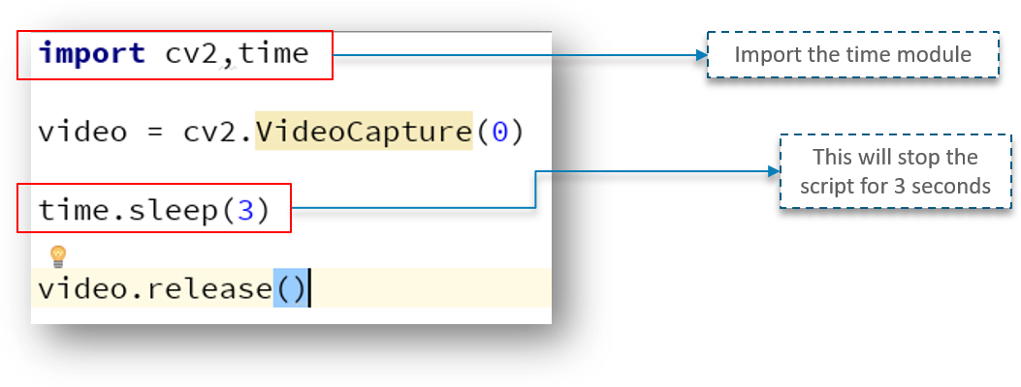

Slide 27
Looking at the above code, we have a new line called time.sleep(3) – This makes the script to stop for 3 seconds. Do note that the parameter passed is the time in seconds. So, when the code is executed, the webcam will be turned on for 3 seconds.

Slide 28
Adding the window:
Adding a window to show the video output is pretty simple and can be compared to the same methods used for images. However, there is a slight change. Check out the following code:

Slide 29
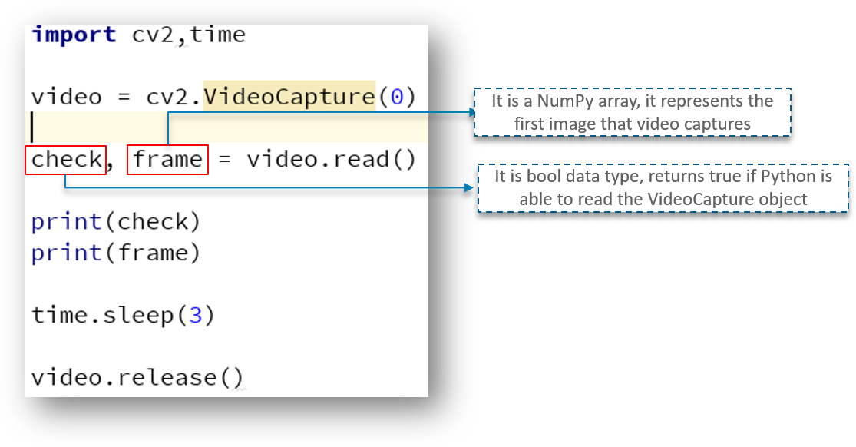

Slide 30
Explanation:
Here, we have defined a NumPy array which we use to represent the first image that the video captures – This is stored in the frame array.
We also have check – This is a boolean datatype which returns True if Python is able to access and read the VideoCapture object.

Slide 31
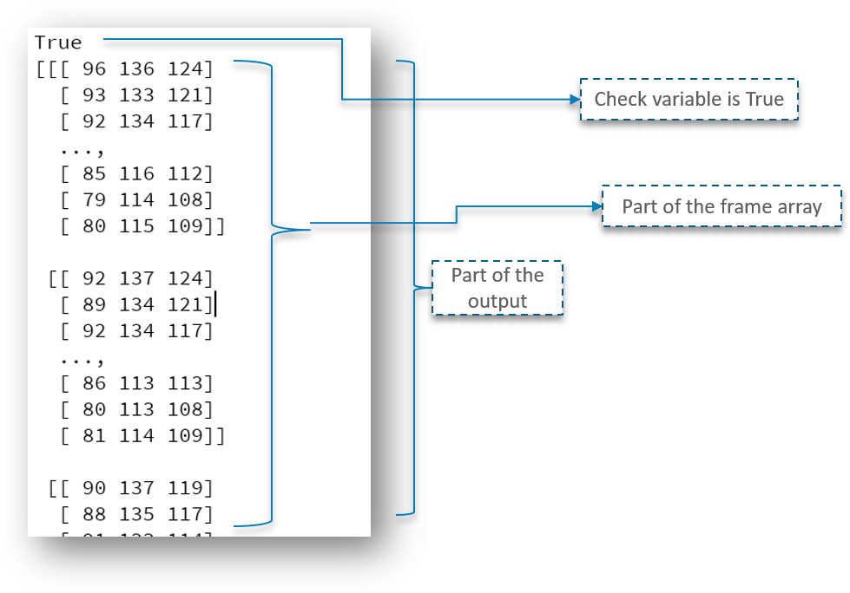
Output:

Slide 32
Explanation:
As you can check out, we got the output as True and the part of the frame array is printed.
But we need to read the first frame/image of the video to begin, correct?
To do exactly that, we need to first create a frame object which will read the images of the VideoCapture object.

Slide 33
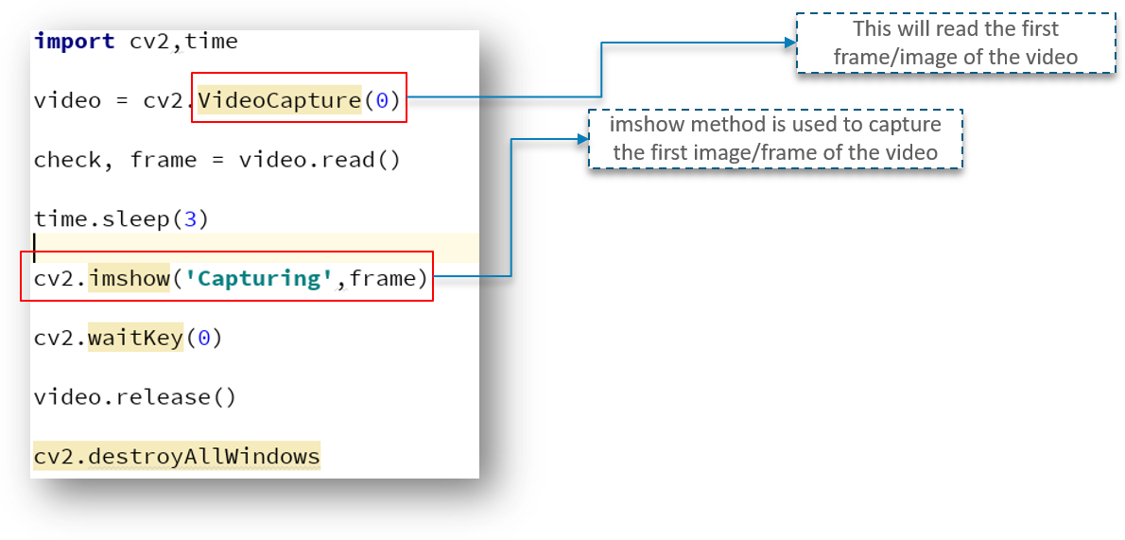
As seen above, the imshow method is used to capture the first frame of the video. All this while, we have tried to capture the first image/frame of the video but directly capturing the video.

Slide 34
Installing Tesseract & Detecting Text from Image
https://github.com/UB-Mannheim/tesseract/wiki
https://pythongeeks.org/python-opencv-text-detection-and-extraction/

Slide 35
Threshold,Thresh Binary,Thresh OTSU
Threshold: Thresholding is a type of image segmentation, where we change the pixels of an image to make the image easier to analyze. In thresholding, we convert an image from colour or grayscale into a binary image, i.e., one that is simply black and white.
Thresh Binary:The thresholded pixels can have a maximum value of 255. cv2. THRESH_BINARY: According to the thresholding type, it thresholds the pixels using a binary approach, putting values below the threshold to 0 and those that are equal to or higher than the threshold to the maximum specified value.
Thresh OTSU :Otsu's method chooses a threshold that minimizes the intraclass variance of the thresholded black and white pixels. The global threshold T can be used with imbinarize to convert a grayscale image to a binary image.

Slide 36
Simple Thresholding
Here, the matter is straight-forward. For every pixel, the same threshold value is applied. If the pixel value is smaller than the threshold, it is set to 0, otherwise it is set to a maximum value. The function cv.threshold is used to apply the thresholding. The first argument is the source image, which should be a grayscale image. The second argument is the threshold value which is used to classify the pixel values. The third argument is the maximum value which is assigned to pixel values exceeding the threshold. OpenCV provides different types of thresholding which is given by the fourth parameter of the function. Basic thresholding as described above is done by using the type cv.THRESH_BINARY. All simple thresholding types are:
cv.THRESH_BINARY
cv.THRESH_BINARY_INV
cv.THRESH_TRUNC
cv.THRESH_TOZERO
cv.THRESH_TOZERO_INV

Slide 37
Code:
import cv2 as cv
import numpy as np
from matplotlib import pyplot as plt
img = cv.imread('gradient.png', cv.IMREAD_GRAYSCALE)
assert img is not None, "file could not be read, check with os.path.exists()"
ret,thresh1 = cv.threshold(img,127,255,cv.THRESH_BINARY)
ret,thresh2 = cv.threshold(img,127,255,cv.THRESH_BINARY_INV)
ret,thresh3 = cv.threshold(img,127,255,cv.THRESH_TRUNC)
ret,thresh4 = cv.threshold(img,127,255,cv.THRESH_TOZERO)
ret,thresh5 = cv.threshold(img,127,255,cv.THRESH_TOZERO_INV)
titles = ['Original Image','BINARY','BINARY_INV','TRUNC','TOZERO','TOZERO_INV']
images = [img, thresh1, thresh2, thresh3, thresh4, thresh5]
for i in range(6):
plt.subplot(2,3,i+1),plt.imshow(images[i],'gray',vmin=0,vmax=255)
plt.title(titles[i])
plt.xticks([]),plt.yticks([])
plt.show()

Slide 38
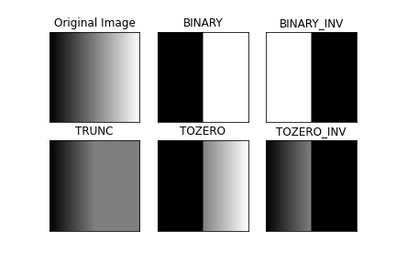

Slide 39
Otsu's Binarization
In global thresholding, we used an arbitrary chosen value as a threshold. In contrast, Otsu's method avoids having to choose a value and determines it automatically.
Consider an image with only two distinct image values (bimodal image), where the histogram would only consist of two peaks. A good threshold would be in the middle of those two values. Similarly, Otsu's method determines an optimal global threshold value from the image histogram.
In order to do so, the cv.threshold() function is used, where cv.THRESH_OTSU is passed as an extra flag. The threshold value can be chosen arbitrary. The algorithm then finds the optimal threshold value which is returned as the first output.
Check out the example below. The input image is a noisy image. In the first case, global thresholding with a value of 127 is applied. In the second case, Otsu's thresholding is applied directly. In the third case, the image is first filtered with a 5x5 gaussian kernel to remove the noise, then Otsu thresholding is applied. See how noise filtering improves the result.

Slide 40
OTSU
import cv2 as cv
import numpy as np
from matplotlib import pyplot as plt
img = cv.imread('noisy2.png', cv.IMREAD_GRAYSCALE)
assert img is not None, "file could not be read, check with os.path.exists()"
# global thresholding
ret1,th1 = cv.threshold(img,127,255,cv.THRESH_BINARY)
# Otsu's thresholding
ret2,th2 = cv.threshold(img,0,255,cv.THRESH_BINARY+cv.THRESH_OTSU)
# Otsu's thresholding after Gaussian filtering
blur = cv.GaussianBlur(img,(5,5),0)
ret3,th3 = cv.threshold(blur,0,255,cv.THRESH_BINARY+cv.THRESH_OTSU)

Slide 41
OTSU Continue..
# plot all the images and their histograms
images = [img, 0, th1,
img, 0, th2,
blur, 0, th3]
titles = ['Original Noisy Image','Histogram','Global Thresholding (v=127)',
'Original Noisy Image','Histogram',"Otsu's Thresholding",
'Gaussian filtered Image','Histogram',"Otsu's Thresholding"]
for i in range(3):
plt.subplot(3,3,i*3+1),plt.imshow(images[i*3],'gray')
plt.title(titles[i*3]), plt.xticks([]), plt.yticks([])
plt.subplot(3,3,i*3+2),plt.hist(images[i*3].ravel(),256)
plt.title(titles[i*3+1]), plt.xticks([]), plt.yticks([])
plt.subplot(3,3,i*3+3),plt.imshow(images[i*3+2],'gray')
plt.title(titles[i*3+2]), plt.xticks([]), plt.yticks([])
plt.show()

Slide 42
