Slide 1
Foundation & Core Programming
Development environment setup
IDE installation and configuration
Introduction to programming fundamentals
Java Features
JVM JDK JRE

Slide 2
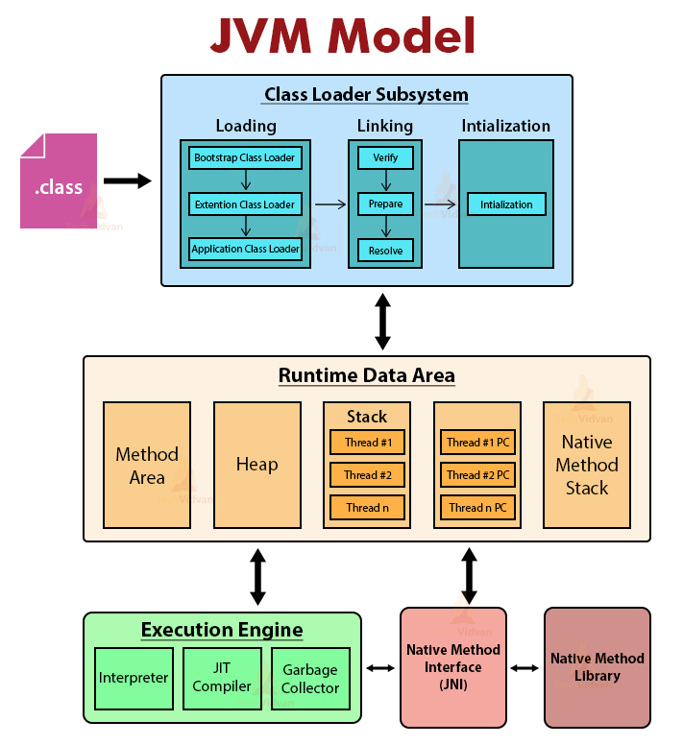
JVM

Slide 3
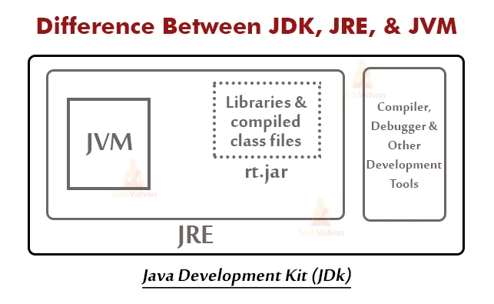
Difference Between JDK, JRE, And JVM

Slide 4
Introduction to Programming
• Understand what programming is
• Learn basic programming concepts
• Get familiar with one common language (e.g., Python)
• Explore how to think like a programmer

Slide 5
What is Programming?
• Writing instructions for computers to perform tasks
• Like writing a recipe or set of rules

Slide 6
Why Programming Matters for Engineers
• Automates tasks and simulations
• Helps in problem-solving and logic building
• Essential in modern tools (MATLAB, Python, etc.)
• Required in jobs, internships, and projects

Slide 7
Common Programming Languages
• Python – beginner-friendly
• C/C++ – performance-oriented
• Java – used in enterprise applications
• JavaScript – for web development

Slide 8
Key Programming Concepts
• Variables – storing data
• Data Types – numbers, text, boolean
• Operators – arithmetic, comparison
• Control Flow – if/else, loops
• Functions – reusable code blocks

Slide 9
Example in Python
```python
# Simple program to check even or odd
num = int(input("Enter a number: "))
if num % 2 == 0:
print("Even")
else:
print("Odd")
```

Slide 10
Logic Building
• Think step by step (flowcharts, pseudocode)
• Break down the problem
• Practice problem-solving (start small!)

Slide 11
Best Practices
• Write clean, readable code
• Use comments
• Indent properly
• Test your code often

Slide 12
Tools to Get Started
• Code Editors: VS Code, PyCharm
• Online Practice: HackerRank, LeetCode
• Version Control: Git & GitHub basics

