Slide 1
Case Study
Implementing IaaS and PaaS in Azure

Slide 2
Contents
Business Requirements
Implementation flow
Takeaway Learnings

Slide 3

Business Requirements
Nilavembu Herbs provides a safer alternative to modern medicine wherever possible and to offer simple, effective and safe remedies for common problems. spreads awareness about the medicinal uses of these natural and safe herbs all over the world and to make it easily available through their online store for all those who want to enjoy its benefits
Nilavembu Herbs requires
A low cost solution based on demand of dynamic business conditions.
As the business expands across EastUS and SEA, they would like to have their DataCenter virtualised using cloud computing.
Critical Data should be made available in case of disaster
As of now they want to have Proof Of Concept(POC) in Microsoft Azure
You have been deployed for POC
The following slides will provides required details.

Slide 4
SEA region
2 web servers with 99.95% high availability
These web services has to be utilised with proper balance with client affinity with Public IP
Selected web servers should be reachable via RDP from internet
A jump port should accessible from internet to upload contents to web servers.
Protect web server traffic restricted to allowed based on ip addresses which will be updated as warranted
Enable backup for WebServers
Have alert generated in case of 80% above cpu usage

Slide 5
EastUS
EastUS server (Server11) should be accessible from internet via public IP
Establish secure Connection to SEA-EUS Azure sites
All servers should be reachable with internal ip addresses

Slide 6
Storage Requirements
EUS based resources should provide data resiliency in case of azure datacentre failure.
The storage should be accessible by applications with secure access. provide access urls and keys.
Sales manager should access his resource from windows explorer.
SEA data resources must provide high resiliency in case of even multiple azure data center failures

Slide 7
Azure Resource management
Create Vmadmin user who can manage all VM in the subscription
Create Backup_admin user who can manage backup only in EUS servers in EURG

Slide 8
Implementation Flow
Listing Business Requirement
Translating to Technical Specification
Implementation
Creating a Jump server in East US region. This server will also act as (Server11)
Creating Infrastructure using Terraform
Installing Internet Information Services(IIS) on to each VM using Ansible
Creation of Storage Account
Creation of Different Users and Setting their Access
4. Backup and Monitoring

Slide 9
1. Listing Business Requirement
A low cost solution based on demand of dynamic business conditions.
As the business expands across EastUS and SEA, they would like to have their DataCenter virtualised using cloud computing.
Critical Data should be made available in case of disaster.
Sales manager should access his resource from windows explorer.

Slide 10
2. Translating to Technical Specification
--SEA region
2 web servers with 99.95% high availability
These web services has to be utilised with proper balance with client affinity with Public IP
Selected web servers should be reachable via RDP from internet
A jump port should accessible from internet to upload contents to web servers.
Protect web server traffic restricted to allowed based on ip addresses which will be updated as warranted
Enable backup for WebServers
Have alert generated in case of 80% above cpu usage
--EastUS
EastUS server (Server11) should be accessible from internet via public IP
Establish secure Connection to SEA-EUS Azure sites
All servers should be reachable with internal ip addresses
--STORAGE Requirement
EUS based resources should provide data resiliency in case of azure datacentre failure.
The storage should be accessible by applications with secure access. provide access urls and keys.
Sales manager should access his resource from windows explorer.
SEA data resources must provide high resiliency in case of even multiple azure data center failures
--Azure resource
Create Vmadmin user who can manage all VM in the subscription
Create Backup_admin user who can manage backup only in EUS servers in EURG

Slide 11
3. Implementation Order
Creating a Jump server in East US region. This server will also act as (Server11)
Creating Infrastructure using Terraform in SEA Region Central US Region*
Resource Group
Availability Set
Network Security Group
Rules for Routes
Virtual Network
Sub net
Load Balancer
NICs
VMs
*Note: Due to absence of 3 Fault Domains in SEA Region, Terraform scripts was giving error on SEA region.
Hence infrastructure related to SEA Region was built in Central US.

Slide 12
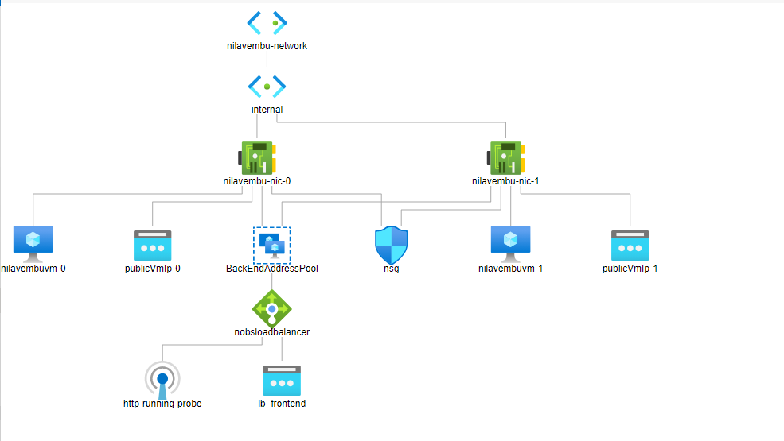
Final Design Structure

Slide 13
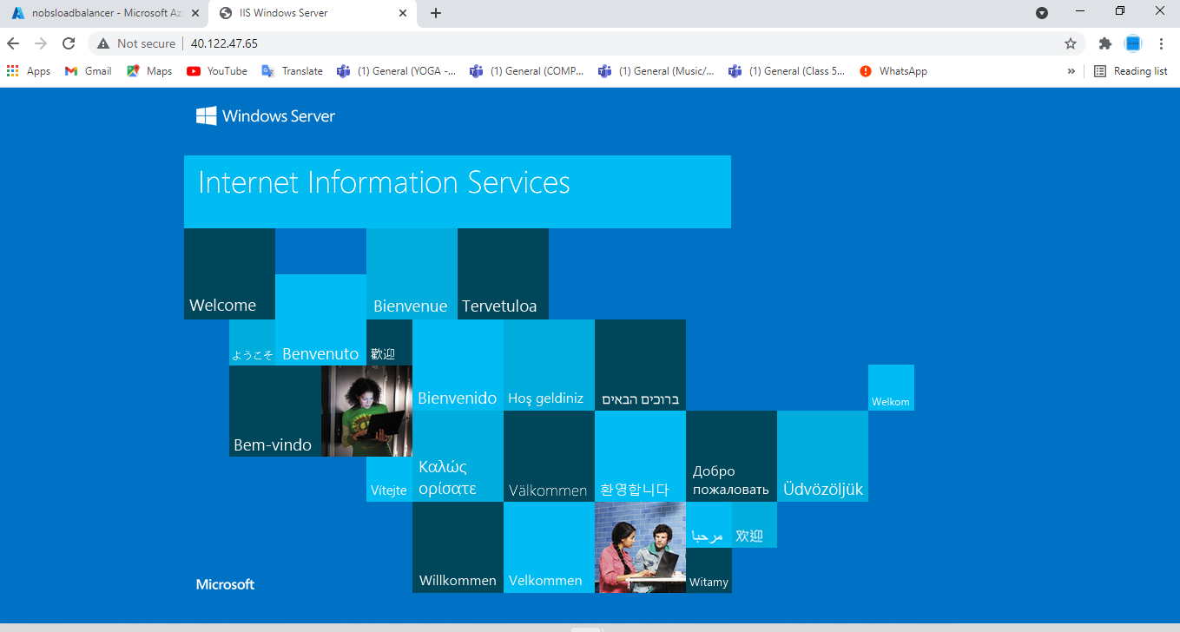
4. Installing IIS on each VM using Ansible
Installing Ansible software
Creating hosts file
Creating iis.yml file having scripts to be executed on each VM
After successful installation, check Load Balancer URL
http://40.122.47.65/

Slide 14
5. Storage Account and User Access
Creating Storage Account
Providing access using SAS keys
Creating users:
- Sales Manager
- Vm Admin
- Backup Admin

Slide 15
5. User Access Management and Monitoring
Assigning Roles through Using Azure RBAC
Monitoring of Infrastructure through Automated alerts:
SMS Alerts
Email Alerts

Slide 16
Components/Tools/Interfaces Used in this POC
Azure Portal
SSH tool (Mobaxterm)
PowerShell
Terraform (HashiCorp)
Ansible (Red Hat)
Azure CLI

Slide 17
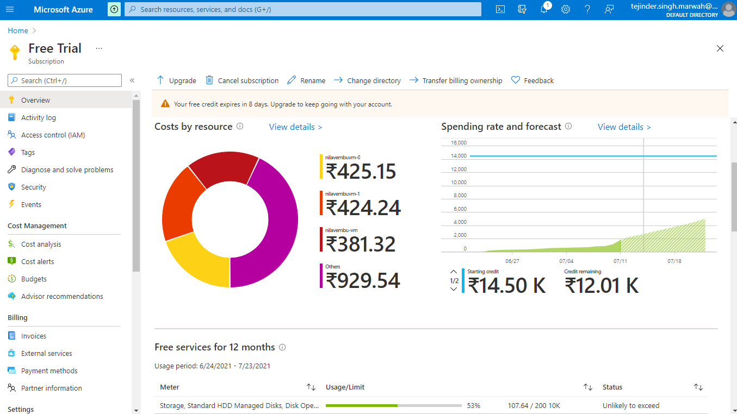
Resource Costs

Slide 18

Questions ?

