Slide 1
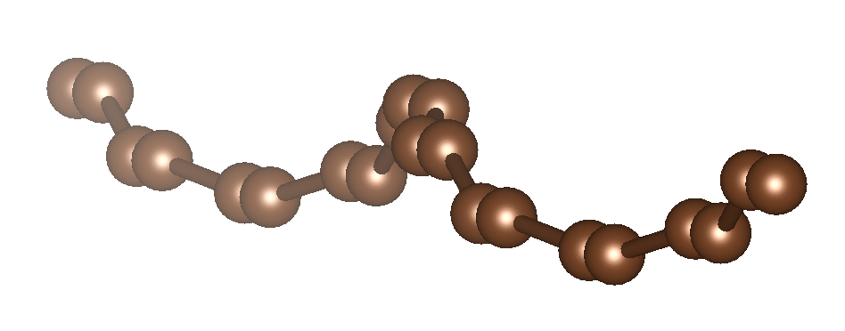


A Wannier-first approach to chiral extended systems
Yashpal Singh, Juan E. Peralta, Mark R. Pederson*, and Koblar A. Jackson
Department of Physics, Central Michigan University, Mt Pleasant, MI, 48858, USA
*Department of Physics, University of Texas, El Paso, TX, 79968, USA
March 17th, 2026
Notes:
"Good morning. I'm Yashpal Singh from Central Michigan University. Today I'll present a Wannier-first approach to extended DFT that handles chiral systems — like nanotubes and helical chains — without supercells, by starting from localized functions rather than Bloch states.”

Slide 2
Why Wannier-first?
Chiral or Screw Symmetry:
Standard periodic codes assume pure translation symmetry.
Chiral systems require large supercells
Irrational twist → No finite supercell.
Bloch States (Delocalized by Construction):
Localized physics: Require post processing (e.g. Wannier90)
Require dense k-mesh + disentanglement + gauge fixing.
“Our method constructs Wannier functions directly in real space, eliminating the need to compute Bloch functions.”
Notes:
Standard periodic code.
Large supercell => computational cost
Impossible supercells.

Slide 3
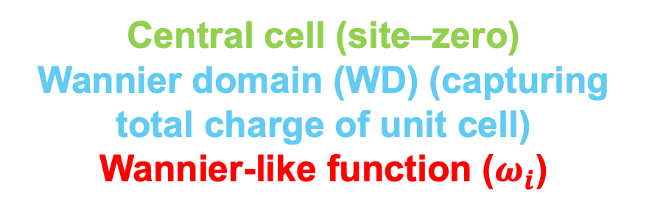
Wannier-function Properties
Localized, unitary transformation of Bloch function.
Wannier functions are identical in every cell and orthogonal to its translations.
Simple translation of localized orbitals, they are not automatically orthogonal to their periodic images.
Central cell (site–zero)
Wannier domain (WD) (capturing total charge of unit cell)
Wannier-like function ($ω_{i}$)
“How do we construct site-zero Wannier functions that are orthogonal to all translated copies?”
Notes:
Two Regions
1) Wannier Domain (WD): Depends on the spread in basis function.
2) Outside WD.
Local representation of a periodic system.
If I start with localized orbitals in one cell and simply translate them, they are not automatically orthogonal to their periodic images.
So the key problem is: how do we construct site-zero Wannier functions that are orthogonal to all translated copies?”

Slide 4
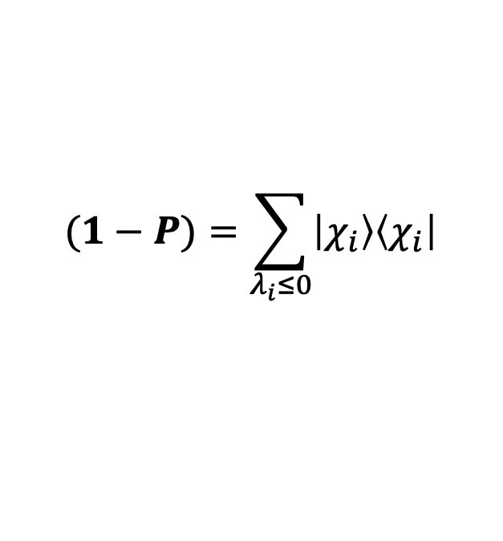
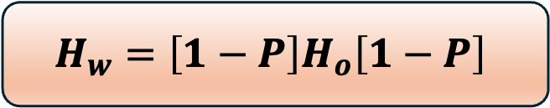
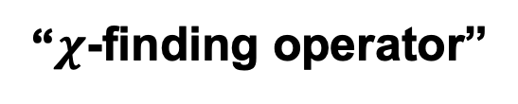
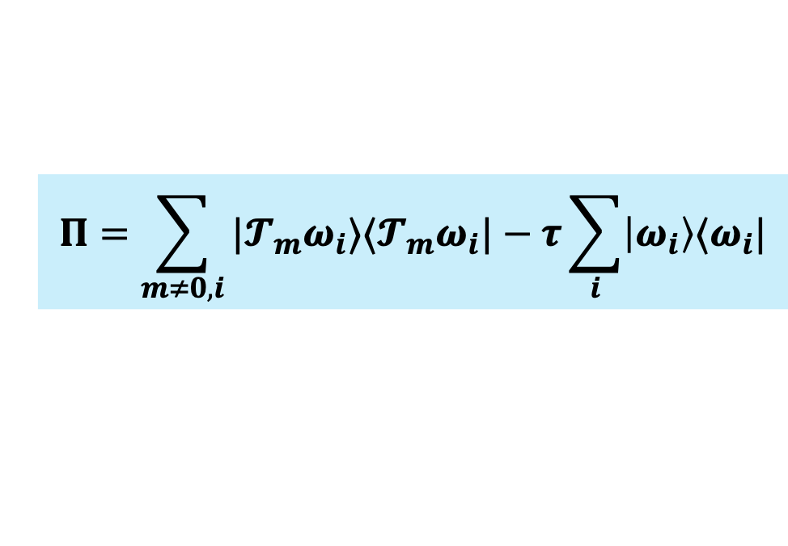
Constructing Localized Wannier Subspace
$$Π=\sum_{m≠0,i}{|𝓣_{m}ω_{i}⟩⟨𝓣_{m}ω_{i}|−τ\sum_{i}{\left|ω_{i}\right\rangle ⟨ω_{i}|}}$$
“$χ$-finding operator”
Pederson and Lin, PRB 35, 2273 (1987)
Eigenvectors with negative eigenvalues corresponds to the Wannier-like functions.
Negative or zero eigenvalues correspond to states that minimize overlap with neighboring cells.
These are the localized site-zero functions
$$(1−P)=\sum_{λ_{i}≤0}{\left|χ_{i}\right\rangle \left\langle χ_{i}\right|}$$
$$H_{w}=\left[1−P\right]H_{o}\left[1−P\right]$$
Project the full crystal Hamiltonian $H_{o}$ onto the subspace orthogonal to the translated Wannier functions at site zero.
Notes:
Operator, minimizes the overlap between approximate Wannier function with their translations.
“The first term represents all neighboring translated orbitals.
The second term represents the central cell orbitals.”
The idea came 1987 : calculated localized Wannier like functions for silicon.
It measures overlap between the central cell and all of its symmetry-related images
Its eigenvectors with non-positive eigenvalues correspond to states localized in the central cell. These define a projection operator that filters out intercell overlap. The crystal Hamiltonian is then projected into this localized subspace.”
“Unlike conventional Wannier methods, this localization is enforced variationally in real space without Fourier transforms.”

Slide 5
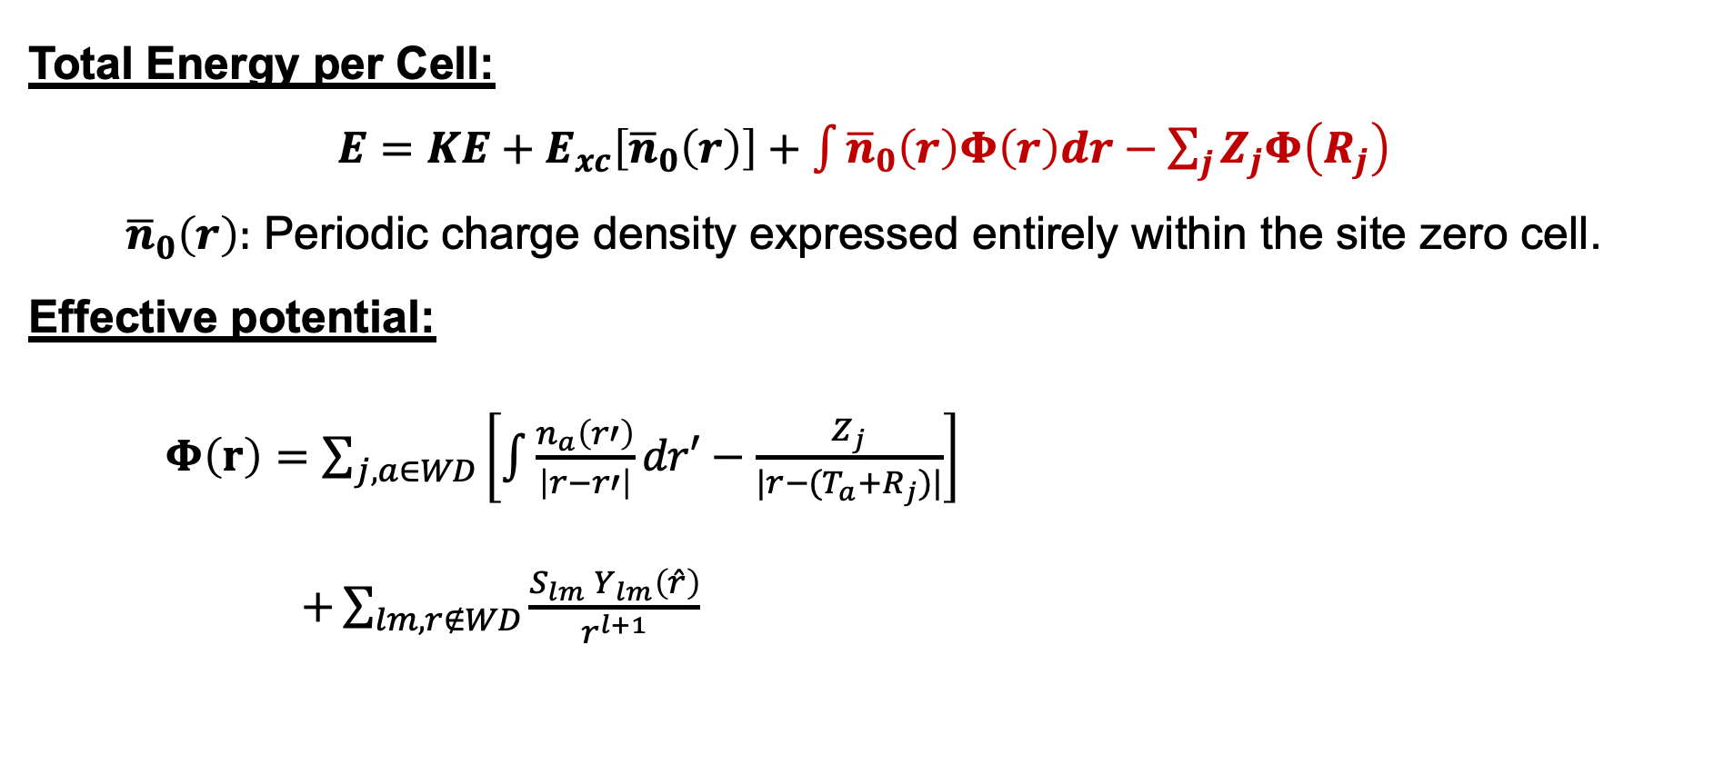
Real-Space Construction of the Crystal Potential
Total Energy per Cell:
$E=KE+E_{xc}\left[{\overline{n}}_{0}\left(r\right)\right]+\int_{ }{{\overline{n}}_{0}\left(r\right)Φ\left(r\right)dr}−\sum_{j}{Z_{j}Φ\left(R_{j}\right)}$
${\overline{n}}_{0}\left(r\right):$ Periodic charge density expressed entirely within the site zero cell.
Effective potential:
$Φ\left(r\right)=\sum_{j,a∈WD}{\left[\int{\frac{n_{a}\left(r′\right)}{\left|r−r′\right|}dr′}−\frac{Z_{j}}{|r−(T_{a}+R_{j})|}\right]}$
$+\sum_{lm,r∉WD}{\frac{S_{lm} Y_{lm}\left(\hat{r}\right)}{r^{l+1}}}$
explicit WD Coulomb terms
multipole long-range terms
Notes:
All the charge associated with the blue volume.
“Once we obtain the Wannier-like functions in the central cell, we must reconstruct the full crystal Hamiltonian.”
“The key idea is that all charge from neighboring cells is folded back into the Wannier domain.”
“Instead of treating the infinite lattice explicitly, we fold neighboring charge contributions into the central region.”
Once we obtain the Wannier-like functions in the central cell, we must reconstruct the full crystal Hamiltonian.
Decay of potential of a neutral charge distribution depends on the lowest non-vanishing multipole.
$$Φ\left(r\right)=\sum_{j,a∈WD}{\left[\int{\frac{n_{a}\left(r′\right)}{\left|r−r′\right|}dr′}−\frac{Z_{j}}{|r−(T_{a}+R_{j})|}\right]}+\sum_{lm,r∉WD}{\frac{S_{lm} Y_{lm}\left(\hat{r}\right)}{r^{l+1}}}$$
This allows us to treat infinite electrostatics entirely in real space, without Ewald summations or reciprocal-space FFTs
The electrostatic potential is separated into two parts
1️⃣ Contributions from cells inside the Wannier domain are treated explicitly.
2️⃣ Contributions from cells outside are treated using a multipole expansion.
So near-field interactions are exact, and far-field interactions are handled analytically.

Slide 6
SCF Loop
Guess $ω_{i}$
Guess 𝝎_𝒊
$Π$ Finding Loop
𝚷 Finding Loop
Build $\left(1−P\right)$and $H_{w}$
Build (𝟏−𝑷) and 𝑯_𝒘
Compute folded density ${\overline{n}}_{0}(r)$ and obtain potential $Φ(r)$
Compute folded density 𝒏 ̅_𝟎 (𝒓) and obtain potential 𝚽(𝒓)
Build updated crystal Hamiltonian $H_{0}$
Build updated crystal Hamiltonian 𝐇_𝟎
Check convergence
(Energy OR density)
SCF Solution
Diagonalize $H_{w}→$new $ω_{i}$
Diagonalize 𝑯_𝒘→new 𝝎_𝒊
NO
YES
Notes:
Putting it all together: we start with a guess wavefunction, construct the Π operator, build the projected Hamiltonian, solve for the charge density and electrostatic potential, compute the total energy, and check for convergence. This is a fully self-consistent calculation — the Wannier functions are optimized variationally, not constructed as a post-processing step.

Slide 7
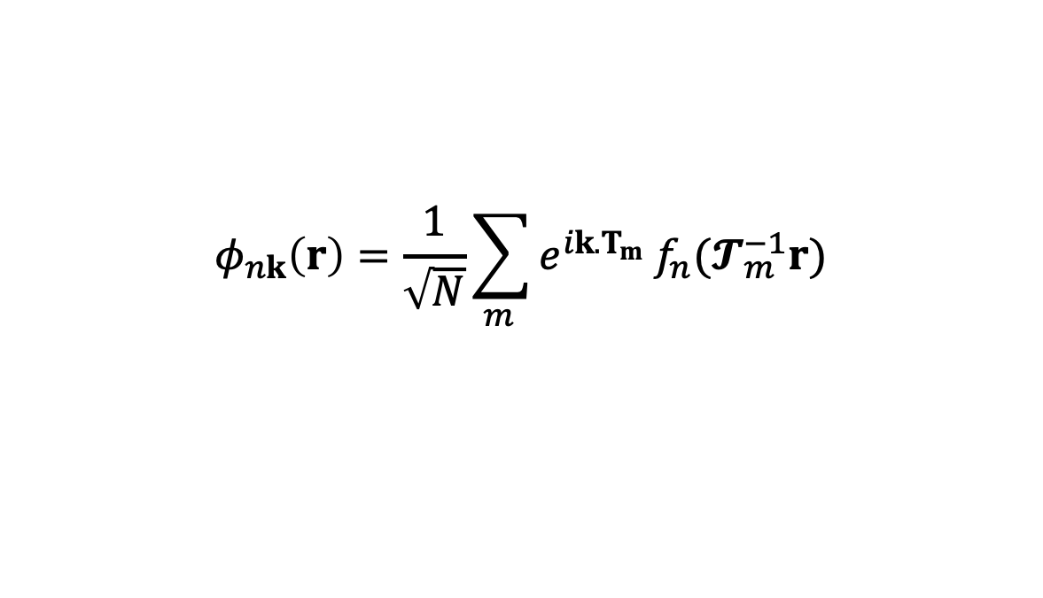
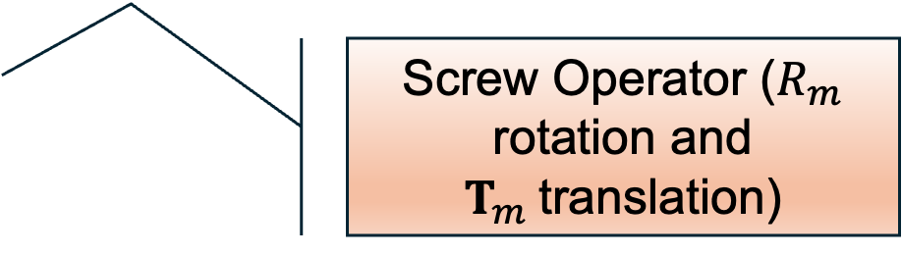
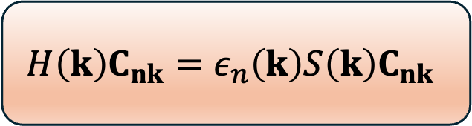
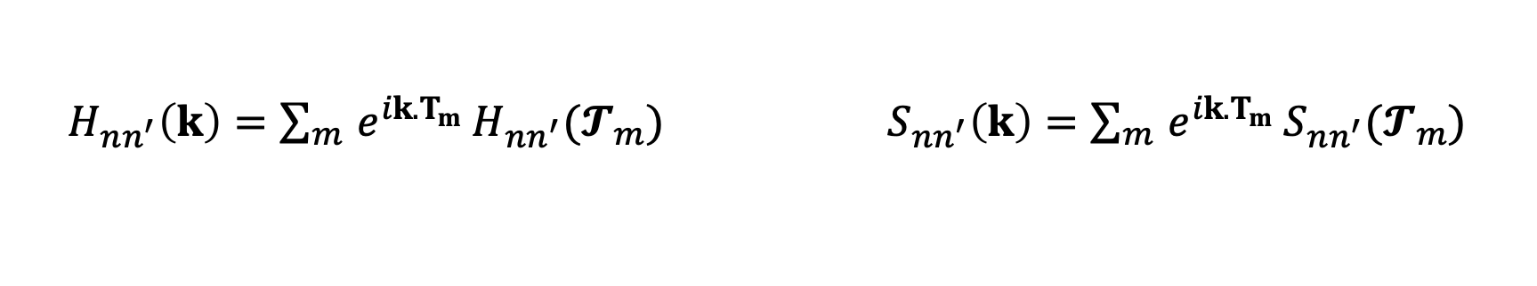
Bandstructure Calculation
$$φ_{nk}\left(r\right)=\frac{1}{\sqrt{N}}\sum_{m }{e^{ik.T_{m}}}f_{n}(𝓣_{m}^{−1}r)$$
Screw Operator ($R_{m}$ rotation and $T_{m}$translation)
Bloch basis constructed from local basis functions.
$H_{nn^{′}}\left(k\right)=\sum_{m }{e^{ik.T_{m}}}H_{nn^{′}}(𝓣_{m})$ ${ S}_{nn^{′}}\left(k\right)=\sum_{m }{e^{ik.T_{m}}}S_{nn^{′}}(𝓣_{m})$
The k-dependent Hamiltonian is obtained by Fourier transforming the real-space matrix elements
$$H\left(k\right)C_{nk}=ε_{n}\left(k\right)S\left(k\right)C_{nk}$$
(Band energies are obtained by solving eigenvalue problem)
Notes:
$$H_{nn^{′}}\left(𝓣_{m}\right)=\left\langle f_{n}\left|\hat{H}\right|𝓣_{m}f_{n^{′}}\right\rangle$$
$=\int{dr f_{n}^{∗}\left(r\right) \hat{H}f_{n^{′}}(𝓣_{m}^{−1}r)}$
$$S_{nn^{′}}\left(𝓣_{m}\right)=\left\langle f_{n}|𝓣_{m}f_{n^{′}}\right\rangle$$
$=\int{dr f_{n}^{∗}\left(r\right) f_{n^{′}}(𝓣_{m}^{−1}r)}$

Slide 8
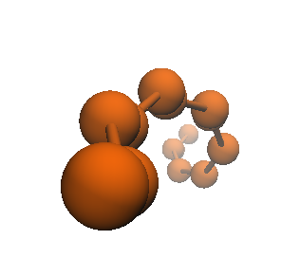
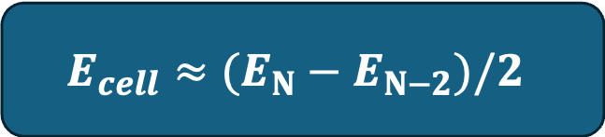


Carbon Chains (-C$≡$C-)
2.30 Bohr
2.92 Bohr
$$−C≡C−C≡C−C≡C−C≡C−C≡C−$$
W-first
WPBC
H–(----C $≡$C–C $≡$C–C $≡$C----)–H → N cells
H–(-- $≡$C–C $≡$C–C $≡$---)–H → N-2 cells
$$E_{N}≈NE_{cell}+2E_{end}$$
$$E_{N−2}≈(N−2)E_{cell}+2E_{end}$$
Infinite Cluster Limit
$$θ=60°$$
$$E_{cell}≈(E_{N}−E_{N−2})/2$$

Slide 9
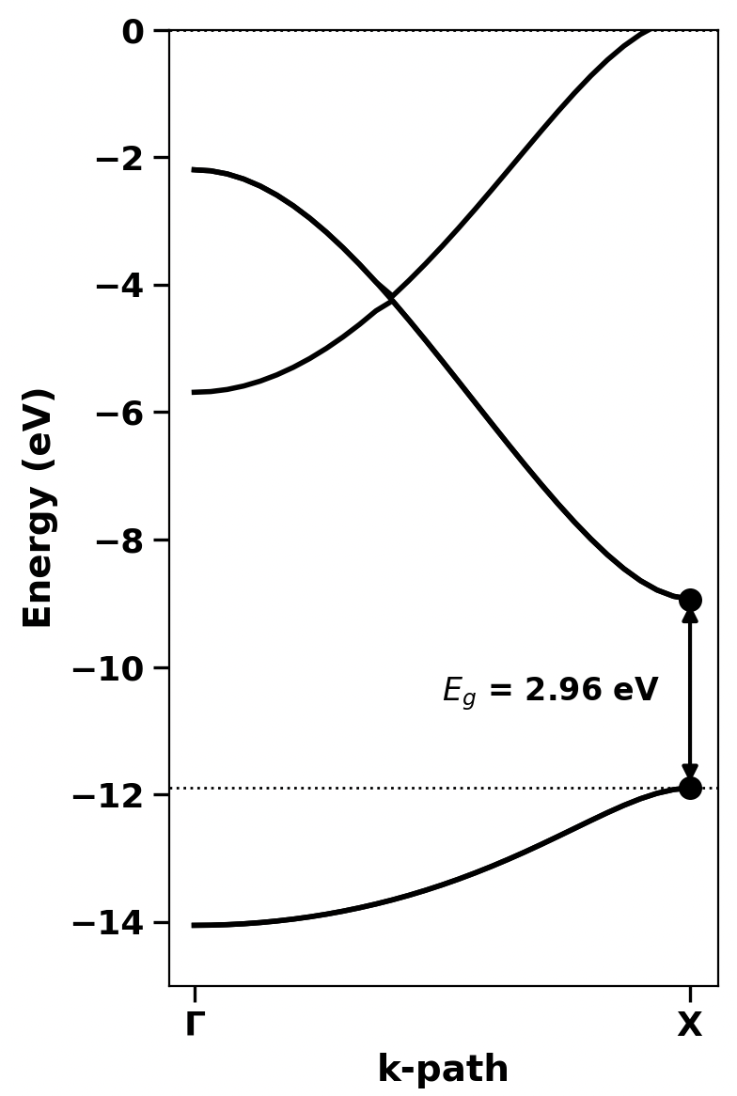
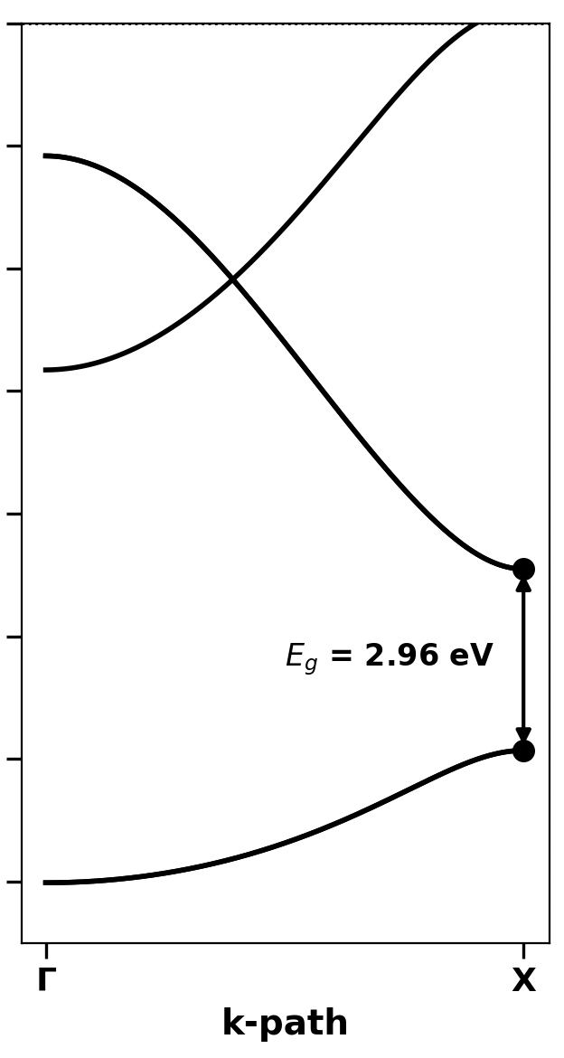
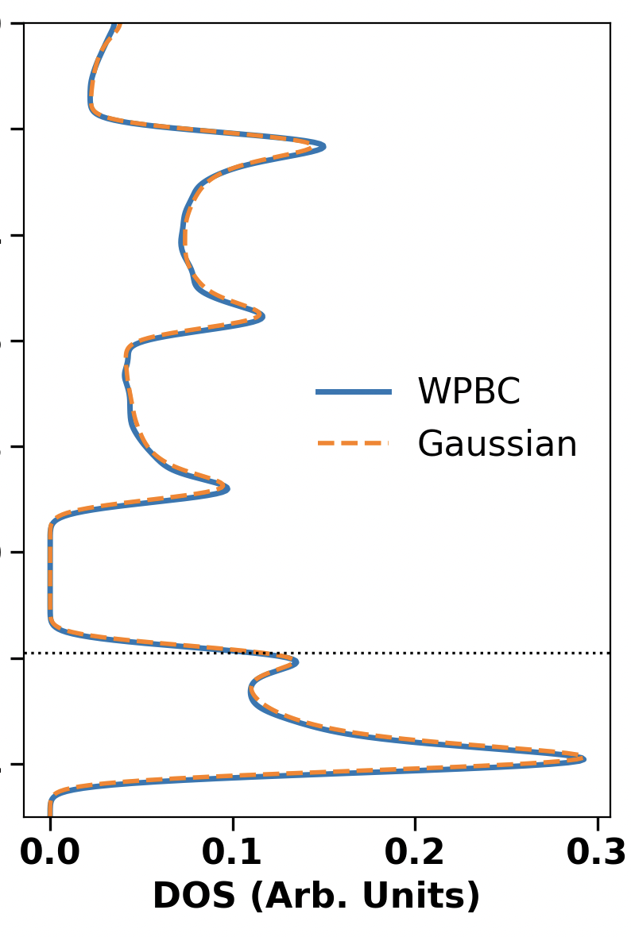
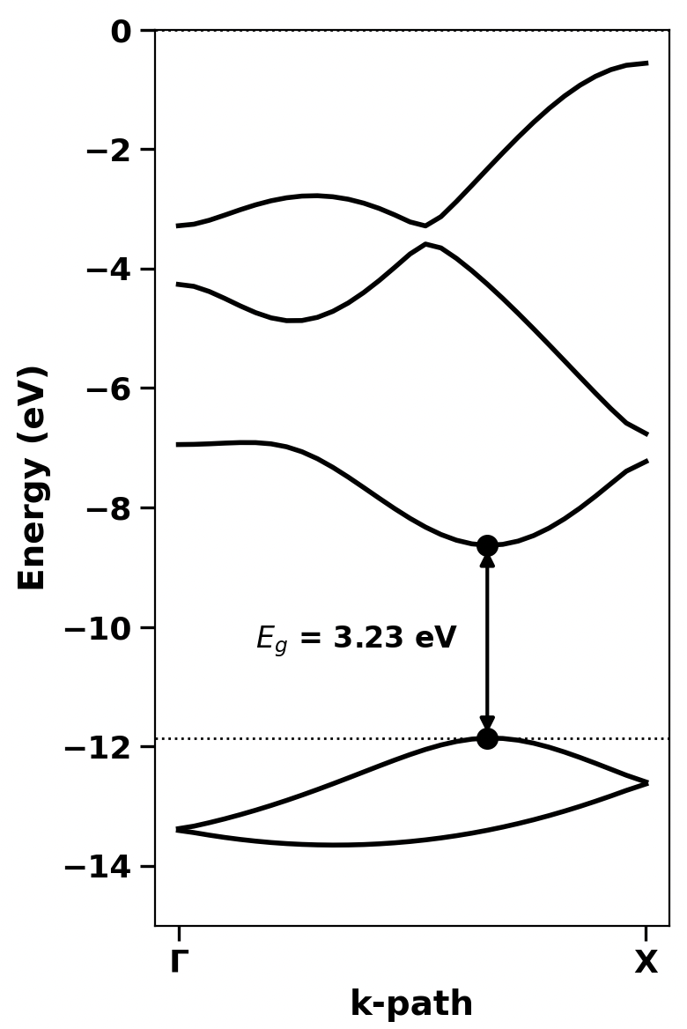
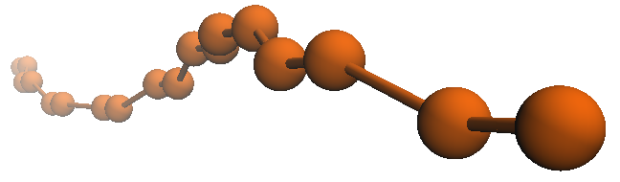

W-first vs Gaussian PBC code
Linear
Chiral
W-first
W-first
W-first
W-first
Gaussian
Code PBC
Energy difference (W-first and Gaussian) <10⁻⁵ Ha
Carbon Chains (-C$≡$C-)
60 degree
Notes:
https://journals.aps.org/prl/abstract/10.1103/PhysRevLett.92.125502
https://www.science.org/doi/10.1126/sciadv.add4627?__cf_chl_tk=3YpGVWkSL_2ltzS3V3Bp0.ww6foxNJGgP1w2hKXSnrM-1771599801-1.0.1.1-J0DgKrQSFHlqLz1Q20En71.nHHOTd6m.WGoY2LEsg0U
https://www.science.org/doi/10.1126/sciadv.adn6519

Slide 10
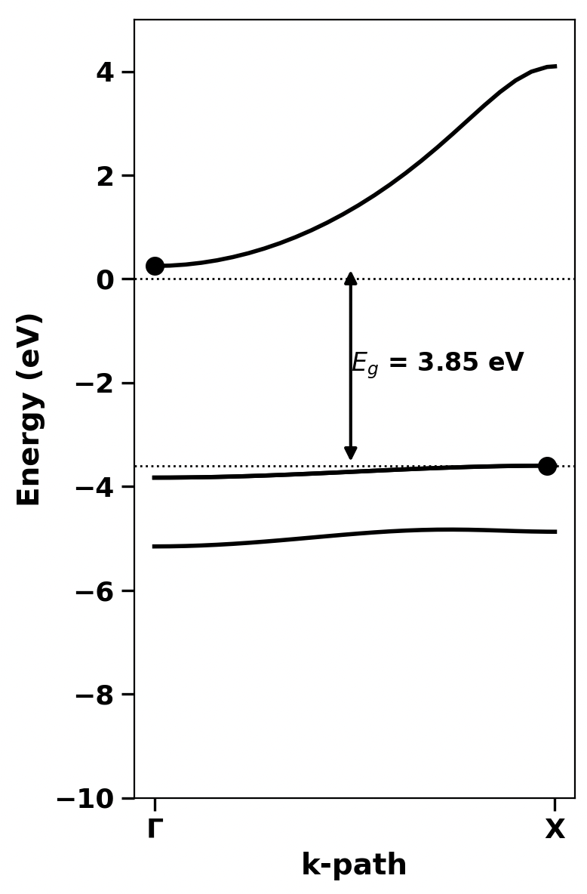
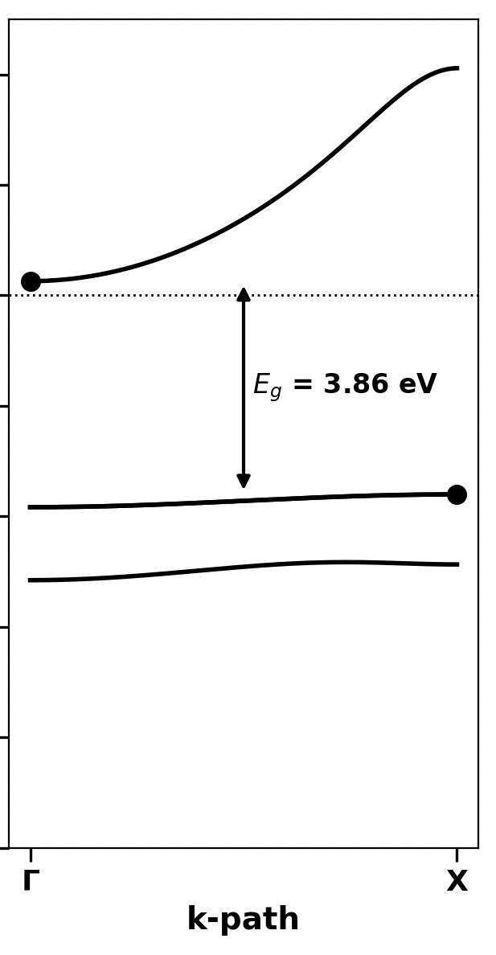
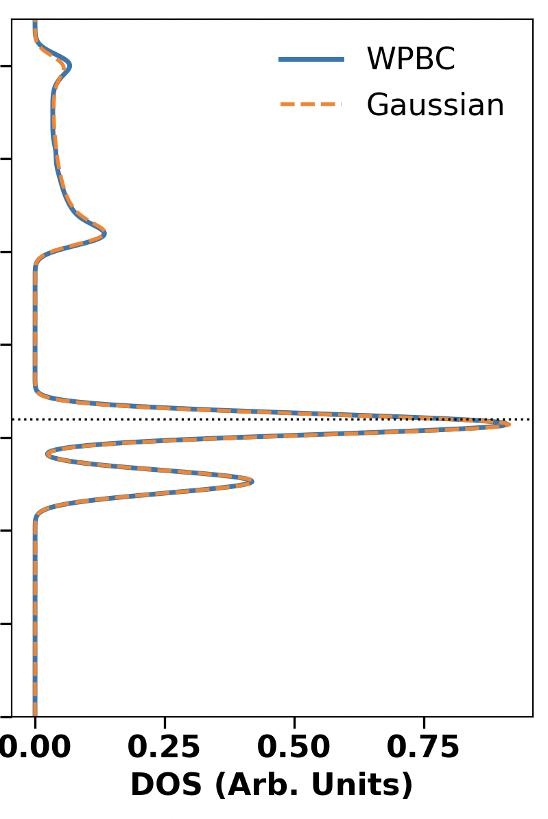
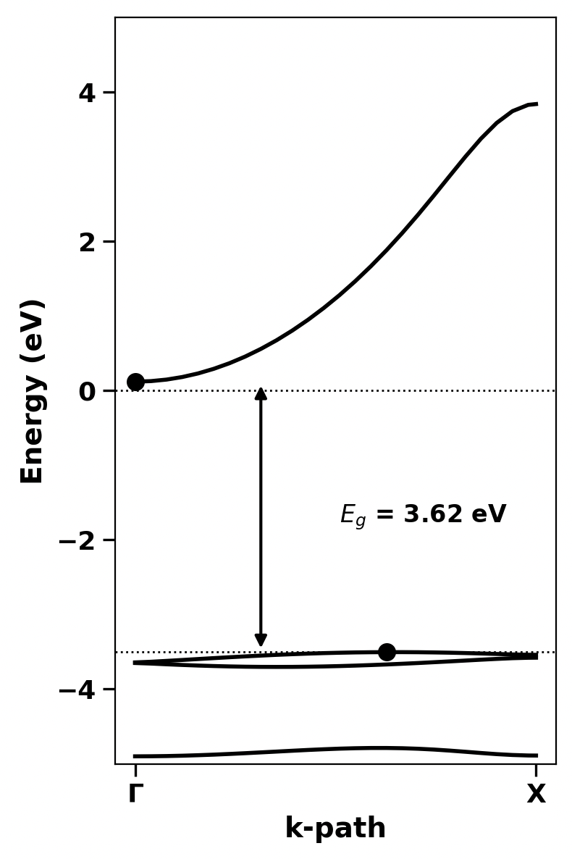
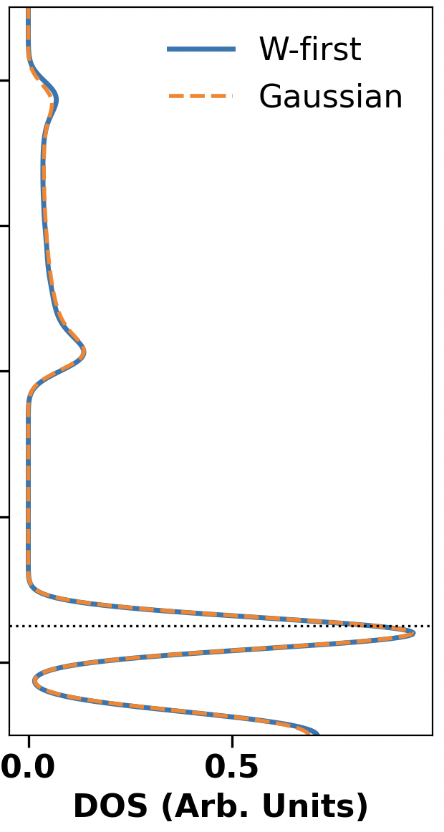
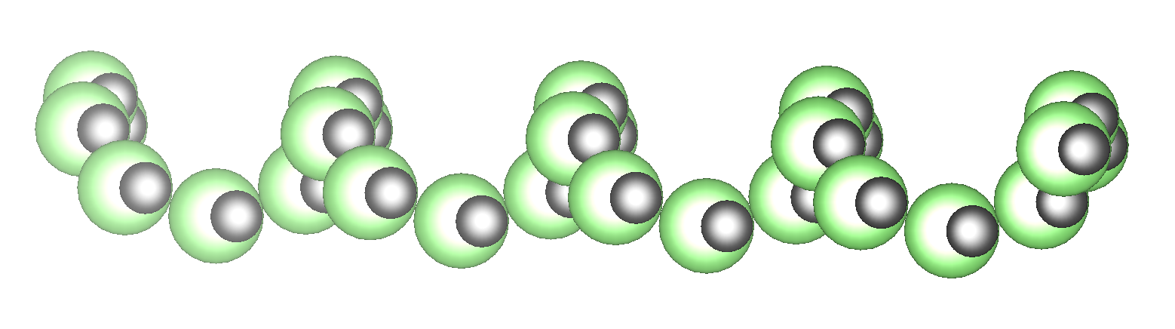
Lithium-Fluorine Chains (-Li-F-,)
Linear
Chiral
W-first
Energy difference (W-first-Gaussian) ~10⁻⁵ Ha

Slide 11
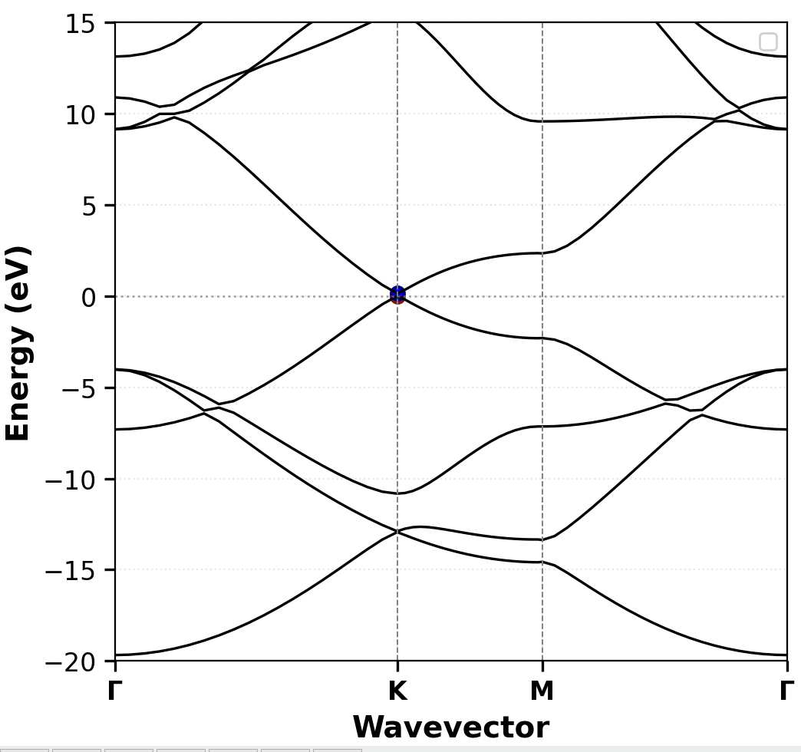
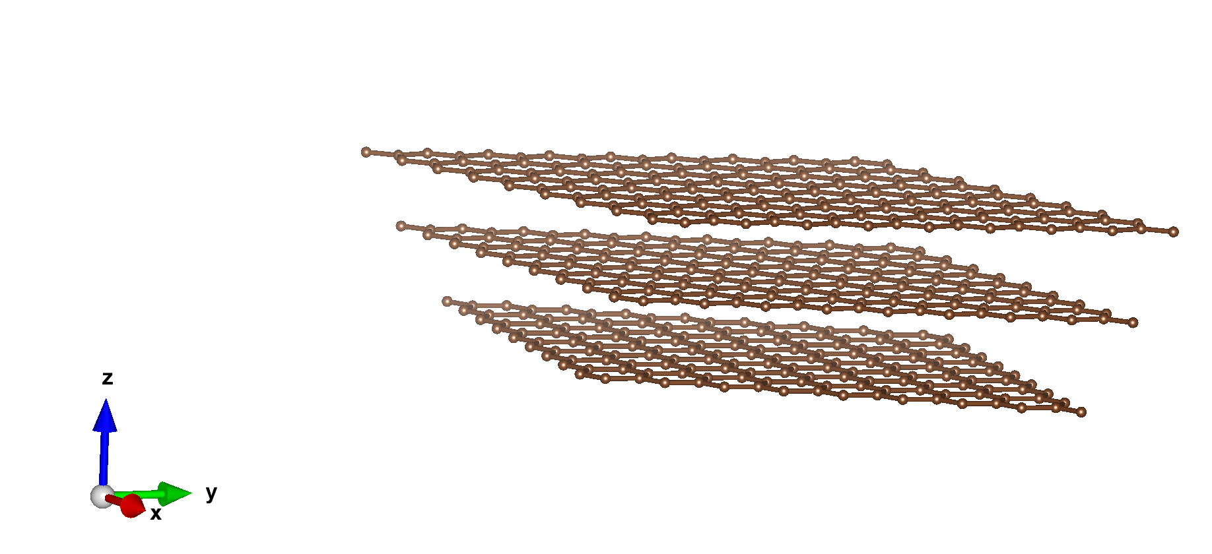
Graphene and derivatives
Dirac Cone
W-First
Notes:
https://journals.aps.org/prl/abstract/10.1103/PhysRevLett.92.125502
https://www.science.org/doi/10.1126/sciadv.add4627?__cf_chl_tk=3YpGVWkSL_2ltzS3V3Bp0.ww6foxNJGgP1w2hKXSnrM-1771599801-1.0.1.1-J0DgKrQSFHlqLz1Q20En71.nHHOTd6m.WGoY2LEsg0U
https://www.science.org/doi/10.1126/sciadv.adn6519

Slide 12
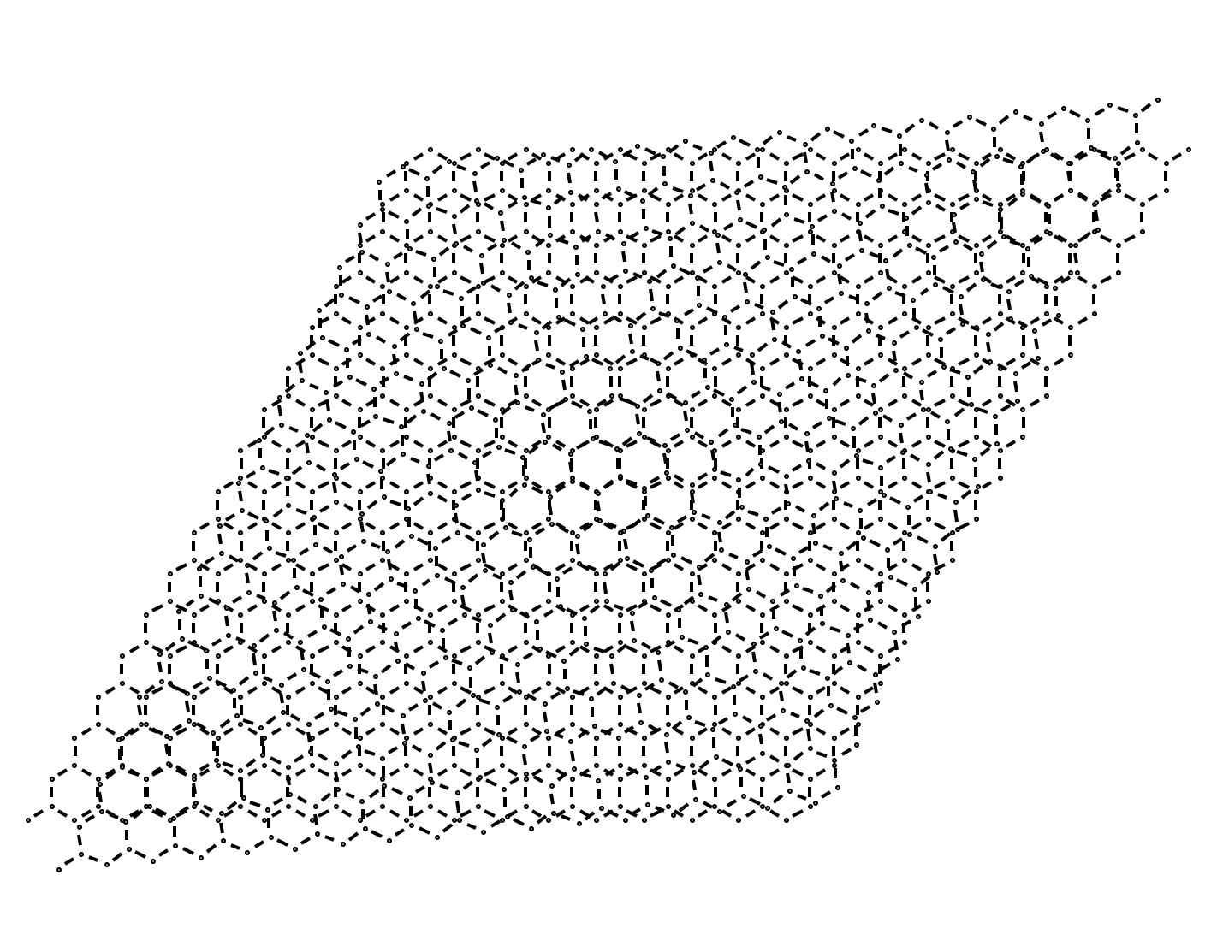
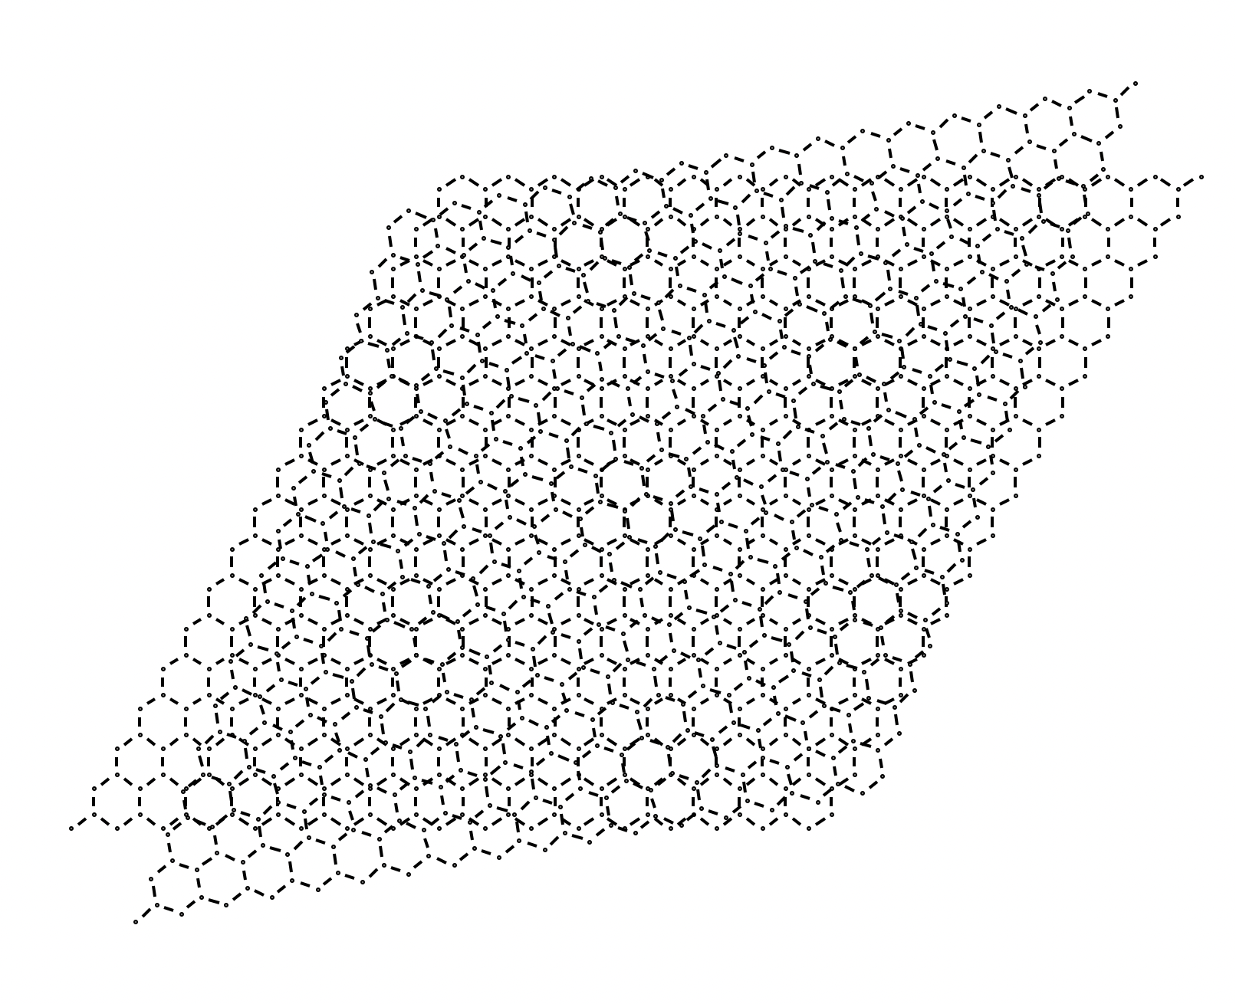
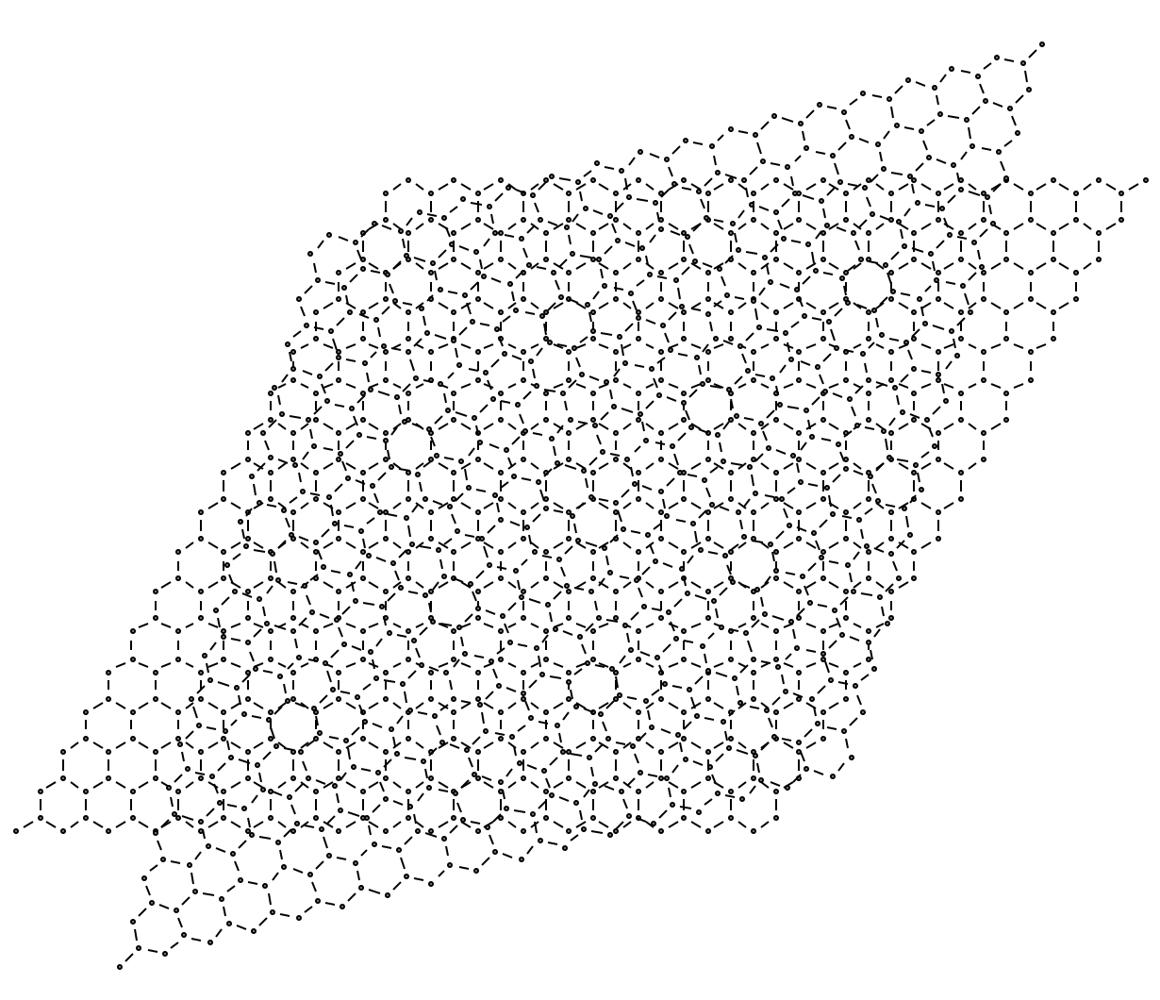
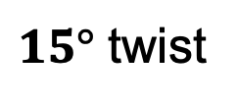

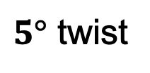
$5°$ twist
Screw operation along z-axis
$10°$ twist
$15°$ twist
Moire’s pattern

Slide 13
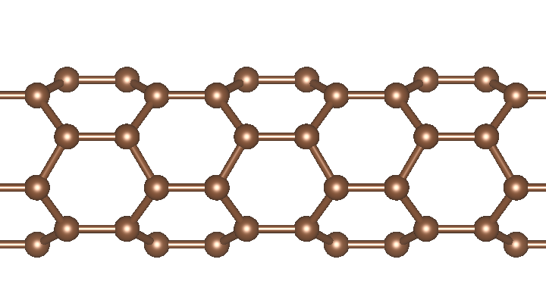
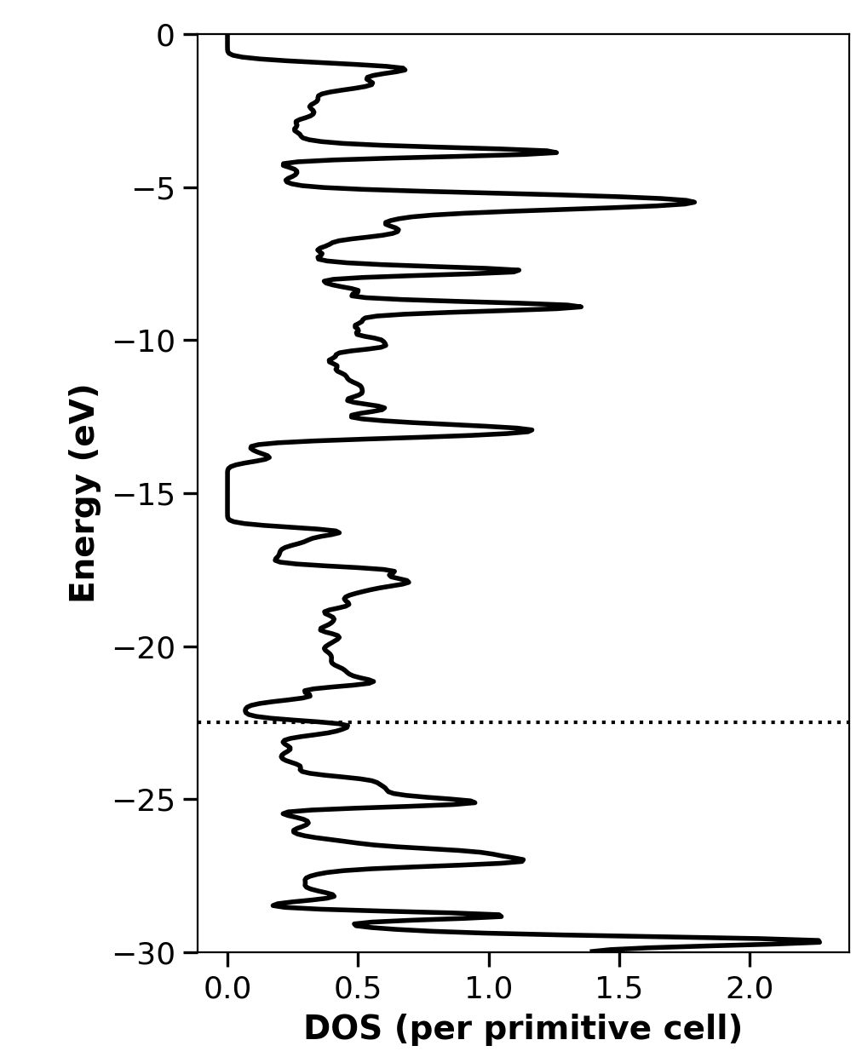
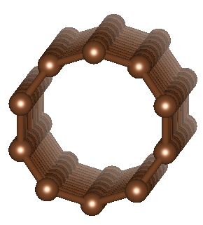
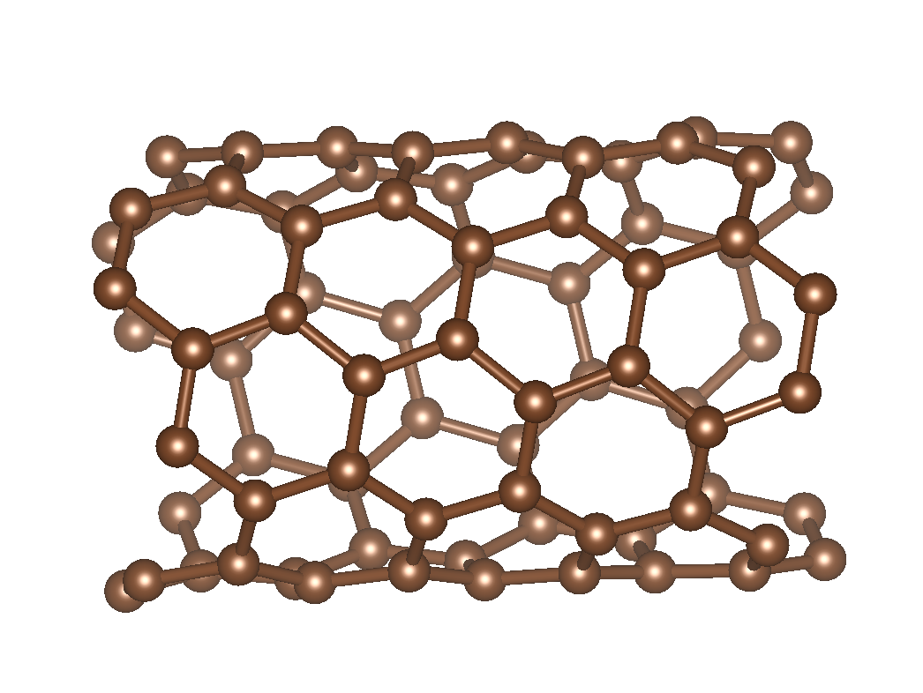
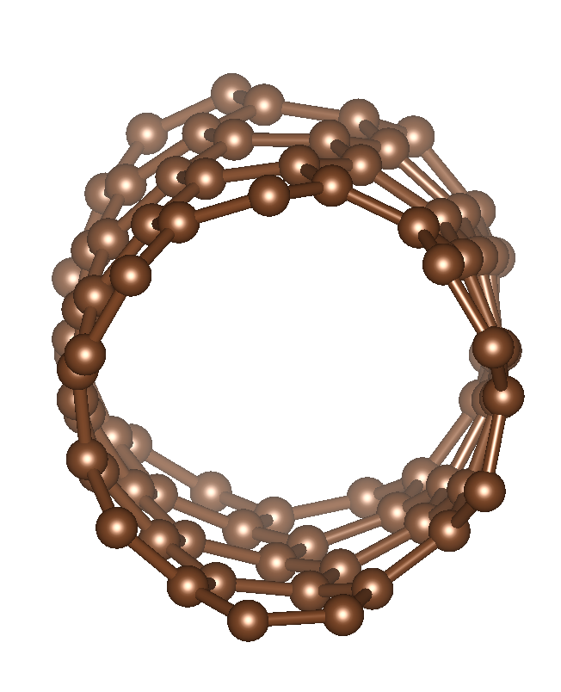
Carbon nanotubes
CNT(5,0)
CNT(5,0)
CNT(6,5)
Notes:
https://journals.aps.org/prl/abstract/10.1103/PhysRevLett.92.125502
https://www.science.org/doi/10.1126/sciadv.add4627?__cf_chl_tk=3YpGVWkSL_2ltzS3V3Bp0.ww6foxNJGgP1w2hKXSnrM-1771599801-1.0.1.1-J0DgKrQSFHlqLz1Q20En71.nHHOTd6m.WGoY2LEsg0U
https://www.science.org/doi/10.1126/sciadv.adn6519

Slide 14
Summary
🔷 What This Enables
  Fully real-space periodic DFT
  Handles chiral (translation + rotation) symmetry
  Avoids supercells for chiral systems
  Compatible with Perdew Zunger-Self Interaction Correction (PZ-SIC).
🔷 Future Directions
  Generalize the chiral methodology. (Nanotube with 2 atom cells only)
  Incorporate in FLOSIC (www.flosic.org) .
  Applications: polymers, chiral magnetic materials, biomolecular helices, etc.
Notes:
“Rather than constructing localized orbitals from Bloch states, we reverse the logic — we build periodicity from localization.”
“This gives us a symmetry-flexible and physically transparent framework for complex periodic systems.”
What we showed:Fully real-space periodic DFT starting from localized Wannier functions
Handles both translation and screw-axis symmetry without supercells
Validated against Gaussian reference to μHartree accuracy
Band structures, DOS, Peierls distortion all correctly reproduced
What's next:Benzene (C₃/C₆ rotational symmetry)
Graphene (2D periodicity)
Carbon nanotubes (full helical symmetry)
Fermi-Löwdin orbital (FLO) construction for SIC
Force evaluation and geometry optimization
helices
twisted chains
chiral polymers
DNA-like systems
To summarize: we've demonstrated a Wannier-first approach to periodic DFT that works entirely in real space. It handles translational and screw-axis symmetry without requiring supercells. We've validated it on carbyne, lithium fluoride, and boron nitride chains, achieving microHartree agreement with reference calculations. Going forward, we're extending to benzene with rotational symmetry, graphene for 2D periodicity, and ultimately carbon nanotubes — the systems that motivated this work. We're also implementing Fermi-Löwdin orbital construction, which will enable self-interaction corrections in a periodic framework. The key message is this: by starting from localization rather than delocalization, we gain the symmetry flexibility needed for chiral systems and a natural framework for orbital-dependent functionals. Thank you.

Slide 15


Acknowledgements
This work was supported by the U.S. Department of Energy, Office of Science, Office of Basic Energy Sciences, as a part of the Computational Chemical Sciences Program under Award No. DE-SC0018331.
The calculations were carried out at the high-performance computing center (HPCC) of the Institute for Cyber-Enabled Research (ICER) at Michigan State University using resources owned by Central Michigan University.
Thank You

Slide 16
Layered Graphene
27 cells in Wannier Domain: nx ny nz going from -1 to 1
TOTAL ENERGY= -74.882235530202308
TOTAL ENERGY= -75.333627728647855
TOTAL ENERGY= -75.334907673558803
TOTAL ENERGY= -75.338786124277419
TOTAL ENERGY= -75.338823441880379
TOTAL ENERGY= -75.338760360801871
TOTAL ENERGY= -75.338763416444408
ERRDOTF, ERRMAXF: 4.0924541139083687E-005 1.6552119639675144E-006
ERRDOTF, ERRMAXF: 4.0923309083631865E-005 1.6552104183989749E-006
ERRDOTF, ERRMAXF: 3.1730416402833373E-005 1.6155524578396090E-006
ERRDOTF, ERRMAXF: 3.1730079888641949E-005 1.6155525952509343E-006
ERRDOTF, ERRMAXF: 5.9172183953355636E-005 4.6465787945728853E-006
ERRDOTF, ERRMAXF: 5.9183915739945874E-005 4.6465777924022920E-006
ERRDOTF, ERRMAXF: 5.0344491096573473E-005 3.6539257054039100E-006
ERRDOTF, ERRMAXF: 5.0344421356203473E-005 3.6539257068599334E-006
ERRDOTF, ERRMAXF: 9.0436237091131547E-006 6.1824772139742401E-007
ERRDOTF, ERRMAXF: 9.0436237150746404E-006 6.1824772267425005E-007
ERRDOTF, ERRMAXF: 4.9392044050450452E-005 1.7274333598183119E-006
ERRDOTF, ERRMAXF: 4.9392043829073614E-005 1.7274333585250010E-006
ERRDOTF, ERRMAXF: 8.8644204379454109E-007 5.5978486760607703E-008
ERRDOTF, ERRMAXF: 8.8644204179573254E-007 5.5978486416850552E-008
delta_rho, CC(q), FOLD= 2.5129244560268500 10.785093046237026 11.952848469981530
delta_rho, CC(q), FOLD= 1.2965924401315523 9.5419383668707312 11.901462739193553
delta_rho, CC(q), FOLD= 1.2639724943527726 9.5336147102536941 11.902948905373911
delta_rho, CC(q), FOLD= 1.0146014120080247 9.5182345770437529 11.905217207945762
delta_rho, CC(q), FOLD= 0.99982747519458470 9.5169814685954055 11.905203215573147
delta_rho, CC(q), FOLD= 0.90410486703107862 9.4929253125735933 11.904564000150630
delta_rho, CC(q), FOLD= 0.90354328670190209 9.4939033124426278 11.904608911773034

Slide 17
Twisted Layered Graphene (5° degree)
ERRDOTF, ERRMAXF: 3.6483772275170166E-004 6.2993510107735894E-006
ERRDOTF, ERRMAXF: 3.6483804551685865E-004 6.2993914711036297E-006
ERRDOTF, ERRMAXF: 2.4365787240704971E-003 2.0203833670413260E-004
ERRDOTF, ERRMAXF: 2.4365785532509685E-003 2.0203834077149566E-004
ERRDOTF, ERRMAXF: 1.7466254602818787E-003 2.0292365875967841E-004
ERRDOTF, ERRMAXF: 1.7466256728203421E-003 2.0292365826356918E-004
ERRDOTF, ERRMAXF: 1.2155346288593521E-003 1.1685047364854941E-004
ERRDOTF, ERRMAXF: 1.2155344245657982E-003 1.1685047244765315E-004
ERRDOTF, ERRMAXF: 2.9286983387195409E-004 3.0127104446435497E-005
ERRDOTF, ERRMAXF: 2.9286906376093307E-004 3.0127104107330844E-005
ERRDOTF, ERRMAXF: 9.9691340639599378E-005 4.0156232572277131E-006
ERRDOTF, ERRMAXF: 9.9688946033649244E-005 4.0156568483764999E-006
ERRDOTF, ERRMAXF: 9.9049149737895484E-005 9.0664013787096432E-006
ERRDOTF, ERRMAXF: 9.9050260146776430E-005 9.0664153081953904E-006
ERRDOTF, ERRMAXF: 9.9481006376344892E-005 8.5761504381586435E-006
ERRDOTF, ERRMAXF: 9.9476329723182128E-005 8.5761792438771673E-006
ERRDOTF, ERRMAXF: 9.9357280678131986E-005 8.4243286407622844E-006
ERRDOTF, ERRMAXF: 9.9352960398391965E-005 8.4242939500692206E-006
TOTAL ENERGY= -74.886011764392890
TOTAL ENERGY= -75.334506593225569
TOTAL ENERGY= -75.335033360705495
TOTAL ENERGY= -75.339692911843372
TOTAL ENERGY= -75.339870228944733
TOTAL ENERGY= -75.339904359983620
TOTAL ENERGY= -75.339811060065642
TOTAL ENERGY= -75.339780691543751
TOTAL ENERGY= -75.339780007693093
delta_rho, CC(q), FOLD= 2.5177256679652085 10.782647919163812 11.952790864600118
delta_rho, CC(q), FOLD= 1.3047034402821656 9.5345556197244559 11.902302935651832
delta_rho, CC(q), FOLD= 1.2646308678563403 9.5282820079901001 11.902054516411274
delta_rho, CC(q), FOLD= 0.99135271300627148 9.5196717806534856 11.905430000819761
delta_rho, CC(q), FOLD= 1.0073511832559217 9.5176175998128265 11.905191498251902
delta_rho, CC(q), FOLD= 0.93918241851188222 9.5024037784821189 11.904858204938737
delta_rho, CC(q), FOLD= 0.90345448624238001 9.4940825692843926 11.904625714577847
delta_rho, CC(q), FOLD= 0.89121686445434922 9.4925371728833152 11.904574603549838
delta_rho, CC(q), FOLD= 0.89105001346087631 9.4926555441492422 11.904567659923684

Slide 18
Twisted Layered Graphene (10° degree)
ERRDOTF, ERRMAXF: 9.8891214846268826E-005 2.4605138291221549E-006
ERRDOTF, ERRMAXF: 9.8888788200290347E-005 2.4603760676476785E-006
ERRDOTF, ERRMAXF: 6.2434209970646374E-004 5.9592615995959829E-005
ERRDOTF, ERRMAXF: 6.2434204983496456E-004 5.9592615840968114E-005
ERRDOTF, ERRMAXF: 9.9627812416221509E-005 1.0022379895226293E-005
ERRDOTF, ERRMAXF: 9.9619285350086627E-005 1.0022381832711286E-005
ERRDOTF, ERRMAXF: 9.9265988432573941E-005 7.5169118011393758E-006
ERRDOTF, ERRMAXF: 9.9273557904652187E-005 7.5168098533825546E-006
ERRDOTF, ERRMAXF: 9.8447843926177328E-005 3.2782086698393548E-006
ERRDOTF, ERRMAXF: 9.8450138777043806E-005 3.2782378374646816E-006
ERRDOTF, ERRMAXF: 9.8549686036623392E-005 7.1803726676294183E-006
ERRDOTF, ERRMAXF: 9.8546891039883290E-005 7.1805067475296981E-006
ERRDOTF, ERRMAXF: 9.8301557362715639E-005 6.3630351032553312E-006
ERRDOTF, ERRMAXF: 9.8299866926011557E-005 6.3629973463341556E-006
ERRDOTF, ERRMAXF: 9.5643396896037797E-005 5.2870477169805273E-006
ERRDOTF, ERRMAXF: 9.5643833842012520E-005 5.2869309829178408E-006
ERRDOTF, ERRMAXF: 9.3164960658057936E-005 5.1715592602475138E-006
ERRDOTF, ERRMAXF: 9.3163716478222538E-005 5.1715786819763408E-006
TOTAL ENERGY= -74.889127721452780
TOTAL ENERGY= -75.336642269845015
TOTAL ENERGY= -75.338103798380189
TOTAL ENERGY= -75.342686845856804
TOTAL ENERGY= -75.342723423807911
TOTAL ENERGY= -75.342657283310530
TOTAL ENERGY= -75.342642987805448
TOTAL ENERGY= -75.342626439413266
TOTAL ENERGY= -75.342627386212826
delta_rho, CC(q), FOLD= 2.5176393157073975 10.782777322944876 11.952794943381006
delta_rho, CC(q), FOLD= 1.3046122708995425 9.5336451732478711 11.901797881755707
delta_rho, CC(q), FOLD= 1.2646758273259757 9.5320691578032850 11.902411180843181
delta_rho, CC(q), FOLD= 1.0181017601024602 9.5237767014123378 11.905404013211726
delta_rho, CC(q), FOLD= 1.0040895037552322 9.5200793376657877 11.905302078181959
delta_rho, CC(q), FOLD= 0.90567568674256593 9.4972446349646589 11.904739856746716
delta_rho, CC(q), FOLD= 0.89933451465758640 9.4964480274506293 11.904714652416933
delta_rho, CC(q), FOLD= 0.89104878729869574 9.4954864709513114 11.904668521278182
delta_rho, CC(q), FOLD= 0.89109008246911059 9.4956450216811881 11.904671624457476

