Slide 1

Diamonds Predictor Platform
- Unified ML workflow for analysis, prediction.
- Handles classification, regression in one pipeline.
Produces reusable artifacts (plots + metrics) for reporting.
This project converts raw diamonds data into business-ready insights and model outputs.

Slide 2
Diamonds Dataset: What We Are Predicting and Why
The dataset contains physical and quality attributes of diamonds: carat, cut, color, clarity, depth, table, x, y, z, and price.
Each row represents one diamond listing with measurable properties and market value.
This is a supervised learning problem with two business questions:
Quality grading support (Cut prediction)
Price estimation support (Price prediction)

Slide 3

Business Value
Supports consistent quality labeling
Reduces manual grading variation
Improves trust in catalog quality tags
This helps teams standardize quality assessments at scale.
Faster and more consistent pricing decisions
Better quote accuracy
Reduced risk of underpricing or overpricing
This gives practical decision support for sales, procurement, and inventory planning.

Slide 4
Main Pipeline Controller
Scope: Main.py
Acts as the end-to-end orchestrator for analysis, classification, regression, and model persistence.
Standardizes data cleanup via prepare_clean_data before downstream tasks.
Runs analysis artifact generation through run_analyzer.
Builds classification pipeline in run_classification with mixed preprocessing:
One-hot encoding for categorical inputs
Standard scaling for numeric inputs
Builds regression pipeline in run_regression using transformed features from build_regression_xy.
Persists deployable models through train_and_save_svc_model and train_and_save_ann_model.
Entry point in main block handles sampling, user prompts, pipeline execution order, and metric/plot output.

Slide 5
Analyzer Module for Data Health and EDA
Scope: Analyzer.py
Bullets:
Loads raw CSV into memory and provides dataset diagnostics.
Enforces cleaning helpers:
Drop auto-generated unnamed columns
Drop missing rows
Optional shuffle for deterministic data order
preprocess_data performs:
Missing value handling
Label encoding for string columns
Standard scaling of resulting numeric frame
Produces core EDA artifacts:
Correlation matrix
Pairplot
Numerical histograms
Categorical histograms
Boxplots
Exports cleaned dataset for downstream modeling.

Slide 6
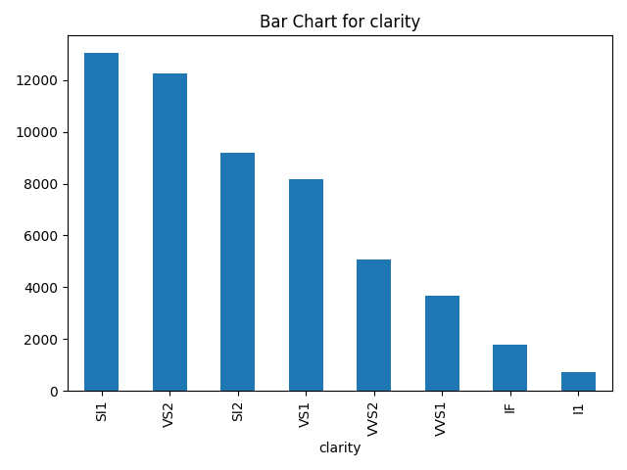
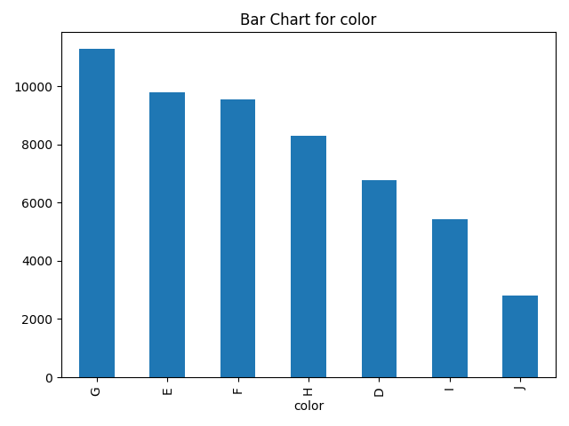
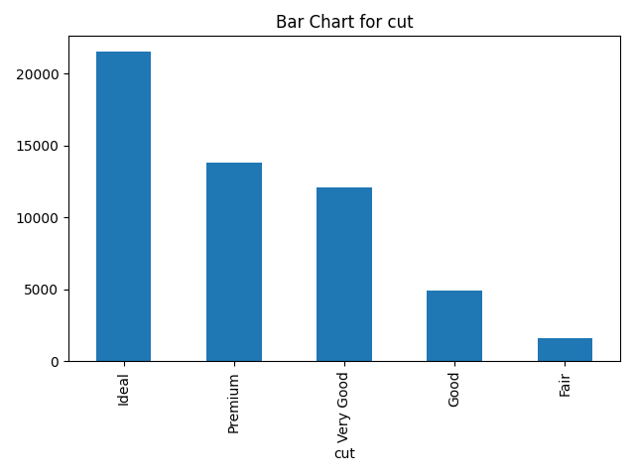
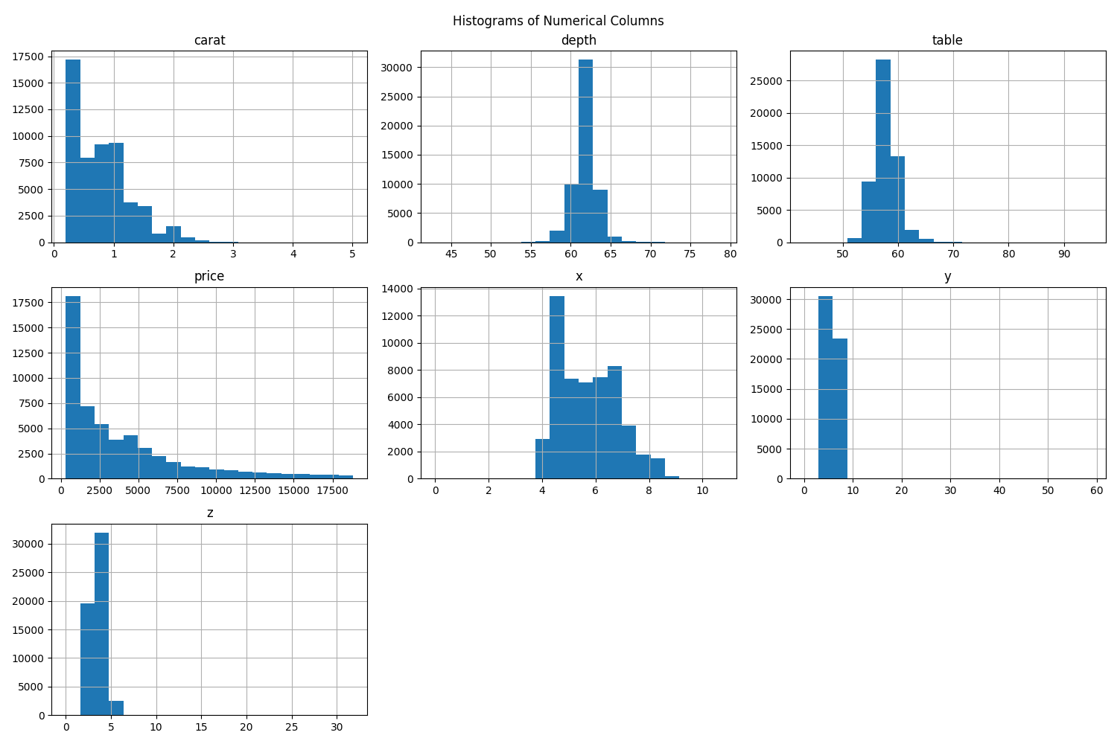
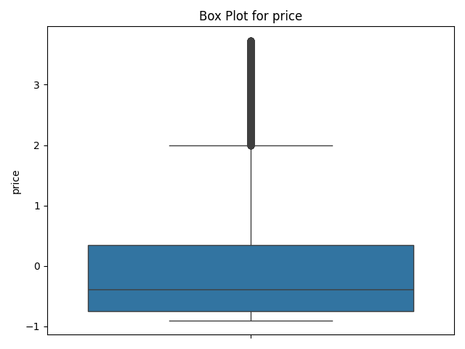

Slide 7
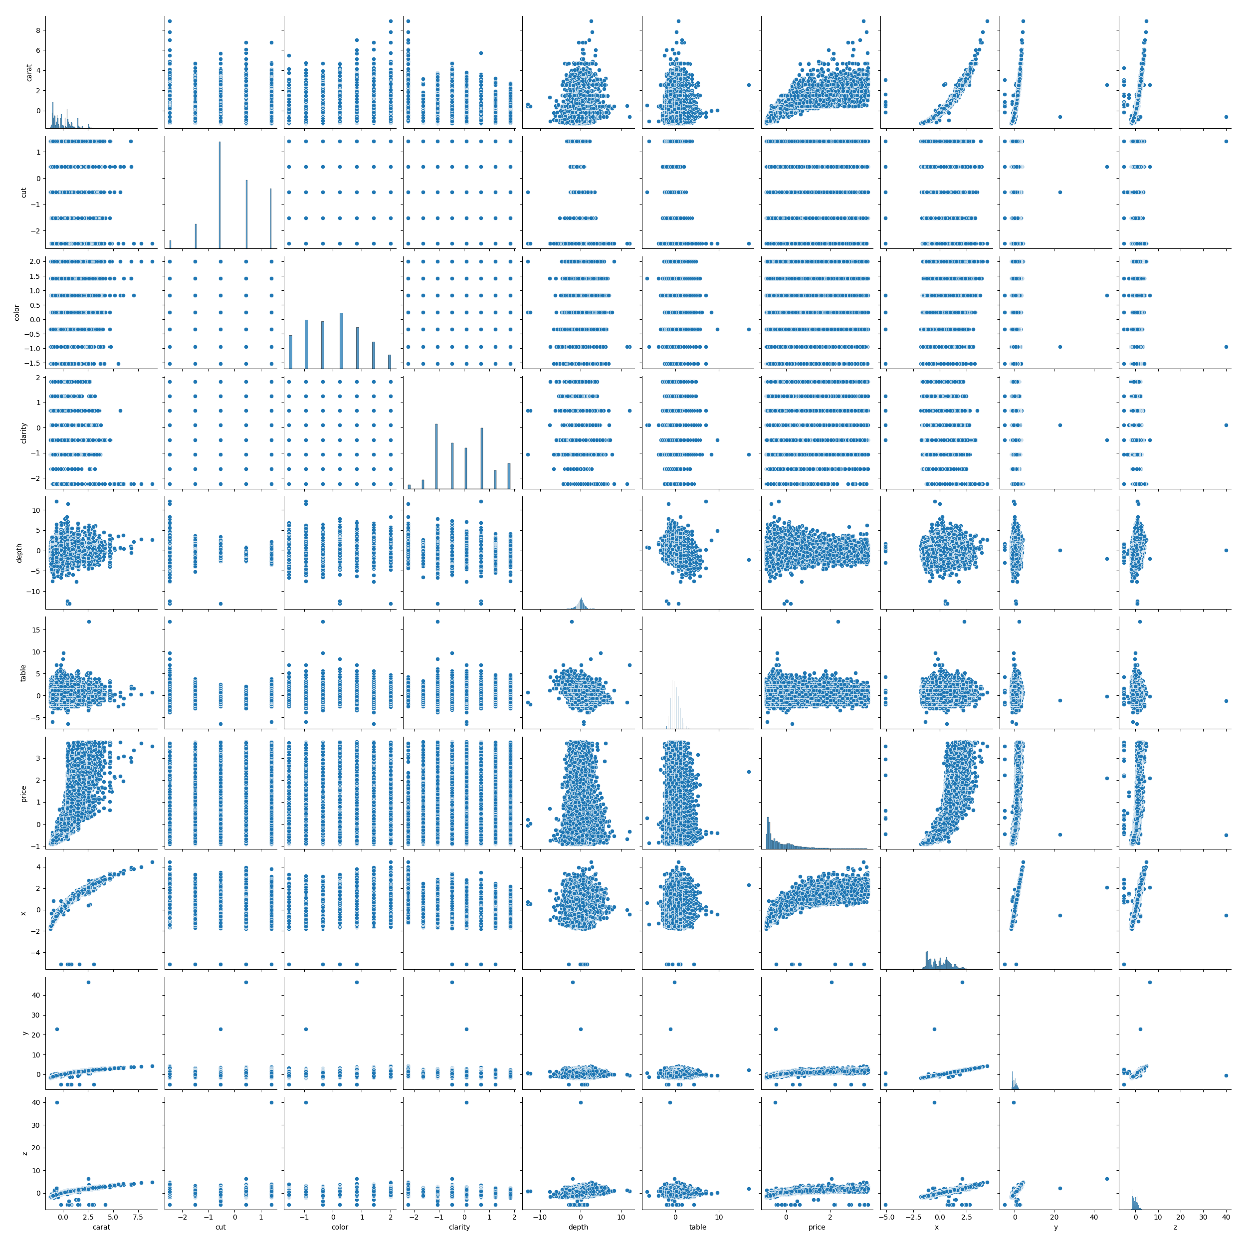

Slide 8
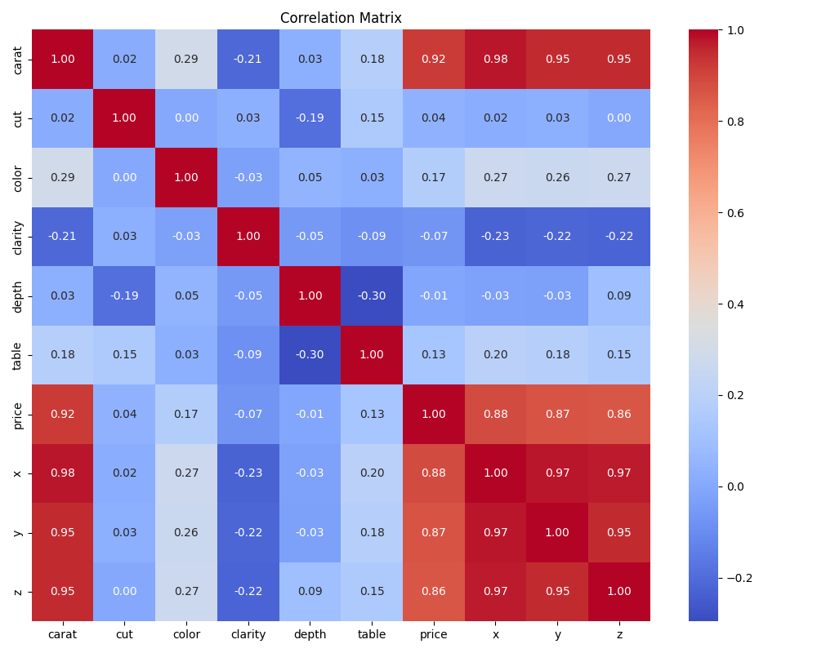

Slide 9
Classifier Module for Cut Prediction
Scope: Classifier.py and classification flow in main.py:135
Bullets:
Encapsulates supervised classification workflow around a target label.
Supports multiple algorithms via model factory:
Logistic Regression
KNN Classifier
Decision Tree
Random Forest
SVC
ANN (TensorFlow/Keras)
Provides unified fit, predict, and score interfaces.
Includes KNN tuning utility to select best neighbor count.
Supports metric evaluation:
Accuracy
Macro F1
Macro Precision
Macro Recall
Generates confusion matrix visualization for error analysis.

Slide 10
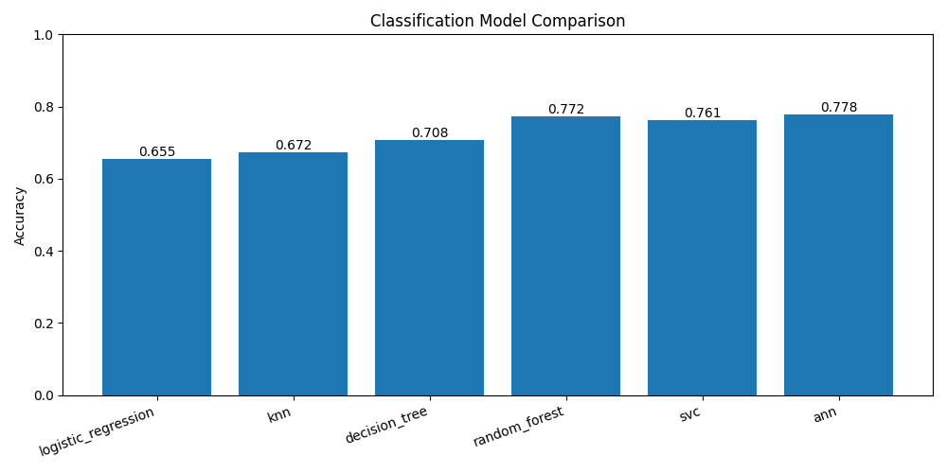

Slide 11
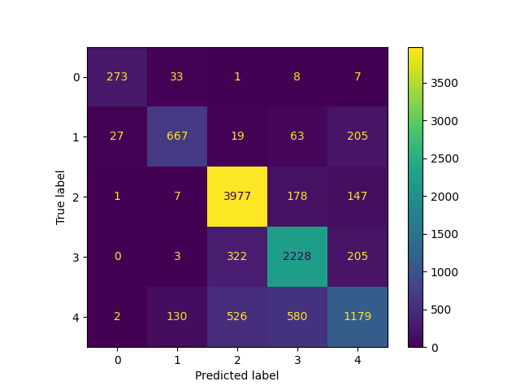

Slide 12
Enable users to enter diamond features (sample form or JSON) and get predicted Cut quality using saved ANN model bundle.
ANN Inference Test Flow using predict_svc.py
User sample form fields (example)
carat: 0.70
color: E
clarity: VS2
depth: 61.5
table: 57
x: 5.70
y: 5.72
z: 3.52
Expected output
Predicted cut: Ideal (example)

Slide 13
QA

Slide 14
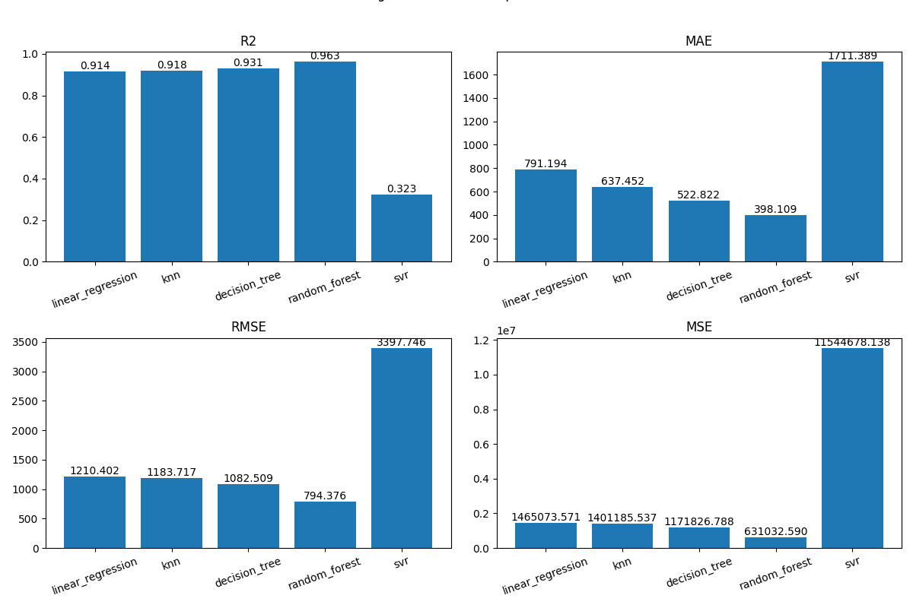
Appendix

