Slide 1


CLICK-N-SHIP
Group Members
Arshdeep Singh
Harsaroop Singh
Elias Khan
Daljeet Singh
Paramjot Singh Chattha

Slide 2


Contents
Our Goals
Used Technologies
Architecture
Framework
Future Plan
Conclusion

Slide 3
FEATURES
Application would be useful for customers as well as sellers
Easy to use interface for end users
Wide range products could be listed on application
Eliminate cost by enabling manufacturers to directly list and sell their products

Slide 4

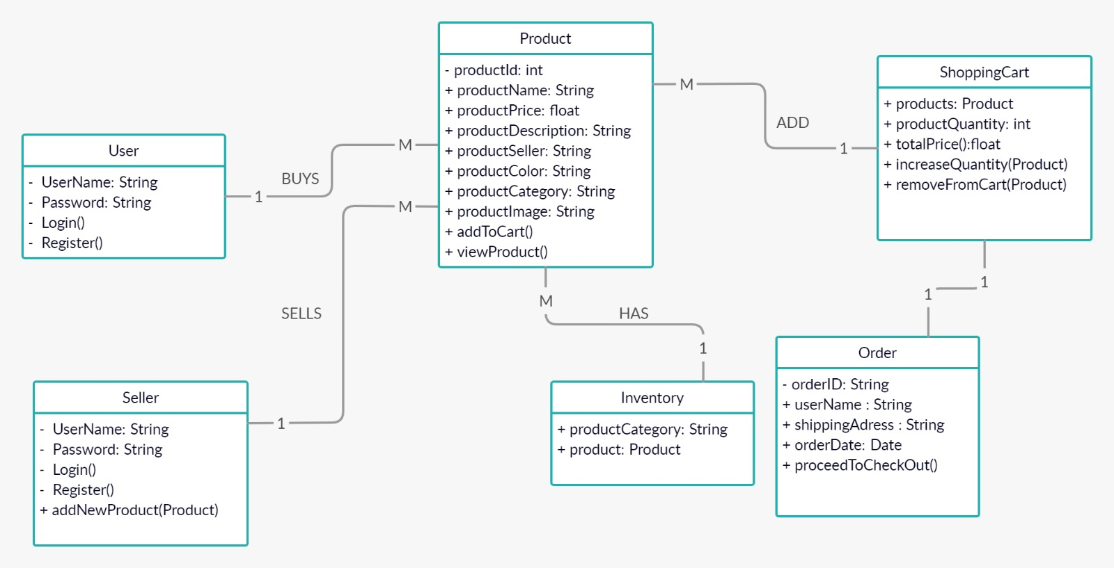
Architecture

Slide 5
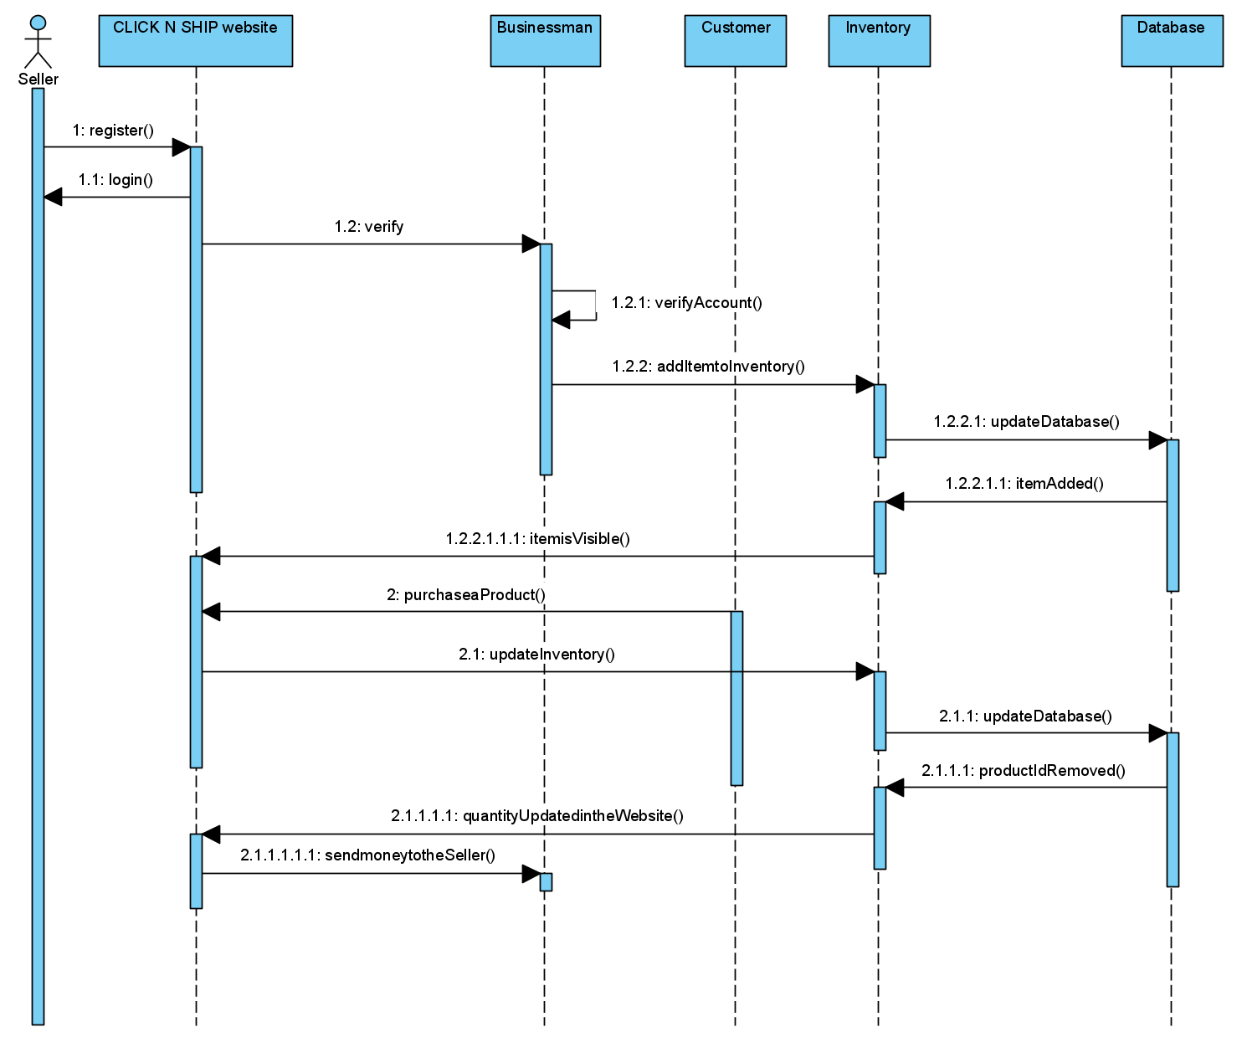

Slide 6
Frameworks and Technologies
Framework Used
Django – For back-end and databases
HTML, CSS (Bootstrap), JavaScript – For Front-end
Technologies
Sqlite – Database
Github – For code repository and issues handling
Microsoft Teams – For team discussions and meetings

Slide 7
Future Plans
We are planning to make this a full-fledged e-commerce website in future and our plans are
More test cases – Our test cases for the current version are for very basic functionalities and we plan to elaborate on that
Adding Better UI/UX – Since our current version project has a good ground work we plan to now focus on the UI of the project and make it more presentable
Seller View – This would enable seller to keep track of all the products they have listed, no of products sold, their total profit and many more.
Checkout Option – This would enable users to buy the product by entering their information and then make payment for their purchase.

Slide 8
Conclusion
We were able to develop a strong base for the web applications by using technologies that are most in use these days. We chose Django because it is an MVC framework and Bootstrap to make elegant UI/UX. Since we spent most of our times last 3 months on back-end and integrating part we still have many things to update in our UI and that will be done in future iterations of the project.

