Slide 1
Project Presentation
ECE1724
Amapreet Singh, 1002513764

Slide 2
Introduction
The purpose of the project is to study the performance of the American Fuzzy Lop fuzzer when the American Fuzzy Lop fuzzer completes the fuzzing of the input program with the inputs that are placed on multiple machines [1].
The technical challenge of the project could be to implement a system with a simple Application Programming Interface that enables users to complete the fuzzing of the input program with multi-system parallelization of the American Fuzzy Lop fuzzer.
The study of the performance of the American Fuzzy Lop fuzzer would be to evaluate the attributes of the American Fuzzy Lop coverage that includes the total paths, the total crashes, and the unique crashes.

Slide 3
Background
MapReduce: Simplified Data Processing on Large Clusters [2].
AFLplusplus [3].
roving [4].
disfuzz-afl [5].

Slide 4
Implementation status
The project includes running the American Fuzzy Lop fuzzer with the GNU Coreutils input programs named base64, md5sum, uniq and who on multiple Google Cloud Platform machines [6].
The design of the system includes multiple Google Cloud Platform machines that are the worker machines with one Google Cloud Platform machine that is the primary machine that orchestrates the operations of the American Fuzzy Lop fuzzer on the worker Google Cloud Platform machines.
The results of the American Fuzzy Lop fuzzer is obtained after logging the attributes of the American Fuzzy Lop coverage that includes the total paths, the total crashes, and the unique crashes during the runtime of the American Fuzzy Lop fuzzer.

Slide 5
Experimental methodology
Run the American Fuzzy Lop fuzzer on one Google Cloud Platform machine.
Start and bootstrap the primary Google Cloud Platform machine.
Start the worker Google Cloud Platform machines from the Google Cloud Platform primary machine.
Obtain the results of the American Fuzzy Lop fuzzer with the GNU Coreutils programs.
Read the results of the American Fuzzy Lop fuzzer that was obtained from the worker Google Cloud Platform machine and indicate the combined results of the American Fuzzy Lop fuzzer.

Slide 6
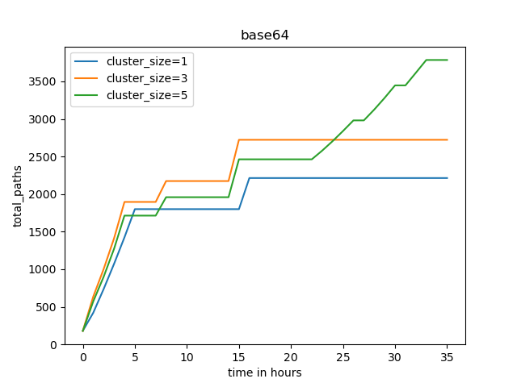
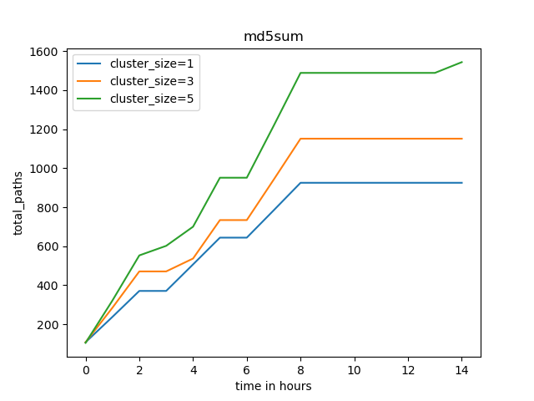
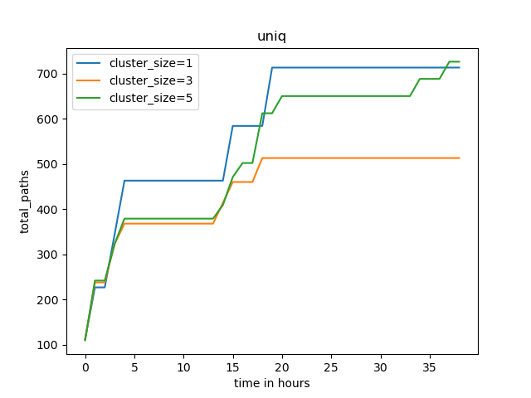
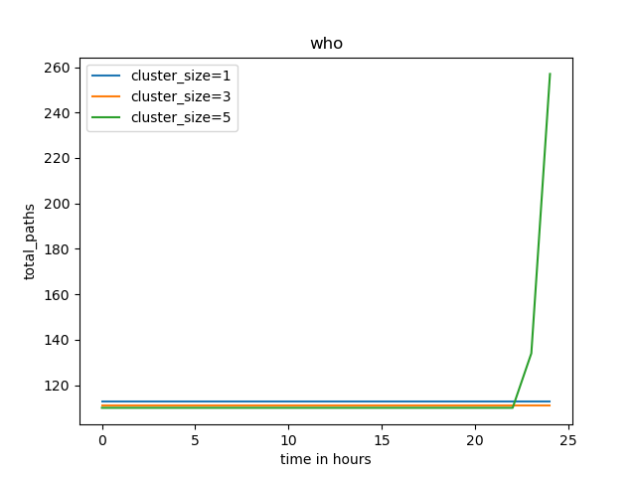
Results

Slide 7
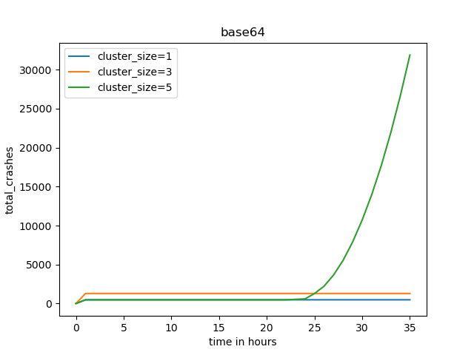
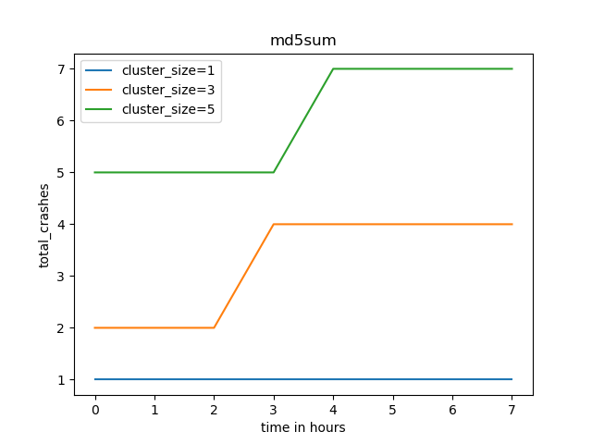
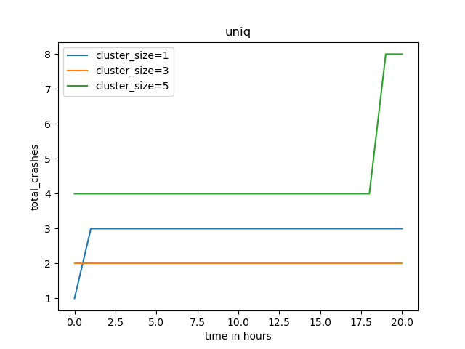
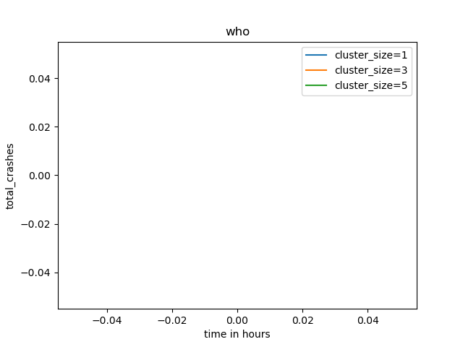
Results

Slide 8
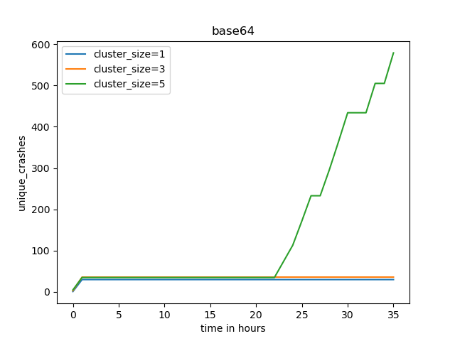



Results

Slide 9
Conclusion
The actual result of the project corresponds with the expected result of the project, where the expected result of the projected indicated that the performance of the American Fuzzy Lop fuzzer would improve when the inputs of the American Fuzzy Lop fuzzer input program are placed on multiple machines in order to complete the fuzzing of the input program.

Slide 10
Future work
The first next step of the project could be to obtain the efficiency of running the American Fuzzy Lop fuzzer on multiple machines after determining the results of the American Fuzzy Lop fuzzer after running multiple instances of the fuzzer on one machine.
The second next step of the project could be to filter out the duplicates in the total paths attribute of the American Fuzzy Lop coverage.
The third next step of the project could be to adjust the primary Google Cloud Platform to combine the results of the American Fuzzy Lop fuzzer that are on multiple machines in order to run the program named afl-cov [9].

Slide 11
References
[1] “american fuzzy lop,” GitHub, Nov. 30, 2021. https://github.com/google/AFL (accessed Feb. 10, 2023).
[2] Jeffrey Dean and Sanjay Ghemawat. 2008. MapReduce: simplified data processing on large clusters. Commun. ACM 51, 1 (January 2008), 107–113. https://doi.org/10.1145/1327452.1327492 (accessed Feb. 10, 2023).
[3] “Parallel Fuzzing,” AFLplusplus. https://aflplus.plus/docs/parallel_fuzzing/ (accessed Mar. 15, 2023).
[4] richö butts, “Roving,” GitHub, Dec. 06, 2022. https://github.com/richo/roving (accessed Mar. 15, 2023).
[5] M. Bogaard, “Distributed Fuzzing for afl,” GitHub, Mar. 13, 2023. https://github.com/MartijnB/disfuzz-afl (accessed Mar. 15, 2023).
[6] “GNU Coreutils 9.1,” www.gnu.org. https://www.gnu.org/software/coreutils/manual/coreutils.html#who-invocation (accessed Feb. 10, 2023).
[7] Mrash, “Mrash/AFL-COV: Produce code coverage results with gcov from AFL-fuzz test cases,” GitHub. [Online]. Available: https://github.com/mrash/afl-cov. (accessed: APr. 9, 2023).

