Slide 1
Developing a State-of-the-Art Question Answering Model Using the Quora Question
A Machine Learning Approach for Human-Like Interaction
Presenter's Name: Shashibhushan Singh
Date: 28/07/2024

Slide 2
Introduction
Objective:
Develop an AI system capable of understanding and generating accurate responses to user queries.
Mimic human-like interaction using the Quora Question Answer Dataset.
Motivation:
Enhance user experience in automated systems.
Improve response accuracy in QA systems.

Slide 3
Dataset Overview
Dataset Source: Quora Question Answer Dataset from Hugging Face.
Data set: https://huggingface.co/datasets/toughdata/quora-question-answer-dataset
Data Description:
Contains pairs of questions and answers.
Used for training, validating, and testing the model.

Slide 4
Data Exploration
Data Structure:
Columns: question, answer, etc.
Example entries for better understanding.
Initial Insights:
Distribution of question lengths.
Distribution of answer lengths.

Slide 5
Data Preprocessing
Steps Taken:
Tokenization using AutoTokenizer.
Splitting dataset into training and validation sets.
Preprocessing text (truncation, padding).

Slide 6
Model Selection
Chosen Model: BERT (Bidirectional Encoder Representations from Transformers).
Reasons:
State-of-the-art performance in NLP tasks.
Pre-trained on a large corpus, fine-tunable for specific tasks.

Slide 7
Training the Model
Training Details:
Training Arguments: learning rate, batch size, number of epochs, etc.
Trainer API from Hugging Face for model training.
Training Process:
Number of epochs.
Training and evaluation strategy.

Slide 8
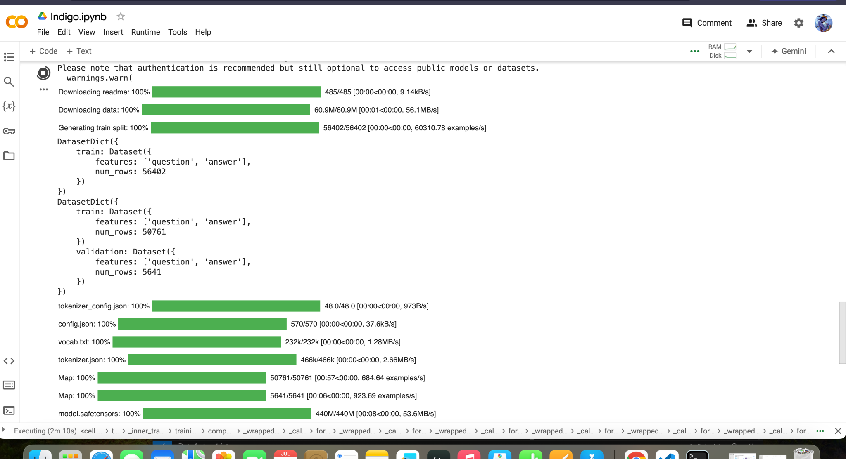

Slide 9
Model Evaluation
Evaluation Metrics:
ROUGE, BLEU, and F1-Score.
Results:
Summary of evaluation results.
Comparison with baseline models (if applicable).

Slide 10
Data Distribution Visualization
Visuals:
Histograms of question lengths.
Histograms of answer lengths.

Slide 11
Feature Importance Visualization
Word Clouds:
Word cloud for most common words in questions.
Word cloud for most common words in answers.

Slide 12
Model Performance Visualization
Training and Validation Loss:
Line charts showing loss over epochs.
Evaluation Metrics:
Line charts showing F1-score over epochs.

Slide 13
Insights and Recommendations
Key Insights:
Patterns observed in question and answer distributions.
Model performance trends.
Recommendations:
Possible improvements in preprocessing steps.
Future work to enhance model accuracy.

Slide 14
Flask Integration
Backend Integration:
Overview of Flask API setup.
Endpoints for making predictions.
Demo:
Live demonstration of the model making predictions via the API.

Slide 15
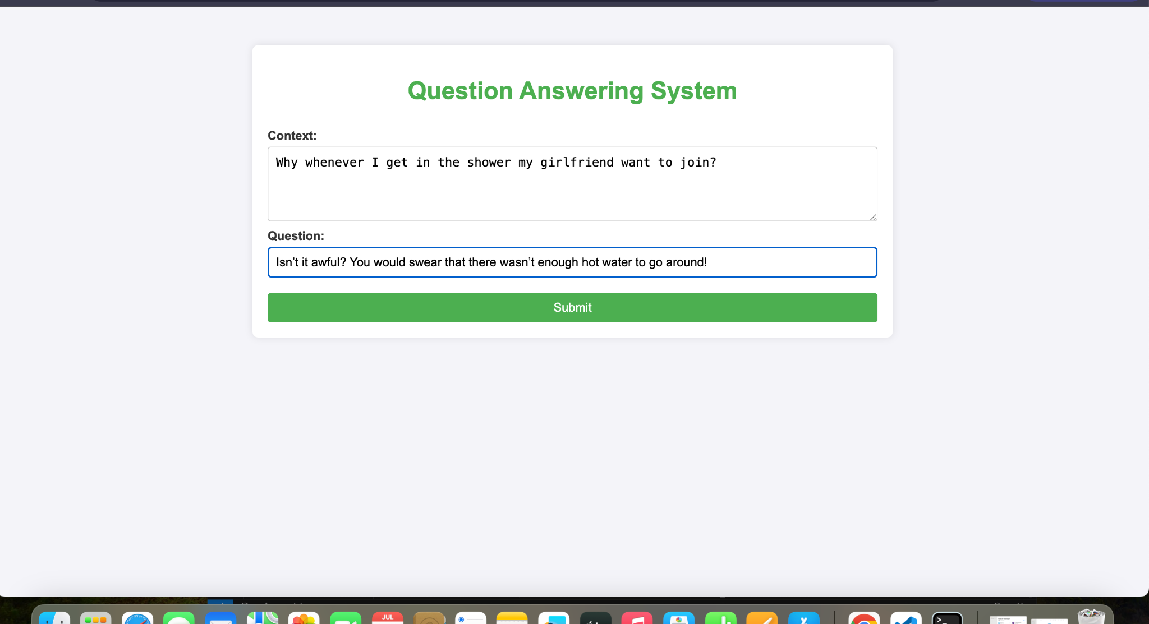

Slide 16
References
Sources:
Dataset: Hugging Face - Quora Question Answer Dataset.
Tools and Libraries: Transformers, PyTorch, Matplotlib, Seaborn, Plotly.

Slide 17
Thank you!!

