Slide 1
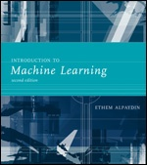
INTRODUCTION TO Machine Learning 2nd Edition
Lecture Slides for
ETHEM ALPAYDIN
© The MIT Press, 2010
alpaydin@boun.edu.tr
http://www.cmpe.boun.edu.tr/~ethem/i2ml2e

Slide 2
CHAPTER 13: Kernel Machines

Slide 3
Kernel Machines
Discriminant-based: No need to estimate densities first
Define the discriminant in terms of support vectors
The use of kernel functions, application-specific measures of similarity
No need to represent instances as vectors
Convex optimization problems with a unique solution

Slide 4
Optimal Separating Hyperplane
(Cortes and Vapnik, 1995; Vapnik, 1995)
Lecture Notes for E Alpaydın 2010 Introduction to Machine Learning 2e © The MIT Press (V1.0)

Slide 5
Margin
Distance from the discriminant to the closest instances on either side
Distance of x to the hyperplane is
We require
For a unique sol’n, fix ρ||w||=1, and to max margin
Lecture Notes for E Alpaydın 2010 Introduction to Machine Learning 2e © The MIT Press (V1.0)

Slide 6
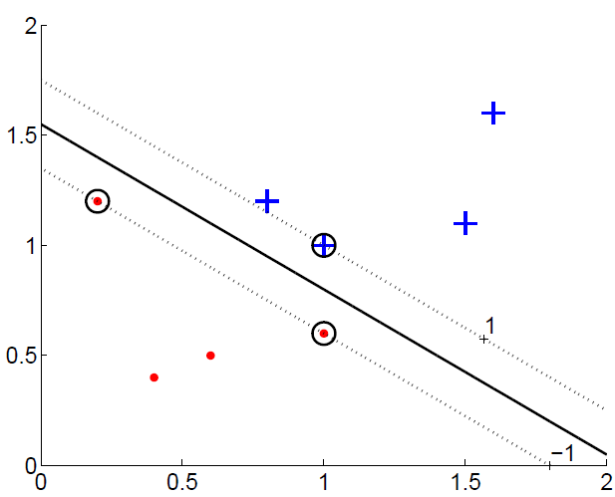
Margin

Slide 8
Most α^{t} are 0 and only a small number have α^{t} >0; they are the support vectors

Slide 9
Soft Margin Hyperplane
Not linearly separable
Soft error
New primal is

Slide 10
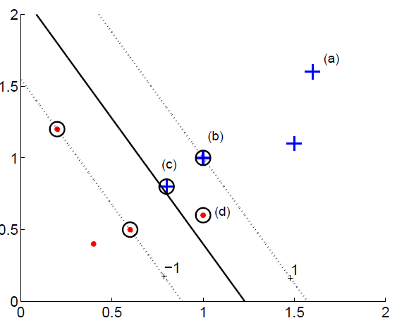

Slide 11
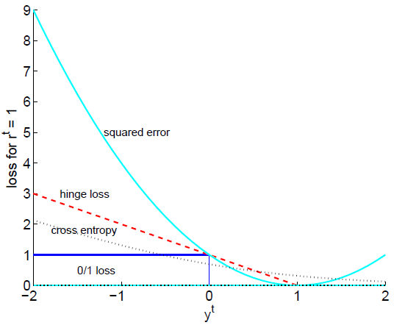
Hinge Loss

Slide 12
ν-SVM
ν controls the fraction of support vectors

Slide 13
Kernel Trick
Preprocess input x by basis functions
z = φ(x) g(z)=w^{T}z
g(x)=w^{T} φ(x)
The SVM solution

Slide 14
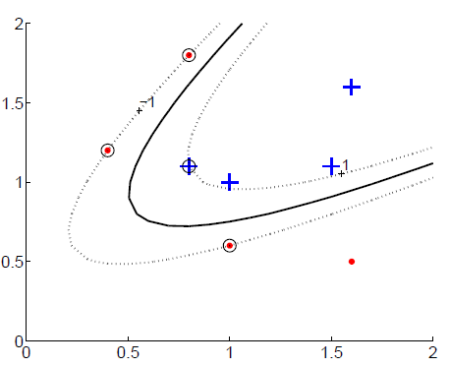
Vectorial Kernels
Polynomials of degree q:

Slide 15
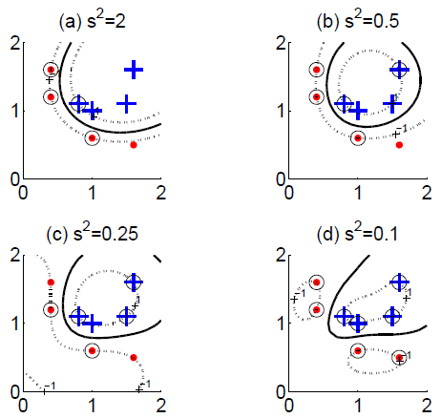
Vectorial Kernels
Radial-basis functions:

Slide 16
Defining kernels
Kernel “engineering”
Defining good measures of similarity
String kernels, graph kernels, image kernels, ...
Empirical kernel map: Define a set of templates m_{i} and score function s(x,m_{i})
φ(x^{t})=[s(x^{t},m₁), s(x^{t},m₂),..., s(x^{t},m_{M})]
and
K(x,x^{t})=φ (x)^{T} φ (x^{t})

Slide 17
Multiple Kernel Learning
Fixed kernel combination
Adaptive kernel combination
Localized kernel combination

Slide 18
Multiclass Kernel Machines
1-vs-all
Pairwise separation
Error-Correcting Output Codes (section 17.5)
Single multiclass optimization

Slide 19
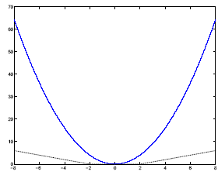
SVM for Regression
Use a linear model (possibly kernelized)
f(x)=w^{T}x+w₀
Use the є-sensitive error function

Slide 20
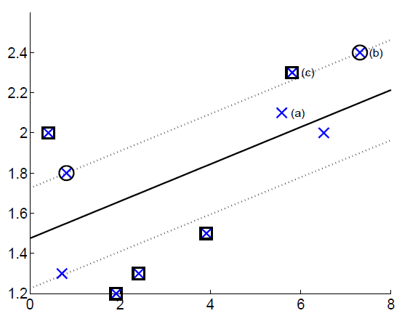

Slide 21
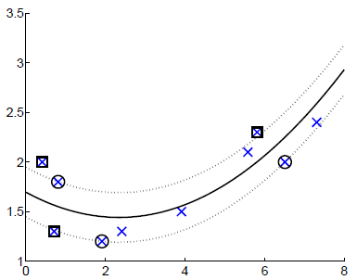
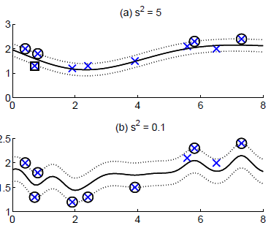
Kernel Regression
Polynomial kernel
Gaussian kernel

Slide 22
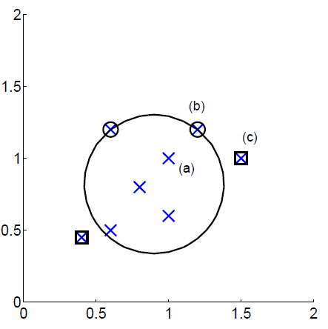
One-Class Kernel Machines
Consider a sphere with center a and radius R

Slide 23
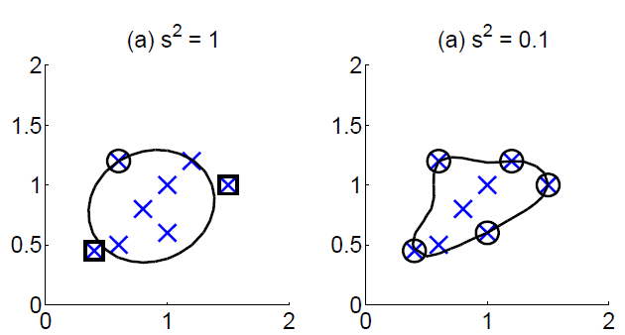

Slide 24
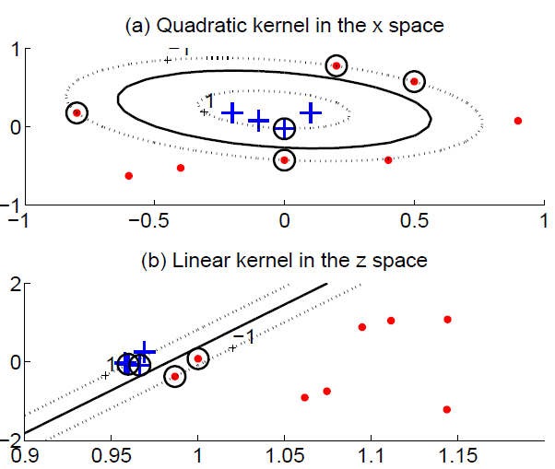
Kernel Dimensionality Reduction
Kernel PCA does PCA on the kernel matrix (equal to canonical PCA with a linear kernel)
Kernel LDA

