Slide 1
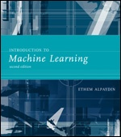
INTRODUCTION TO Machine Learning 2nd Edition
Lecture Slides for
ETHEM ALPAYDIN
© The MIT Press, 2010
alpaydin@boun.edu.tr
http://www.cmpe.boun.edu.tr/~ethem/i2ml2e

Slide 2
CHAPTER 4: Parametric Methods

Slide 3
Parametric Estimation
X = { x^{t} }_{t} where x^{t} ~ p (x)
Parametric estimation:
Assume a form for p (x |θ ) and estimate θ , its sufficient statistics, using X
e.g., N ( μ, σ²) where θ = { μ, σ²}

Slide 4
Maximum Likelihood Estimation
Likelihood of θ given the sample X
l (θ|X) = p (X |θ) = ∏_{t} p (x^{t}|θ)
Log likelihood
L(θ|X) = log l (θ|X) = ∑_{t} log p (x^{t}|θ)
Maximum likelihood estimator (MLE)
θ* = argmax_{θ} L(θ|X)

Slide 5
Examples: Bernoulli/Multinomial
Bernoulli: Two states, failure/success, x in {0,1}
P (x) = p_{o}^{x} (1 – p_{o} ) ^{(1 – x)}
L (p_{o}|X) = log ∏_{t} p_{o}^{xt} (1 – p_{o} ) ^{(1 – xt)}
MLE: p_{o} = ∑_{t} x^{t} / N
Multinomial: K>2 states, x_{i} in {0,1}
P (x₁,x₂,...,x_{K}) = ∏_{i} p_{i}^{xi}
L(p₁,p₂,...,p_{K}|X) = log ∏_{t} ∏_{i} p_{i}^{xit}
MLE: p_{i} = ∑_{t} x_{i}^{t} / N

Slide 6
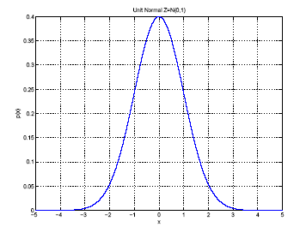
Gaussian (Normal) Distribution
p(x) = N ( μ, σ²)
MLE for μ and σ²:
μ
σ

Slide 7
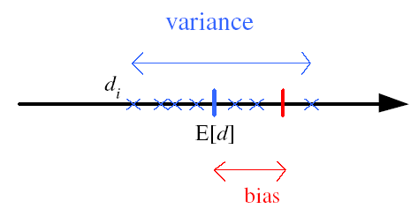
Bias and Variance
Unknown parameter θ
Estimator d_{i} = d (X_{i}) on sample X_{i}
Bias: b_{θ}(d) = E [d] – θ
Variance: E [(d–E [d])²]
Mean square error:
r (d,θ) = E [(d–θ)²]
= (E [d] – θ)² + E [(d–E [d])²]
= Bias² + Variance
θ

Slide 8
Bayes’ Estimator
Treat θ as a random var with prior p (θ)
Bayes’ rule: p (θ|X) = p(X|θ) p(θ) / p(X)
Full: p(x|X) = ∫ p(x|θ) p(θ|X) dθ
Maximum a Posteriori (MAP): θ_{MAP} = argmax_{θ} p(θ|X)
Maximum Likelihood (ML): θ_{ML} = argmax_{θ} p(X|θ)
Bayes’: θ_{Bayes’} = E[θ|X] = ∫ θ p(θ|X) dθ

Slide 9
Bayes’ Estimator: Example
x^{t} ~ N (θ, σ_{o}²) and θ ~ N ( μ, σ²)
θ_{ML} = m
θ_{MAP} = θ_{Bayes’} =

Slide 10
Parametric Classification

Slide 11
Given the sample
ML estimates are
Discriminant becomes

Slide 12
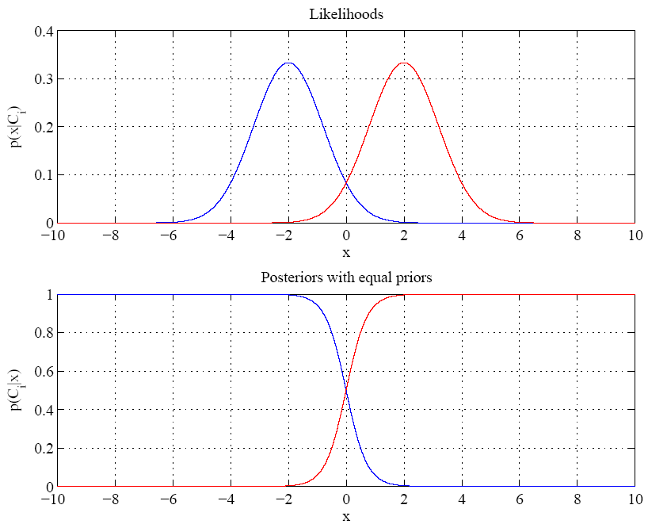
Equal variances
Single boundary at
halfway between means

Slide 13
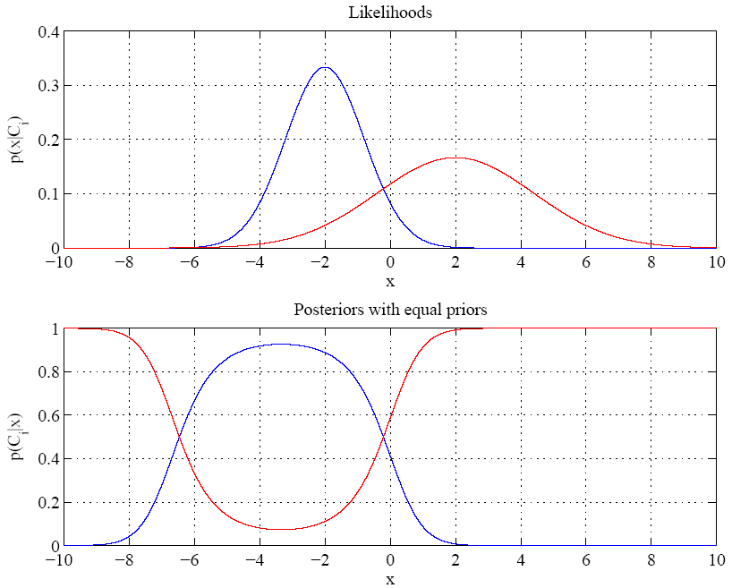
Variances are different
Two boundaries

Slide 14
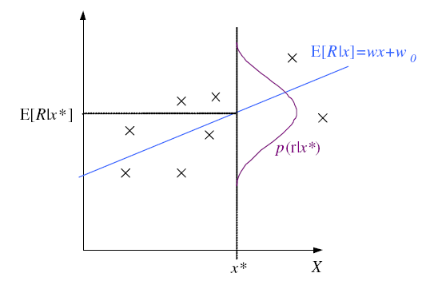
Regression

Slide 15
Regression: From LogL to Error

Slide 16
Linear Regression

Slide 17
Polynomial Regression

Slide 18
Other Error Measures
Square Error:
Relative Square Error:
Absolute Error: E (θ |X) = _{∑t} |r^{t} – g(x^{t}| θ)|
ε-sensitive Error:
E (θ |X) = _{∑ t} 1(|r^{t} – g(x^{t}| θ)|>ε) (|r^{t} – g(x^{t}|θ)| – ε)

Slide 19
Bias and Variance
noise
squared error
bias
variance

Slide 20
Estimating Bias and Variance
M samples X_{i}={x^{t}_{i} , r^{t}_{i}}, i=1,...,M
are used to fit g_{i} (x), i =1,...,M

Slide 21
Bias/Variance Dilemma
Example: g_{i}(x)=2 has no variance and high bias
g_{i}(x)= _{∑t} r^{t}_{i}/N has lower bias with variance
As we increase complexity,
bias decreases (a better fit to data) and
variance increases (fit varies more with data)
Bias/Variance dilemma: (Geman et al., 1992)

Slide 22
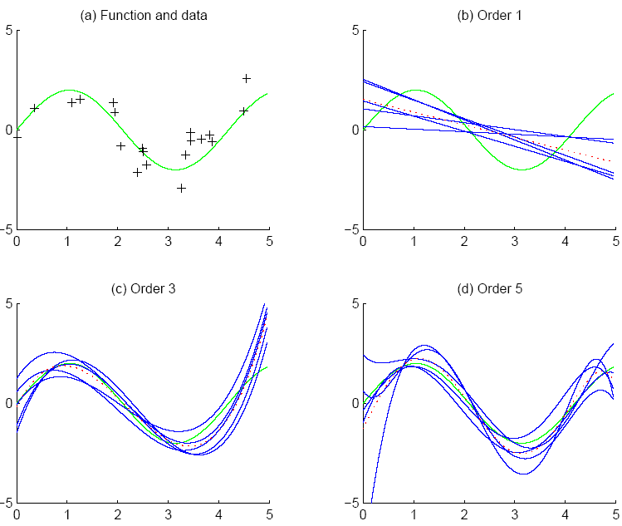
f
f
bias
g_{i}
g
variance

Slide 23
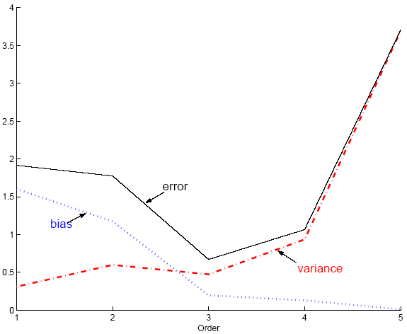
Polynomial Regression
Best fit “min error”

Slide 24
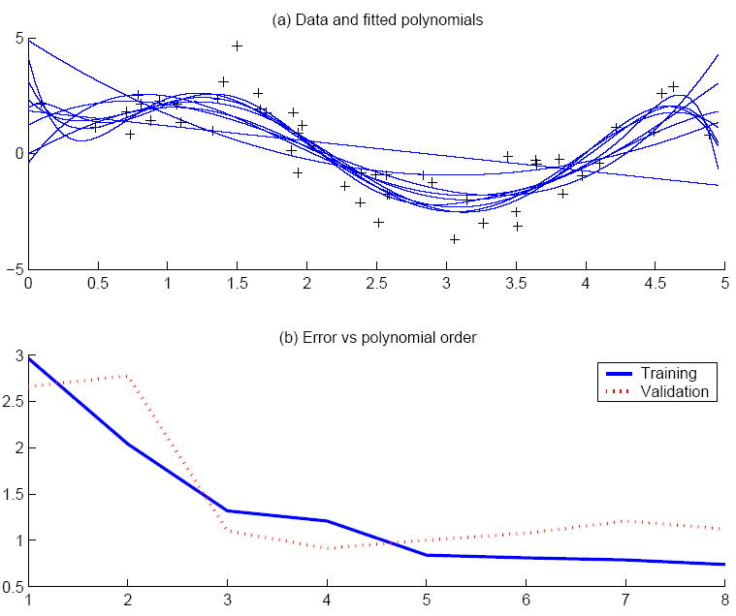
Best fit, “elbow”

Slide 25
Model Selection
Cross-validation: Measure generalization accuracy by testing on data unused during training
Regularization: Penalize complex models
E’=error on data + λ model complexity
Akaike’s information criterion (AIC), Bayesian information criterion (BIC)
Minimum description length (MDL): Kolmogorov complexity, shortest description of data
Structural risk minimization (SRM)

Slide 26
Bayesian Model Selection
Prior on models, p(model)
Regularization, when prior favors simpler models
Bayes, MAP of the posterior, p(model|data)
Average over a number of models with high posterior (voting, ensembles: Chapter 17)

Slide 27
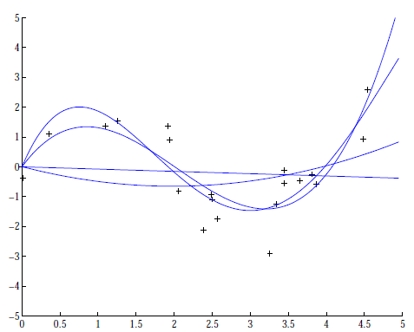
Regression example
Coefficients increase in magnitude as order increases:
1: [-0.0769, 0.0016]
2: [0.1682, -0.6657, 0.0080]
3: [0.4238, -2.5778, 3.4675, -0.0002
4: [-0.1093, 1.4356,
-5.5007, 6.0454, -0.0019]

