Slide 1
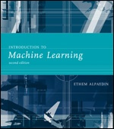
INTRODUCTION TO Machine Learning 2nd Edition
Lecture Slides for
ETHEM ALPAYDIN
© The MIT Press, 2010
alpaydin@boun.edu.tr
http://www.cmpe.boun.edu.tr/~ethem/i2ml2e

Slide 2
CHAPTER 8: Nonparametric Methods

Slide 3
Nonparametric Estimation
Parametric (single global model), semiparametric (small number of local models)
Nonparametric: Similar inputs have similar outputs
Functions (pdf, discriminant, regression) change smoothly
Keep the training data;“let the data speak for itself”
Given x, find a small number of closest training instances and interpolate from these
Aka lazy/memory-based/case-based/instance-based learning

Slide 4
Density Estimation
Given the training set X={x^{t}}_{t} drawn iid from p(x)
Divide data into bins of size h
Histogram:
Naive estimator:
or

Slide 5
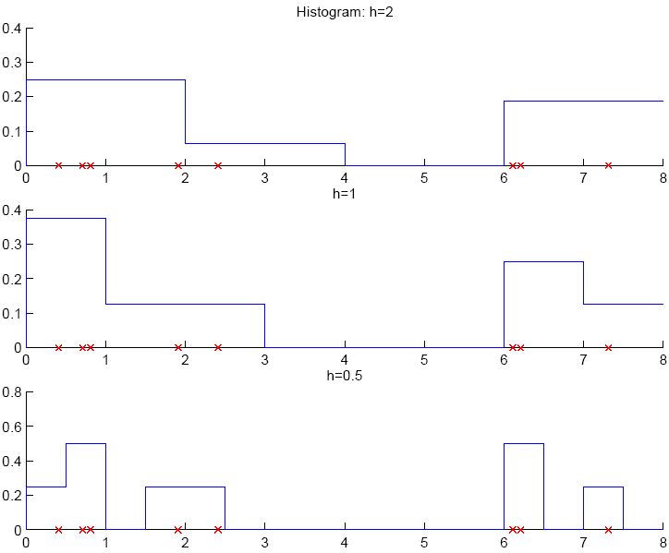

Slide 6
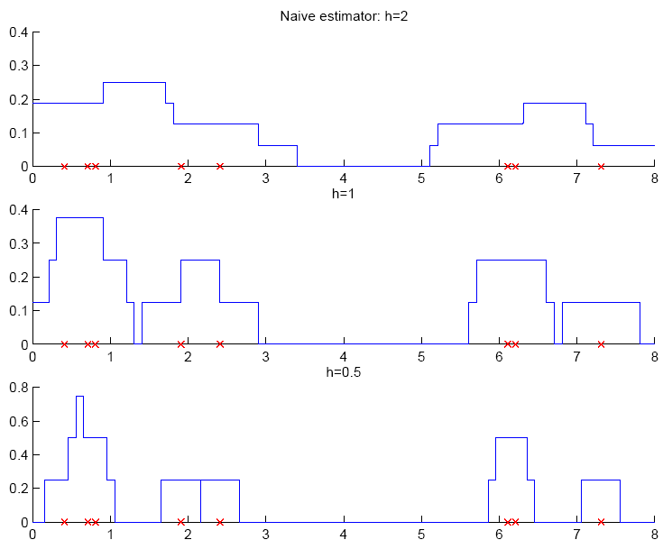

Slide 7
Kernel Estimator
Kernel function, e.g., Gaussian kernel:
Kernel estimator (Parzen windows)

Slide 8
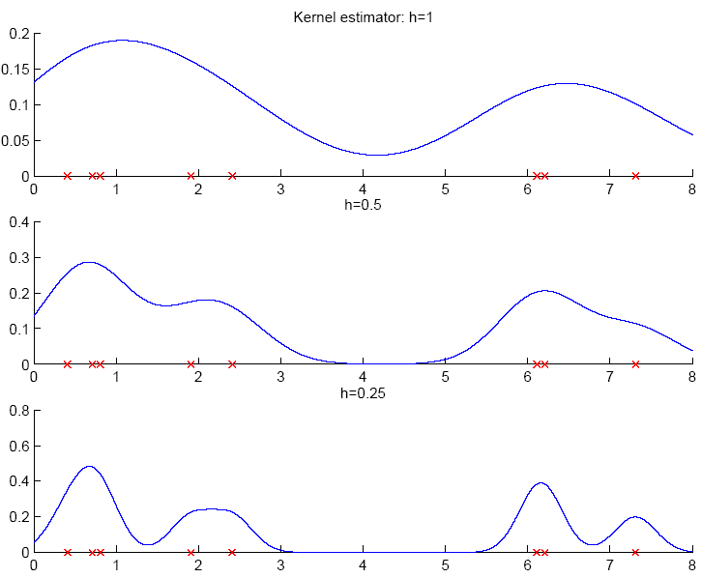

Slide 9
k-Nearest Neighbor Estimator
Instead of fixing bin width h and counting the number of instances, fix the instances (neighbors) k and check bin width
d_{k}(x), distance to kth closest instance to x

Slide 10
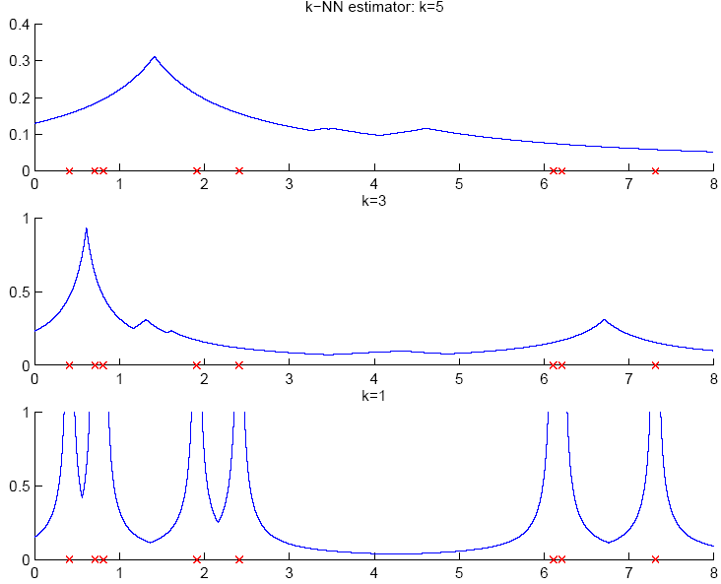

Slide 11
Multivariate Data
Kernel density estimator
Multivariate Gaussian kernel
spheric
ellipsoid

Slide 12
Nonparametric Classification
Estimate p(x|C_{i}) and use Bayes’ rule
Kernel estimator
k-NN estimator

Slide 13
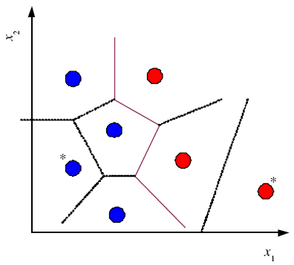
Condensed Nearest Neighbor
Time/space complexity of k-NN is O (N)
Find a subset Z of X that is small and is accurate in classifying X (Hart, 1968)

Slide 14
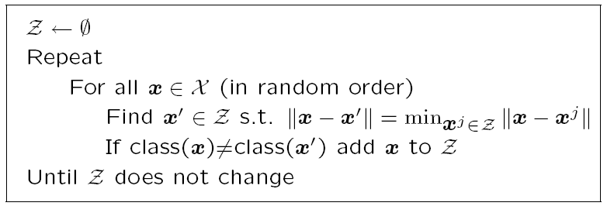
Condensed Nearest Neighbor
Incremental algorithm: Add instance if needed

Slide 15
Nonparametric Regression
Aka smoothing models
Regressogram

Slide 16
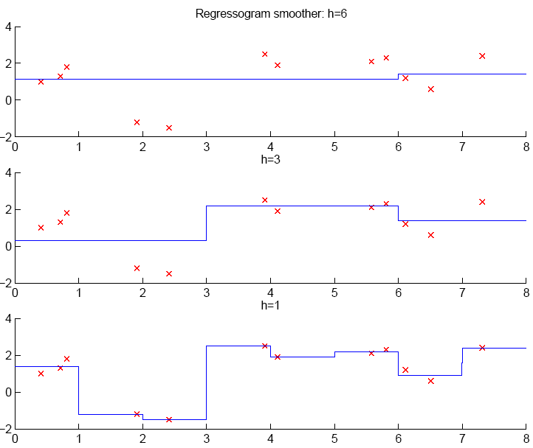

Slide 17
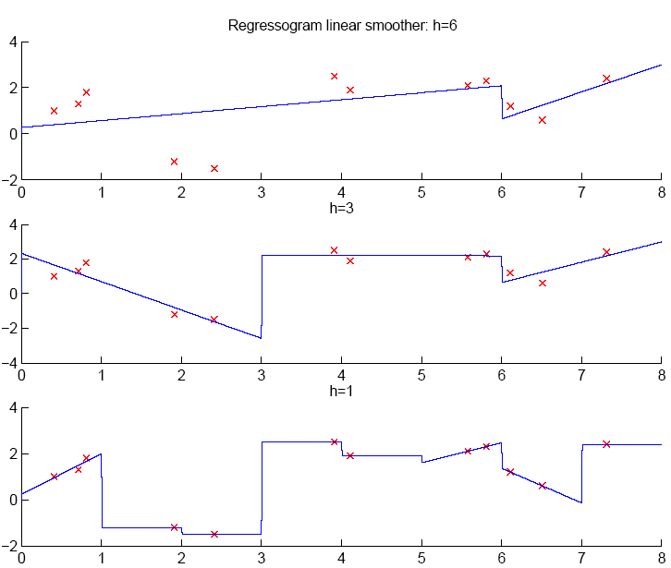

Slide 18
Running Mean/Kernel Smoother
Running mean smoother
Running line smoother
Kernel smoother
where K( ) is Gaussian
Additive models (Hastie and Tibshirani, 1990)

Slide 19
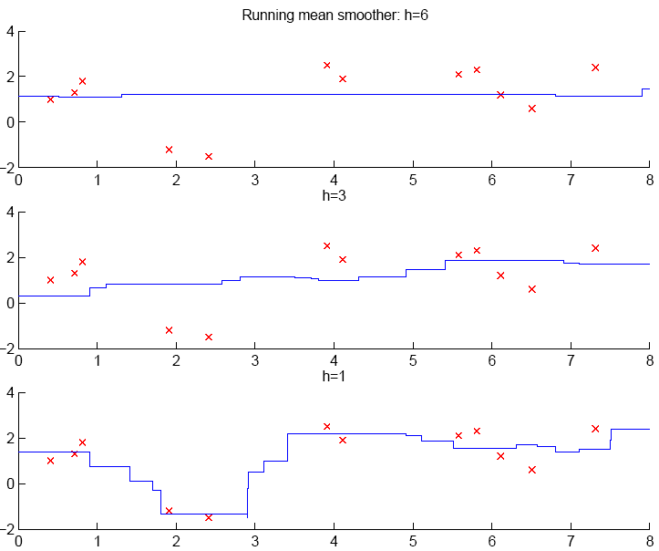

Slide 20
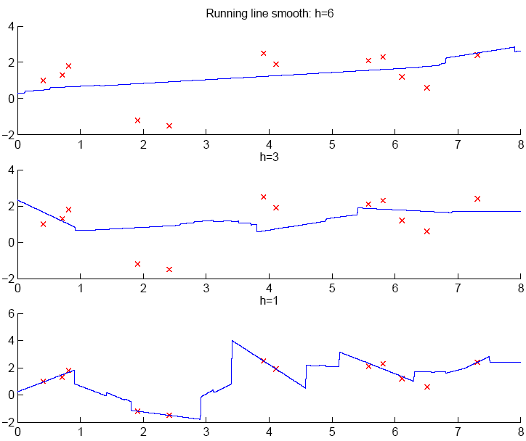

Slide 21
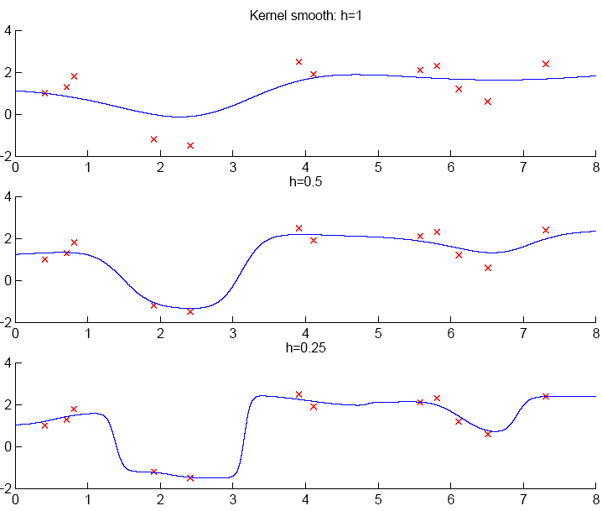

Slide 22
How to Choose k or h?
When k or h is small, single instances matter; bias is small, variance is large (undersmoothing): High complexity
As k or h increases, we average over more instances and variance decreases but bias increases (oversmoothing): Low complexity
Cross-validation is used to finetune k or h.

Slide 23
