Slide 1
OpenCL

Slide 2
OpenCL - Benedict R. Gaster, Lee Howes, David R, Perhaad Mistry, Dana Schaa, “Heterogeneous Computing with OpenCL”, Elsevier Inc., 1st Edition, 2012.

Slide 3
OpenCL Introduction
Open Computing Language is a heterogeneous programming framework that is managed by Khronos group.
OpenCL is a framework for developing applications that execute across a range of device type made by different vendors.

Slide 4
OpenCL specifications
It is defined in 4 parts called Models.
Platform Model: Specifies that there is one processor coordinating the execution (the host) and one or more processors capable of executing OpenCL C code(the devices).

Slide 5
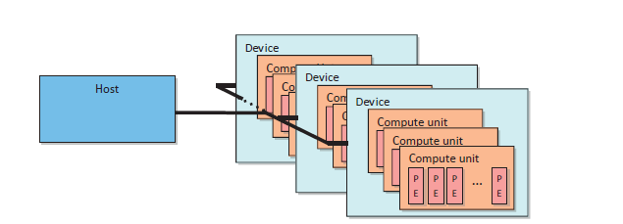
Host-Device Interaction

Slide 6
OpenCL specifications
Execution Model: Defines how the OpenCL environment is configured on the host and how kernels are executed on the device.
This includes
setting up on OpenCL context on the host
providing mechanisms for host-device interaction
Defining a concurrency model used for execution on devices

Slide 7
OpenCL specifications
Memory Model: Defines the abstract memory hierarchy that kernels use regardless of the actual underlying memory architecture.
Programming Model: Define how the concurrency model is mapped to physical hardware

Slide 8
Platform and Devices
Defines the roles of the host and devices & provides an abstract hardware model for devices.
Devices that a platform can target are limited to those with which a vendor knows how to interact.
If company A’s platform is chosen, it can’t communicate with company B’s GPU.

Slide 9
Platform and Devices
Platform model defines a device as an array of compute units, with each compute unit functionally independent from the rest.
These compute units are further divided into processing elements.

Slide 10
Host-Device Interaction

Slide 11
Step 1: Discover & initialize platforms
clGetPlatformIDs() – It is used to discover the set of available platforms for a given system.
This function will be called twice by an application.
The first call passes an unsigned int pointer as the num_platforms argument and NULL is passed as a platform’s argument.
The pointer is populated with the available number of platforms.
Then the programmer can allocate space to hold the platform information.

Slide 12
Step 1:Discover & Initialize Platforms
cl_int clGetPlatformIDs(
cl_uint num_entries,
cl_platform_id *platforms,
cl_uint *num_platforms);

Slide 13
Step 1:Discover & Initialize Platforms
cl_uint num_platforms=0;
cl_platform_id *platforms =NULL;
//to get number of platforms
status= clGetPlatformIDs(0,NULL,&num_platforms);
//Allocate enough space for each platform
platforms=(cl_platform_id*) malloc (num_platforms*sizeof(cl_platform_id));
status=clGetPlatformIDs(num_platforms, platforms, NULL);

Slide 14
Step 1:Discover & Initialize Platforms
cl_int clGetPlatformIDs(
cl_uint num_entries,
cl_platform_id *platforms,
cl_uint *num_platforms);
For the second call, cl_platform_id pointer is passed to function with enough space allocated for num_entries platforms.

Slide 15
clGetPlatformInfo()
Number of platforms: 1
Platform Profile: FULL_PROFILE
Platform Version: OpenCL 1.1 AMD-APP-SDK-v2.4
Platform Name: AMD Accelerated Parallel Processing
Platform Vendor: Advanced Micro Devices, Inc.

Slide 16
Step 2:Discover & initialize Devices
clGetDeviceIDs() call works very similar to clGetPlatformIDs(). It takes the additional arguments of a platform and a device type.
Device type argument can be used to limit the devices to GPUs only(CL_DEVICE_TYPE_GPU), CPUs only(CL_DEVICE_TYPE_CPU), all devices(CL_DEVICE_TYPE_ALL)

Slide 17
Step 2:Discover & initialize Devices
cl_int clGetDeviceIDs(
cl_platform_id platform,
cl_device_type device_type,
cl_uint num_entries,
cl_device_id *devices,
cl_uint *num_devices)

Slide 18
Step 2:Discover & initialize Devices
cl_int clGetDeviceIDs(
cl_platform_id platform,
cl_device_type device_type,
cl_uint num_entries,
cl_device_id *devices,
cl_uint *num_devices)

Slide 19
Step 2:Discover & initialize Devices
cl_unit num_devices=0;
cl_device_id *devices=NULL;
//to get number of devices
status=clGetDeviceIDs(platform[0],CL_DEVICE_TYPE_GPU,0,NULL,&num_devices);
//Allocate enough space for each device
devices=(cl_device_id*) malloc (num_devices *sizeof(cl_device_id));
status=clGetDeviceIDs(platform[0],CL_DEVICE_TYPE_GPU,num_devices,devices,NULL);

Slide 20
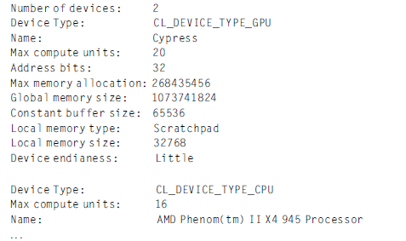
clGetDeviceInfo()

Slide 21
Execution Environment- Context
Context is an abstract container that exists on the host.
A context coordinates
the mechanisms for host-device interactions
Manages the memory objects that are available to the devices
Keep track of the programs and kernels that are created for each device

Slide 22
Step 3:Create a context
cl_context clCreateContext (
const cl_context_properties *properties,
cl_uint num_devices,
const cl_device_id *devices,
void (CL_CALLBACK *pfn_notify)( const char *errinfo, const void *private_info, size_t cb,
void *user_data),
void *user_data,
cl_int *errcode_ret)

Slide 23
Step 3:Create a context
The number and IDs of the devices that the programmer wants to associate with the context must be supplied.

Slide 24
Step 4: Create command queue
Communication with a device occurs by submitting commands to a command queue.
Once the host decides which devices to work with and a context is created, one command queue needs to be created per device.
Whenever the host needs an action to be performed by a device, it will submit commands to the proper command queue.

Slide 25
Step 4:Create a command queue
cl_command_queue
clCreateCommandQueue(
cl_context context,
cl_device_id device,
cl_command_queue_properties properties,
cl_int* errcode_ret)

Slide 26
Step 4:Create a command queue
The parameter properties by default is INORDER ie command queue commands are pulled from the queue in the order they were received.

Slide 27
Memory objects
In OpenCL the data needs to be physically present on a device before execution can begin.
In order for data to be transferred to a device it must first be encapsulated as a memory object.
2 types:
buffers
images

Slide 28
Buffers
Whenever a memory object is created, it is valid only within a single context.
If a kernel that is dependent on such a buffer is executed on a accelerator device such as a GPU, the buffer may be transferred to the device.
It is visible for all devices associated with the context.

Slide 29
Step 5:Create device buffers
cl_mem clCreateBuffer(
cl_context context,
cl_mem_flags flags,
size_t size,
void *host_ptr,
cl_int *errcode_ret)
flags can be CL_MEM_READ_ONLY or CL_MEM_WRITE_ONLY or CL_MEM_READ_WRITE

Slide 30
Step 6:Write host data to device buffers
Data contained in host memory is transferred to and from an OpenCL buffer using the commands clEnqueueWriteBuffer() and clEnqueueReadBuffer() respectively.

Slide 31
Step 6:Write host data to device buffers
cl_int clEnqueueWriteBuffer (
cl_command_queue command_queue,
cl_mem buffer,
cl_bool blocking_write,
size_t offset,
size_t cb,
const void *ptr,
cl_uint num_events_in_wait_list,
const cl_event *event_wait_list,
cl_event *event)

Slide 32
Step 6: Write host data to device buffers
blocking_write is set to CL_TRUE if the transfer into an OpenCL buffer should complete before function returns.
offset The offset in bytes in the buffer object to write to.
cb The size in bytes of data being written.
ptr The pointer to buffer in host memory where data is to be written from
If event_wait_list is NULL, then this particular command does not wait on any event to complete. If event_wait_list is NULL, num_events_in_wait_list must be 0.

Slide 33
Step 6: Write host data to device buffers
If event_wait_list is not NULL, the list of events pointed to by event_wait_list must be valid and num_events_in_wait_list must be greater than 0.
event Returns an event object that identifies this particular write command and can be used to query or queue a wait for this particular command to complete.

Slide 34
Creating a OpenCL program Object
OpenCL C code (written to run on an OpenCL device) is called a program.
A program is a collection of functions called kernels, where kernels are units of execution that can be scheduled to run on a device.
OpenCL programs are compiled at runtime through a series of API calls

Slide 35
Creating a OpenCL program Object
The process of creating a kernel is as follows:
The OpenCL C source code is stored in a character stream/string
The source code is turned into a program object cl_program by calling clCreateProgramWithSource()
The program object is then compiled for one of OpenCL devices with clBuildProgram()

Slide 36
Transfer kernel code to a character array
char *source_str;
size_t source_size;
fp = fopen(“vectadd.cl", "r");
if (!fp) {
fprintf(stderr, "Failed to load kernel.\n");
getchar();
exit(1);
}
source_str = (char*)malloc(MAX_SOURCE_SIZE);
source_size = fread( source_str, 1, MAX_SOURCE_SIZE, fp);
fclose( fp );

Slide 37
Step 7: Create and compile the program
cl_program clCreateProgramWithSource(
cl_context context,
cl_uint count,
const char** strings,
const size_t *lengths,
cl_int *errcode_ret);

Slide 38
Step 7: Create and compile the program
cl_int clBuildProgram(
cl_program program,
cl_uint num_devices,
cl_device_id * device_list,
const char *options, void (ptr_notify *) (cl_program, void *user_data), void *user_data)

Slide 39
Step 7: Create and compile the program
cl_program program= clCreateProgramWithSource(context,1,(const char **)&source_str, (const size_t *) &source_size, &status);
status=clBuildProgram(program, numDevices, devices, NULL,NULL,NULL);

Slide 40
Kernels & OpenCL execution Model
Kernels are the part of OpenCL program that actually executed on a device.

Slide 41
Kernels and the OpenCL Execution Model
// 3 versions of functions that Perform an element-wise addition of A and B and store in C.
// Serial or sequential version - There are N elements per array.
void vecadd(int *C, int* A, int *B, int N)
{
for(int i = 0; i < N; i++)
{
C[i] =A[i] + B[i];
}
}

Slide 42
Kernels and the OpenCL Execution Model
Threaded C implementation
// There are N elements per array and NP CPU cores.
void vecadd(int *C, int* A, int *B, int N, int NP, int tid)
{
int ept =N/NP; // elements per thread
for(int i =tid*ept; i < (tid+1)*ept; i++)
{
C[i] =A[i] + B[i];
}
}

Slide 43
OpenCL implementation
The unit of concurrent execution in OpenCL is a work item.
Single iteration of a loop is mapped to a work-item
We tell OpenCL runtime to generate as many work-items as elements in the input and output arrays and allow the runtime to map those work-items to the underlying hardware
get_global_id() will give the position of the current work item.

Slide 44
Kernels and the OpenCL Execution Model
OpenCL implementation
// N work-items will be created to execute this kernel.
Return type must be void
__kernel void vecadd(__global int *C, __global int* A, __global int *B)
{
int tid =get_global_id(0); // OpenCL intrinsic function
C[tid] = A[tid] + B[tid];
}

Slide 45
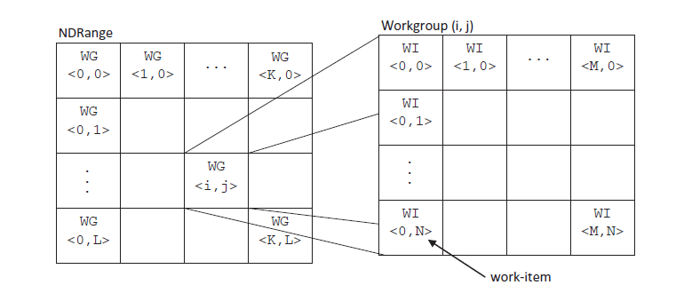
Work-items & Work groups

Slide 46
Create the Kernel
The final stage to obtain a CL kernel object that can be used to execute kernels on a device is to extract the kernel from the program object.
The name of the kernel is passed to clCreateKernel function along with the program object.
The kernel object will be retuned if the program object was valid and particular kernel is formed.

Slide 47
Step 8:Create the Kernel
cl_kernel clCreateKernel(
cl_program program,
const char* kernel_name ,
cl_int * errcode_ret);
kernel_name - A function name in the program declared with the __kernel qualifier

Slide 48
Step 9: Set the kernel arguments
cl_int clSetKernelArg(
cl_kernel kernel,
cl_uint arg_index ,
size_t arg_size,
const void * arg_value);
Arg_index-Arguments to the kernel are referred by indices that go from 0 for the leftmost argument to n - 1, where n is the total number of arguments declared by a kernel.

Slide 49
Step 9: Set the kernel arguments
We must specify each kernel argument individually using the function clSetKernelArg().
When the kernel is executed this information is used to transfer arguments to the device.

Slide 50
Step 10: Set global & local work size
size_t global_item_size = N;
size_t local_item_size =1;

Slide 51
OpenCL execution Model
When a kernel is executed, the programmer specifies the number of work items that should be created as an n demensional range, ie NDRange & NDRange is 1 or 2 or 3 dimensional index space of work items that will often map to the dimension of either the input or output data.

Slide 52
Step 11: Enqueue the kernel for execution
cl_int clEnqueueNDRangeKernel(
cl_command_queue command_queue,
cl_kernel kernel,
cl_uint work_dim,
const size_t *global_work_offset,
const size_t *global_work_size,
const size_t *local_work_size,
cl_uint num_events_in_wait_list,
const cl_event *event_wait_list,
cl_event *event)

Slide 53
Step 11: Enqueue the kernel for execution
4 fields are related to work-item creation:
work_dim:specifies the number of dimensions in which work-item will be created
global_work_size:specifies the number of work items in each dimension of the ND range
local_work_size:specifies the number of work items in each dimension of the workgroup
global_work_offset:used to provide global IDs to the work items that do not start from zero

Slide 54
Step 11: Enqueue the kernel for execution
Status= clEnqueueNDRangeKernel( cmdQueue, kernel, 1, NULL, &global_item_size, &local_item_size, 0, NULL, NULL);
The clEnqueueNDRangeKernel() call is asynchronous: it will return immediately after the command is enqueued in the command queue

Slide 55
Step 12: Read the output buffer back to the host
cl_int clEnqueueReadBuffer (
cl_command_queue command_queue,
cl_mem buffer,
cl_bool blocking_write,
size_t offset,
size_t cb,
const void *ptr,
cl_uint num_events_in_wait_list,
const cl_event *event_wait_list,
cl_event *event)

Slide 56
Step 13:Release OpenCL resources
// Free OpenCL resources
clReleaseKernel(kernel);
clReleaseProgram(program);
clReleaseCommandQueue(cmdQueue);
clReleaseMemObject(bufferA);
clReleaseMemObject(bufferB);
clReleaseMemObject(bufferC);
clReleaseContext(context);

Slide 57
Step 13:Release OpenCL resources
// Free host resources
free(A);
free(B);
free(C);
free(platforms);
free(devices);

Slide 58
Time taken for kernel
cl_int clGetEventProfilingInfo(
cl_event event,
cl_profiling_info param_name,
size_t param_value_size,
void *param_value,
size_t *param_value_size_ret);

Slide 59
Time taken for kernel
cl_profiling_info | Return Type | Info. returned in param_value
CL_PROFILING_COMMAND_START | cl_ulong | A 64-bit value that describes the current device time counter in nanoseconds when the command identified by event starts execution on the device.
CL_PROFILING_COMMAND_END | cl_ulong | A 64-bit value that describes the current device time counter in nanoseconds when the command identified by event has finished execution on the device.

Slide 60
Time taken for kernel
cl_event event;
ret = clEnqueueNDRangeKernel(command_queue, kernel, 1, NULL,&global_item_size, &local_item_size, 0, NULL, &event);
cl_ulong time_start, time_end;
double total_time;
clGetEventProfilingInfo(event, CL_PROFILING_COMMAND_START, sizeof(time_start), &time_start, NULL);

Slide 61
Time taken for kernel
clGetEventProfilingInfo(event, CL_PROFILING_COMMAND_END, sizeof(time_end), &time_end, NULL);
total_time = double (time_end - time_start);
total_time=total_time/1000000;
Profiling of OpenCL commands can be enabled by using a command-queue created with CL_QUEUE_PROFILING_ENABLE flag set in properties argument to clCreateCommandQueue

Slide 62
clGetPlatformInfo()
cl_int clGetPlatformInfo(
Cl_platform_id platform,
cl_platform_info param_name,
size_t param_value_size,
void *param_value,
size_t *param_value_size_ret);

Slide 63
clGetPlatformInfo()
Char *profile=NULL; size_t size;
clGetPlatformInfo(&platform_id,CL_PLATFORM_PROFILE, NULL,profile,&size);
profile=(char *) malloc(size);
clGetPlatformInfo(&platform_id,CL_PLATFORM_PROFILE, size,profile,NULL);
cout<<profile;

Slide 64
Barrier Operations
2 types of barrier operations for a command queue:
cl_int clFinish(cl_command_queue cmdQueue);
This function blocks until all of the commands in a command queue have completely executed.
cl_int clFlush(cl_command_queue cmdQueue);
This function blocks until all of the commands in a command queue have been removed from the command queue.

Slide 65
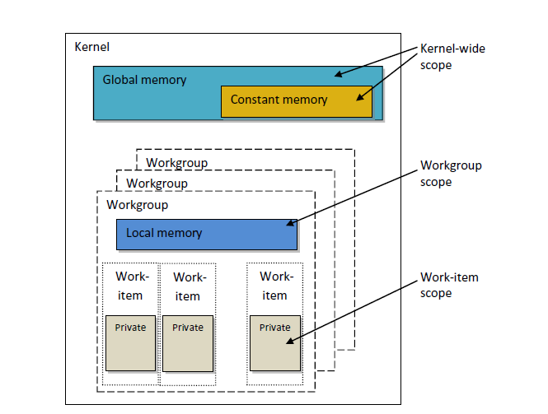
The abstract memory model

Slide 66
The abstract memory model
Global Memory(__global) – Is visible to all compute units on the device, similar to main memory on a CPU based system.
Whenever data is transferred from host to device and transferred back from device to host, it must reside in global memory.

Slide 67
The abstract memory model
Constant Memory(__constant) – It is modeled as a part of global memory, so memory objects that are transferred to global memory can be specified as constant variables whose values never change fall into this category.
Local Memory (__local) – It is modeled as being shared by a workgroup. It is a scratchpad memory whose address space is unique to each compute device.

Slide 68
The abstract memory model
Private Memory – It is unique to an individual work item. Local variables and non_pointer kernel arguments are private by default.

Slide 69
Inside a GPU, all work items of the same work group must be executed on a single "core".
You can synchronize threads (work items) inside a work group, because they all are resident in the same core

Slide 70
Work groups & Work items
Work Dimension is 1 and global_work_size=1024
local_work_size=128
Since there are 1024 total work-items and 128 work-items / work-group,
a simple division of 1024 / 128 = 8 work-groups.
The global size (GSZ) is the total number of work-items (WI)
The local size (LSZ) is the number of work-items per work-group (WI/WG)
The number of work-groups is the global size / local size or or GSZ /LSZ or WG

Slide 71
Work groups & Work items
For example a 2D kernel enqueue may look like
global_work_size[2]={4,4}
local_work_size[2]={2,2}
This specifies:
A global size of 4 work-items in dimension 0 and 4 work-items in dimension 1, for a total of 4 * 4 = 16 total work-items (WI).
It also specifies the local size to be 2 WI/WG in dimension 0 and 2 WI/WG in dimension 1.
This results in 4/2 = 2 work-group in dimension 0 and 4/2 = 2 work-groups in dimension 1 for a total of 4 work-groups (WG)

